Slide 1




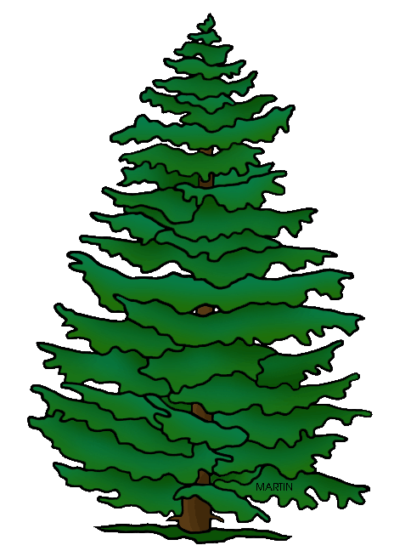




Simple Biosphere Model
SiB4 Version 2
August 18, 2019
SiB4 on Google Drive
https://bit.ly/2sq5adF
Kathy Haynes Katherine.Haynes@colostate.edu
Ian Baker baker@atmos.colostate.edu
Scott Denning Scott.Denning@colostate.edu

Slide 2
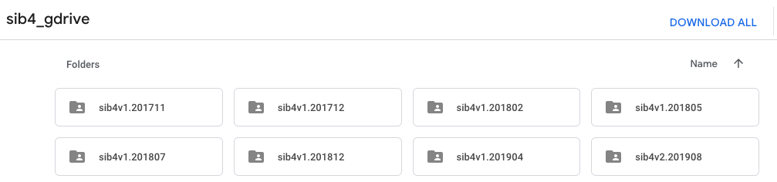
SiB4 version code, driver data, post processing maps, site evaluation data, and output sorted by date and version.
Latest Version 1: sib4v1.201904
→ 1x1 gridded output includes post-processed GFED v4.1 fire emissions
Version 1
Version 2
Latest Version 2: sib4v2.201908
→ New seasonal and climatological variables for phenological and respiration
processes calculated using running means
→ New leaf transfer processes for senescence
→ New respiration processes, and parameters to select PFT-appropriate behavior
→ New inclusion of fire emissions (GFED4), with burned carbon removal from pools
→ Updated crop growing-degree-day phenology
→ Modified grazing scheme
→ Adjusted steady-state (equilibrium) carbon pool calculations
→ Carbon balance checked daily

Slide 3
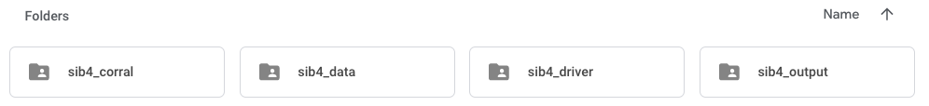

SiB4 code used to generate output
Post-processing datasets and maps
→ Crop redistribution
→ Grid and land mask maps
→ Native PFT and soil maps
Global, region, group, and site driver data
→ PFT tiles and soil properties
→ MERRA2 driver data (1980-2018)
→ GFED4 fire emissions (2003-2018)
→ Global restart file
SiB4 Output
→ Global
- Land Points Vector
- 0.5 x 0.5 Grid
- 1 x 1 Grid
→ Regions
→ Groups
- Sites groups by PFT

Slide 4
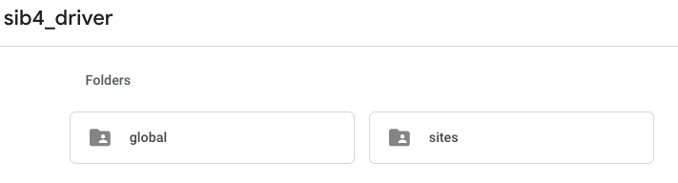
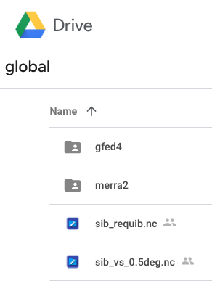
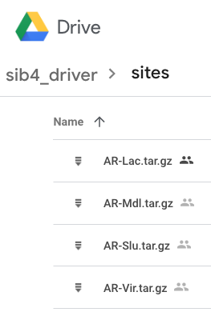
Global Fire Emissions Database (GFED 4.1)
→ 2003-2018
→ 0.5 x 0.5 Degrees
→ C and CO₂ Emissions
Modern-Era Retrospective analysis for Research and Applications (MERRA 2)
→ 1980-2018
→ 0.5 x 0.5 Degrees
→ Precipitation scaled to Global Precipitation Climatology Project (GPCP 2.3)
→ Sites listed alphabetically
→ MERRA2 and vegetation structure files included
→ Restart file with equilibrium pools
→ Vegetation structure file with PFT/soil info

Slide 5
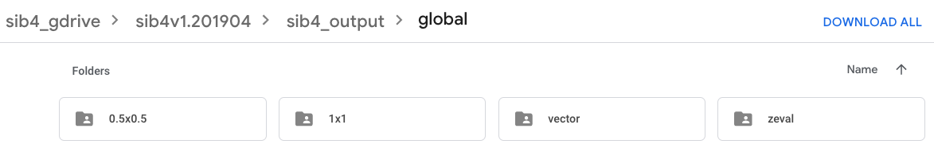
Land Points Only
10 Non-Weighted PFTs
(per grid cell)
Gridded
Area-Weighted, Unstacked PFTs
NEE, GPP, RE, LAI
FLUXNET / MODIS Comparisons
350 Sites, Hourly/Daily/Monthly

Slide 6
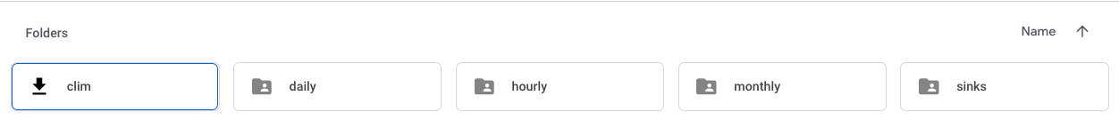

1998-2018 ‘Climatology’
Hourly, Daily, Monthly Means
GPP and RE Multipliers
Per Grid Cell Per PFT
~3.3 Gt C Sink Per Year
Compressed Netcdf4 Output
Saved in Annual Tar Files
1998-2018
▸Pools in Equilibrium per PFT per Grid Cell ≈ Balanced
▸Interannual Variability
▸Version 1:
→ 21-Year Post-Balanced Fluxes
NEE = 0; GPP = ‘Assim’; RE=‘Resp_Bal’
→ 21-Year Post-Balanced Crop Harvest Loss
▹Constant respiration ‘Resp_Crop’
▹Human/Livestock Population
→ Post-Processed Fire Emissions
▹Fire emissions removed from 2003-2018
▹Global Fire Emissions Database (GFED4.1)
▸Version 2:
→ Balance solely from ‘equilibrium’
pools in 1998
→ Crop harvest transferred entirely to
dead carbon pools
→ GFED4.1 fire emissions removed
from carbon pools during run

Slide 7
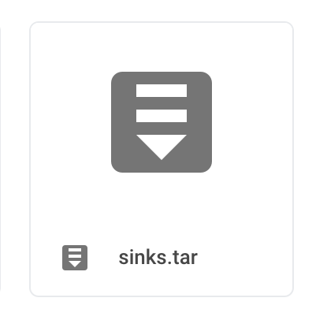

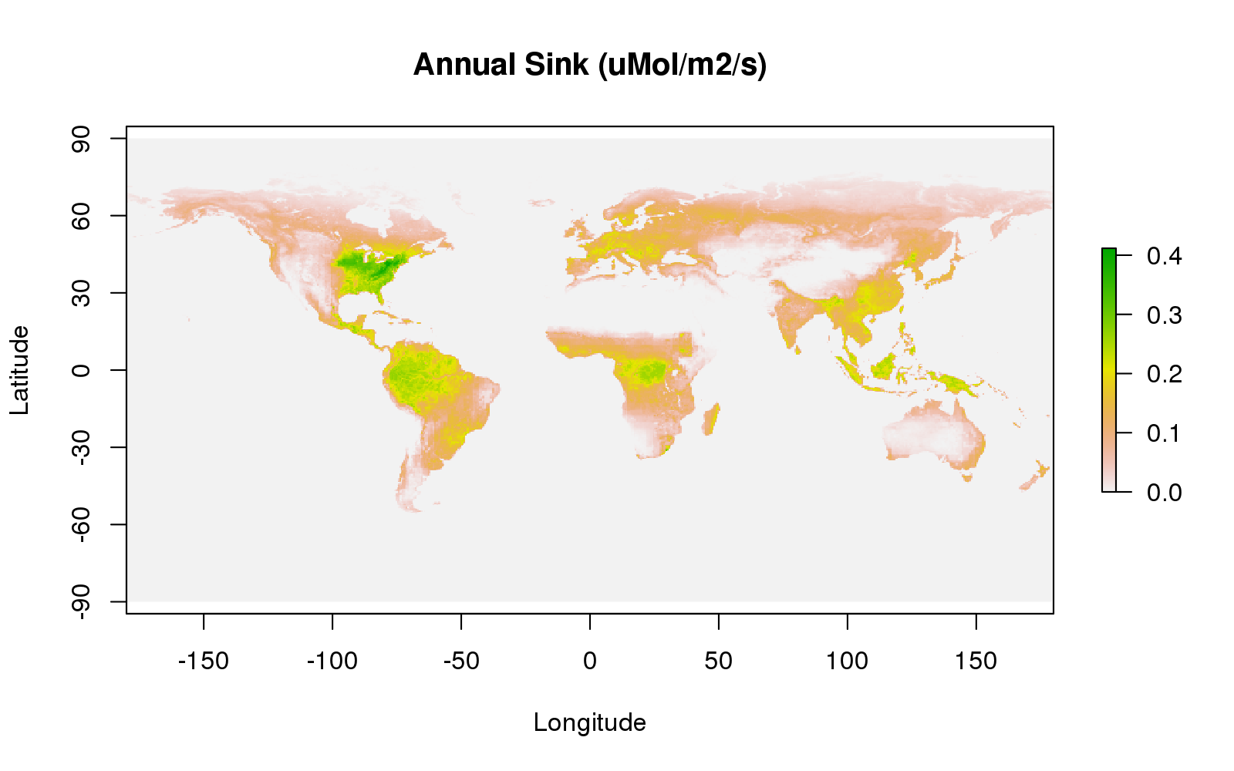
Annual Sink (µmol m⁻² s⁻¹)
3.3 Gt C Sink Per Year
▸CO₂ Fertilization
▸N Fertilization
▸Boreal Forest Warming
▸ Forest Regrowth

Slide 8
Simple Biosphere Model
SiB4
Code, Tools, Visualization on GitLab
https://gitlab.com/kdhaynes/sib4v2_corral.git

Slide 9
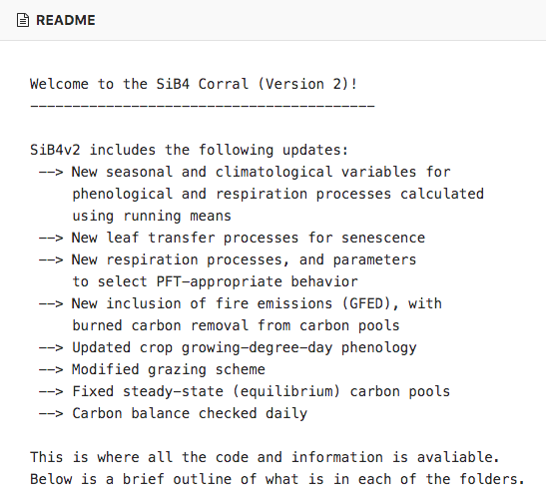
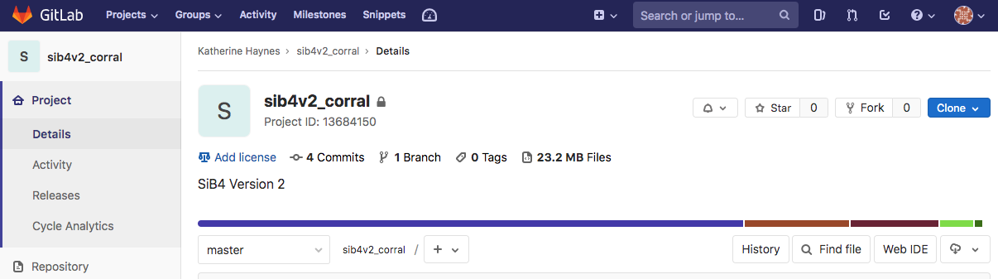
▸Provide us with your GitLab user name to be added to member list
▸git clone https://<username>@gitlab.com/kdhaynes/sib4v2_corral.git

Slide 10
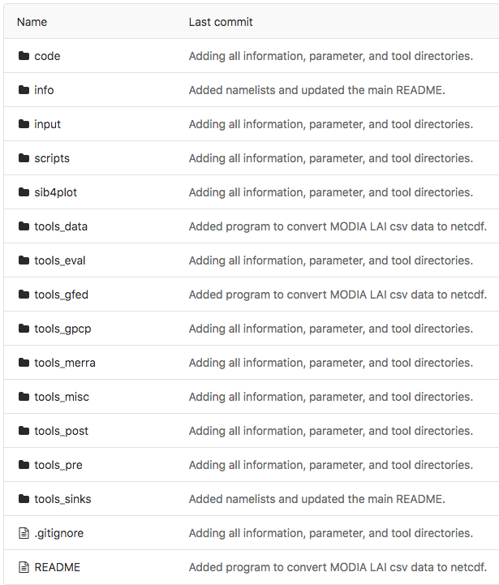
Code to run SiB4
Parameter files and diagnostic output choices
Content Information

Slide 11
