Slide 1
The Simple Biosphere Model: SiB4
Updated Aug 17, 2019
GitLab:
git clone https://USERNAME@gitlab.com/kdhaynes/sib4v2_corral.git
sib4v2_corral
55 MB
README
14 Directories
Information
info
Running
code
input
scripts
Viewing
sib4plot
Tools
tools_data
tools_eval
tools_gfed
tools_gpcp
tools_merra
tools_misc
tools_post
tools_pre
tools_sinks

Slide 2
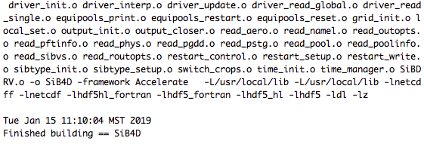
Compiling SiB4
Change to the 'code' directory
Edit the Makefile for any necessary computer/system specifications
-> LAPACK
-> NETCDF (and HDF for NETCDF4 compression)
At the prompt, type 'make’
-> Compiler: GNU’s gfortran (default),
Portland Group (COMPILER=pgi), Intel (COMPILER=ifort)
-> Optimization: Optimized (O2, default),
Debugging (OPT=debug)
Compiles all objects and links necessary objects/libraries
Creates the executable SiB4D
Finishes with the message: "Finished building == SiB4D"

Slide 3
Running SiB4
Move the executable from the 'code’ directory to the main directory
Move a name-list (namel_sibdrv) containing the simulation specifications into the
main directory
Edit the name-list to specify simulation details/options
(all generic namel_sibdrv files use local references from the main directory)
Option 1) Site Simulations
- Change into the ‘info/sites’ directory
- Copy the generic namel_sibdrv file into the main directory
- Edit the namel_sibdrv file, replacing the XX site identifiers with a specific site
- Sample site simulation in ‘info/sites/sample.tgz’
Option 2) Group Simulations
- Change into the ‘info/groups’ directory
- Copy the generic namel_sibdrv file into the main directory
- Edit the namel_sibdrv file, replacing the number of points and directory information
Option 3) Global Simulations (0.5 x 0.5 degrees)
- Change into the ‘info/global’ directory
- Copy the namel_sibdrv file into the main directory

Slide 4
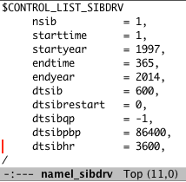
SiB4 Name List:
Simulation Control Options
nsib = number of points to simulate
starttime = Day of year to start simulation
startyear = Year to start simulation
Diagnostic Output Frequency Information
> 0 in units of seconds
< 0 in units of months
0=no output
– Three Types of Diagnostic Output –
dtsibqp = QP Output Interval
dtsibpbp = PBP Output Interval
dtsibhr = HR Output Interval
endtime = Last day of year to simulate
endyear = Last year to simulate
dtsib = Model time-step (in seconds)
QP = All Points (monthly maps)
PBP = Select Points (daily/hourly time-series)
HR = All Points (hourly maps)
dtsibrestart = Restart output interval
> 0 in units of seconds
< 0 in units of months
0 = no output

Slide 5
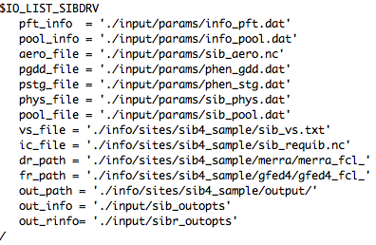
SiB4 Name List:
IO Options
Parameter Files
pft_info = Plant Functional Type (PFT) Info
pool_info = Pool Information
aero_file = Aerodynamic Parameters
pgdd_file = Growing Degree-Day Phenology
Parameters (crops)
pstg_file = Stage-Based Phenology
Parameters (non-crops)
phys_file = Physiology Parameters
pool_file = Pool Parameters
Site Information
vs_file = File containing the site lat/lon, vegetation structure, and soil information
Restart File
ic_file = File containing the initial conditions
Driver Data
dr_path = Directory containing driver data
Fire Data
fr_path = Directory containing fire emissions
Output Information
out_path = Directory for output files
out_info = File containing the diagnostic
variables to be saved
out_rinfo = File containing restart
variables to be saved

Slide 6
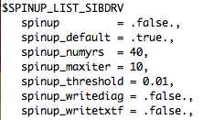
SiB4 Name List:
Spin-Up Options
Spinup Information
spinup = .TRUE. for a spinup simulation
spinup_default = .TRUE. for default initial pools
(zero pools except minimal leaf)
spinup_output = .TRUE. to output diagnostics during a spinup simulation
spinup_numyrs = number of years to run per spinup iteration
spinup_maxiter = maximum number of spinup iterations
spinup_threshold = threshold for declaring pools in equilibrium
pool * (1 - threshold) < pool equilibrium < pool * (1 + threshold)
spinup_writediag = .TRUE. to save diagnostic variables during spinup
spinup_writetxtf = .TRUE. to write equilibrium pool stats to file

Slide 7
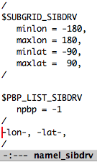
SiB4 Name List:
Sub-Grid and Point Output Options
Subgrid Boundaries
For non-point simulations, SiB4 has the capability of simulating only a subset of the grid specified in the vs_file. Setting these to locations inside the domain will cause SiB4 to only simulate the points inside this specified subgrid domain.
Point-By-Point Output Information
For non-point simulations, SiB4 has the capability of saving diagnostics for only a select number of points in the ‘pbp’ output files.
npbp = number of points to save
This is immediately followed by a list of the longitude and latitude of all the desired points to save.

Slide 8
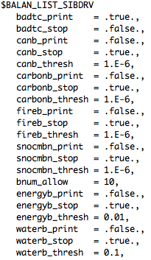
SiB4 Name List:
Balance Check Options
All balances print a message if an offense occurs.
Canopy Air Space Temperatures
badtc_print = print out bad canopy temperatures?
badtc_stop = stop for bad canopy temperatures?
Canopy Balance
canb_print = print canopy balance values?
Canb_stop = stop if canopy balance fails?
canb_thresh = canopy balance threshold
Carbon Balance
carbonb_print = print carbon balance values?
carbonb_stop = stop if carbon balance fails?
carbonb_thresh = carbon balance threshold
Fire Balance
fireb_print = print fire balance values?
fireb_stop = stop if fire balance fails?
fireb_thresh = fire balance threshold
Energy and Water Balance Options
bnum_allow = number of allowable balance offenses
energyb_print = print energy balance values?
energy_stop = stop if energy balance fails?
energyb_thresho = energy balance threshold
waterb_print = print water balance values?
waterb_stop = stop if water balance fails?
waterb_thresh = water balance threshold
Snow Balance
snocmbn_print = print snow combine info?
snocmbn_stop = stop if snow combine fails?
snowcmbn_thresh = snow combine threshold

Slide 9
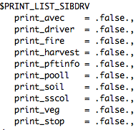
SiB4 Name List:
Screen Printing Options
print_avec = print avec/bvec (photosynthesis vectors) values?
print_driver = print driver data?
print_fire = print fire information?
print_harvest = print harvest information?
print_pftinfo = print PFT information?
print_pooll = print live pool values?
print_soil = print soil properties?
print_sscol = print soil/snow layer information?
print_veg = print vegetation values?
print_stop = stop after printing information?

Slide 10
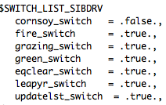
SiB4 Name List:
Switches
cornsoy_switch = switch between corn and soybeans?
fire_switch = use fire emissions?
grazing_switch = allow grazing?
green_switch = use greenness fraction?
equibclear_switch = clear climate/equilibrium variables
at the start of the simulation?
leapyear_switch = use leap years?
updatelst_switch = update carbon pools at 0 LST?
(rather than 0 GMT)

Slide 11
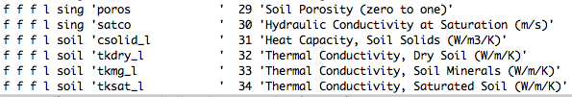
SiB4 Input File: Diagnostic Output
3 different diagnostic outputs
-> QP (all points, typically monthly)
-> PBP (select or all points, typically daily)
-> HR (all points, typically hourly)
Select variables to be output
- Change to the ‘input’ directory
- Open the ‘sib_outopts’ file
- Turn each variable output on/off using the first three columns
1) T = Output variable in QP files
2) T = Output variable in PBP files
3) T = Output variable in HR files
- Change the variable name and title/unit information if desired
Non-Changeable Information
l = land unit
g = grid cell
sing = single layer
soil = soil layers
stot = snow and soil layers
variable number used to
match the code variable

Slide 12

SiB4 Input File: Restart Output
SiB4 has the capability to change both the prognostic variables being output in the restart files and the default values of these variables; however, this is likely not going to be changed for a typical simulation.
Change restart variable input/output
(only if necessary)
- In the 'input' directory, open the ‘sibr_outopts’ file
- To turn each variable output on/off,
alter the first two columns
Column 1) T = Restart Files
Column 2) T = Equilibrium Restart Files
- Change the variable default value (last column)
-> For temperatures, values < 0 use closest driver data
-> For snow/soil variables, the same value is used in the entire column
-> For soil moisture (www_liq/ice), if the default value is less than 1.e⁻¹²,
then the initial value is set to saturation
Variable number used to
match the code variable
(non-changeable)
Variable default value
Variable name

Slide 13
SiB4 Input Files: Parameters
Change any parameters (if necessary)
- Change to the 'input/params' directory
- Alter any of the phenology, physiology, or pool parameters
+ Phenology Variables
phen_gdd.dat = Growing Degree-Day Defined Phenology Parameters (crops)
phen_stg.dat = Stage-Based Dynamic Phenology Parameters (non-crops)
+ Physiology variables
sib_aero.nc = Aerodynamic/Boundary Layer Parameters
sib_phys.dat = Physiological Parameters
+ Pool Values
sib_pool.dat

Slide 14
Running SiB4
Spin-Up SiB4: Perform a spin-up simulation to acquire balanced carbon pools
(for site simulations only, for global simulations preferably use a provided restart file)
- Setup a spinup simulation
+ Set the 'spinup' flag to true
+ Specify the number of years to use in the spinup calculation (spinup_numyrs)
+ Specify the maximum number of iterations for the spinup (spinup_maxiter)
+ Specify the threshold required to declare pools balanced (spinup_threshold)
+ Specify whether to save output during the spinup (spinup_writediag/writetxtf)
- Run a spinup simulation, save necessary output, and setup a regular simulation
+ In the main directory, type ‘./SiB4D’
+ Following the simulation, save the equilibrium restart file (sib_requib.nc)
+ In the namel_sibdrv file:
-- Set the initial condition file to the newly-created restart file
-- Set the spinup flag to false
Run SiB4
- In the main directory, type './SiB4D’

Slide 15
Additional SiB4 Notes
SiB4 can be run using multiple processors.
This is done by dividing up the points into separate chunks that are run individually.
To run a single chunk, at the prompt type:
>./SiB4D rank nchunks
- Rank specifies which process number
- Nchunks specifies the total number of processes
SiB4 can be run specifying the location of namel_sibdrv,
rather than requiring the name-list to be in the same directory as the executable
At the prompt: >./SiB4D /directory/namel_sibdrv
Instructions for running SiB4 global simulations are in the ‘info/all/README_run’ file
Instructions for running SiB4 site simulations are in the ‘info/sites/README_site’ file
Instructions for running SiB4 at a sample site (all data provided) are in both the
‘info/sites/README_sample’ file and the ‘info/README_start’ file

Slide 16
Running SiB4 on Multiple Processors
On a machine with multiple cores that does not require job submission/queuing, there are scripts in the ‘scripts’ directory that will start and check multiple simulations at once.
Starting multiple simultaneous jobs (chunks)
For global simulations:
-- Copy the ccrunsibg script into the
main directory
-- Edit the script
-> Check the number of processes
(second number of command is
the total nchunks)
-> Check that each process is included
on a separate line with incrementing
numbers (1 through nchunks)
-> Change the screen output files
(after the ‘>’ symbol)
-- Run the script (type ‘ccrunsibg’ at
the prompt in the main directory)
For site simulations:
-- Create a name-list file for each site
-- Copy the ccrunsibs script into the
main directory
-- Edit the script
-> Change the location/names of the
individual site namel_sibdrv files
-> Change the screen output files
(after the ‘>’ symbol, make sure
each one has a different name)
-- Run the script (type ‘ccrunsibs’ at
the prompt in the main directory)

Slide 17
Running SiB4 on Multiple Processors
Checking multiple simultaneous jobs
Use one of three scripts to check for running SiB4D processes.
To use these scripts without having to go to the ‘scripts’ directory separately,
either copy them into your main directory or include the ‘scripts’ directory in your path.
ccdonesib: Performs a check to see the status of all processes.
To use, edit the script to specify:
-- Total number of processes being run (nprocs)
-- Screen output file directory, filename prefix and filename suffix
-- Executable (main process) name (i.e. SiB4D by default)
Returns a list:
-- Number of processes checking (nprocs)
-- Number still running
-- Number that have finished successfully
-- Number that are not done (including those that did not finish successfully)
-- Number missing (no screen output saved)
cchecksib: Looks for all running executables (main processes, SiB4D unless otherwise specified).
Returns:
-- ‘Done’ if all are done
-- Prints a message if some are still running,
and stays running until all processes are done or the script is stopped
ccnumsib: Looks for all running executables and returns the number found.

Slide 18
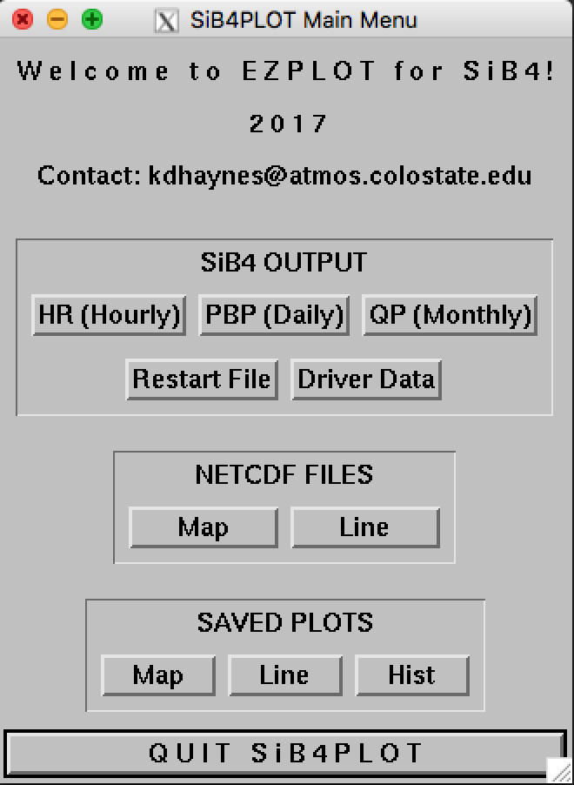
Viewing SiB4 Output: SiB4Plot
• IDL program to view netcdf files
+ SiB4 Output
+ SiB4 Restart Files
+ SiB4 Driver Data
+ Generic Gridded Netcdf Files
+ 2-D Netcdf Files
+ Saved plots created with SiB4Plot
• Analogous to EZPlot
• Instructions for set-up are in the
README file

Slide 19
SiB4 Tools
Tools_Data: Fortran and IDL programs to process data
-> MODIS LAI
-> FluxNet
Tools_Eval: Fortran routine to pull out FluxNet, MODIS, and SiB4 fluxes/LAI, saving the results in Netcdf files for evaluation
Tools_GFED: Fortran routines to process GFED data for fire emissions
Tools_GPCP: Fortran routines to process GPCP global data to scale driver data precipitation.
Tools_MERRA: Fortran routines and scripts to obtain and process MERRA2 data for driver data
Tools_Misc: Miscellaneous IDL routines
-> Plot site locations
-> Map PFT fractions
-> Plot potential/stress factors
Tools_Post: Fortran post-processing tools
-> Add balanced respiration to output
-> Balance respiration
-> Check the carbon balance
-> Combine output (from PFT to gridcell)
-> Conjoin output (combine time)
-> Copy output
-> Distribute crop carbon globally
-> Disjoin output (break apart time)
-> Calculate GPP totals
-> Grid files
-> Create climatological mean output
-> Merge output from different processors
-> Pull specific variables
-> Regrid files
-> Rename variables
-> Replace respiration
-> Unstack PFTs
-> sib4post.pl is a perl script allowing the post processing of numerous years at once
Tools_Pre: Fortran routines to prepare files
-> Create aerodynamic parameter file
-> Create SiB4 PFT file
-> Create driver data files from global data
-> Combine driver data files from site data
-> Create SiB4 vegetation file
-> Re-grid high-resolution PFT data
Tools_Sinks: R routines to obtain GPP and Respiration scalars (betas) to create a specified annual global sink

Slide 20
SiB4 Code
- Compiling/Linking Script: Makefile
- Main Program: SiBDRV.F90
- Main Land-Atmosphere Control Subroutines:
-> sibcontrol.F90: Controls order of phenology and pool calculations
-> sibmain.F90: Controls the order of flux and hydrology calculations
Variable Modules
+ Module_IO: Input/Output Variables
+ Module_Local: Local Energy/Water Balance Organized Into Type
+ Module_Oparams: Non-PFT specific Parameters
+ Module_Param: Aerodynamic/Phenological/Physiological/Pool Parameters
+ Module_PFTInfo: Plant Functional Type (PFT) Information
+ Module_Phosib: Module for time-step only photosynthesis variables
+ Module_PoolInfo: Pool Information
+ Module_PParams: Physical Parameters
+ Module_SiB: SiB Variables (Gridcell and Land Unit containing one PFT)
+ Module_SiBConst: SiB Constants
+ Module_SiBVS: Vegetation Structure Variables
+ Module_Time: Time Variables

Slide 21
SiB4 Code: Scientific Routines
Balance Checks
+ Balan_carbon: Check carbon balance
+ Balan_eh2o: Check maintenance of water and energy balances
Fluxes
+ AddInc: Add increments to prognostic variables and diagnose heat fluxes and mixing ratios
+ CAS_Update: Updates canopy air space variables
+ Delef: Calculates partial derivatives of canopy and ground latent heat fluxes
+ Delhf: Calculates partial derivatives of canopy and ground sensible heat fluxes
+ Dellwf: Calculates partial derivatives of canopy and ground radiative heat fluxes
+ Flux_rbrd: Calculates leaf surface-canopy air space (CAS) and ground-CAS resistances
+ Flux_update: Updates fluxes and hydrological prognostic variables
+ Flux_vmf: Calculates ustar and transfer coefficients for momentum/heat fluxes
+ Flux_vrbrd: Calculates ventilation mass flux and resistances
+ Local_set: Set local variables
+ Phocycalc: Calculates stomatal conductance, assimilation and canopy conductance
+ Phonveg: Calculate canopy conductance for non-vegetation
+ Phosort: Sort photosynthesis variables
+ Phostress: Calculate potential/stress variables for photosynthesis
+ SiBSlv: Sets up coupled system of partial differential equations for prognostic variable updating

Slide 22
SiB4 Code:
Scientific Routines
Hydrology (Soil/Snow)
+ Dtess_Eau: Computes the values and derivatives of saturation, mixing ratio, and vapor pressure
+ Hydro_Canopy: Calculates the interception and drainage of rainfall and snow
+ Hydro_Nveg: Calculate hydrology for non-vegetation
+ Hydro_SetS: Update soil hydrology diagnostics from soil moisture at beginning of time-step
+ Hydro_SetV: Update vegetation hydrology diagnostics at beginning of time-step
+ Hydro_Snow: Evaluates and updates snow mass and snow water
+ Hydro_Soil: Calculates water processes in soil
+ Snow_Combine: Combines snow layers if necessary
+ Snow_Compact: Calculates the metamorphisms of changing snow characteristics
+ Snow_Subdivide: Subdivides snow layers if they exceed their prescribed maximum thickness

Slide 23
SiB4 Code:
Scientific Routines
Phenology
+ Mapper: Calculates vegetation aerodynamic parameters and leaf projection relative to the sun
+ Phen_defined: Determine defined phenology stage (crops)
+ Phen_dynamic: Determine dynamic phenology stage (non-crops)
+ Phen_gss: Determine if conditions are appropriate for growing season start
+ Phen_update: Update phenology running-mean variables
Pools
+ Pool_assim: Update live carbon pools from photosynthetic gains
+ Pool_auto_resp: Calculates autotrophic respiration
+ Pool_auto_tran: Calculates transfer from the live pools
+ Pool_graze: Calculate grazing
+ Pool_het_retr: Calculates heterotrophic respiration and dead pool transfer
+ Pool_update: Control routine to update the carbon pools (daily)
+ Veg_update: Updates vegetation information (e.g. LAI, FPAR, aerodynamics)
Pool Equilibrium and Spin-Up
+ EquiPools_Calc: Calculates the quasi-equilibrium carbon pools

Slide 24
SiB4 Code: Scientific Routines
Radiation
+ RadAbs: Calculates absorption of radiation by the surface
+ RadFac: Calculates albedos via two stream approximation
+ RadNet: Calculates net radiation from physics and current canopy and ground losses
+ Zenith: Calculates solar zenith angle
Miscellaneous
+ COS_Calc: Calculates uptake of carbonyl sulfide (COS) by plants and soil
+ SIF_Calc: Calculates fluorescence (SIF)

Slide 25
SiB4 Code: Driver and Fire Data
Driver Data (Forcing Surface Meteorological Data)
+ Driver_Init: Sets the driver data time/update variables and reads the initialization information
+ Driver_Interp: Interpolates the driver data between read times
+ Driver_Read_Global: Reads the driver data for non-point simulations
+ Driver_Read_Single: Reads the driver data for single site simulations
+ Driver_Update: Updates the time and control variables for the driver data
Fire Data (Carbon Fire Emission Data)
+ Fire_Init: Sets the fire data time/update variables and reads the initialization information
+ Fire_Interp: Interpolates the fire emissions between read times and
removes the burned carbon from the pools
+ Fire_Read_Global: Reads the fire emissions for non-point simulations
+ Fire_Read_Single: Reads the fire emissions for single site simulations
+ Fire_Update: Updates the time and control variables for the fire data

Slide 26
SiB4 Code: Initialization
Initialization
+ Grid_Init: Sets up the grid for the simulation
+ SiBType_Init: Initializes the variables in the SiB type (sets variables to zero)
+ SiBType_Setup: Sets up the variables in the SiB type (sets variables to starting values)
File Reading
+ Read_Aero: Reads the SiB aerodynamic tables
+ Read_Namel: Reads in the namelist file
+ Read_OutOpts: Reads in the file controlling the variables to be output
+ Read_PFTInfo: Reads in the plant functional type (PFT) information
+ Read_PGDD: Reads the growing-degree-day phenology parameters
+ Read_Phys: Reads the physiological parameters
+ Read_Pool: Reads the pool parameters
+ Read_PoolInfo: Reads the pool information
+ Read_PStg: Reads the stage-based dynamic phenology parameters
+ Read_ROutOpts: Reads in restart variables output options and default values
+ Read_SiBVS: Reads the vegetation structure

Slide 27
SiB4 Code: Output and Time Routines
Output
+ Diagnostic_Create: Creates the diagnostic output files
+ Diagnostic_Save: Saves the diagnostic variables for the output
+ Diagnostic_Write: Writes the diagnostic output to the specified files
+ Output_Closer: Closes any open files
+ Output_Control: Updates output frequency variables and controls file creation and writing
+ Output_Init: Reads in output selections and sets up output variables
+ Restart_Read: Read the restart and equilibrium files
+ Restart_Write: Write the restart and equilibrium files
Time
+ Time_Init: Initializes the time variables
+ Time_Manager: Updates the time variables
Miscellaneous
+ Kinds: Module defining variable precision for all common data types
+ NC_Util: Program to check netcdf functions and report errors if present

