Slide 1
B
Biblio
by Wonderly
Knowledge base for AI coding teams
Make every coding agent write
like your best engineer.
Biblio gives every coding agent one source of truth: your team's engineering standards. It checks the agent's code against those standards in review, then saves the corrections so the same mistake doesn't ship twice.
Seed round · 2026

Slide 2
THE PROBLEM
Right now, AI coding is
a wild west.
The same model and the same codebase produce wildly different code depending on who is prompting it. That variance ends up in production.
10 agents
+20%
∞ repeats
Ten different baselines
Context files don't scale
Corrections don't stick
Every developer prompts differently, with a different tool. Your standards only apply when someone remembers to paste them in.
Repo-level AGENTS.md files were found to lower task success while adding over 20% to inference cost (ETH Zürich, 2026).
A reviewer catches a bad pattern in today's PR. Next sprint a different agent writes it again, because nothing wrote the lesson down.
A longer AGENTS.md won't fix this.
Biblio · Wonderly
02

Slide 3
WHY NOW
Teams adopted agents fast.
Quality didn't keep up.
Agents are everywhere
28.7M
Claude Code, Codex, Cursor, and Copilot are now standard issue. A large share of new code is written by an agent.
software developers worldwide, on the way to 45M by 2030
Quality became the bottleneck
As AI volume climbs, studies show more duplicated code and less refactoring. Shipping fast stopped being the hard part. Trusting what shipped is.
$7.4B → $24B
Leaders are on the hook
AI code tools market, 2025 to 2030 (about 27% CAGR)
Eng managers and CTOs answer for what AI ships, with no way to see or enforce their standards across every agent.
>20%
The research caught up
Peer-reviewed studies now show static context files often make agents worse, and that guidance pulled in on demand works better.
extra inference cost from repo context files, for worse results
Biblio · Wonderly
03

Slide 4
THE INSIGHT
Writing the standard down is easy.
Getting agents to use it is the problem.
Static files & skills
Biblio
AGENTS.md, CLAUDE.md, rules
one source of truth
✕
Loaded into every prompt whether they're relevant or not
✓
Agents pull the section they need, when they need it
✕
Copied between repos, then drift out of sync
✓
One source, synced to every repo and every agent
✕
No way to know if any agent actually followed them
✓
Code review checks the work against the same standard
✕
Corrections vanish when the chat session ends
✓
Corrections get saved and reused by the whole team
Biblio · Wonderly
04

Slide 5
THE PRODUCT
One MCP server. Every agent your
team already uses.
Biblio runs as one MCP server your agents connect to. Nothing to install locally, no repos to restructure. They get your standards, your reviews, and your team's memory from a single endpoint.
Composable knowledge base
Hybrid retrieval
Shared memory
Pull standards from any GitHub repo into a partition, or write them in Biblio directly. They stay current without anyone syncing.
Full-text, vector, and graph search over snippets and sections, so agents grab a few lines instead of a whole file.
Lessons from past mistakes, recalled by every agent and developer on the team, including in CI.
Built-in code review
Telemetry for leaders
Runs in your network
Review agents check every PR. The same agents run locally, so issues get caught before the PR exists.
OpenTelemetry traces and metrics show which docs get used and which agents your team actually runs.
OAuth, encrypted tokens, signed webhooks, and a Kubernetes deploy. Host it inside your own perimeter.
Biblio · Wonderly
05

Slide 6
HOW IT WORKS
The loop that keeps
code on standard
Docs feed the agents writing code. Review checks that code against the same docs. When review catches something, it gets saved as a memory the agents read the next time around.
Docs
01
Ground
Your standards, served to every agent.
Memory
Biblio
Agents
02
Retrieve
one server
Agents pull the snippet they need, not the rulebook.
03
Review
The same docs review every PR and local change.
Reviews
04
Remember
Fixes get saved for the whole team to reuse.
Biblio · Wonderly
06

Slide 7
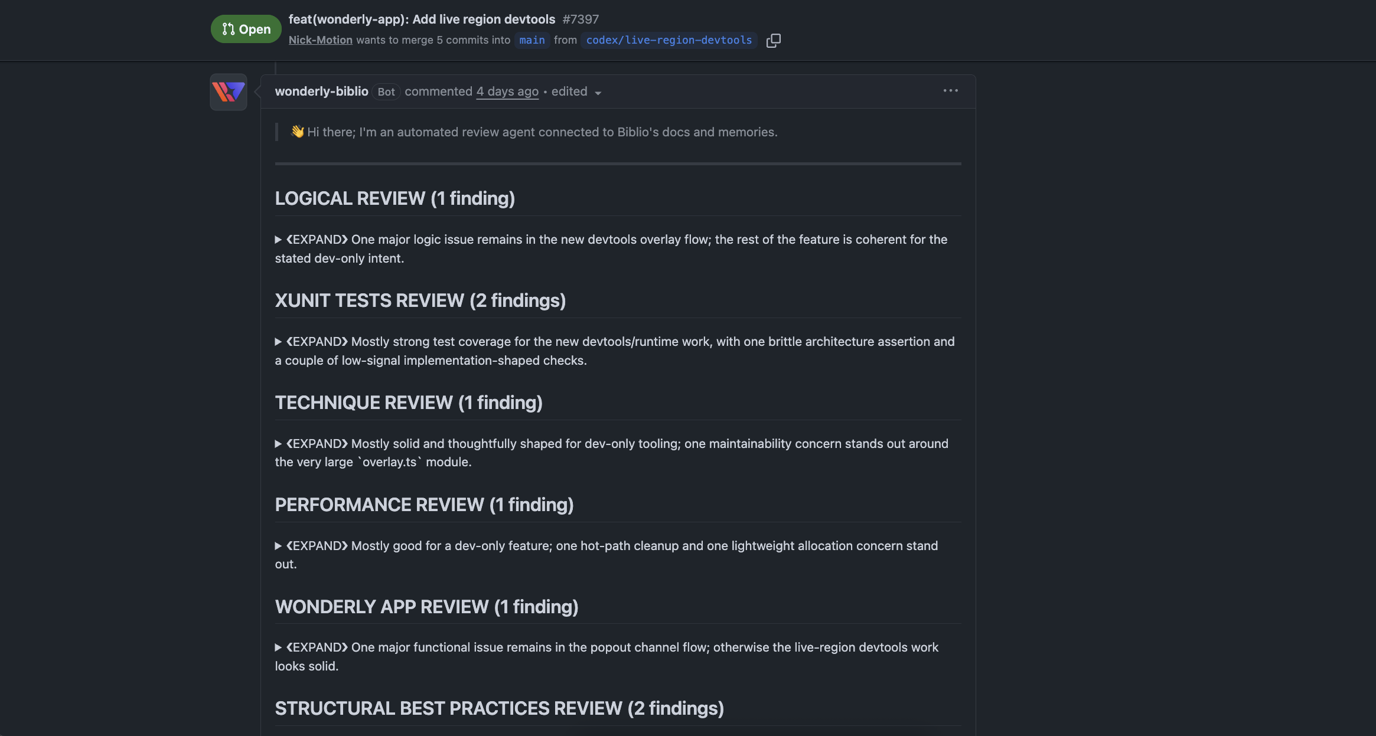
PROOF · IN PRODUCTION
Every PR, reviewed by
a team of expert agents.
github.com · PR #7397
One comment per PR, split by reviewer: logic, tests, technique, performance, and structure.
You set up each reviewer with a name and a focus, like a SQL expert or a performance reviewer.
A reviewer only runs when the diff touches files it cares about, so reviews stay quick.
Biblio · Wonderly
07

Slide 8
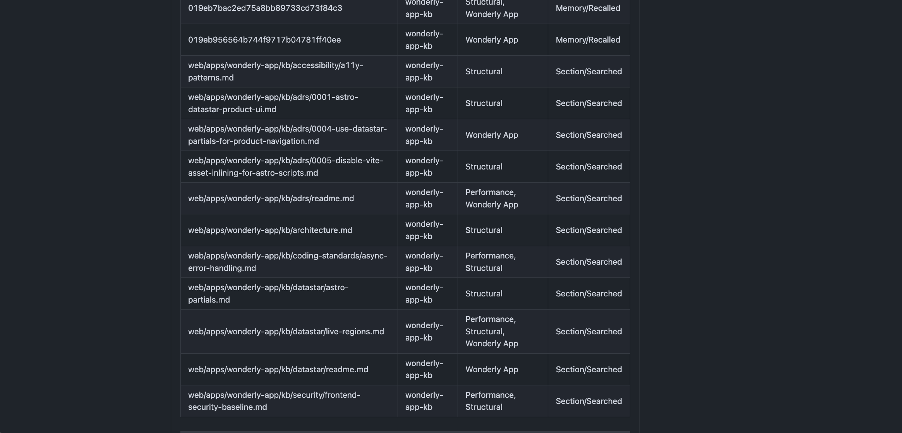
PROOF · THE LOOP, IN WRITING
Every review shows which
docs and memories
it actually used.
github.com · PR #7397
Competitors can't show you this. Here is what you get:
Every file and memory the reviewer read, which partition it came from, and how it was used.
Change a standard and the next review changes with it. Writing and reviewing read the same source.
A written record of exactly what shaped the AI's review, ready for any audit.
Biblio · Wonderly
08

Slide 9
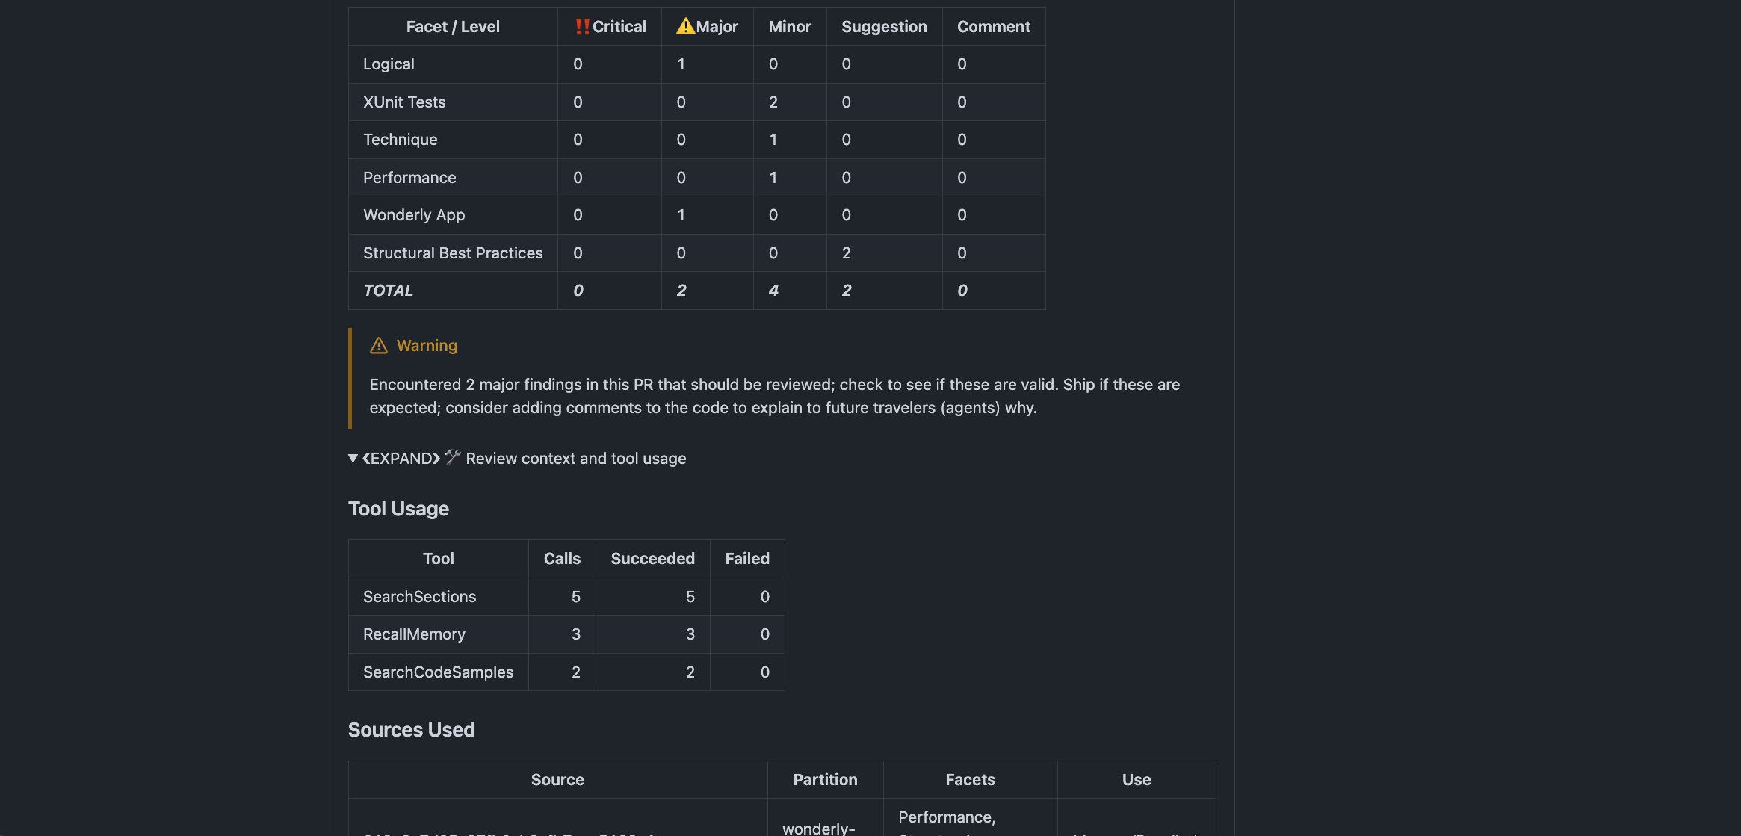
PROOF · FOR ENGINEERING LEADERS
What the review found,
and how it got there.
github.com · PR #7397
A summary table by reviewer and severity, so you can decide ship or fix in seconds.
The exact searches and memory lookups each agent ran while reviewing.
It's OpenTelemetry, so doc usage, agent mix, and review trends flow into Datadog or wherever you already look.
More views: knowledge base, shared memory, dashboards
Biblio · Wonderly
09

Slide 10
MARKET
A new layer in a market that's
already big and growing fast.
TAM · $24B
TAM — $24B by 2030
SAM · $1.8B
The AI code tools market, growing about 27% a year from $7.4B in 2025.
SOM
SAM — $1.8B
$15M
Code quality and context tools for mid-to-large engineering orgs. Roughly 5M developers in our target accounts at about $360 a seat per year.
SOM — $15M (3-yr)
Design partners at AI-forward orgs of 50 to 500 engineers, expanding seat by seat.
Sources: Mordor Intelligence; Research & Markets; developer population estimates, 2025–26.
10

Slide 11
COMPETITION
Each competitor covers one piece.
Biblio connects them.
Curated docs
Cross-agent retrieval
Shared memory
Code review
Leader telemetry
Review tools (CodeRabbit, Greptile)
–
–
review only
✓
–
Context tools (Unblocked, Context7)
aggregates
✓
–
some
–
Memory tools (Mem0, Zep)
–
infra
✓
–
–
Skills platforms (Tessl)
skills
–
–
–
✓
Biblio
✓
✓
✓
✓
✓
Review tools only learn inside their own reviews. Context tools serve docs but never check that agents follow them. Memory tools are infrastructure you still have to build on. Biblio is the one place docs, review, and memory work together for every agent.
11

Slide 12
BUSINESS MODEL
Open core. Start with one team,
grow across the company.
MOST POPULAR
Open source
Team
Enterprise
Free
~$30 /dev / mo
Custom
✓
Self-host the full server
✓
Managed hosting
✓
SSO, audit, on-prem
✓
Single team or repo
✓
Code review agents
✓
SLA and onboarding
✓
Community support
✓
Shared memory and telemetry
✓
Governance and analytics
Gets teams in the door
Where the revenue comes from
Where accounts grow
Teams start on the free self-hosted version. As agent use spreads, they move to paid seats and the account grows.
Biblio · Wonderly
12

Slide 13
TRACTION & GO-TO-MARKET
Running inside Wonderly.
Opening up to design partners.
How it spreads
In production
1
Open-source start
Used by Wonderly's own engineering team today
A developer finds the self-hosted server and starts using it.
6 agents
2
A team signs on
That team moves to managed Biblio for review and memory.
Works with Claude Code, Codex, Cursor, Copilot, OpenCode, and VS Code
3
It spreads
Usage data makes the case to the CTO, and it rolls out across repos.
Open core
Public repo developers can adopt on their own
4
Enterprise deal
SSO, audit, and on-prem turn it into a company-wide contract.
Biblio · Wonderly
13

Slide 14
TEAM
The people who built it
and run it.
CC
—
—
Charles Chen
Founder / CEO
Founding Engineers
Principal Software Engineer
[Add name]
[Add team]
Built Biblio at Wonderly. Background in MCP, retrieval, and developer tools.
Engineering leadership and GTM. Owns vision, fundraising, and enterprise relationships.
Building the rest of the system: indexing, review agents, memory graph, telemetry.
Built at Wonderly, to solve a problem the team kept hitting themselves.
Biblio · Wonderly
14

Slide 15
THE ASK
Raising to bring this to
every engineering team.
Product
$[ X ]M seed
Harden the managed platform and expand review agents, memory, and analytics.
Enough runway to reach real revenue, 18 to 24 months
Go-to-market
Run the design-partner program and grow the open-source base.
Team
Founding engineers and the first GTM hire.
Want to see it on a real PR? Happy to walk you through one.
gary.chao@weaccelerate.com · biblio.wonderly.info

