Slide 1
Future Frame Prediction and Segmentation
Final Project for NYU Deep Learning - Spring 23
Anisha Bhatnagar Anoushka Gupta Charvi Gupta
ab10945 ag8733 cg4177
05/02/2023 Team 23

Slide 2
Problem Statement
And Literature Review
Problem Statement - Using the first 11 frames of a video predict the segmentation mask of the last (22nd) frame.
ConvLSTMs (introduced by Shi et al (2015)) have been used for sequence to sequence predictions as they can effectively capture the spatio temporal features. (other common techniques make use of convolutional AutoEncoders)
U-nets (introduced by Ronneberger et al (2015)) perform well on segmentation related tasks due to the skip connections and the contracting and expansive networks. The contracting (downsampling) network easily learns feature maps and identifies the objects in an image. The expansive(upsampling) network takes the feature map generated by the contracting network and generates a segmentation mask by using the skip connections.

Slide 3
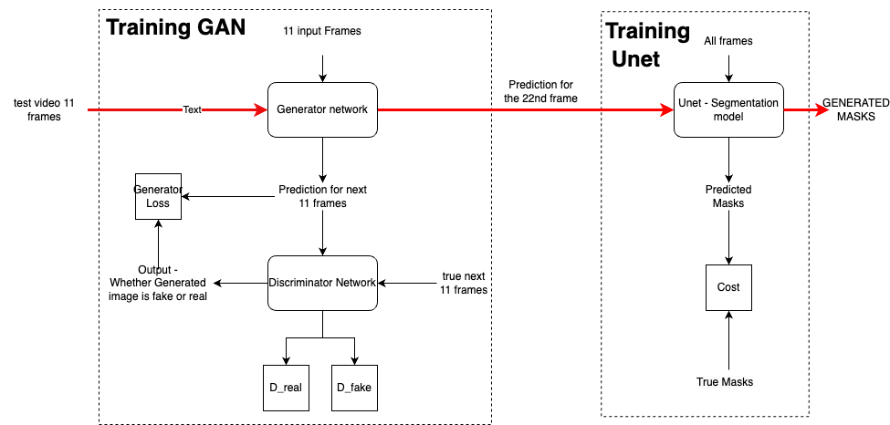
Solution Approach

Slide 4
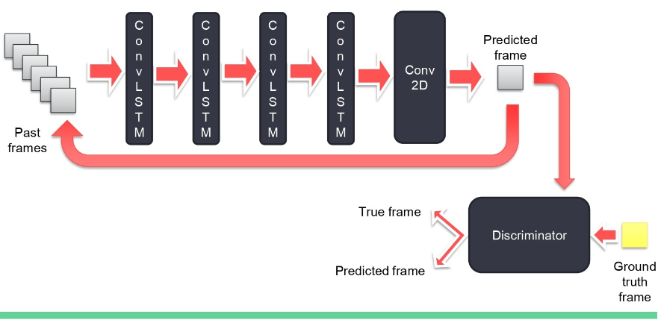
Future Frame Prediction -
Model
A GAN was used to perform frame prediction. The Generator model used had 4 convLSTM layers followed by one Conv2D head.
The 1st 11 frames were used as input into the model. The predicted frames were fed back into the model to continue prediction for the next 10 frames.
BCE Loss was used to train the discriminator, a combination of l1_l2 loss and BCE loss was used to train the generator.
Training was performed using 2000 videos out of the unlabeled set for 50 epochs on v100.
(Image taken from Vineeth S. )
Notes:
The input to the model were images of size 160 x240.
The generator model used 4 convLSTM layers followed by one conv2D head. The discriminator used the binary cross entropy loss.
A combination of l1 l2 and BCE was used to train the generator.
The model was trained on 2000 videos from the unlabelled set for 50 epochs using a v100 GPU.

Slide 5
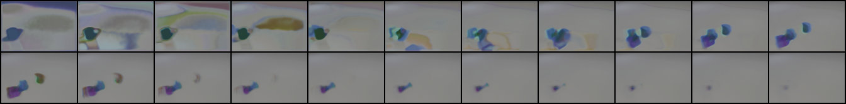
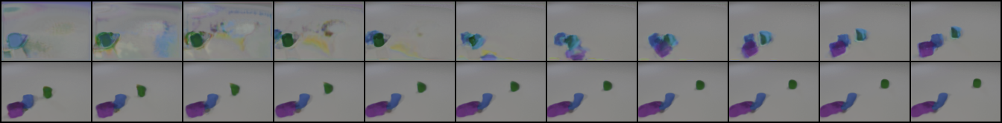
Visualization of intermediate results
After 2000 steps
After 25000 steps
Notes:
Here, lets visualize some intermediate results of our training after 2000 and 25000 training steps.The second row shows the predicted 12th to 22nd frame after 2000 steps of training Here we can see that the frames become progressively blurry and in the 22nd frame the objects vanished. However, after 25000 steps of training, the model starts learning how to predict long range dependencies of between input frames and future frames more accurately and we can see the objects more clearly in the 22nd frame.

Slide 6
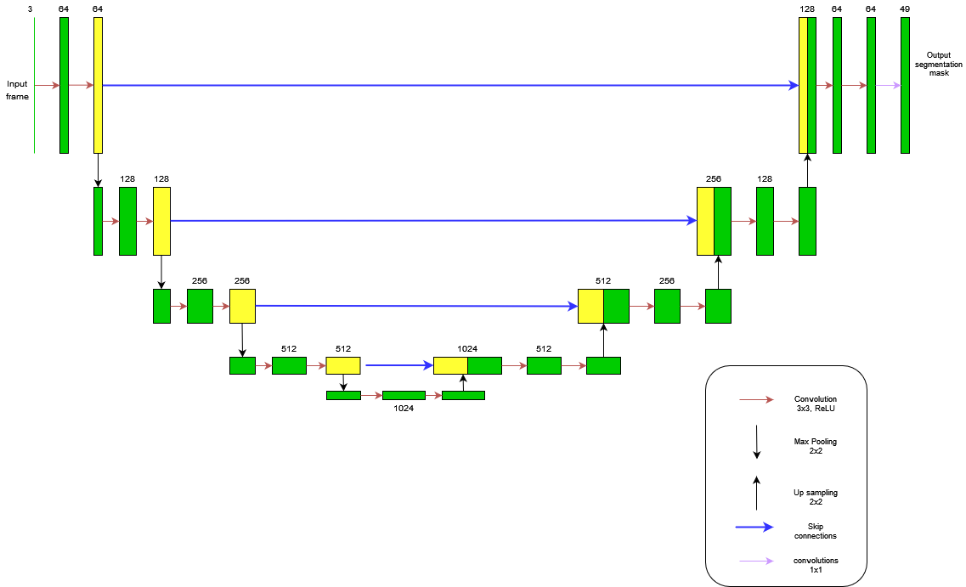
Segmentation Model
The segmentation model was based on the Unet model which gave an output of 49 x 160 x 240 which is the one hot encoding matrix for each class in the mask. The model was trained for 10 epochs using CrossEntropyLoss as the loss function and a Adam Optimizer.
The 22nd frame which was predicted by the ConvLSTM model was fed into the Unet model to generate the final masks
Notes:
The segmentation model gave an output of 49 x 160 x 240 which was the one hot encoding for each class in the mask.

Slide 7
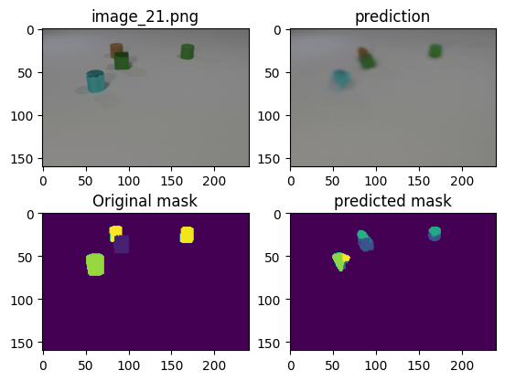
Results
On the validation dataset, which had 1000 videos our model achieved a Jaccard index score of 0.2437
Notes:
These are the results of our model on the validation set. Here we can see the ground truth 22nd drame, the 22nd frame generated by our model, followed by the ground truth mask and the predicted segmentation mask . The model is able to capture the position and color of the obejcts to a good extent. However the edges of the objects are blurry.

Slide 8
Thank you
Charvi Gupta (cg4177@nyu.edu),
Anoushka Gupta (ag8733@nyu.edu),
Anisha Bhatnagar (ab10945@nyu.edu)

