Slide 1
The HMM Algorithm

Slide 2
HMM Overview
Unit 1
  Construct a profile HMM given an MSA
    Special rules for HMM construction
  Given a sequence, find the probability the sequence satisfies the HMM for a certain state
    Forward algorithm
Unit 2
  Construct a profile HMM
  Given a sequence, find the posterior probability of each move of the traceback
    Forward-backward algorithm

Slide 3
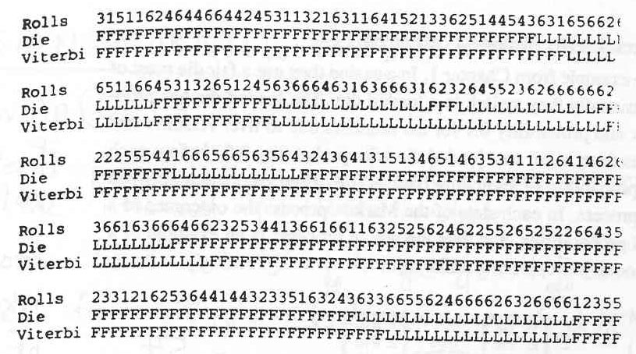
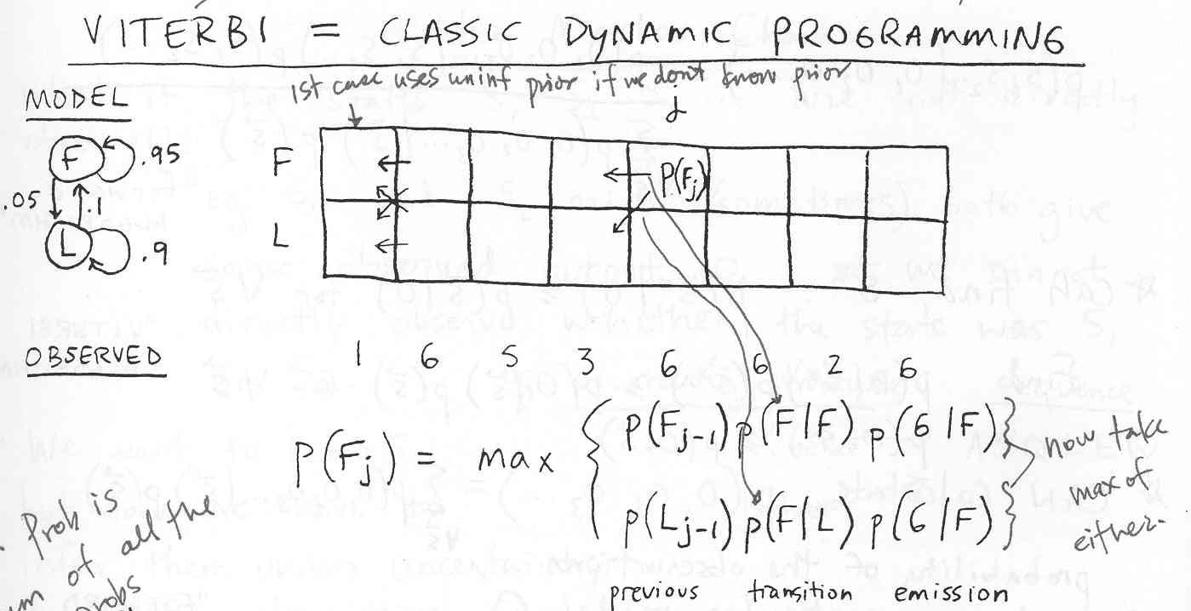
Algorithm Review
Viterbi – Maximize probability
  Used in HMM to give most probable STATE path

Slide 4
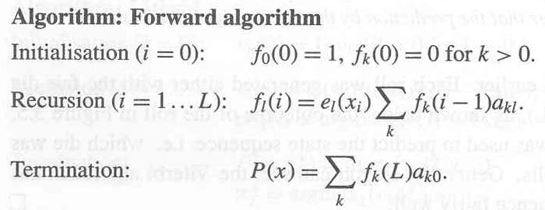
Algorithm Review
Forward – Total sum of probabilities
  Calculate total probability of the observations under a particular model
Emission
Prior
Transition

Slide 5
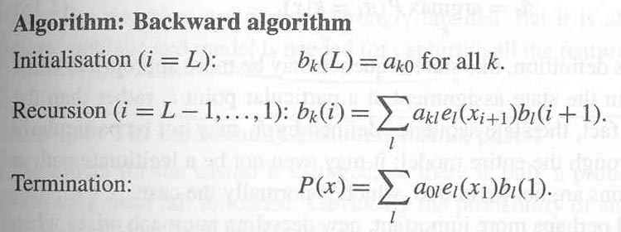
Algorithm Review
Backward – Total sum of probabilities
  Calculate total probability of the observations under a particular model going backwards
Emission
Prior
Transition

Slide 6
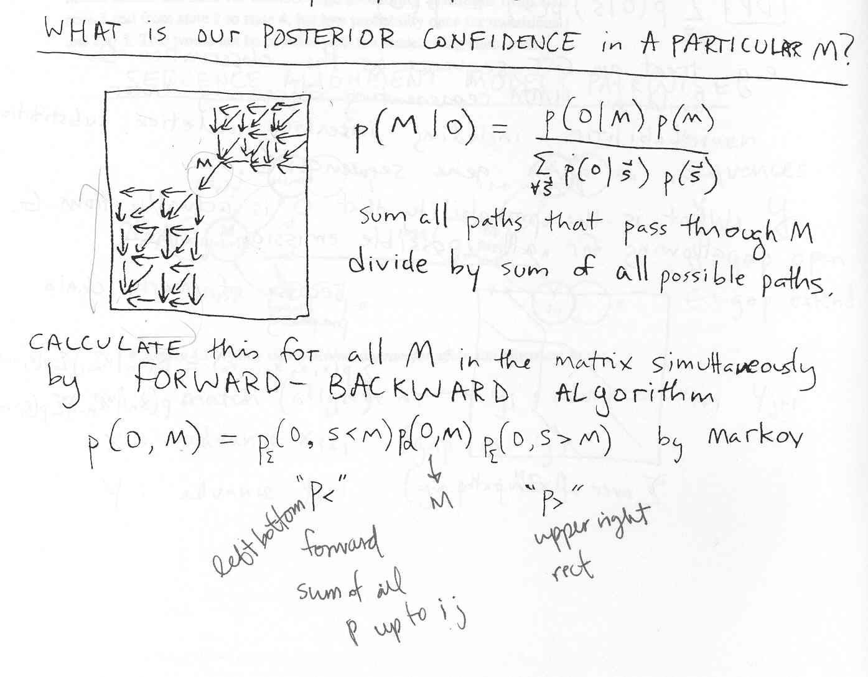
Algorithm Review
Forward-backward – Calculate posterior probability of a particular state

Slide 7
Unit 1 Input / Output
Input: profileprob <alignment file> <sequence file>
  CLUSTAL MSA file (used to generate HMM)
  FASTA seq file (probe seq to compare against the HMM)
Output
  Stdout
    Total probability of the FASTA seq matching the HMM (Forward algorithm)

Slide 8
HMM Overview
Unit 1
  Construct a profile HMM given an MSA
    Special rules for HMM construction
  Given a sequence, find the probability the sequence satisfies the HMM for a certain state
    Forward algorithm
Unit 2
  Construct a profile HMM
  Given a sequence, find the posterior probability of each move of the traceback
    Forward-backward algorithm

Slide 9
Step 1: Create profile HMM
Special rules
  Two states
    Match
      Insertion states are defined to be a transition from a match state to a match state
    Deletion
  Insertion state transition prob =
  Deletion state transition prob

Slide 10
Step 1: Create profile HMM
Clustal MSA:
______1_2_3__
tst1 A E C
tst2 A - C
tst3 A E E
tst4 A E -
1st col TRANSITION probabilities:
Gap prob = (N_G(k) + 1) / (N_total + 2)
a_{GAP} = (0+1)/(4+2) = 1/6
Match prob = 1 – gap prob
a_{MATCH} = (4+1)/(4+2) = 1 – 1/6 = 5/6
Ins prob = gap prob
a_{INS} = 1/6
Insertions are treated as matches that loop back to same column
1st col EMISSION probabilities:
e_i(k) = (N_i(k) + 1) /
(N_total – N_G(k) + 20)
e_{A} = (4+1)/(4-0+20) = 5/24
e_{remaining 19} = 19 /(4-0+20) = 19/24
Denominator:
N_total = # seq = 4
N_G(k) = # seq’s w/ gaps = 0
AA = 20
Pseudocount (Laplace’s rule): add one to the count of all transitions (states) or emissions (residues) to ensure nonzero probability of missing transitions & emissions

Slide 11
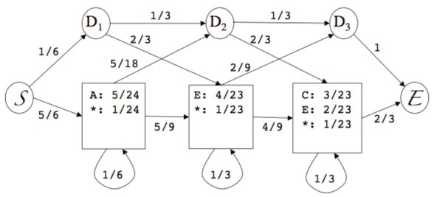
Step 1: Create profile HMM
Clustal MSA:
______1_2_3__
tst1 A E C
tst2 A - C
tst3 A E E
tst4 A E -
1st col TRANSITION probabilities:
Gap prob = 1/6
Match prob = 5/6
Ins prob = 1/6
2nd col TRANSITION probabilities:
Gap prob = (N_G(k) + 1) / (N_total + 2)
a_{GAP} = (1+1)/(4+2) = 2/6 = 1/3
Match prob = 1 – gap prob
a_{MATCH} = 2/3
Ins prob = gap prob
a_{INS} = 1/3
2nd col Match TRANSITION probabilities:
M->D prob= 5/6 * 1/3 = 5/18
M->M prob= 5/6 * 2/3 = 5/9
1-1/6 = 5/6

Slide 12
Step 1: Create profile HMM
Clustal MSA:
______1_2_3__
tst1 A E C
tst2 A - C
tst3 A E E
tst4 A E -
3rd col Match TRANSITION probabilities:
M->D prob= 2/3 * 1/3 = 2/9
M->M prob= 2/3 * 2/3 = 4/9
3rd col
Gap prob
a_{GAP} = 1/3
Match prob = 1 – gap prob
a_{MATCH} = 2/3
Ins prob = gap prob
a_{INS} = 1/3
1-1/3 = 2/3
1-1/3 = 2/3

Slide 13

Step 2: Forward Algorithm
Data Structures
  HMM prob. matrix
  Match matrix
  Deletion matrix

Slide 14
Step 2: Forward Algorithm
SEQ1: A
After ln to log conversion (logX = ln(X)/ln(10)):
seq1 LOG_PROB=-1.73
Deletion Matrix
Match Matrix
 | - | A
0 | null | ln(5/6 * 5/24) = -1.75
1 | Null | ln(1/6 * 2/3 * 1/23) = -5.33
2 | null | ln(1/6 * 1/3 * 2/3 * 1/23) = -6.43
 | - | A
0 | ln(1/6) = -1.79 | null
1 | ln(1/6 *1/3) = -2.89 | ln(5/6 * 5/24 * 5/18) = -3.03
2 | ln(1/6 * 1/3 * 1/3) = -3.99 | ln[(5/6 * 5/24 * 5/18 * 1/3) + (1/6 * 2/3 * 1/23 * 2/9)] = -4.07

Slide 15
Step 2: Forward Algorithm
Forward algorithm formula:
M(i, j) = ln( emission_{i}( seq( j-1) ) )+
ln( e^{M(i-1, j-1)} * transition_{Mi-1,Mj} + e^{M(i,j-1)} * transition_{Mi,Mj} + e^{D(i-1,j-1)} * transition_{Di-1,Dj})
D(I,j) = ln(e^{M(i-1,j)}) * transition_{Mi-1,Dj}
+ e(D(i-1,j)) * transition_{Di-1,Dj}

Slide 16
Computing with Log-Probabilities
log(A + B) = log(A) + log(1+exp(log(B) – log(A))
A=exp(logProbA)*probA, B=exp(logProbB)*probB
logProbA and logProbB are the logs of some probability
Substituting for A and B =>
log(exp(logProbA)*probA + exp(logProbB)*probB)=
logProbA + log(probA) + log(1 + exp(logProbB + log(probB) - logProbA - log(probA)))

