Slide 1
Probabilistic Model of HMM’s

Slide 2
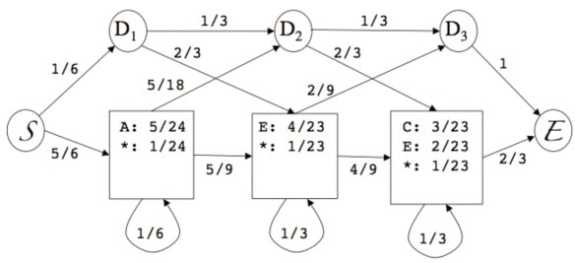
What Kind of Scoring System is Used?
Use statistical features of the whole set of seqs (MSA) in the scoring
Unlike pairwise alignment (using traditional scoring matrices), create position specific probabilities for each residue and transition in every column
Use log instead of log-odds scores (results in non-normalized scores)
Scoring (after log transformation) will always be negative
  Less negative score is a better score
Clustal MSA:
______1_2_3__
tst1 A E C
tst2 A - C
tst3 A E E
tst4 A E -

Slide 3
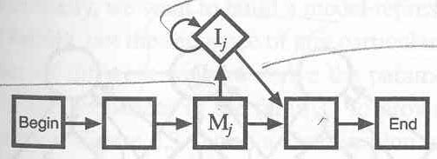
What Kind of Scoring System is Used?
Uniform gap scores ignores information in our MSA
Gap “penalties” similar to affine gap scoring model
Gap extension penalty
D
D
D
D
M
M
M
M
Gap opening & closing penalties
Gap opening & closing penalties
Gap extension penalty

Slide 4
Optimality Guarantee
Viterbi Algorithm
  Similar to dynamic programming
    Gradually construct globally optimal path by applying optimal local rule
Forward Algorithm
  Not looking for optimal path

