Slide 1
Specifications and Detailed Design Plan
Teresa Breyer
Sulmin Kim
Gary Chen

Slide 2
Project Organization
Development Environment
  Implementation language: Java
  SitePad Pro on Windows
  Emacs on Linux
Staging Environment
  Linux server at Gary’s apartment
  Build environment
    Jakarta ant – xml based makefiles
  Testing environment
    Mike’s web application for verification purposes
    Perl scripts to run test suite
Roles
  Architecture: Gary
  Lead programmer: Teresa
  Quality Assurance: Sul-min

Slide 3
Specifications for Part 1
Requirements Spec
  Read CLUSTAL format file
  Read FASTA format file
  Output total probability of each alignment
Functional Spec
  Generate an alignment based HMM probabilistic model profile
  Generate dynamic programming matrices based on each FASTA sequence against HMM model
  Compute alignment probability using forward algorithm

Slide 4
Specifications for Part 2
Requirements Spec
  Read CLUSTAL format file
  Read FASTA format file
  Output posterior probability of each position of each alignment
Functional Spec
  Generate dynamic programming matrices based on each FASTA sequence against HMM model
  Compute forward, backward, and viterbi probabilities
  Track traceback moves

Slide 5
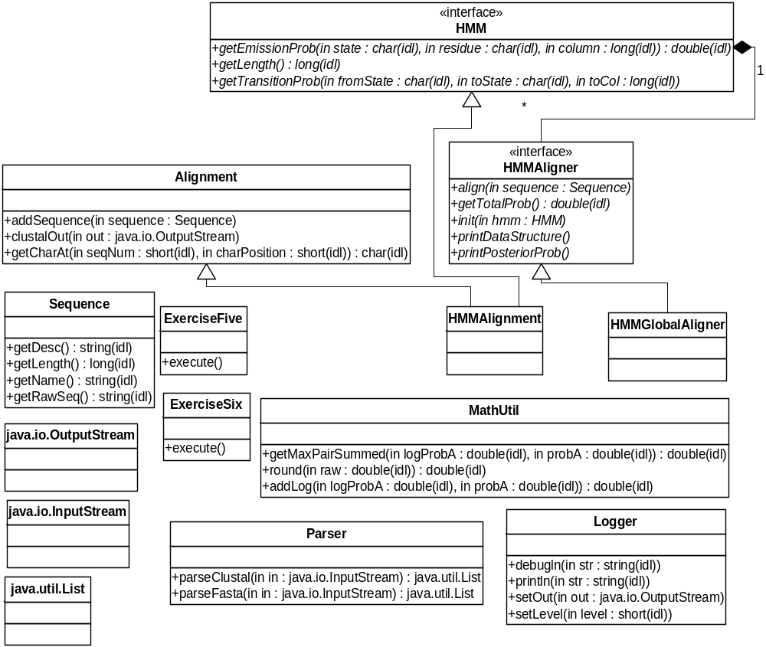
Modules:
Main classes
HMM
I/O
Core objects
Java SDK

Slide 6
Function Prototypes
HMMAlignment – encapsulates an alignment and computes position specific probabilities similar to LaPlace model
public double getEmissionProb(byte state, char ch, int position)
public int getLength()
public double getTransitionProb(byte fromState, byte toState, int toPosition)
private double getBeginTransitionProb(byte toState)
private double getDeletionTransitionProb(byte toState, int toPosition)
private double getMatchEmission(char ch, int position)
private double getMatchInsertTransitionProb(byte toState, int toPosition)
private int getResidueCounts(int position)
private int getResidueCounts(int position, char ch)
private void initProbModel()

Slide 7
Function Prototypes
HMMGlobalAligner – encapsulates dynamic programming functionality between a sequence and an HMM probabilistic model
public void init(HMM hmm)
public align()
throws DataFormatException
public double getTotalProb()
throws DataFormatException
public void printDataStructure()
throws DataFormatException
public void printPosteriorProbs()
throws DataFormatException
private void computeBackwardProbs()
throws DataFormatException
private void computeForwardProbs()
throws DataFormatException
private void computeViterbiProbs()
throws DataFormatException

Slide 8
Code Example:
public class ExerciseFive {
private static void printUsage() {
System.out.println("Usage: ./profileprob <clustal_infile> <fasta_infile> <residue_definition_file> <debug_level(0=terse,1=verbose)>");
System.exit(1);
}
private void execute(String clustalFileName, String fastaFileName, String residueDefFileName)
throws Exception{
Parser parser= new Parser();
List clustalSequences = parser.parseClustal(new FileInputStream(clustalFileName));
List fastaSequences = parser.parseFasta(new FileInputStream(fastaFileName));
HMM hmm = new HMMAlignment(clustalSequences, new FileInputStream(residueDefFileName));
HMMAligner aligner = new HMMGlobalAligner(); // replace null with the name of Teresa's new class
aligner.init(hmm);
Iterator it = fastaSequences.iterator();
while (it.hasNext()) {
Sequence seq = (Sequence)it.next();
aligner.align(seq);
Logger.println(seq.getName()+" LOG_PROB="+aligner.getTotalProb());
if (Logger.getLevel()>=Logger.DEBUG) {
aligner.printDataStructure();
}
}
}
public static void main(String args[]) {
try {
if (args.length<4) {
printUsage();
}
int debugLevel = Integer.parseInt(args[args.length-1]);
Logger.setLevel(debugLevel);
Logger.setOut(System.out);
ExerciseFive exercise = new ExerciseFive();
exercise.execute(args[0], args[1], args[2]);
}
catch (Exception ex) {
Logger.println("Application error of type "+ex.getClass().getName()+": "+ex.getMessage());
if (Logger.getLevel()>=Logger.DEBUG) {
ex.printStackTrace(System.out);
}
}
}

