Slide 1
Introduction to profile hidden Markov models
Robert Riley, Michael Strong, Qiang Xu, Ben Redelings

Slide 2
Background
Unit 1: Pairwise sequence alignment
  Assumptions:
    Global: Sequences diverge by a process of point mutation
    Local: Sequences diverge by point mutation, and by ‘shuffling’ of functional subsequences
Seq0 MSETVICSSRATVMLYDDGNK....RWLPAGTGPQA
Seq1 MGEQPIFTCQAHVFHIDPKTKR...TWITASMKA..
Evolution

Slide 3
Background
Unit 2: Multiple sequence alignment
  Assumption:
    By aligning many related sequences, we can get a sense of a ‘consensus’, or most likely path through the alignment
Consensus

Slide 4
Background
What does this mean biologically?
Perhaps the most likely path represents a common ancestor
  Time of divergence in speciation or gene-duplication events can be estimated from multiple sequence alignments
Consensus might tell us about functional constraints on the protein
t

Slide 5
Background
Unit 3
  Two ideas that were implicit in earlier units are now explicit:
    Proteins exist in families
    Proteins are composed of discrete domains

Slide 6
What is a protein family?
A group of sequences related by evolution
Functional constraints on residue identity vary as a function of position in a sequence
  A few positions are conserved
  Most are allowed to vary
Result: it is possible for sequences of the same family to lack detectable sequence similarity
Depending on the estimator, the ‘twilight zone’ of sequence similarity is about 25% sequence identity
  Doolittle RF, 1986. Of URFs and ORFs: a primer on how to analyze derived amino acid sequences. University Science Books, Mill Valley California
Q9UI08/1-109 MSEQSICQARASVMVYDDTSK....KWVPIKPGQQGFSRINIYHNTAS.NTFRVVGVKLQ.........DQQVVINYSIVKGLKYNQAT...PTFHQW.....RDARQVYGLNFASKEEATTFSNAMLFAL
Q9V8R3/1-95 .............MVYDDNQK....KWVPSGSSS.GLSKVQIYHHQQN.NTFRVVGRKLQ.........DHEVVINCSILKGLKYNQAT...ATFHQW.....RDSKFVYGLNFSSQNDAENFARAMMHAL
P70433/1-108 MSEQSICQARAAVMVYDDANK....KWVPAGGST.GFSRVHIYHHTGN.NTFRVVGRKIQ.........DHQVVINCAIPKGLKYNQAT...QTFHQW.....RDARQVYGLNFGSKEDANVFASAMMHAL
VASP_HUMAN/1-110 MSETVICSSRATVMLYDDGNK....RWLPAGTGPQAFSRVQIYHNPTA.NSFRVVGRKMQP........DQQVVINCAIVRGVKYNQAT...PNFHQW.....RDARQVWGLNFGSKEDAAQFAAGMASAL
O96607/1-107 MGEQPIFTCQAHVFHIDPKTKR...TWITASMKA..VNVSFFYDSSRN..LYRIISVEGT...........KAVINSTITPNMTFTQTS...QKFGQWS...DVRANTVYGLGFASEAELTKFVEKFQEVK
Q9Z2X5/6-110 ..EQPIFSTRAHVFQIDPATKR...NWIPAGKHA..LTVSYFYDATRN..VYRIISIGGA...........KAIINSTVTPNMTFTKTS...QKFGQWA...DSRANTVYGLGFGSEQQLTQFAEKFQEVK
YKC2_CAEEL/22-133 IS.ASDKILSSGICQLLFSENG...HWRIPNGGT..AVALFLKNSTER..YYRIIVMEPSADPDWEPTVQFDFLIRDKKFETMQEH......ARLLVF.....EAESRYIGLNFYDSKECENFHNSVCKRQ
LA17_YEAST/16-124 LPKASNKIIDVTVARLYIAYP.DKNEWQYTGLSG...ALALVDDLVGNTFFLKLVDINGHR..........GVIWDQELYVNFEYYQDR...TFFHTF.....EMEECFAGLLFVDINEASHFLKRVQKRE
Q9VAT0/34-140 LG.KKCQTLNTAVVQIYKTEGSAHAHWKKRHTG....VVCFVKDSAIRSYFMRAYCLIKN...........ELIWEHEIYDGMEVVKSR...PFLLTF.....EGSDGHVGLNFVSEEECDSFFRIVDATI
WASP_HUMAN/39-145 LG.RKCLTLATAVVQLYLALPPGAEHWTKEHCG....AVCFVKDNPQKSYFIRLYGLQAG...........RLLWEQELYSQLVYSTPT...PFFHTFA.....GDDCQAGLNFADEDEAQAFRALVQEKI
WASL_RAT/31-135 LG.KKCVTMSSAVVQLYAADRN..CMWSKKCSG....VACLVKDNPQRSYFLRIFDIKDG...........KLLWEQELYNNFVYNSPR...GYFHTFA.....GDTCQVALNFANEEEAKKFRKAVTDLL
Q17795/8-114 .SEAVCLT..AAVVQLLKSDRG...AWRVDLPHG...VISLVKDYAQRAYFLRIFDILEE...........RIVWDFKLYKAF.RAQSFPQCRKLLAFEQMENGEDGVVIGLNFFSEYEAAEFKRKRI...

Slide 7
What is a domain?
Protein domains are discrete functional modules
  Independently folding
  There are no ‘half’ domains in nature
Even when a pair of sequences is related by a common domain, often they may differ by another domain.
Thus global alignment model fails to describe this case.
SH2
SH3
Pkinase
BAR
SH3

Slide 8
Are all sequence substitutions the same?
Position matters
  Key residues perform essential functions
  Examples
    catalytic sites
    hydrophobic core
    protein-recognition motifs
    disulfide bonds

Slide 9
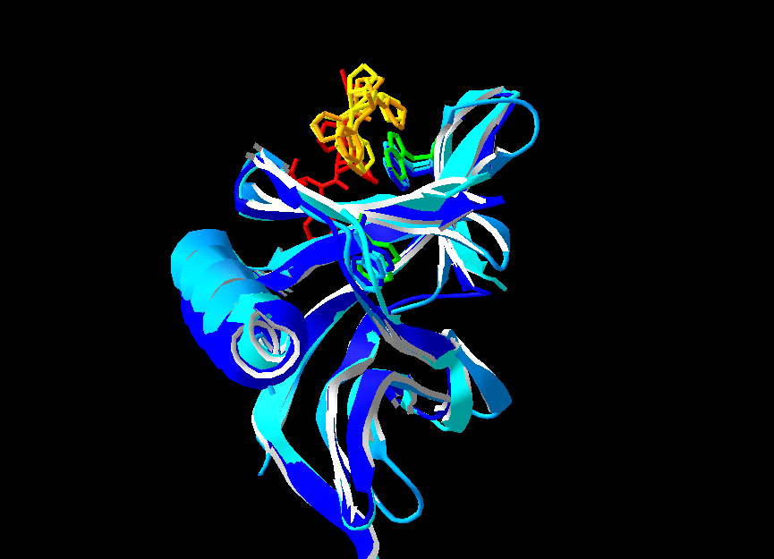
Example
WH1 domain
  Involved in cytoskeletal function
  Conserved Trp residue is absolutely conserved despite wide variance in the at other positions
  Some members of the family have no detectable (by BLAST) sequence similarity to other members
Q9UI08/1-109 MSEQSICQARASVMVYDDTSK....KWVPIKPGQQGFSRINIYHNTAS.NTFRVVGVKLQ
Q9V8R3/1-95 .............MVYDDNQK....KWVPSGSSS.GLSKVQIYHHQQN.NTFRVVGRKLQ
P70433/1-108 MSEQSICQARAAVMVYDDANK....KWVPAGGST.GFSRVHIYHHTGN.NTFRVVGRKIQ
VASP_HUMAN/1-110 MSETVICSSRATVMLYDDGNK....RWLPAGTGPQAFSRVQIYHNPTA.NSFRVVGRKMQ
O96607/1-107 MGEQPIFTCQAHVFHIDPKTKR...TWITASMKA..VNVSFFYDSSRN..LYRIISVEGT
Q9Z2X5/6-110 ..EQPIFSTRAHVFQIDPATKR...NWIPAGKHA..LTVSYFYDATRN..VYRIISIGGA
YKC2_CAEEL/22-133 IS.ASDKILSSGICQLLFSENG...HWRIPNGGT..AVALFLKNSTER..YYRIIVMEPS
LA17_YEAST/16-124 LPKASNKIIDVTVARLYIAYP.DKNEWQYTGLSG...ALALVDDLVGNTFFLKLVDINGH
Q9VAT0/34-140 LG.KKCQTLNTAVVQIYKTEGSAHAHWKKRHTG....VVCFVKDSAIRSYFMRAYCLIKN
WASP_HUMAN/39-145 LG.RKCLTLATAVVQLYLALPPGAEHWTKEHCG....AVCFVKDNPQKSYFIRLYGLQAG
WASL_RAT/31-135 LG.KKCVTMSSAVVQLYAADRN..CMWSKKCSG....VACLVKDNPQRSYFLRIFDIKDG
Q17795/8-114 .SEAVCLT..AAVVQLLKSDRG...AWRVDLPHG...VISLVKDYAQRAYFLRIFDILEE

Slide 10
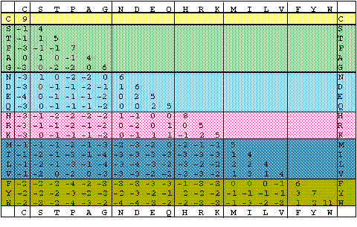
Blosum62
Trp is always highly conserved in proteins
What about residues that are allowed to vary?

Slide 11
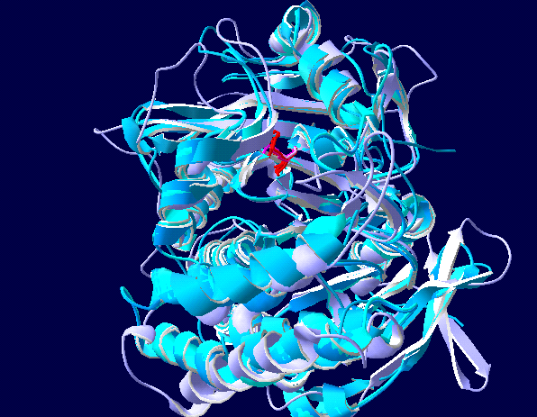
Example
Serine carboxypeptidase
Substituting serine for most other residues is not heavily penalized. Yet in this family of proteins, catalytic serine residues are absolutely conserved.
Conclusion - functional constraints on proteins result in position-specific preferences for amino acid substiutions
YBY9_YEAST/83-494 LNGGPGCSSF TGLLFELGPS SIGADM.... ..KPIHNPYS WNNNASMIFL
CBPY_YEAST/116-528 LNGGPGCSSL TGLFFELGPS SIGPDL.... ..KPIGNPYS WNSNATVIFL
CBPY_CANAL/132-538 LNGGPGCSSL TGLFFELGPS SIDKNL.... ..KPVYNPHS WNANASVIFL
CBPX_ARATH/84-494 LTGGPGCSSE LAVFYENGPF KITSNM.... ..SLAWNEYG WDQVSNLLYV
CBP3_WHEAT/75-481 LTGGPGCSSE LAVFYENGPF TIANNM.... ..SLVWNKFG WDKISNIIFV
CBP3_HORVU/82-488 LTGGPGCSSE LAVFYENGPF TIANNM.... ..SLVWNKFG WDKISNIIFV
CBP3_ORYSA/75-481 LTGGPGCSSE LAVFYENGPF TISNNM.... ..SLAWNKFG WDTISNIIFV
CPS1_PENJA/12-417 FNGGPGCSSM IGLFQENGPC HFVNGD.... .STPSLNENS WNNYANMIYI
PRTP_MOUSE/34-471 LNGGPGCSSL DGLLTEHGPF LIQPDG.... .VTLEYNPYA WNLIANVLYI
PRTP_HUMAN/39-477 LNGGPGCSSL DGLLTEHGPF LVQPDG.... .VTLEYNPYS WNLIANVLYL
NF31_NAEFO/20-479 TNGGPGCSSL GGEASEHGLF LVNADG.... .ATITRNPYS WNRVSNILYI
CBP1_ORYSA/47-507 LNGGPGCSSF DGFVYEHGPF NFESGGSAKS LPKLHLNPYS WSKVSSVIYL
CBP1_HORVU/41-496 LNGGPGCSSF DGFVYEHGPF NFESGGSVKS LPKLHLNPYA WSKVSTMIYL
VCP_AEDAE/69-447 LQGGPGASSL FGMFEENGPF HIHRNK.... ..SVKQREYS WHQNHHMIYI
SXA2_SCHPO/65-503 LQGGPGCAGT LGFFSENGPI EISQSS.... .PSPSLNPES WTNFANMLWL

Slide 12
Profile HMMs
The Pfam database of protein family profiles
  Eddy SR, Bioinformatics. 1998;14(9):755-63
  Bateman A et al., Nucleic Acids Res 2002 Jan 1;30(1):276-80
Turn a multiple sequence alignment into a position-specific scoring matrix for use in sequence alignment
3071 protein families which match 69% of proteins in SwissProt and TrEMBL
Structural data incorporated where available
Features domain and active site functional annotation
Predictions of
  non-domain regions
  secondary structure

Slide 13
HMMs for fold recognition
Karplus K, Barrett C, Hughey R. Hidden Markov models for detecting remote protein homologies. Bioinformatics 1998;14(10):846-56
Sequence of unknown structure
Database of profile HMMs
Similarity undetectable by pairwise comparison
Relationship detected by HMM
Sequences of known structures
Homology model

Slide 14
HMMs for predicting protein-protein interactions
Assumption: the functional constraints on proteins include protein-protein interactions. Interacting domains may be conserved
  Fraser HB et al., Science 2002, 296:750-2
Count co-occurrence of domains in interacting partners in protein interaction maps
Construct a matrix of domain co-occurrence
Infer potential interaction in pairs of proteins, each having a member of a highly correlated domain pair
Deng M et al., Genome Res 2002 Oct;12(10):1540-8
Wojcik J, Schacter V., Bioinformatics 2001;17 Suppl 1:S296-305
0 | 1 | 0 | 2 | 1
1 | 2 | 5 | 0 | 1
0 | 5 | 7 | 24 | 3
2 | 0 | 24 | 0 | 2
1 | 1 | 3 | 2 | 4
interaction

