Slide 1
Training of profile HMMs
Testing
Robert Riley

Slide 2
What is testing?
Robustness of code
  Does it crash easily?
Verification of results
  Does our HMM find distant homologs?
  Do our alignments look reasonable?

Slide 3
Testing methodology
Compare:
Results
Our program
--------
---------
-------
---------
------------
--------
Our HMM
Protein sequence
database
(SwissProt, nr)
Pfam HMM
--------
---------
-----------
----------
------------
--------
-----------
---------
HMMER
Does our HMM training/alignment method give the same results as an accepted standard?
  Bateman A et al., NAR, 2002, v. 30, n. 1

Slide 4
Testing methodology
Known members of family
Proteins found by our HMM
False negatives
False positives
True positives

Slide 5
How do we define a family?
Use Pfam profile HMM as ‘gold standard’
Decide on an E-value threshold
Identify all proteins in SwissProt v. 40 that hit Pfam profile HMM with E-value below threshold
Use our HMM, trained on a subset of the family
  e.g., all hemoglobin-α sequences
Compare coverage of family

Slide 6
Evaluating results
False positives:
  We identify as a homolog a protein that does not truly belong to the family
False negatives
  We fail to identify a legitimate member of the family

Slide 7
Sensitivity and specificity
Sensitivity
  The probability of identifying a protein as a homolog, given that it belongs to the family being considered.
Specificity
  The probability of not identifying a protein as a homolog, given that it does not belong to the family.

Slide 8
Sensitivity and specificity
Sensitivity
b / (a + b)
Specificity
c / (c + d)
a | b
c | d
+
True homology
-
-
+
Hit

Slide 9
Test cases
Profile HMMs were trained on five protein families
  Actins 235
  Globins
    Hemoglobin α 183
    Hemoglobin β 183
  P53 proteins 31
  Profilins 75
  Ubiquitins 20
Proteins were selected by ‘naïve’ method, i.e., all proteins named ubiquitin.
Single-domain proteins were chosen for simplicity

Slide 10
Initial test development with HMMER
Family | Reference set | Test set | True positives | False positives | True negatives | False negatives | Sensitivity | Specificty
Actins | 268 | 265 | 265 | 0 | 119338 | 3 | 0.99 | 1.00
HB-α | 822 | 593 | 593 | 0 | 118784 | 229 | 0.72 | 1.00
HB-β | 822 | 592 | 591 | 1 | 118783 | 231 | 0.72 | 1.00
P53 | 33 | 33 | 33 | 0 | 119573 | 0 | 1.00 | 1.00
Profilins | 78 | 78 | 78 | 0 | 119528 | 0 | 1.00 | 1.00
Ubiquitins | 63 | 43 | 43 | 0 | 119543 | 20 | 0.68 | 1.00
Reference set: proteins hit by Pfam HMM
Test set: proteins hit by our HMM
E-value threshold : 0.01

Slide 11
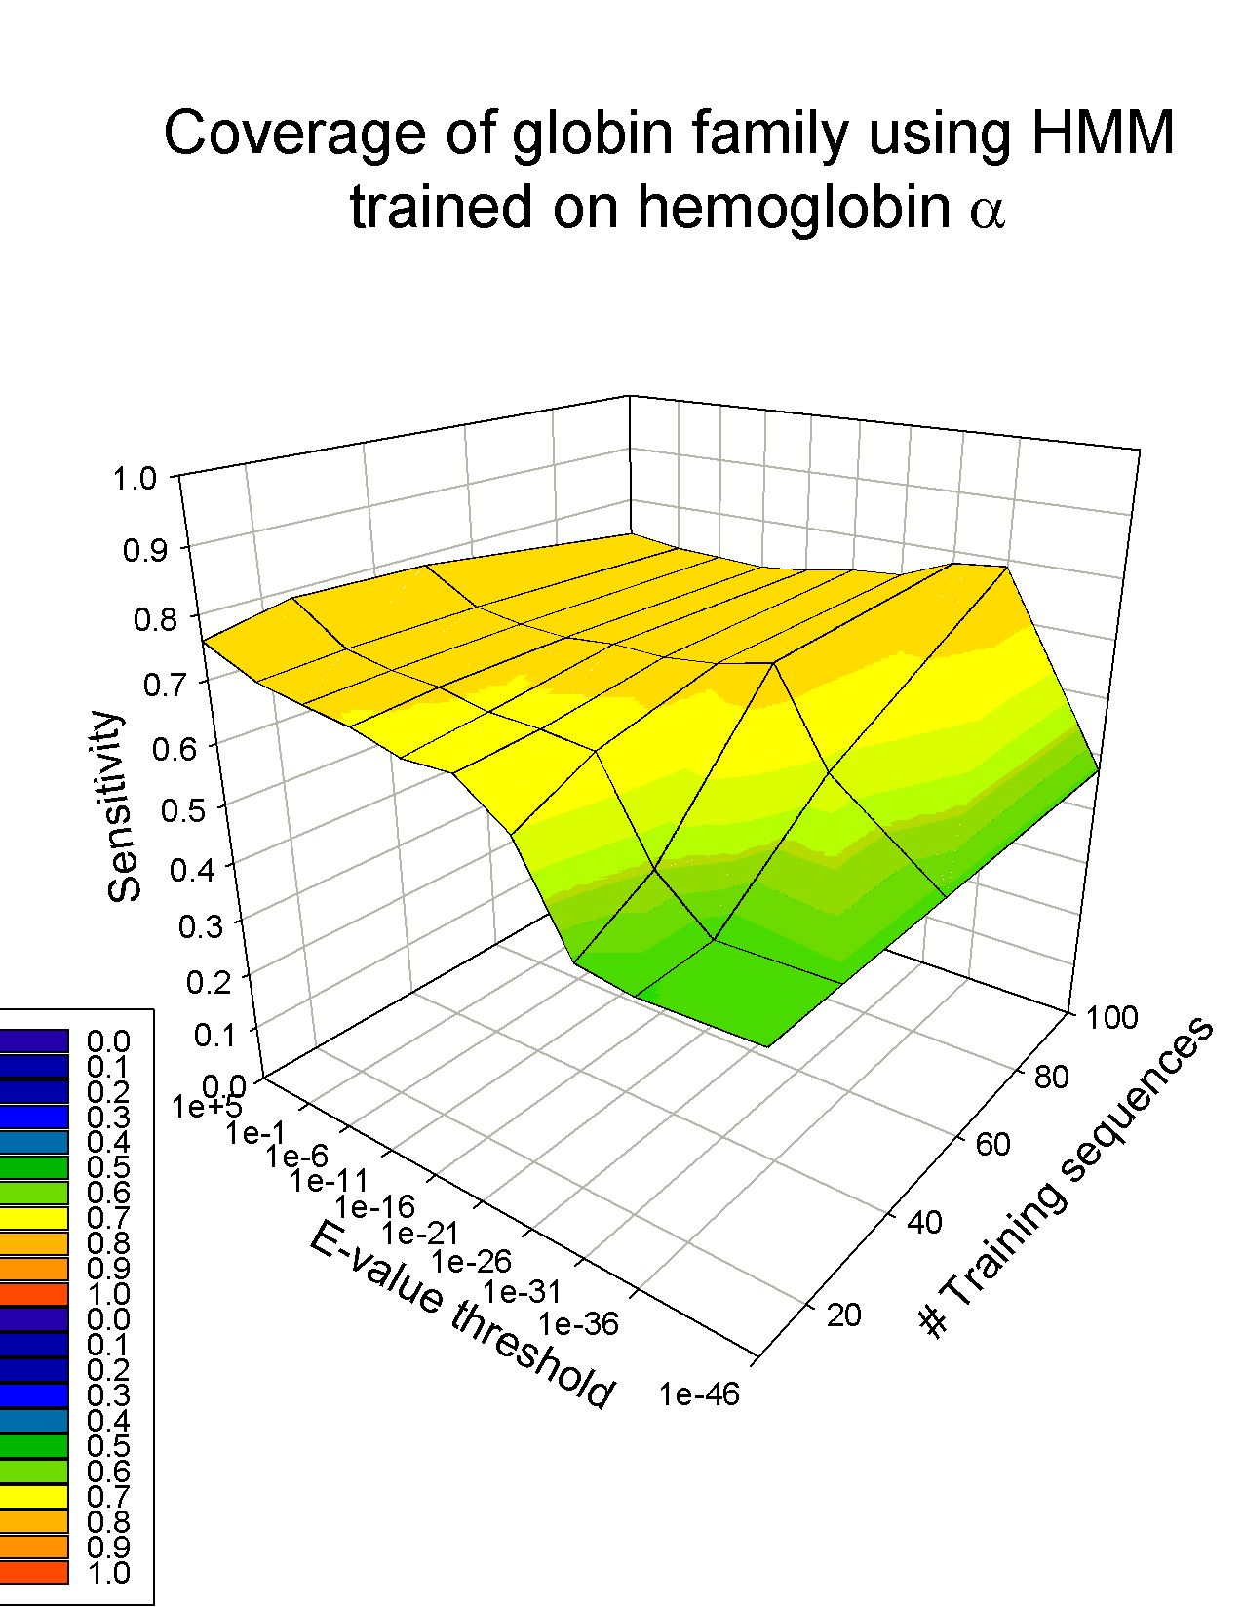
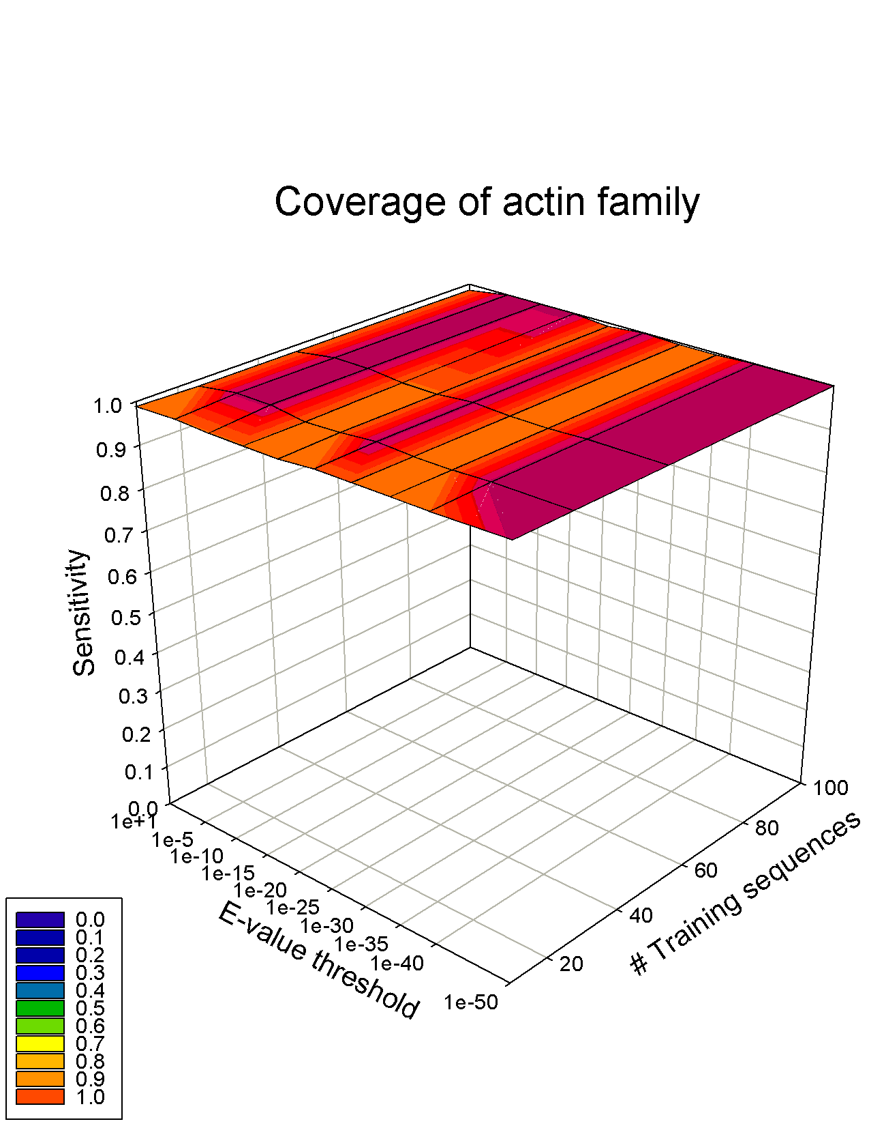
Coverage of globin family is more sensitive to training set than actin family
Again, developed using HMMER

Slide 12
Our results
3098 globins
from NCBI
Profile HMM
Compare score
Distributions
3098 random
proteins from
SwissProt

Slide 13
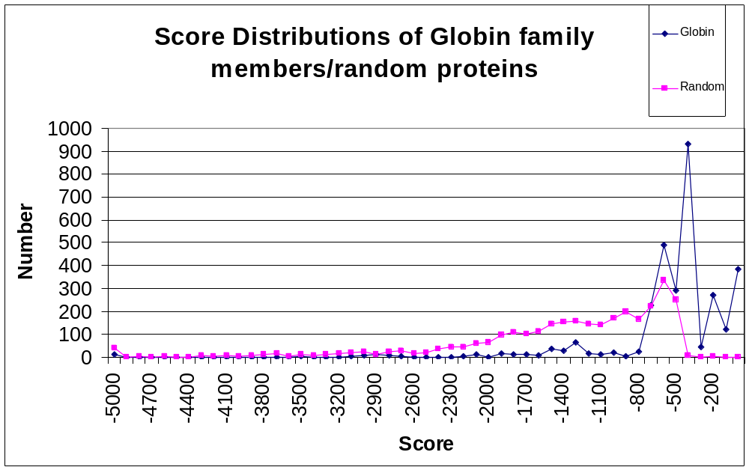
Our results

Slide 14
Future work
Implement alignment output
Run our profile HMM through a more rigorous set of tests
Refine our test sets to include more protein families with distant homologs

