Slide 1
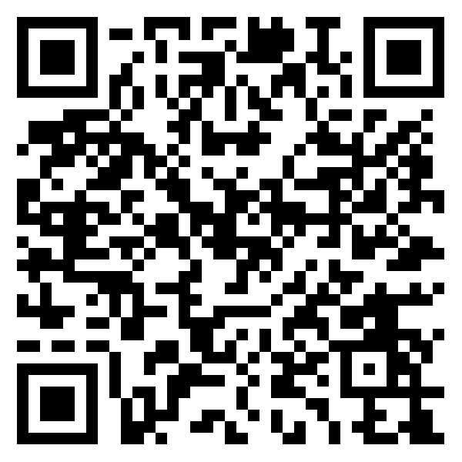






Gerry Chen
Robotics PhD (est 2024)
Georgia Institute of Technology
gerry.chen2015@gmail.com
(412) 956-3047
gerry-chen.com
bit.ly/3ytFLSk
gchenfc
bit.ly/3Ev8o5l
gerry-chen
gchenfc
very_merry_gerry

