Slide 1
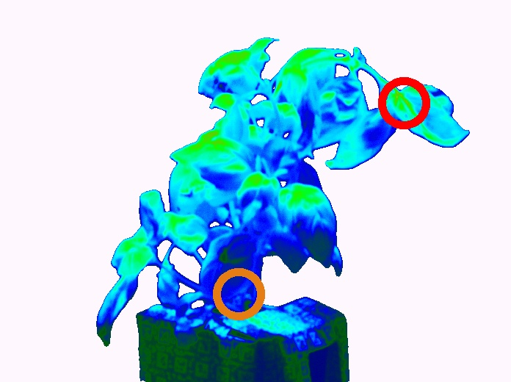
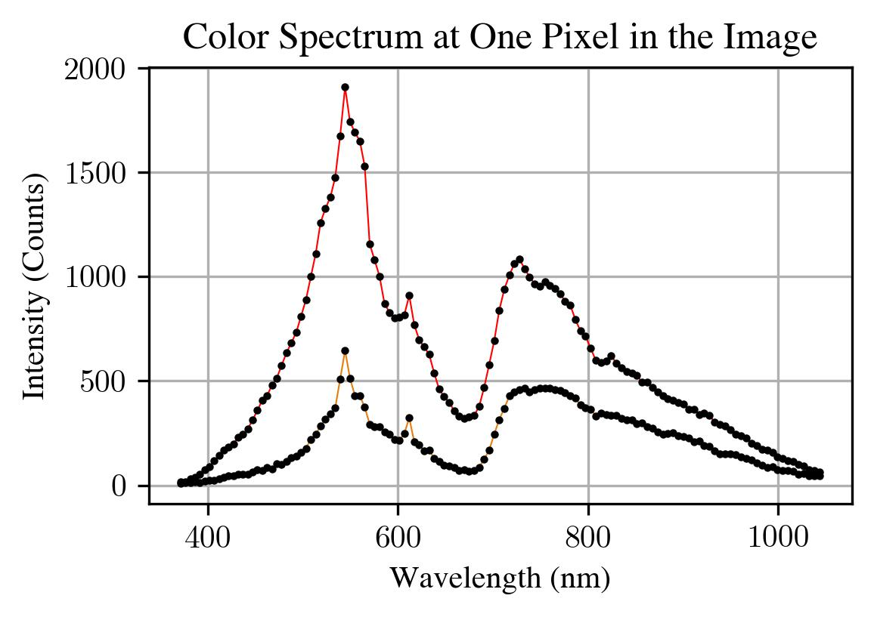
Wavelength Embeddings
xyz
Intensities
Hyperspectral Image
Sampler
HS-NeRF Field
Volumetric Renderer
Ray Bundle
dir
Densities
Appearance
Embedding

