Slide 1
Chiquita Banana
She is sooo cool
About Me!!

Slide 2


About me
Name: Haley
Nick Name: Chiquita Banana
Age: 14 and loving it!!
Favorite color: black
Favorite singer: Avril Lavigne
I love 2 listen 2 rock music! Especially linkin park and avril lavigne

Slide 3
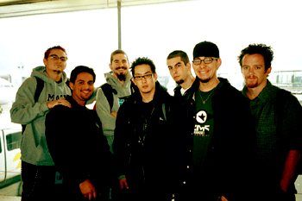
Linkin Park
These are the guyz!! Chester is my favorite!!!

Slide 4
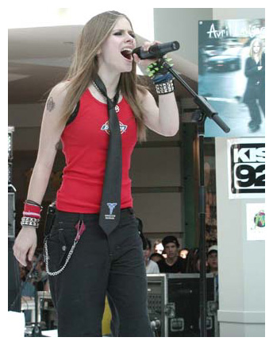

 |  | Chester Bennington Vocalist Age: 18,0.5
Avril Lavigne
This Is Avril!! I am in love with her!
She is my HERO!!!!!! She is one of
the only women rock singers!!

Slide 5
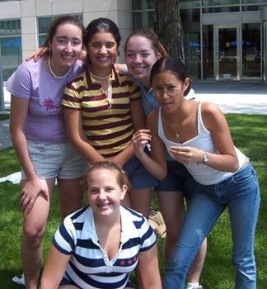

ARTEMIS
Artemis is sooo much fun! I wish it would never end!
We work on lots of fun things like web pages!
When I leave I‘m gonna miss every one!!!
This is a great picture of me ,Sarah
Allie Mel, and Caitlin. We are all at
MIT!!!

Slide 6
QUOTES
MOOOOO- caitlin, allie, mel, sarah,me
Shally- allie
Pornographic!!- Caitlin
Looming Giants Union- Jen and Haley
Shove it in the hole!!-Sarah
Mishey!!!!- Nina/ allie
How many holes do we have??- Sarah

