Slide 1
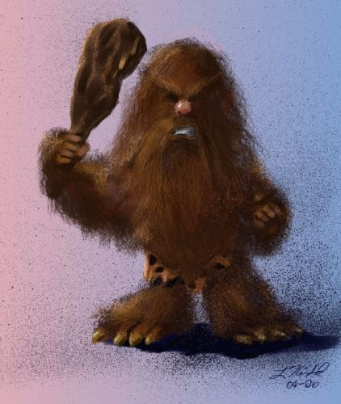
powerpoint!
SO EASY, EVEN A CAVEMAN CAN DO IT

Slide 2
WHAT IS IT?
A powerful program to make cool-looking, easy-to-understand presentations
All of the Artemis presentations (including this one) were done in PowerPoint

Slide 3
let’s do this!
Go to the START menu on your computers, then click the “All Programs” button; then, go to “Microsoft Office,” and then Microsoft Office PowerPoint 2007
From now on, this kind of direction will be notated
Start > All Programs > Microsoft Office > Microsoft Office PowerPoint 2007

Slide 4
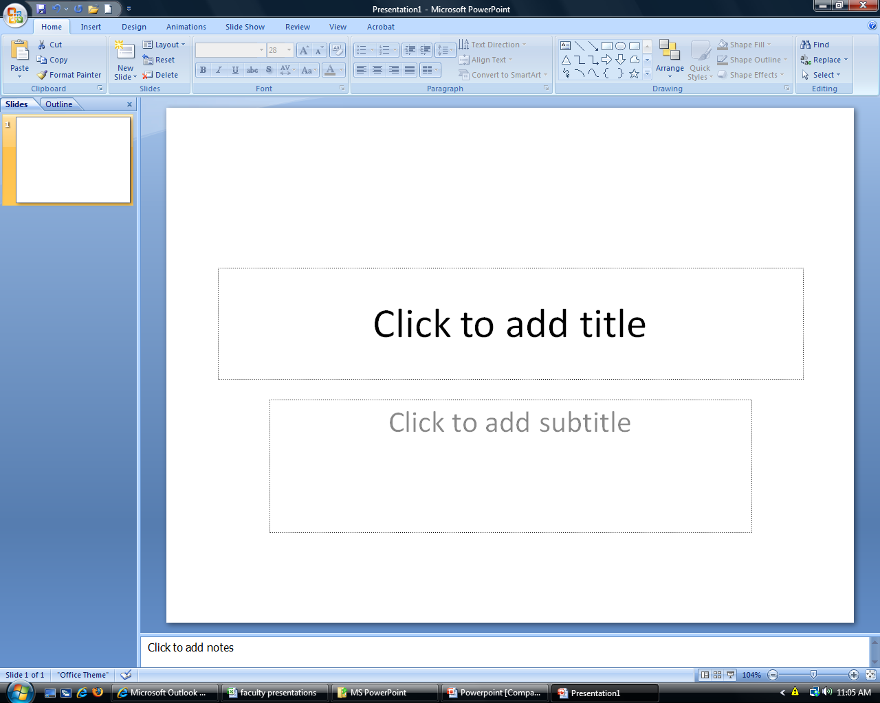
adding a slide
Try clicking on the first slide and pressing “Enter”.
You can add as many slides as you like

Slide 5
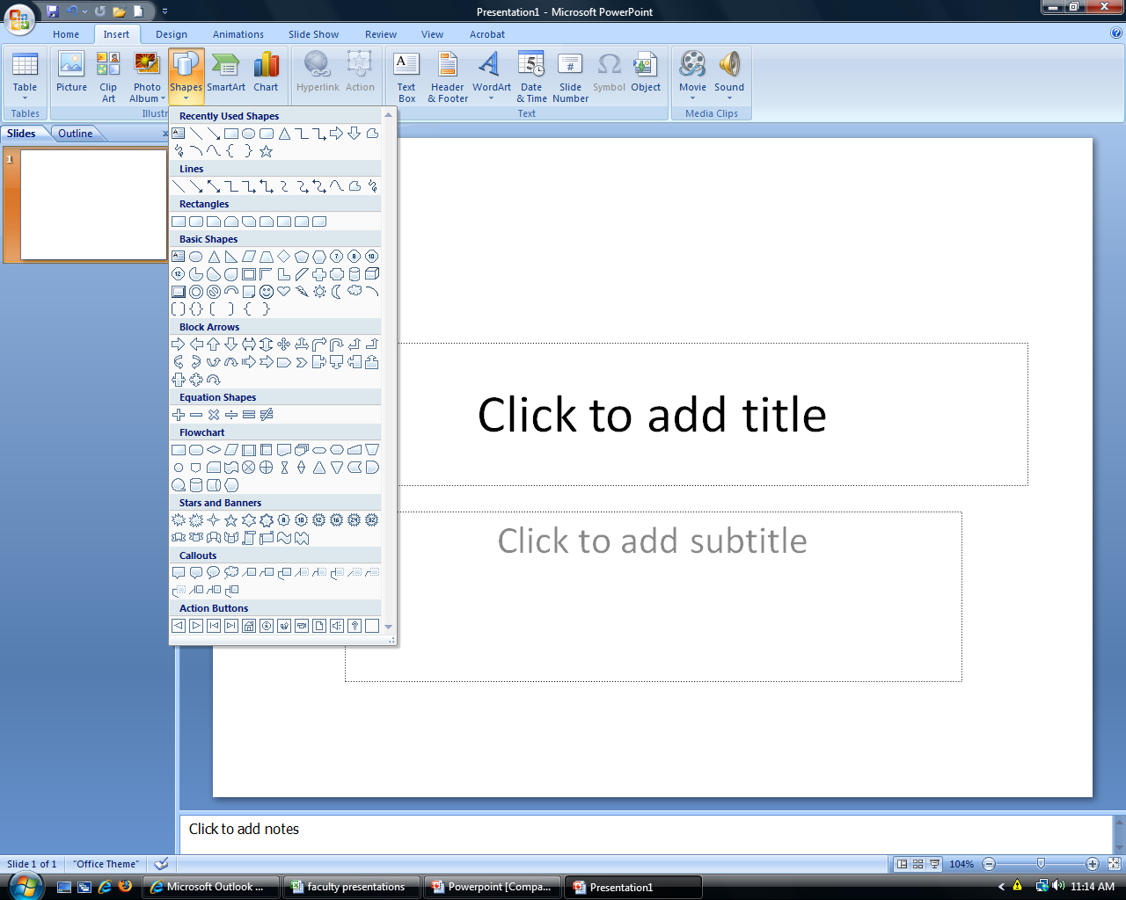
go to “insert” > “shapes”

Slide 6
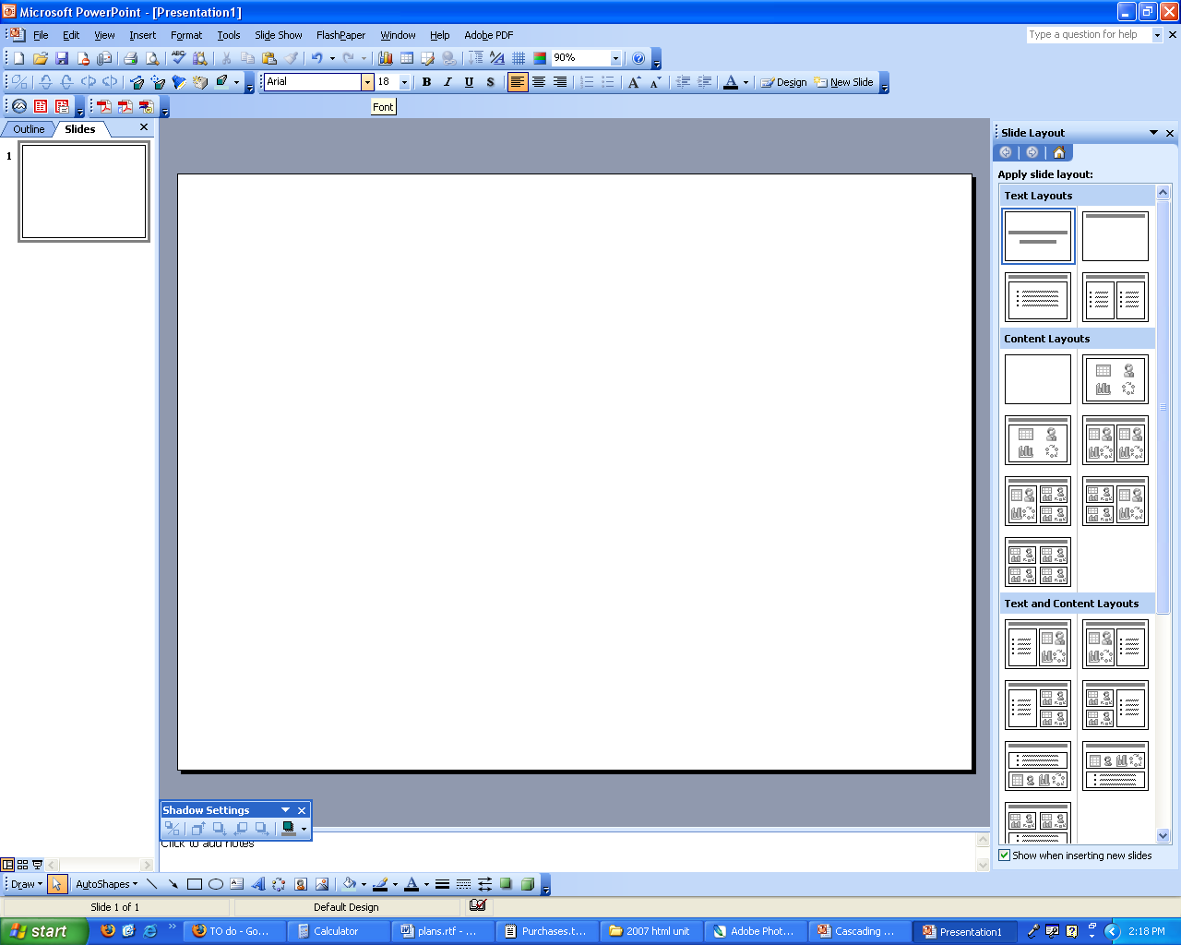
try playing around with the drawing tools
Hubba hubba…
Stickfigures never looked so good

Slide 7
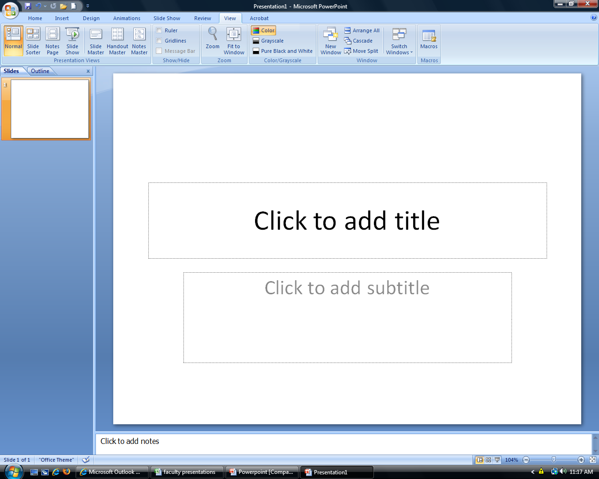
view options
You have 4 choices:
Normal
Slide Sorter
Notes Page
Slide Show

Slide 8
what about the background?
Right-click on the background of a slide. Select “Format background.”
Try out some different backgrounds.
You can also go to the “Design” toolbar and select a pre-made color scheme. Snazzy!

Slide 9


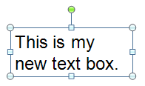
adding and formatting text
Go to the Insert tab at the top of the window, and click insert text book.
Click and drag a rectangle where you want your box to be.
Rotate your
text box!
Use this box to format the font, color, and
Make bigger or smaller!
background color.

Slide 10
WordArt!
Go to the Insert tab again and click WordArt
Select a style
You can edit its colors and font by right clicking and going to Format
WordArt is awesome to use as a heading or to emphasize something.

Slide 11
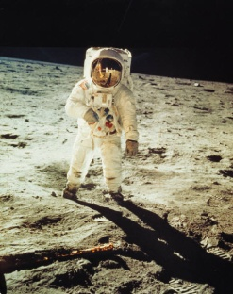
can i add pictures?
Of course!
Go to Insert > Picture
Choose a photo from somewhere on your computer, and press “Insert”
You can also add pictures from the Clipart file (Insert > Clipart)

Slide 12


pictures, continued…
It doesn’t stop there! You can use PowerPoint as a photo editor
Double-click on your picture
This brings up the picture editing toolbar. Give it a shot!

Slide 13


If you use a picture as a background, you might want to “wash it out” by adjusting its brightness
As a general tip, Google Images (images.google.com) is a great place to look for “stock images”, or images available to everyone

Slide 14
pictures, continued…
Normally, when you save PowerPoint presentations, they will save as a PowerPoint document, or .ppt
You can also save them as .jpg or .gif, which are the most common photo file types--that way, your computer will treat each slide like a photo

Slide 15
flow charts
Can illustrate things like instructions to do something or your family tree
_{Add Arrows}
Go to “Insert”
Choose a shape you like
_{Format it!}
_{Repeat!}

Slide 16
for
a challenge,
make a chart by going to
“Insert” → SmartArt

Slide 17
what about animation?
As you may have noticed, you have an “Animations” toolbar
You can choose different animation techniques to transition from one slide to the next!

Slide 18


questions??? conerns?

Slide 19
powerpoint tips
Keep it simple
Don’t overdo the animation--it can be annoying
Unified presentations look better
Don’t write down every little thing that you plan on saying because nobody wants to read an entire paragraph of notes on what you are just going to say anyways
Pictures! are good

Slide 20
YOUR MISSION, should you choose to accept. . .

Slide 21
WHO ARE YOU??
Create a PowerPoint presentation answering the question “Who are you?” and present it to the class
It must:
Use at least one clipart
Have a background, formatted text, and WordArt
Use several pictures
Contain 6 to 10 slides
Include animation!

Slide 22
slide ideas
Basics
Your name, age, where you were born, etc.
Family tree
Hobbies
Places you’d like to visit
Favorites
Books, TV shows, music, food, classes, etc.
How-to
Flow chart teaching us something you know
Dreams and Goals
Where do you want to be in 5 years? 10? 25?
Fun facts about you
Example: Natalie is allergic to raccoons.

Slide 23


