Slide 1
Methods!

Slide 2
Part 1: Methods
A method is a sequence of instructions or behaviors that will be carried out when requested.
You can use them to create new methods so that the characters can do more.
Built in methods are basic instructions every character already knows how to perform.
The two types of methods are class-level and world-level.

Slide 3
Part 2: Class-level methods
A class-level method defines the behavior for a single character.
Step 1:How to create a class-level method
In our example world, click on the turtle in the object tree (upper left panel).
In turtle's details (lower left panel) click the methods tab and then the button create new method. Name it 'walk‘

Slide 4
Step 2: How to write a method
We want to move the turtle's legs back and forth as the turtle moves forward.
First, drag the control statement do in order, from the bottom of the window, into the editor.
This is the default setting for Alice, meaning that the instructions will be carried out in order, one after the other.

Slide 5

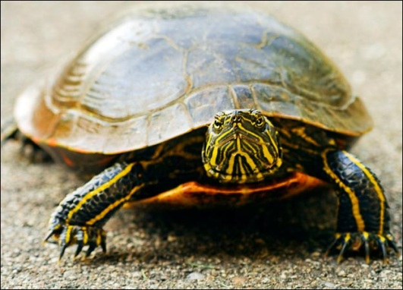
Writing a method (cont 1)
Next, in the object tree, click on the + beside turtle to see the different body parts.
Drag the frontLeftLeg into the method. Select turn - backward. Choose other and type in 0.1
Turtle the turtle

Slide 6
Writing a method (cont 2)
Finally, click more at the end of the turn command and choose duration = .25 seconds.
The default time for an action to be performed is 1 second. We are changing it to 0.25 so that it will happen faster.
Next, we want the turtle to move forward at the same time that the back leg goes forward
So drag in the control statement do together

Slide 7
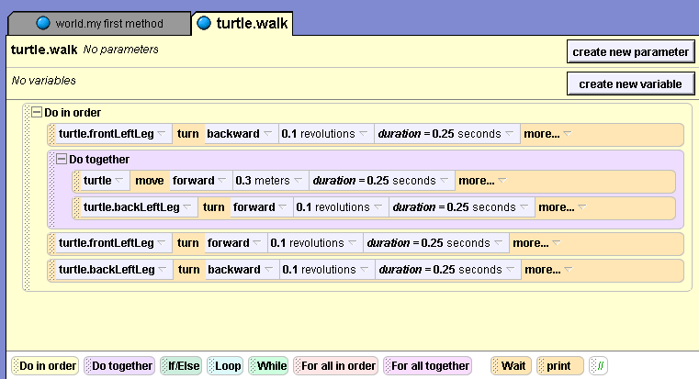
Writing a method (cont 3)
Finish dragging and dropping the instructions until your method looks like the picture below. Ask if you need help.

Slide 8
Writing a method (cont 4)
Finally, add a comment to your method to tell someone reading your code what it does.
Your comment can say: "Move the turtles legs back and forth"
This comment is not Alice code.
It is simply an explanation for someone trying to understand your code. Alice ignores the comments when it plays your world.
//This is a comment

Slide 9
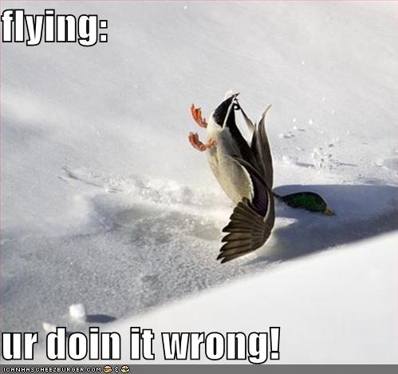
Step 3: To call your method
Click on world.myfirstmethod to get back to it and then drag turtle.walk into it.
Push the play button to watch the turtle walk.

Slide 10

Bunny Time!
Go to tutorial 2 in Alice
File → Open World
Click on the tutorial tab
Go to Tutorial2
Have fun!

Slide 11
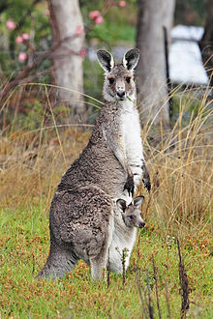
Step 4: Writing a method for Kangaroo
Do on Your Own!
In the object tree, click on kangaroo. In kangaroo's details, click the button create new method and name it 'hop'
To write the method, drag and drop the instructions listed on the following slides
Your first step is to drag a do together into the method.
To find the lowerleg of the kangaroo, you click the + beside the leg tab.

Slide 12
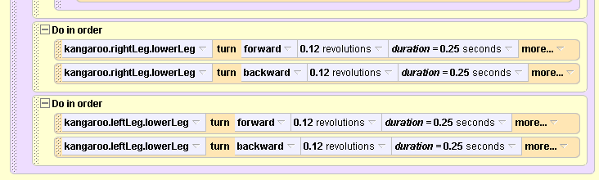

Slide 13
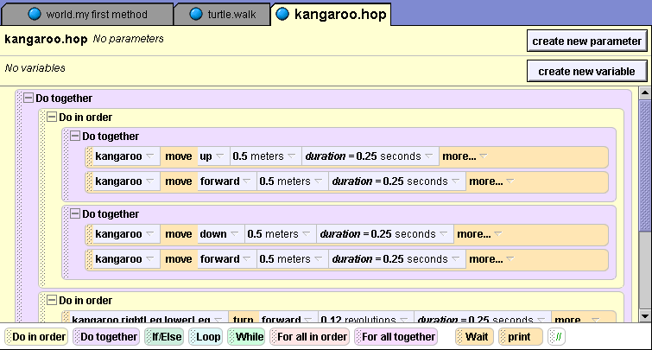
Kangaroo.hop method (cont 1)

Slide 14
Kangaroo.hop method (cont 2)
Remember, to call your method to test it.
Click on world.myfirstmethod to get back to it and then delete what you have there.
Drag kangaroo.hop into it.
Push the play button to watch the kangaroo hop.

Slide 15

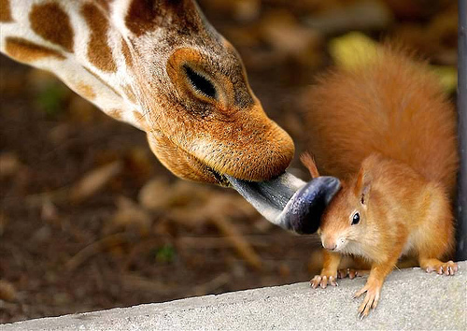
Part 3: World-level methods
A world-level method has characters that interact with each other.

Slide 16
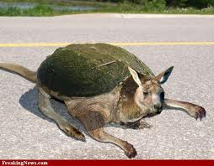
Step 5: Writing a world-level method:
In our example, we are going to write a method so that the turtle and the kangaroo race each other.
Click on world in the object tree. Click on the methods tab and the button create new method. Name it 'race'.

Slide 17
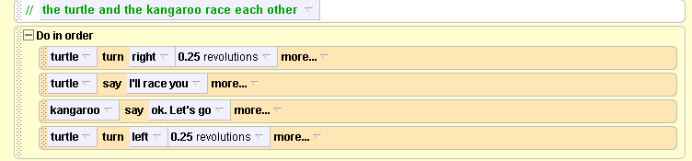
Writing a world-level method (cont 1)
First, we want the turtle to have a conversation with the kangaroo.
The first step is to drag a do in order into the method.
Then, click on turtle in the object tree and drag it into the method.
Put the following code into this method:

Slide 18
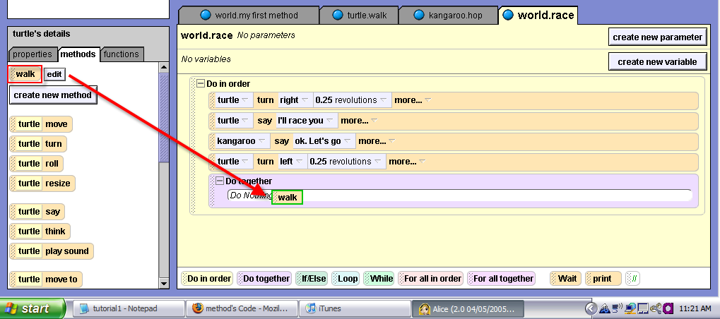
Writing a world-level method (cont 2)
Since we want the turtle and the kangaroo to move together, drag the control statement do together into the race method.
Click on turtle in the object area and click on method tab.

Slide 19
Writing a world level method (cont 3)
Click on kangaroo in the object tree.
Drag kangaroo.hop into the do together under turtle.walk.
Click on world.myFirstMethod. Delete what you have there.

Slide 20
Play your world
Click on 'world' in the object area and drag world.race into myFirstMethod. Push play.
The characters only move once.
If we repeatedly call the hop and walk methods in world.race, it will look more like a race.
Instead of dragging the instructions over multiple times, let's use a loop.

Slide 21
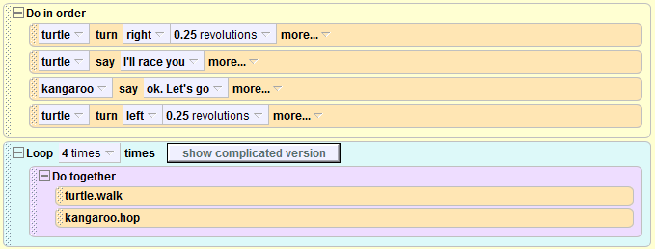
Step 6: Loops
One of the control statements is Loop. Drag Loop from the bottom of the window into the world.race method right above the do together. Select other and type in 4.
Below is what your code should look like.

Slide 22
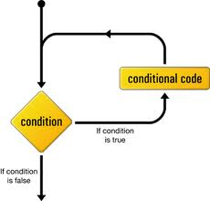
Play your world
When you push play, the Kangaroo will win the race.
Congratulations on creating one of your first methods!
Please save your work in your folder

