Slide 1
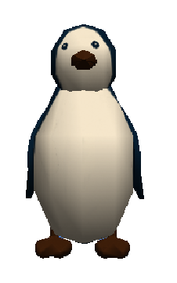
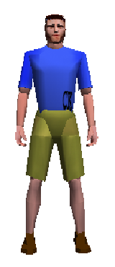
Using Functions in Alice
By Jenna Hayes
Under the direction of Professor Susan Rodger
Duke University
July 2008

Slide 2
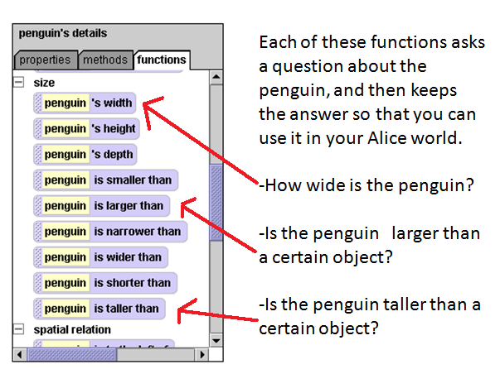
Step 1: Understanding Functions
2.
1.
We will be using functions. A function in Alice is basically a question about information in your Alice world that Alice answers. Click on the penguin object in the object tree. Then click on the functions tab. You will see a LONG list of functions. Scroll down and look at the functions under size.
These functions can be very useful in Alice. What if, for example, you want to make something move up and stand on top of the penguin’s head? You don’t know how exactly how tall the penguin is. But Alice does!

Slide 3
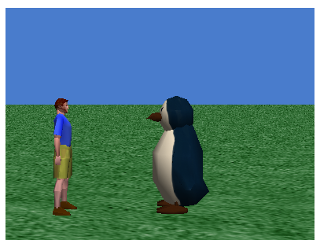
Step 2: Using the True or False Functions
We are going to add commands so that when the Alice world starts, if the penguin is taller, it will say “Hah! I’m taller!”, but if the normalGuy is taller, he will say, “Hah! I’m taller!”.
Some functions in Alice are statements to which the answer is either true or false, like the one on the previous page that says, “penguin is taller than.” We want to know whether the penguin is taller than the normalGuy. It’s almost impossible to tell just by looking at them, because their heights are so close together. So we will use a function to know for sure.

Slide 4
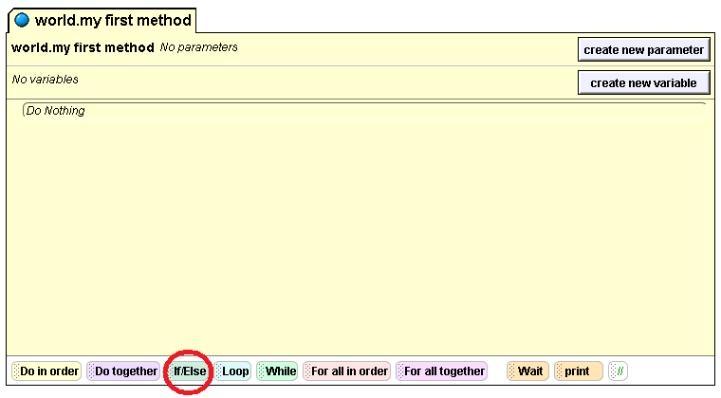
Step 2: cont.
Since we only want the penguin to say “Hah! I’m taller” IF he is taller, we need to use something called an If Else statement. It is located below your method editor:
First drag a Do in order into your method editor. Then, inside that, drag in an If Else statement. Select true when you drop it. We will replace this later.

Slide 5
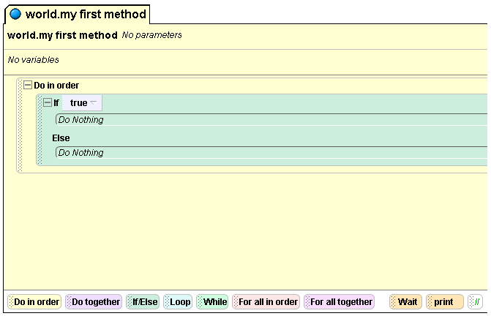
Here is where you put the question that is either true or false. For us, that will be penguin is taller than normalGuy. Since it is currently set at true, that means this If Else says, “If this statement right here is true, do whatever commands are right under it.”
Step 2: cont.
This is where you put whatever you want to happen if the answer to your question is true. This is where we’ll tell the penguin to say “Hah! I’m taller!”
This is where you put whatever you want to happen if the answer to your question is NOT true. If it is not true, it will skip everything above the Else, and go straight to whatever is here. This is where we’ll tell the person to say “Hah! I’m taller!”, because if our statement is false, and the penguin is NOT taller, that means the person is taller!

Slide 6
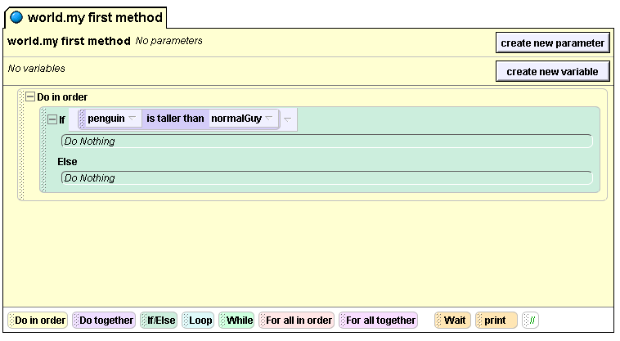
Step 2: cont.
So let’s construct our question. Click on penguin in the object tree and then click on functions. Find the penguin is taller than function, and drag it over the word true in your If Else statement. When the little menu pops up, click on normalGuy. Your code will look like this:

Slide 7
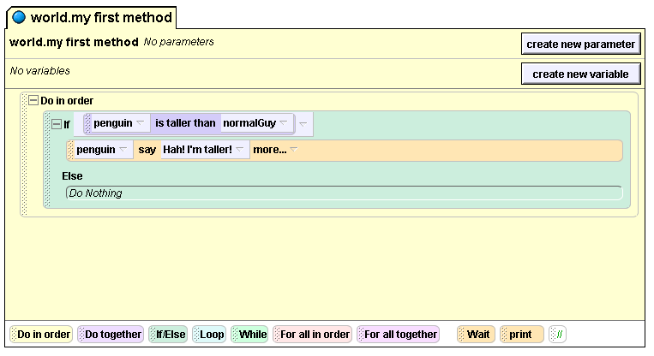
Step 2: cont.
Now click on penguin in the object tree, and then click on methods. Find penguin say, and drag it into the method editor under If. When the menu pops up, click on other, and type in “Hah! I’m taller!”. Your code will look like this:

Slide 8
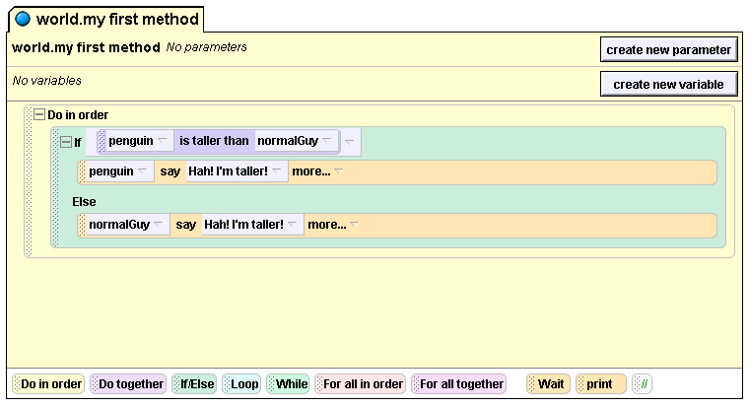
Step 2:
Now click on normalGuy in the object tree, and click on methods. Find normalGuy say and put under the Else part of your If Else statement. Tell him to say “Hah! I’m taller!” Your code will look like this:
Now play your world. Who is taller, the penguin or the person?

Slide 9
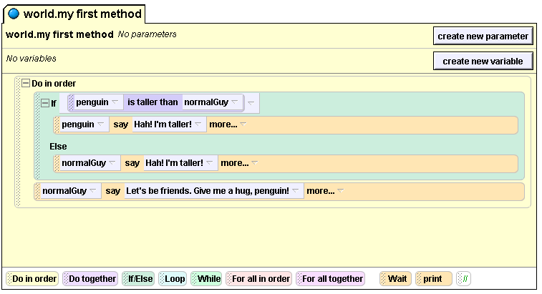
Step 3: Using Number Functions
Now we’re going to use one of the functions that is a question whose answer is a number. We’re going to make the penguin move right up to the man and give him a hug. The only problem is, we don’t know how far to tell him to move! That’s why we’ll use a function!
First we’ll tell the man to say something. He’s tired of competing with the penguin about their height, and he wants to be friends. Click on normalGuy in the object tree, then click on methods. Find normalGuy say, and drag it under your If Else statement. Make him say “Let’s be friends. Give me a hug, penguin!” Your code will look like this:

Slide 10
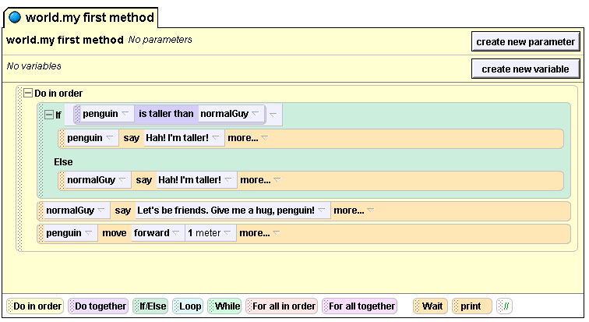
Step 3: cont.
Now we want the penguin to move right up to the guy to hug him. Click on penguin in your object tree and then click on methods. Find the penguin move and drag it into your method editor under everything else. We don’t know exactly how far yet, so just put 1 meter for now. Your code will look like this:
Play your world just to see what it looks like.

Slide 11
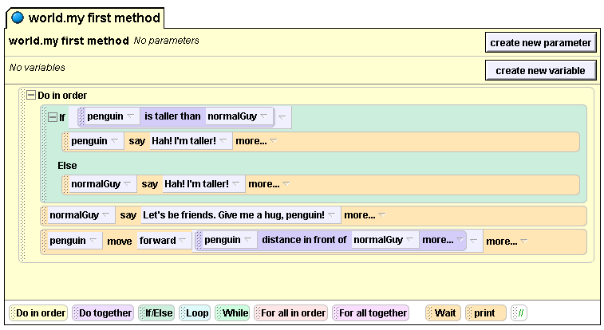
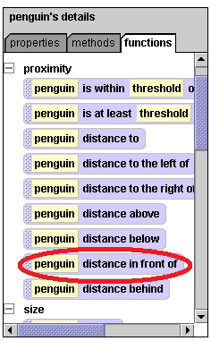
Step 3: cont.
Now we’re going to use a function to tell the penguin how far forward to move. Click on penguin in your object tree, and then click on the functions tab. Find the function called distance in front of.
Drag that function over the 1 meter on your penguin move forward command and drop it there. On the menu that pops up, select normalGuy. Your code will look like this:

Slide 12
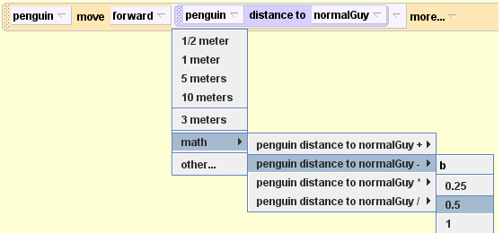
Step 3: cont.
Try playing your world. What happens? The penguin moves too far, into the body of the normalGuy. It would be nice if the penguin would stop about 0.5m before normalGuy.
We can select math, followed by “-”, followed by a number. Click here to apply math.
Your code for this line will then look like this:

Slide 13
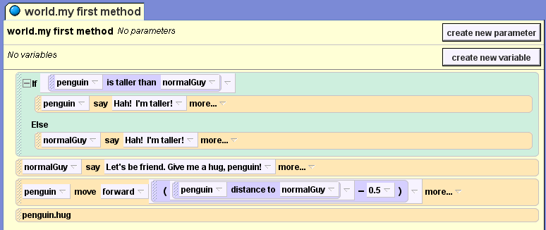
Step 4: Finishing Up
The last thing you need to do is make the penguin hug the guy. Click on penguin in the object tree, and then click on the methods tab. Find the hug method (near the top of the methods) and drag it into your method editor under everything else. Your final code will look like this:
Now play your world and watch the magic!

Slide 14
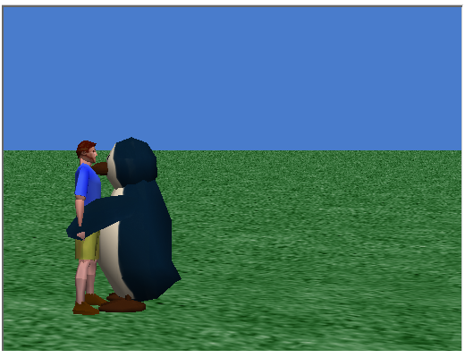
Now you know the basics of using functions. We only used two functions in this tutorial, but there are MANY functions in the Alice world that can be useful. Feel free to explore the uses of other functions.

Slide 15
Penguin Fun!
Do the penguin tutorial if we have extra time

Slide 16
Come up with more environments
Play around!
Make own methods/functions/whatever
Look at the tutorials

Slide 17
Bibliography
"Tutorials for Grades 5-12." Adventures in Alice Programming. N.p., n.d. Web. 13 June 2012. <http://www.cs.duke.edu/csed/alice/aliceInSchools/workshop08/tutorials.php>

