Slide 1
Light! : The Tutorial
By Ruthie Tucker
Under the direction of Professor Susan Rodger, Duke University
July 2008

Slide 2

Getting Started
Lets start with a blank world.
Snow is easiest to use for this because it reflects light so well.
Open a new world to begin

Slide 3
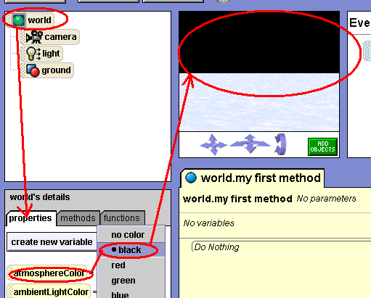
Creating the Sky
Go to world and select properties.
Select “Atmosphere Color” and change it to black.
Note that this will change the sky to black.
While you are here, try changing the sky to other colors.

Slide 4


Creating the sky continued
Now right below it there is a setting called “Ambient Light Color”, set it to black.
It should set a shade over your entire world.
Your world should now look like this

Slide 5
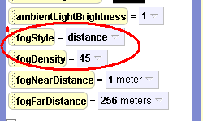
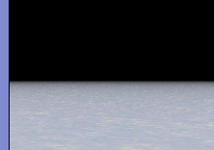
Fog makes your world look fuzzy
Now go to “fog style” and select “distance”
Be careful not to select “density” under “Fog style”
“density” will make your world invisible
You can control your density level in the “Fog density” tab below “fog Style.

Slide 6
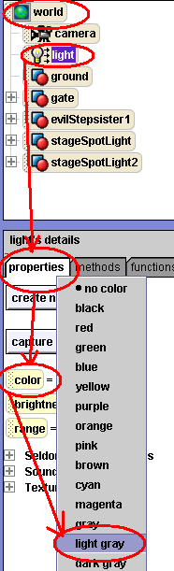
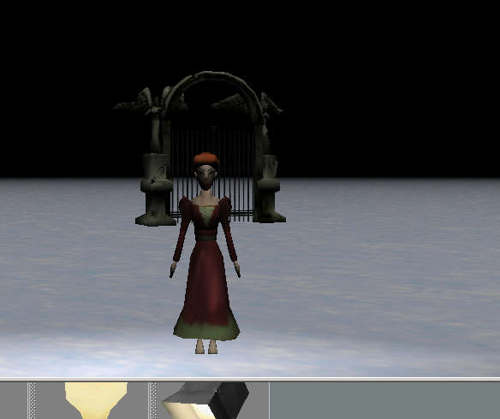
Environment concluded
Finally, go to the subcategory of world called “light”
Scroll down to properties/color and select light gray
This should make your world look very dark

Slide 7
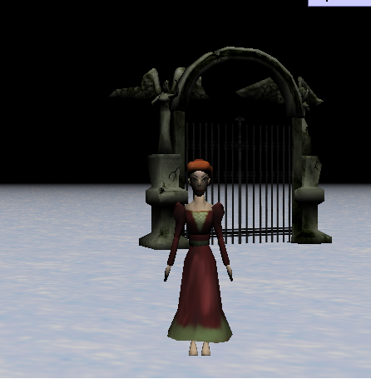
Getting started with specific light
Lets add some characters to our world as reference points for our light.
Add one person and one object of your choice to your world

Slide 8
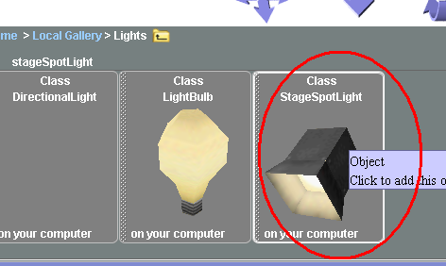
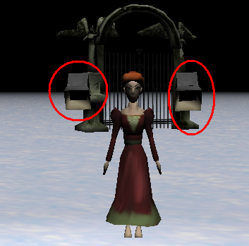
Specific Lighting
Now, go into “add objects” again and scroll to the folder called “light”
There should be an object called “Stage Spotlight”
Import two of them into your world
Your lights should appear beside your person.

Slide 9
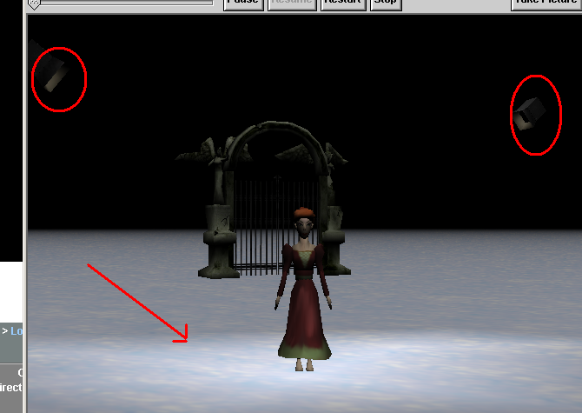
Spotlights
Each Stage light has two components
The stage light: which is the actual physical object that you can drop in.
And the Light: which shines on the world
Play around with the positioning until you get the lights right
Note that the Stage lights are up in the air but the light is spotlighting my person

Slide 10

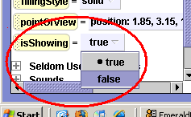
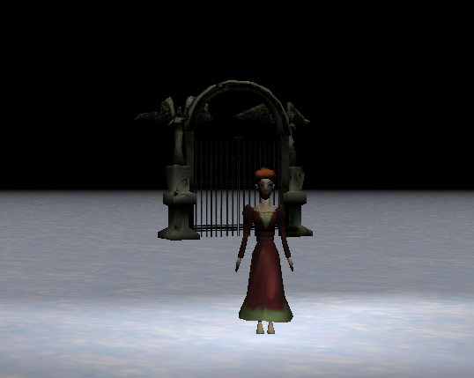
Stage light continued
Now click on stage spotlight and set “Is showing” to false.
The physical object should become invisible but the light should still be there.
Your world should now look like this

Slide 11
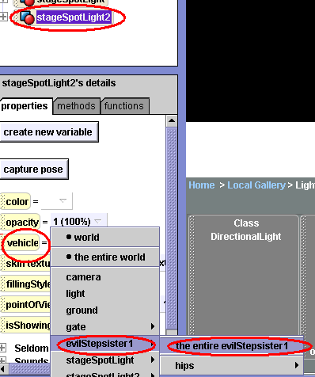
Light as a vehicle
Now, try setting the stage lights as vehicles to your person.
Move your person around and see if the light follows them.
Once you are done, set both of the lights as vehicles to the gate

Slide 12
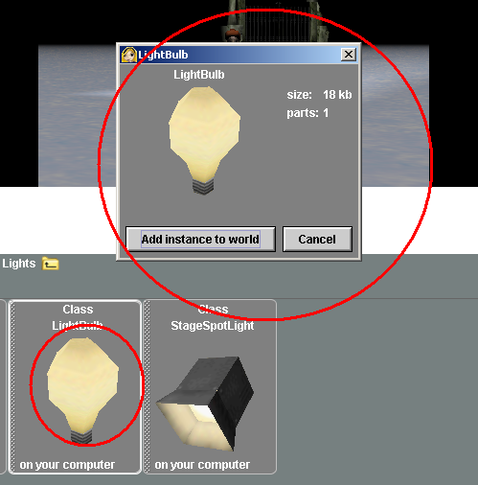
Light bulbs
Now go into “add objects” again, under the “lights” folder and add a “light bulb” to your world

Slide 13
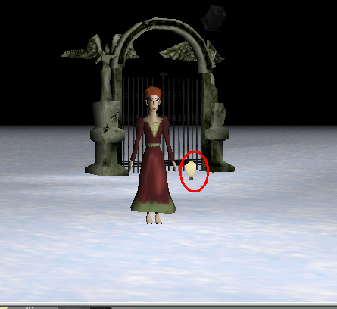
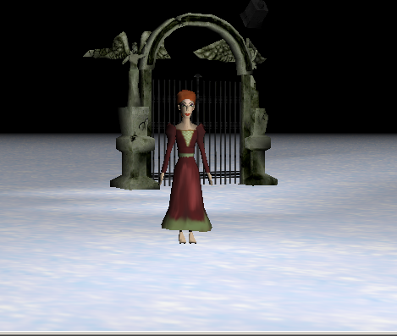
Light bulb continued
Note how the light bulb has the same features as the stage light.
There is a physical object and an area of light.
Just like the stage light, we can set “is showing” to false for the physical light bulb, but the ambiance of the light will still be there.

Slide 14
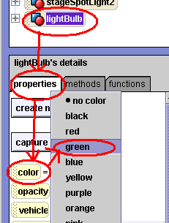
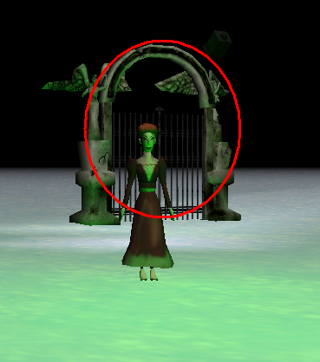
Light bulb continued
Now, try clicking on the properties from the light bulb and changing the color.
The ambiance of the light should change
Note the green hue that is now on our person

Slide 15
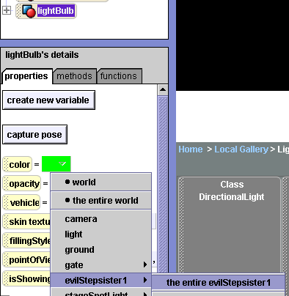
Light bulb continued
Now set the light bulb as a vehicle to your person
Have her move around, and see if the green light follows her.
You can turn the light on and off or have it stationary or following a character, simply by using the vehicle and “is showing” properties.

Slide 16
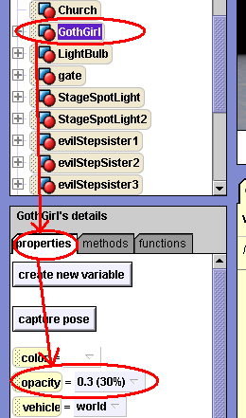
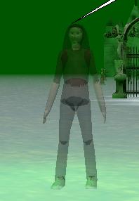
Opacity
Opacity works much the same way that “is showing” works
However Opacity can be measured in gradations, while “Is showing” is (fittingly) either showing or not.

Slide 17
Opacity Continued
Go to the “properties” settings of your person.
Look for the setting called “Opacity”
When you click on it there should be a series of percentage gradations

Slide 18
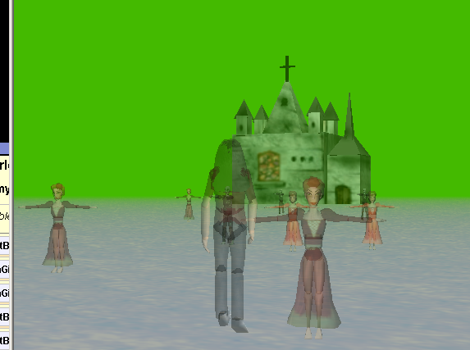
Opacity continued
Try changing the opacity of your person. You should notice that the smaller the percentage, the more your person seems see through or invisible.

Slide 19


Looping Opacity
Now create a new method for your opacity changing code.
Loop it.
Now call it in a “when the world starts” event.

Slide 20
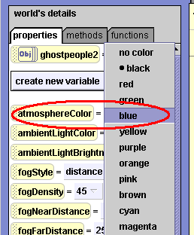
Creating the Dawn
The Dawn is created in a world level method.
It is a series of color changes, placed in a “Do in Order” method.
Color changes can be found under World Properties

Slide 21
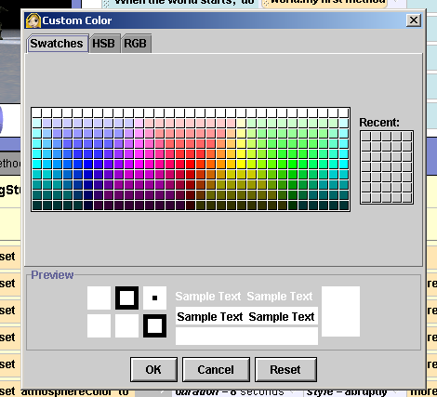
Dawn continued
If you do not wish to use the colors in the main column you can click on “other” at the bottom of the list.
This should give you a rainbow of shades to choose from

Slide 22
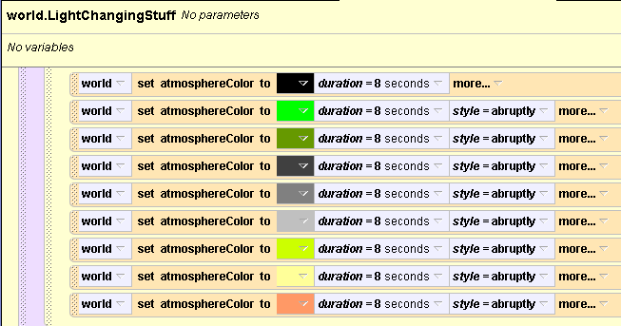
Dawn Continued
Once you are done choosing your colors you should have a list like this.
Set the duration for each color to several seconds.
Finally set “style” to “abruptly”
This will make the colors fade in and out instance of roughly changing

Slide 23
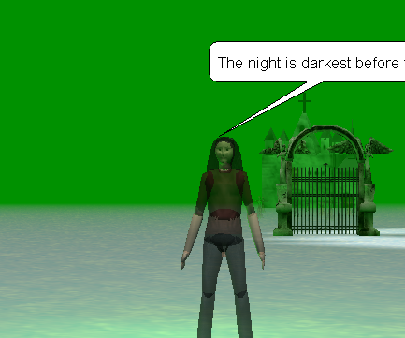
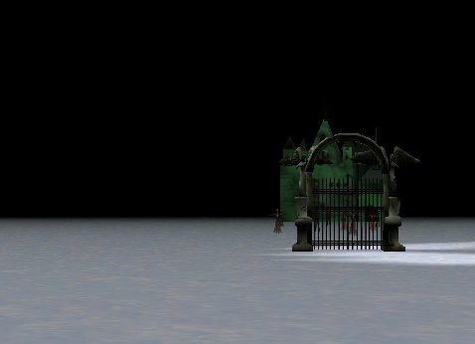
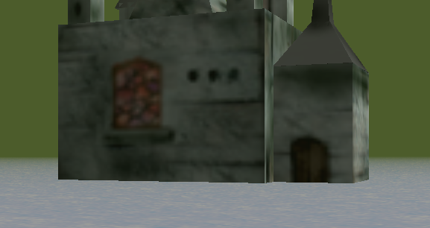
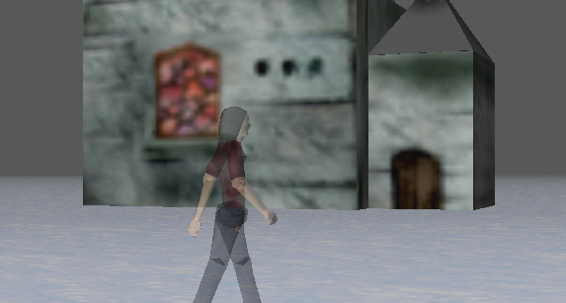
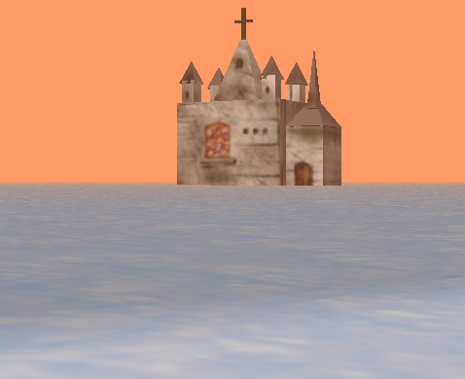
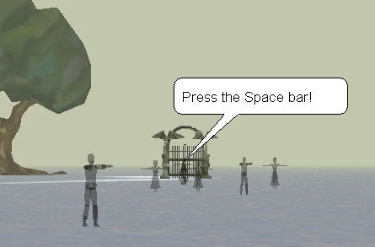
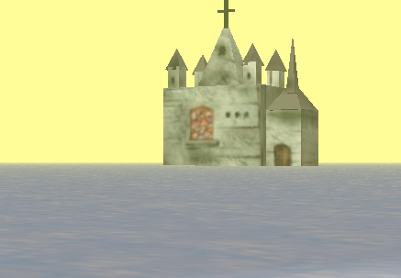
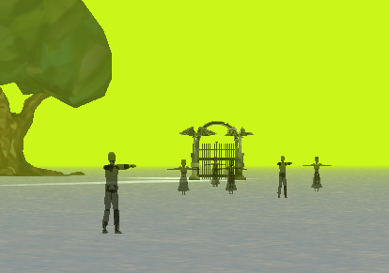
Dawn Conclusion
Now set your Dawn method as an event for “when the world starts” so that it will play in the background of your world
Now your world should slowly shift to the Dawn as the world plays

Slide 24
Conclusion
By combining the things that you have learned in this tutorial, in a variety of ways, you can create many new possibilities for your worlds.
And that’s all folks!!!!!!!!!

