Slide 1
Cryptography

Slide 2
What is Public-key encryption?
Encryption is the key to information security
The main idea- by using only public information, a sender can lock up their information in such a way that it can only be unlocked (privately) by the intended recipient.

Slide 3
Wait, what?
Let’s say we each have a box. Each of us buys a padlock with our name on it and puts it on a table, unlocked for everyone to use. You have the key to your lock and no one else does.
Now Melanie wants to send a secure message to Elyse. She puts it in Elyse’s box, then locks the box with Elyse’s lock.
Since only Elyse can unlock her box, the message is safe!

Slide 4

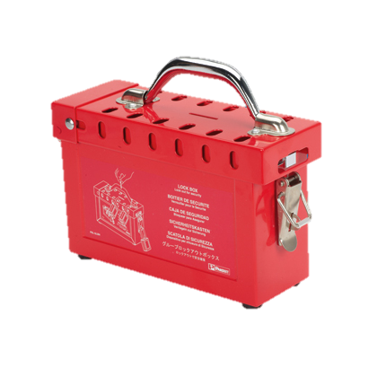
CR
PL
ML
AC
Only Elyse’s key can unlock it and get the message!
CR
PL
AC
ML
EM
EM

Slide 5
Public keys and private keys
You can think of the pad lock from the earlier example as a public key- everyone has access to it and can use it to secure the message in the box. Anyone who wants to send Elyse a message just has to grab her lock from the table, put a message in her box, and lock the box.
The key, in this case, is a private key- only the recipient of the message has it. If you don’t have the private key, you can’t unlock the message!
The public key and private key are a pair, just like the lock and key- you need both for the system to work!

Slide 6
Sending Messages- Alice and bob
Alice wants to send Bob a secret message. Instead of an actual box and key, though, Alice just wants to hand him a piece of paper.
Eve wants to intercept Alice’s message and read it.
Alice needs to use encryption so that Bob can read her message but no one else can.
Instead of a box and key, though, we are going to use maps.

Slide 7
The Idea
Alice wants to send Bob a message in words. To do that, she first has to convert her message into numbers.
We can use ASCII for this!
Let’s say that Alice wants to send Bob a message that simply says “B.” According to the ASCII character codes chart, this means that she wants to somehow send him the number 66.

Slide 8
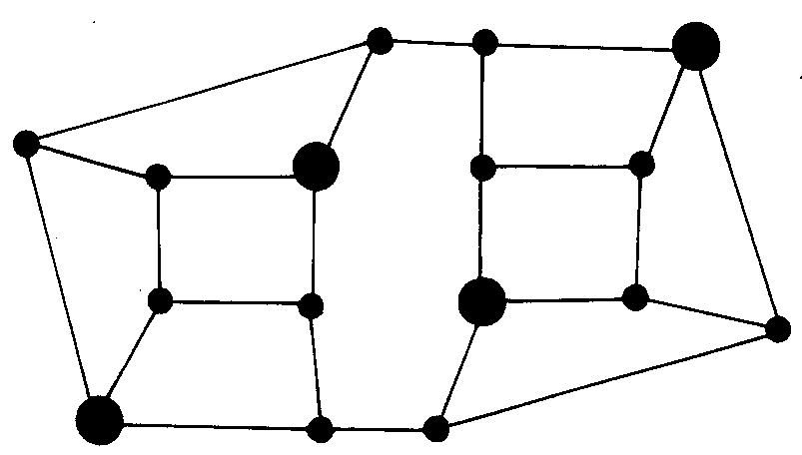
Step One- Bob’s Private Key
Before Alice can send Bob a message, Bob needs to create his own private key. In this example, Bob’s private key is a map.
Only Bob can see this map!

Slide 9
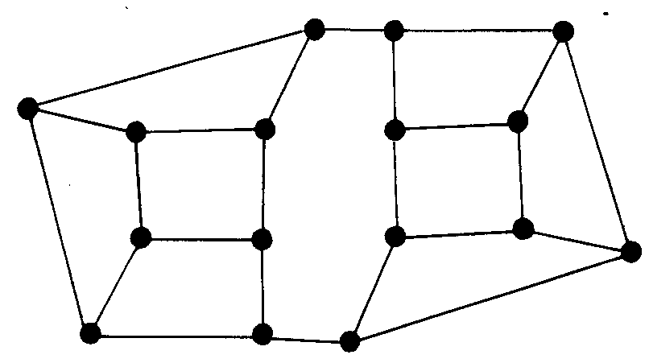
Step 2- Bob’s Public Map
Once Bob has made his private map, he publishes a public map for everyone to see! Now anyone, including Alice, can send him a message using it.

Slide 10
How Does It Work?
Alice wants to send Bob the number 66. To do that, she needs to place random numbers on each intersection of the map, so that all of the numbers on the map add up to 66.
2
1
8
3
1
3
6
2
5
4
4
5
6
2
3
11

Slide 11
That Doesn’t Seem Safe…
You’re right! That message definitely isn’t secure- if someone were to intercept it, all they would have to do is add up the numbers to figure out the message!
This is where the encoding part comes in- Alice needs to encrypt this map so that only Bob can read it!

Slide 12
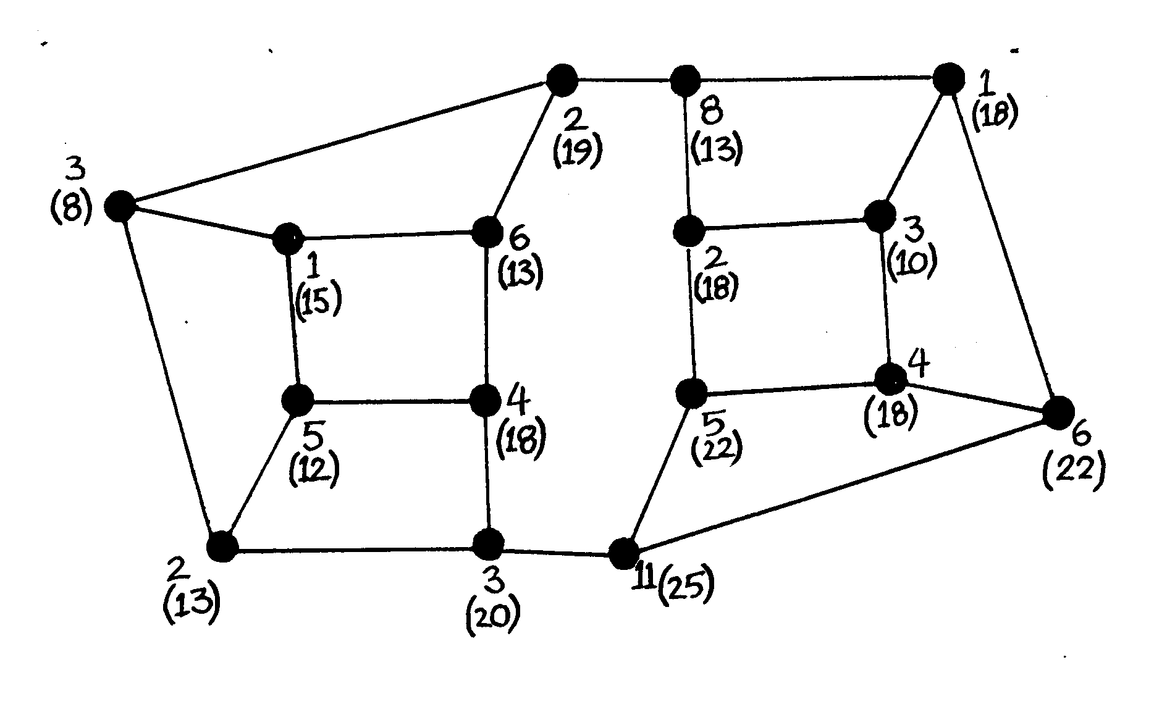
Alice’s Encryption
To make her map secure, Alice needs to assign a new number to each node. This new number is the sum of the three surrounding nodes and the node itself. The new number is in parentheses.

Slide 13
Sending The Message
Once Alice has assigned a new value to each of the nodes, she sends her map with just the new numbers (not the original ones!) to Bob.
Now Bob needs to decode the message using his private key.

Slide 14
Cracking The Code
Remember Bob’s map? When you first saw it, it probably didn’t make any sense.
This map tells us that when we add up the large nodes, we get the original message!

Slide 15

The Final Result
Anyone without that vital piece of information would probably be stumped by the map- they wouldn’t know what to do with all of those numbers! With Bob’s private key, however, it’s easy to decrypt. 13+13+22+18 = 66!
18
13
22
13

Slide 16
Your Turn
Now that you’ve seen encryption in action, it’s time to try it out yourself!
First we will try it with pre-made maps, and then we will make our own.

Slide 17
Public Key Encryption in Computer Science
Sending messages to each other is fun and all, but how does this apply to computer science?
Public key encryption is used all of the time to send messages between computers.
For instance, let’s say you wanted to buy something online with your credit card. You only want the person you are buying from to receive your credit card number.
What’s stopping someone from stealing your credit card number by intercepting it?

Slide 18
The Solution- RSA
Instead of just sending your credit card number as-is, the computer will encrypt the number based on the recipient’s public key.
That way, only the recipient will be able to decode the message- just like the lock and key analogy!
The way that computers use this concept is called the RSA public key cryptosystem.

Slide 19
How does it work?
The big idea behind RSA is that it is very difficult to factor large numbers.
When we say “factor,” we mean finding all of the prime factors of a number. This means finding the prime numbers that multiply together to make the original number.
For example, the prime factorization of 6 is 2x3, the prime factorization of 24 is 2x2x2x3, etc.
It can take a supercomputer several months to factor a 100 digit number!

Slide 20
How does this help us?
It may be very difficult to factor large numbers, but it’s very easy to multiply two prime numbers together!
Using that fact, we can choose two large prime numbers (say 12,553 and 13,007) and multiply them together to get 163,276,871.
If we were told to factor 163,276,871 without any hints, it would be very difficult to do!
Although the math behind cryptography can be difficult, the underlying principle is pretty simple!

Slide 21
RSA- What Happens
Just like with our maps, the first step is to choose a private key. Instead of creating a map, this algorithm requires you to choose 2 large prime numbers to be your private key. The larger they are, the better!
For this example we are going to use 12,553 and 13,007.

Slide 22
RSA- What Happens
Next, we need to make a public key that goes with our private key.
For this algorithm, the public key is a pair of numbers
The first number is the product of our two numbers (12553 x 13007 = 163,276,861). Let’s call it m.
The second number is any number that is relatively prime to (i.e. shares no common factors with) the product of (12,553 -1)x(13007-1), which is 163,251,312. For this example, we will use 79,921 (trust us, it’s relatively prime!) Let’s call it k.

Slide 23
Why is that public key safe?
Like we said before, it is very difficult to factor large numbers! If someone saw the number 163,276,861 and wanted to figure out the two primes we chose originally by factoring it, it would take them a very long time!
And these numbers aren’t even that big!
So now the public knows that our two numbers are 163,276,861 (m) and 79,921 (k). Using these numbers, how can someone send us a message?

Slide 24
Sending the Message Using Mods
RSA involves modular arithmetic, which we discussed briefly.
Let’s say we want to send the message “To be or not to be.” This means that we want to send the number 30251215252824253030251215 .
We can’t send it all at once! You can only send your message in pieces that are smaller than the “m” you’ve chosen. In this case, our “m” is 9 digits long, so we’re actually sending four numbers: 30251215, 25282425, 30302512, 15.

Slide 25
Sending the Message Using Mods
Now, we take each of these numbers and plug it in to a special equation:
“number”^k = “encoded number”(mod m)
One equation: 30251215^79921 = “encoded number”(mod 163276861)
You can see that in order to solve the equation, we need our recipient’s public key, or “m” and “k.” Without these two numbers, we can’t encode our number!
If you solve this equation for each number, you get four new numbers, the “encoded numbers”. We did this part for you; here is our message after it has been encoded:
149419241, 62721998, 118084566, 40481382

Slide 26
Decoding the Message
Once we send those numbers to our recipient, they need to decode it.
For each number we sent them, they need to solve this equation:
“answer”^k = “number”(mod m)
One equation: “answer”^79921 = 149419241(mod 163276861)
Remember: The yellow and brown numbers are our public key, and the green number is part of our encoded message.

Slide 27
Where does the factoring come in?
We won’t go into the specifics about how to solve this equation, but the important thing to know is that in order to solve it, we need to factor our number “m” (163,276,861).
Luckily, our recipient knows the prime factorization of m- it is his private key, the two prime numbers he chose in the first place! In our example, those numbers were 12,553 and 13,007.
Anyone else who tried to solve those equations without knowing that would have a very difficult time!

Slide 28
Summary
Even if computers become better at factoring large numbers, this method will still work!
For instance, if computers can factor 200 digit numbers very quickly in the future, all you need to do is choose two 200 digit primes for your private key- that way, you get a 400 digit number for your number “m” in your public key, which is extremely hard to factor!

