Slide 1
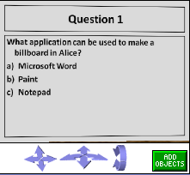
Making Billboards
By Deborah Nelson
Duke University,
Under the direction of
Professor Susan Rodger,
July 14, 2008

Slide 2
Loading the World
Open a new world, with any template
Save it in a directory that you can find again, and then start Alice and open the world.
NOTE: You cannot double-click the file to open it
Windows will not know what to use, and even if you select Alice from a list of programs, the loading will fail.

Slide 3
Loading (cont 1)
First: It is always a good idea to drop a Dummy Camera in the original position. After you have opened the file, and set up your world, go into the "Layout" mode by clicking on the green button Add Objects (toward the middle of screen)
Click more controls. Click drop a dummy at the camera. Rename the dummy 'originalPosition.' To leave the layout mode, click done

Slide 4
Use of a Billboard
Billboards can be used to add text to your world
They can be made in
Paint
Power Point
Or any other tool that can have text and graphics and saved as an image file

Slide 5

In Paint
Open up a paint document
Click on the A to add text
Type the following into your text box:
Instructions:
Press the Up arrow to move forward
Press the space bar to jump
Press i to show the instructions or make them disappear

Slide 6
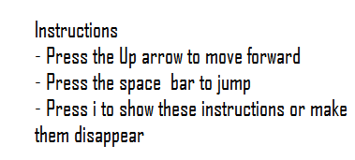
Paint: Increasing the size
Your text might be really small.
To increase the size:
Click on the View
View text toolBar
Increase the size to 18 or how every big you want

Slide 7
Adding Graphics
We just added text to our instructions but feel free to use the graphics in paint to draw shapes such as circles or rectangles for legends

Slide 8
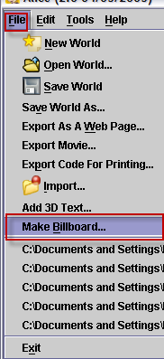
Save Paint & Open Alice
Now, save your document as an image type such as .png, .jpg, .bmp, etc.
In your Alice world, click on the file menu and select Make Billboard

Slide 9
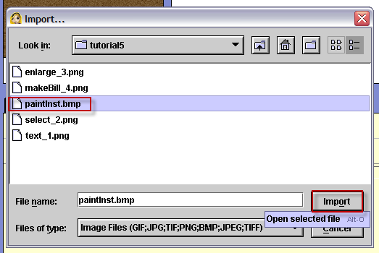
Import paint billboard
Find your paint document in the directory that you saved it in
Click import

Slide 10
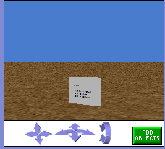
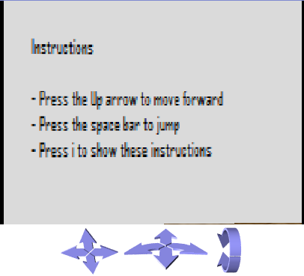
Reposition the billboard
Now, the billboard has appeared in the world:
Click on the Add Objects button
Enlarge the billboard with the resize button
Use the left/right to make the billboard face the camera
And use the mouse to bring it forward

Slide 11
Create a world method
Let’s write a method to make the instructions either visible or invisible:
Click on the world in the object tree
Select the method tab
Click create new method
Name it instr

Slide 12
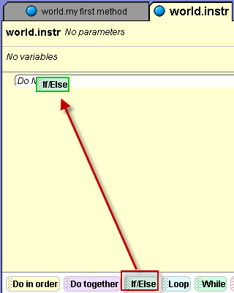
Writing instr
Click on if/else and drag it into your method
In the drop down menu, select true

Slide 13
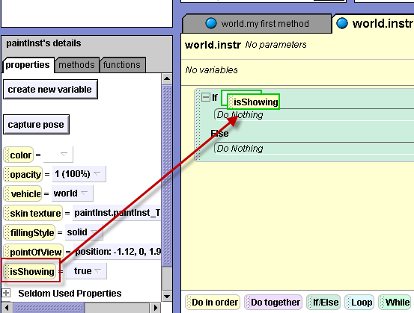
Write Instr (cont 1)
Click on your billboard in the object tree
Click on the properties tab
Drag isShowing
into world.instr on
top of true

Slide 14
Write instr (cont 2)
Then, drag isShowing into the method again, on top of the first Do Nothing. In the drop down menu, select false.
Drag isShowing into the method again, on top of the Do Nothing that is underneath else. In the drop down menu, select true.
See the screenshot on the next slide for an illustration of what your method should look like now

Slide 15
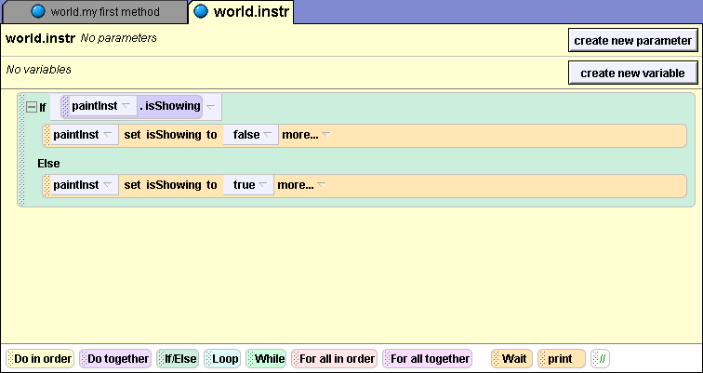
Complete Instr Method

Slide 16
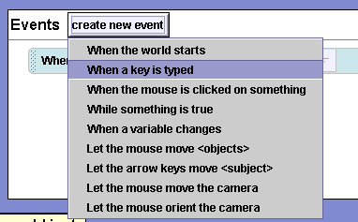
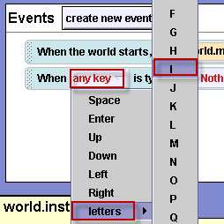
Create new event
Click on the create new
event
Select when a key is
typed
Click on any key.
Select letters, and select i

Slide 17
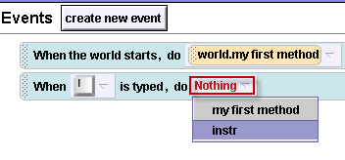
Create new event (cont 1)
Click on Nothing
and select instr
Play your world. Press i to make the billboard disappear and reappear

Slide 18
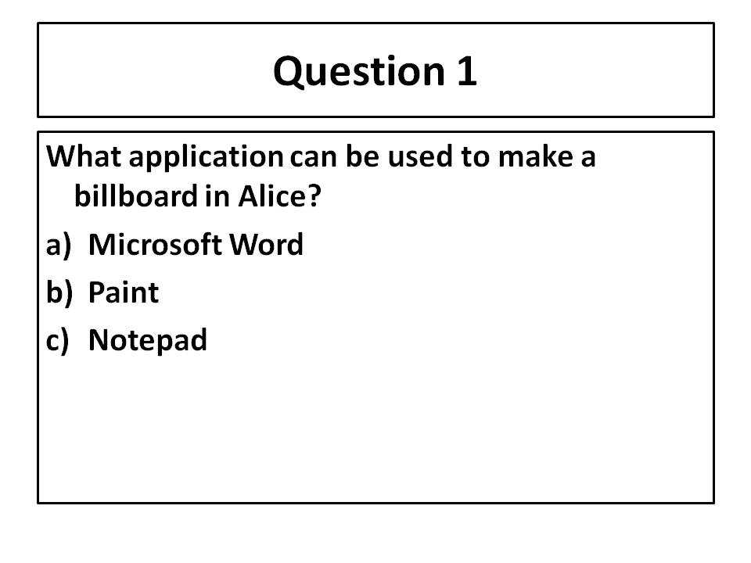
In Power Point
You can also use Power Point to make a billboard
Open up a Power Point document
Make one slide. type the text until your slide looks like this
I’ve added a border around the text

Slide 19
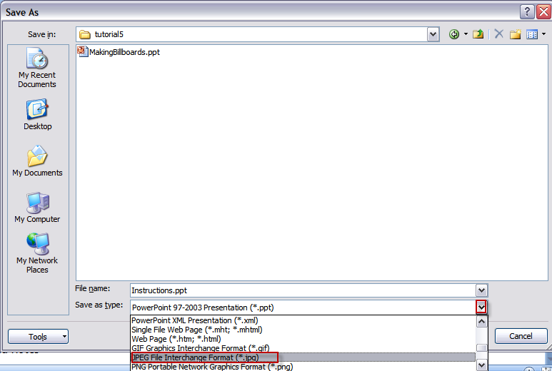
Saving the power point
When you save the Power Point, select the file type: .JPG

Slide 20
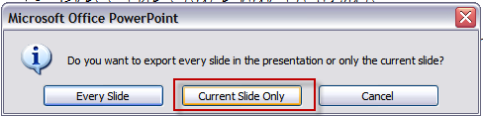
Saving the power point
Click save (in a directory you can find again)
When this window pops up,
Click on current slide only
In order to import a file as a billboard, it must have an image file extension

Slide 21
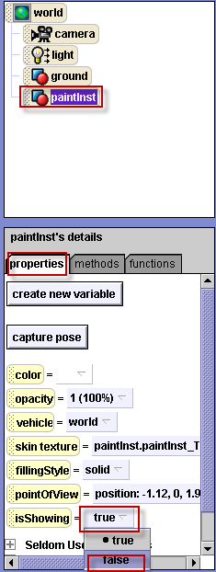
Make Paint Billboard invisible
Click on your paint billboard in the object tree.
Click on the properties tab and set isShowing to false.

Slide 22
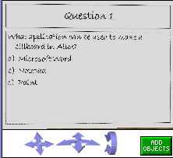
Import power point billboard
Now in your Alice world, go to the file menu and select Make Billboard
Find your power point slide and import it into your world
Move and resize your billboard until it looks like this:

Slide 23
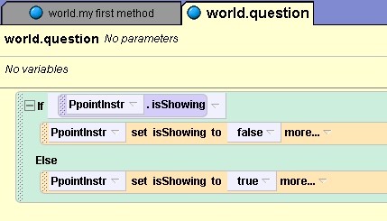
Write a method
In World details, create a new method
Name it question
Drag in the if statement and the isShowing instructions until your method looks like this:

Slide 24
Create a new event to alternate between the billboards
Now, create a new event, when a key is typed
Select the letter q; then select question
Your event should look like this
Now, play your world. Press i and q to alternate between the two billboards

Slide 25
Recap
You can make a billboard to give the user instructions, ask multiple choice questions, etc
Use either paint or power point to make the billboards
It is helpful to use an event to give the user the choice of making billboards appear or disappear
But, you can also just set isShowing to true or false in your method at the appropriate time

