Slide 1
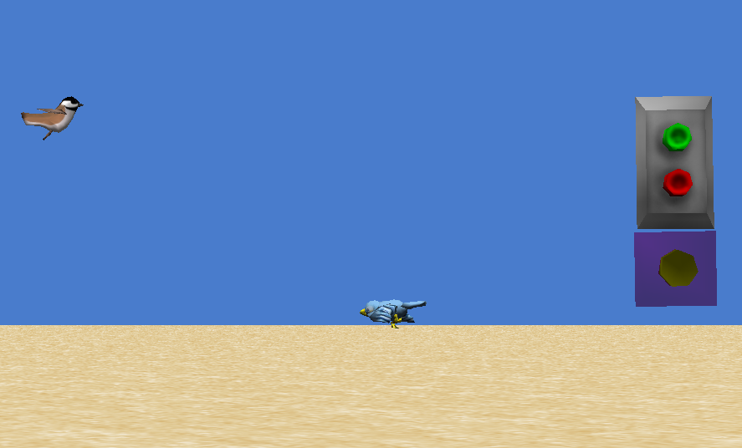
Events
This tutorial will teach you the basics of events in Alice, which are things you tell Alice to do in response to a certain action, like clicking on an object or pressing a key.

Slide 2
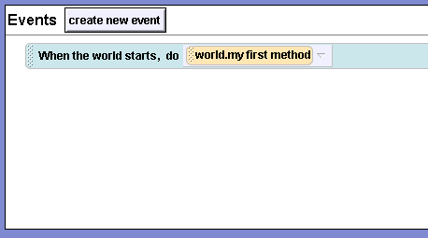
When the World Starts
The events editor, where your events are located, is found in the upper right hand part of the Alice screen. There is always one default method: When the world starts, do world.my first method. This means that whenever you push the play button, Alice will do whatever code you have put in my first method. Try playing your world. Nothing should happen, because there is nothing in my first method.

Slide 3
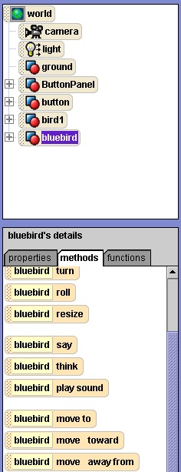
When the World Starts
We are now going to change When the world starts. First, click on bluebird in your object tree, and then look in its methods pane until you find the method move to.

Slide 4
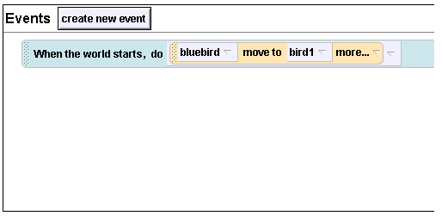
When the World Starts
Now drag and drop bluebird move to over world.my first method on the When the world starts event in your events editor. Select bird1, and then the entire bird1. Your events editor will now look like this:

Slide 5
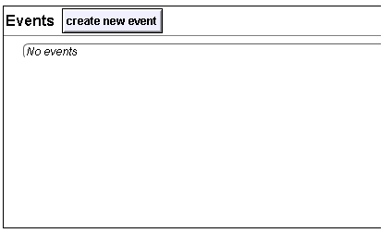
Playing Your World
Press play to see the bluebird fly to the other bird. Alice will probably give you a warning before it plays; just click ok. As you can see, Alice will do whatever you tell it to in When the world starts. Now right click on your event and select delete. Your method editor will now look empty like this:

Slide 6
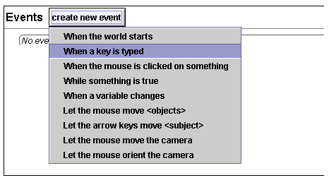
Keyboard Events
There are several different types of events besides When the world starts. One of these is a keyboard event, which is when you tell Alice to do something when a certain key is typed. We are going to create one of these now. Click the create new event button and select When a key is typed.

Slide 7
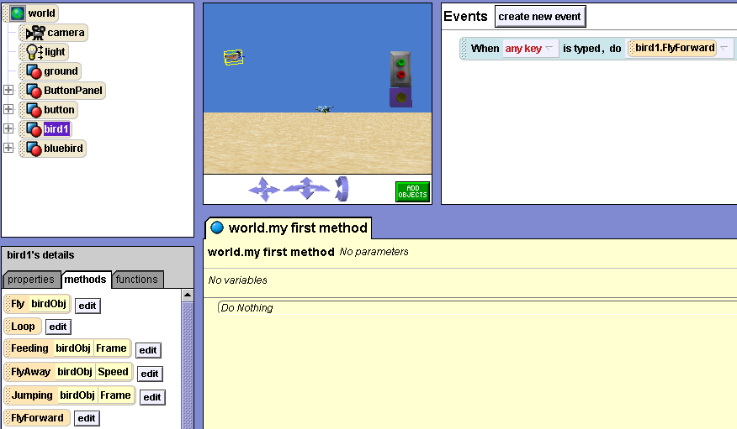
Keyboard Events
Now you will have an event that says When any key is typed, do nothing. Click on bird1 in the object tree, and find its flyForward method. Drag and drop it over where your method says nothing.

Slide 8
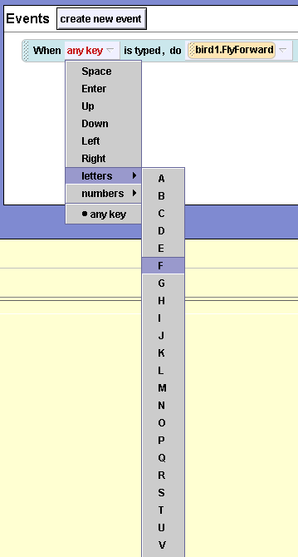
Keyboard Events
Now when you play your world and press almost any key, your bird will fly forward. Let's make it so that you have to press a specific key. Click on the down arrow next to any key on your event, and look at the keys you can choose from. We'll select letters, and then F, because we are making the bird fly.

Slide 9
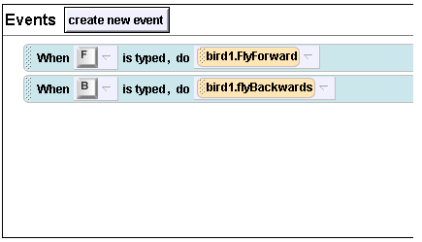
Keyboard Events
Now follow the previous steps to make another keyboard event. This time, make it so that when you press the letter B, bird1 does its flyBackwards method. Your event editor will look like this when your done.
Here is your new keyboard event.
Play your world and test out your new event.

Slide 10
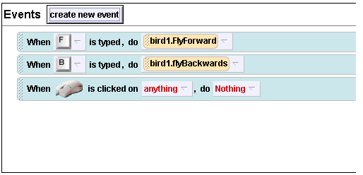
Mouse-Click Events
You can also create an event that is tied to a mouse clicking, either just clicking on anything, or clicking on a specific object. Create a mouse event by selecting When the mouse is clicked on something in the “create new event” menu. Your event editor will look like this:

Slide 11
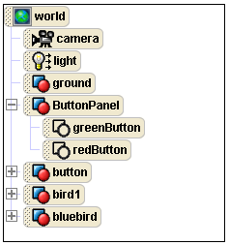
Mouse-Click Events
We are going to make this event so that when the mouse is clicked on the green button, the bluebird does its approach method. Find the green button in the object tree by clicking on the plus sign next to ButtonPanel.

Slide 12
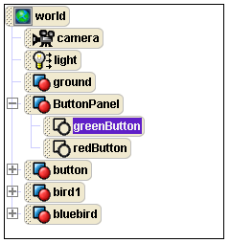
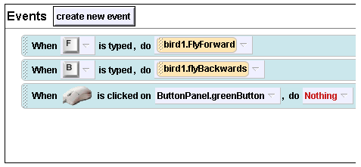
Mouse-Click Events
Now drag greenButton from the object tree over to the anything in your mouse event, and drop it there.

Slide 13
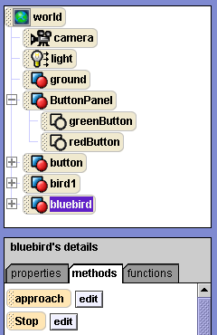
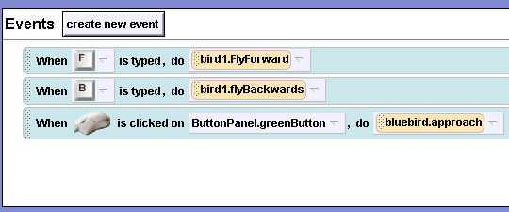
Mouse-Click Events
Now click on bluebird in the object tree, and look on the methods pane to find its approach method. Drag this over to where your mouse event says Nothing and drop it there.

Slide 14
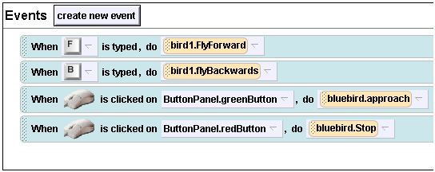
Mouse-Click Events
Play your world and click on the green button to observe the bluebird’s approach. Notice that it keeps moving, even if it crashes into you. Let’s create an event that stops the bird. Create a mouse-click event so that when you click on the red button, the bluebird does its stop event. Your event editor will look like this when your done:
Now play your world and test out your latest event.

Slide 15
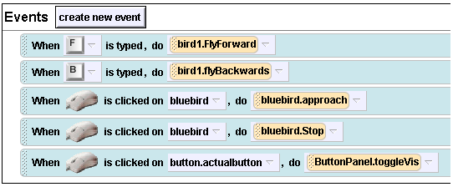
Mouse-Click Events
Now we’re going to make one more mouse click event. Make an event so that when the mouse is clicked on the purple button, (which is called actualButton and is a part of button on the object tree) the other two buttons disappear. You can do this by dragging ButtonPanel’s toggleVis method onto your event. Your event editor will look like this when you’re finished:

Slide 16
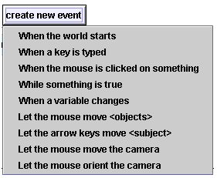
Other Events
You have probably noticed that there are many other events in the create new event drop down menu. Some of these are very useful, such as Let arrow keys move. This is good for steering a vehicle or a person in a game. There is also Let the mouse move, which allows you to click on something with your mouse and drag it around in your world. Test out some of these events until you feel you are comfortable with events in general.

