Slide 1
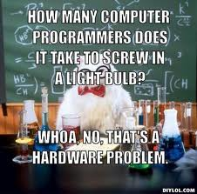
Hardware

Slide 2
Peripherals
Can connect to a computer but is not part of it
Input/Output devices

Slide 3
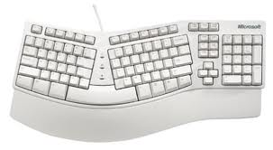
Keyboard
Alphabetic layouts
QWERTY—standard keyboard
QWERTZ—used in Germany and Central Europe
AZERTY—used in France, Belgium, and some African countries
Alphabetical layout—used by some companies
Ergonomic keyboard
Minimizes muscle strain

Slide 4
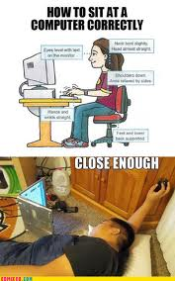
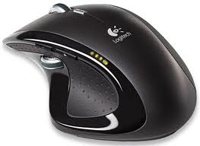
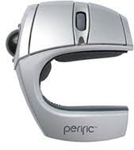
Mouse
Navigate the computer
Ergonomic mouse

Slide 5
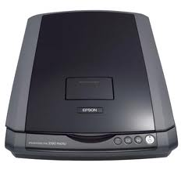
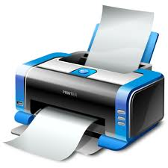
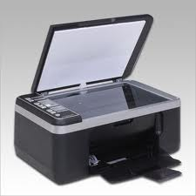
Printer/Scanner
Scanner
Printer
Scan documents
Print things!

Slide 6
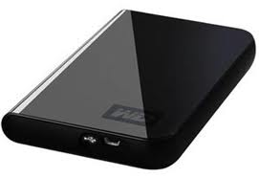
External hard Drive
Removable (plugs into USB)
Stores data
Can clone disks
Data recovery
Backup files
Can be used for booting operating systems

Slide 7
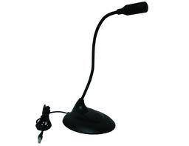
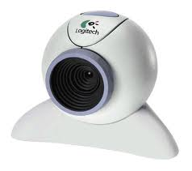
Other Peripherals
Webcam
Microphone
See people!
Talk to people!

Slide 8
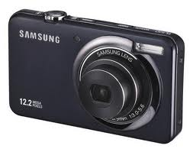
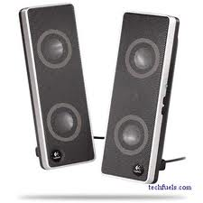
More Stuff
Digital Camera
Speakers

Slide 9
Other Important Things

Slide 10
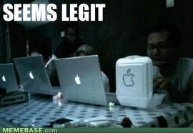
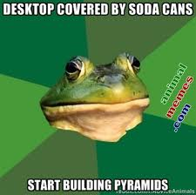
Computer Types
Desktop
Laptop
Portable/smaller
$$$
Bigger
Cheaper
Better quality

Slide 11
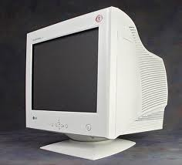
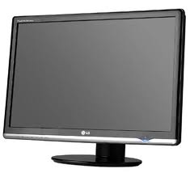
Monitors
CRT
LCD
“Cathode Ray Tube”
Old school!
“Liquid Crystal Display”
Newer (all the monitors in this lab are LCD)

Slide 12

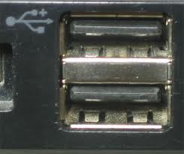
Ports
PS2
USB
“Personal System 2”
Older
“Universal Serial Bus”
More common in newer computers

Slide 13
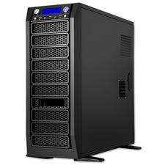
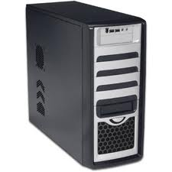
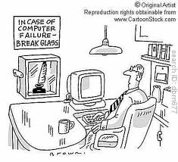
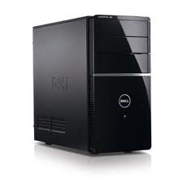
Computer Case
Mostly depends on height
Full Tower
Mid Tower
Mini Tower

Slide 14
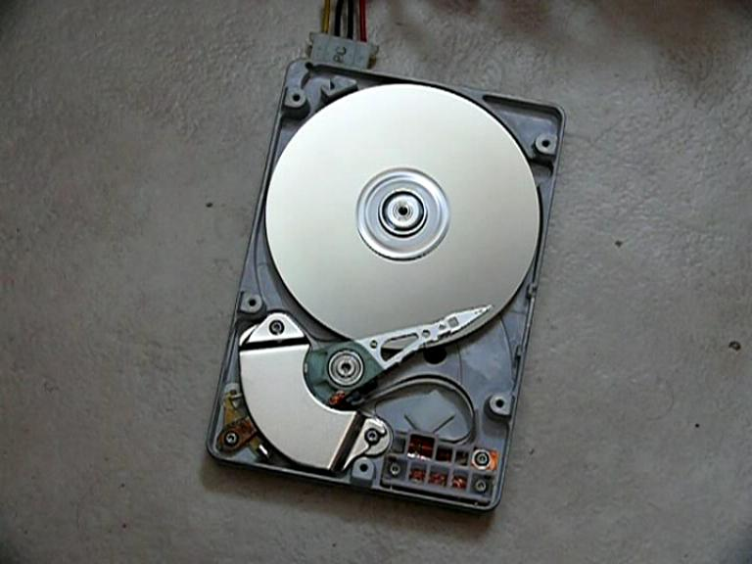
Hard Drive
Used for storing and retrieving digital information, primarily computer data.
Doesn’t get erased when you turn off your computer
Larger storage capacity then RAM or ROM

Slide 15
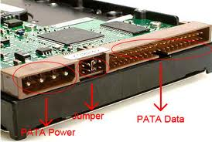
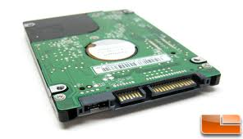
Hard Drive
(P)ata
Sata
Parallel ATA
Advanced Technology Attachment
Older
Serial Advanced Technology Attachment
Basically, they’re the same but have different types of ports to plug them into the computer

Slide 16
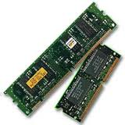
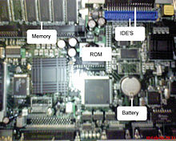
Memory
RAM
ROM
“Random Access Memory”
Short term
RAM sticks
Where programs being run by the processor are stored
“Read Only Memory”
Long term
Stores the program needed to initially boot the computer
Only allows reading (cannot alter it)

Slide 17

Fun Task
“Build” your own computer!
Look up the different pieces of hardware and combine them in Photoshop to make your own computer!
You can do either the internal hardware, external hardware, or both!

