Slide 1
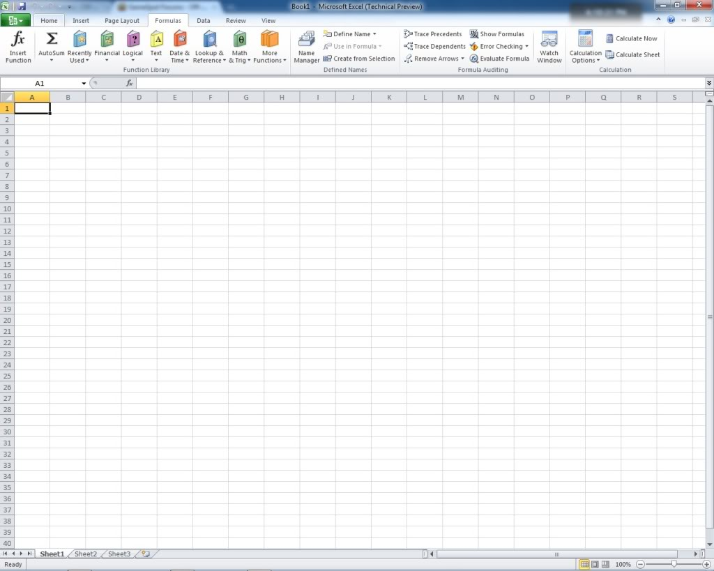
Introduction to
Microsoft EXCEL

Slide 2

What is Excel??
An electronic spreadsheet program
What does that mean?
Stores and manipulates numbers
Makes tables with text or numbers
Creates graphs and charts

Slide 3
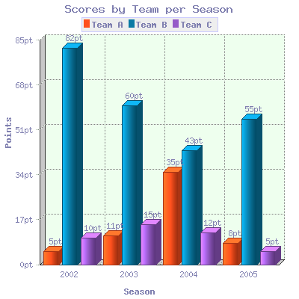
Why are we learning it??
It does calculations for you – like a calculator but better
Impress your teachers with sleek charts and tables
Save time on homework by avoiding repetitive calculations
Almost every business and organization uses it to represent data

Slide 4
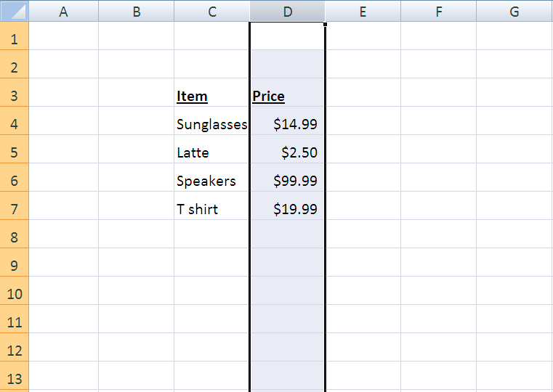
How does it work?
COLUMNS
(letters)
Cell D7
ROWS
(numbers)
Each cell stores a piece of information (numbers, text, function) and cells are grouped by columns and rows.

Slide 5
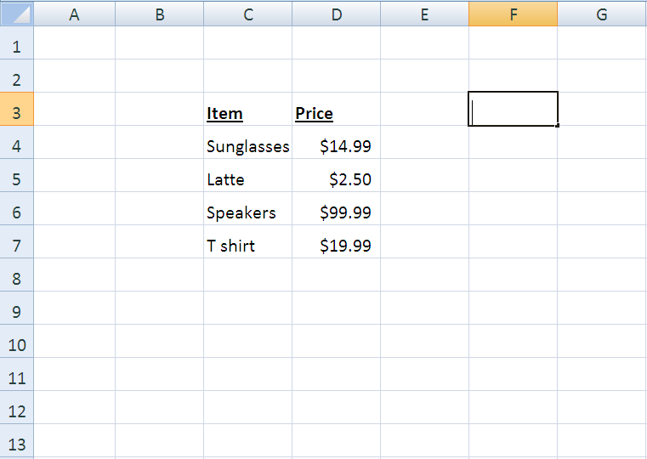
So how do we store this information??
A text cursor will appear when you double click on the cell you want to use.

Slide 6
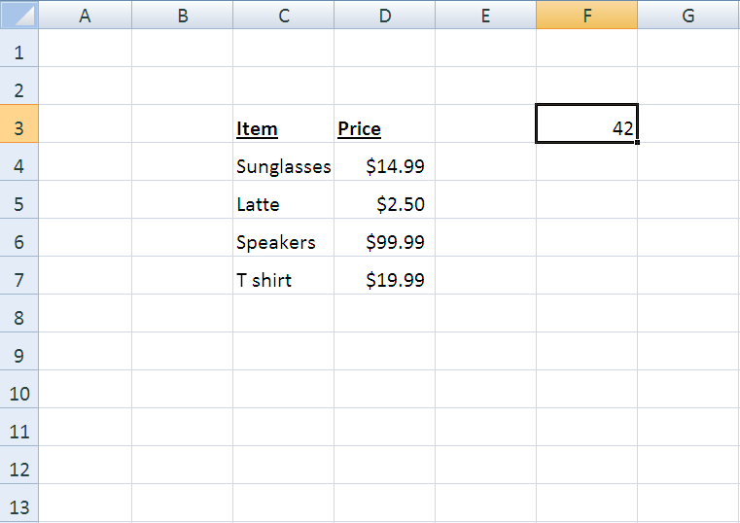
So how do we store this information??
A text cursor will appear when you double click on the cell you want to use.
Now the cell F3 has stored the number 42.

Slide 7
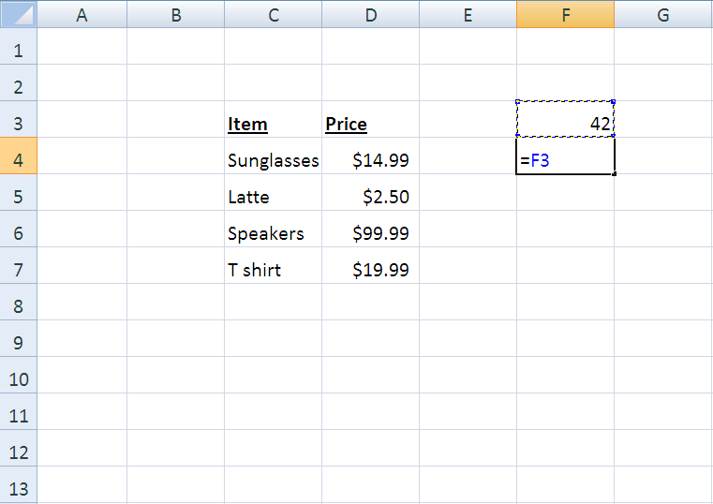
How can we make cells use the information in other cells?
A text cursor will appear when you double click on the cell you want to use.
Type “=“ in the new cell, and click on the cell that you want the new one to depend on.

Slide 8
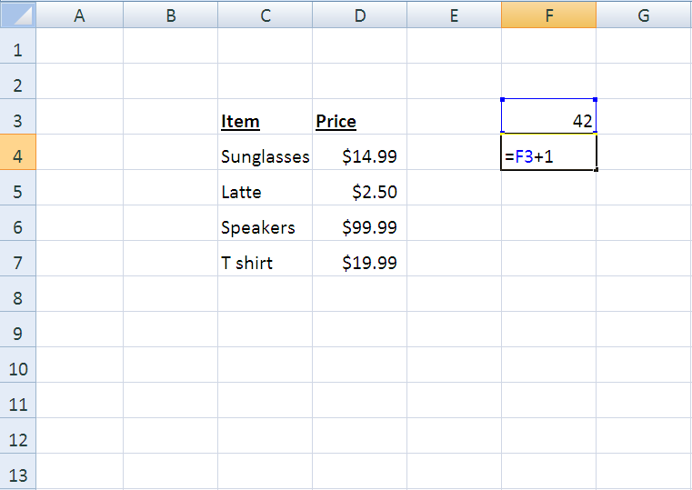
How can we make cells use the information in other cells?
A text cursor will appear when you double click on the cell you want to use.
Press ENTER, and now the cell F4 will always be equal to the value in F3 plus 1.

Slide 9
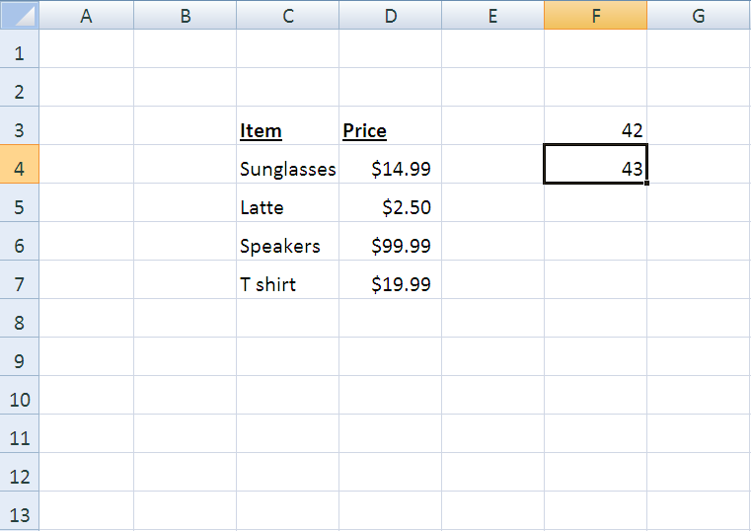
How can we make cells use the information in other cells?

Slide 10

How can we make cells use the information in other cells?
Even if we alter the value in F3! The value in F4 will automatically update.

Slide 11
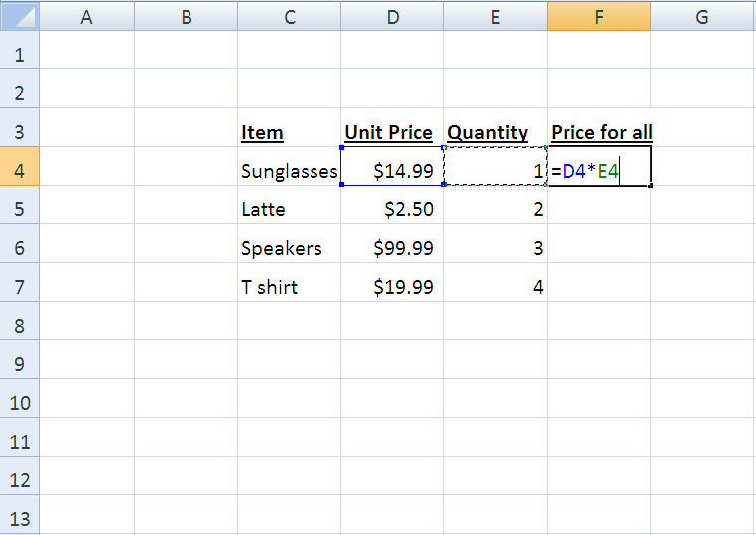
How can we make cells use the information in other cells?
We can even make a cell depend on more than one other cell!

Slide 12
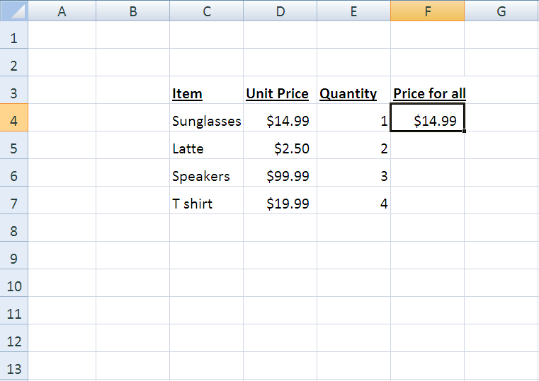
How can we make cells use the information in other cells?
But we’re lazy and don’t want to type this in for all of the other items! So how can we make Excel do it for us?

Slide 13
How can we make cells use the information in other cells?
Move the cursor to the bottom right corner of the box around the cell.

Slide 14
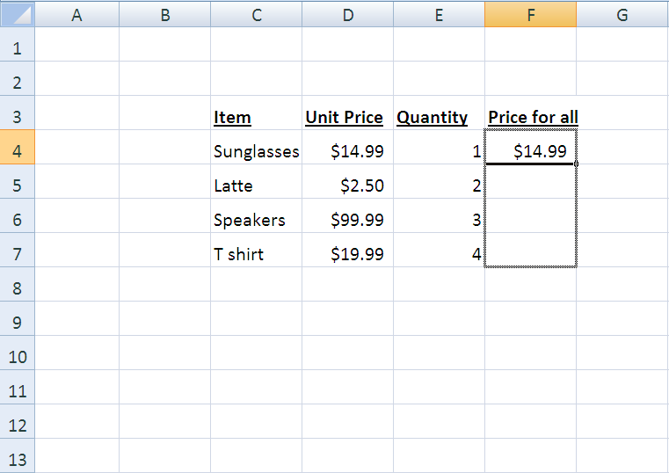
How can we make cells use the information in other cells?
Drag the cursor down to the last cell that you want to use.

Slide 15
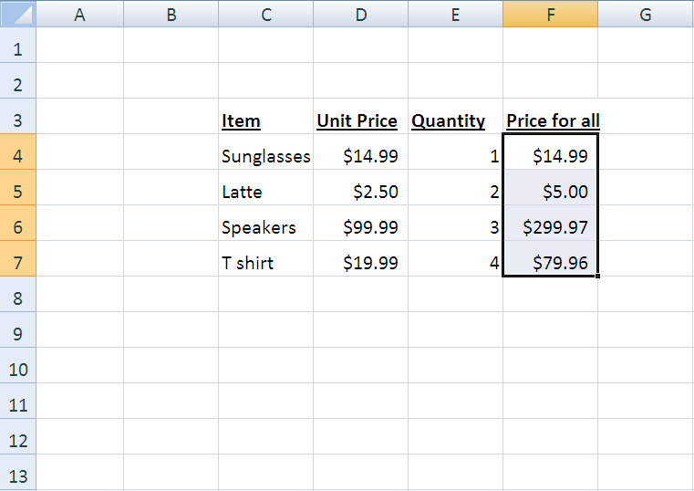
How can we make cells use the information in other cells?
Now the rest of the multiplications for each row have been calculated for us!

Slide 16
Functions in Excel
Formulas to perform general operations
Depend on other cells
Automatically update
Today, we will use SUM() and IF()
SUM() adds the values in user-selected cells
IF() displays a value that depends on whether or not a condition is true
Input 1
Input 2
Output

Slide 17
SUM()
SUM() has the form =SUM(Cell names)
Add adjacent cells using a colon
Typing =SUM(A1:A3) adds cells A1, A2, and A3.
And typing =SUM(A1:B2) adds A1, A2, B1, and B2.
Separate nonadjacent cells with commas to add them: =SUM(A1,B4,G17)

Slide 18
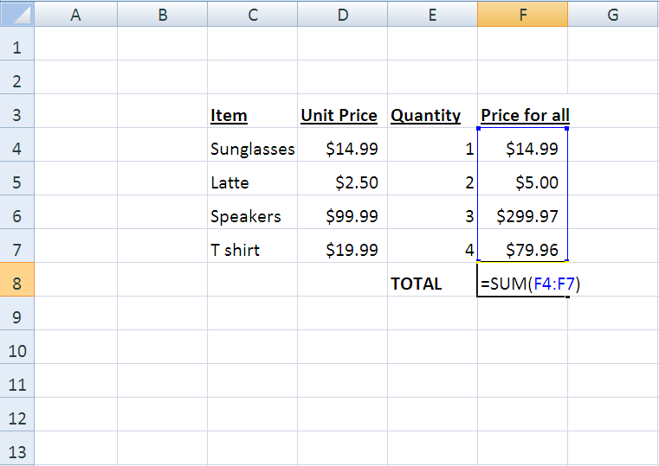
SUM()

Slide 19
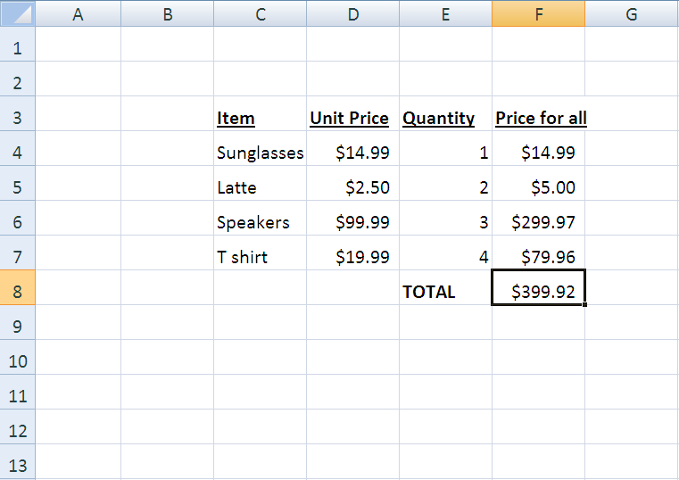
SUM()
Hooray!

Slide 20
IF()
IF() has the form =IF(Statement, Output if True, Output if False)
Example 1: =IF(A1>=6, 1, 5)
If A1 is greater than or equal to 6, then the cell will display 1.
If it is less than 6, the cell will display 5.
Example 2: =IF(A1=B18, “Same”, “Different”)
What will the cell display if A1 is 100 and B18 is 99.9?

Slide 21
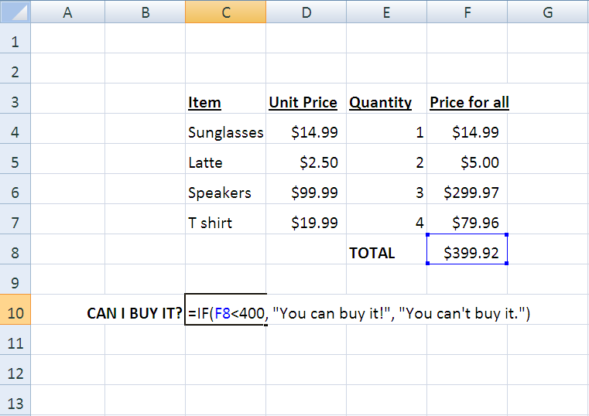
IF()
F8

Slide 22
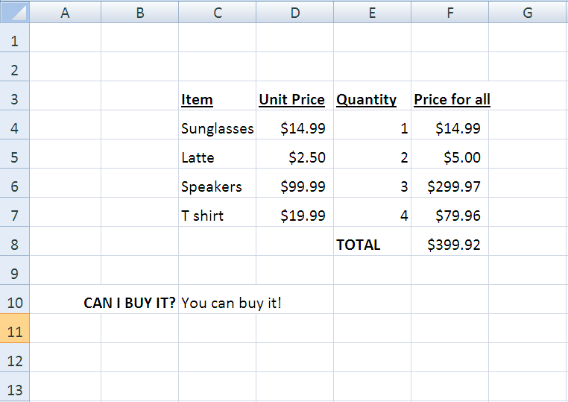
IF()
The condition F8 < 400 is satisfied.

Slide 23
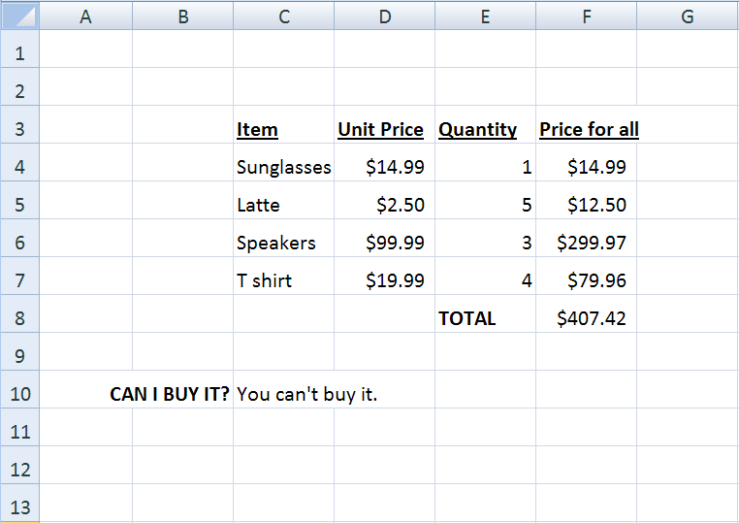
IF()
The condition F8 < 400 isn’t satisfied anymore.

Slide 24

REMEMBER!
Every function must begin with an equal sign!!
Press “Enter” to finish inputting the entry
if you click away from the cell, Excel will think you want to enter in the value of another cell
Functions need text between in quotations!!!!
“Like this.”

Slide 25
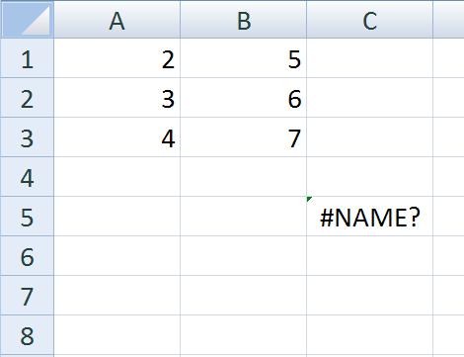
MOST IMPORTANTLY
Machines understand things much differently than people do.
You and I would understand that someone who entered this…
=SUUM(A1:B3)
meant to add the values in that range.
But in this situation, Excel gets confused because it has no idea what that entry means.

Slide 26
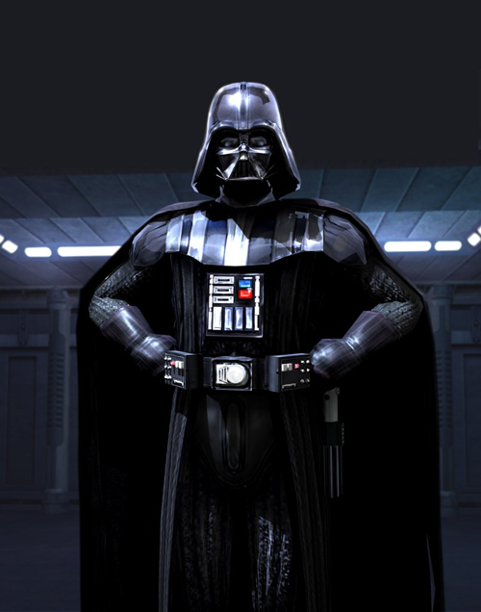

Computers only understand perfect commands
The computer is here to do your bidding.
But that’s why we like them so much.
They are here to do exactly what we say, and they don’t mess up (most of the time)
YOU’RE
THE BOSS
You
Computer

Slide 27
Any questions?

Slide 28
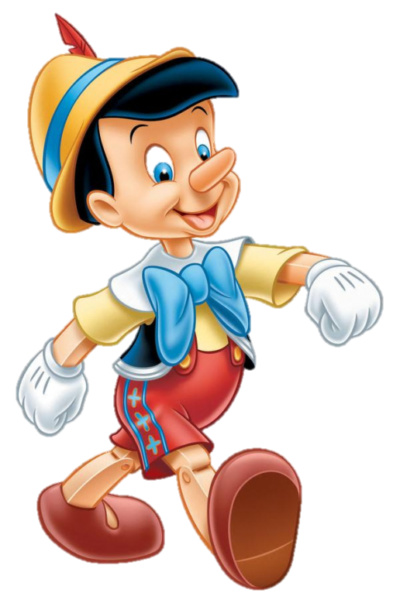

Project
Pinocchio has just finished 8th grade! Help him calculate his final grade!

