Slide 1
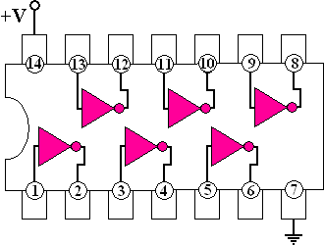
Logic Gates

Slide 2

What are logic gates?
In the binary lesson, we discussed the switches inside a computer
Logic gates are the switches that turn ON or OFF depending on what the user is doing!
They are the building blocks for how computers work!!!!
Logic gates are to computers as cells are to the human body
They’re really fun because they’re logic puzzles

Slide 3

What are logic gates?
Logic gates turn ON when a certain condition is true, and OFF when the condition is false
In other words, they check whether or not the information they get follows a certain rule
They either spit out the answer true (ON) or false (OFF)
If the information they are given changes, so does their answer!!

Slide 4
Let’s do an example!
ON
(they are equal)
Logic
Gate
5
5
Let’s say a certain logic gate needs to determine if two numbers are equal
If they are equal, it will go into its ON position, indicating true
If they are not equal, it will go into its OFF position, indicating false
OFF
(they are not equal)
Logic
Gate
6
5

Slide 5
Let’s do an example!
1
(ON)
Logic
Gate
1
(ON)
1 (ON)
BUT we learned before that computers only think of things in terms of ON and OFF, which to them is 1 and 0
So a computer wouldn’t take an input of 5 or 6 – all of the information need to be 0s and 1s
Reminder: Input refers to the information you give the logic gate, and output refers to what it spits out!
Let’s try this example again, keeping this rule in mind!
0
(OFF)
Logic
Gate
0 (OFF)
1
(ON)

Slide 6

Types of Logic Gates!
We are going to learn about the main types of logic gates!
They are NOT, AND, OR, and XOR
There are also other ones, such as NAND, NOR, and XNOR that we’re not going to cover .
If you want to impress people, tell them you know about Boolean logic – that’s the fancy name for what we’re doing!

Slide 7
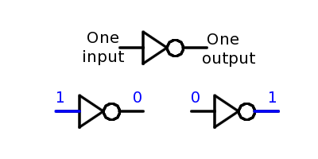
NOT
NOT is the easiest logic gate!
All it does is take in an input that is either ON or OFF
It then spits out the opposite!
Another name for a NOT gate is inverter
NOT gate
Input
Output

Slide 8
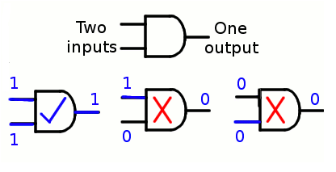
AND
AND is a really important logic gate
Unlike NOT, AND needs two inputs
It only turns on when both inputs are ON
If only one input is on, it spits out OFF
If both inputs are off, it spits out OFF
AND gate
Input 1
Input 2
Output

Slide 9
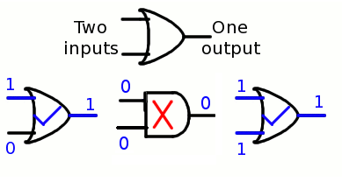
OR
OR is another really useful logic gate
OR is much less picky than AND! OR only needs one
input to be ON for it to spit out ON
It is also ON when both inputs are ON
It is OFF when both inputs are OFF
OR gate

Slide 10
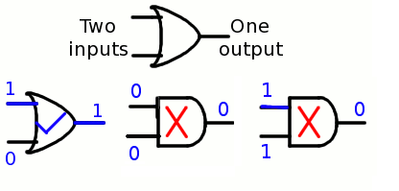
XOR
XOR is the short way to say “Exclusive OR”
XOR is a lot like OR, but with one small difference
Like OR, XOR also only needs one input to be ON for it to spit out ON
BUT unlike OR, when both inputs are ON, XOR spits
out OFF
It is also OFF when both inputs are OFF
XOR gate

Slide 11
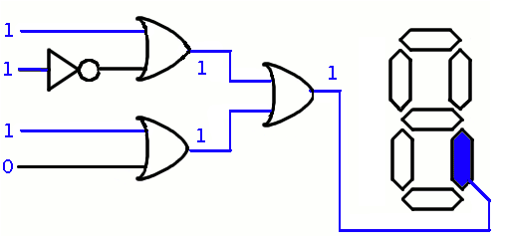
Stacking Logic Gates!
An output of one logic gate can be an input to another logic gate!
This is cool because it creates trees of gates that depend on each other

Slide 12
Let’s Do an Example!
NOT
NOT
1
1
0

Slide 13
Example 2!
1
AND
NOT
1
0
0

Slide 14
Example 3!
1
AND
1
1
XOR
0
1
OR
1
0

Slide 15
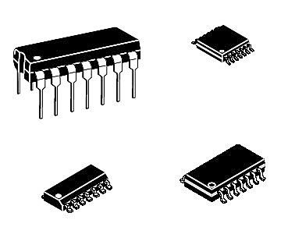
By the way, logic gates actually look like weird bugs in real life!
However, the diagrams we use are easier to understand

Slide 16
Any Questions??

