Slide 1

Overview
Architecture
Data & config
Implementation
Use cases
Demonstration
Results
Conclusion
Architecture and Streaming
using Apache Flume
Oil & Gas Equipment Monitoring
Assignment 1, Group 2
Amit Kumar Jha
Archana Yadav
Chinar Goel
Satya Prakash Gupta
Tanya Kapoor
BITS Pilani, 12 September 2026
01
Notes:
Cover image: AI-generated illustration created for this presentation. It is illustrative and not a photograph of the demonstrated plant. Group members are listed alphabetically.

Slide 2

Overview
Architecture
Data & config
Implementation
Use cases
Demonstration
Results
Conclusion
Stream Processing and Analytics Course
CCZG556
Apache Flume: Oil & Gas Equipment Monitoring
Assignment
Group
Group members, alphabetical order
1
2
01
Amit Kumar Jha
2025MT03001
02
Archana Yadav
2025MT03046
Platform
03
Chinar Goel
2025MT03125
https://flume.apache.org/
04
Satya Prakash Gupta
2025MT03128
05
Tanya Kapoor
2025MT03099
02
Notes:
Sources: https://github.com/gchinar/apache-flume-oilgas-group2 and https://flume.apache.org/FlumeUserGuide.html. Technical implementation follows oilgas/simulate_sensor.ps1, oilgas/app/dashboard.py, and apache-flume-1.11.0-bin/conf/oilgas.conf.

Slide 3
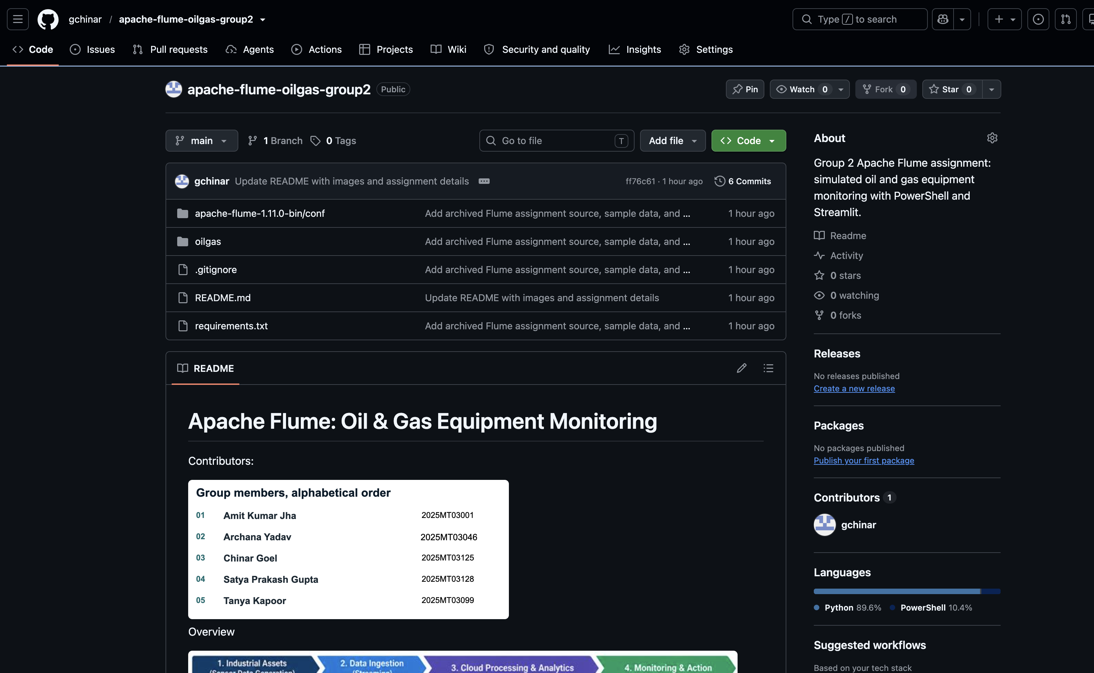
Overview
Architecture
Data & config
Implementation
Use cases
Demonstration
Results
Conclusion
Source code repository
github.com/gchinar/apache-flume-oilgas-group2
03
Notes:
Sources: https://github.com/gchinar/apache-flume-oilgas-group2 and https://flume.apache.org/FlumeUserGuide.html. Technical implementation follows oilgas/simulate_sensor.ps1, oilgas/app/dashboard.py, and apache-flume-1.11.0-bin/conf/oilgas.conf.

Slide 4
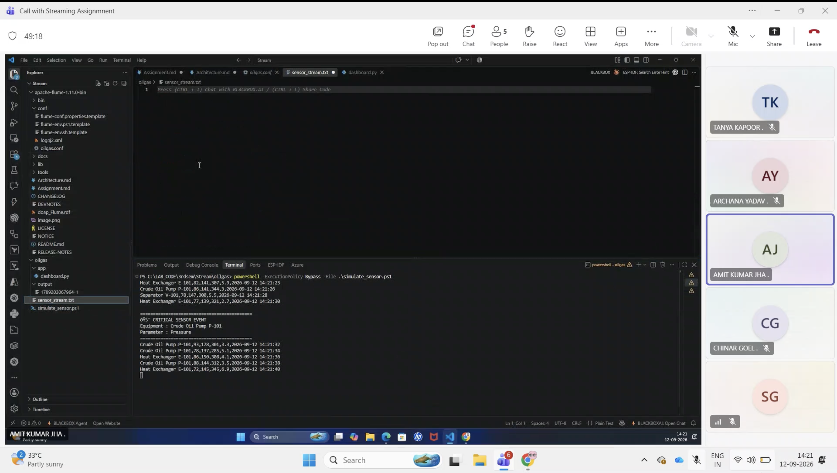
Overview
Architecture
Data & config
Implementation
Use cases
Demonstration
Results
Conclusion
Recorded demonstration
Watch the recorded demonstration on Google Drive
Alternative: watch on YouTube
04
Notes:
Sources: https://github.com/gchinar/apache-flume-oilgas-group2 and https://flume.apache.org/FlumeUserGuide.html. Technical implementation follows oilgas/simulate_sensor.ps1, oilgas/app/dashboard.py, and apache-flume-1.11.0-bin/conf/oilgas.conf.

Slide 5
Overview
Architecture
Data & config
Implementation
Use cases
Demonstration
Results
Conclusion
Problem and abstract
Oil and gas equipment monitoring
2 s
configured sleep between events
Oil and gas equipment requires continuous monitoring of operating conditions. This prototype collects simulated sensor readings through Apache Flume and displays the latest asset status in a Streamlit dashboard. Threshold checks identify abnormal measurements so operators can inspect the affected equipment.
4
equipment units monitored
4
parameters checked per event
Architecture and Streaming using Apache Flume
05
Notes:
Sources: https://github.com/gchinar/apache-flume-oilgas-group2 and https://flume.apache.org/FlumeUserGuide.html. Technical implementation follows oilgas/simulate_sensor.ps1, oilgas/app/dashboard.py, and apache-flume-1.11.0-bin/conf/oilgas.conf.

Slide 6
Overview
Architecture
Data & config
Implementation
Use cases
Demonstration
Results
Conclusion
Apache Flume data-flow model
A Flume agent is a JVM process that moves events through a source, a channel, and a sink. The channel lets ingestion and delivery run asynchronously.
Producer
Source
Channel
Sink
Destination
external data
accepts events
stages events
drains events
stores or forwards
PUT transaction
TAKE transaction
Transactions protect the handoff at the channel. Durability still depends on the selected source, channel, and sink.
Architecture and Streaming using Apache Flume
06
Notes:
Sources: https://github.com/gchinar/apache-flume-oilgas-group2 and https://flume.apache.org/FlumeUserGuide.html. Technical implementation follows oilgas/simulate_sensor.ps1, oilgas/app/dashboard.py, and apache-flume-1.11.0-bin/conf/oilgas.conf.

Slide 7
Overview
Architecture
Data & config
Implementation
Use cases
Demonstration
Results
Conclusion
Flume architecture components and responsibilities
Component
Responsibility in a Flume flow
Mapping in this prototype
Agent
JVM process that hosts named sources, channels, and sinks and manages their lifecycle.
a1
Event
Unit of data flow with a byte payload and optional string headers.
One six-field CSV line
Source
Receives or creates events and puts them into one or more channels inside a transaction.
source1, Exec Source
Channel
Passive staging store that separates ingestion speed from sink delivery speed.
channel1, Memory Channel
Sink
Takes events from one channel inside a transaction and writes or forwards them.
sink1, File Roll Sink
Source and sink run asynchronously. Transactions protect the channel handoff, while recoverability depends on the channel type. Memory Channel favors speed but cannot recover queued events after an agent failure.
Architecture and Streaming using Apache Flume
07
Notes:
Sources: https://github.com/gchinar/apache-flume-oilgas-group2 and https://flume.apache.org/FlumeUserGuide.html. Technical implementation follows oilgas/simulate_sensor.ps1, oilgas/app/dashboard.py, and apache-flume-1.11.0-bin/conf/oilgas.conf.

Slide 8
Overview
Architecture
Data & config
Implementation
Use cases
Demonstration
Results
Conclusion
Case-study architecture
One line becomes one Flume event and remains CSV throughout the prototype
append every 2 s
new file every 30 s
PowerShell
Text file
Exec Source
Memory
File Roll
Output
Streamlit
sensor simulator
sensor_stream
.txt
Get-Content -Wait
channel1
sink1
local CSV files
live dashboard
Source file C:\LAB_CODE\3rdsem\oilgas\sensor_stream.txt
Streamlit rescans the output files after each two-second refresh cycle.
Architecture and Streaming using Apache Flume
08
Notes:
Sources: https://github.com/gchinar/apache-flume-oilgas-group2 and https://flume.apache.org/FlumeUserGuide.html. Technical implementation follows oilgas/simulate_sensor.ps1, oilgas/app/dashboard.py, and apache-flume-1.11.0-bin/conf/oilgas.conf.

Slide 9
Overview
Architecture
Data & config
Implementation
Use cases
Demonstration
Results
Conclusion
Event model and simulation
CSV event schema
Normal operating limits
Temperature
70–95 °C
Equipment,Temperature,Pressure,Flow,Vibration,Timestamp
Crude Oil Pump P-101,85,145,310,4.2,2026-09-12 14:21:52
Pressure
130–160 bar
Flow
280–350 m³/h
Illustrative CSV record
Simulation behavior
Vibration
2–7 mm/s
Randomly selects one of four equipment units for each event
Generates temperature, pressure, flow, and vibration measurements
Injects high temperature or vibration every fifth event
Appends a CSV line to sensor_stream.txt, then waits two seconds
Architecture and Streaming using Apache Flume
09
Notes:
Sources: https://github.com/gchinar/apache-flume-oilgas-group2 and https://flume.apache.org/FlumeUserGuide.html. Technical implementation follows oilgas/simulate_sensor.ps1, oilgas/app/dashboard.py, and apache-flume-1.11.0-bin/conf/oilgas.conf. CSV row is an illustrative schema example.

Slide 10
Overview
Architecture
Data & config
Implementation
Use cases
Demonstration
Results
Conclusion
Flume agent configuration
SOURCE
type = exec
shell = powershell.exe -NoProfile -Command
command = Get-Content -Path '.../sensor_stream.txt' -Wait
Reads existing lines, then waits for appended lines
CHANNEL
type = memory
capacity = 1000
transactionCapacity = 100
Buffers events in RAM for fast handoff
SINK
type = file_roll
sink.directory = C:/LAB_CODE/3rdsem/oilgas/output
sink.rollInterval = 30
Writes local files and rolls to a new file every 30 seconds
a1.sources.source1.channels = channel1
a1.sinks.sink1.channel = channel1
Configuration file: apache-flume-1.11.0-bin/conf/oilgas.conf
Architecture and Streaming using Apache Flume
10
Notes:
Sources: https://github.com/gchinar/apache-flume-oilgas-group2 and https://flume.apache.org/FlumeUserGuide.html. Technical implementation follows oilgas/simulate_sensor.ps1, oilgas/app/dashboard.py, and apache-flume-1.11.0-bin/conf/oilgas.conf.

Slide 11
Overview
Architecture
Data & config
Implementation
Use cases
Demonstration
Results
Conclusion
Implementation environment and setup
Languages and packages
Project folders
Java runs Apache Flume 1.11.0.
PowerShell generates and follows CSV events.
Python uses Streamlit and pandas.
Root: C:\LAB_CODE\3rdsem
Keep oilgas and apache-flume-1.11.0-bin
as sibling folders.
Preparation in PowerShell
java -version
py --version
py -m pip install streamlit pandas
New-Item -ItemType Directory -Force C:\LAB_CODE\3rdsem\oilgas\output
if (!(Test-Path C:\LAB_CODE\3rdsem\oilgas\sensor_stream.txt)) {
New-Item -ItemType File C:\LAB_CODE\3rdsem\oilgas\sensor_stream.txt
}
Install the Flume binary distribution separately. Update all configured paths together if relocating the project.
Architecture and Streaming using Apache Flume
11
Notes:
Sources: https://github.com/gchinar/apache-flume-oilgas-group2 and https://flume.apache.org/FlumeUserGuide.html. Technical implementation follows oilgas/simulate_sensor.ps1, oilgas/app/dashboard.py, and apache-flume-1.11.0-bin/conf/oilgas.conf.

Slide 12
Overview
Architecture
Data & config
Implementation
Use cases
Demonstration
Results
Conclusion
PowerShell sensor simulator
Abnormal-event generation
$counter++
if ($counter % 5 -eq 0) {
$alertType = Get-Random -Minimum 1 -Maximum 3
if ($alertType -eq 1) {
$temperature = (Get-Random -Minimum 960 -Maximum 1101) / 10.0
} else {
$vibration = (Get-Random -Minimum 80 -Maximum 121) / 10.0
}
}
Every fifth event raises temperature to 96–110 °C or vibration to 8–12 mm/s. The other parameters retain their generated normal values.
Source: oilgas/simulate_sensor.ps1
Architecture and Streaming using Apache Flume
12
Notes:
Sources: https://github.com/gchinar/apache-flume-oilgas-group2 and https://flume.apache.org/FlumeUserGuide.html. Technical implementation follows oilgas/simulate_sensor.ps1, oilgas/app/dashboard.py, and apache-flume-1.11.0-bin/conf/oilgas.conf.

Slide 13
Overview
Architecture
Data & config
Implementation
Use cases
Demonstration
Results
Conclusion
Dashboard logic and alert handling
Latest reading per equipment
Dashboard output
latest = (
df.sort_values("Timestamp")
.groupby("Equipment")
.tail(1)
.reset_index(drop=True)
)
1
Check all four measurements against their configured limits
2
Count equipment with at least one abnormal measurement
3
Show Normal or Alert status for each equipment unit
Threshold evaluation
4
Display the parameter, value, and breached limit
minimum, maximum, unit = LIMITS[parameter]
if value < minimum: return True, "Below normal limit"
if value > maximum: return True, "Above normal limit"
return False, ""
5
Refresh the latest readings and the 20 most recent events
Architecture and Streaming using Apache Flume
13
Notes:
Sources: https://github.com/gchinar/apache-flume-oilgas-group2 and https://flume.apache.org/FlumeUserGuide.html. Technical implementation follows oilgas/simulate_sensor.ps1, oilgas/app/dashboard.py, and apache-flume-1.11.0-bin/conf/oilgas.conf.

Slide 14
Overview
Architecture
Data & config
Implementation
Use cases
Demonstration
Results
Conclusion
Dashboard: read and normalize
read_flume_output()
Input handling decisions
1
Return an empty DataFrame when output/ is absent
Malformed rows
Skip a line when len(parts) != 6
2
Sort all sink files by modification time
Type conversion
Use errors='coerce' for numeric values and timestamps
3
Strip lines and keep only six-field CSV records
File read failure
Convert four measurements and the timestamp
Catch the exception and continue with remaining files
4
Refresh model
5
Drop rows with a null Equipment field
Sleep two seconds, rerun, and rescan all rolled files
Missing numeric values are skipped during alert checks. Invalid data can appear normal.
Architecture and Streaming using Apache Flume
14
Notes:
Sources: https://github.com/gchinar/apache-flume-oilgas-group2 and https://flume.apache.org/FlumeUserGuide.html. Technical implementation follows oilgas/simulate_sensor.ps1, oilgas/app/dashboard.py, and apache-flume-1.11.0-bin/conf/oilgas.conf.

Slide 15
Overview
Architecture
Data & config
Implementation
Use cases
Demonstration
Results
Conclusion
Suitable use cases and production limits
Good fit
Needs hardening
Streaming-architecture demonstrations and laboratory exercises
Equipment telemetry prototypes at a plant or edge location
Central collection of application or machine logs
Short-term file landing before downstream analysis
Small deployments that favor simple configuration and speed
Safety-critical control or automated shutdown decisions
Strict no-loss pipelines during agent or host failure
High-volume analytics that repeatedly rescans every output file
Multi-site operation without authentication, monitoring, or redundancy
Production direction
File or Kafka Channel, tracked source offsets, incremental reads, external configuration
Architecture and Streaming using Apache Flume
15
Notes:
Sources: https://github.com/gchinar/apache-flume-oilgas-group2 and https://flume.apache.org/FlumeUserGuide.html. Technical implementation follows oilgas/simulate_sensor.ps1, oilgas/app/dashboard.py, and apache-flume-1.11.0-bin/conf/oilgas.conf.

Slide 16
Overview
Architecture
Data & config
Implementation
Use cases
Demonstration
Results
Conclusion
Streaming integration commands
Terminal 1: Flume agent
1
cd C:\LAB_CODE\3rdsem\apache-flume-1.11.0-bin
java -cp "lib\*" org.apache.flume.node.Application -n a1 -f conf\oilgas.conf
Terminal 2: PowerShell simulator
2
cd C:\LAB_CODE\3rdsem\oilgas
powershell -ExecutionPolicy Bypass -File .\simulate_sensor.ps1
Terminal 3: Streamlit dashboard
3
cd C:\LAB_CODE\3rdsem\oilgas\app
python -m streamlit run dashboard.py
Architecture and Streaming using Apache Flume
16
Notes:
Sources: https://github.com/gchinar/apache-flume-oilgas-group2 and https://flume.apache.org/FlumeUserGuide.html. Technical implementation follows oilgas/simulate_sensor.ps1, oilgas/app/dashboard.py, and apache-flume-1.11.0-bin/conf/oilgas.conf.

Slide 17
Overview
Architecture
Data & config
Implementation
Use cases
Demonstration
Results
Conclusion
Demonstration walkthrough
Recorded demonstration: Google Drive
Alternative video link: YouTube
01
Group introduction
02
Architecture
Introduce the monitoring problem and the four equipment units
Explain the local source, channel, sink, and dashboard
03
Code and setup
04
Streaming files
Show the simulator, agent configuration, and launch commands
Show generated CSV readings and the rolled output files
05
Dashboard
06
Closing
Identify abnormal measurements and the subsequent return to normal
Summarize the pipeline and the main observations
Architecture and Streaming using Apache Flume
17
Notes:
Screenshots supplied in the user presentation. Demonstration illustrations show the visible equipment values and interface states.

Slide 18
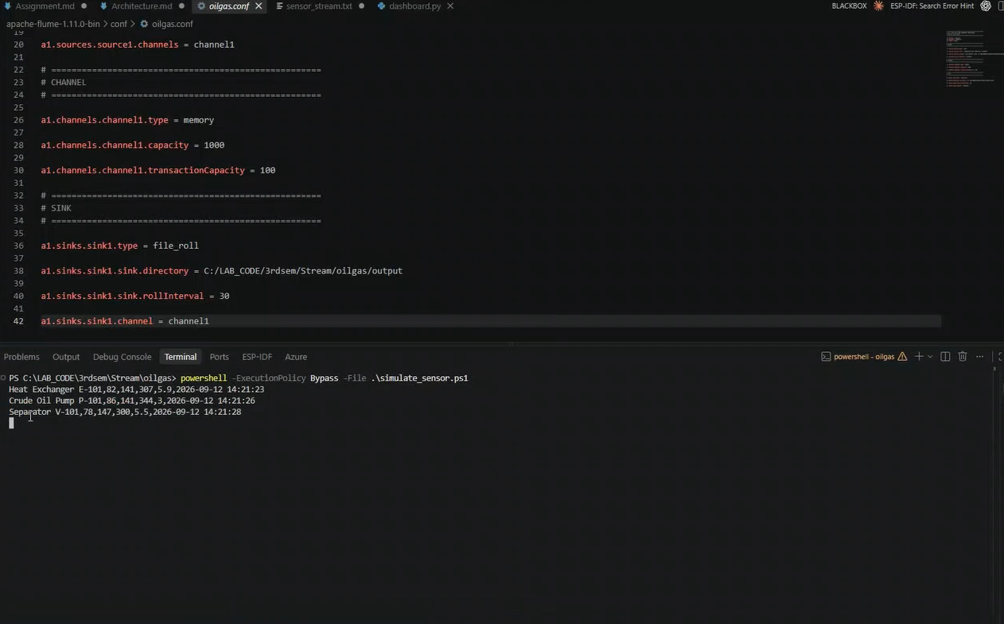
Overview
Architecture
Data & config
Implementation
Use cases
Demonstration
Results
Conclusion
Demonstration: Flume configuration
Memory capacity 1000, transaction capacity 100, file roll interval 30 seconds
Architecture and Streaming using Apache Flume
18
Notes:
Screenshots supplied in the user presentation. Demonstration illustrations show the visible equipment values and interface states.

Slide 19
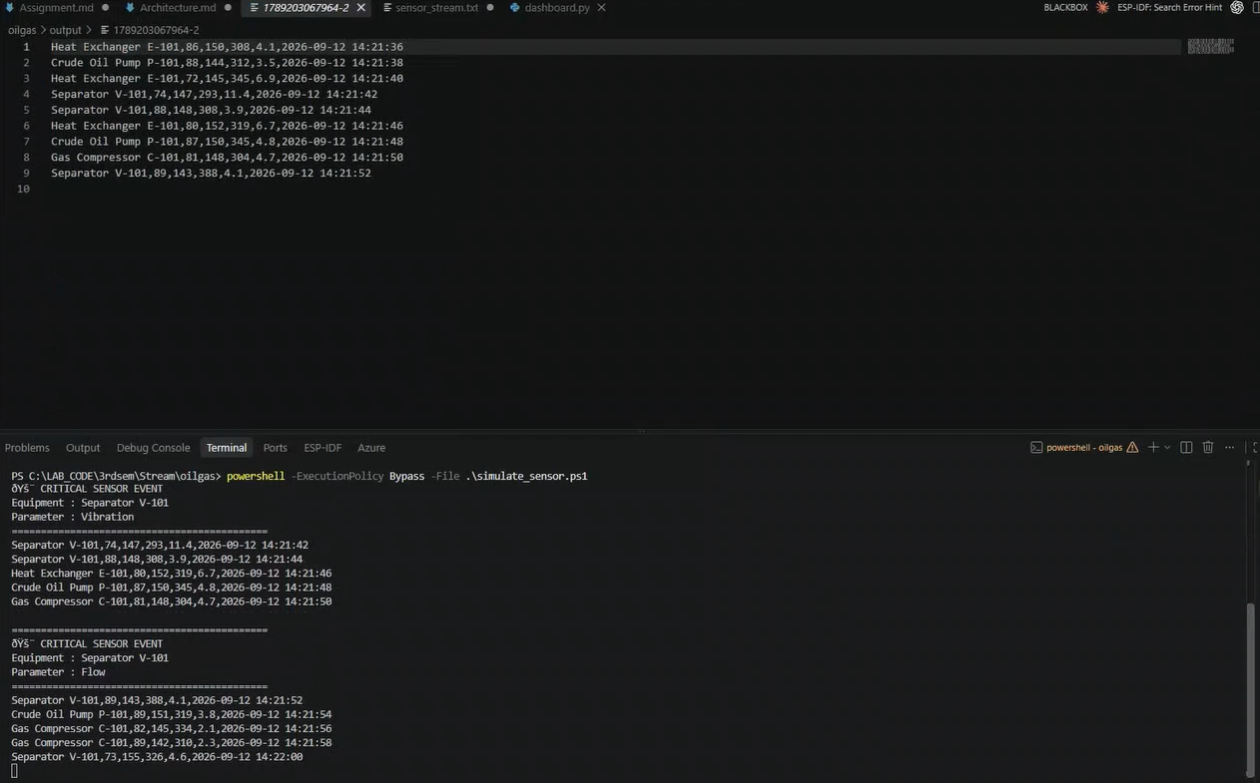
Overview
Architecture
Data & config
Implementation
Use cases
Demonstration
Results
Conclusion
Demonstration: event delivery
The same Separator V-101 event appears in the terminal and output file
Separator V-101,89,143,388,4.1,2026-09-12 14:21:52
Architecture and Streaming using Apache Flume
19
Notes:
Screenshots supplied in the user presentation. Demonstration illustrations show the visible equipment values and interface states.

Slide 20
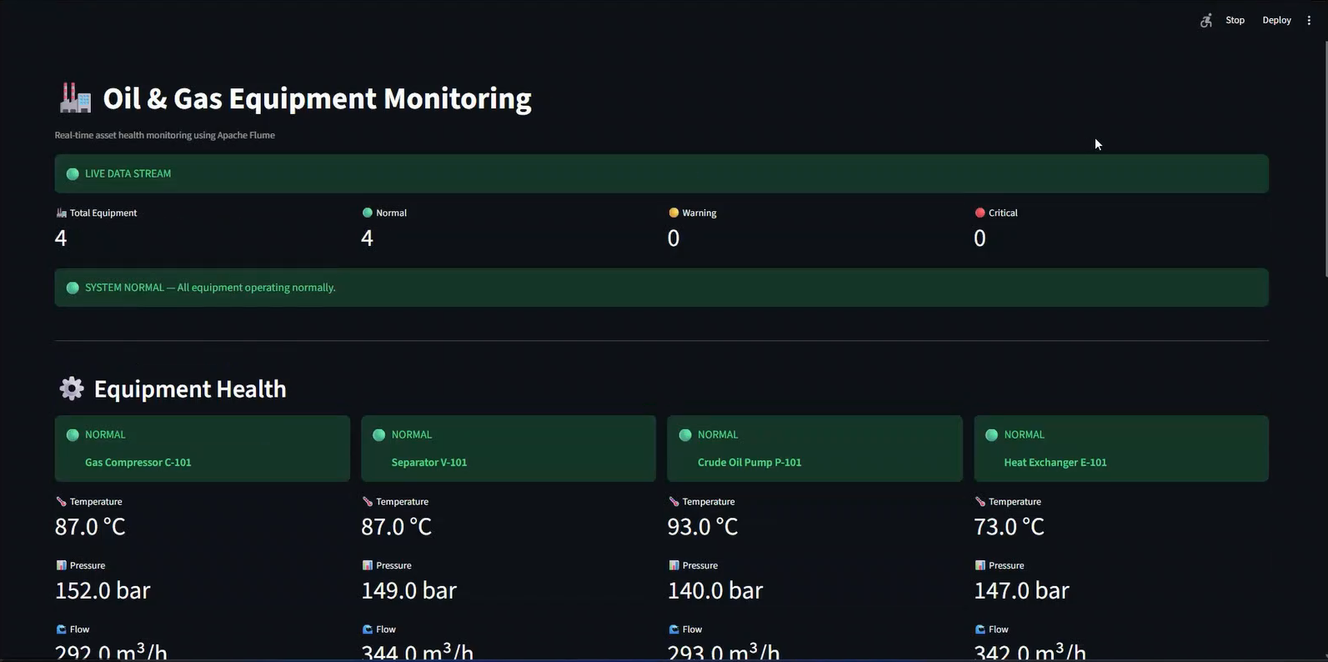
Overview
Architecture
Data & config
Implementation
Use cases
Demonstration
Results
Conclusion
Dashboard: Normal operation
4 assets: 4 normal, 0 warning, 0 critical
Architecture and Streaming using Apache Flume
20
Notes:
Screenshots supplied in the user presentation. Demonstration illustrations show the visible equipment values and interface states.

Slide 21
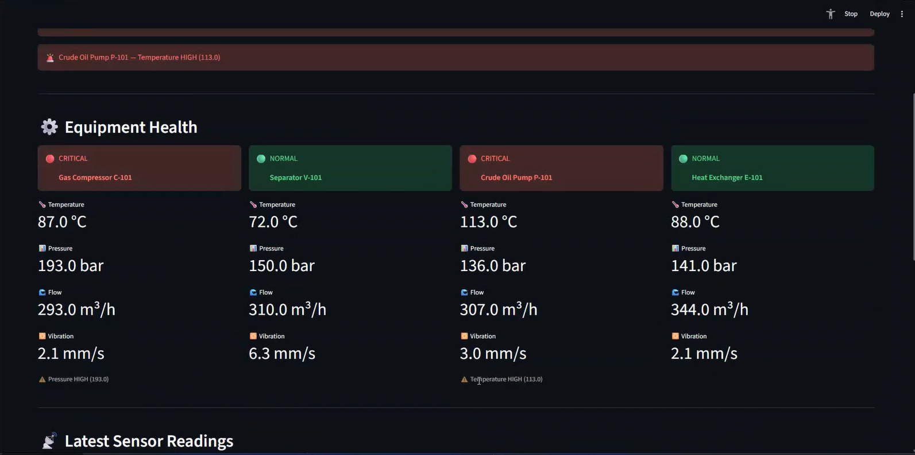
Overview
Architecture
Data & config
Implementation
Use cases
Demonstration
Results
Conclusion
Dashboard: pressure and temperature alerts
Gas Compressor C-101 pressure 193 bar. Crude Oil Pump P-101 temperature 113 °C
Architecture and Streaming using Apache Flume
21
Notes:
Screenshots supplied in the user presentation. Demonstration illustrations show the visible equipment values and interface states.

Slide 22
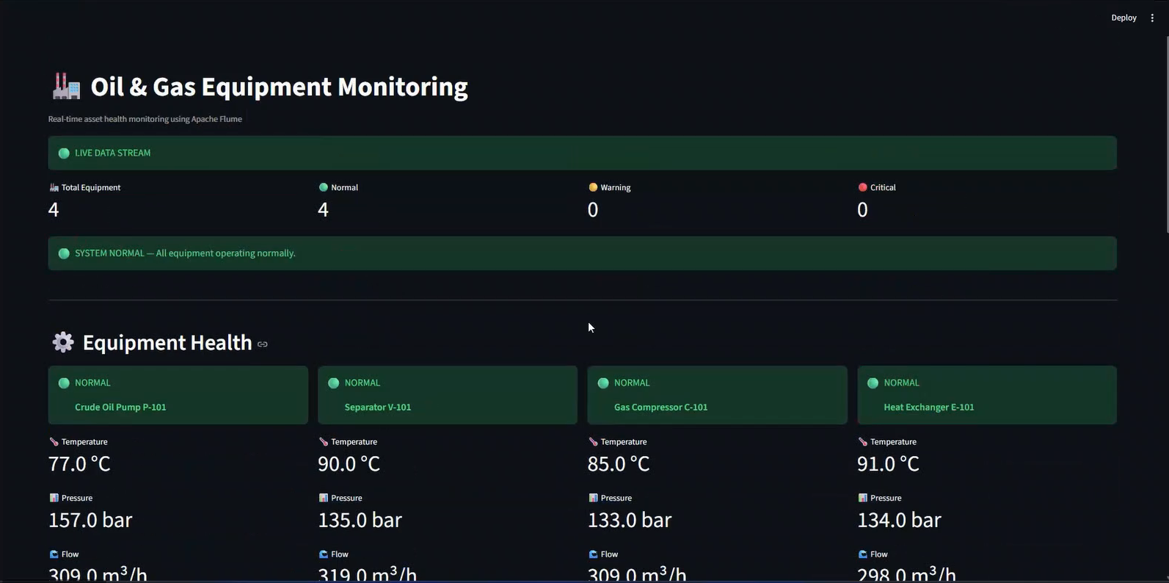
Overview
Architecture
Data & config
Implementation
Use cases
Demonstration
Results
Conclusion
Dashboard: return to normal
All four assets return to Normal, with 0 Warning and 0 Critical
Architecture and Streaming using Apache Flume
22
Notes:
Screenshots supplied in the user presentation. Demonstration illustrations show the visible equipment values and interface states.

Slide 23
Overview
Architecture
Data & config
Implementation
Use cases
Demonstration
Results
Conclusion
Processing results
Events captured by equipment
644
distinct events in input and output
43
files created by the File Roll Sink
96
abnormal records (14.9%)
55 / 41
temperature / vibration alerts
Supplied sample dataset: 644 input and output records match, with no duplicates.
Architecture and Streaming using Apache Flume
23
Notes:
Sources: https://github.com/gchinar/apache-flume-oilgas-group2 and https://flume.apache.org/FlumeUserGuide.html. Technical implementation follows oilgas/simulate_sensor.ps1, oilgas/app/dashboard.py, and apache-flume-1.11.0-bin/conf/oilgas.conf. Counts calculated from the supplied sensor_stream.txt and 43 output files. These are sample-dataset results, not a benchmark.

Slide 24
Overview
Architecture
Data & config
Implementation
Use cases
Demonstration
Results
Conclusion
Framework inferences from the prototype
Implementation observation
Inference
The configuration selects built-in components without custom Java code.
This pipeline uses configuration for ingestion and Python for monitoring.
The Exec Source follows process output and the Memory Channel stores events in RAM.
RAM events can be lost. Restarting Get-Content can replay the source file.
The dashboard performs parsing, state selection, threshold checks, and visualization.
Flume moves events. Downstream applications still own analytics and business rules.
The supplied sample contains 644 matching input and output records.
The saved files show matching delivery for this sample. Failure recovery requires separate testing.
Flume provides configurable event ingestion and file delivery. Production use requires durable buffering, tracked source offsets, and downstream monitoring.
Architecture and Streaming using Apache Flume
24
Notes:
Sources: https://github.com/gchinar/apache-flume-oilgas-group2 and https://flume.apache.org/FlumeUserGuide.html. Technical implementation follows oilgas/simulate_sensor.ps1, oilgas/app/dashboard.py, and apache-flume-1.11.0-bin/conf/oilgas.conf.

Slide 25
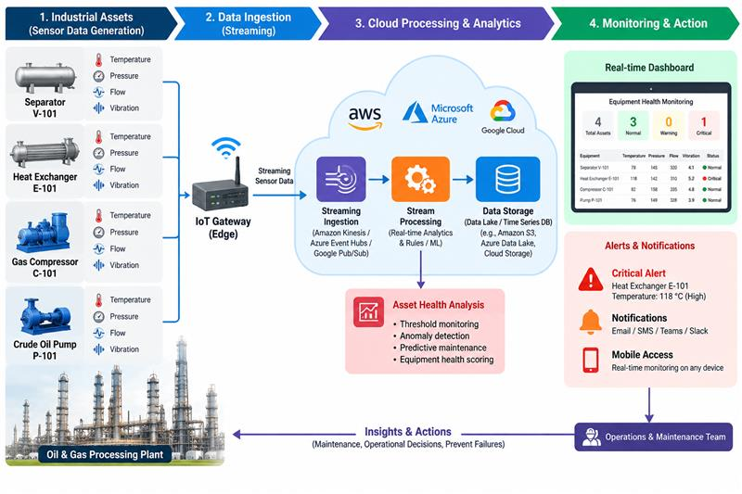
Overview
Architecture
Data & config
Implementation
Use cases
Demonstration
Results
Conclusion
Appendix: conceptual illustration
Possible future architecture
What the illustration adds
Physical sensors feed an IoT gateway. Cloud services could process and store readings, then notify operators.
Current implementation
PowerShell simulation, local Apache Flume ingestion, rolled files, and Streamlit monitoring.
Cloud services, ML, and external notifications are future scope.
Architecture and Streaming using Apache Flume
25
Notes:
Conceptual architecture illustration supplied by the user. Cloud integration is future scope.

Slide 26
Overview
Architecture
Data & config
Implementation
Use cases
Demonstration
Results
Conclusion
Conclusions
What the prototype demonstrates
Recommended production changes
A configurable source, channel, and sink path carries six-field telemetry events
The channel separates producer timing from sink writes
The File Roll Sink creates 30-second landing files while ingestion continues
The dashboard derives latest state and threshold alerts from the landed files
Use durable buffering and a source with tracked offsets
Read new output incrementally and deduplicate replayed records
Reject invalid measurements and flag stale equipment data
Externalize paths and limits, then add pipeline monitoring
Main inference
Flume handles event ingestion. Python applies monitoring rules and presents asset status.
Architecture and Streaming using Apache Flume
26
Notes:
Sources: https://github.com/gchinar/apache-flume-oilgas-group2 and https://flume.apache.org/FlumeUserGuide.html. Technical implementation follows oilgas/simulate_sensor.ps1, oilgas/app/dashboard.py, and apache-flume-1.11.0-bin/conf/oilgas.conf.

Slide 27
Overview
Architecture
Data & config
Implementation
Use cases
Demonstration
Results
Conclusion
References and implementation sources
Project source repository
https://github.com/gchinar/apache-flume-oilgas-group2
oilgas/simulate_sensor.ps1
oilgas/app/dashboard.py
apache-flume-1.11.0-bin/conf/oilgas.conf
Sample data
oilgas/sensor_stream.txt
oilgas/output/ (43 files)
Apache Flume 1.11.0 User Guide
https://flume.apache.org/FlumeUserGuide.html
Architecture and Streaming using Apache Flume
27
Notes:
Sources: https://github.com/gchinar/apache-flume-oilgas-group2 and https://flume.apache.org/FlumeUserGuide.html. Technical implementation follows oilgas/simulate_sensor.ps1, oilgas/app/dashboard.py, and apache-flume-1.11.0-bin/conf/oilgas.conf.

