Slide 1
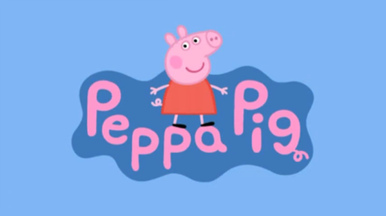
Learning language from
Grzegorz Chrupała
in collaboration with
Mitja Nikolaus
Abdellah Fourtassi
Afra Alishahi

Slide 2
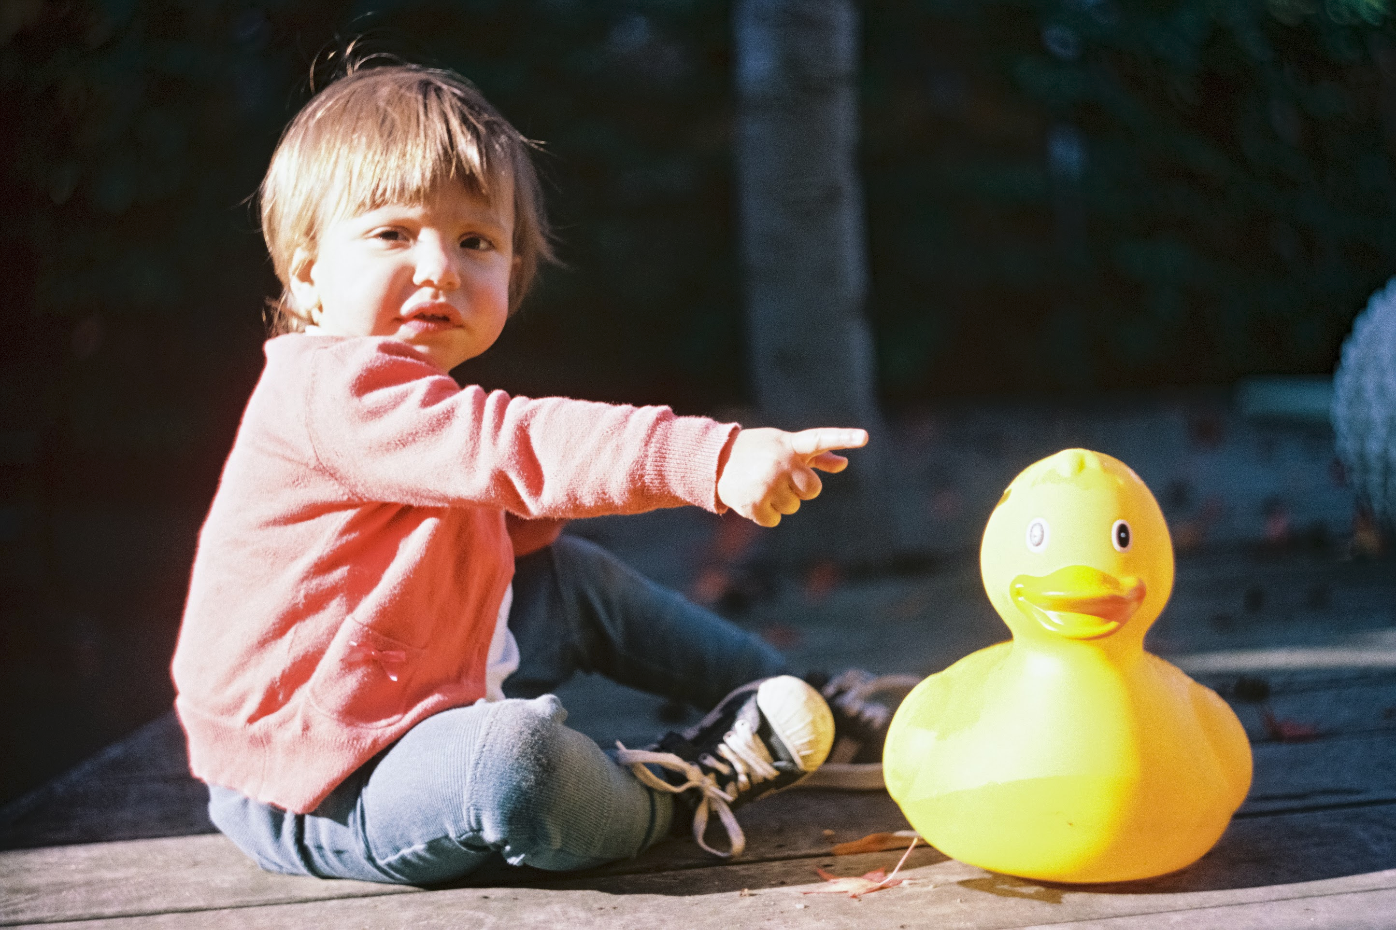
How do children learn a language?
They pick it up by exploiting:
  Language-internal statistics
  Correlations with objects and actions present in scenes co-occurring with speech.
  Clues such as gaze and pointing
  Inferring intentions of speakers
  Questioning
  Other incompletely understood mechanisms

Slide 3
Can we model this computationally?
Some of these mechanisms rely on interaction with competent speakers.
  Modeling this is a difficult open problem.
Some progress on learning from correlations with co-occurring scenes.
  This will be the focus of my talk.

Slide 4
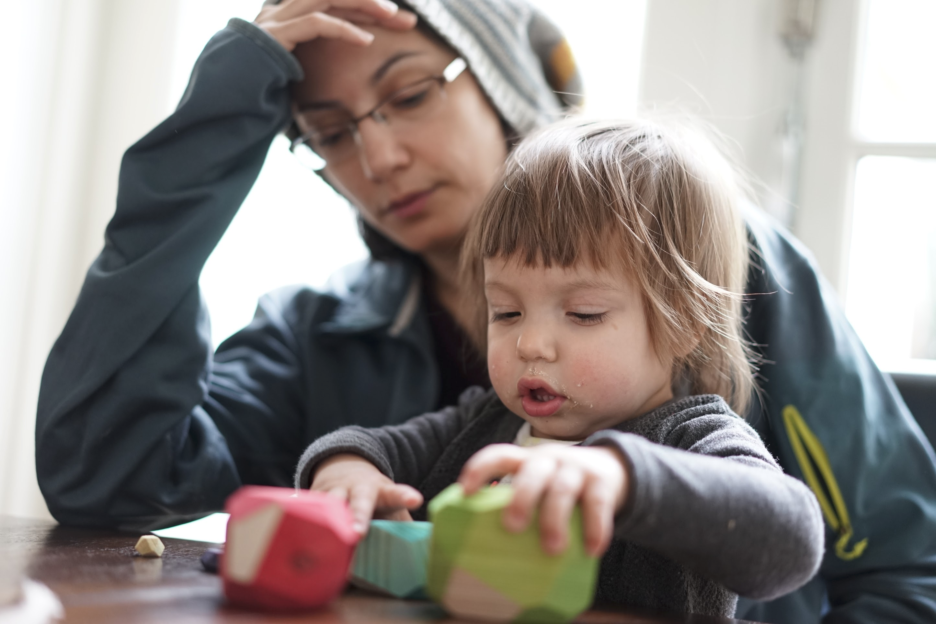
Weak supervision
Scene itself needs to be understood: perception
Correlations are noisy:
  Speaking about things not present
  Speaking only about a subset of what is present
  Only approximate synchronicity between modalities

Slide 5
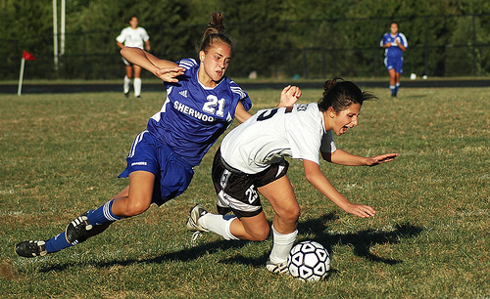
Spoken image captioning
A soccer player in blue is chasing after the player in black-and-white.
The girls are playing soccer.
Flickr Audio Captions. Harwath et al 2015.

Slide 6
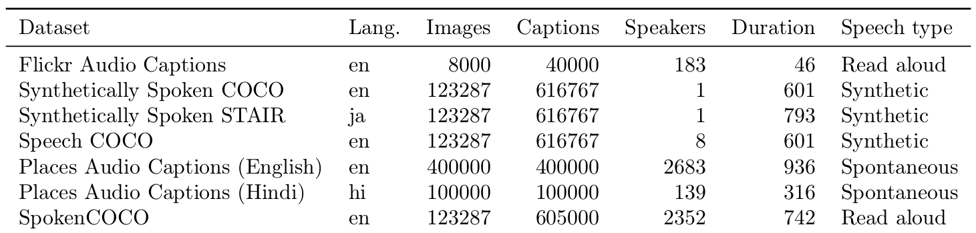
Spoken image captioning

Slide 7
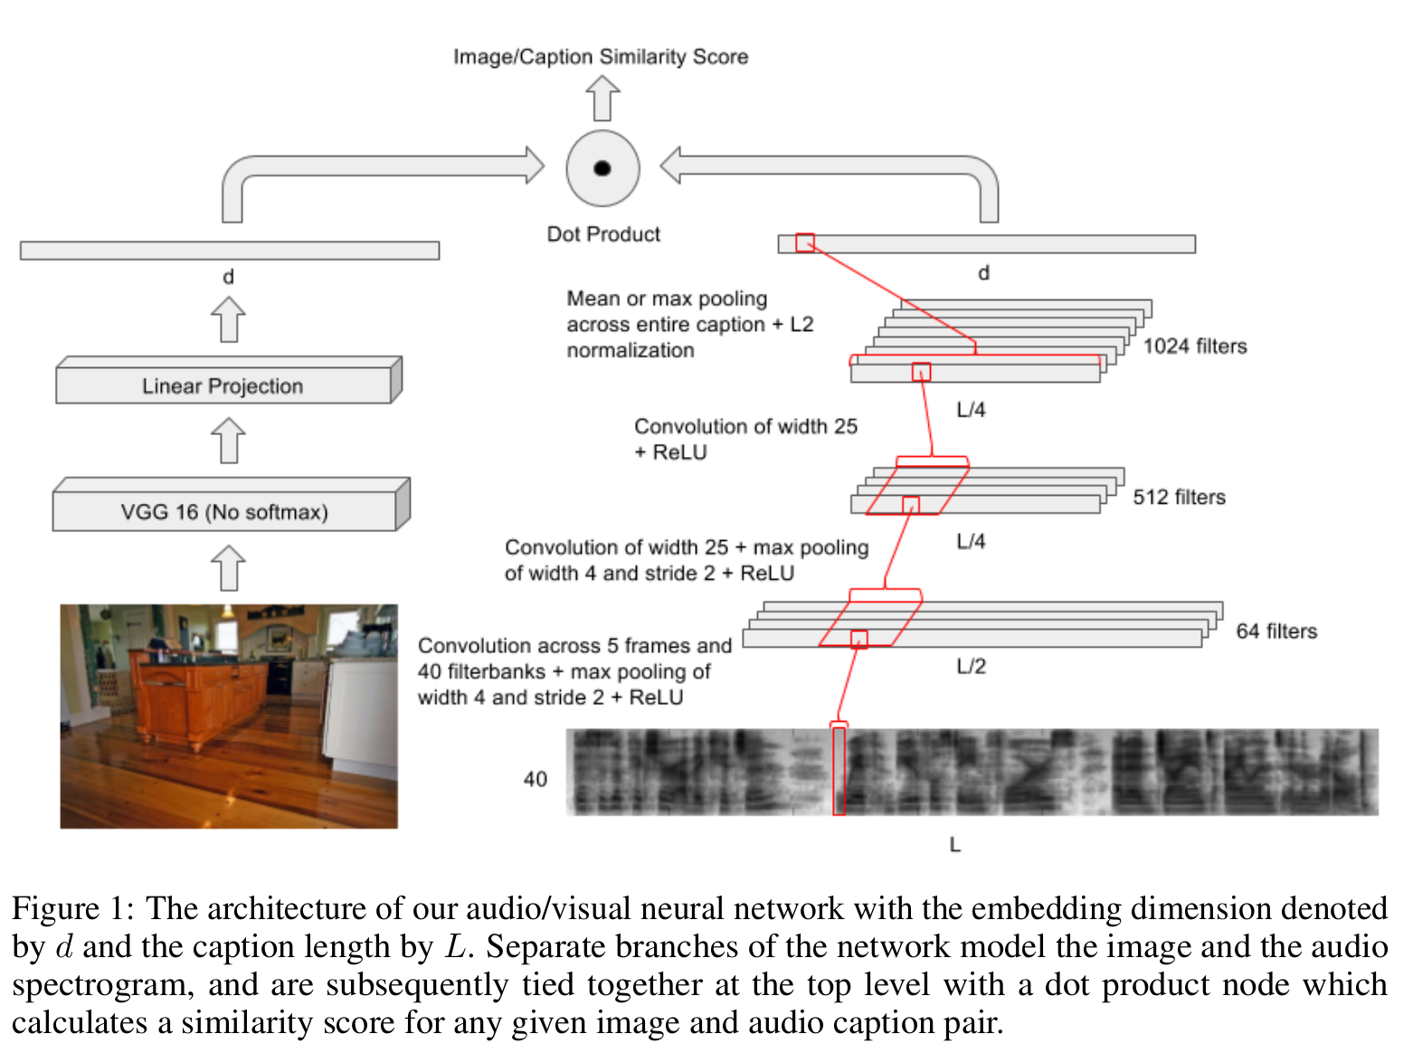
From Harwath et al. 2016

Slide 8
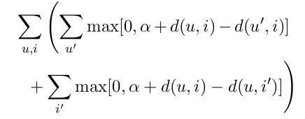
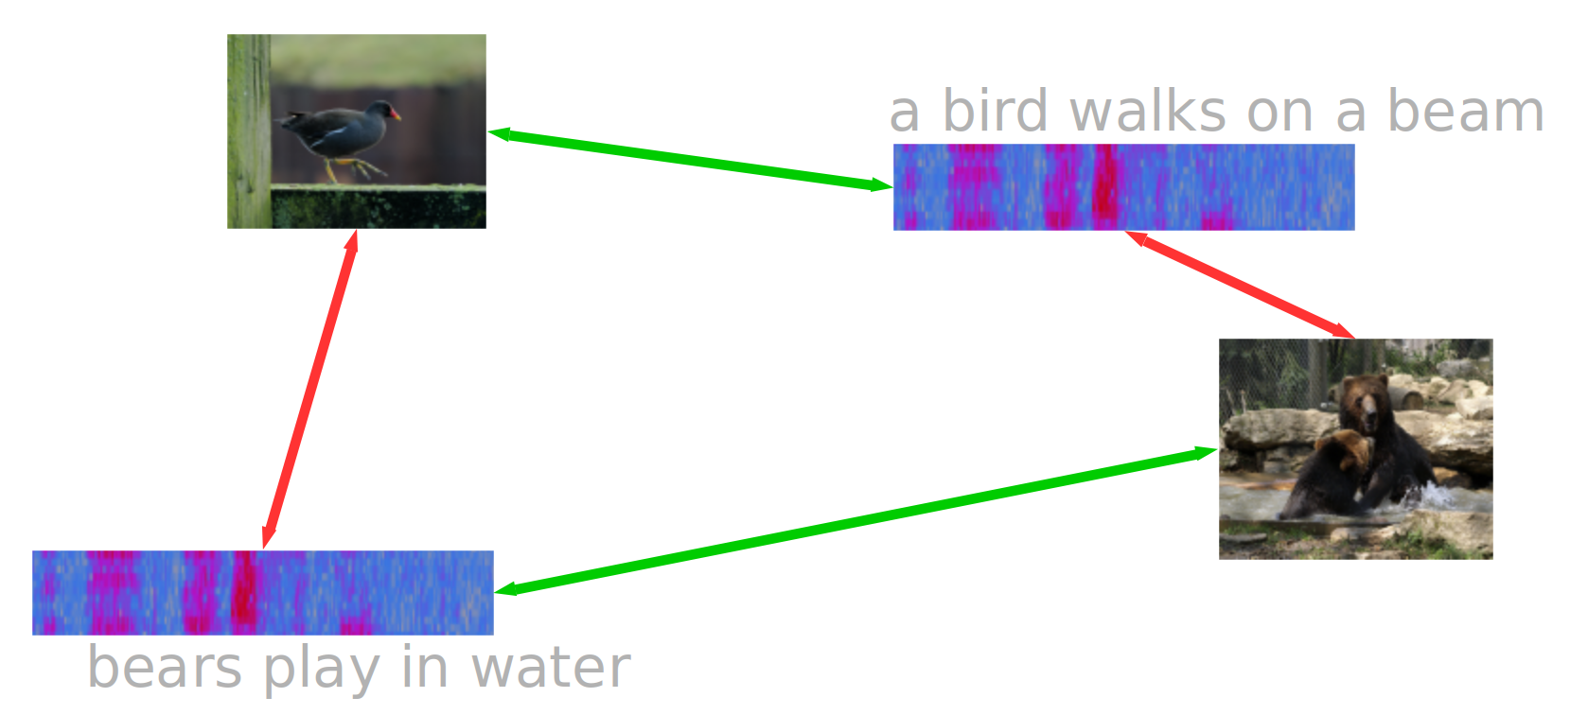
Triplet loss

Slide 9
Evaluation by retrieval
Embed caption
Embed K images
Rank images by distance to caption embedding
Recall @ N: proportion of correct items among top-N ranked

Slide 10
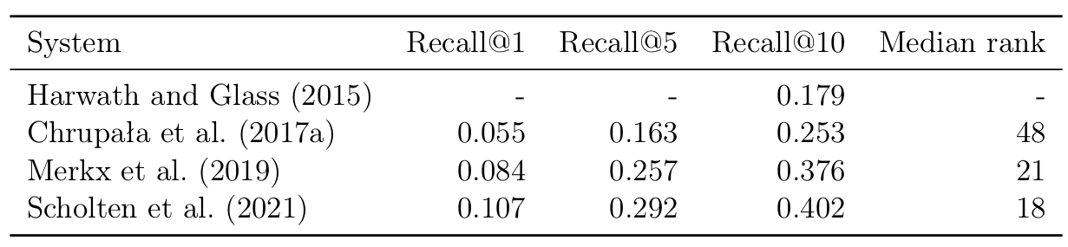
Progress on spoken caption data

Slide 11
Video datasets
Cooking and How-to videos.
Videos with spoken captions
  Spoken Moments in Time - http://moments.csail.mit.edu/spoken.html

Slide 12
Real-world data
A: They are fighting over bread.
C: What?
A: They are fighting over bread.
C: Yeah.

Slide 13
Ecological validity
Image/video captions
Strong correlations between visual scene and the meaning of the utterances.
Few/weak correlations between scene and non-semantic features of the audio.
(speaker voice, emotion, ambient noise)
Real world data
Weaker correlations between visual scene and meaning of the utterances.
Correlations between scene and non-semantic features of the audio are common.

Slide 14
Peppa Pig Cartoons

Slide 15
Peppa Pig Cartoons
Aimed at young children
Simple cartoon graphics
Simple but realistic spoken language
Correlations between speech and visuals tend to be there but less consistent than in captions
Frequent confounds with non-semantic features.

Slide 16
Peppa Pig: dialogs vs narrations
Dialogs
  conversations among cartoon characters
Narrations
  comments by narrator
  often descriptive

Slide 17
Narrations for evaluation
Train on dialogs
Evaluate (mainly) on narrations
  Descriptive (similar to captions)
  Voice held constant
  Less confounding
If model trained on dialogs generalizes to narrations
  Evidence that it’s using semantic features of speech, and doesn’t rely on confounds

Slide 18
Data
Split into dialog and narration carried out by: Papasarantopoulos, N., & Cohen, S. B. (2021). Narration Generation for Cartoon Videos. arXiv preprint arXiv:2101.06803.

Slide 19
Segmentation
Fixed
  Video/Audio clips of 2.3 seconds
  Generalization to other sizes?
Jitter
  Video/Audio clips independently randomly resized around mean=2.3 seconds

Slide 20
Pretraining
Audio
  Unsupervised
  Librispeech
  960 hours of read English speech
Video
  Supervised
  Kinetics-400
  700 human actions
  600K 10s clips

Slide 21
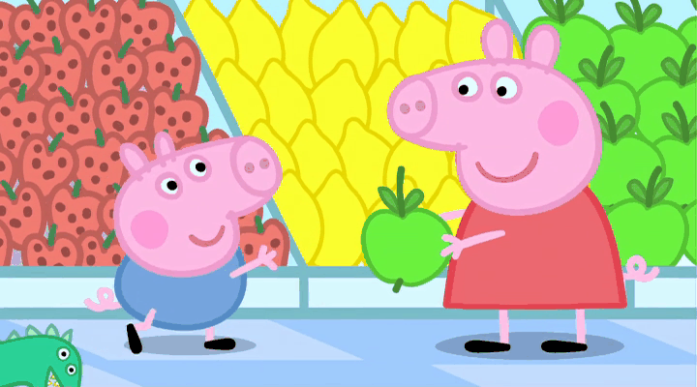

Architecture
LOSS

Slide 22
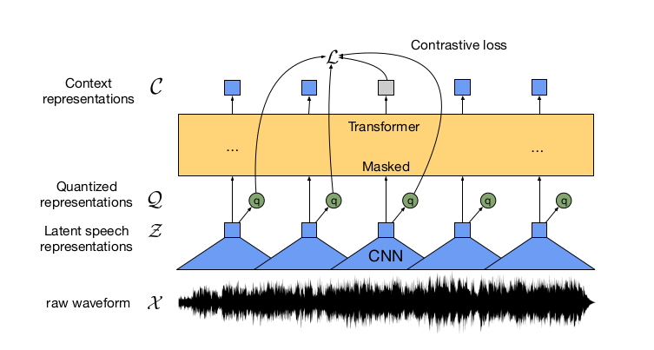
Audio Encoder
Wav2Vec 2.0
Baevski, A., Zhou, Y., Mohamed, A., & Auli, M. (2020). wav2vec 2.0: A framework for self-supervised learning of speech representations. Advances in Neural Information Processing Systems, 33, 12449-12460.

Slide 23
Audio encoder

Slide 24
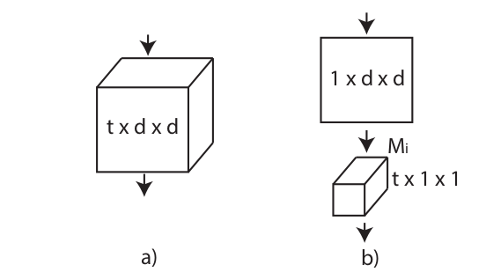
Video Encoder
ResNet (2+1)D
a) 3D convolution
b) (2+1)D convolution
Notes:
The illustration is given for
the simplified setting where the input consists of a spatiotemporal
volume with a single feature channel. (a) Full 3D convolution is
carried out using a filter of size t × d × d where t denotes the tem-
poral extent and d is the spatial width and height. (b) A (2+1)D
convolutional block splits the computation into a spatial 2D con-
volution followed by a temporal 1D convolution. We choose the
numbers of 2D filters (M i ) so that the number of parameters in our
(2+1)D block matches that of the full 3D convolutional block.

Slide 25
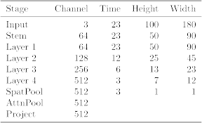
Video Encoder
Tran, D., Wang, H., Torresani, L., Ray, J., LeCun, Y., & Paluri, M. (2018). A closer look at spatiotemporal convolutions for action recognition. In Proceedings of the IEEE conference on Computer Vision and Pattern Recognition (pp. 6450-6459).

Slide 26
Retrieval evaluation
Two conditions
  Fixed: fixed-sized segments
  Jitter: variable-sized segments
  Recall @ 10

Slide 27
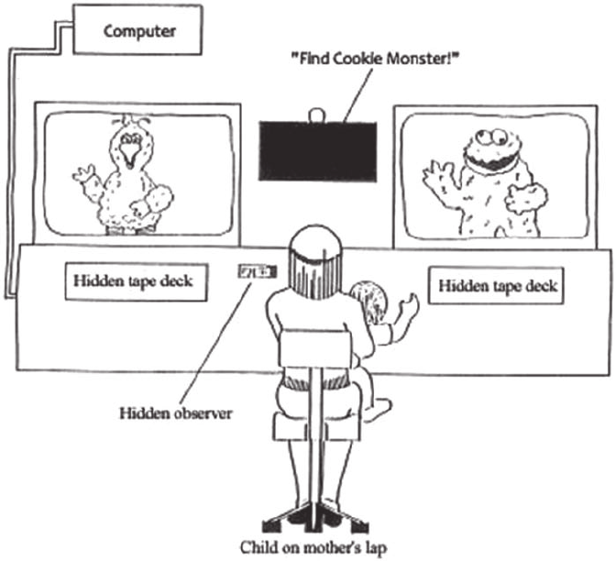
Evaluating Infants’ Language Knowledge
Intermodal Preferential Looking Paradigm
Used to assess childrens’ early semantic and syntactic knowledge
For example: comprehension of first words
Hirsh-Pasek, K., & Golinkoff, R. M. (1996). The intermodal preferential looking paradigm: A window onto emerging language comprehension.

Slide 28
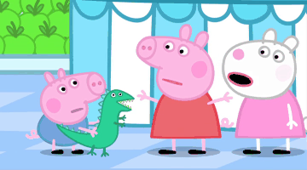
Triplet evaluation
Extract video/audio clips aligned with subtitle lines
Repeat 500 times
  Sample triplets of same length
  Compute success rate: anchor close to positive than negative
Strawberry!

Slide 29
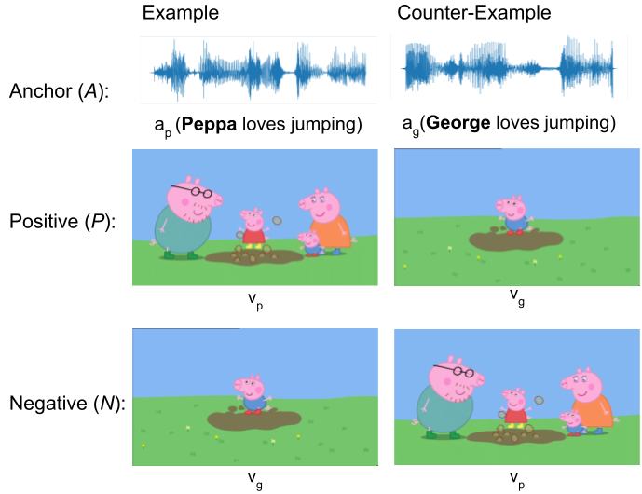
Targeted triplets
As above, but triplets are matched to differ by a single word (via aligned transcriptions).
Allows to partition results by word, grammatical category.

Slide 30
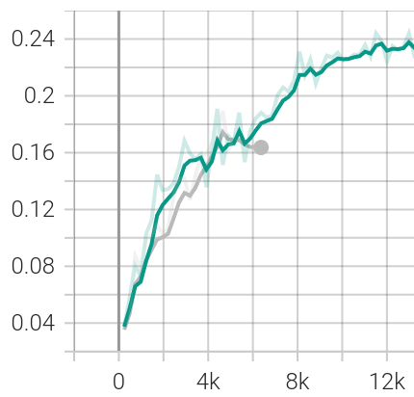
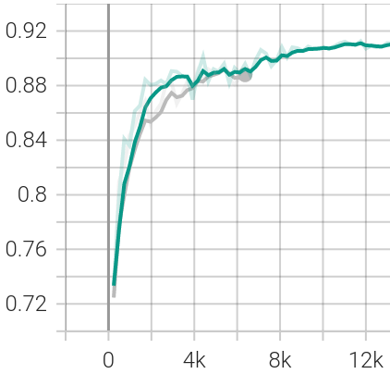
Effect of fixed vs variable size segments
Recall
Triplet
Fixed
Jitter

Slide 31
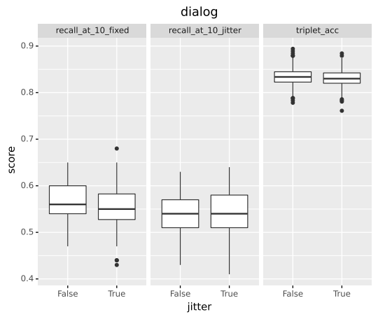
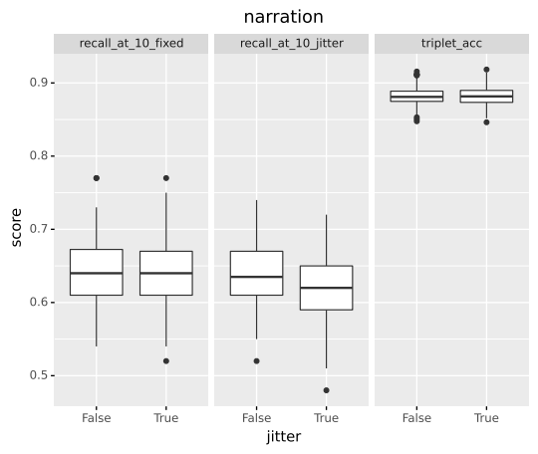
Effect of fixed vs variable size segments

Slide 32
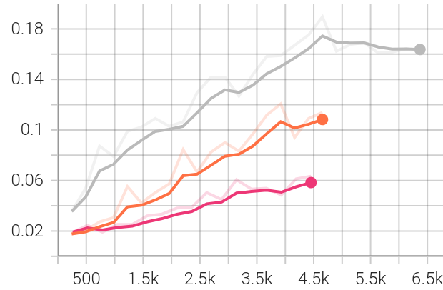
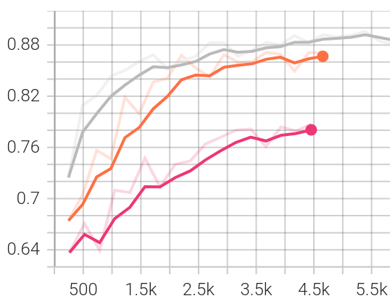
Effect of pretraining
Recall
Triplet
Full pretraining
Audio only
Video only
Notes:
AV - 206974
A - 206975
V - 206976
None - 206977

Slide 33
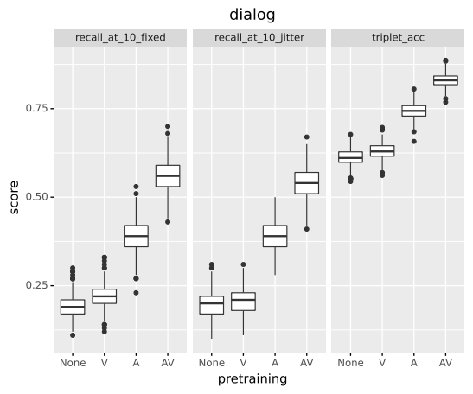
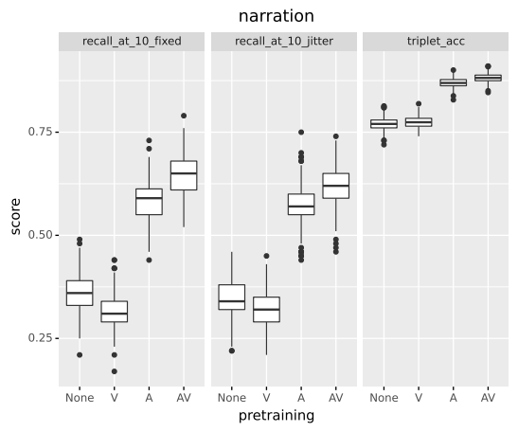
Effect of pretraining
Notes:
AV - 206974
A - 206975
V - 206976
None - 206977

Slide 34
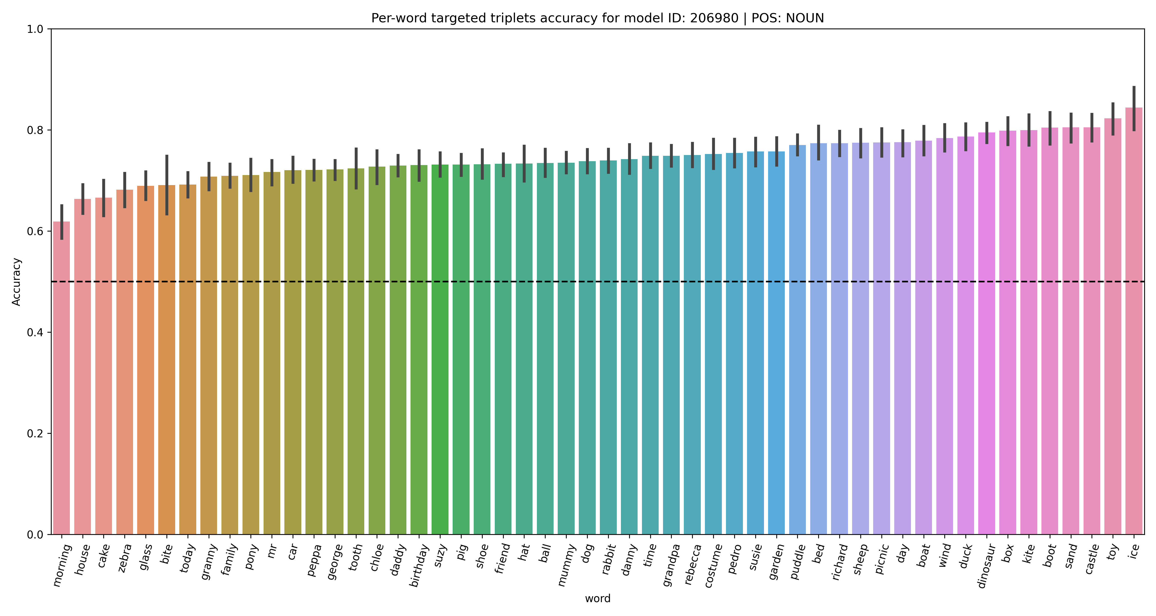
Targeted triplet: Nouns

Slide 35
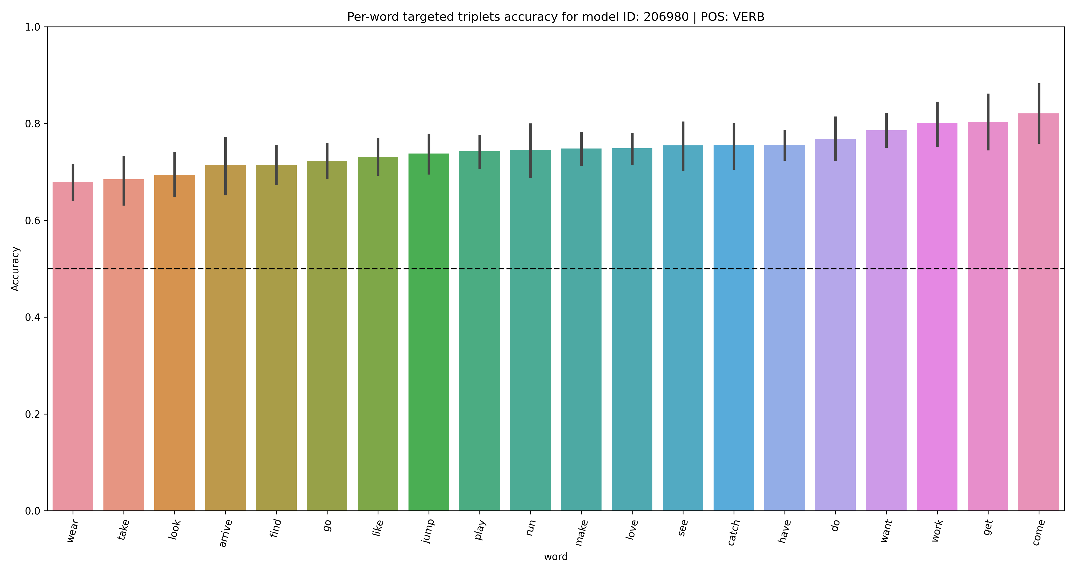
Targeted triplets: Verbs

Slide 36
Further work
Role of temporal video information
  Bag-of-stills baseline
  Effect on language learned
Analysis of representation
  Linguistic vs non-linguistic information

Slide 37
Extras

Slide 38
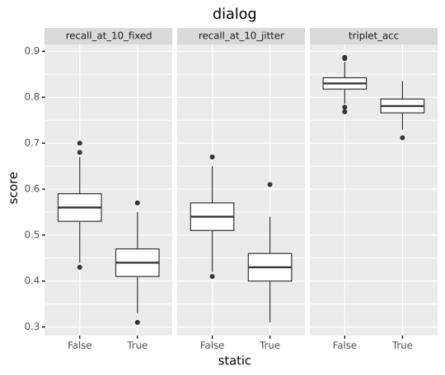
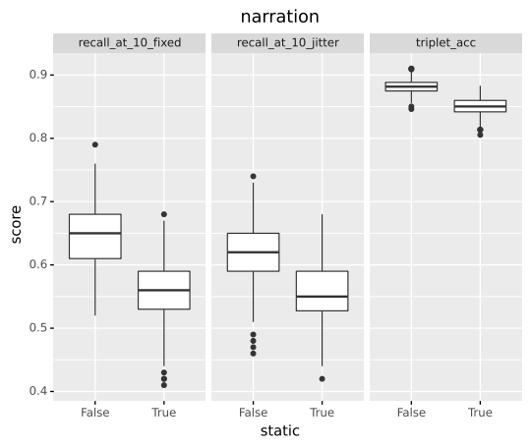
Effect of temporal information

Slide 39
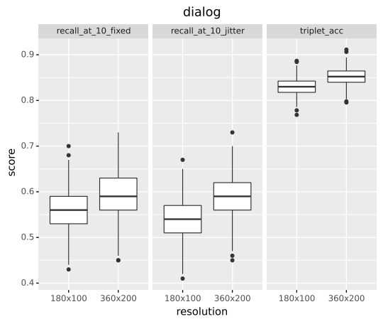
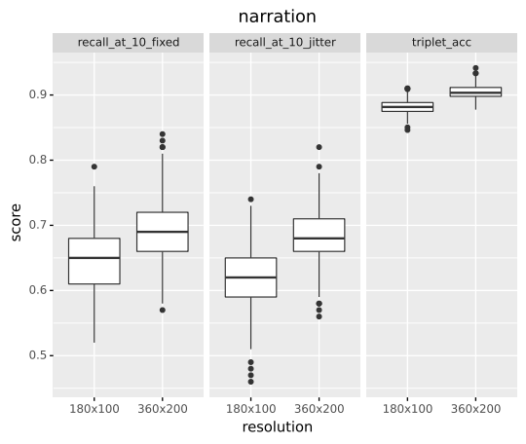
Effect of resolution
Notes:
Low vs hi rez
206974 - edu_206964

