Slide 1
Recurrent Neural Networks
Deep Learning
Grzegorz Chrupała
@gchrupala

Slide 2
Artificial neural networks
Can learn non-linear decision boundaries
  and approximate any computable function
Learn intermediate representations
(Vast topic – we only scratch the surface)

Slide 3
Perceptron

Slide 4
Logistic regression

Slide 5
Neural network
(Multilayer perceptron)
Input layer
Hidden layer
Output layer

Slide 6
Size of input
MLP takes a fixed sized vector, and maps it to a value or another vector
Can we deal with variable-size inputs?
  Images
  Base sequence in DNA
  Speech signal

Slide 7
Long distance dependencies
The ratio of men who survive to the women and children who survive is/are not clear in this story.
The idea she forgot she had said she hated. [What’s the object of hate?]

Slide 8
Can such dependencies be captured with a convolution?

Slide 9
Recurrent networks
Dynamic hidden layer(s) evolve in time
Weights are shared at each time-step

Slide 10
Unrolled graph
t
t+1
t+2

Slide 11
Simple Recurrent Nets
W: hidden-to-hidden connections
U: input-to-hidden connections

Slide 12
SRN aka Elman net
Elman, J. L. (1990). Finding structure in time. Cognitive science, 14(2), 179-211.
Elman, J. L. (1991). Distributed representations, simple recurrent networks, and grammatical structure. Machine learning, 7(2-3), 195-225.

Slide 13
Predicting next step
Elman used this network to simulate sequence processing
Network was shown part of the sequence and had to predict next element

Slide 14
Output
SRN as is has no output
Let’s modify it to make predictions

Slide 15
Predicting next step
Predicted
?
Real

Slide 16
SRN with an output at each time step
V are hidden-to-output weights
a is an activation function
What should a be, supposing the target is
  Boolean value (0 or 1)
  Value between (-1,1)
  Any real-valued number

Slide 17
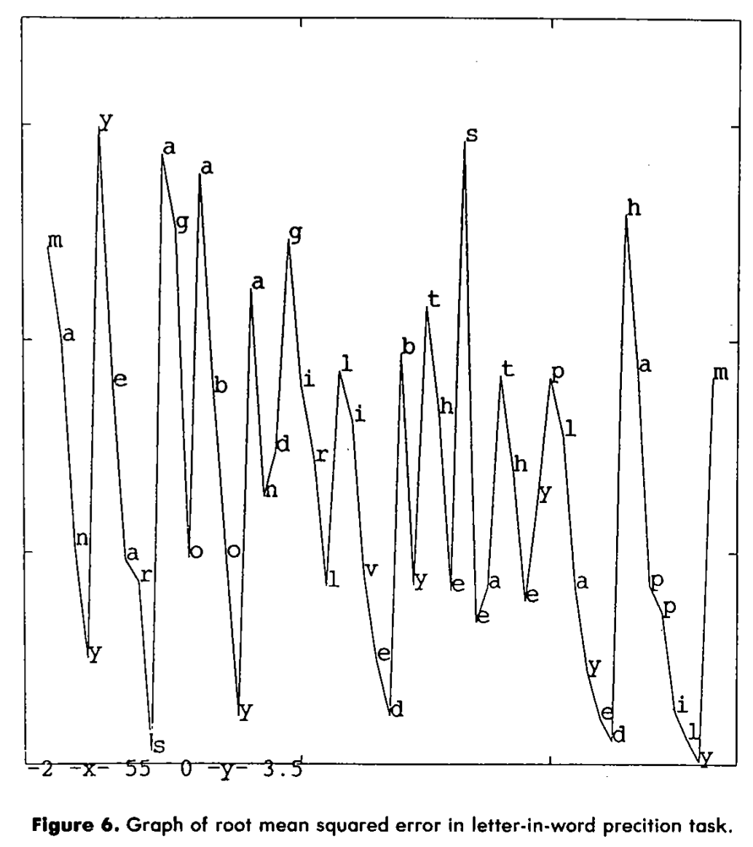
Predicting letters
At each point network is trying to predict what comes next
Y-axis shows RMSE
What pattern do you see?
Elman, J. L. (1990). Finding structure in time. Cognitive science, 14(2), 179-211.

Slide 18
Self-supervision
By predicting what comes next, we get supervision for free
The activations in the hidden layer can be interesting (and useful)

Slide 19
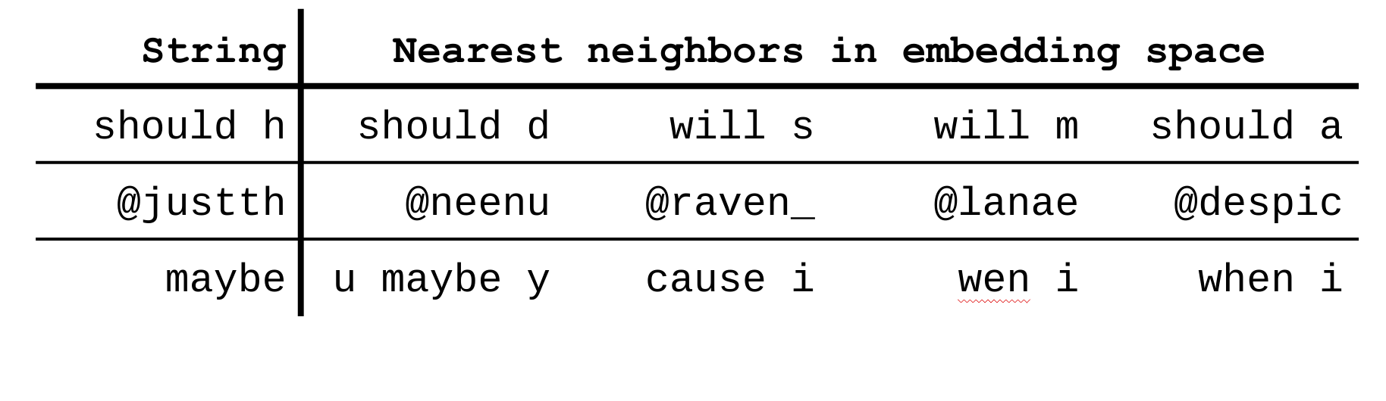
Letter prediction SRN trained on Twitter
Chrupała, G. (2014). Normalizing tweets with edit scripts and recurrent neural embeddings. In Proceedings of the 52nd Annual Meeting of the Association for Computational Linguistics (Vol. 2, pp. 680-686).

Slide 20
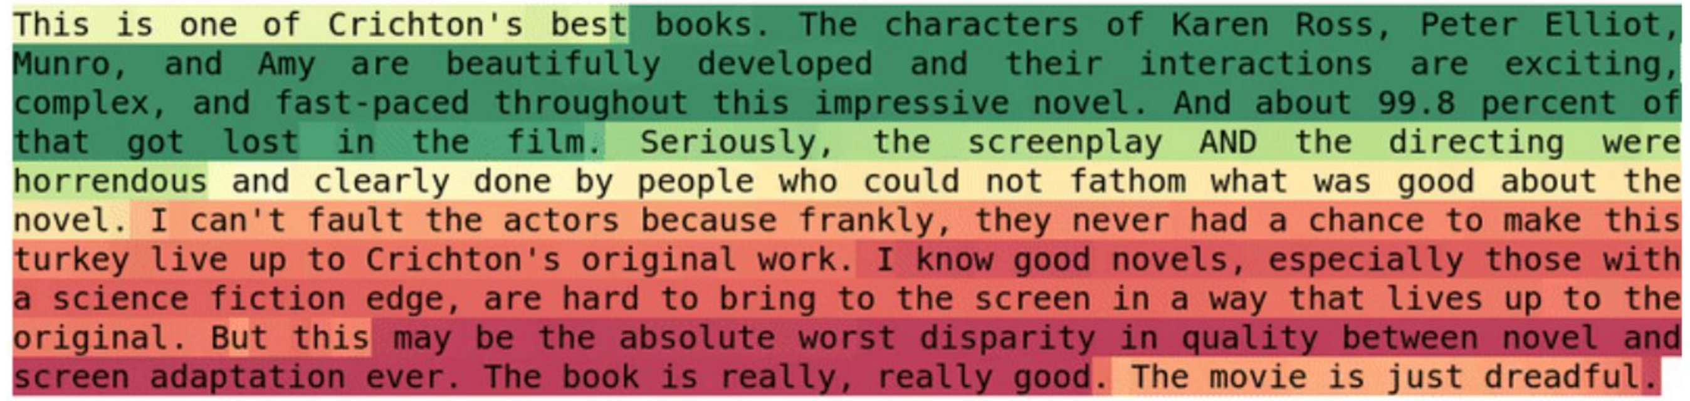
Letter prediction RNN trained on Amazon reviews
Activation of a neuron at each point in text
Radford, A., Jozefowicz, R., & Sutskever, I. (2017). Learning to Generate Reviews and Discovering Sentiment. arXiv preprint arXiv:1704.01444.

Slide 21
How could such representations be useful?

Slide 22
Representation learning
Such representations can be learned from large amounts of data with self-supervision
And used as features in supervised classification tasks:
  Text segmentation
  Tweet normalization
  Sentiment classification

Slide 23
Other RNN architectures
What changes do we need to model:
  Sentiment classification
  Translation

Slide 24
Sentiment classification
this
movie
sucks

Slide 25
Neural Mchine Translation
Encoder-decoder architecture
Sequence-to-sequence architecture

Slide 26
ce
film
est
nul
this
movie
sucks

Slide 27
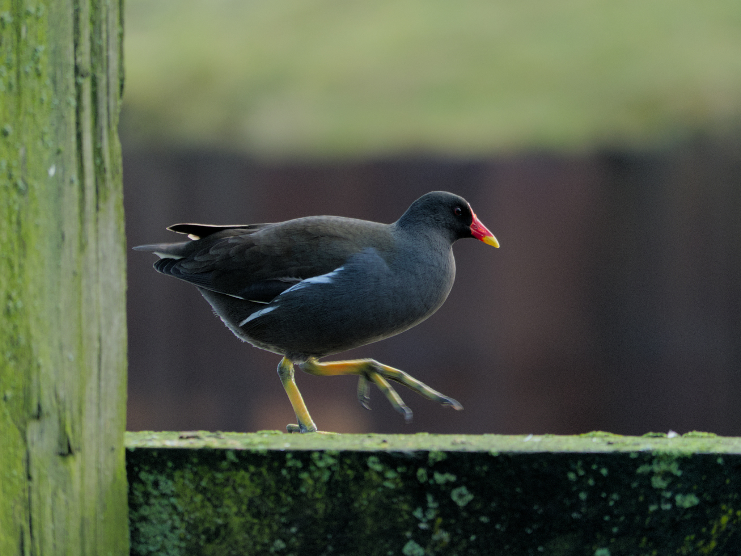
Caption generation
What would the architecture look like?
A funny bird

Slide 28
A
funny
bird
Recurrent
network
Convolutional
network

Slide 30
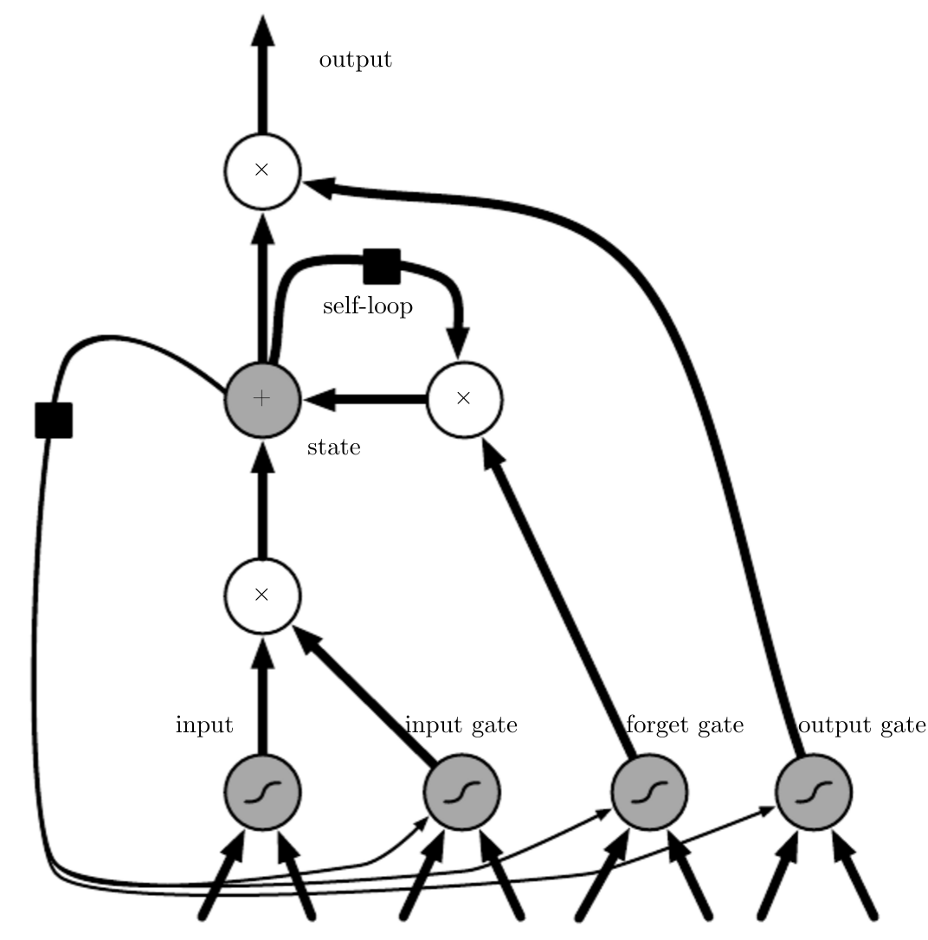
Long Short-Term Memory
Hochreiter, S., & Schmidhuber, J. (1997). Long short-term memory. Neural computation, 9(8), 1735-1780.
See Hinton explain: https://www.youtube.com/watch?v=lsV5rFbs-K0&list=PLnnr1O8OWc6YM16tj9pdhBZOS9tDktNrx&index=5
Graph: http://www.deeplearningbook.org/contents/rnn.html

Slide 31
Minimal Gated Unit

Slide 33




Specificity of neurons

