Slide 1
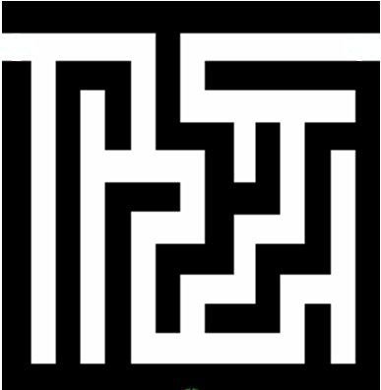
Backtracking: Idea
Backtracking is a technique used to solve problems with a large search space, by systematically trying and eliminating possibilities.
A standard example of backtracking would be going through a maze.
At some point, you might have two options of which direction to go:
Portion A
Junction
Portion B

Slide 2
Backtracking
One strategy would be to try going through Portion A of the maze.
If you get stuck before you find your way out, then you "backtrack" to the junction.
At this point in time you know that Portion A will NOT lead you out of the maze,
so you then start searching in Portion B
Junction
Portion B
Portion A

Slide 3
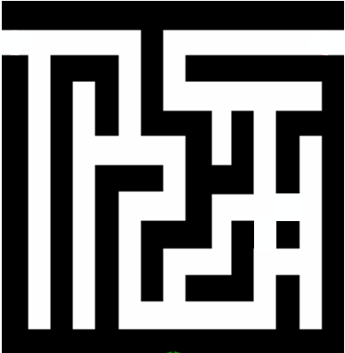
Backtracking
Clearly, at a single junction you could have even more than 2 choices.
The backtracking strategy says to try each choice, one after the other,
if you ever get stuck, "backtrack" to the junction and try the next choice.
If you try all choices and never found a way out, then there is no solution to the maze.
Junction
C
B
A

Slide 4
Backtracking-Simulation
dead end
?
dead end
dead end
?
start
?
?
dead end
dead end
?
success!

Slide 5
Backtracking
Dealing with the maze:
From your start point, you will iterate through each possible starting move.
From there, you recursively move forward.
If you ever get stuck, the recursion takes you back to where you were, and you try the next possible move.
Make sure you don't try too many possibilities,
Mark which locations in the maze have been visited already so that no location in the maze gets visited twice.
If a place has already been visited, there is no point in trying to reach the end of the maze from there again.

Slide 6
Backtracking- Key Points
The neat thing about coding up backtracking is that it can be done recursively, without having to do all the bookkeeping at once.
Instead, the stack of recursive calls does most of the bookkeeping (i.e., keeps track of which locations we’ve tried so far.)
Backtracking is really just depth-first search on an implicit graph of configurations.
Backtracking can easily be used to iterate through all subsets or permutations of a set.
Backtracking ensures correctness by enumerating all possibilities.
For backtracking to be efficient, we must prune the search space.

Slide 7




Backtracking Algorithm for Rat in a Maze
Define Recursive Function
Explore Possible Moves
Define a function that explores paths and backtracks when necessary.
Discuss how the algorithm tries moving in all possible directions to find the right path.
Mark the Path and Backtrack
Visual Representation
Emphasize the importance of marking the path and undoing marks during backtracking for methodical navigation.
Show step-by-step visuals of the algorithm in action to aid understanding.

Slide 8
Rat in a Maze - Code Snippet
Consider a rat placed at (0, 0) in a square matrix of order N * N. It has to reach the destination at (N – 1, N – 1). Find all possible paths that the rat can take to reach from source to destination. The directions in which the rat can move are ‘U'(up), ‘D'(down), ‘L’ (left), ‘R’ (right). Value 0 at a cell in the matrix represents that it is blocked and rat cannot move to it while value 1 at a cell in the matrix represents that rat can be travel through it.
Step-by-step approach:
Create isValid() function to check if a cell at position (r, c) is inside the maze and unblocked.
Create findPath() to get all valid paths:
Base case: If the current position is the bottom-right cell, add the current path to the result and return.
Mark the current cell as blocked.
Iterate through all possible directions.
Calculate the next position based on the current direction.
If the next position is valid (i.e, if isValid() return true), append the direction to the current path and recursively call the findPath() function for the next cell.
Backtrack by removing the last direction from the current path.
Mark the current cell as unblocked before returning.

Slide 9
Applications of Maze Solving Approach
Robotics:
Autonomous robots often use maze-solving algorithms to navigate through unknown environments. This is crucial for tasks like exploration, search and rescue missions, and automated warehouse systems.
Computer Games/ Puzzle Solving :
Maze-solving algorithms are frequently used in the development of computer games, particularly in designing levels and creating challenging environments for players.
Path Planning/ Network Routing :
Beyond mazes, these algorithms are applied to more complex path-planning problems in fields such as logistics, transportation, and traffic management and to find the most efficient path for data transmission in a network.
Artificial Intelligence and Machine Learning:
Maze-solving problems are often used as benchmarks or exercises in AI and machine learning courses. Reinforcement learning algorithms, for example, can be trained to solve mazes as part of their learning process.
Maze Generation:
Algorithms used for maze solving can also be applied to generate interesting and challenging mazes for entertainment purposes, such as in video games or puzzles.
Telecommunications:
Maze-solving principles are applicable in optimizing the routing of signals in telecommunications networks, helping to ensure efficient data transmission.
Circuit Design:
In electronic design automation, maze-solving algorithms can be used for optimizing the layout of components on a circuit board to minimize signal interference and improve overall performance.

Slide 10
N Queens Problem
Base Case: In the N-Queens problem, the base case occurs when all queens are successfully placed on the board without conflicting with each other.
Constraint Satisfaction: The constraint is that no two queens can share the same row, column, or diagonal. Ensuring that each queen is placed in a position that satisfies these constraints is crucial.
Decision Space: At each step, we need to decide the row where the next queen will be placed. The decision space consists of the remaining rows that are not threatened by the already placed queens.
Solution Space: The solution space for the N-Queens problem is the set of all possible arrangements of queens on the chessboard. The size of the solution space is N! since there are N choices for the queen's position in the first row, N−1 choices for the second row, and so on.
Optimization: Backtracking can be optimized by pruning the search space whenever a conflict is detected. If placing a queen at a certain position leads to a conflict, there's no need to explore further from that position.

Slide 11
N Queens Problem
Loop Conditions: The backtracking algorithm should iterate over all possible positions for placing the next queen within the constraints of the problem.
Resource Constraints: The N-Queens problem may have resource constraints such as memory usage (especially for large N) and time complexity. Efficient data structures and pruning techniques help manage these constraints.
Corner Cases: Corner cases in the N-Queens problem may include scenarios where N=0 or N=1, where there are no valid solutions since there are no queens to place or only one queen on the board, respectively.
Backtracking Strategies: In the N-Queens problem, depth-first search (DFS) is commonly used, where we explore each possible position for the next queen recursively until a solution is found or all possibilities are exhausted.
Early Termination: If we detect that it's impossible to place N queens on the board due to conflicts, we can terminate the backtracking process early, saving computational resources.

Slide 12
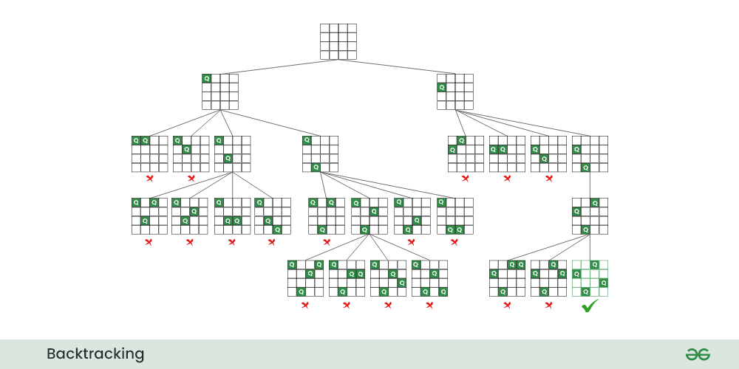

Slide 13
1) Start in the leftmost column
2) If all queens are placed
return true
3) Try all rows in the current column. Do following
for every tried row.
a) If the queen can be placed safely in this row
then mark this [row, column] as part of the
solution and recursively check if placing
queen here leads to a solution.
b) If placing queen in [row, column] leads to a
solution then return true.
c) If placing queen doesn't lead to a solution
then unmark this [row, column] (Backtrack)
and go to step (a) to try other rows.
4) If all rows have been tried and nothing worked,
return false to trigger backtracking.

