Slide 1

Application Based Programming
In Python
CSE114/CSP114
B.Tech
2402 Term, January-2025
Functions : Defining a function, Calling a function, Types of functions, Function Arguments
Faculty:
Mr. Anuj Gupta
Department of Computer Science and Engineering
School of Engineering and Technology, Sharda University

Slide 2
Object Oriented Programming
Object Oriented Programming is a fundamental concept in Python, empowering developers to build modular, maintainable, and scalable applications.
By understanding the core OOP principles (classes, objects, inheritance, encapsulation, polymorphism, and abstraction), programmers can leverage the full potential of Python OOP capabilities to design elegant and efficient solutions to complex problems.
OOPs is a way of organizing code that uses objects and classes to represent real-world entities and their behavior.
In OOPs, object has attributes thing that has specific data and can perform certain actions using methods.

Slide 3
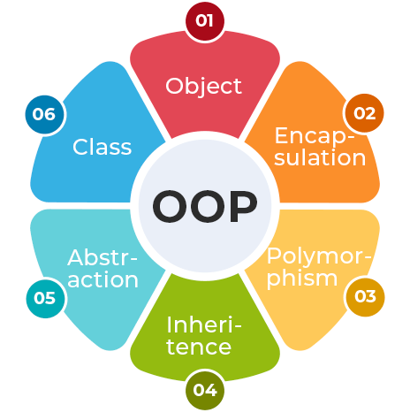
OOPs Concepts in Python
Class in Python
Objects in Python
Polymorphism in Python
Encapsulation in Python
Inheritance in Python
Data Abstraction in Python

Slide 4
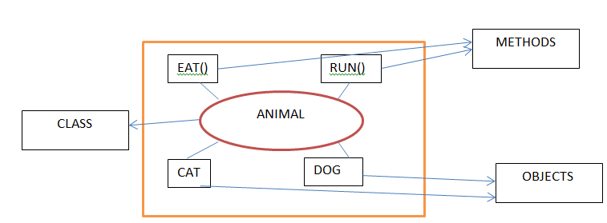
Class
Collection of objects is called class.
It is a logical entity. It can't be physical.
Almost everything in Python is an object, with its properties and methods.
A class is a group of objects which have common properties.
A Class is like an object constructor, or a "blueprint" for creating objects.
Class doesn't consume any space.
A class in Java can contain:
Fields
Methods
Constructors
Blocks
Nested class and interface

Slide 5
Class
Some points on Python class:
Classes are created by keyword class.
Attributes are the variables that belong to a class.
Attributes are always public and can be accessed using the dot (.) operator. Example: Myclass.Myattribute
class MyClass:
x = 5
p1 = MyClass()
print(p1.x)

Slide 6
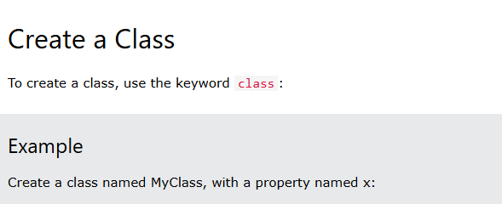

Slide 7
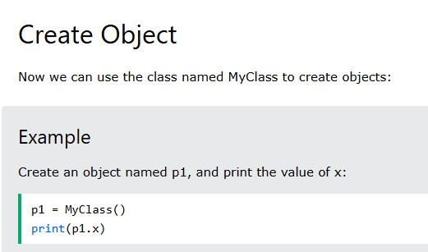

Slide 8
The __init__() function
All classes have a function called __init__(), which is always executed when the class is being initiated.
Use the __init__() function to assign values to object properties, or other operations that are necessary to do when the object is being created.

Slide 9
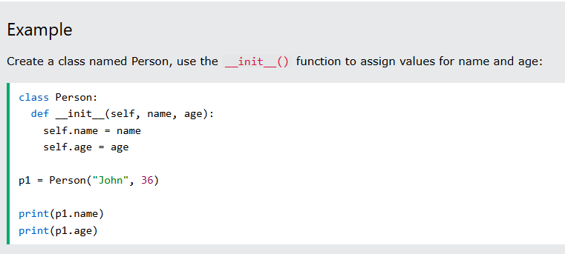


Slide 10
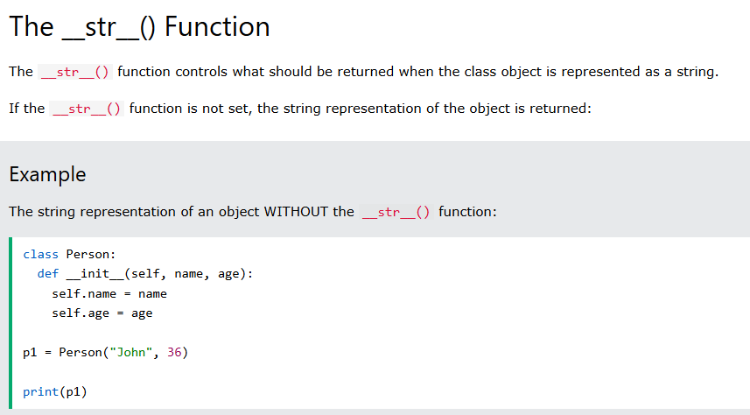


Slide 11
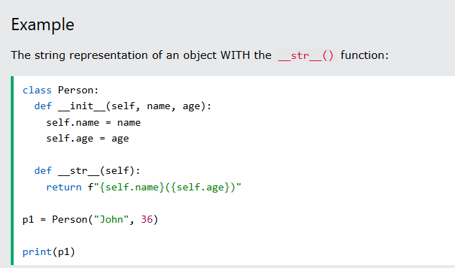


Slide 12
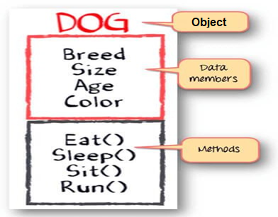
Object
• Object means a real-world entity such as a pen, chair, table, computer, watch, etc.
• Any entity that has state and behaviour is known as an object.
• It can be physical or logical.
• An Object can be defined as an instance of a class.
• An object contains an address and takes up some space in memory.

Slide 13


