Slide 1
Causal inference with observational data in addiction research Propensity score matching in the presence of missing data using R
Dr. Gary Chan StatsNotebook.io National Centre for Youth Substance Use Research, University of Queensland

Slide 3
Software for today’s workshop
R
RStudio
StatsNotebook (Windows only)

Slide 4
Disclaimer
No statistical methods can replace good study design.
Application of causal models do not guarantee that you can make causal claims (and most of the time, you CANNOT make causal claims).
Causal inference using observational data can only be made under certain assumptions
Use of certain statistical method is more likely to let you draw valid causal inference.

Slide 5
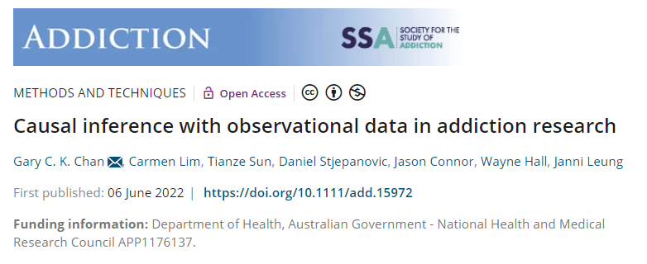
Methods paper in Addiction
Potential outcome/ Counterfactual framework
Matching
Propensity score
Inverse probability treatment weighting
Marginal structural model
Interrupted time series with controls

Slide 6
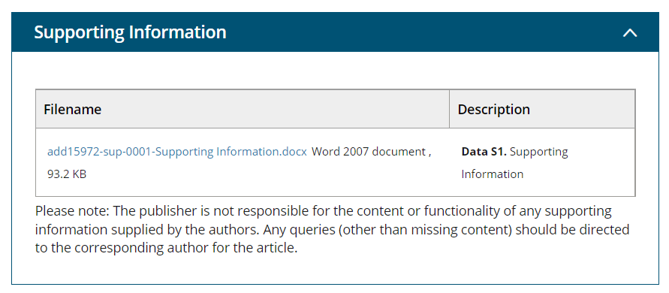
Download the appendix of this paper
https://onlinelibrary.wiley.com/doi/10.1111/add.15972

Slide 7
Correction
Appendix 4. p.17 plot <- ggplot() + geom_point(data = alc_mup_data, aes(y = alcohol, x = time, color = state)) + geom_line(data = alc_mup_data, aes(y = predicted, x = time, color = state, group = groups)) + geom_vline(xintercept = max((alc_mup_data %>% filter(intervention == "0"))$time), linetype = "dashed") + theme_bw(base_family = "sans") + theme(legend.position = "bottom") plot
Appendix 3. p.10 (Not covered today) alc_iptw <- iptw(list(home_alc_2 ~ home_alc_1 + alc_use1 + alc_peer1 + smk1, home_alc_3 ~ alc_use2 + alc_peer2 + smk2, home_alc_4 ~ alc_use3 + alc_peer3 + smk3 ), timeInvariant ~ sex, data = as.data.frame(alc_data), cumulative = TRUE, priorTreatment = TRUE, stop.method = "es.max", n.trees = 10000)

Slide 9
Propensity score matching

Slide 10
RCTs
Randomized controlled trial is the gold standard for establishing causal relationship
Participants are assigned randomly into receiving treatment or not receiving treatment (For the rest of the talk, I will use the term “treatment”, “exposure” and “intervention” interchangeably).
Participant characteristics (both measured and unmeasured) in treatment and control condition are similar.
Randomization removes all confounding.
Overall, only difference between two group of participants will be whether they receive treatment.

Slide 11
RCTs
Randomized controlled trial is the gold standard for establishing causal relationship
Participants are assigned randomly into receiving treatment or not receiving treatment (For the rest of the talk, I will use the term “treatment”, “exposure” and “intervention” interchangeably).
Participant characteristics (both measured and unmeasured) in treatment and control condition are similar.
Randomization removes all confounding.
Overall, only difference between two group of participants will be whether they receive treatment.

Slide 12
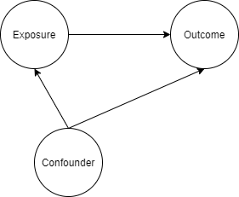
Confounding
A confounder is a variable that influences both the outcome and exposure (More about confounding in second section of this presentation).

Slide 13


Confounding
Ice cream sales is strongly associated with shark attack.

Slide 14

Confounding
Ice cream sales is strongly associated with shark attack.

Slide 15

Potential outcomes/ Counterfactual framework
Two treatment conditions: Treatment ($A=1$) and control ($A=0$).
For an individual $i$, there would be two potential outcomes: $Y_{i}^{A=1}$and $Y_{i}^{A=0}$
The individual causal effect of the treatment: $Y_{i}^{A=1}{− Y}_{i}^{A=0}$
Only one of the outcomes is observed.

Slide 16


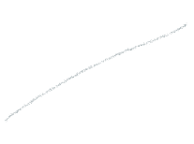












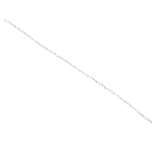

What could have happened should this participant not received treatment
Participant
Individual causal effect of treatment: Difference between these two potential outcomes
Challenge:
Only one of these outcomes can be observed
What could have happened should this participant received treatment

Slide 17

What could have happened should all participants not received treatment
Average Treatment Effect (ATE):
Average difference between these two potential outcomes in the study population
What would have happened in the population should the whole population received treatment vs the whole population not received treatment
Classical treatment effect estimated from RCT
Participants
Statistical solution:
Some of the participants received treatment
Some didn’t
ATE can be estimated
What could have happened should all participants received treatment

Slide 18

What could have happened should those participants who received treatment not received treatment
This is a counterfactual outcome.
Average Treatment Effect on the Treated (ATT):
Average difference between the outcome of those who were treated and the counterfactual outcome of what would have happened should these participants not received treatment
Participants
Statistical solution:
Some of the participants received treatment
Some didn’t
ATT can be also estimated
In RCT, ATT and ATE are the same.
What happen to participants who received treatment

Slide 19
RCTs
May lack generalizability
RCTs are often conducted in highly controlled environment that do not resemble any real-life circumstances.
Not always feasible, particularly regarding questions of harm
Does smoking cause cancer?
Does cannabis use cause psychosis?
Not suitable for studying sustained exposure over a long period of time and long-term outcome
Does daily smoking over 10 years cause cancer?
Does heavy cannabis use during adolescence increase risk of psychosis in mid-adulthood?

Slide 20
Observational study
Provides “real world evidence”
Cancer outcome among smokers and non-smokers
Psychosis among cannabis users and non-users
Biggest threat for causal inference
Confounding
Systematic difference between those who were under “treatment” condition (i.e. smoking and using cannabis) and “control” condition
E.g. factors that predisposed individual to unhealthy habits that lead to smoking and long-term adverse health outcome (e.g. Socioeconomic disadvantage?)

Slide 21
Propensity Score Matching
Emulate a RCT where confounding factors are balanced between treatment and control condition
In a RCT, all potential confounding factors are balanced between treatment and control condition due to randomization.
In RCT, ATT and ATE are the same
In observational study, they could be different
Need to decide what to estimate
ATE: More appropriate for treatment that targets the whole population
Distributing information flyer to smokers for smoking cessation
ATT : More appropriate for treatment that is more individualized, or has higher access barrier
Intensive, structured smoking cessation program

Slide 22
Propensity Score Matching
Matching can be used to estimate ATT and ATE, but is commonly used to estimate ATT.
Will focus on ATT in this talk.
Two steps
For each treated participant, match this participants with an untreated participant who has very similar characteristics
The matched sample can now be analysed as if the data is from a RCT, with adjustment for standard error to adjust for the potential bias introduced in the matching process.

Slide 23
Propensity Score Matching
Matching can be used to estimate ATT and ATE, but is commonly used to estimate ATT.
Will focus on ATT in this talk.
Two steps
For each treated participant, match this participants with an untreated participant who has very similar characteristics
The matched sample can now be analysed as if the data is from a RCT, with adjustment for standard error to adjust for the potential bias introduced in the matching process.

Slide 24
Propensity score matching
Propensity score can be considered as the probability of receiving treatment, calculated based on a range of covariates (potential confounders)
Can be estimated using logistic regression or non-parametric machine learning method

Slide 25

Participants from an observational study

Slide 26
Participants from an observational study

Slide 27
Propensity score matching
What is the effect of smoking on psychological distress?
The demographic of smokers and non-smokers are often very different
The association could be confounded by
Education level
Socio-economic status
And many other factors
If we are able to perform a RCT, we would randomised participants into “smoking” and “non-smoking” condition, and measure their psychological distress at a certain time point.
Randomisation will ensure that education level, SES and other variables are balanced between the smoking and non-smoking group.

Slide 28
Observational study
Propensity Score Matching
 | Unmatched sample mean |  |  | Matched sample mean
 | Smoke (N = 974) | Not smoke (N = 7026) | Standardised mean difference | Smoke (N = 974) | Not smoke (N = 974) | Standardised mean difference
Male | 0.494 | 0.442 | 0.104 | 0.494 | 0.475 | 0.037
Indigenous status | 0.052 | 0.018 | 0.157 | 0.052 | 0.048 | 0.018
Finished high school | 0.422 | 0.638 | -0.437 | 0.422 | 0.436 | -0.029
Partnered | 0.463 | 0.691 | -0.458 | 0.463 | 0.444 | 0.039
Regionality
Major cities | 0.585 | 0.677 | -0.187 | 0.585 | 0.587 | -0.004
Inner regional | 0.218 | 0.190 | 0.067 | 0.218 | 0.232 | -0.035
Outer regional or more remote | 0.197 | 0.133 | 0.162 | 0.197 | 0.181 | 0.041
English speaking | 0.958 | 0.913 | 0.223 | 0.958 | 0.954 | 0.021
Risky alcohol use | 0.643 | 0.541 | 0.212 | 0.643 | 0.640 | 0.006
Age | 51.606 | 53.782 | -0.168 | 51.606 | 51.298 | 0.024

Slide 29
Advantage of matching
Clearly separate the “design” and “analysis” phase.
Calculating propensity score can be considered as the “design” phase, like the randomisation phase in RCTs.
Outcome is not used in the matching procedures
A researchers can fit many models to the data and pick the one that produce the best balance.
The researchers proceed to the “analysis” phase only when a good balance is achieved.
Reduce the temptation to cherry-pick a model that produces the desired conclusion

Slide 30
Advantage of matching
In regression analysis, the researchers can only hope that adding covariates into the model can adjust for potential confounding effect from other variables
In matching, the researchers can specifically check whether balance is achieved,
Even if balance is not achieved, the researchers can evaluate how bad the imbalance is, and can inform future data collection.

Slide 31
Second stage
A simple regression analysis using the matched sample
The DV is regressed on the IV, other covariates are not necessary. Cluster-robust standard error is required to account for the matching procedure.
Adding covariates can produce “doubly robust” estimates
As long as one of the model is correctly specified (either the propensity score model or the regression model), the effect estimate will be unbiased.

Slide 33
What variables should we adjust for? A short introduction to directed acyclic graphS

Slide 34
Key reference
Pearl, Glymour and Jewell (2016). Causal inference in statistics, A Primer.
Pearl and MacKenzie (2019). The book of why. The new science of cause and effect.

Slide 35
We record the recovery rates of 700 patients who were given access to a drug. A total of 350 patients chose to take the drug and 350 patients did not.
Would you recommend this drug?
 | Drug | No drug
Men | 81 out of 87 recovered (93%) | 234 out of 270 recovered (87%)
Women | 192 out of 263 recovered (73%) | 55 out of 80 recovered (69%)
Combined data | 273 out of 350 recovered (78%) | 289 out of 350 recovered (83%)

Slide 36
A drug could affect recovery by lowering the blood pressure but it could also have a toxic effect. Blood pressure and recovery outcome were recorded at the end of the trial.
Would you recommend this drug?
 | Drug | No drug
Low blood pressure | 81 out of 87 recovered (93%) | 234 out of 270 recovered (87%)
High blood pressure | 192 out of 263 recovered (73%) | 55 out of 80 recovered (69%)
Combined data | 273 out of 350 recovered (78%) | 289 out of 350 recovered (83%)

Slide 37
Multiple studies demonstrated that low birth-weight children born to smoking mothers have LOWER risk of infant mortality.
Smoking might be a good way to prevent infant mortality?
Maybe at least for some babies, having a smoking mother may be beneficial?

Slide 38
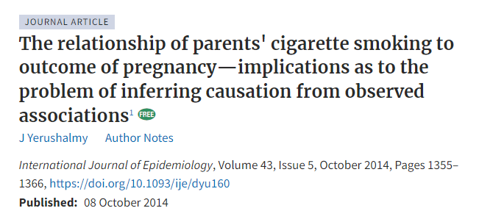
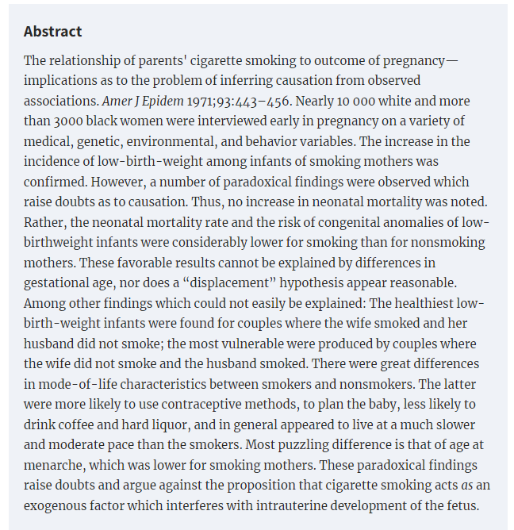

Slide 39

Directed Acyclic Graphs (DAGs)
Represent assumptions between variables
Use arrows to show the direction of hypothesized causal effect
“X causes Y, Y causes Z”, “X causes Z”

Slide 40

Directed Acyclic Graphs (DAGs)
Directed path
Trace the arrow from cause to effect

Slide 41



Directed Acyclic Graphs (DAGs)
Non-directed path

Slide 42

Directed Acyclic Graphs (DAGs)
A path can have many “nodes”

Slide 43

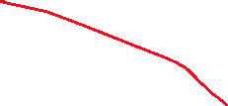





Directed Acyclic Graphs (DAGs)
If all the paths from an exposure (E) to an outcome (O) are directed paths, the observed association (e.g., correlation) is an unbiased estimate of the causal effect of E on O.

Slide 44




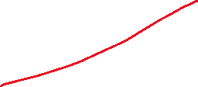



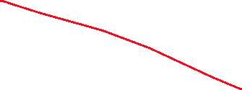

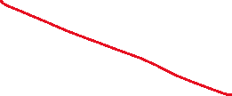
Directed Acyclic Graphs (DAGs)
4 paths
E -> M -> 0
E -> 0
E <- C -> 0
E -> S <- O

Slide 45
Directed Acyclic Graphs (DAGs)
C is a “confounder”
S is a “Collider”
M is a “Mediator”

Slide 46
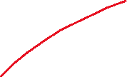




Directed Acyclic Graphs (DAGs)
Non-directed paths are potential source of bias.
Association between an exposure and an outcome can be “transmitted” through an “open” non-directed path.
E <- C -> O exits E against the direction of an arrow.
“Backdoor path”

Slide 47
Directed Acyclic Graphs (DAGs)
C is a “confounder”
The path E <- C -> O needs to be “closed”.
Conditioning can close an open path
“Controlling” for C in a regression analysis
Stratifying the analysis by C

Slide 48


Directed Acyclic Graphs (DAGs)
S is a “collider” (Two arrows entering S)
A path with a collider is closed by default.
Correlation between E and O represents a causal effect of E on O
No conditioning is needed.
No statistical adjustment is needed.

Slide 49
Directed Acyclic Graphs (DAGs)
“Controlling” for S in a regression analysis will open the path.
Biasing collider path
This will introduce bias for estimating the causal effect of E on O.

Slide 50
Directed Acyclic Graphs (DAGs)
“Controlling” for M in a regression analysis will close the path.
Block part of the effect from E to O.
This will introduce bias for estimating the causal effect of E on O.

Slide 51
Directed Acyclic Graphs (DAGs)
Estimating the overall causal effect of E on O.
Adjusting for M closes the path E -> M -> O, which is part of the causal impact of E on O
This will lead to a biased estimate!
Adjusting for C closes the path E <- C -> O, which is a biasing backdoor path.
This will remove bias caused by confounding.
Adjusting for S opens the path E -> S <- O, which becomes a biasing collider path.
This will lead to a biased estimate!

Slide 52
Directed Acyclic Graphs (DAGs)
A path can contain many variables!
A <- B <- C -> D <- E -> F -> G <- H -> I -> J
Is this path open?
If not, how to open this path?
Can we close a path after opening it?

Slide 53
De-confounding
Rule 1.
A -> B -> C, controlling for B close the path (B is a mediator)
Rule 2.
A <- B -> C, controlling for B close the path (B is a confounder)
Rule 3.
A -> B <- C, controlling for B open the path (B is a collider)

Slide 54
Rule 4. Controlling for descendants (proxies) of a variable is like partially controlling for the variable itself.
Controlling for a descendant of a mediator partially close a path
Controlling for a descendant of a collider partially open a path

Slide 55
Example 1
B is associated with both X and Y.

Slide 56
Example 1
No adjustment is needed.
Adjusting for B partially closes the path.

Slide 57



Example 2
A, B, C, D are commonly considered as “pre-exposure” variables.

Slide 58
Example 2
A, B, C, D are commonly considered as “pre-exposure” variables.
No adjustment is needed
X <- A -> B <- D -> E -> Y is closed because B is a collider.
Adjusting for B and/or C will open this path, introducing bias.
Adjusting for A will re-close this path.

Slide 59

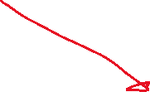

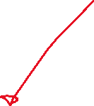
Example 3

Slide 60
Example 3
X <- B -> Y is a backdoor path
Controlling for B
If data on B is not collected, some researchers might adjust for A because A is considered to be a proxy for B
This partially close the confounding bias through B but open the path X -> A <- B -> Y

Slide 61



Example 4

Slide 62

Example 4
M-bias
B is associated with X and also Y.
Many researchers would consider B as a confounder and adjust for it.
B is in fact a collider, adjusting for B will open a non-directed path

Slide 63



Example 5

Slide 64



Example 5
Backdoor path X <- B -> C ->Y
Adjusting for B can close this path but will open the biasing collider path
X <- A -> B <- C ->Y
Adjusting for C alone will be sufficient.
Other options
E.g., Adjusting for A, B and C.

Slide 65
Smoking and infant mortality
Conditioning on a collider is not always intentional.
It can be due to selection bias
It is not uncommon for researchers to select their samples based on certain characteristics
E.g., Babies who have low birth weight…..

Slide 66



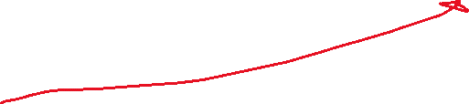

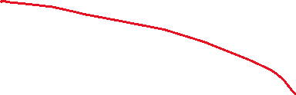

Smoking and infant mortality
When estimating the effect of smoking on mortality, conditioning on low birth weight will open the biasing path smoking -> LBW <- other risk factors -> mortality

Slide 67

Smoking and infant mortality
Among babies with low birth weight, if their mothers were smokers, smoking is likely to be a cause of LBW, and although smoking is likely to cause infant mortality, it may not cause a huge increase in risk.
Among babies with low birth weight, if their mothers were non-smokers, the cause of LBW could be due to other more dangerous conditions, and therefore, among LBW babies whose mothers were non-smokers, they would have a higher mortality rate because of these dangerous conditions.

Slide 68
Unintentional conditioning
Let’s look at the association between smoking and heart disease among people with poor mental health (e.g., depression) in a cross-sectional survey………

Slide 69




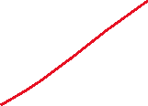
Unintentional conditioning
Let’s look at the association between smoking and heart disease among people with poor mental health (e.g., depression) in a cross-sectional survey………

Slide 71
Interrupted time series analysis with controls

Slide 72
References
Bernal, J. L., Cummins, S., & Gasparrini, A. (2017). Interrupted time series regression for the evaluation of public health interventions: a tutorial. International journal of epidemiology, 46(1), 348-355.
Bhaskaran, K., Gasparrini, A., Hajat, S., Smeeth, L., & Armstrong, B. (2013). Time series regression studies in environmental epidemiology. International journal of epidemiology, 42(4), 1187-1195.
Bottomley, C., Scott, J. A. G., & Isham, V. (2019). Analysing interrupted time series with a control. Epidemiologic methods, 8(1).
Hemming, K., Haines, T. P., Chilton, P. J., Girling, A. J., & Lilford, R. J. (2015). The stepped wedge cluster randomised trial: rationale, design, analysis, and reporting. BMJ, 350.
Linden, A. (2015). Conducting interrupted time-series analysis for single-and multiple-group comparisons. The Stata Journal, 15(2), 480-500.
Linden, A. (2018). Combining synthetic controls and interrupted time series analysis to improve causal inference in program evaluation. Journal of evaluation in clinical practice, 24(2), 447-453.
Lopez Bernal, J., Cummins, S., & Gasparrini, A. (2018). The use of controls in interrupted time series studies of public health interventions. International journal of epidemiology, 47(6), 2082-2093.
Turner, S. L., Karahalios, A., Forbes, A. B., Taljaard, M., Grimshaw, J. M., Cheng, A. C., . . . McKenzie, J. E. (2020). Design characteristics and statistical methods used in interrupted time series studies evaluating public health interventions: a review. Journal of clinical epidemiology, 122, 1-11.

Slide 73

Motivating Example
To reduce alcohol consumption in Northern Territory, the government implemented a minimum price for alcohol in 2018.
Does this policy work? (i.e. reducing alcohol consumption in the population?)

Slide 74
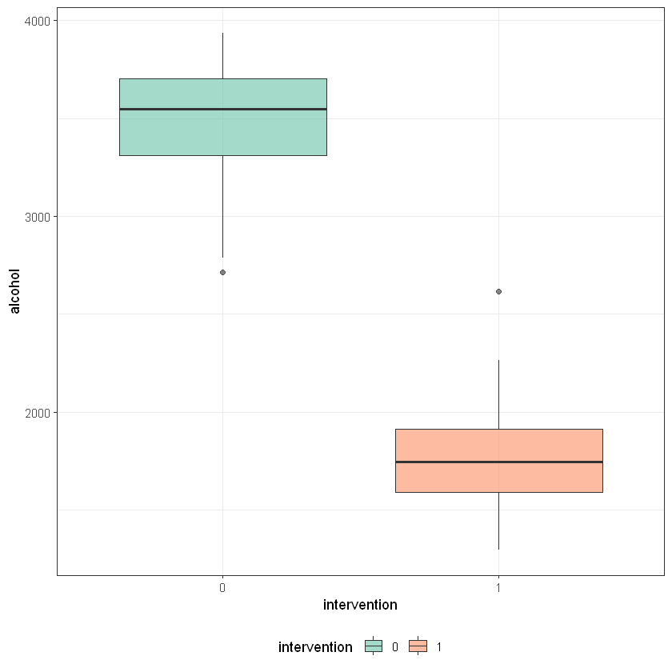
Naïve analysis
Compared average/median population alcohol consumption before and after.

Slide 75
Naïve analysis
Compared average population alcohol consumption before and after.
Ignore the underlying trend
If there is an existing downward trend, population alcohol at “post-intervention period” will be lower regardless if minimum pricing has any impact

Slide 76
Interrupted time series analysis (ITS)
Evaluate policy impact on an outcome (e.g. population alcohol consumption) over a clearly defined time period (e.g. 2 year before and 2 year after the implementation of minimum pricing policy)
A time series of the outcome (population alcohol consumption) is used to established an underlying trend
We then test of such trend is “interrupted” by an intervention at a known time point (the day on which the minimum pricing policy was implemented)

Slide 77
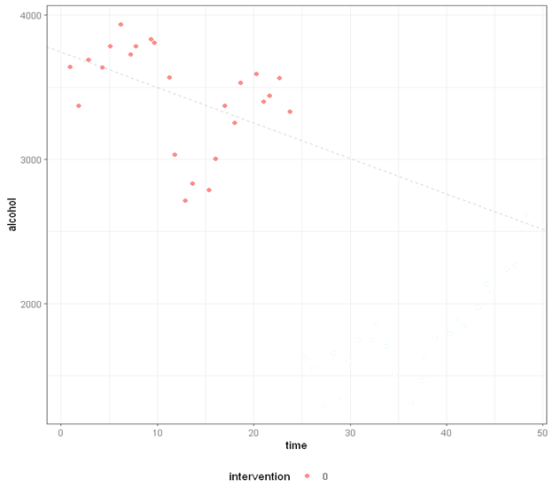
Interrupted time series analysis (ITS)
ITS is compatible with the causal inference framework
Can be conceptualized as comparing the observed post-intervention data to the expected trend, i.e. what would have been observed if there were no intervention
The expected trend is never observed thus it is a counterfactual scenario.

Slide 78
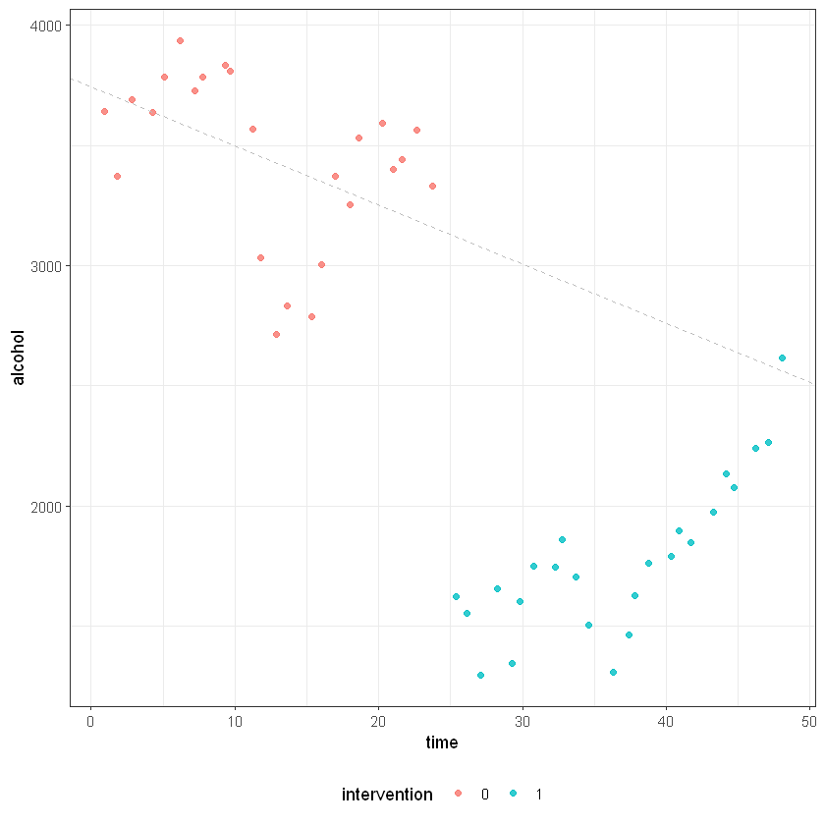
Interrupted time series analysis (ITS)
ITS is compatible with the causal inference framework
Can be conceptualized as comparing the observed post-intervention data to the expected trend, i.e. what would have been observed if there were no intervention
The expected trend is never observed thus it is a counterfactual scenario.

Slide 80
ITS study design
Requires a clear differentiation of the pre-intervention and post-intervention period.
Outcome measures that change relatively quickly after the intervention are suitable
Alcohol consumption (suitable)
Incident of liver cirrhosis (NOT suitable)

Slide 81
ITS study design
No fixed limits on the number of data point
Power depends on
Distribution of the data
Variability within the data
Aggregated population data usually have relatively small variability
Strength of the effect
Strong intervention effect = strong power

Slide 82
ITS study design
More data =/= better
If historical trend changed substantially, it would not give an accurate estimation of the current underlying trend
Inspect pre-intervention data visually before any formal analysis

Slide 83
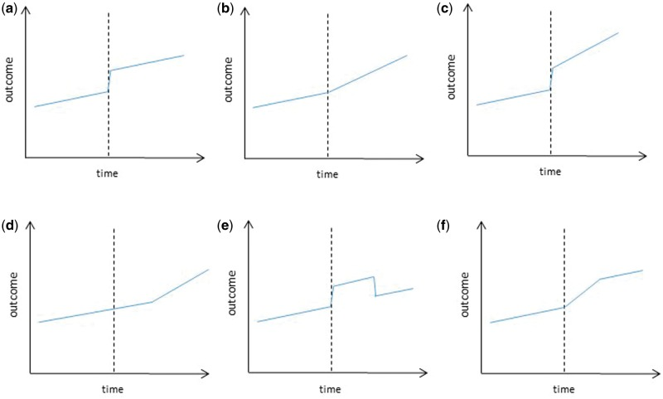
ITS study design
Specify the model a-priori
How will the intervention impact on the outcome?
Is immediate change expected?
Is an “interruption” of the underlying trend expected?
Figure from Bernal, et al (2017)

Slide 84
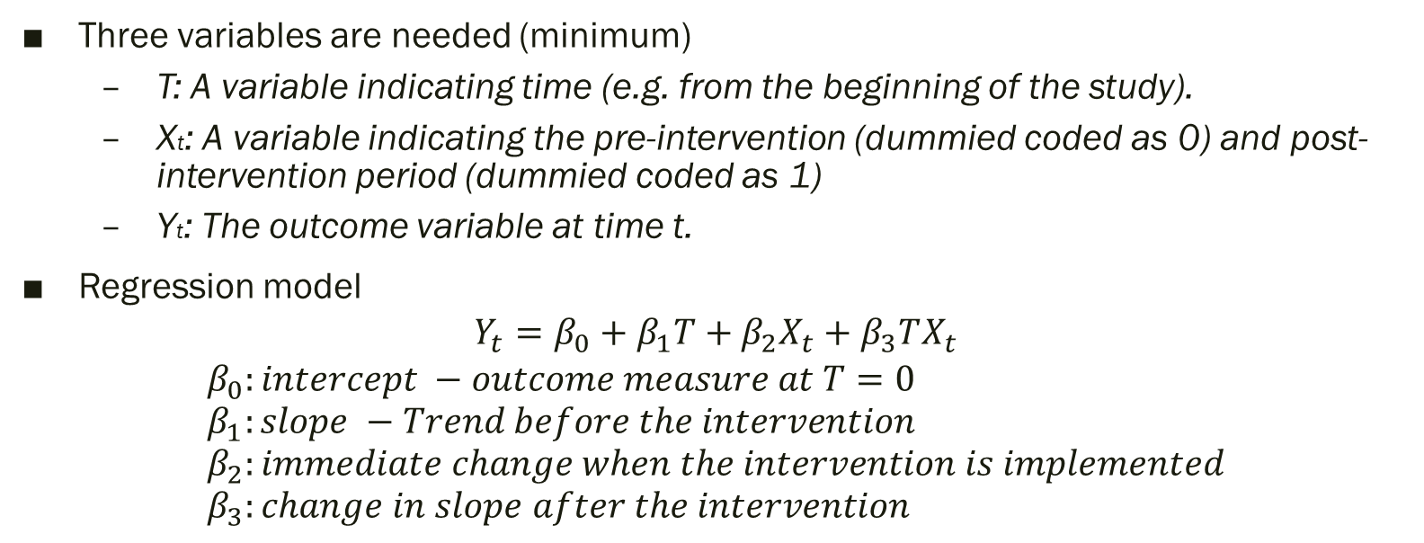
Regression model for ITS
Three variables are needed (minimum)
T: A variable indicating time (e.g. from the beginning of the study).
Xt: A variable indicating the pre-intervention (dummied coded as 0) and post-intervention period (dummied coded as 1)
Yt: The outcome variable at time t.
Regression model
$$Y_{t}=β_{0}+β_{1}T+β_{2}X_{t}+β_{3}TX_{t}$$
$$β_{0}:intercept −outcome measure at T=0 \\ β_{1}:slope −Trend before the intervention \\ β_{2}:immediate change when the intervention is implemented \\ β_{3}:change in slope after the intervention$$

Slide 85
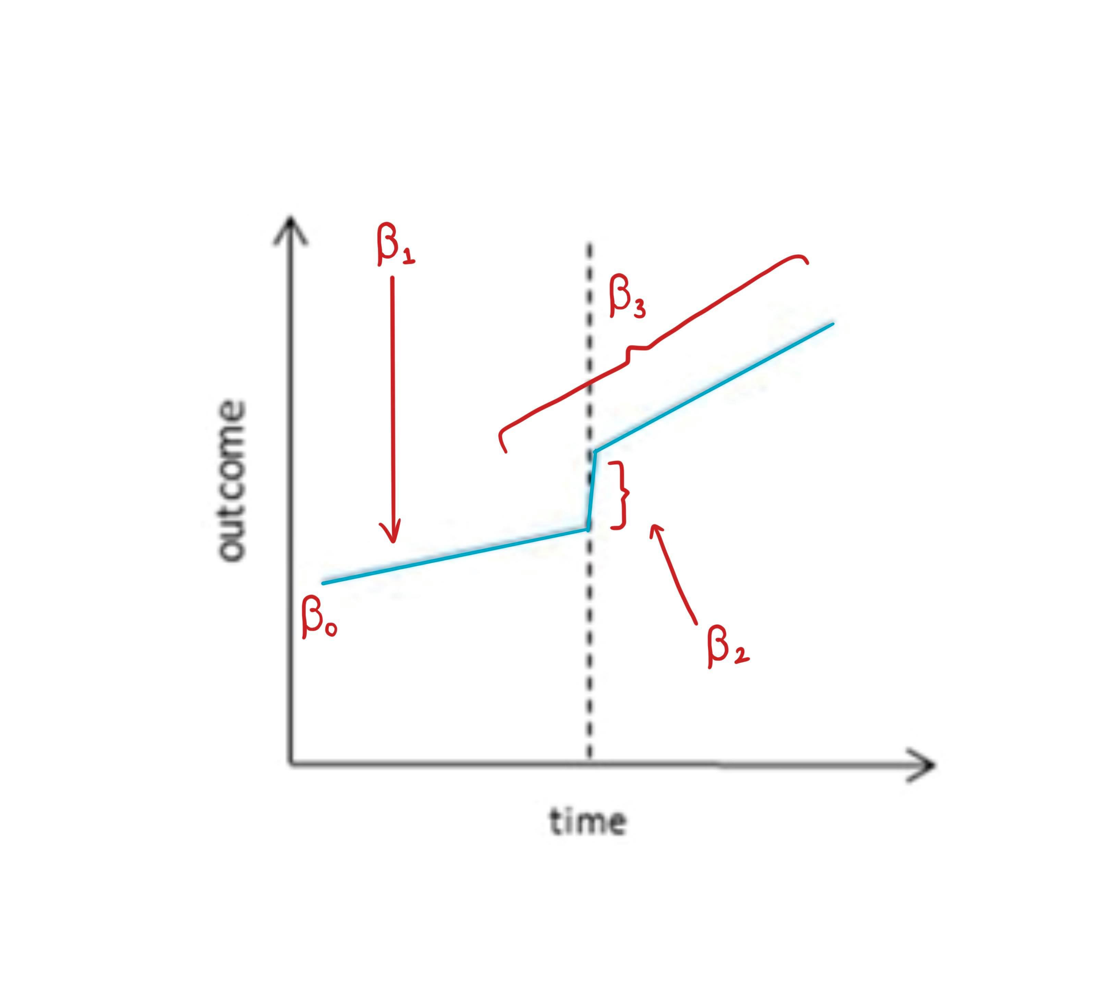

Regression model for ITS
Regression model
$$Y_{t}=β_{0}+β_{1}T+β_{2}X_{t}+β_{3}TX_{t}$$
$$β_{0}:intercept −outcome measure at T=0 \\ β_{1}:slope −Trend before the intervention \\ β_{2}:immediate change when the intervention is implemented \\ β_{3}:change in slope after the intervention$$

Slide 86
Regression model for ITS
Seasonality
When there is an obvious seasonal pattern in the outcome (e.g. incident of flu), it is important to account for seasonality
If the pre- or post- intervention has more data from the winter months, the results would be biased.
Add a variable representing “seasons” – Spring, Summer, Autumn and Winter
Use more complex functions (combination of sine and cosine).

Slide 87
Regression model for ITS
Autocorrelation
Observations tend to be more similar in closer time that those further apart.
Violated the assumption of standard regression
In public health research, autocorrelation is generally largely explained by other variables such as seasonality.
Autocorrelation is rarely a big issue in public health research.
Plot the Autocorrelation function (ACF) or the Partial autocorrelation function (PACF)
Accounting for autocorrelation specifically by specifying the error (residual) structure.

Slide 88
Motivating Example
To reduce alcohol consumption in Northern Territory, the government implemented a minimum price for alcohol in 2018.
Does this policy work? (i.e. reducing alcohol consumption in the population?)

Slide 89
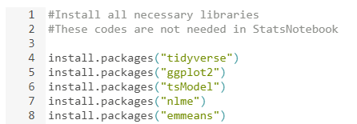
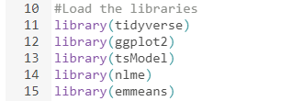
Motivating Example
R/RStudio/StatsNotebook
Libraries required
tidyverse
ggplot2
tsModel
nlme
emmeans

Slide 90
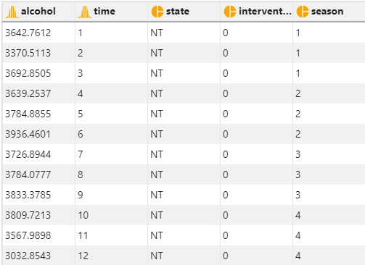
Motivating Example
Simulated dataset https://statsnotebook.io/blog/data_management/example_data/alcohol_data_NT.csv

Slide 91
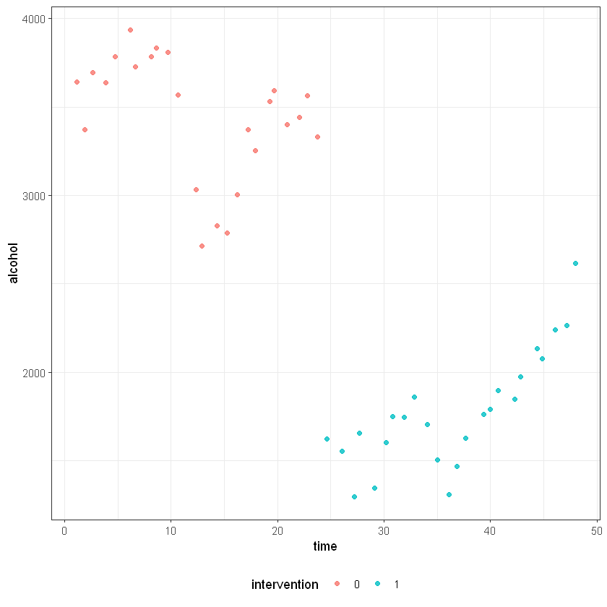
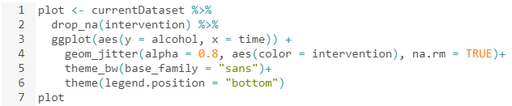
Motivating Example
Plotting the data

Slide 92

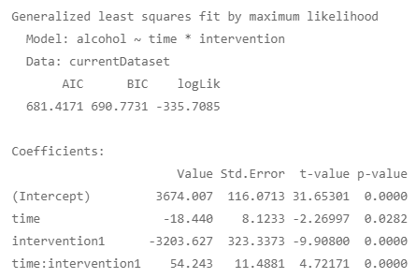
Motivating Example
Running the preliminary model

Slide 93

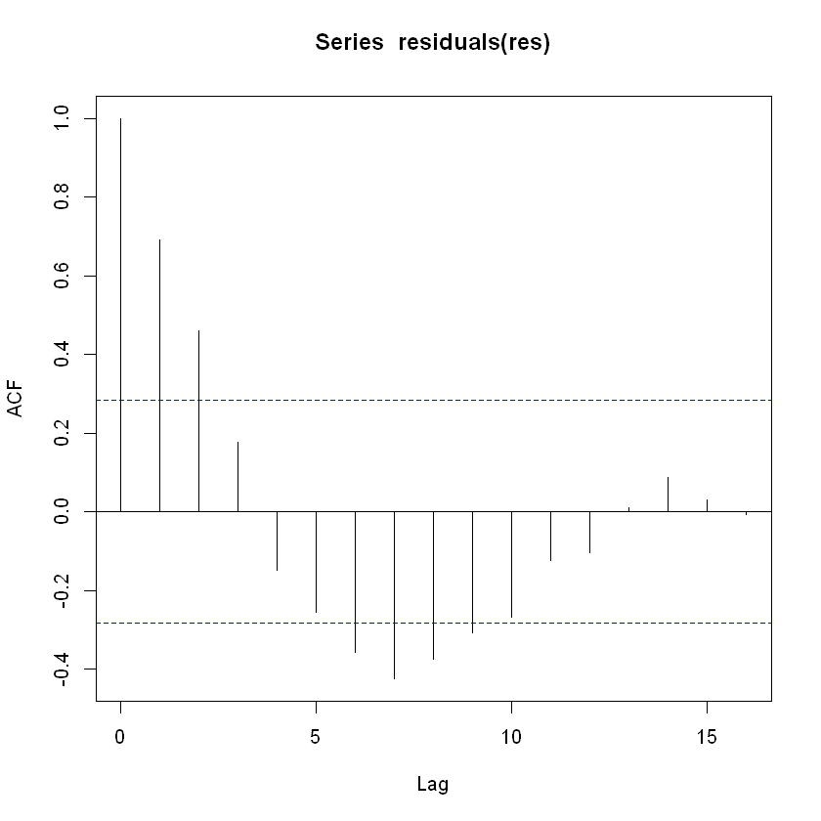
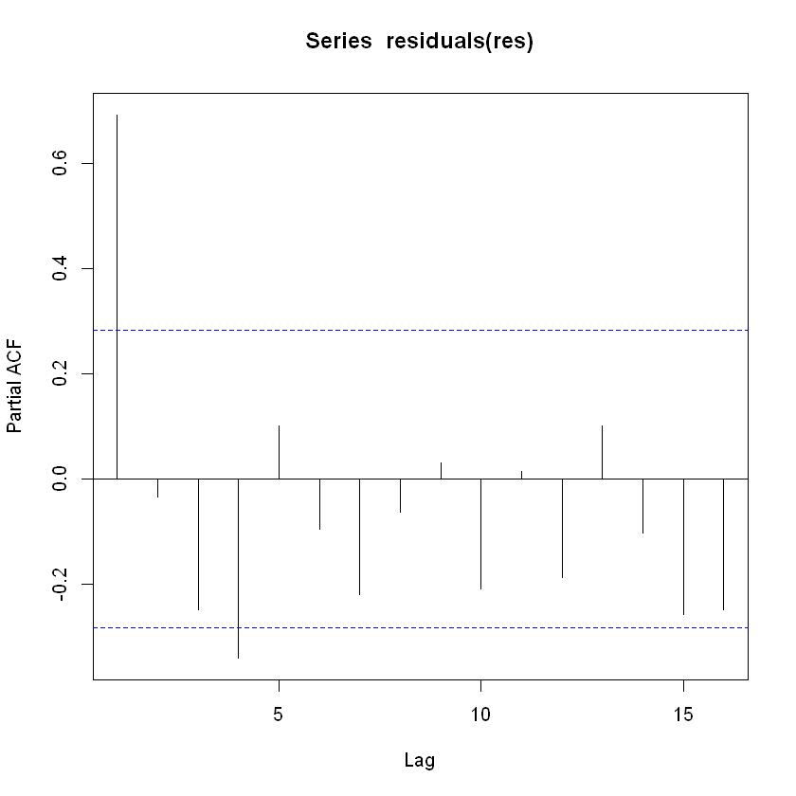
Motivating Example
Plotting the autocorrelation function and the partial autocorrelation function

Slide 94
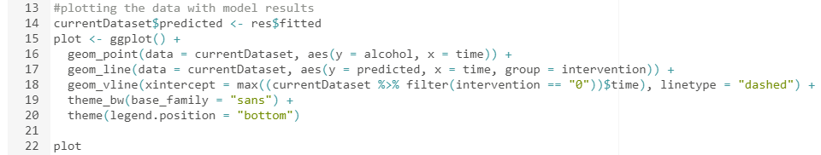
Motivating Example
Plotting model-based prediction

Slide 95
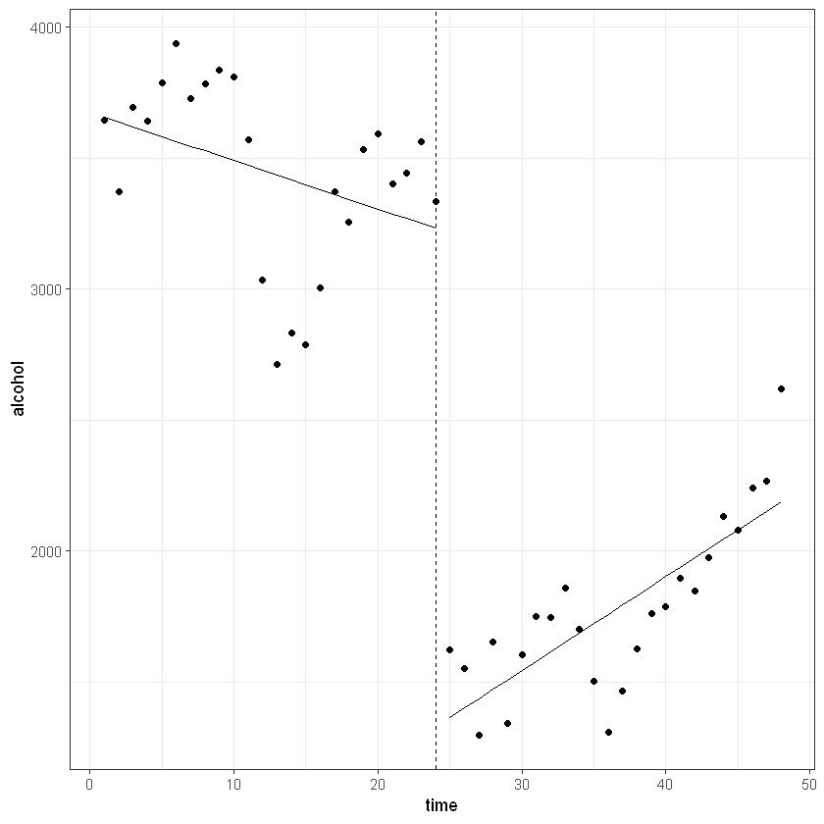
Motivating Example

Slide 96
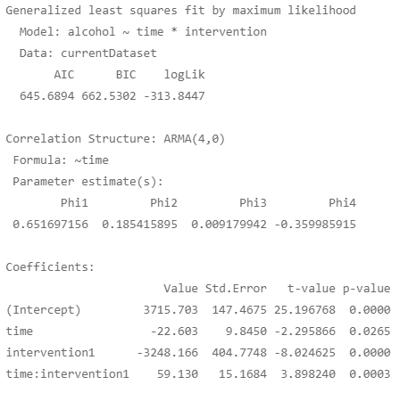

Motivating Example
Rerun the model adjusting for autocorrelation

Slide 97

Motivating Example

Slide 98
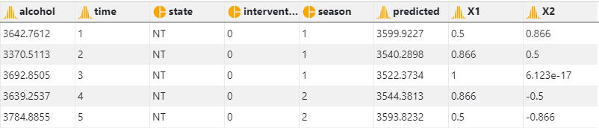
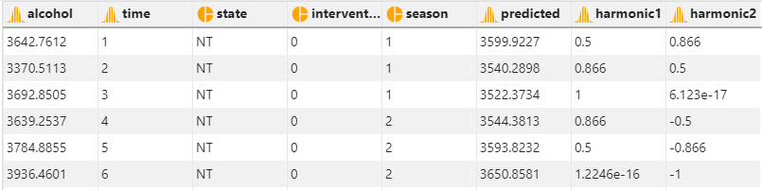
Motivating Example
Rerun the model adjusting for seasonality using the harmonic() from the tsModel library
Two parameters: Number of sine/cosine pair to use and the length of one cycle

Slide 99

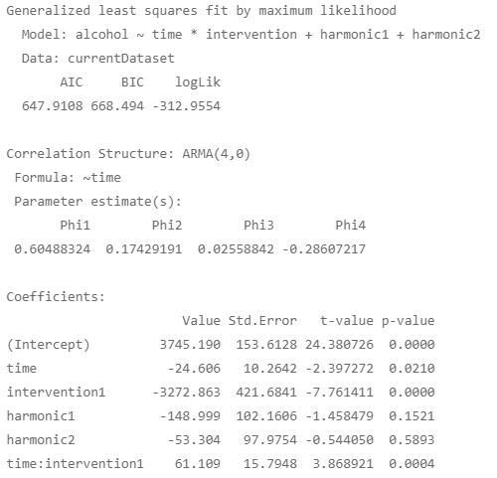
Motivating Example

Slide 100
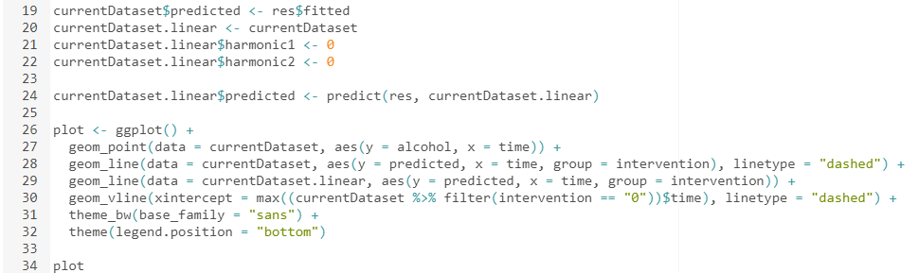
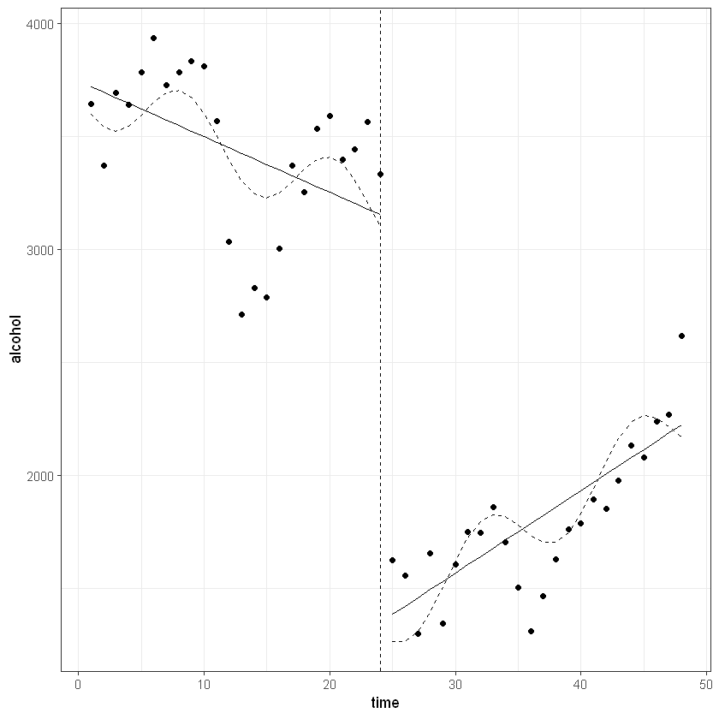
Motivating Example

Slide 101
Interrupted time series analysis (ITS)
Follow a single population over time => free from problems due to between group differences such as selection bias and unmeasured confounding
Controls for within-group characteristics.
Major threat to causal inference
Time-varying confounding
E.g. National Campaign on reducing alcohol use around the same period.
Inclusion of a “control” can address this issue

Slide 102
ITS with controls
Stronger design
Evaluate intervention within (pre/post comparison) and between groups
Absence of any intervention effect in the control provide stronger evidence
Compare the time series data from Northern Territory with those from other states (e.g. Queensland)
If there is an “interruption” in alcohol use Northern Territory and there is no such interruption in Queensland, we can confidently conclude that the minimum pricing policy reduced alcohol consumption in the Northern Territory population.

Slide 103
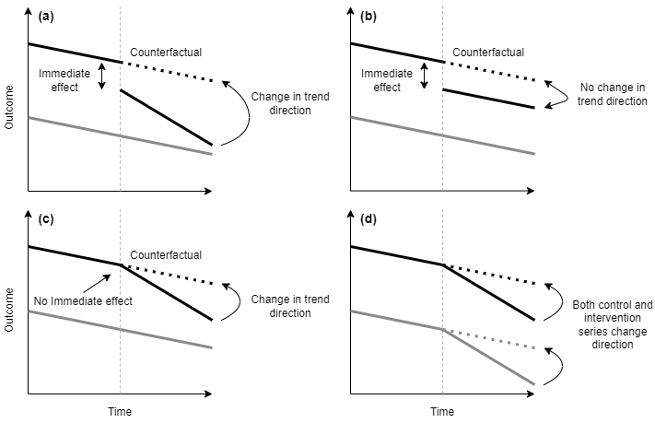

Slide 104
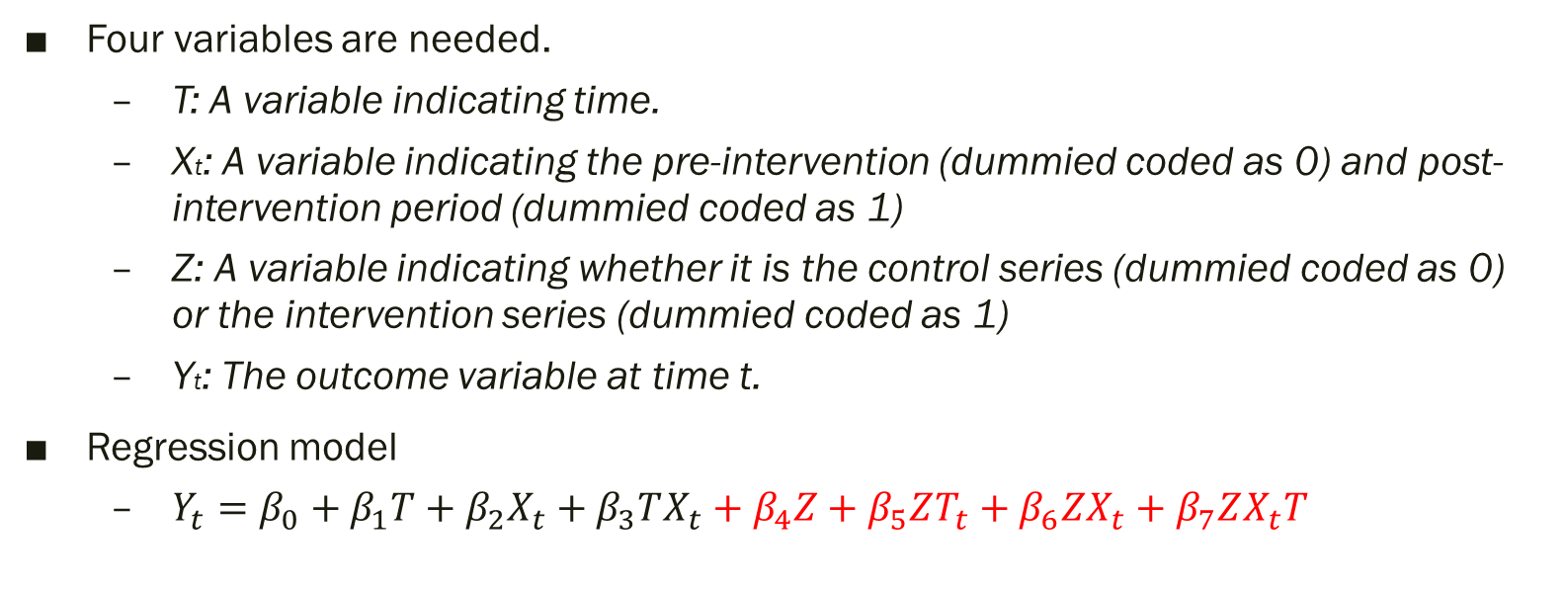
Regression model for ITS with controls
Four variables are needed.
T: A variable indicating time.
Xt: A variable indicating the pre-intervention (dummied coded as 0) and post-intervention period (dummied coded as 1)
Z: A variable indicating whether it is the control series (dummied coded as 0) or the intervention series (dummied coded as 1)
Yt: The outcome variable at time t.
Regression model
$Y_{t}=β_{0}+β_{1}T+β_{2}X_{t}+β_{3}TX_{t}+β_{4}Z+β_{5}ZT_{t}+β_{6}ZX_{t}+β_{7}ZX_{t}T$

Slide 105
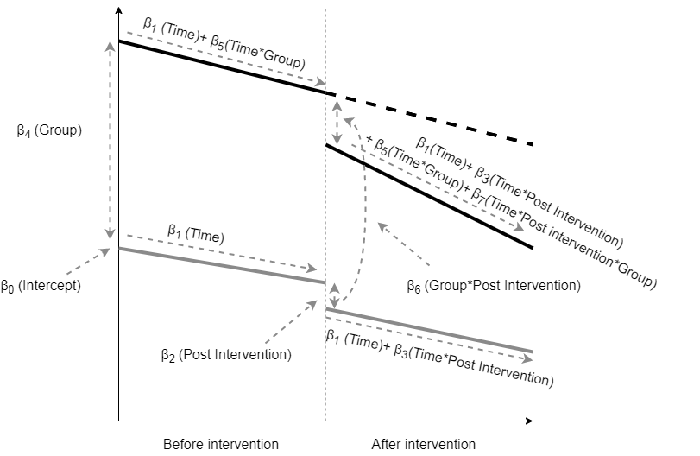

Regression model for ITS with controls
Regression model
$$Y_{t}=β_{0}+β_{1}T+β_{2}X_{t}+β_{3}TX_{t}+β_{4}Z+β_{5}ZT_{t}+β_{6}ZX_{t}+β_{7}ZX_{t}T \\ β_{0}:Intercept −Outcome of the control series at T=0 \\ β_{1}:Slope before the intervention of the control series \\ β_{2}:Immediate change in the control series after the intervention \\ β_{3}:Change in slope after the intervention in the control series \\ β_{4}:Difference in intercept between the control and intervention series \\ β_{5}:Difference in the preintervention slope between the control and intervention series \\ β_{6}:Difference in the immediate change between the control and the intervention series after the intervention \\ β_{7}:Difference in the change in slope after the intervention between the control and the intervention series$$

Slide 106
Motivating Example
To reduce alcohol consumption in Northern Territory, the government implemented a minimum price for alcohol in 2018.
Does this policy work? (i.e. reducing alcohol consumption in the population?)
Compare the population alcohol consumption trends before and after minimum pricing policy in Northern Territory (i.e. within the state)
Compare if the pre/post implementation trend in Northern Territory against Western Australia (across states)

Slide 107
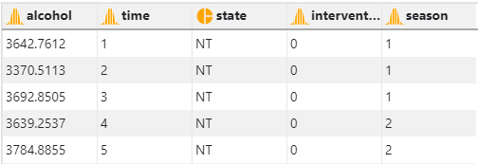
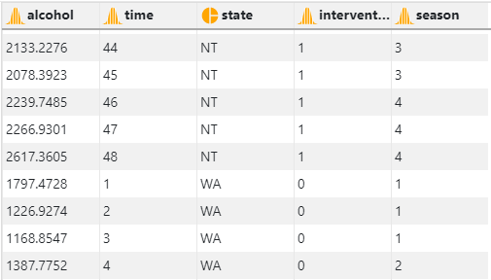
Motivating Example

Slide 108
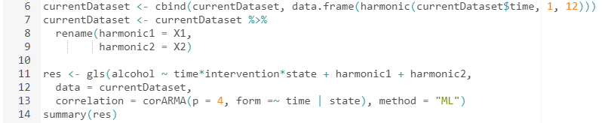
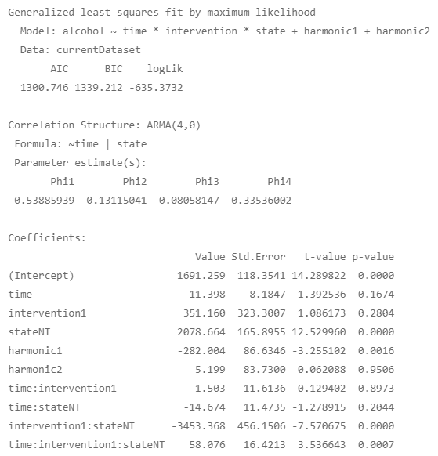
Motivating Example

Slide 109

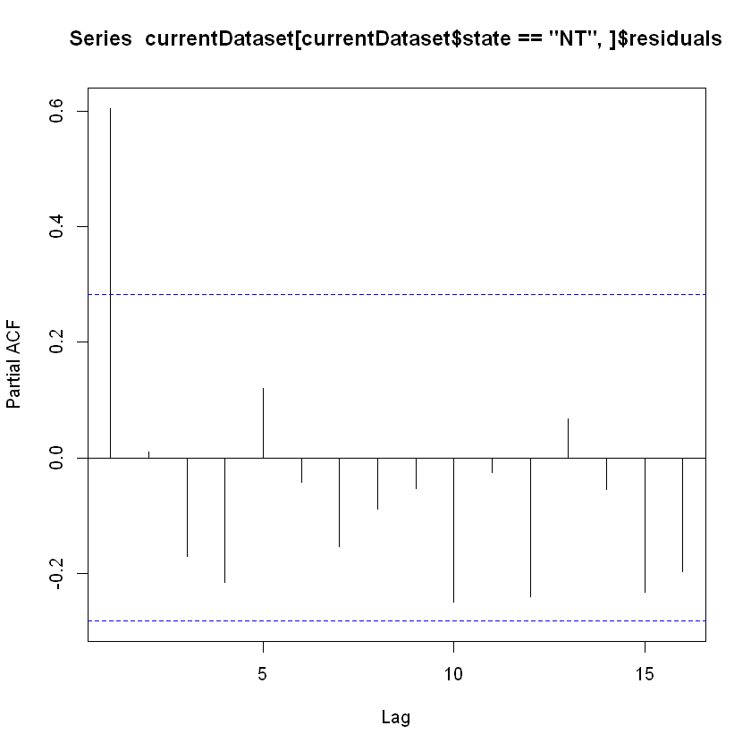

Motivating Example

Slide 110


Motivating Example

Slide 111

StatsNotebook
Graphical interface for R

Slide 112

StatsNotebook

Slide 113


StatsNotebook

Slide 114

StatsNotebook

Slide 115


StatsNotebook

Slide 116

StatsNotebook

Slide 117

StatsNotebook

Slide 118
Other considerations
What if my variable is a count variable or a rate
Number of emergency presentation relating to alcohol use (count)
Number of alcohol-related domestic violence incidents per 100000 population (rate)
Count variable with a Poisson distribution can be approximate by normal distribution when the mean of the Poisson distribution is “large” enough.
How large is large?

Slide 119


Normal approximation

Slide 120


Normal approximation

Slide 121


Normal approximation

Slide 122
Poisson regression
Poisson regression can be used to model count variable.
The glm() function can be used.
In the presence of autocorrelation, the standard error will need to be adjusted.
The NeweyWest() function from the package sandwich is needed.

Slide 123

Other related topics
Use of synthetic controls
Create a synthetic control by weighting data from different states (e.g. QLD, WA, NSW, etc)
Stepped wedged design

Slide 125

Thank you.
Follow me on Twitter for future statistics webinar @GaryCkChan
Email: c.chan4@uq.edu.au

