Slide 1
Causal inference with observational data
Dr. Gary Chan Associate Professor
StatsNotebook.io National Centre for Youth Substance Use Research, University of Queensland

Slide 3
Correlation and causation
Correlation does not imply causation
Scientific literature often reports association very cautiously.
“Cannabis use is associated with other illicit substance use”
“Vaping is associated with smoking initiation”
Nonetheless, these associational statements are often interpreted causally, and are used to justify policy decisions.

Slide 4
When does correlation imply causation?
This workshop will give you a very brief and non-technical introduction to
The counterfactual framework for causal inference
Propensity score matching
Using Directed Acyclic Graphs to identify for “de-confounding”
Inverse probability treatment weighting
E-value for sensitivity analysis
Writing up the results for academic publication

Slide 5
This workshop assumes basic knowledge in R.
It will not focus on the technical details of the methods.
Use of equations will be minimum.

Slide 6
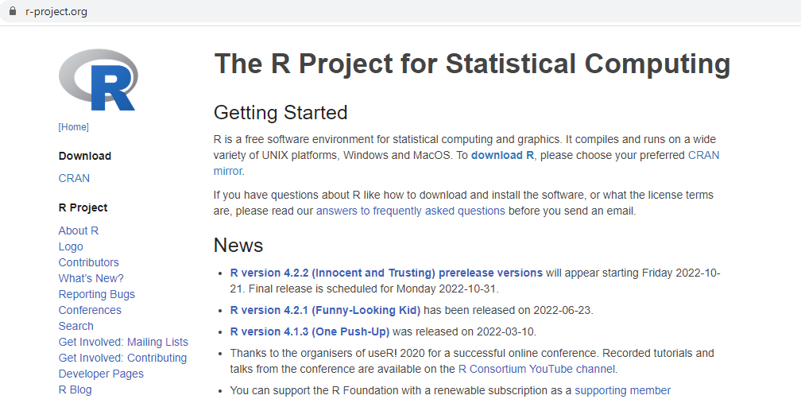
Software for today’s workshop
R – www.r-project.org
If you already have R installed, update to the latest version (R 4.2.1).

Slide 7

Software for today’s workshop
RStudio https://www.rstudio.com/products/rstudio/download/

Slide 9

About me
Associate Professor at The University of Queensland
Specialised in
psychology, epidemiology, public health policy in substance and behavioral addiction
Application of causal methods in psychology, epidemiology and medical research
Former consultant at United Nations Office on Drugs and Crime
Biostatistics consultant at Western Moreton Health Service Group

Slide 11
Disclaimer
No statistical methods can replace good study design.
Application of causal models do not guarantee that you can make causal claims (and most of the time, you CANNOT make causal claims).
Causal inference using observational data can only be made under certain assumptions
Use of certain statistical method is more likely to let you draw valid causal inference.

Slide 12
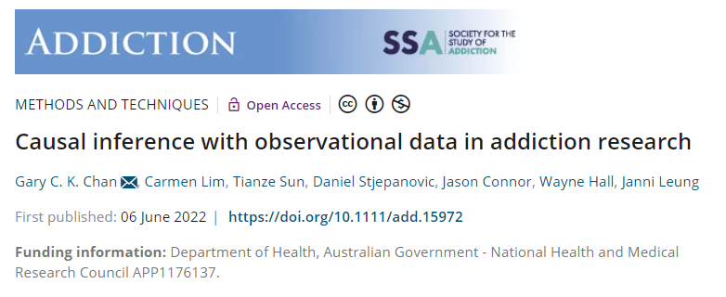
Methods paper in Addiction
Potential outcome/ Counterfactual framework
Matching
Propensity score
Inverse probability treatment weighting
Marginal structural model
Interrupted time series with controls

Slide 13
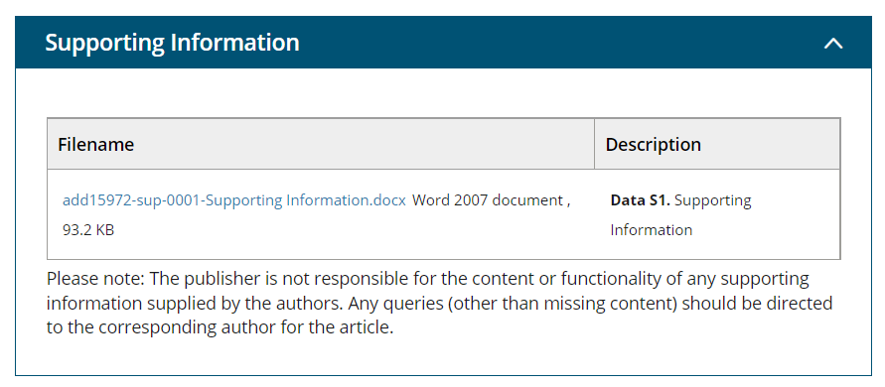
Download the appendix of this paper
https://onlinelibrary.wiley.com/doi/10.1111/add.15972

Slide 14
Correction
Appendix 4. p.17 plot <- ggplot() + geom_point(data = alc_mup_data, aes(y = alcohol, x = time, color = state)) + geom_line(data = alc_mup_data, aes(y = predicted, x = time, color = state, group = groups)) + geom_vline(xintercept = max((alc_mup_data %>% filter(intervention == "0"))$time), linetype = "dashed") + theme_bw(base_family = "sans") + theme(legend.position = "bottom") plot
Appendix 4. Last page plot <- ggplot() + geom_point(data = alc_mup_data, aes(y = alcohol, x = time, color = state)) + geom_line(data = alc_mup_data, aes(y = predicted, x = time, color = state, group = groups), linetype = "dashed") + geom_line(data = alc_mup_data.linear, aes(y = predicted, x = time, color = state, group = groups)) + geom_vline(xintercept = max((alc_mup_data %>% filter(intervention == "0"))$time), linetype = "dashed") + theme_bw(base_family = "sans") + theme(legend.position = "bottom") plot
Appendix 3. p.10 alc_iptw <- iptw(list(home_alc_2 ~ home_alc_1 + alc_use1 + alc_peer1 + smk1, home_alc_3 ~ alc_use2 + alc_peer2 + smk2, home_alc_4 ~ alc_use3 + alc_peer3 + smk3 ), timeInvariant ~ sex, data = as.data.frame(alc_data), cumulative = TRUE, priorTreatment = TRUE, stop.method = "es.max", n.trees = 10000)

Slide 16
Propensity score matching

Slide 17
RCTs
Randomized controlled trial is the gold standard for establishing causal relationship
Participants are assigned randomly into receiving treatment or not receiving treatment (For the rest of the talk, I will use the term “treatment”, “exposure” and “intervention” interchangeably).
Participant characteristics (both measured and unmeasured) in treatment and control condition are similar.
Randomization removes all confounding.
Overall, only difference between two group of participants will be whether they receive treatment.

Slide 18
RCTs
Randomized controlled trial is the gold standard for establishing causal relationship
Participants are assigned randomly into receiving treatment or not receiving treatment (For the rest of the talk, I will use the term “treatment”, “exposure” and “intervention” interchangeably).
Participant characteristics (both measured and unmeasured) in treatment and control condition are similar.
Randomization removes all confounding.
Overall, only difference between two group of participants will be whether they receive treatment.

Slide 19
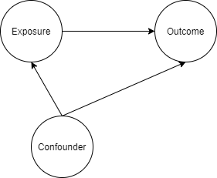
Confounding
A confounder is a variable that influences both the outcome and exposure (More about confounding in second section of this presentation).

Slide 20


Confounding
Ice cream sales is strongly associated with shark attack.

Slide 21

Confounding
Ice cream sales is strongly associated with shark attack.

Slide 22

Potential outcomes/ Counterfactual framework
Two treatment conditions: Treatment ($A=1$) and control ($A=0$).
For an individual $i$, there would be two potential outcomes: $Y_{i}^{A=1}$and $Y_{i}^{A=0}$
The individual causal effect of the treatment: $Y_{i}^{A=1}{− Y}_{i}^{A=0}$
Only one of the outcomes is observed.

Slide 23


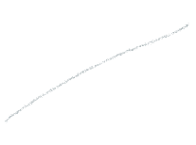



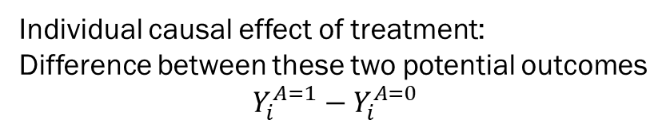











What could have happened should this participant not received treatment ($Y_{i}^{A=0})$
Participant i
Individual causal effect of treatment: Difference between these two potential outcomes
$$Y_{i}^{A=1}{− Y}_{i}^{A=0}$$
Challenge:
Only one of these outcomes can be observed
What could have happened should this participant received treatment ($Y_{i}^{A=1})$

Slide 24
Before commencement of a study, (prior to assignment to treatment or control condition), there are two potential outcomes.
After a study begins and the individual is exposed to either treatment or control, there is one observed outcome, and one counterfactual outcome.
Individual treatment effect is not identifiable.

Slide 25
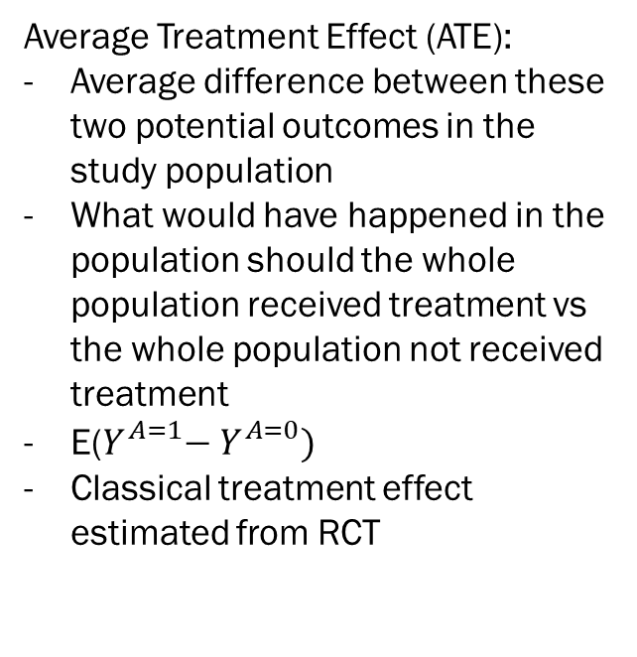

What could have happened should the whole population not received treatment
E($Y_{}^{A=0}$) can be considered as the “average outcome” if the whole population not receive treatment
Average Treatment Effect (ATE):
Average difference between these two potential outcomes in the study population
What would have happened in the population should the whole population received treatment vs the whole population not received treatment
E($Y_{}^{A=1}{− Y}_{}^{A=0})$
Classical treatment effect estimated from RCT
Population
Statistical solution:
Some of the participants received treatment
Some didn’t
ATE can be estimated
What could have happened should the whole population received treatment
E($Y_{}^{A=1}$) can be considered as the “average outcome” if the whole population received treatment

Slide 26
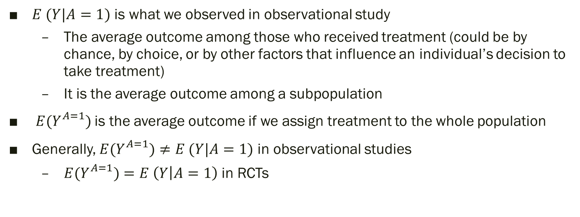
$E (Y|A=1)$ is what we observed in observational study
The average outcome among those who received treatment (could be by chance, by choice, or by other factors that influence an individual’s decision to take treatment)
It is the average outcome among a subpopulation
${E(Y}_{}^{A=1})$is the average outcome if we assign treatment to the whole population
Generally, ${E(Y}_{}^{A=1})≠E (Y|A=1)$ in observational studies
${E(Y}_{}^{A=1})=E \left(Y | A=1\right)$ in RCTs

Slide 27
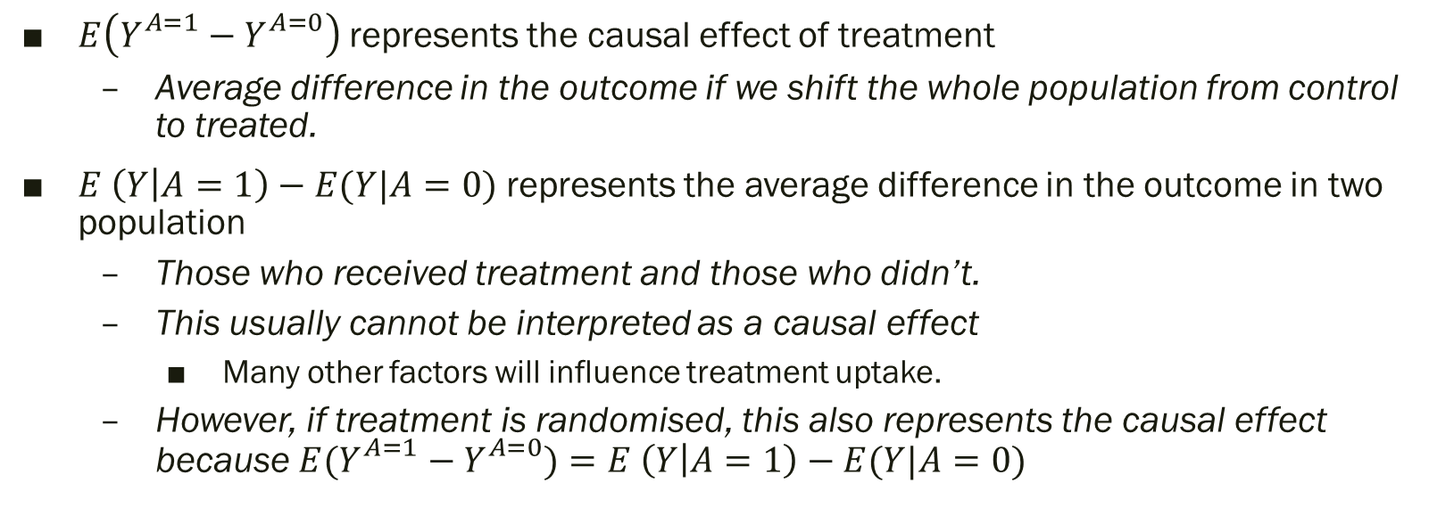
$E\left(Y_{}^{A=1}{− Y}_{}^{A=0}\right)$ represents the causal effect of treatment
Average difference in the outcome if we shift the whole population from control to treated.
$E \left(Y | A=1\right)−E(Y|A=0)$ represents the average difference in the outcome in two population
Those who received treatment and those who didn’t.
This usually cannot be interpreted as a causal effect
Many other factors will influence treatment uptake.
However, if treatment is randomised, this also represents the causal effect because ${E(Y}_{}^{A=1}{ − Y}_{}^{A=0})=E \left(Y | A=1\right)−E(Y|A=0)$

Slide 29
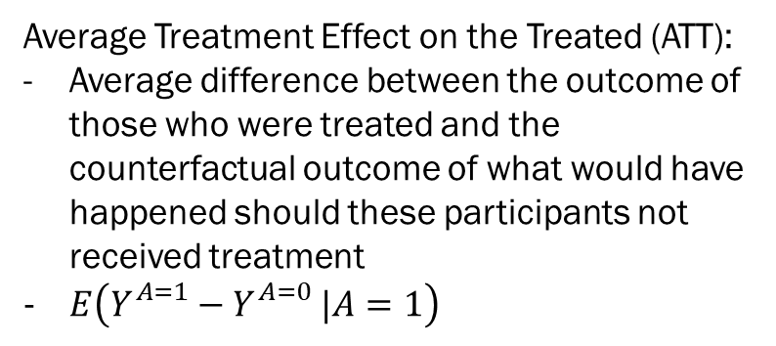

What could have happened should those who received treatment if they have not received treatment
This is a counterfactual outcome.
Average Treatment Effect on the Treated (ATT):
Average difference between the outcome of those who were treated and the counterfactual outcome of what would have happened should these participants not received treatment
$E\left(Y_{}^{A=1}{− Y}_{}^{A=0}|A=1\right)$
Population
Statistical solution:
Some of the participants received treatment
Some didn’t
ATT can be also estimated
In RCT, ATT and ATE are the same.
What happen to those who received treatment

Slide 30

$E\left(Y_{}^{A=1}{− Y}_{}^{A=0}|A=1\right)$
Among those who were treated, what is the treatment effect?

Slide 32
RCTs
RCT can be used to estimate the causal effect
May lack generalizability
RCTs are often conducted in highly controlled environment that do not resemble any real-life circumstances.
Not always feasible, particularly regarding questions of harm
Does smoking cause cancer?
Does cannabis use cause psychosis?
Not suitable for studying sustained exposure over a long period of time and long-term outcome
Does daily smoking over 10 years cause cancer?
Does heavy cannabis use during adolescence increase risk of psychosis in mid-adulthood?

Slide 33
Observational study
Provides “real world evidence”
Cancer outcome among smokers and non-smokers
Psychosis among cannabis users and non-users
Biggest threat for causal inference
Confounding
Systematic difference between those who were under “treatment” condition (i.e. smoking and using cannabis) and “control” condition
E.g. factors that predisposed individual to unhealthy habits that lead to smoking and long-term adverse health outcome (e.g. Socioeconomic disadvantage?)

Slide 34
Propensity Score Matching
Emulate a RCT where confounding factors are balanced between treatment and control condition
In a RCT, all potential confounding factors are balanced between treatment and control condition due to randomization.
In RCT, ATT and ATE are the same
In observational study, they could be different
Need to decide what to estimate
ATE: More appropriate for treatment that targets the whole population
Distributing information flyer to smokers for smoking cessation
ATT : More appropriate for treatment that is more individualized, or has higher access barrier
Intensive, structured smoking cessation program

Slide 35
Propensity score
Probability of receiving treatment, given the observed covariates X (i.e., a set of participant characteristics).
It is a balancing score
At each value of the propensity score, the distribution of the covariates X between the treated and control is the same
Conditioning on the propensity score, treatment assignment can be considered as random (there is a catch though…)
After matching participant with similar propensity score, difference between the treatment and control group can be considered as a causal effect due to treatment

Slide 36
Propensity score
True propensity score is unknown
Can be estimated using logistic regression or non-parametric machine learning method
Key focus – Covariate balance
Other parameters estimated from the propensity score model do not matter much
Standard concerns such collinearity, model fit statistics for classification ability not useful for variable selection

Slide 37
Propensity Score Matching
Propensity score matching can be used to estimate ATT and ATE, but is commonly used to estimate ATT.
Will focus on ATT in this talk.
Two steps
For each treated participant, match this participants with an untreated participant who has very similar characteristics
The matched sample can now be analysed as if the data is from a RCT, with adjustment for standard error to adjust for the potential bias introduced in the matching process.

Slide 38
Propensity Score Matching
Propensity score matching can be used to estimate ATT and ATE, but is commonly used to estimate ATT.
Will focus on ATT in this talk.
Two steps
For each treated participant, match this participants with an untreated participant who has very similar characteristics
The matched sample can now be analysed as if the data is from a RCT, with adjustment for standard error to adjust for the potential bias introduced in the matching process.

Slide 39

Participants from an observational study

Slide 40
Participants from an observational study

Slide 41
Propensity score matching
What is the effect of smoking on psychological distress?
The demographic of smokers and non-smokers are often very different
The association could be confounded by
Education level
Socio-economic status
And many other factors
If we are able to perform a RCT, we would randomised participants into “smoking” and “non-smoking” condition, and measure their psychological distress at a certain time point.
Randomisation will ensure that education level, SES and other variables are balanced between the smoking and non-smoking group.

Slide 42
Observational study
Propensity Score Matching
 | Unmatched sample mean |  |  | Matched sample mean
 | Smoke (N = 974) | Not smoke (N = 7026) | Standardised mean difference | Smoke (N = 974) | Not smoke (N = 974) | Standardised mean difference
Male | 0.494 | 0.442 | 0.104 | 0.494 | 0.475 | 0.037
Indigenous status | 0.052 | 0.018 | 0.157 | 0.052 | 0.048 | 0.018
Finished high school | 0.422 | 0.638 | -0.437 | 0.422 | 0.436 | -0.029
Partnered | 0.463 | 0.691 | -0.458 | 0.463 | 0.444 | 0.039
Regionality
Major cities | 0.585 | 0.677 | -0.187 | 0.585 | 0.587 | -0.004
Inner regional | 0.218 | 0.190 | 0.067 | 0.218 | 0.232 | -0.035
Outer regional or more remote | 0.197 | 0.133 | 0.162 | 0.197 | 0.181 | 0.041
English speaking | 0.958 | 0.913 | 0.223 | 0.958 | 0.954 | 0.021
Risky alcohol use | 0.643 | 0.541 | 0.212 | 0.643 | 0.640 | 0.006
Age | 51.606 | 53.782 | -0.168 | 51.606 | 51.298 | 0.024

Slide 43
Advantage of matching
Clearly separate the “design” and “analysis” phase.
Calculating propensity score can be considered as the “design” phase, like the randomisation phase in RCTs.
Outcome is not used in the matching procedures
Researchers can fit many models to the data and pick the one that produce the best balance.
Researchers proceed to the “analysis” phase only when a good balance is achieved.
Reduce the temptation to cherry-pick a model that produces the desired conclusion

Slide 44
Advantage of matching
In regression analysis, the researchers can only hope that adding covariates into the model can adjust for potential confounding effect from other variables
In matching, the researchers can specifically check whether balance is achieved,
Even if balance is not achieved, the researchers can evaluate how bad the imbalance is, and can inform future data collection.

Slide 45
Second stage
A simple regression analysis using the matched sample
The DV is regressed on the IV, other covariates are not necessary. Cluster-robust standard error is required to account for the matching procedure.
Adding covariates can produce “doubly robust” estimates
As long as one of the model is correctly specified (either the propensity score model or the regression model), the effect estimate will be unbiased.

Slide 46
Exercise
Research question
Does smoking have a causal impact on psychological distress?
Follow the instruction in Appendix 1 to reproduce the results
What is the conclusion?
The numbers you obtained might be slightly different from those in the appendix due to difference in version package.

Slide 47
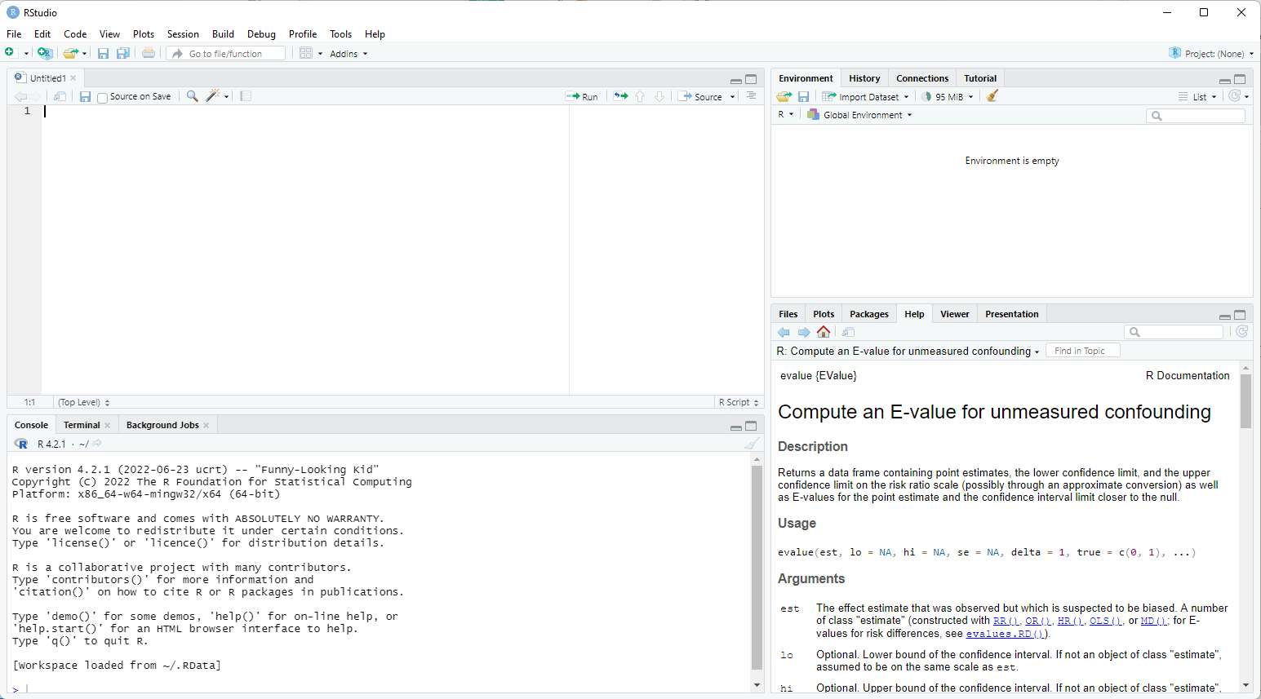
Propensity score matching in R

Slide 49
Considerations for PSM
Matching method
Nearest
For each treated participant, find a participant in the control group that is closest match
Matching occurs at individual level, it might not produce the “best overall” match at the group level

Slide 50
Considerations for PSM
Matching method
Nearest
For each treated participant, find a participant in the control group that is closest match
Matching occurs at individual level, it might not produce the “best overall” match at the group level
Very fast algorithm

Slide 51













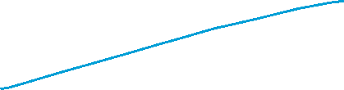

Slide 52
Considerations for PSM
Matching method
Optimal
Consider the overall matching quality
Take longer to run
Modern computer can usually produce the matched set within a reasonable time frame

Slide 53
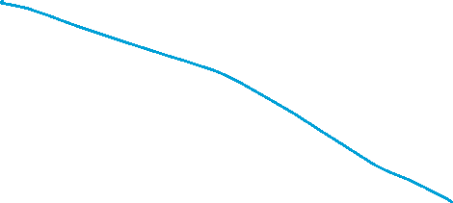
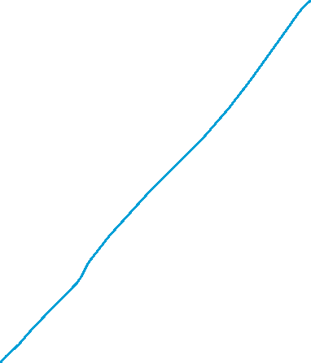
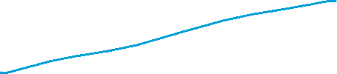

Slide 54
Considerations for PSM
Matching ratio
1:1
Match each treated participant to one participant in the control group
Major concern
Discarding a large number of observation
May reduce power

Slide 55
Considerations for PSM
Matching ratio
1:1
Reduction in power is usually minimal
Precision is largely driven by the smaller group (treatment group in most case)
Increasing the sample size from the control group may not increase power much

Slide 56
Considerations for PSM
Matching ratio
1:M
Retain a larger proportion of the sample (mainly from the control group)
By definition, this will produce worse matches
The 2nd , 3rd , 4th … by definition produce worse match than the 1st match
Bigger bias in the estimates
Bias-variance trade off
May slightly increase power and reduce variance in the estimates
But inducing a larger bias in the estimates
If data is yet to be collected
Cost consideration

Slide 57
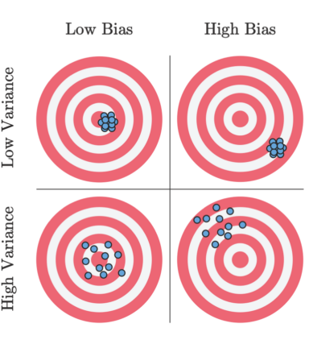
Considerations for PSM
Bias-variance trade-off

Slide 58
Considerations for PSM
With or without replacement
Matching with replacement often produce better match
Participants from the control group can be “re-used”
Inference becomes more complex because of the increased dependence in the data

Slide 60
Assumption
There are several key assumptions of the propensity score methods.
No interference
Whether an individual receives treatment does not affect the outcome of another individual.
Violated if there is a spillover or contagion effect
Vaccination in small community

Slide 61
Assumption
There are several key assumptions of the propensity score methods.
Consistency
For each individual, only one of the two potential outcomes is observed. This assumption requires that the potential outcome under the observed treatment is the same as the observed outcome.
A technical assumption to link the counterfactual world and the real world
Untestable

Slide 62
Assumption
There are several key assumptions of the propensity score methods.
No unmeasured confounding
After matching on a range of potential confounders, treatment assignment is independent of the potential outcome.
Participants with the same covariates can be considered as being assigned to treatment or control randomly.
People from lower SES might be more likely to smoke
But within each stratum of SES, participants might be equally likely to smoke?
This is a requirement for all statistical model for causal inference (but untestable)
Need to consider theoretical framework
Developmental psychology
Family, school and peer factors are all potential confounders
Need to include key factors in these domains

Slide 63
Assumption
There are several key assumptions of the propensity score methods.
No unmeasured confounding
Matching can only adjust for confounding due to observed variables
No guarantee that balance will be achieved in unmeasured variables
Sensitivity analysis is needed (will be discussed later).

Slide 64
Assumption
There are several key assumptions of the propensity score methods.
Positivity
Treatment is not deterministic at every level of each of the covariates.
There is no certainty about whether a participant will receive treatment or not.

Slide 65
Assumption
There are several key assumptions of the propensity score methods.
Correct specification for the propensity score model.
This assumption is likely to be violated to some degree – All models are wrong!

Slide 67
Diagnosis
Assessing balance
Standardised mean difference
For categorical variable, standardised mean difference represents difference in proportion
Rule of thumb: 0.1 as the cut-off
Propensity Score Matching
 | Unmatched sample mean |  |  | Matched sample mean
 | Smoke (N = 974) | Not smoke (N = 7026) | Standardised mean difference | Smoke (N = 974) | Not smoke (N = 974) | Standardised mean difference
Male | 0.494 | 0.442 | 0.104 | 0.494 | 0.475 | 0.037
Indigenous status | 0.052 | 0.018 | 0.157 | 0.052 | 0.048 | 0.018
Finished high school | 0.422 | 0.638 | -0.437 | 0.422 | 0.436 | -0.029
Partnered | 0.463 | 0.691 | -0.458 | 0.463 | 0.444 | 0.039
Regionality
Major cities | 0.585 | 0.677 | -0.187 | 0.585 | 0.587 | -0.004
Inner regional | 0.218 | 0.190 | 0.067 | 0.218 | 0.232 | -0.035
Outer regional or more remote | 0.197 | 0.133 | 0.162 | 0.197 | 0.181 | 0.041
English speaking | 0.958 | 0.913 | 0.223 | 0.958 | 0.954 | 0.021
Risky alcohol use | 0.643 | 0.541 | 0.212 | 0.643 | 0.640 | 0.006
Age | 51.606 | 53.782 | -0.168 | 51.606 | 51.298 | 0.024

Slide 68
Diagnostic
Assessing balance
Standardised mean difference
Ideally, higher order terms of continuous variables and interaction terms between continuous variables are also balance.
Compare the higher order terms (e.g., square, cubic, etc)
Compare interaction terms between continuous variables

Slide 69
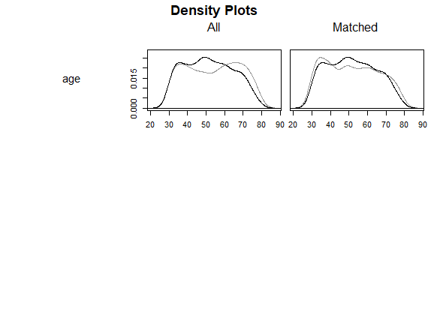
Diagnostic
Assessing balance
Examining the distribution of continuous variables

Slide 70
Exercise
Repeat the analysis in Appendix 1
Read the help page of matchit
?matchit
Try using other configurations
nearest matching (using the method option)
1:3 as matching ratio (using the ratio option)
using Generalised boost model (gbm) instead of logistic regression (glm) (using the distance option)
smk_matching2 <- matchit(smoker ~ sex + indigeneity + high_school + partnered + remoteness + language + risky_alcohol + age, data = smk_data, method = "nearest", distance = "gbm", ratio = 3)

Slide 71
Exercise
Repeat the analysis in Appendix 1
Evaluate the balance of the squared term of age
Compare the age distribution between the treatment and control group
smk_matching_summary2 <- summary(smk_matching2, addlvariables = ~ I(age^2))
plot(smk_matching_summary2, abs = FALSE)
plot(smk_matching2, type = "density")

Slide 73
What variables should we adjust for? A short introduction to directed acyclic graphS

Slide 74
Key reference
Pearl, Glymour and Jewell (2016). Causal inference in statistics, A Primer.
Pearl and MacKenzie (2019). The book of why. The new science of cause and effect.

Slide 75
We record the recovery rates of 700 patients who were given access to a drug. A total of 350 patients chose to take the drug and 350 patients did not.
Would you recommend this drug?
 | Drug | No drug
Men | 81 out of 87 recovered (93%) | 234 out of 270 recovered (87%)
Women | 192 out of 263 recovered (73%) | 55 out of 80 recovered (69%)
Combined data | 273 out of 350 recovered (78%) | 289 out of 350 recovered (83%)

Slide 76
A drug could affect recovery by lowering the blood pressure but it could also have a toxic effect. Blood pressure and recovery outcome were recorded at the end of the trial.
Would you recommend this drug?
 | Drug | No drug
Low blood pressure | 81 out of 87 recovered (93%) | 234 out of 270 recovered (87%)
High blood pressure | 192 out of 263 recovered (73%) | 55 out of 80 recovered (69%)
Combined data | 273 out of 350 recovered (78%) | 289 out of 350 recovered (83%)

Slide 77
Multiple studies demonstrated that low birth-weight children born to smoking mothers have LOWER risk of infant mortality.
Smoking might be a good way to prevent infant mortality?
Maybe at least for some babies, having a smoking mother may be beneficial?

Slide 78
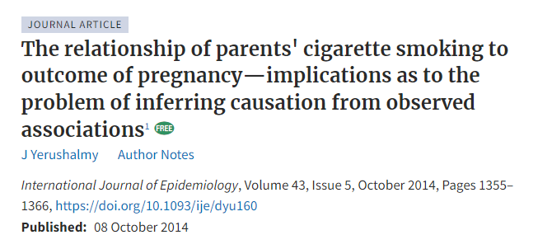
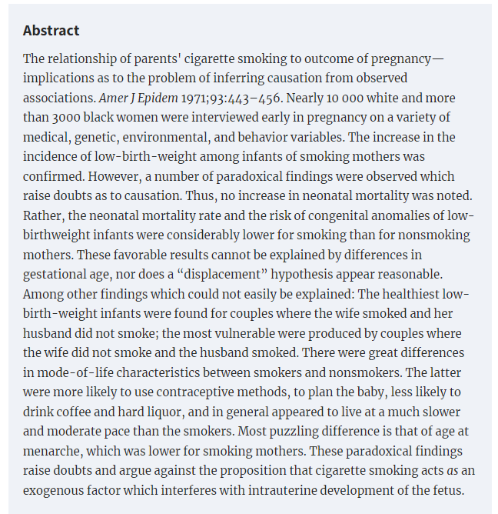

Slide 80

Directed Acyclic Graphs (DAGs)
Represent assumptions between variables
Use arrows to show the direction of hypothesized causal effect
“X causes Y, Y causes Z”, “X causes Z”

Slide 81

Directed Acyclic Graphs (DAGs)
Directed path
Trace the arrow from cause to effect

Slide 82



Directed Acyclic Graphs (DAGs)
Non-directed path

Slide 83

Directed Acyclic Graphs (DAGs)
A path can have many “nodes”

Slide 84

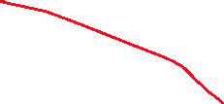





Directed Acyclic Graphs (DAGs)
If all the paths from an exposure (E) to an outcome (O) are directed paths, the observed association (e.g., correlation) is an unbiased estimate of the causal effect of E on O.

Slide 85




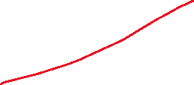



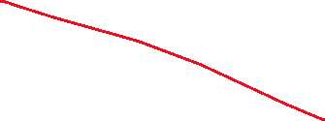

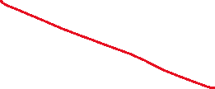
Directed Acyclic Graphs (DAGs)
4 paths
E -> M -> 0
E -> 0
E <- C -> 0
E -> S <- O

Slide 86
Directed Acyclic Graphs (DAGs)
C is a “confounder”
S is a “Collider”
M is a “Mediator”

Slide 87
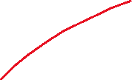




Directed Acyclic Graphs (DAGs)
Non-directed paths are potential source of bias.
Association between an exposure and an outcome can be “transmitted” through an “open” non-directed path.
E <- C -> O exits E against the direction of an arrow.
“Backdoor path”

Slide 88
Directed Acyclic Graphs (DAGs)
C is a “confounder”
The path E <- C -> O needs to be “closed”.
Conditioning can close an open path
“Controlling” for C in a regression analysis
Stratifying the analysis by C

Slide 89


Directed Acyclic Graphs (DAGs)
S is a “collider” (Two arrows entering S)
A path with a collider is closed by default.
Correlation between E and O represents a causal effect of E on O
No conditioning is needed.
No statistical adjustment is needed.

Slide 90
Directed Acyclic Graphs (DAGs)
“Controlling” for S in a regression analysis will open the path.
Biasing collider path
This will introduce bias for estimating the causal effect of E on O.

Slide 91
Directed Acyclic Graphs (DAGs)
“Controlling” for M in a regression analysis will close the path.
Block part of the effect from E to O.
This will introduce bias for estimating the causal effect of E on O.

Slide 92
Directed Acyclic Graphs (DAGs)
Estimating the overall causal effect of E on O.
Adjusting for M closes the path E -> M -> O, which is part of the causal impact of E on O
This will lead to a biased estimate!
Adjusting for C closes the path E <- C -> O, which is a biasing backdoor path.
This will remove bias caused by confounding.
Adjusting for S opens the path E -> S <- O, which becomes a biasing collider path.
This will lead to a biased estimate!

Slide 93
Directed Acyclic Graphs (DAGs)
A path can contain many variables!
A <- B <- C -> D <- E -> F -> G <- H -> I -> J
Is this path open?
If not, how to open this path?
Can we close a path after opening it?

Slide 94
De-confounding
Rule 1.
A -> B -> C, controlling for B close the path (B is a mediator)
Rule 2.
A <- B -> C, controlling for B close the path (B is a confounder)
Rule 3.
A -> B <- C, controlling for B open the path (B is a collider)

Slide 95
Rule 4. Controlling for descendants (proxies) of a variable is like partially controlling for the variable itself.
Controlling for a descendant of a mediator partially close a path
Controlling for a descendant of a collider partially open a path

Slide 96
Example 1
B is associated with both X and Y.

Slide 97
Example 1
No adjustment is needed.
Adjusting for B partially closes the path.

Slide 98



Example 2
A, B, C, D are commonly considered as “pre-exposure” variables.

Slide 99
Example 2
A, B, C, D are commonly considered as “pre-exposure” variables.
No adjustment is needed
X <- A -> B <- D -> E -> Y is closed because B is a collider.
Adjusting for B and/or C will open this path, introducing bias.
Adjusting for A will re-close this path.

Slide 100

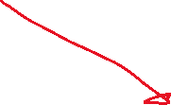

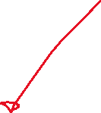
Example 3

Slide 101
Example 3
X <- B -> Y is a backdoor path
Controlling for B
If data on B is not collected, some researchers might adjust for A because A is considered to be a proxy for B
This partially close the confounding bias through B but open the path X -> A <- B -> Y

Slide 102



Example 4

Slide 103

Example 4
M-bias
B is associated with X and also Y.
Many researchers would consider B as a confounder and adjust for it.
B is in fact a collider, adjusting for B will open a non-directed path

Slide 104



Example 5

Slide 105



Example 5
Backdoor path X <- B -> C ->Y
Adjusting for B can close this path but will open the biasing collider path
X <- A -> B <- C ->Y
Adjusting for C alone will be sufficient.
Other options
E.g., Adjusting for A, B and C.

Slide 106
Smoking and infant mortality
Conditioning on a collider is not always intentional.
It can be due to selection bias
It is not uncommon for researchers to select their samples based on certain characteristics
E.g., Babies who have low birth weight…..

Slide 107



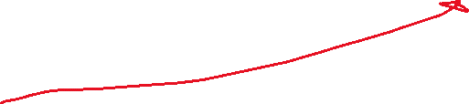

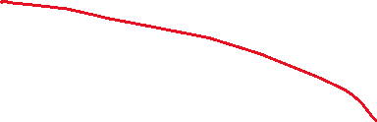

Smoking and infant mortality
When estimating the effect of smoking on mortality, conditioning on low birth weight will open the biasing path smoking -> LBW <- other risk factors -> mortality

Slide 108

Smoking and infant mortality
Among babies with low birth weight, if their mothers were smokers, smoking is likely to be a cause of LBW, and although smoking is likely to cause infant mortality, it may not cause a huge increase in risk.
Among babies with low birth weight, if their mothers were non-smokers, the cause of LBW could be due to other more dangerous conditions, and therefore, among LBW babies whose mothers were non-smokers, they would have a higher mortality rate because of these dangerous conditions.

Slide 109
Unintentional conditioning
Let’s look at the association between smoking and heart disease among people with poor mental health (e.g., depression) in a cross-sectional survey………

Slide 110




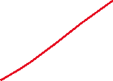
Unintentional conditioning
Let’s look at the association between smoking and heart disease among people with poor mental health (e.g., depression) in a cross-sectional survey………

Slide 112
Inverse probability treatment weighting

Slide 113
Inverse Probability Treatment Weighting (IPTW)
Emulate a RCT where confounding factors are balanced between treatment and control condition in a pseudo-population created by “treatment weight”
In a RCT, all potential confounding factors are balanced between treatment and control condition due to randomization.
Two steps
Estimate the probability of receiving/not receiving treatment and calculate the weight for each participant
The weighted sample can now be analysed as if the data is from a RCT.
Only very simple analysis is needed.

Slide 114
Inverse Probability Treatment Weighting (IPTW)
Scenario
Research question: Does adolescent cannabis use (exposure) cause use of other illicit drug use in adulthood (outcome)?
Gateway effect?
Sex is a potential confounder
Females are less likely to use cannabis during adolescence, and less likely to use illicit substance in adulthood

Slide 115
Inverse Probability Treatment Weighting (IPTW)
Research question: Does adolescent cannabis use (exposure) cause use of other illicit drug in adulthood (outcome)?
Females are less likely to use cannabis during adolescence, and also less likely to use illicit substance in adulthood
For the “treatment” group (those who used cannabis), there is a lower proportion of female
Original unweighted data
 |  | Male |  | Female
 |  | N | % | N | %
Cannabis use | No (control) | 192 | 54% | 162 | 46%
 | Yes (“treatment”) | 29 | 63% | 17 | 37%
Overall |  | 221 | 55% | 179 | 45%

Slide 116
Inverse Probability Treatment Weighting (IPTW)
Females are less likely to use cannabis during adolescence, and also less likely to use illicit substance in adulthood
Even adolescent cannabis use does not cause future illicit drug use, individual in the control group (no cannabis use) will be less likely to use illicit substance
There is likely to be an observed association between cannabis use and illicit drug use, even cannabis does not cause future illicit drug use.
 |  | Male |  | Female
 |  | N | % | N | %
Cannabis use | No (control) | 192 | 54% | 162 | 46%
 | Yes (“treatment”) | 29 | 63% | 17 | 37%
Overall |  | 221 | 55% | 179 | 45%

Slide 117
Inverse Probability Treatment Weighting (IPTW)
Original unweighted data
Remove confounding
Apply IPTW to the data
Ensure the same sex ratio in the control and treatment condition
 |  | Male |  | Female
 |  | N | % | N | %
Cannabis use | No (control) | 192 ↑ | 54% | 162 ↓ | 46%
 | Yes (“treatment”) | 29 ↓ | 63% | 17 ↑ | 37%
Overall |  | 221 | 55% | 179 | 45%
 |  | Male |  | Female
 |  | N | % | N | %
Cannabis use | No (control) | 196 | 55 | 158 | 45
 | Yes (“treatment”) | 25 | 55 | 21 | 45
Overall |  | 221 | 55% | 179 | 45%

Slide 118
De-confounding through creating a pseudo-population in which a set of potential confounders are balanced.
Can be used to estimate ATE and ATT
IPTW is commonly used to estimate ATE
Unless specified, we will focus on ATE

Slide 120
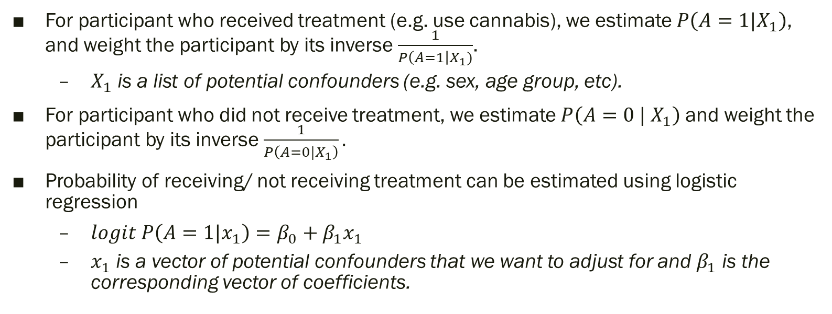
Inverse Probability Treatment Weighting (IPTW)
For participant who received treatment (e.g. use cannabis), we estimate $P\left(A=1|X_{1}\right)$, and weight the participant by its inverse $\frac{1}{P\left(A=1\right|X_{1})}$.
$X_{1}$ is a list of potential confounders (e.g. sex, age group, etc).
For participant who did not receive treatment, we estimate $P\left(A=0 | X_{1}\right)$ and weight the participant by its inverse $\frac{1}{P\left(A=0|X_{1}\right)}.$
Probability of receiving/ not receiving treatment can be estimated using logistic regression
$logit P\left(A=1|x_{1}\right)=β_{0}+β_{1}x_{1}$
$x_{1}$ is a vector of potential confounders that we want to adjust for and $β_{1}$ is the corresponding vector of coefficients.

Slide 121
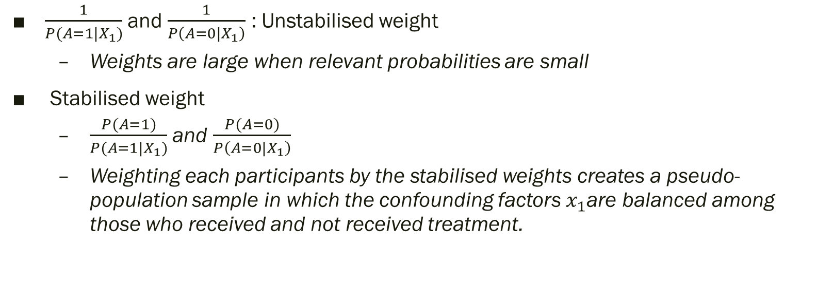
Inverse Probability Treatment Weighting (IPTW)
$\frac{1}{P(A=1|X_{1})}$ and $\frac{1}{P\left(A=0|X_{1}\right)}$ : Unstabilised weight
Weights are large when relevant probabilities are small
Stabilised weight
$\frac{P(A=1)}{P(A=1|X_{1})}$ and $\frac{P(A=0)}{P\left(A=0|X_{1}\right)}$
Weighting each participants by the stabilised weights creates a pseudo-population sample in which the confounding factors $x_{1}$are balanced among those who received and not received treatment.
 |  | Male |  | Female
 |  | N | % | N | %
Cannabis use | No (control) | 196 | 55 | 158 | 45
 | Yes (“treatment”) | 25 | 55 | 21 | 45
Overall |  | 221 | 55% | 179 | 45%

Slide 122
Inverse Probability Treatment Weighting (IPTW)
Emulate a RCT where confounding factors are balanced between treatment and control condition in a pseudo-population created by “treatment weight”
In a RCT, all potential confounding factors are balanced between treatment and control condition due to randomization.
Two steps
Estimate the probability of receiving/not receiving treatment and calculate the weight for each participant
The weighted sample can now be analysed as if the data is from a RCT.
Only very simple analysis is needed.

Slide 123
Exercise
Research question
Does smoking have a causal impact on psychological distress?
Follow the instruction in Appendix 1 to reproduce the results
What is the conclusion?
The numbers you obtained might be slightly different from those in the appendix due to difference in version package.

Slide 125
Assumption
Assumptions of IPTW analysis is similar to those from matching
No interference
Consistency
No unmeasured confounding
Positivity
Correct specification of the IPTW model
This assumption is likely to be violated
Include interaction and higher order terms could improve the validity of this assumption

Slide 127
Consideration for IPTW
Distribution of weight
Large weight increases noise in the estimate
What if a single participant has a weight of 1000
This single participant represents 1000 people!
Observation from this single participant could have substantial influence on the result.

Slide 128
Consideration for IPTW
Distribution of weight
A large weight could also indicate near violation of the positivity assumption.
Participant with extremely large weight suggests that having certain combination of covariates are highly unlikely to receive treatment.

Slide 129
Consideration for IPTW
Plot the weight
smk_data %>% ggplot(aes(x = weight)) + geom_histogram(color = "white", alpha = 0.60, position = "identity", na.rm = TRUE)
Summarise statistics
summary(smk_data$weight)
head(sort(smk_data$weight), 10)
tail(sort(smk_data$weight), 10)

Slide 130
Consideration for IPTW
Weight truncation
Discard participants with extremely large weight
Bias-variance trade-off
Dropping participants will lead to biased estimate
But dropping participants with large weight will reduce variance

Slide 131
Consideration for IPTW
Weight truncation
Drop participants with over the 99% percentile
quantile(smk_data$weight, c(.99))
truncated_smk_data <- smk_data[smk_data$weight < 16.82, ]
design_iptw2 <- svydesign(ids = ~1, weights = ~weight, data = truncated_smk_data)

Slide 133
Exercise
Repeat the analysis in Appendix 2
Examine the distribution of weight
Drop participants with weight over 99% percentile
Compare your results

Slide 134
Exercise
IPTW can be used to estimate ATT.
Repeating the analysis but change the “estimand” to “ATT”
Conduct one set of analysis using all participants
Conduct another set of analysis using truncated weights
Compare the results from matching

Slide 136
Extension to multi-wave studies
Marginal structural Model (MSM) using IPTW
The terms MSM have been used very loosely in applied research.
MSM is a model for the mean of the potential outcome.
IPTW can be used to estimate the parameters in MSM.

Slide 137
Extension to multi-wave study
Marginal structural Model using IPTW
Does adolescent cannabis use lead to other illicit substance use in adulthood?
Peers’ cannabis use is likely to be a confounder
Having peers who used cannabis increases the risk of using cannabis and also other substance.
Peers’ cannabis use is likely to be a mediator
An individual’s own cannabis use also increase affiliation with peers who use cannabis.
Peers’ cannabis is thus a time-varying confounder that is
affected by prior “treatment” (individual’s own cannabis use)
affect both future cannabis use (i.e. future “treatment”) and illicit substance use (outcome)

Slide 138
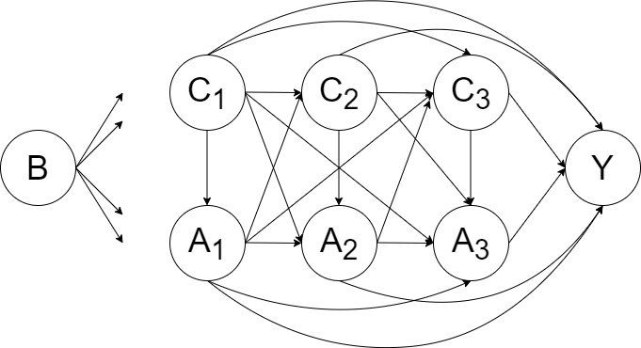
Extension to multi-wave study
B – A set of baseline confounders (It could be considered as a subset of C1 )
C1, C2 and C3 – A set of potential time-varying confounders for exposure A1, A2 and A3.
A1, A2 and A3 – Time-varying exposure (Affected by previous exposure and confounders; affect future exposure and future confounders)
Y – outcome

Slide 139
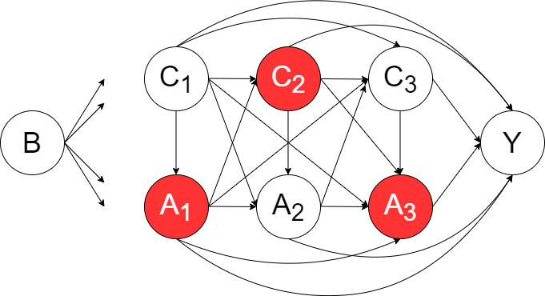
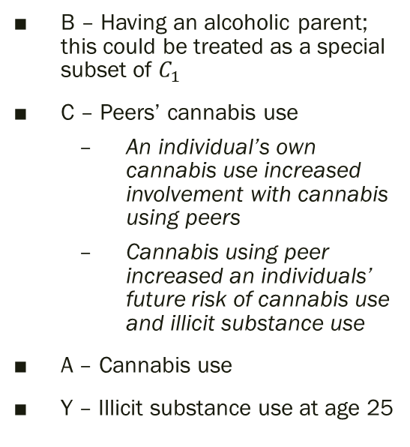
Extension to multi-wave study
B – Having an alcoholic parent; this could be treated as a special subset of $C_{1}$
C – Peers’ cannabis use
An individual’s own cannabis use increased involvement with cannabis using peers
Cannabis using peer increased an individuals’ future risk of cannabis use and illicit substance use
A – Cannabis use
Y – Illicit substance use at age 25

Slide 140
Extension to multi-wave study
Standard methods such as regression analysis will produce biased estimates.
Adjusting for peers’ cannabis use - block part of the causal effect from previous cannabis use because it is a mediator
Not adjusting for peers’ cannabis use – ignore the confounding effects; violate the exchangeability assumption (no unmeasured confounding)

Slide 141
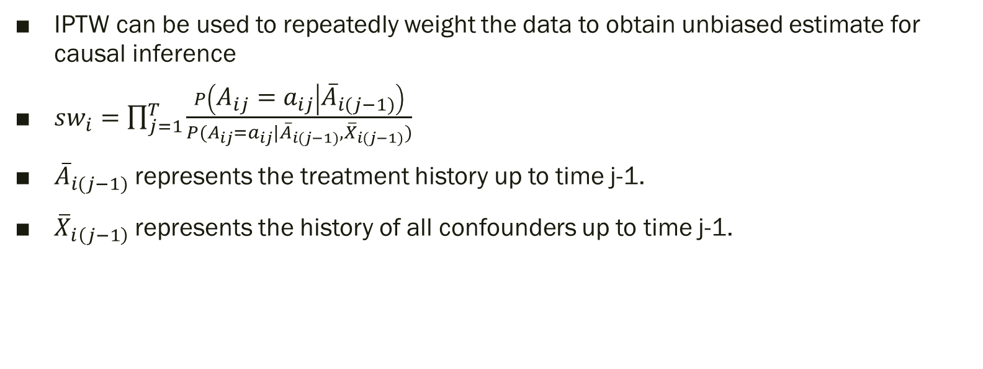
Extension to multi-wave study
IPTW can be used to repeatedly weight the data to obtain unbiased estimate for causal inference
$sw_{i}=\prod_{j=1}^{T}{\frac{P\left(A_{ij}=a_{ij} | {\overline{A}}_{i(j−1)}\right)}{P(A_{ij}=a_{ij}|{\overline{A}}_{i(j−1)}, {\overline{X}}_{i(j−1)})}}$
${\overline{A}}_{i(j−1)}$ represents the treatment history up to time j-1.
${\overline{X}}_{i\left(j−1\right)}$represents the history of all confounders up to time j-1.

Slide 142
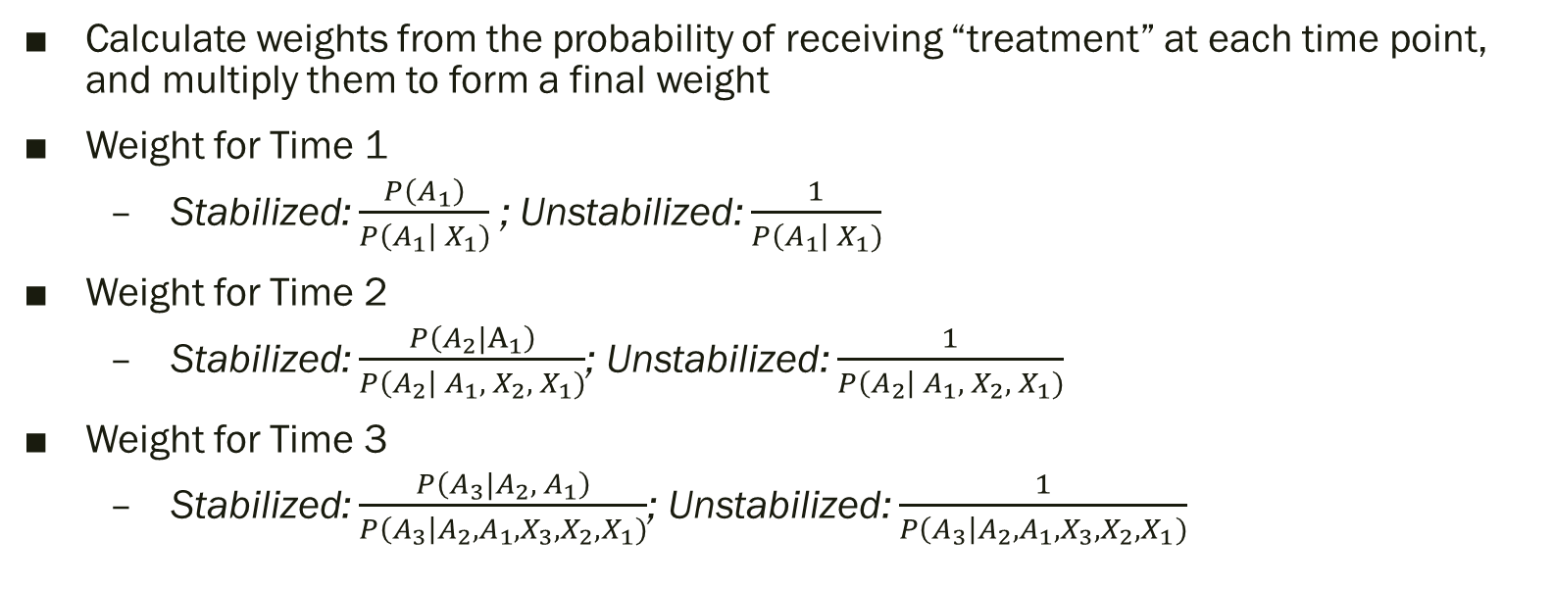
Calculating weights
Calculate weights from the probability of receiving “treatment” at each time point, and multiply them to form a final weight
Weight for Time 1
Stabilized: $\frac{P\left(A_{1}\right)}{P\left(A_{1}\right| X_{1})}$ ; Unstabilized: $\frac{1}{P\left(A_{1}\right| X_{1})}$
Weight for Time 2
Stabilized: $\frac{P\left(A_{2}|A_{1}\right)}{P\left(A_{2}\right| A_{1}, { X_{2}, X}_{1})}$; Unstabilized: $\frac{1}{P\left(A_{2}\right| A_{1}, { X_{2}, X}_{1})}$
Weight for Time 3
Stabilized: $\frac{P\left(A_{3}|A_{2},{ A}_{1}\right)}{P\left(A_{3}\right|A_{2},A_{1},X_{3}, X_{2}, X_{1})}$; Unstabilized: $\frac{1}{P\left(A_{3}\right|A_{2},A_{1},X_{3}, X_{2}, X_{1})}$

Slide 143

Calculating weights
Final weight:
Weight at Time 1 x Weight at Time 2 x Weight at Time 3
$\frac{P\left(A_{1}\right)}{P\left(A_{1}\right| {\overline{X}}_{1})}$ x $\frac{P\left(A_{2}|A_{1}\right)}{P\left(A_{2}\right| A_{1}, { X_{2}, X}_{1})}$ x $\frac{P\left(A_{3}|A_{2},{ A}_{1}\right)}{P\left(A_{3}\right|A_{2},A_{1},X_{3}, X_{2}, X_{1})}$

Slide 144
Confounders
A confounder is a variable that influence both the exposure and the outcome
Theoretical framework from developmental psychology
Three key domains of influence: Family, peer and school
Variables used to calculate the IPTW
Academic achievement (Time-varying)
Peer group (Time-varying)
Family members’ substance use (only measured at baseline)
For each time point, the set of confounders can be taken from the previous time point
E.g. Peers’ cannabis use at wave 1 is used to predict probability of cannabis use at wave 2

Slide 145
Exercise
Does home alcohol access have an effect on future risky alcohol use?
Follow the instruction on Appendix 3.

Slide 147
Sensitivity analysis
All models are wrong!
The assumption “no unmeasured confounding” is very likely to be violated because it is impossible to adjust for all confounders
We hope that bias from unmeasured confounding is negligible after adjusting for key confounders
Key references
VanderWeele and Mathur (2020). Developing best-practice guidelines for the reporting of E-values.
VanderWeele and Ding (2017). Sensitivity analysis in observational research: Introducing the E-Value

Slide 148
Sensitivity analysis
Sensitivity analysis can be used to evaluate how “sensitive” our findings are to confounding.
How much unmeasured confounding is needed to negate a conclusion?
E-value
The minimum strength of association, on the risk ratio scale, that an unmeasured confounder would need to have with both the treatment and the outcome to fully explain away a specific treatment-outcome association, conditional on the measured covariates.

Slide 149
Sensitivity analysis
Install and load the Evalue package
install.packages(“EValues”, dependencies = T) library(“Evalues”)
?Evalue
Online calculator
https://www.evalue-calculator.com/

Slide 150
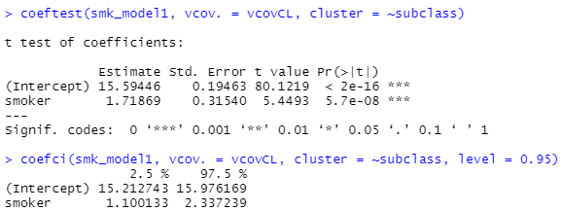
Example
For linear regression, we need the estimate, the associated standard error and also standard deviation of the outcome.
The estimate is 1.72, with a standard error of 0.315.

Slide 151
Example
We also need to calculate the standard deviation of the outcome
Putting it together
est = OLS(1.72, sd = 6.9261) evalue(est = est, se = 0.315)

Slide 152
Exercise
Calculate the E-value from logistic regression
We will need the odds ratio and the corresponding confidence interval
The R function for this calculation is in the form
evalue(est = OR(?, rare = FALSE), lowerOR, upperOR)
Replace ?, lowerOR and upperOR with relevant value.
What is the E-value for an OR of 2 with a 95% CI (1.63, 2.44)?

Slide 153
Reporting E-value
Reporting the E-value for the estimate and the confidence interval
What are some potential confounders that are not measured, and could potentially negate the findings
In the literature, what is the effect size of such unmeasured confounders on the exposure and outcome – is the effect large enough the negate the finding?

Slide 155
Preparing the results for publication
Reproducible
Before starting the analysis, thoroughly think through the analysis plan
Pre-register your hypothesis and analytic on open science framework or other related open repository is recommended
“It is hypothesized the smokers had higher level of psychological distress.”
“Propensity score matching will match smokers with non-smokers on the following variables: biological sex, age, education level, ….. Different matching ratio and matching algorithm will be used. The set of matching ratio and algorithm that produce the best match will be determined based on standard mean difference and distribution in all variables used for matching. Once an ideal set of matches is identified, to estimate the average treatment effect among the treated of smoking on psychological distress, we will fit a linear regression model using psychological distress as the outcome and smoking status (smoker vs non-smoker) as the exposure variable, with other variables used in the matching procedure as covariates. Cluster-robust variance will be used to estimate standard errors with matching stratum membership pas the clustering variable.”

Slide 156
Preparing results for publications
Reporting the results
Propensity score matching was used to estimate the average treatment effect among treated (ATT) of smoking on psychological distress, accounting for confounding by the included covariates. Propensity scores were estimated using logistic regression. Smokers were matched to non-smokers at 1:1 ratio without replacement using optimal matching. This configuration produced adequate balance in all included variables (Table 1). Standardised mean differences for all included variables were less than 0.1. Each smoker was matched with a non-smoker, and the final sample size was 1948. Psychological distress was then regressed on smoking status and other variables in a linear regression. Cluster-robust standard error was used to account for clustering. This analysis estimated the effect of smoking was 1.71 (95% CI = [1.14, 2.35]), indicating smoking on average increased psychological distress by 1.71. To evaluate if the finding was sensitive to unmeasured confounding, E-value was calculated. E-value represents the minimum strength of association, on the risk ratio scale, that an unmeasured confounder would need to have with both the smoking status and psychological distress to fully explain away the effect found in this study. The E-value for the estimate was 1.82 and the lower bound of the confidence interval was 1.59, indicating that a moderate level (THIS NEEDS SUBJECTIVE JUDGEMENT AND FURTHER DISCUSSION IN THE DISCUSSION SECTION) of confounding was needed to negate our finding. All analyses were done in R 4.2.1 with the MatchIt, sandwich, and lmtest package.

Slide 158
Thank you.
Follow me on Twitter for future statistics webinar @GaryCkChan
Email: c.chan4@uq.edu.au

