Slide 1
causal inference with observational data in addiction research
Dr. Gary Chan StatsNotebook.io National Centre for Youth Substance Use Research, University of Queensland

Slide 3
Outlines
Directed Acyclic Graphs
Propensity score matching
Modified disjunctive cause criterion

Slide 4
Software for today’s workshop
R
RStudio

Slide 5
Disclaimer
No statistical methods can replace good study design.
Application of causal models do not guarantee that you can make causal claims (and most of the time, you CANNOT make causal claims).
Causal inference using observational data can only be made under certain assumptions
Use of certain statistical method is more likely to let you draw valid causal inference.

Slide 6
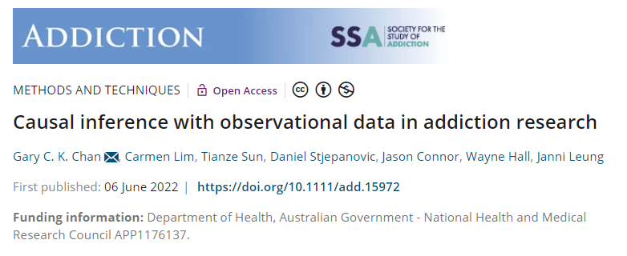
Methods paper in Addiction
Potential outcome/ Counterfactual framework
Matching
Propensity score
Inverse probability treatment weighting
Marginal structural model
Interrupted time series with controls

Slide 7
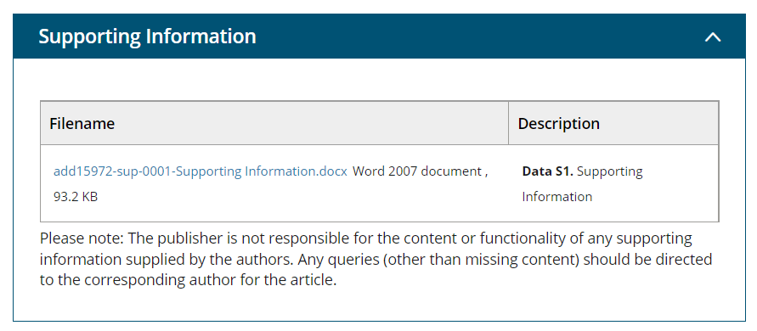
Download the appendix of this paper
https://onlinelibrary.wiley.com/doi/10.1111/add.15972

Slide 8
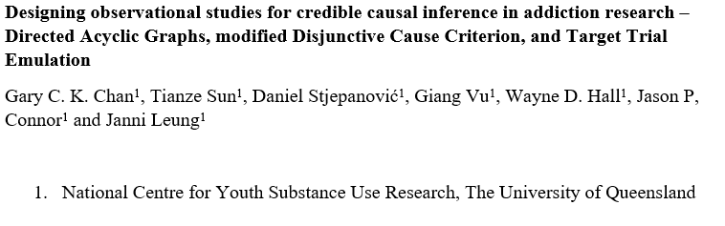
DAGs
Modified Disjunctive Cause Criterion
Target Trial Emulation

Slide 10
Causal inference and Randomised controlled trials

Slide 11
RCTs
Randomized controlled trial is considered by many to be the gold standard for establishing causal relationship
Participants are assigned randomly into receiving treatment or not receiving treatment
With a sufficiently large sample size, randomizing participants to treatment or control (placebo) conditions ensures that all pre-treatment variables, measured or unmeasured, are similarly distributed across conditions.
This theoretically allows the treatment effect to be isolated.

Slide 12
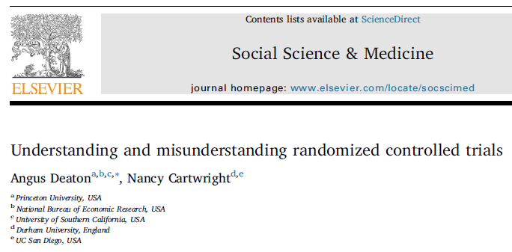
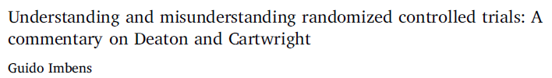
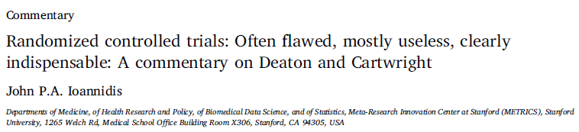
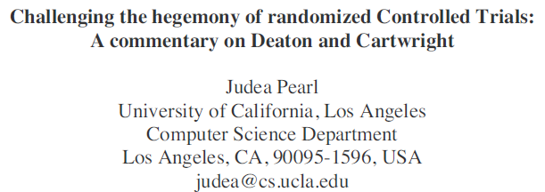
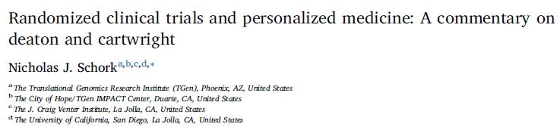
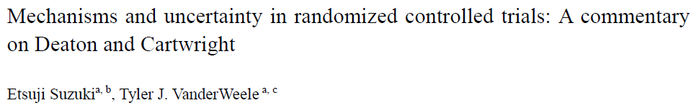

Slide 13
RCTs
The mere act of randomisation does not guarantee a balance in all pre-treatment variables between the treatment and control group
In the presence of a large number of causes for the outcome, the sample size required to achieve this balance often exceed the typical sample size in published research (N ~ 80).

Slide 14
RCTs
If an outcome can be caused by many variables, with a small sample size, it is likely that at least one of the causes is not balance between the treatment and control group.
Youth smoking is caused by a large range of factors
Family factor – parental monitoring, parental substance use
Biological factor – genetic susceptibility to nicotine
Community factor – Local law on tobacco control, density of tobacco retail outlets
With a small sample size, very likely that at least one of the causes are higher in one group
Random confounding
This is a separate issue from the sample size calculation for statistical power
This is often not considered by the researchers

Slide 15
RCTs
May lack generalizability
RCTs are often conducted in highly controlled environment that do not resemble any real-life circumstances.
Not always feasible, particularly regarding questions of harm
Does smoking cause cancer?
Does cannabis use cause psychosis?
Not suitable for studying sustained exposure over a long period of time and long-term outcome
Does daily smoking over 10 years cause cancer?
Does heavy cannabis use during adolescence increase risk of psychosis in mid-adulthood?

Slide 16
Observational studies
Real-world evidence is needed
Observational studies
21st Century Cures Act supports the use of real-world data from observational studies for health care decisions and drug approvals.

Slide 17
Observational studies
Major threats
Confounding bias
Selection bias

Slide 18
Observational studies
Provides “real world evidence”
Cancer outcome among smokers and non-smokers
Psychosis among cannabis users and non-users
Biggest threat for causal inference
Confounding
Systematic difference between those who were under “treatment” condition (i.e. smoking and using cannabis) and “control” condition
E.g. factors that predisposed individual to unhealthy habits that lead to smoking and long-term adverse health outcome (e.g. Socioeconomic disadvantage?)

Slide 19


Confounding
Ice cream sales is strongly associated with shark attack.

Slide 20

Confounding
Ice cream sales is strongly associated with shark attack.

Slide 22
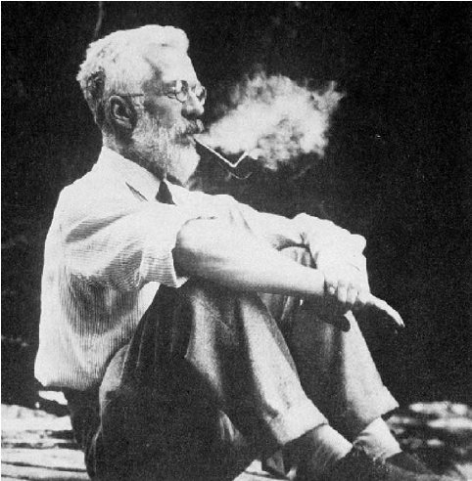
Convince me that smoking causes cancer (Imagine you were in the 60s)

Slide 23
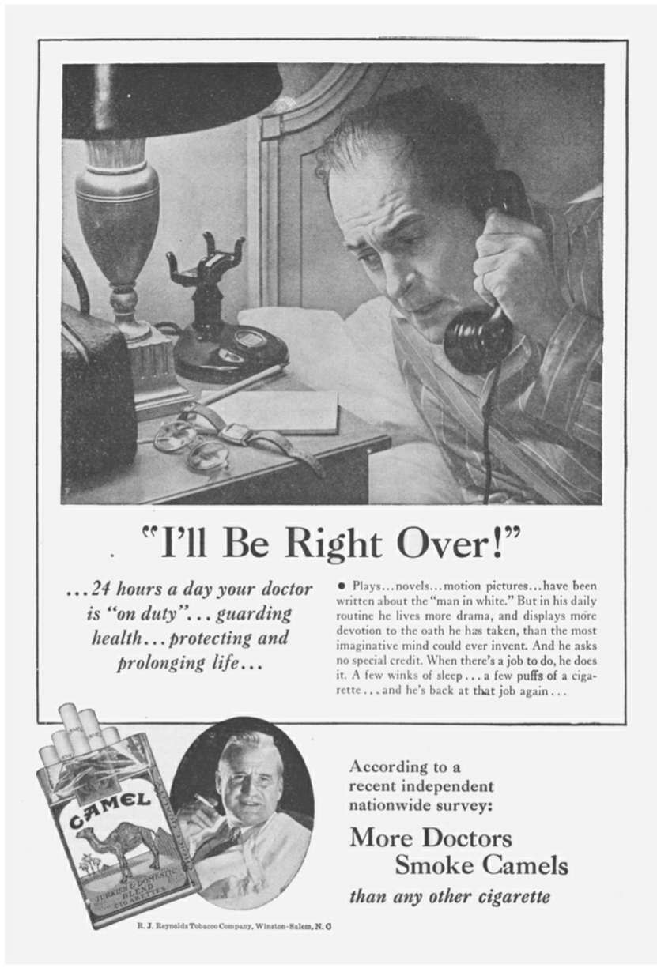
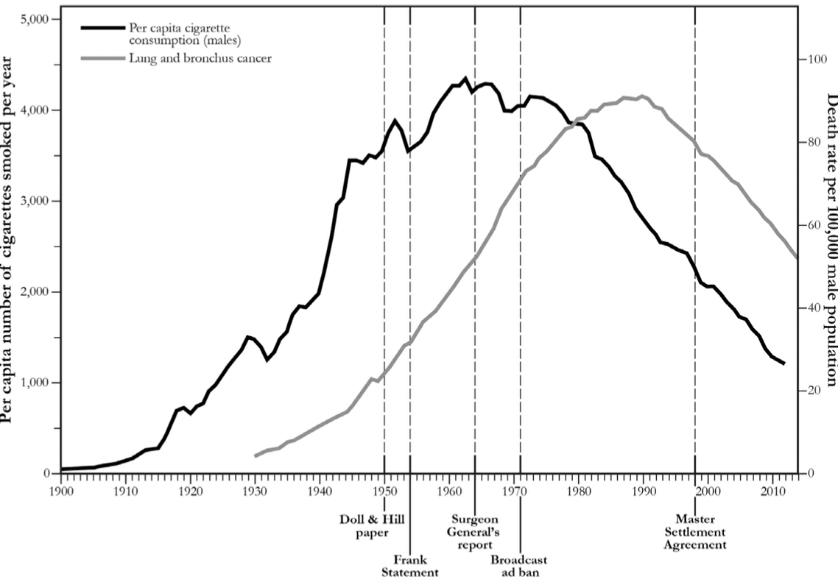

Slide 24
“Motor cars… were a new factor and if I had had to put money on anything at the time, I should have put it on motor exhausts or possibly the tarring of roads”
- Richard Doll

Slide 25
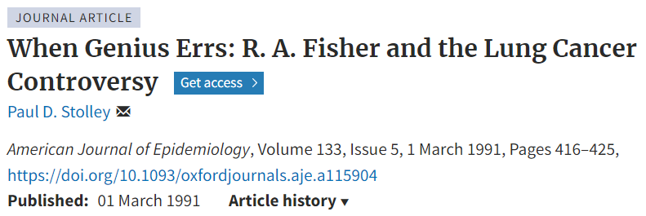

Slide 27
What variables should we adjust for? A short introduction to directed acyclic graph (DAG)

Slide 28
Key reference
Pearl, Glymour and Jewell (2016). Causal inference in statistics, A Primer.
Pearl and MacKenzie (2019). The book of why. The new science of cause and effect.

Slide 29
We record the recovery rates of 700 patients who were given access to a drug. A total of 350 patients chose to take the drug and 350 patients did not.
Would you recommend this drug?
 | Drug | No drug
Men | 81 out of 87 recovered (93%) | 234 out of 270 recovered (87%)
Women | 192 out of 263 recovered (73%) | 55 out of 80 recovered (69%)
Combined data | 273 out of 350 recovered (78%) | 289 out of 350 recovered (83%)

Slide 30
A drug could affect recovery by lowering the blood pressure but it could also have a toxic effect. Blood pressure and recovery outcome were recorded at the end of the trial.
Would you recommend this drug?
 | Drug | No drug
Low blood pressure | 81 out of 87 recovered (93%) | 234 out of 270 recovered (87%)
High blood pressure | 192 out of 263 recovered (73%) | 55 out of 80 recovered (69%)
Combined data | 273 out of 350 recovered (78%) | 289 out of 350 recovered (83%)

Slide 31
Multiple studies demonstrated that low birth-weight children born to smoking mothers have LOWER risk of infant mortality.
Smoking might be a good way to prevent infant mortality?
Maybe at least for some babies, having a smoking mother may be beneficial?

Slide 32
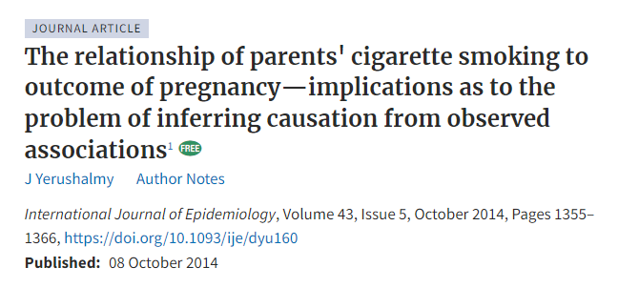
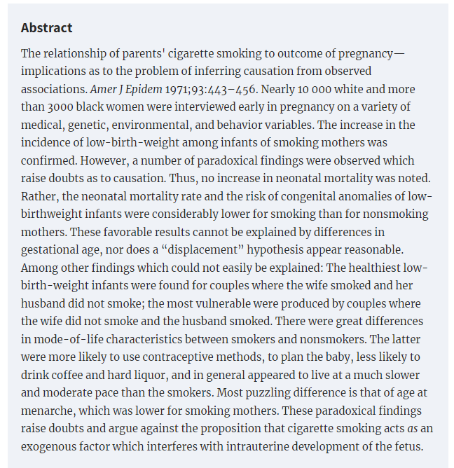

Slide 34
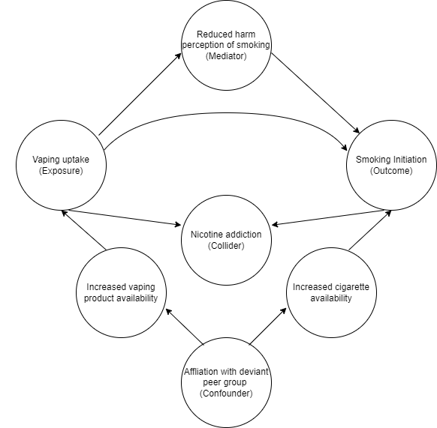
DAGs
Construction based on expert knowledge, theory, existing research
Hypothetical example
For illustration purpose only
Illustrate the rules to de-confound the exposure outcome association
To fully de-confound the exposure-outcome association, much more variables need to be considered.

Slide 35

DAGs
Represent assumptions between variables
Use arrows to show the direction of hypothesized causal effect
“X causes Y, Y causes Z”, “X causes Z”
Y is the descendant of X
X is the ancestor of Y

Slide 36

DAGs
Path – a sequence of arrows
Directed path
Sequence of arrows in the same direction
Represents causal effect
Total causal effect
Joint effect of all directed paths from exposure to outcome

Slide 37



DAGs
Non-directed path
These paths may transmit non-causal association
Backdoor path

Slide 38
DAGs
Confounder is often defined as a common cause of both exposure and outcome
Backdoor path
A path between the exposure and outcome with an arrow pointing to the exposure
Such path needs to be blocked
“Adjusting” for one or more variables in this path in a multivariable regression model

Slide 39

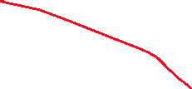





Directed Acyclic Graphs (DAGs)
If all the paths from an exposure (E) to an outcome (O) are directed paths, the observed association (e.g., correlation) is an unbiased estimate of the causal effect of E on O.

Slide 40
DAGs
Colliders
Variable with two arrows pointing to it.
Path with a collider is by default blocked.
“Adjusting” for a collier will “open” a path, allowing information to flow through and induce a non-causal association between exposure and outcome

Slide 41
DAGs
Mediator
Variable on a directed path between the exposure and outcome
“Adjusting” for a mediator will block part of the total causal effect from the exposure to the outcome
Mediator should not be adjusted for (except in mediation analysis)

Slide 42
DAGs
Confounder
Collider
Mediator

Slide 43
--- QUICK RECAP ---

Slide 44
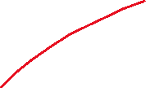




Directed Acyclic Graphs (DAGs)
Non-directed paths are potential source of bias.
Association between an exposure and an outcome can be “transmitted” through an “open” non-directed path.
E <- C -> O exits E against the direction of an arrow.
“Backdoor path”

Slide 45
Directed Acyclic Graphs (DAGs)
C is a “confounder”
The path E <- C -> O needs to be “closed”.
Conditioning can close an open path
“Controlling” for C in a regression analysis
Stratifying the analysis by C

Slide 46


Directed Acyclic Graphs (DAGs)
S is a “collider” (Two arrows entering S)
A path with a collider is closed by default.
Correlation between E and O represents a causal effect of E on O
No conditioning is needed.
No statistical adjustment is needed.

Slide 47
Directed Acyclic Graphs (DAGs)
“Controlling” for S in a regression analysis will open the path.
Biasing collider path
This will introduce bias for estimating the causal effect of E on O.

Slide 48
Directed Acyclic Graphs (DAGs)
“Controlling” for M in a regression analysis will close the path.
Block part of the effect from E to O.
This will introduce bias for estimating the causal effect of E on O.

Slide 49




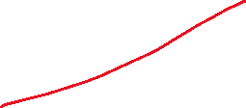



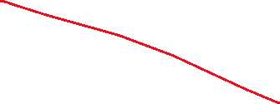

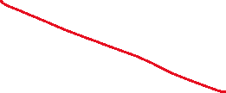
Directed Acyclic Graphs (DAGs)
Estimating the overall causal effect of E on O.
Adjusting for M closes the path E -> M -> O, which is part of the causal impact of E on O
This will lead to a biased estimate!
Adjusting for C closes the path E <- C -> O, which is a biasing backdoor path.
This will remove bias caused by confounding.
Adjusting for S opens the path E -> S <- O, which becomes a biasing collider path.
This will lead to a biased estimate!

Slide 50
Directed Acyclic Graphs (DAGs)
A path can contain many variables!
A <- B <- C -> D <- E -> F -> G <- H -> I -> J
Is this path open?
If not, how to open this path?
Can we close a path after opening it?

Slide 51
De-confounding
Rule 1.
A -> B -> C, open by default, controlling for B close the path (B is a mediator)
Rule 2.
A <- B -> C, open by default, controlling for B close the path (B is a confounder)
Rule 3.
A -> B <- C, closed by default, controlling for B open the path (B is a collider)

Slide 52
De-confounding
Rule 4. Controlling for descendants (proxies) of a variable is like partially controlling for the variable itself.
Controlling for a descendant of a mediator partially close a path
Controlling for a descendant of a collider partially open a path

Slide 54
Example 1
B is associated with both X and Y.

Slide 55
Example 1
No adjustment is needed.
Adjusting for B partially closes the path.

Slide 56



Example 2
A, B, C, D are commonly considered as “pre-exposure” variables.

Slide 57
Example 2
A, B, C, D are commonly considered as “pre-exposure” variables.
No adjustment is needed
X <- A -> B <- D -> E -> Y is closed because B is a collider.
Adjusting for B and/or C will open this path, introducing bias.
Adjusting for A will re-close this path.

Slide 58

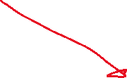

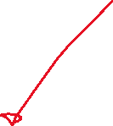
Example 3

Slide 59
Example 3
X <- B -> Y is a backdoor path
Controlling for B
If data on B is not collected, some researchers might adjust for A because A is considered to be a proxy for B
This partially close the confounding bias through B but open the path X -> A <- B -> Y

Slide 60



Example 4

Slide 61

Example 4
M-bias
B is associated with X and also Y.
Many researchers would consider B as a confounder and adjust for it.
B is in fact a collider, adjusting for B will open a non-directed path

Slide 62



Example 5

Slide 63



Example 5
Backdoor path X <- B -> C ->Y
Adjusting for B can close this path but will open the biasing collider path
X <- A -> B <- C ->Y
Adjusting for C alone will be sufficient.
Other options
E.g., Adjusting for A, B and C.

Slide 64
Smoking and infant mortality
Conditioning on a collider is not always intentional.
It can be due to selection bias
It is not uncommon for researchers to select their samples based on certain characteristics
E.g., Babies who have low birth weight…..

Slide 65



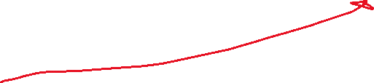

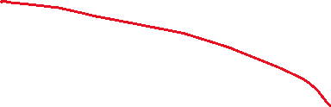

Smoking and infant mortality
When estimating the effect of smoking on mortality, conditioning on low birth weight will open the biasing path smoking -> LBW <- other risk factors -> mortality

Slide 66
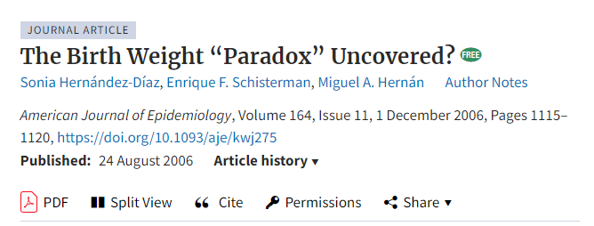
Smoking and infant mortality
Among babies with low birth weight, if their mothers were smokers, smoking is likely to be a cause of LBW, and although smoking is likely to cause infant mortality, it may not cause a huge increase in risk.
Among babies with low birth weight, if their mothers were non-smokers, the cause of LBW could be due to other more dangerous conditions, and therefore, among LBW babies whose mothers were non-smokers, they would have a higher mortality rate because of these dangerous conditions.

Slide 67
Unintentional conditioning
Let’s look at the association between smoking and heart disease among people with poor mental health (e.g., depression) in a cross-sectional survey………

Slide 68




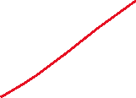
Unintentional conditioning
Let’s look at the association between smoking and heart disease among people with poor mental health (e.g., depression) in a cross-sectional survey………

Slide 69
We record the recovery rates of 700 patients who were given access to a drug. A total of 350 patients chose to take the drug and 350 patients did not.
Would you recommend this drug?
 | Drug | No drug
Men | 81 out of 87 recovered (93%) | 234 out of 270 recovered (87%)
Women | 192 out of 263 recovered (73%) | 55 out of 80 recovered (69%)
Combined data | 273 out of 350 recovered (78%) | 289 out of 350 recovered (83%)

Slide 70
A drug could affect recovery by lowering the blood pressure but it could also have a toxic effect. Blood pressure and recovery outcome were recorded at the end of the trial.
Would you recommend this drug?
 | Drug | No drug
Low blood pressure | 81 out of 87 recovered (93%) | 234 out of 270 recovered (87%)
High blood pressure | 192 out of 263 recovered (73%) | 55 out of 80 recovered (69%)
Combined data | 273 out of 350 recovered (78%) | 289 out of 350 recovered (83%)

Slide 72
Propensity score matching

Slide 73

Potential outcomes/ Counterfactual framework
Two treatment conditions: Treatment ($A=1$) and control ($A=0$).
For an individual $i$, there would be two potential outcomes: $Y_{i}^{A=1}$and $Y_{i}^{A=0}$
The individual causal effect of the treatment: $Y_{i}^{A=1}{− Y}_{i}^{A=0}$
Only one of the outcomes is observed.

Slide 74


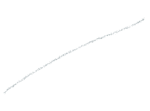














What could have happened should this participant not received treatment
Participant
Individual causal effect of treatment: Difference between these two potential outcomes
Challenge:
Only one of these outcomes can be observed
What could have happened should this participant received treatment

Slide 75

What could have happened should all participants not received treatment
Average Treatment Effect (ATE):
Average difference between these two potential outcomes in the study population
What would have happened in the population should the whole population received treatment vs the whole population not received treatment
Classical treatment effect estimated from RCT
Participants
Statistical solution:
Some of the participants received treatment
Some didn’t
ATE can be estimated
What could have happened should all participants received treatment

Slide 76

What could have happened should those participants who received treatment not received treatment
This is a counterfactual outcome.
Average Treatment Effect on the Treated (ATT):
Average difference between the outcome of those who were treated and the counterfactual outcome of what would have happened should these participants not received treatment
Participants
Statistical solution:
Some of the participants received treatment
Some didn’t
ATT can be also estimated
In RCT, ATT and ATE are the same.
What happen to participants who received treatment

Slide 77
Propensity Score Matching
Emulate a RCT where confounding factors are balanced between treatment and control condition
In a RCT, all potential confounding factors are theoretically balanced between treatment and control condition due to randomization.
In RCT, ATT and ATE are the same
In observational study, they could be different
Need to decide what to estimate
ATE: More appropriate for treatment that targets the whole population
Distributing information flyer to smokers for smoking cessation
ATT : More appropriate for treatment that is more individualized, or has higher access barrier
Intensive, structured smoking cessation program delivered by psychologist

Slide 78
Propensity Score Matching
Matching can be used to estimate ATT and ATE, but is commonly used to estimate ATT.
Will focus on ATT in this talk.
Two steps
For each treated participant, match this participants with an untreated participant who has very similar characteristics
The matched sample can now be analysed as if the data is from a RCT, with adjustment for standard error to adjust for the potential bias introduced in the matching process.

Slide 79
Propensity Score Matching
Matching can be used to estimate ATT and ATE, but is commonly used to estimate ATT.
Will focus on ATT in this talk.
Two steps
For each treated participant, match this participants with an untreated participant who has very similar characteristics
The matched sample can now be analysed as if the data is from a RCT, with adjustment for standard error to adjust for the potential bias introduced in the matching process.

Slide 80
Propensity score matching
Propensity score can be considered as the probability of receiving treatment, calculated based on a range of covariates (potential confounders)
Can be estimated using logistic regression or non-parametric machine learning method

Slide 81

Participants from an observational study

Slide 82
Participants from an observational study

Slide 83
Propensity score matching
What is the effect of smoking on psychological distress?
The demographic of smokers and non-smokers are often very different
The association could be confounded by
Education level
Socio-economic status
And many other factors
If we are able to perform a RCT, we would randomised participants into “smoking” and “non-smoking” condition, and measure their psychological distress at a certain time point.
With a large enough sample, randomisation will ensure that education level, SES and other variables are balanced between the smoking and non-smoking group.

Slide 84
Observational study
Propensity Score Matching
 | Unmatched sample mean |  |  | Matched sample mean
 | Smoke (N = 974) | Not smoke (N = 7026) | Standardised mean difference | Smoke (N = 974) | Not smoke (N = 974) | Standardised mean difference
Male | 0.494 | 0.442 | 0.104 | 0.494 | 0.475 | 0.037
Indigenous status | 0.052 | 0.018 | 0.157 | 0.052 | 0.048 | 0.018
Finished high school | 0.422 | 0.638 | -0.437 | 0.422 | 0.436 | -0.029
Partnered | 0.463 | 0.691 | -0.458 | 0.463 | 0.444 | 0.039
Regionality
Major cities | 0.585 | 0.677 | -0.187 | 0.585 | 0.587 | -0.004
Inner regional | 0.218 | 0.190 | 0.067 | 0.218 | 0.232 | -0.035
Outer regional or more remote | 0.197 | 0.133 | 0.162 | 0.197 | 0.181 | 0.041
English speaking | 0.958 | 0.913 | 0.223 | 0.958 | 0.954 | 0.021
Risky alcohol use | 0.643 | 0.541 | 0.212 | 0.643 | 0.640 | 0.006
Age | 51.606 | 53.782 | -0.168 | 51.606 | 51.298 | 0.024

Slide 85
Advantage of matching
Clearly separate the “design” and “analysis” phase.
Calculating propensity score can be considered as the “design” phase, like the randomisation phase in RCTs.
Outcome is not used in the matching procedures
A researchers can fit many models to the data and pick the one that produce the best balance.
The researchers proceed to the “analysis” phase only when a good balance is achieved.
Reduce the temptation to cherry-pick a model that produces the desired conclusion

Slide 86
Advantage of matching
In regression analysis, the researchers can only hope that adding covariates into the model can adjust for potential confounding effect from other variables
In matching, the researchers can specifically check whether balance is achieved,
Even if balance is not achieved, the researchers can evaluate how bad the imbalance is, and can inform future data collection.

Slide 87
Second stage
A simple regression analysis using the matched sample
The DV is regressed on the IV, other covariates are not necessary. Cluster-robust standard error is required to account for the matching procedure.
Adding covariates can produce “doubly robust” estimates
As long as one of the model is correctly specified (either the propensity score model or the regression model), the effect estimate will be unbiased.

Slide 89
Considerations for PSM
Matching method
Nearest
For each treated participant, find a participant in the control group that is closest match
Matching occurs at individual level, it might not produce the “best overall” match at the group level
Very fast algorithm

Slide 90













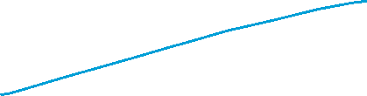

Slide 91
Considerations for PSM
Matching method
Optimal
Consider the overall matching quality
Take longer to run
Modern computer can usually produce the matched set within a reasonable time frame

Slide 92
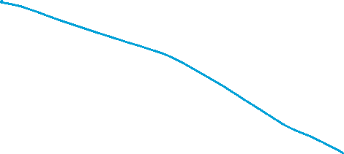
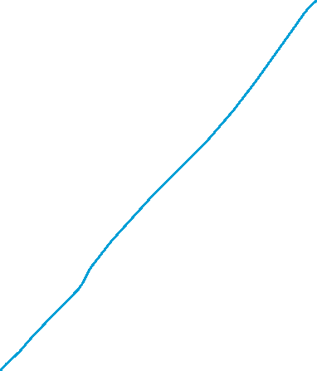
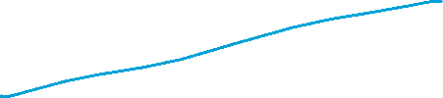

Slide 93
Considerations for PSM
Matching ratio
1:1
Match each treated participant to one participant in the control group
Major concern
Discarding a large number of observation
May reduce power

Slide 94
Considerations for PSM
Matching ratio
1:1
Reduction in power is usually minimal
Precision is largely driven by the smaller group (treatment group in most case)
Increasing the sample size from the control group may not increase power much

Slide 95
Considerations for PSM
Matching ratio
1:M
Retain a larger proportion of the sample (mainly from the control group)
By definition, this will produce worse matches
The 2nd , 3rd , 4th … by definition produce worse match than the 1st match
Bigger bias in the estimates
Bias-variance trade off
May slightly increase power and reduce variance in the estimates
But inducing a larger bias in the estimates
If data is yet to be collected
Cost consideration

Slide 96
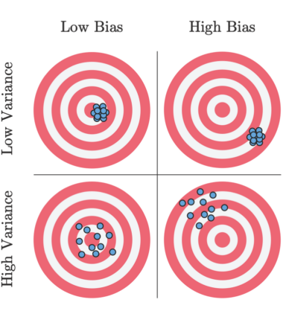
Considerations for PSM
Bias-variance trade-off

Slide 97
Considerations for PSM
With or without replacement
Matching with replacement often produce better match
Participants from the control group can be “re-used”
Inference becomes more complex because of the increased dependence in the data

Slide 99
Assumption
There are several key assumptions of the propensity score methods.
No interference
Whether an individual receives treatment does not affect the outcome of another individual.
Violated if there is a spillover or contagion effect
Vaccination in small community

Slide 100
Assumption
There are several key assumptions of the propensity score methods.
Consistency
For each individual, only one of the two potential outcomes is observed. This assumption requires that the potential outcome under the observed treatment is the same as the observed outcome.
A technical assumption to link the counterfactual world and the real world
Untestable

Slide 101
Assumption
There are several key assumptions of the propensity score methods.
No unmeasured confounding
After matching on a range of potential confounders, treatment assignment is independent of the potential outcome.
Participants with the same covariates can be considered as being assigned to treatment or control randomly.
People from lower SES might be more likely to smoke
But within each stratum of SES, participants might be equally likely to smoke?
This is a requirement for all statistical model for causal inference (but untestable)
Need to consider theoretical framework
Developmental psychology
Family, school and peer factors are all potential confounders
Need to include key factors in these domains

Slide 102
Assumption
There are several key assumptions of the propensity score methods.
No unmeasured confounding
Matching can only adjust for confounding due to observed variables
No guarantee that balance will be achieved in unmeasured variables
Sensitivity analysis is needed.

Slide 103
Assumption
There are several key assumptions of the propensity score methods.
Positivity
Treatment is not deterministic at every level of each of the covariates.
There is no certainty about whether a participant will receive treatment or not.

Slide 104
Assumption
There are several key assumptions of the propensity score methods.
Correct specification for the propensity score model.
This assumption is likely to be violated to some degree – All models are wrong!

Slide 106
Modified Disjunctive Cause Criterion
DAGs
Major advantages
Simple algorithmic rules to identify “de-confounder”
Limitation
A complete knowledge about all variables intertwined with the exposure and outcomes are often not available
Addiction is a complex human behavior

Slide 107
Modified Disjunctive Cause Criterion
Youth vaping and smoking
Family dynamics and behaviours (e.g., parental monitoring)
Community (e.g., density of vaping and tobacconist store)
Personal biology (e.g., genetic susceptibility to nicotine addiction)
Schooling environment (e.g., school connectedness)
…….

Slide 108
Modified Disjunctive Cause Criterion
Major advantages
Simple algorithmic rules to identify “de-confounder”
Limitation
A complete knowledge about all variables intertwined with the exposure and outcomes are often not available
Addiction is a complex human behavior
DAGs are vital for evaluating causal claims
Key confounding variables in a simplified DAG between the exposure and outcome are not controlled for, or important backdoor paths are not blocked, association between an exposure and outcome is likely to be biased.

Slide 109
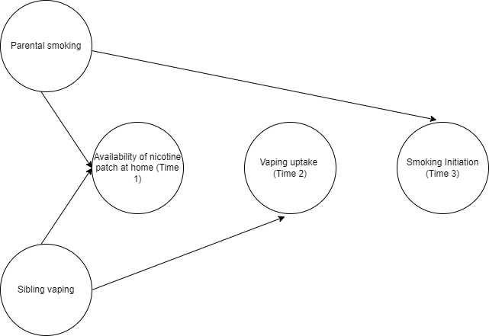
Modified Disjunctive Cause Criterion
Rule of thumb
Control for all pre-exposure variable

Slide 110
Rule of thumb
Adjust for all common causes
Often lacks data on some common causes
DAGs demonstrate that it is possible to identify a variable that is not a common cause, but sufficient to de-confound the bias due to a common cause.

Slide 111
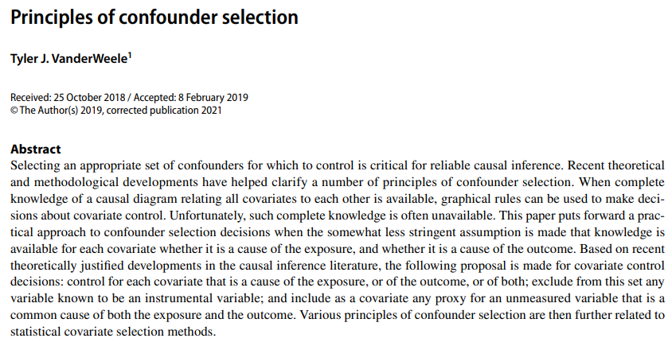

Slide 112
Modified Disjunctive Cause Criterion
The three criteria of control variable selection proposed by VanderWeele should:
include all variables that were either a cause of the exposure, the outcome, or both;
exclude any instrumental variables for the exposure and the outcome; and
include any proxy variables for an unmeasured confounder that are a common cause for both the exposure and outcome.

Slide 113
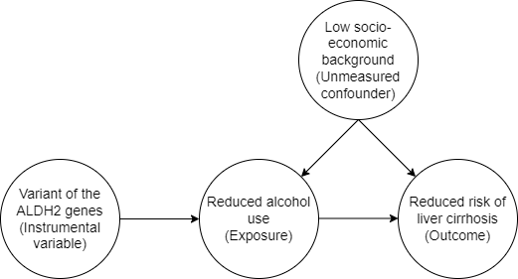
Modified Disjunctive Cause Criterion
Instrumental variable methods by itself is an important method for causal inference
An instrumental variable is a variable that is a cause of the exposure but has no direct causal effect on the outcome, and does not indirectly affect the outcome through variables other than via the exposure.

Slide 114
Modified Disjunctive Cause Criterion
Disjunctive cause criterion still place substantial burden on the researchers
Identifying potential instrumental variables for exclusion can be particularly daunting.
Few instrumental variables are as clear-cut as the ALDH2 example

Slide 116

Thank you.
Follow me on X (Twitter) for future statistics webinar @GaryCkChan
Email: c.chan4@uq.edu.au
Available for statistical consultation

