Slide 1
Causal inference using longitudinal observation data Adjusting for time-varying confounding using IPTW and marginal structural model
Dr. Gary Chan StatsNotebook.io National Centre for Youth Substance Use Research, University of Queensland

Slide 2
Disclaimer

Slide 3
Disclaimer
All methods I am going to show today are wrong.

Slide 4
Disclaimer
All methods I am going to show today are wrong.
“All models are wrong, but some are useful – George box”
For analysis of multi-wave longitudinal data, IPTW/MSM is less wrong than standard regression methods.

Slide 5
Disclaimer
All methods I am going to show today are wrong.
“All models are wrong, but some are useful – George box”
For analysis of multi-wave longitudinal data, IPTW/MSM is less wrong than standard regression methods.
Application of causal models do not guarantee that you can make causal claims (and most of the time, you CANNOT make causal claims).

Slide 6
Disclaimer
All methods I am going to show today are wrong.
“All models are wrong, but some are useful – George box”
For analysis of multi-wave longitudinal data, IPTW/MSM is less wrong than standard regression methods.
Application of causal models do not guarantee that you can make causal claims (and most of the time, you CANNOT make causal claims).
Causal inference using observational data can only be made under certain assumptions
For analysis of multi-wave longitudinal data, IPTW/MSM is more likely to let you draw valid causal inference.

Slide 7
Webinar outline
IPTW for single time point study (cross-sectional study)
IPTW for multi-wave longitudinal study
Using multiple imputation with IPTW

Slide 8
RCTs
Randomized controlled trial is the gold standard for establishing causal relationship
Participants are assigned randomly into receiving treatment or not receiving treatment.
Participant characteristics (both measured and unmeasured) in treatment and control condition are similar.
Randomization removes all confounding.
Overall, only difference between two group of participants will be whether they receive treatment.

Slide 9
RCTs
Randomized controlled trial is the gold standard for establishing causal relationship
Participants are assigned randomly into receiving treatment or not receiving treatment.
Participant characteristics (both measured and unmeasured) in treatment and control condition are similar.
Randomization removes all confounding.
Overall, only difference between two group of participants will be whether they receive treatment.

Slide 10
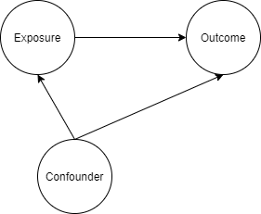
Confounding
A confounder is a variable that influences both the outcome and exposure

Slide 11
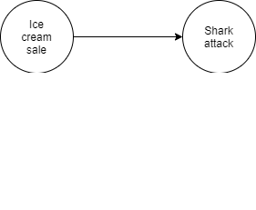
Confounding
Ice cream sales is strongly associated with shark attack.

Slide 12

Confounding
Ice cream sales is strongly associated with shark attack.

Slide 13
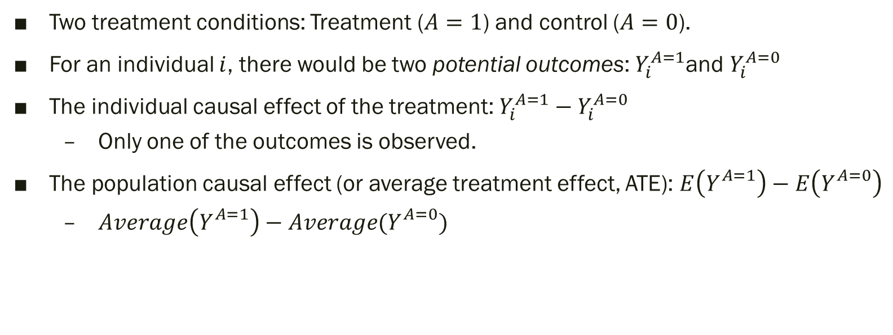
Potential outcomes/ Counterfactual framework
Two treatment conditions: Treatment ($A=1$) and control ($A=0$).
For an individual $i$, there would be two potential outcomes: $Y_{i}^{A=1}$and $Y_{i}^{A=0}$
The individual causal effect of the treatment: $Y_{i}^{A=1}{− Y}_{i}^{A=0}$
Only one of the outcomes is observed.
The population causal effect (or average treatment effect, ATE): $E\left(Y_{}^{A=1}\right)−E\left(Y_{}^{A=0}\right)$
$Average\left(Y_{}^{A=1}\right)−Average(Y_{}^{A=0})$

Slide 14
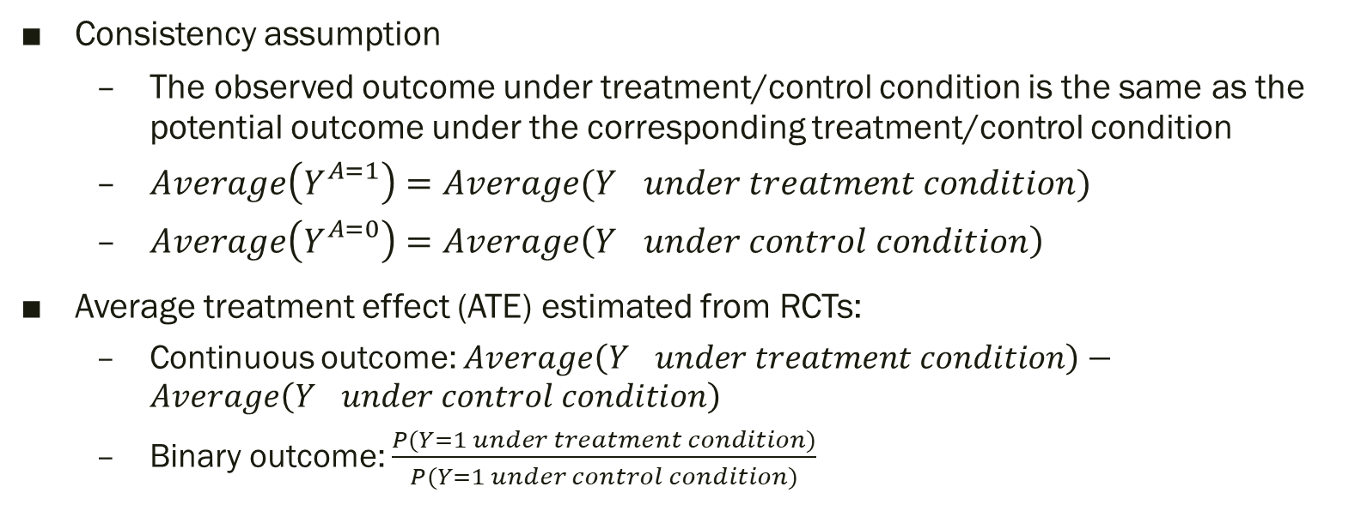
Potential outcomes/ Counterfactual framework
Consistency assumption
The observed outcome under treatment/control condition is the same as the potential outcome under the corresponding treatment/control condition
$Average\left(Y_{}^{A=1}\right)=Average(Y_{} under treatment condition)$
$Average\left(Y_{}^{A=0}\right)=Average\left(Y_{} under control condition\right)$
Average treatment effect (ATE) estimated from RCTs:
Continuous outcome: $Average\left(Y_{} under treatment condition\right)−Average\left(Y_{} under control condition\right)$
Binary outcome: $\frac{P(Y=1 under treatment condition)}{P(Y=1 under control condition)}$

Slide 15
RCTs
May lack generalizability
RCTs are often conducted in highly controlled environment that do not resemble any real-life circumstances.
Not always feasible, particularly regarding questions of harm
Does smoking cause cancer?
Does cannabis use cause psychosis?
Not suitable for studying sustained exposure over a long period of time and long-term outcome
Does daily smoking over 10 years cause cancer?
Does heavy cannabis use during adolescence increase risk of psychosis in mid-adulthood?

Slide 16
Observational study
Provides “real world evidence”
Cancer outcome among smokers and non-smokers
Psychosis among cannabis users and non-users
Biggest threat for causal inference
Confounding
Systematic difference between those who were under “treatment” condition (i.e. smoking and using cannabis) and “control” condition
E.g. factors that predisposed individual to unhealthy habits that lead to smoking and long-term adverse health outcome (e.g. Socioeconomic disadvantage?)

Slide 17
Inverse Probability Treatment Weighting (IPTW)
Emulate a RCT where confounding factors are balanced between treatment and control condition in a pseudo-population created by “treatment weight”
In a RCT, all potential confounding factors are balanced between treatment and control condition due to randomization.
Two steps
Estimate the probability of receiving/not receiving treatment and calculate the weight for each participant
The weighted sample can now be analysed as if the data is from a RCT.
Only very simple analysis (e.g. t-test) is needed.

Slide 18
Single time point study
Scenario
Research question: Does adolescent cannabis use (exposure) cause use of other illicit drug use in adulthood (outcome)?
Gateway effect?
Sex is a potential confounder
Females are less likely to use cannabis during adolescence, and less likely to use illicit substance in adulthood

Slide 19
Single time point study
Research question: Does adolescent cannabis use (exposure) cause use of other illicit drug in adulthood (outcome)?
Females are less likely to use cannabis during adolescence, and also less likely to use illicit substance in adulthood
For the “treatment” group (those who used cannabis), there is a lower proportion of female
Original unweighted data
 |  | Male |  | Female
 |  | N | % | N | %
Cannabis use | No (control) | 192 | 54% | 162 | 46%
 | Yes (“treatment”) | 29 | 63% | 17 | 37%
Overall |  | 221 | 55% | 179 | 45%

Slide 20
Single time point study
Females are less likely to use cannabis during adolescence, and also less likely to use illicit substance in adulthood
Even adolescent cannabis use does not cause future illicit drug use, individual in the control group (no cannabis use) will be less likely to use illicit substance
There is likely to be an observed association between cannabis use and illicit drug use, even cannabis does not cause future illicit drug use.
 |  | Male |  | Female
 |  | N | % | N | %
Cannabis use | No (control) | 192 | 54% | 162 | 46%
 | Yes (“treatment”) | 29 | 63% | 17 | 37%
Overall |  | 221 | 55% | 179 | 45%

Slide 21
Single time point study
Original unweighted data
Remove confounding
Apply IPTW to the data
Ensure the same sex ratio in the control and treatment condition
 |  | Male |  | Female
 |  | N | % | N | %
Cannabis use | No (control) | 192 ↑ | 54% | 162 ↓ | 46%
 | Yes (“treatment”) | 29 ↓ | 63% | 17 ↑ | 37%
Overall |  | 221 | 55% | 179 | 45%
 |  | Male |  | Female
 |  | N | % | N | %
Cannabis use | No (control) | 196 | 55 | 158 | 45
 | Yes (“treatment”) | 25 | 55 | 21 | 45
Overall |  | 221 | 55% | 179 | 45%

Slide 22
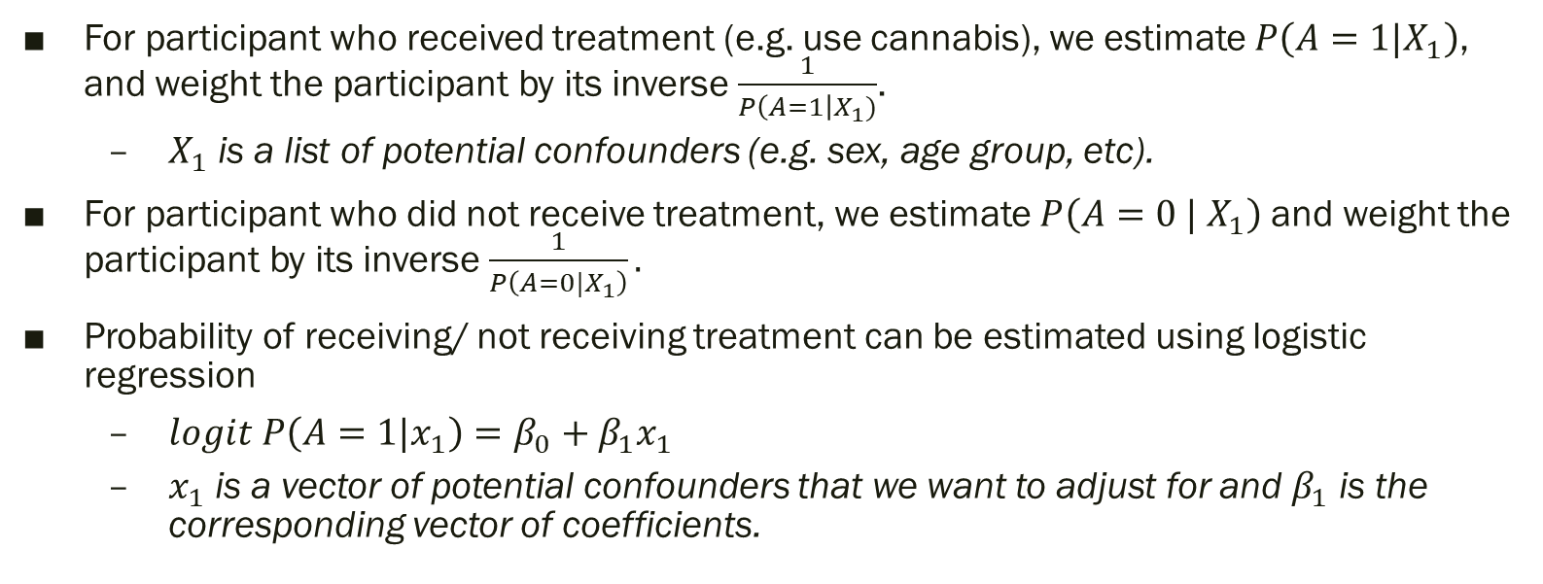
Single time point study
For participant who received treatment (e.g. use cannabis), we estimate $P\left(A=1|X_{1}\right)$, and weight the participant by its inverse $\frac{1}{P\left(A=1\right|X_{1})}$.
$X_{1}$ is a list of potential confounders (e.g. sex, age group, etc).
For participant who did not receive treatment, we estimate $P\left(A=0 | X_{1}\right)$ and weight the participant by its inverse $\frac{1}{P\left(A=0|X_{1}\right)}.$
Probability of receiving/ not receiving treatment can be estimated using logistic regression
$logit P\left(A=1|x_{1}\right)=β_{0}+β_{1}x_{1}$
$x_{1}$ is a vector of potential confounders that we want to adjust for and $β_{1}$ is the corresponding vector of coefficients.

Slide 23
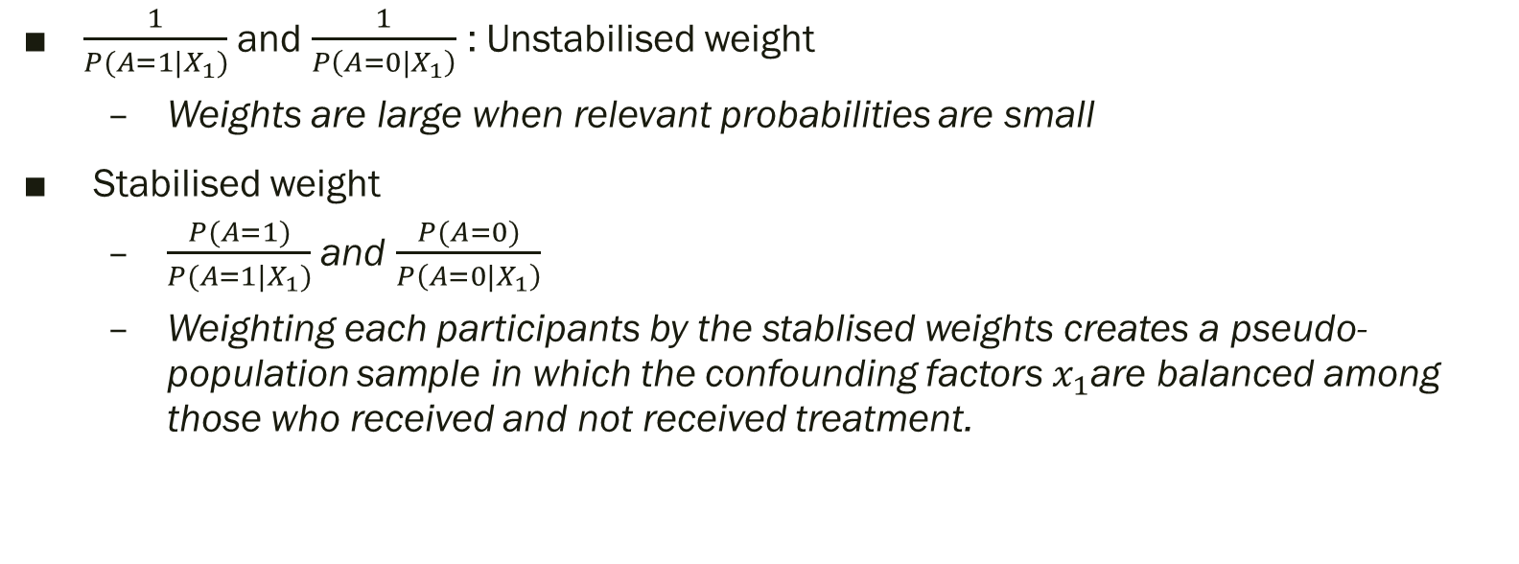
Single time point study
$\frac{1}{P(A=1|X_{1})}$ and $\frac{1}{P\left(A=0|X_{1}\right)}$ : Unstabilised weight
Weights are large when relevant probabilities are small
Stabilised weight
$\frac{P(A=1)}{P(A=1|X_{1})}$ and $\frac{P(A=0)}{P\left(A=0|X_{1}\right)}$
Weighting each participants by the stablised weights creates a pseudo-population sample in which the confounding factors $x_{1}$are balanced among those who received and not received treatment.
 |  | Male |  | Female
 |  | N | % | N | %
Cannabis use | No (control) | 196 | 55 | 158 | 45
 | Yes (“treatment”) | 25 | 55 | 21 | 45
Overall |  | 221 | 55% | 179 | 45%

Slide 24
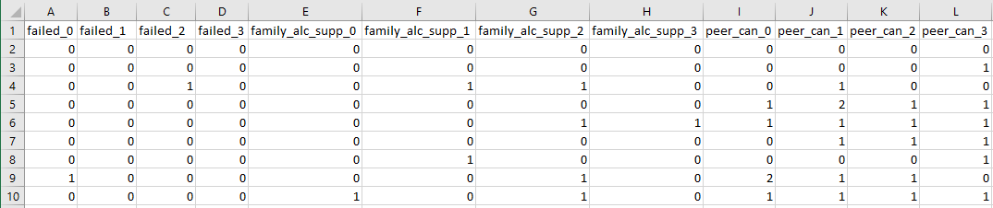
Single time point study
ipw package in R
Use logistic regression to compute the probability of using cannabis (“treatment”) and not using cannabis (“control”) by sex
Simulated data
Variables: can_3 (0: no use; 1 use), illicit (0: no use; 1 use) and sex (0: Male; 1: Female)
https://statsnotebook.io/consultation/iptw_msm/
van der Wal, W. M. and R. B. Geskus (2011). "ipw: an R package for inverse probability weighting." J Stat Softw 43(13): 1-23.

Slide 25

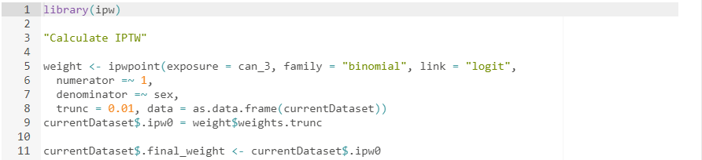
Single time point study
Load data
Calculate IPTW

Slide 26
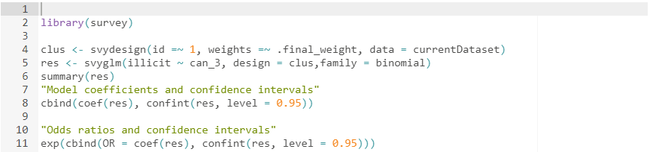
Single time point study
Step 2
Weighted logistic regression using illicit substance use as the outcome and cannabis use as the exposure
survey package in R

Slide 27
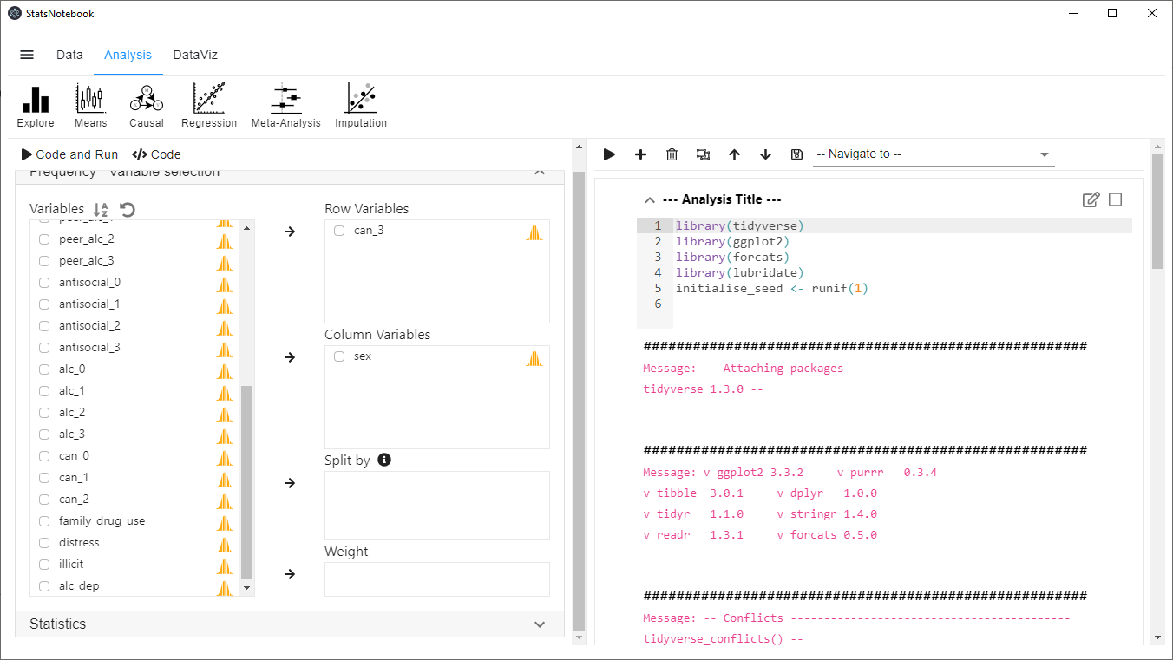
Single time point study
StatsNotebook
Notebook application (similar to Jupyter)
Graphical interface (common statistical analysis, data visualization, etc)

Slide 28
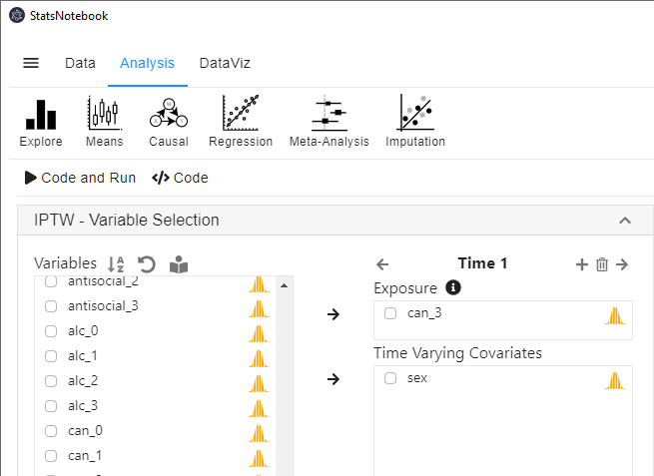
Single time point study
Analysis
Causal
Inverse probability treatment weight (IPTW)

Slide 29
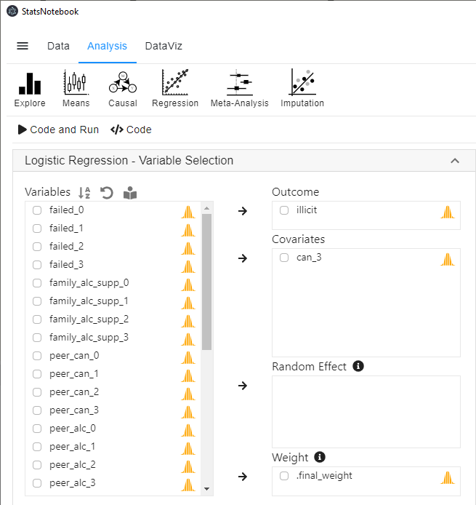
Single time point study
Analysis
Regression
Logistic regression

Slide 30
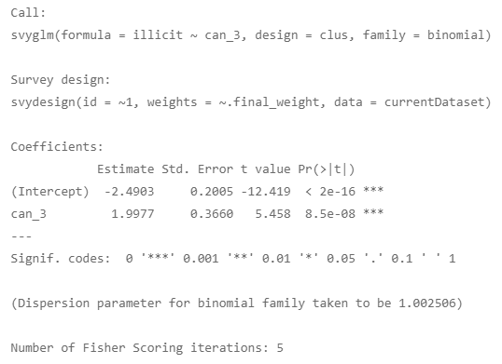
Single time point study
Weighted results

Slide 31
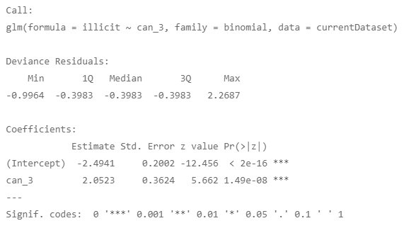
Single time point study
Unweighted results

Slide 32
Key assumption for causal inference
Exchangeability
No unmeasured confounding given the set of variables used in the weighting procedure
This is a requirement for all statistical model for causal inference (but untestable)
Need to consider theoretical framework
Developmental psychology
Family, school and peer factors are all potential confounders
Need to include key factors in these domains
Sensitivity analysis (e.g. E-value approach, VanderWeele and Ding, 2017)

Slide 33
Key assumption for causal inference
Positivity
The probability of receiving treatment/ not receiving treatment is non-zero.
This assumption is violated if treatment assignment is deterministic.

Slide 34
Key assumption for causal inference
The model for computing the probability of receiving/ not receiving treatment is correctly specified.
It is nearly certain that this assumption is violated to some extent (ALL MODELS ARE WRONG).
Include interaction terms
Machine learning algorithm to model potential non-linear relationship between confounders and exposure (will implement this in the next version of StatsNotebook)

Slide 35
Single time point study
We can weight the data by a larger set of potential confounding variables
Sex (sex; 0: Male; 1: Female)
Alcohol use (alc_3 ; 0: No; 1: Yes)
Antisocial behavior (antisocial_3; 0: No; 1: Yes)
Peers’ alcohol use (peer_alc_3; 0: None; 1: 1-2 friends; 2: 3 or more friends)
Peers’ cannabis use (peer_can_3; 0: None; 1: 1-2 friends; 2: 3 or more friends)
Academic grade (failed_3; 0: No failed subject; 1: At least failed 1 subject)
Family history of substance use (family_drug_use; 0: No; 1: Yes)
Psychological distress (distress; higher score -> higher distress)
Exposure
Cannabis use (can_3; 0: No; 1: Yes)

Slide 36
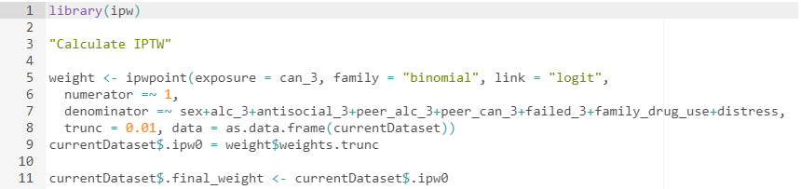
Single time point study
Calculate IPTW

Slide 37
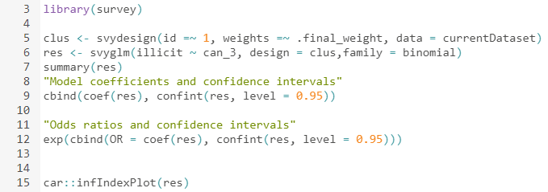
Single time point study
Outcome model (logistic regression) with IPTW

Slide 38
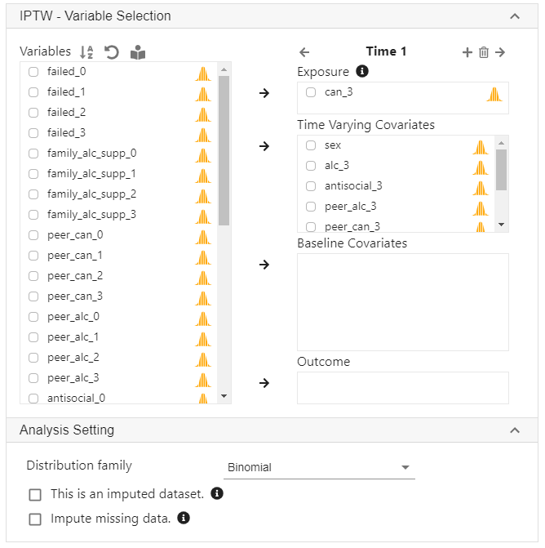
StatsNotebook
Causal
IPTW

Slide 39
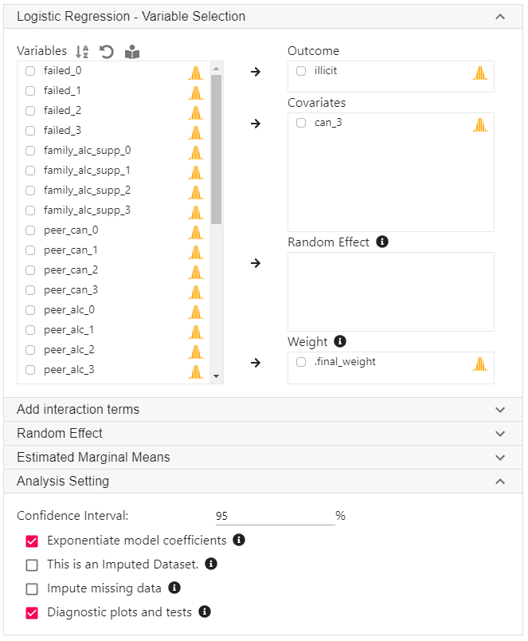
StatsNotebook
Regression
Logistic regression

Slide 40
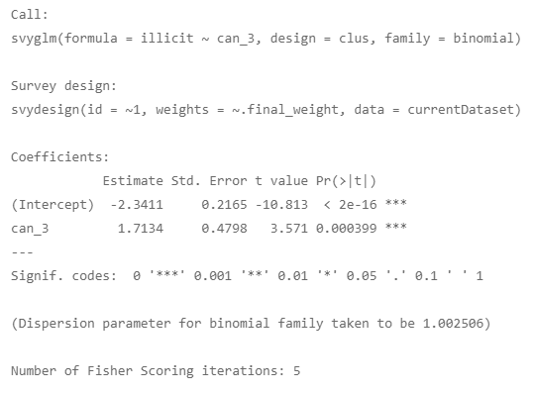
Single time point study

Slide 42
Extension to longitudinal study
Does adolescent cannabis use lead to other illicit substance use in adulthood?
Peers’ cannabis use is likely to be a confounder
Having peers who used cannabis increases the risk of using cannabis and also other substance.
Peers’ cannabis use is likely to be a mediator
An individual’s own cannabis use also increase affiliation with peers who use cannabis.
Peers’ cannabis is thus a time-varying confounder that is
affected by prior “treatment” (individual’s own cannabis use)
affect both future cannabis use (i.e. future “treatment”) and illicit substance use (outcome)

Slide 43
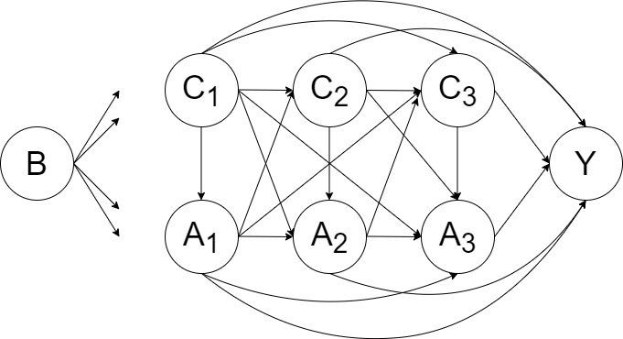
Extension to longitudinal study
B – A set of baseline confounders (It could be considered as a subset of C1 )
C1, C2 and C3 – A set of potential time-varying confounders for exposure A1, A2 and A3.
A1, A2 and A3 – Time-varying exposure (Affected by previous exposure and confounders; affect future exposure and future confounders)
Y – outcome

Slide 44
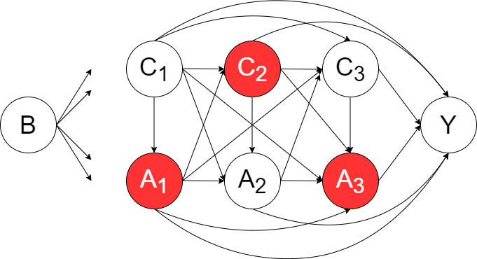
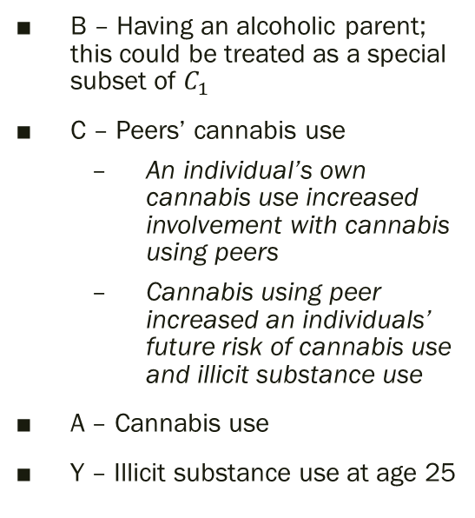
Extension to longitudinal study
B – Having an alcoholic parent; this could be treated as a special subset of $C_{1}$
C – Peers’ cannabis use
An individual’s own cannabis use increased involvement with cannabis using peers
Cannabis using peer increased an individuals’ future risk of cannabis use and illicit substance use
A – Cannabis use
Y – Illicit substance use at age 25

Slide 45
Extension to longitudinal study
Standard methods such as regression analysis will produce biased estimates.
Adjusting for peers’ cannabis use - block part of the causal effect from previous cannabis use because it is a mediator
Not adjusting for peers’ cannabis use – ignore the confounding effects; violate the exchangeability assumption (no unmeasured confounding)

Slide 46
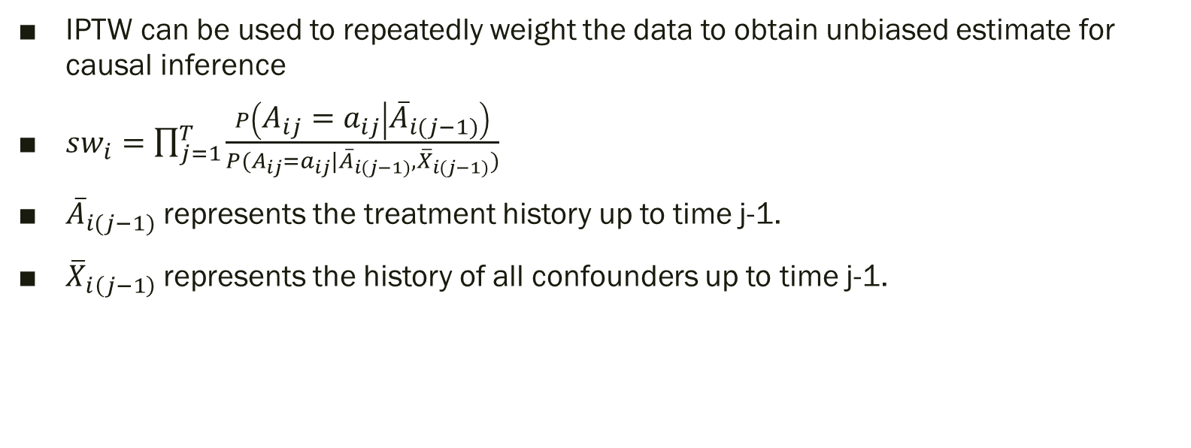
Extension to longitudinal study
IPTW can be used to repeatedly weight the data to obtain unbiased estimate for causal inference
$sw_{i}=\prod_{j=1}^{T}{\frac{P\left(A_{ij}=a_{ij} | {\overline{A}}_{i(j−1)}\right)}{P(A_{ij}=a_{ij}|{\overline{A}}_{i(j−1)}, {\overline{X}}_{i(j−1)})}}$
${\overline{A}}_{i(j−1)}$ represents the treatment history up to time j-1.
${\overline{X}}_{i\left(j−1\right)}$represents the history of all confounders up to time j-1.

Slide 47
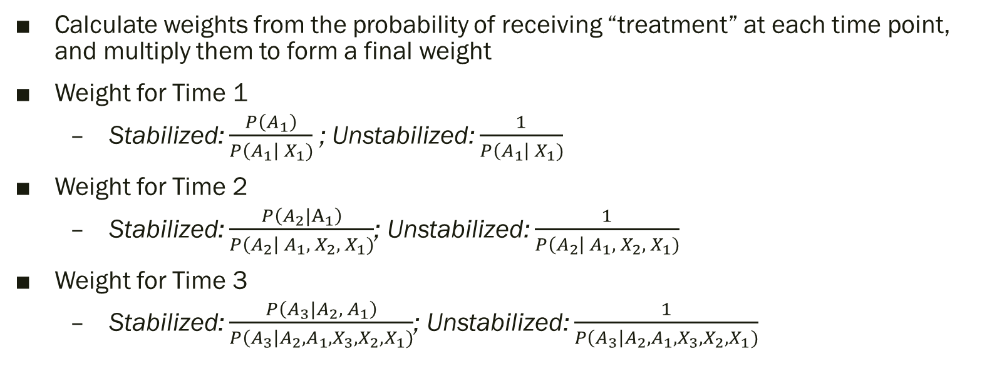
Calculating weights
Calculate weights from the probability of receiving “treatment” at each time point, and multiply them to form a final weight
Weight for Time 1
Stabilized: $\frac{P\left(A_{1}\right)}{P\left(A_{1}\right| X_{1})}$ ; Unstabilized: $\frac{1}{P\left(A_{1}\right| X_{1})}$
Weight for Time 2
Stabilized: $\frac{P\left(A_{2}|A_{1}\right)}{P\left(A_{2}\right| A_{1}, { X_{2}, X}_{1})}$; Unstabilized: $\frac{1}{P\left(A_{2}\right| A_{1}, { X_{2}, X}_{1})}$
Weight for Time 3
Stabilized: $\frac{P\left(A_{3}|A_{2},{ A}_{1}\right)}{P\left(A_{3}\right|A_{2},A_{1},X_{3}, X_{2}, X_{1})}$; Unstabilized: $\frac{1}{P\left(A_{3}\right|A_{2},A_{1},X_{3}, X_{2}, X_{1})}$

Slide 48

Calculating weights
Final weight:
Weight at Time 1 x Weight at Time 2 x Weight at Time 3
$\frac{P\left(A_{1}\right)}{P\left(A_{1}\right| {\overline{X}}_{1})}$ x $\frac{P\left(A_{2}|A_{1}\right)}{P\left(A_{2}\right| A_{1}, { X_{2}, X}_{1})}$ x $\frac{P\left(A_{3}|A_{2},{ A}_{1}\right)}{P\left(A_{3}\right|A_{2},A_{1},X_{3}, X_{2}, X_{1})}$

Slide 49
Confounders
A confounder is a variable that influence both the exposure and the outcome
Theoretical framework from developmental psychology
Three key domains of influence: Family, peer and school
Variables used to calculate the IPTW
Academic achievement (Time-varying)
Peer group (Time-varying)
Family members’ substance use (only measured at baseline)
For each time point, the set of confounders can be taken from the previous time point
E.g. Peers’ cannabis use at baseline (peer_can_0) is used to predict probability of cannabis use at Time 1 (can_1)

Slide 50
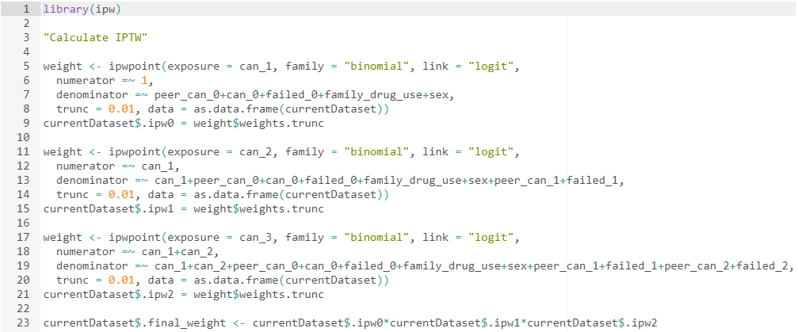
R codes (ipw)

Slide 51
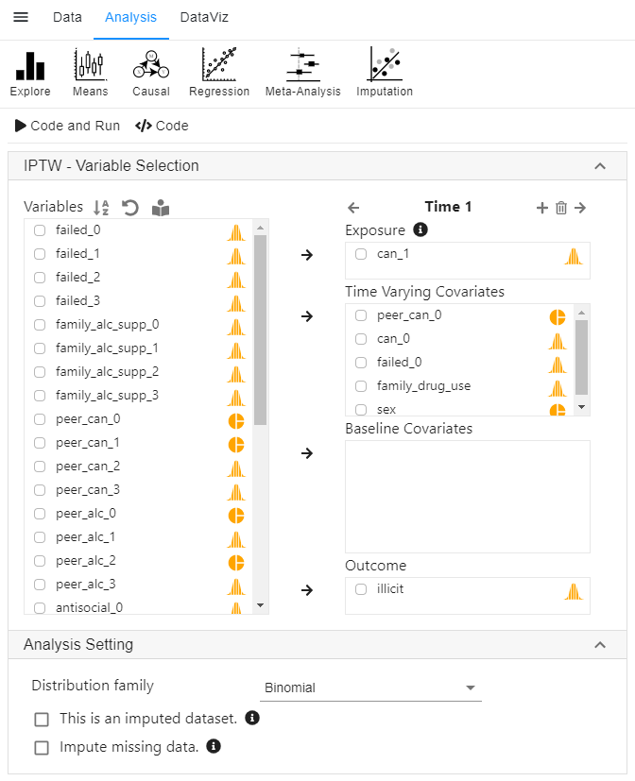
StatsNotebook

Slide 52
Outcome model
3 waves of treatment data
Eight different “treatment” trajectories
Cannabis use Time 1 | Cannabis use Time 2 | Cannabis use Time 3
No | No | No
Yes | No | No
Yes | Yes | No
Yes | Yes | Yes
No | Yes | No
No | Yes | Yes
No | No | Yes
No | No | No

Slide 53
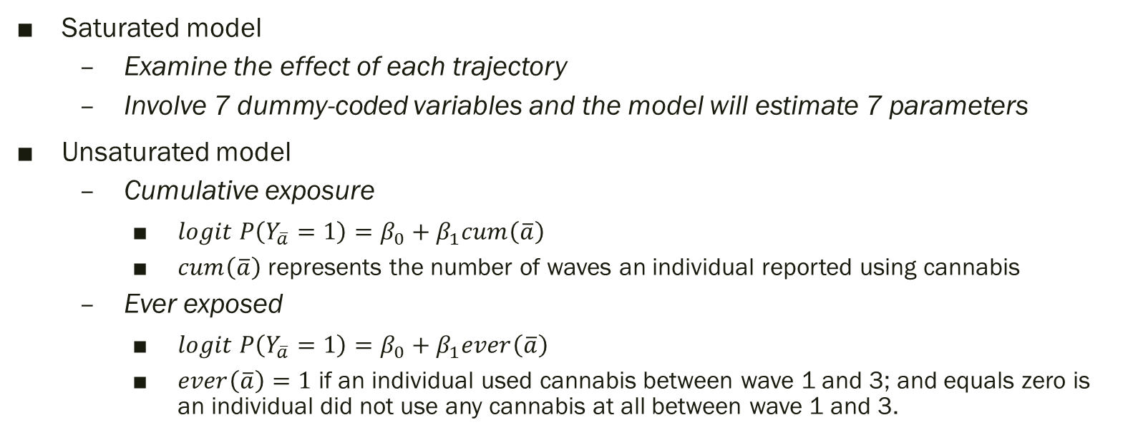
Outcome model
Saturated model
Examine the effect of each trajectory
Involve 7 dummy-coded variables and the model will estimate 7 parameters
Unsaturated model
Cumulative exposure
$logit P\left(Y_{\overline{a}}=1\right)=β_{0}+β_{1}cum\left(\overline{a}\right)$
$cum\left(\overline{a}\right)$ represents the number of waves an individual reported using cannabis
Ever exposed
$logit P\left(Y_{\overline{a}}=1\right)=β_{0}+β_{1}ever\left(\overline{a}\right)$
$ever\left(\overline{a}\right)=1$ if an individual used cannabis between wave 1 and 3; and equals zero is an individual did not use any cannabis at all between wave 1 and 3.

Slide 54
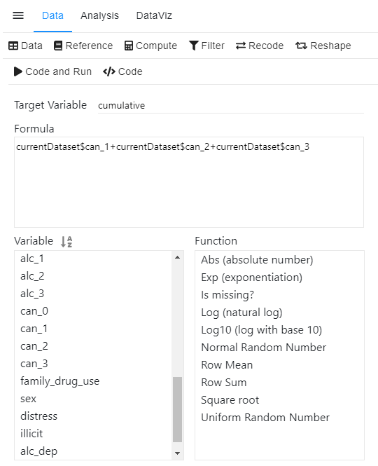
Creating cumulative exposure variable
Creating new variables for cumulative exposure model (same code as before)
R code
StatsNotebook

Slide 55
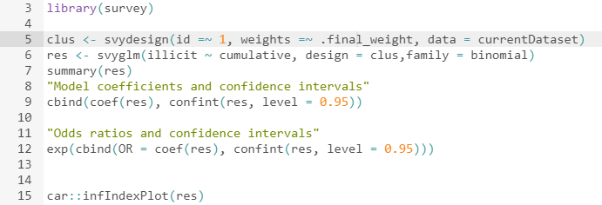
Weighted analysis
survey package in R

Slide 56
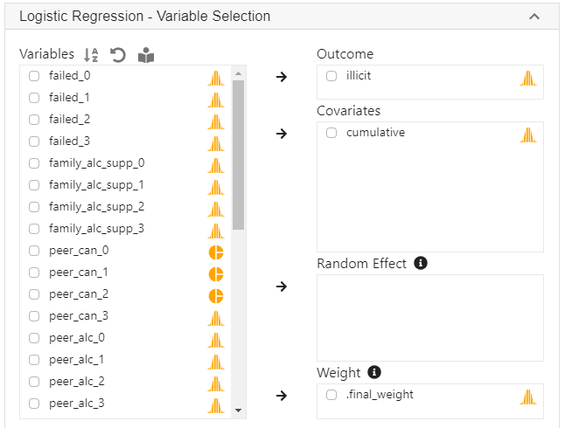
Weighted analysis
StatsNotebook

Slide 57
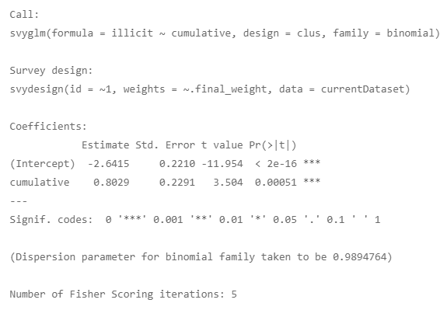
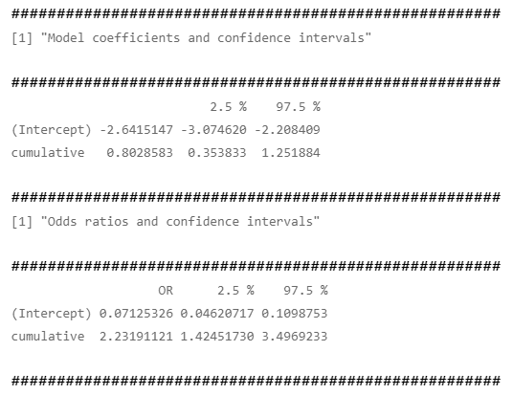
Results

Slide 58
Interpretation
If the assumptions of IPTW/MSM are satisfied, we can interpret the odds ratio as causal parameter
Cannabis use causes future illicit substance use
Every additional wave of using cannabis increases the odds of future illicit substance use by 2.23 times.
No unmeasured confounding given the set of variables used in the weighting procedure
Sensitivity analysis (e.g. E-value, VanderWeele and Ding, 2018)
Consistency
Positivity
Correct specification of the models for creating the weight
It is nearly certain that this model is wrong.
Correct specification of the outcome model
It is nearly certain that the outcome model is wrong if it is an unsaturated model.

Slide 59
Example
Does parental supply of alcohol increase the risk of alcohol dependence in young adulthood?
Examine the cumulative effect of parental alcohol supply on alcohol dependence in young adulthood
Adjusting for the confounding effect of
Individuals’ own alcohol consumption during adolescence
School grade
Peers’ alcohol use
Antisocial behaviours

Slide 61
Missing data
Inevitable in longitudinal research
Dropping out of study
Missing data in certain questionnaire items

Slide 62
Missing data
Multiple imputation can be used to impute missing data.
Based on the information in the available data, missing data will be imputed multiple times to form multiple imputed dataset.
IPTW is computed for each imputed dataset.
The outcome model is run on each imputed dataset.
Results from different imputed dataset are combined using Rubin’s formula.

Slide 63

Missing data
Load data

Slide 64
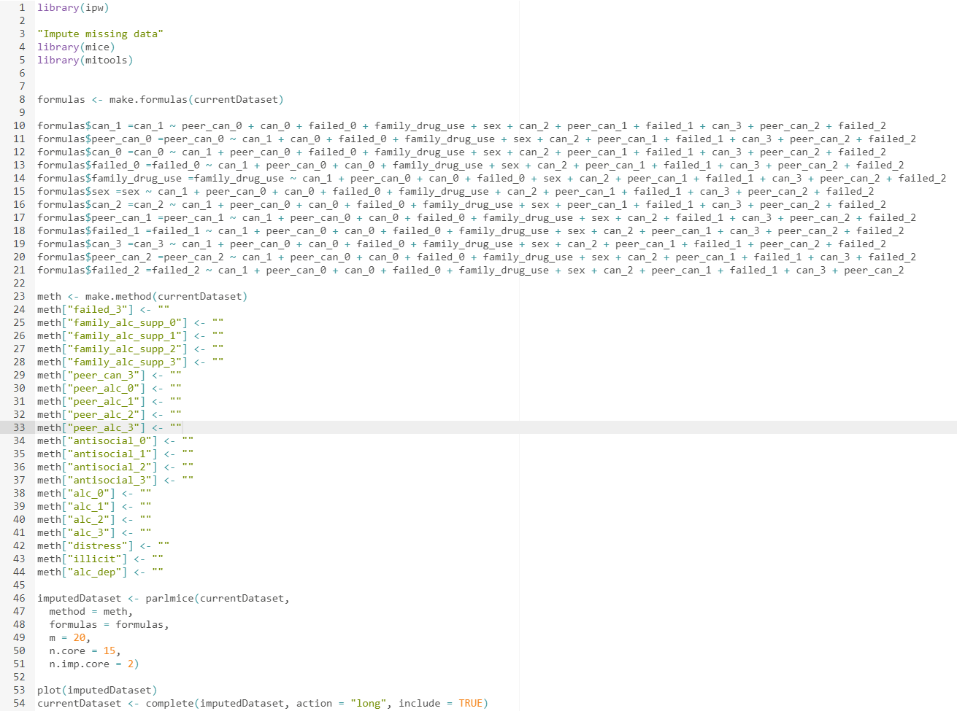
Multiple imputation R Code

Slide 65
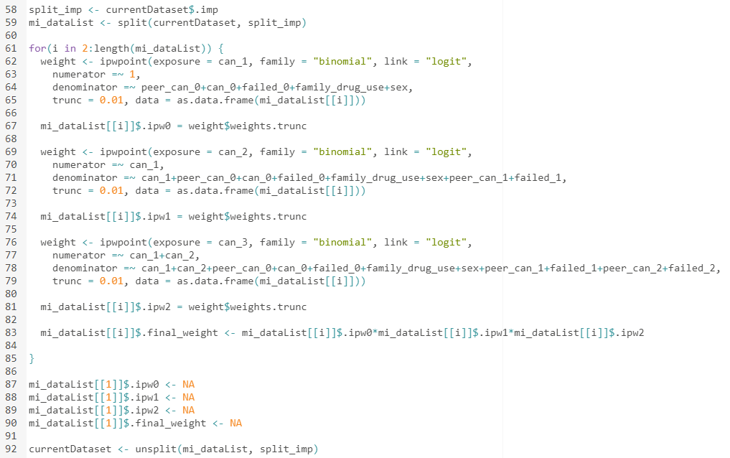
Compute IPTW (R code)

Slide 66
Creating cumulative exposure variable
Creating new variables for cumulative exposure model (same code as before)
R code
StatsNotebook

Slide 67
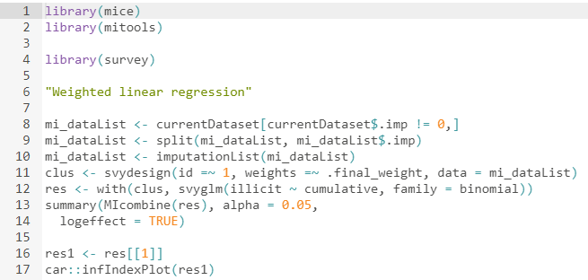
Weighted analysis
survey and mitools package

Slide 68
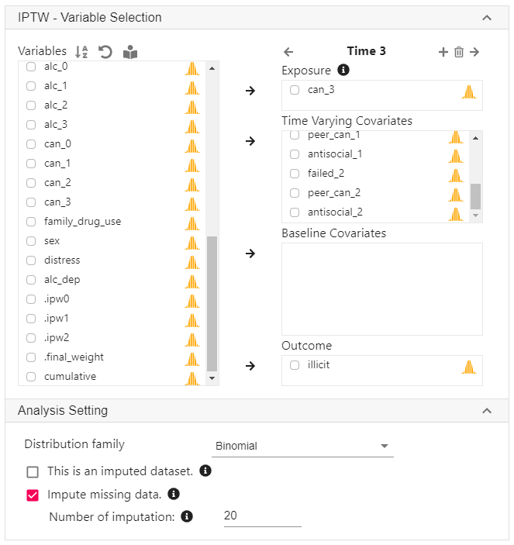
StatsNotebook
Missing data will be imputed based on all exposure and time-varying covariates
Possible to use variables not included in the analysis and include interaction in the imputation procedure.
Analysis
Imputation

Slide 69
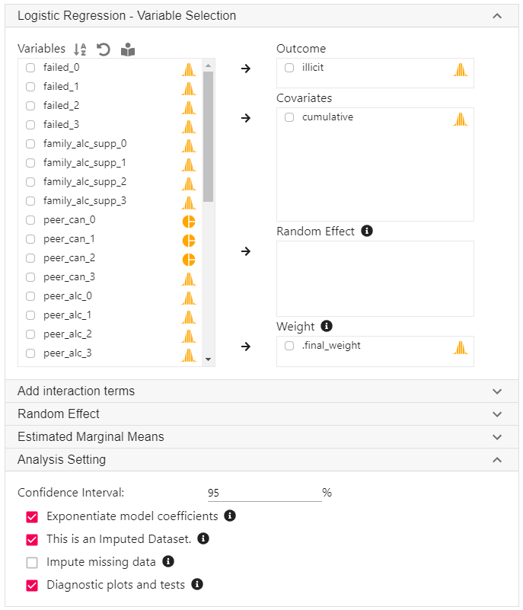
StatsNotebook

Slide 70
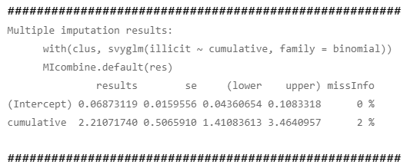
Weighted analysis
Key output from R

Slide 72
Planned improvement
Longitudinal targeted maximum likelihood estimation
Estimating treatment weight using superlearner algorithm

Slide 73
Suggestions and Bug report
Twitter: @GaryCKChan
Facebook: facebook.com/StatsNotebook
Github: github.com/gckc123/StatsNotebook
Email: c.chan4@uq.edu.au

Slide 74
Future workshops and updates
Future workshops
Causal mediation analysis
Data visualization
Longitudinal data analysis
Machine learning/ Ensemble learning
Experimental design
Twitter: @GaryCKChan
Facebook: facebook.com/StatsNotebook
Github: github.com/gckc123/StatsNotebook
Email: c.chan4@uq.edu.au

