Slide 1
Interrupted time series analysis Application to public health research
Dr. Gary Chan StatsNotebook.io National Centre for Youth Substance Use Research, University of Queensland

Slide 2
References
Bernal, J. L., Cummins, S., & Gasparrini, A. (2017). Interrupted time series regression for the evaluation of public health interventions: a tutorial. International journal of epidemiology, 46(1), 348-355.
Bhaskaran, K., Gasparrini, A., Hajat, S., Smeeth, L., & Armstrong, B. (2013). Time series regression studies in environmental epidemiology. International journal of epidemiology, 42(4), 1187-1195.
Bottomley, C., Scott, J. A. G., & Isham, V. (2019). Analysing interrupted time series with a control. Epidemiologic methods, 8(1).
Hemming, K., Haines, T. P., Chilton, P. J., Girling, A. J., & Lilford, R. J. (2015). The stepped wedge cluster randomised trial: rationale, design, analysis, and reporting. BMJ, 350.
Linden, A. (2015). Conducting interrupted time-series analysis for single-and multiple-group comparisons. The Stata Journal, 15(2), 480-500.
Linden, A. (2018). Combining synthetic controls and interrupted time series analysis to improve causal inference in program evaluation. Journal of evaluation in clinical practice, 24(2), 447-453.
Lopez Bernal, J., Cummins, S., & Gasparrini, A. (2018). The use of controls in interrupted time series studies of public health interventions. International journal of epidemiology, 47(6), 2082-2093.
Turner, S. L., Karahalios, A., Forbes, A. B., Taljaard, M., Grimshaw, J. M., Cheng, A. C., . . . McKenzie, J. E. (2020). Design characteristics and statistical methods used in interrupted time series studies evaluating public health interventions: a review. Journal of clinical epidemiology, 122, 1-11.

Slide 3
Motivating Example
To reduce alcohol consumption in Northern Territory, the government implemented a minimum price for alcohol in 2018.
Does this policy work? (i.e. reducing alcohol consumption in the population?)

Slide 4
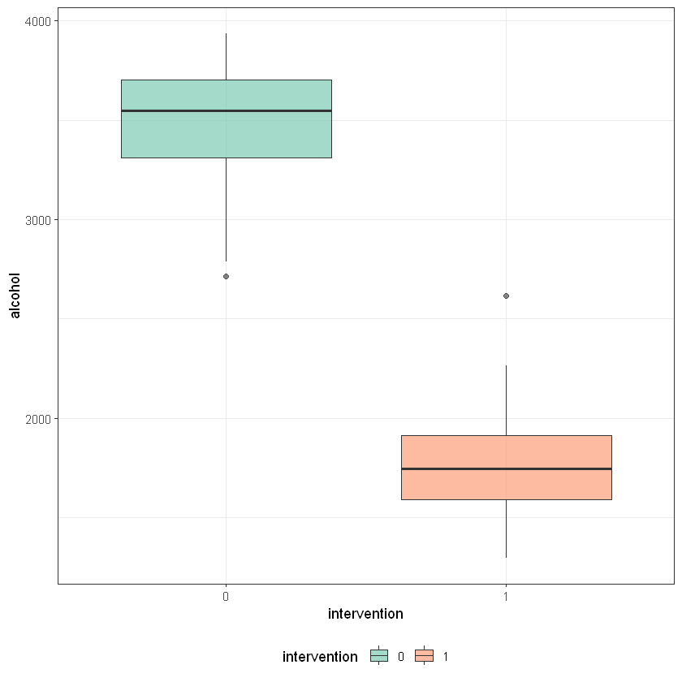
Naïve analysis
Compared average/median population alcohol consumption before and after.

Slide 5
Naïve analysis
Compared average population alcohol consumption before and after.
Ignore the underlying trend
If there is an existing downward trend, population alcohol at “post-intervention period” will be lower regardless if minimum pricing has any impact

Slide 6
Interrupted time series analysis (ITS)
Evaluate policy impact on an outcome (e.g. population alcohol consumption) over a clearly defined time period (e.g. 2 year before and 2 year after the implementation of minimum pricing policy)
A time series of the outcome (population alcohol consumption) is used to established an underlying trend
We then test of such trend is “interrupted” by an intervention at a known time point (the day on which the minimum pricing policy was implemented)

Slide 7
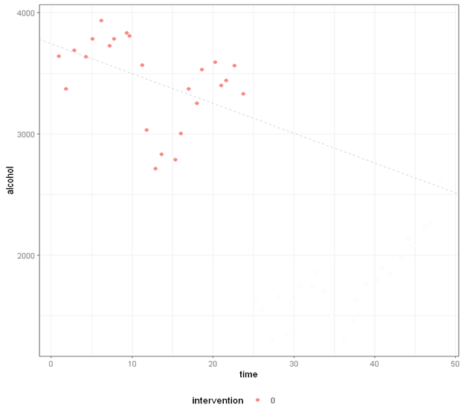
Interrupted time series analysis (ITS)
ITS is compatible with the causal inference framework
Can be conceptualized as comparing the observed post-intervention data to the expected trend, i.e. what would have been observed if there were no intervention
The expected trend is never observed thus it is a counterfactual scenario.

Slide 8
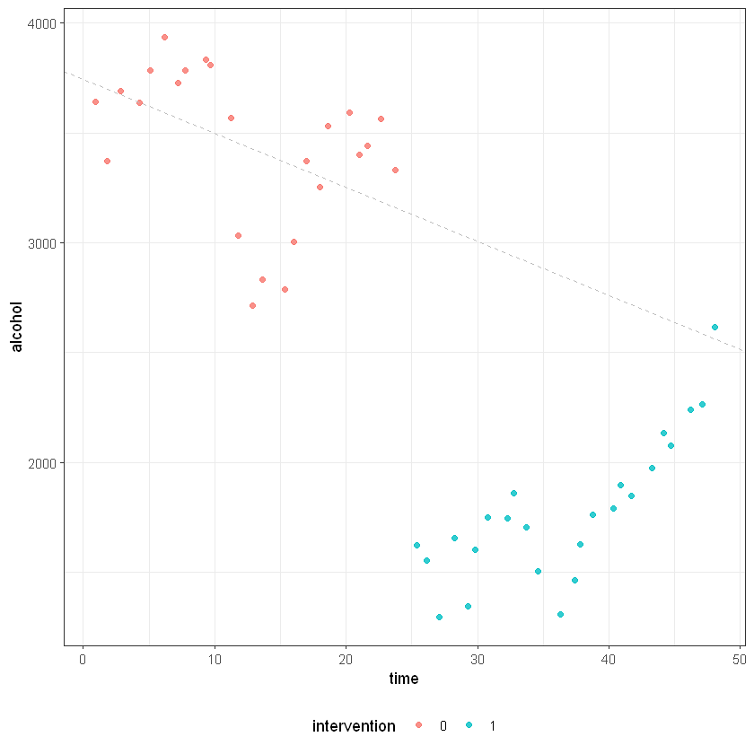
Interrupted time series analysis (ITS)
ITS is compatible with the causal inference framework
Can be conceptualized as comparing the observed post-intervention data to the expected trend, i.e. what would have been observed if there were no intervention
The expected trend is never observed thus it is a counterfactual scenario.

Slide 9
ITS study design
Requires a clear differentiation of the pre-intervention and post-intervention period.
Outcome measures that changes relatively quickly after the intervention are suitable
Alcohol consumption (suitable)
Incident of liver cirrhosis (NOT suitable)

Slide 10
ITS study design
No fixed limits on the number of data point
Power depends on
Distribution of the data
Variability within the data
Aggregated population data usually have relatively small variability
Strength of the effect
Strong intervention effect = strong power

Slide 11
ITS study design
More data =/= better
If historical trend changed substantially, it would not give an accurate estimation of the current underlying trend
Inspect pre-intervention data visually before any formal analysis

Slide 12
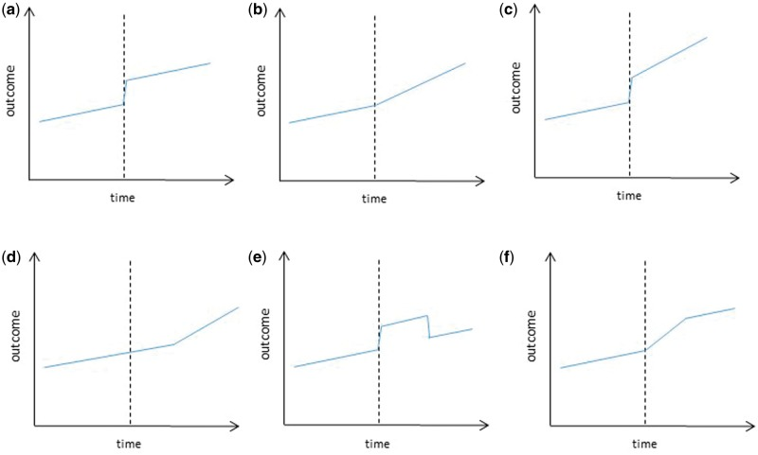
ITS study design
Specify the model a-priori
How will the intervention impact on the outcome?
Is immediate change expected?
Is an “interruption” of the underlying trend expected?
Figure from Bernal, et al (2017)

Slide 13
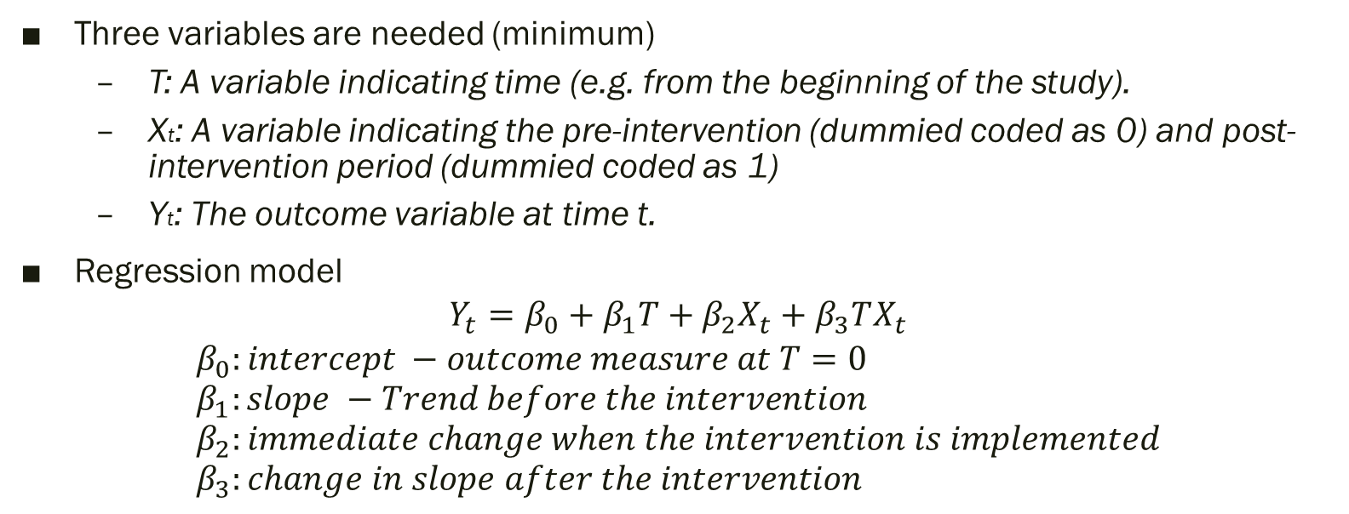
Regression model for ITS
Three variables are needed (minimum)
T: A variable indicating time (e.g. from the beginning of the study).
Xt: A variable indicating the pre-intervention (dummied coded as 0) and post-intervention period (dummied coded as 1)
Yt: The outcome variable at time t.
Regression model
$$Y_{t}=β_{0}+β_{1}T+β_{2}X_{t}+β_{3}TX_{t}$$
$$β_{0}:intercept −outcome measure at T=0 \\ β_{1}:slope −Trend before the intervention \\ β_{2}:immediate change when the intervention is implemented \\ β_{3}:change in slope after the intervention$$

Slide 14
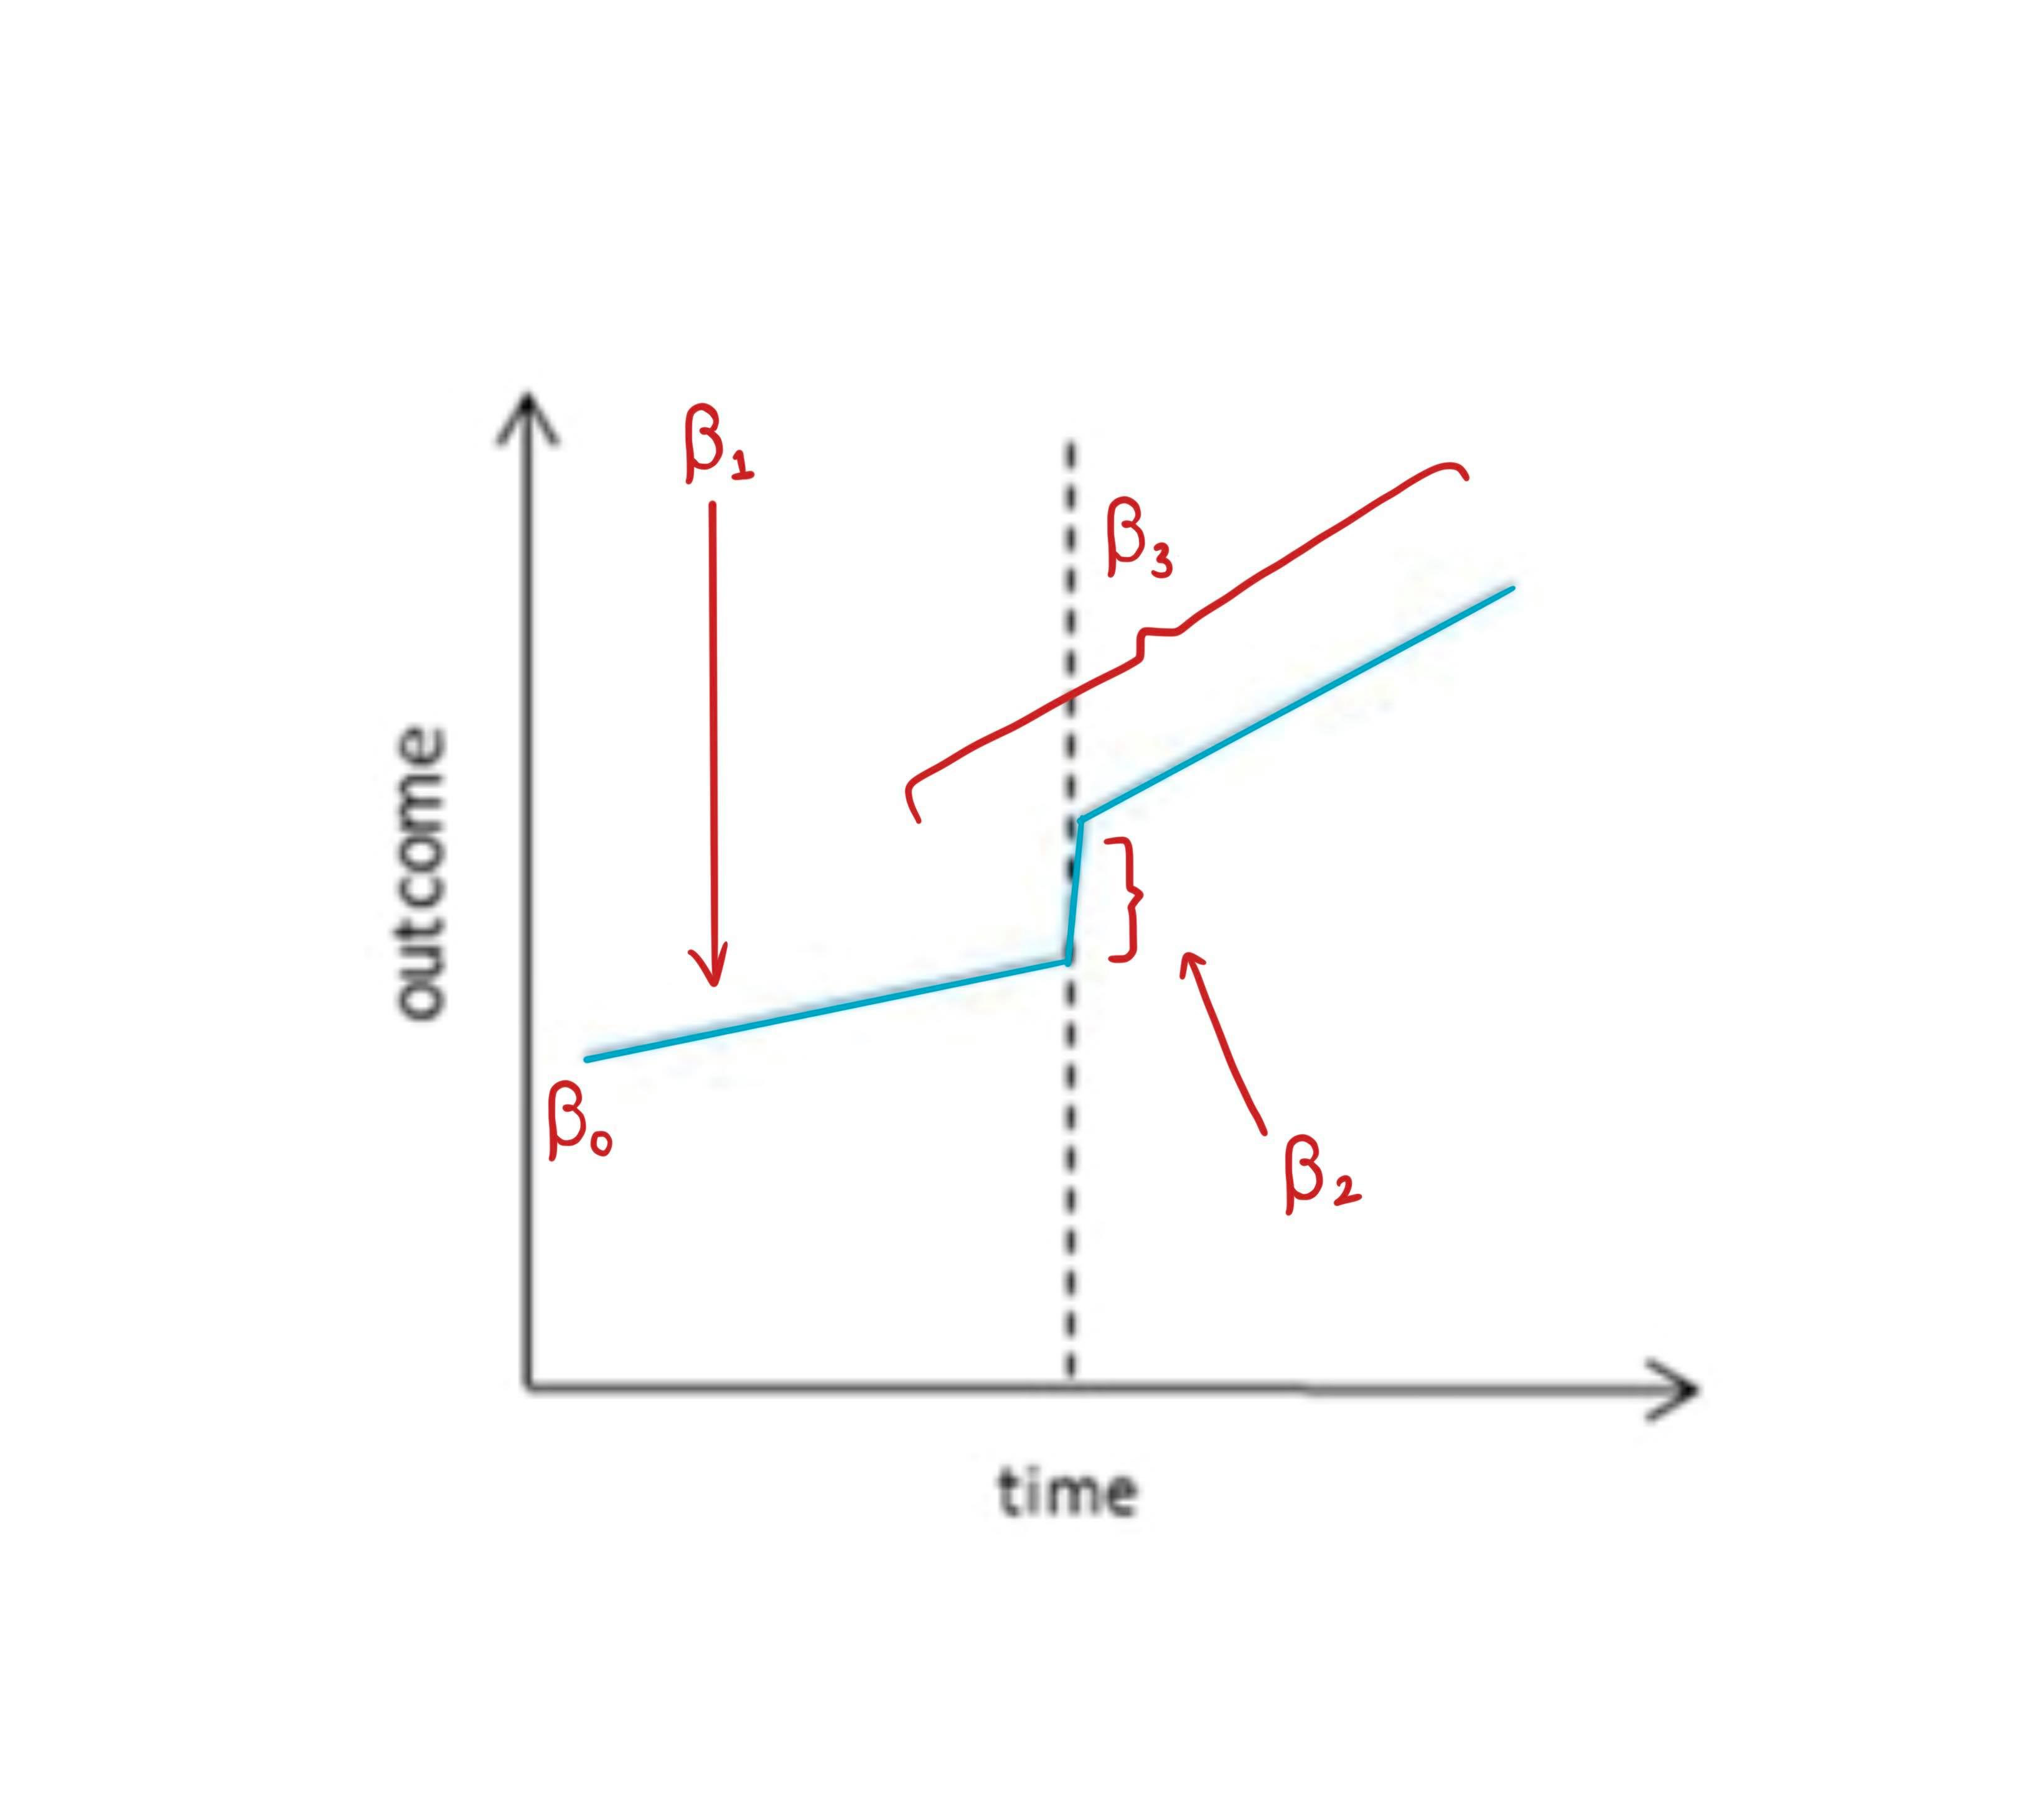

Regression model for ITS
Regression model
$$Y_{t}=β_{0}+β_{1}T+β_{2}X_{t}+β_{3}TX_{t}$$
$$β_{0}:intercept −outcome measure at T=0 \\ β_{1}:slope −Trend before the intervention \\ β_{2}:immediate change when the intervention is implemented \\ β_{3}:change in slope after the intervention$$

Slide 15
Regression model for ITS
Seasonality
When there is an obvious seasonality pattern in the outcome (e.g. incident of flu), it is important to account for seasonality
If the pre- or post- intervention has more data from the winter months, the results would be biased.
Add a variable representing “seasons” – Spring, Summer, Autumn and Winter
Use more complex functions (combination of sine and cosine).

Slide 16
Regression model for ITS
Autocorrelation
Observations tend to be more similar in closer time that those further apart.
Violated the assumption of standard regression
In public health research, autocorrelation is generally largely explained by other variables such as seasonality.
Autocorrelation is rarely a big issue in public health research.
Plot the Autocorrelation function (ACF) or the Partial autocorrelation function (PACF)
Accounting for autocorrelation specifically by specifying the error (residual) structure.

Slide 17
Motivating Example
To reduce alcohol consumption in Northern Territory, the government implemented a minimum price for alcohol in 2018.
Does this policy work? (i.e. reducing alcohol consumption in the population?)

Slide 18
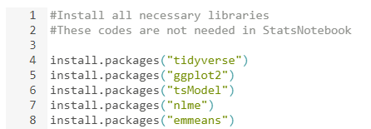
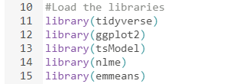
Motivating Example
R/RStudio/StatsNotebook
Libraries required
tidyverse
ggplot2
tsModel
nlme
emmeans

Slide 19
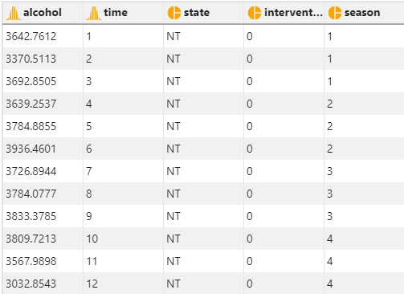
Motivating Example
Simulated dataset https://statsnotebook.io/blog/data_management/example_data/alcohol_data_NT.csv

Slide 20
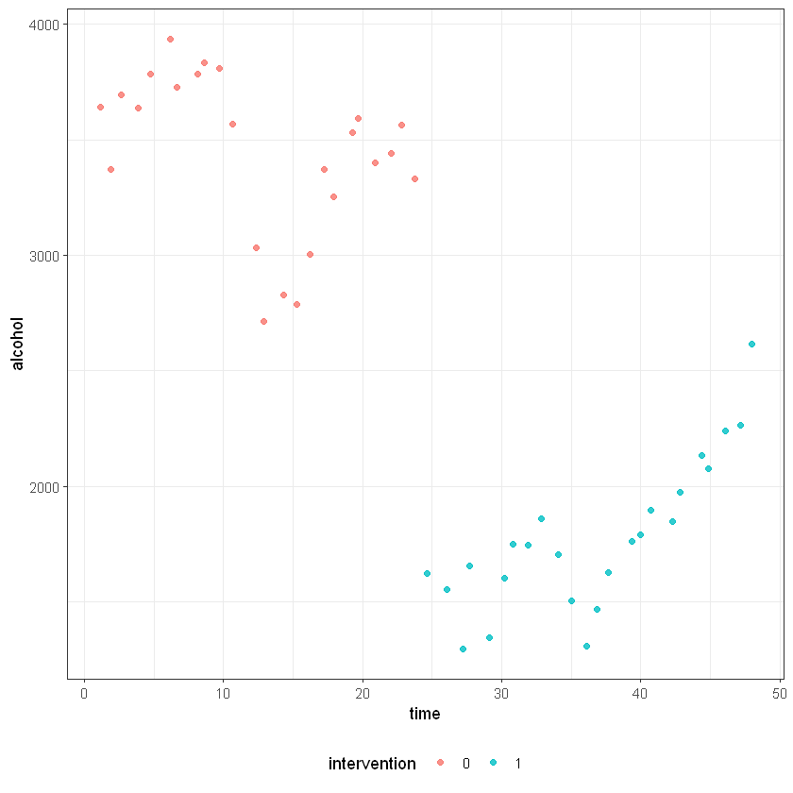
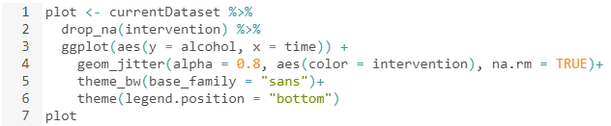
Motivating Example
Plotting the data

Slide 21

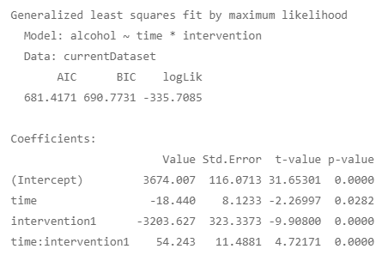
Motivating Example
Running the preliminary model

Slide 22

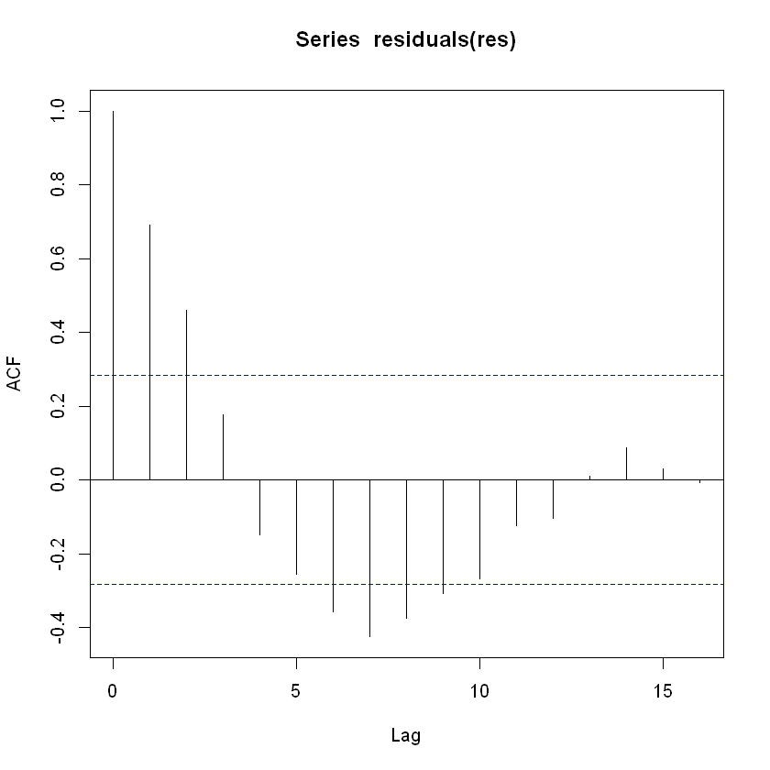
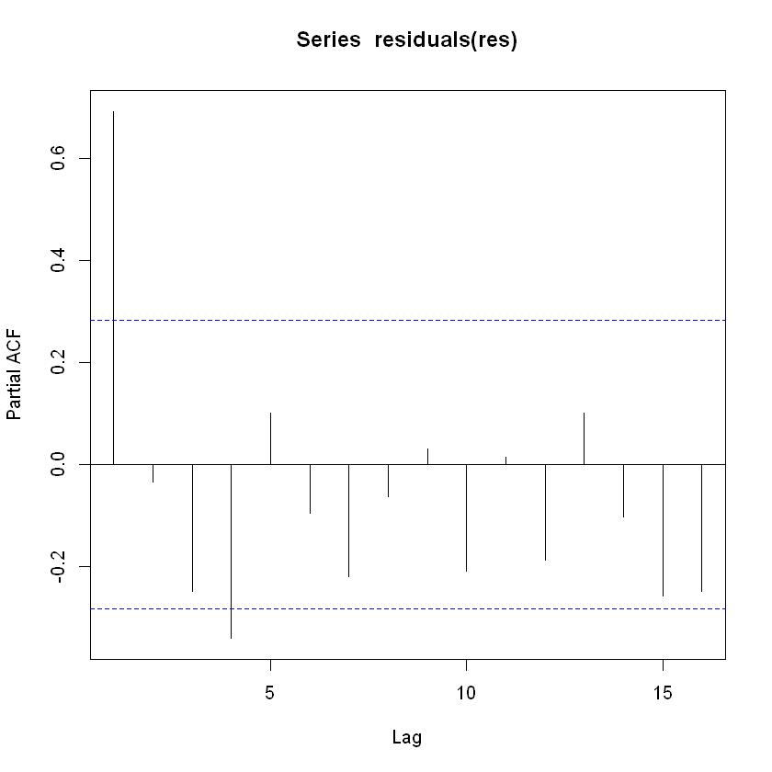
Motivating Example
Plotting the autocorrelation function and the partial autocorrelation function

Slide 23
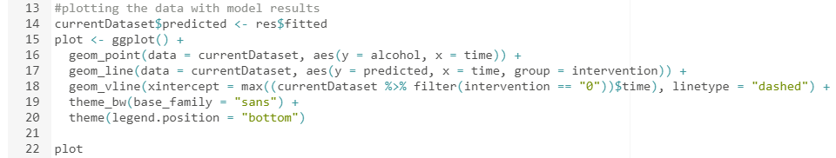
Motivating Example
Plotting model-based prediction

Slide 24
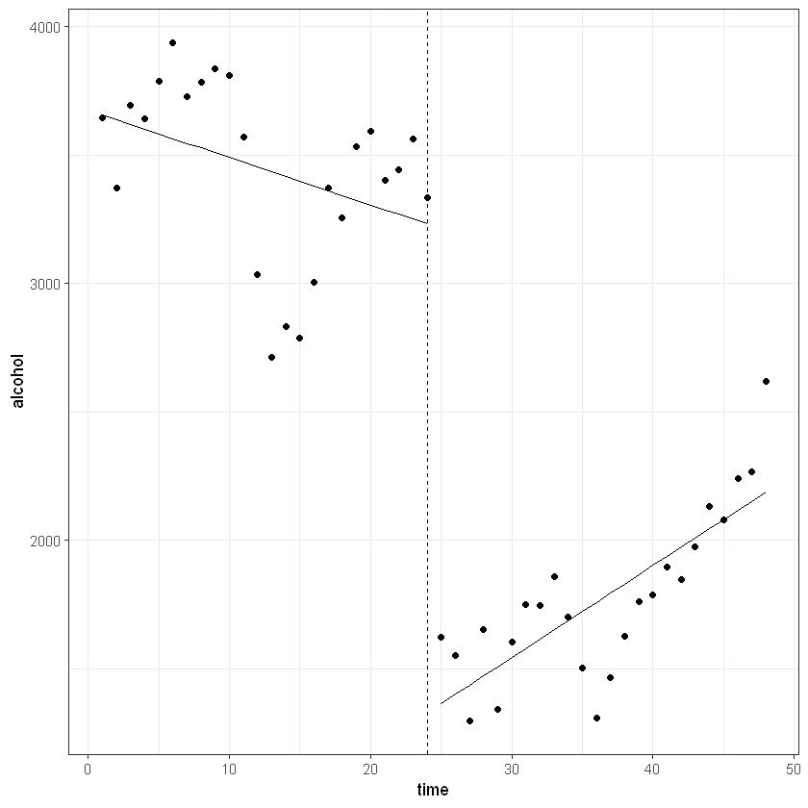
Motivating Example

Slide 25
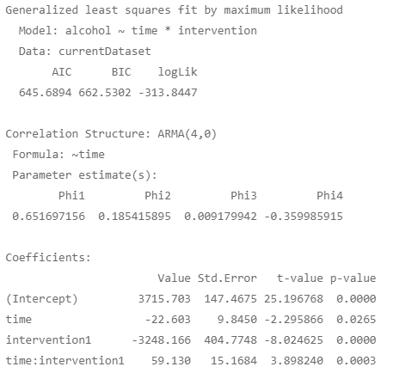

Motivating Example
Rerun the model adjusting for autocorrelation

Slide 26

Motivating Example

Slide 27
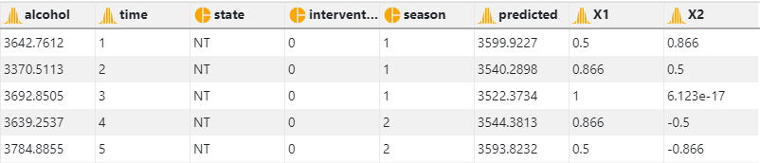
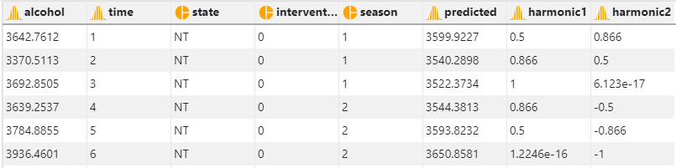
Motivating Example
Rerun the model adjusting for seasonality using the harmonic() from the tsModel library
Two parameters: Number of sine/cosine pair to use and the length of one cycle

Slide 28

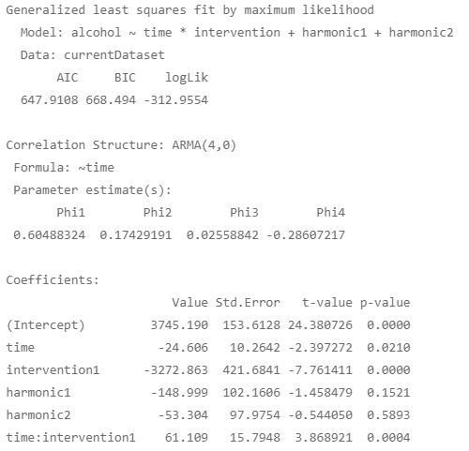
Motivating Example

Slide 29
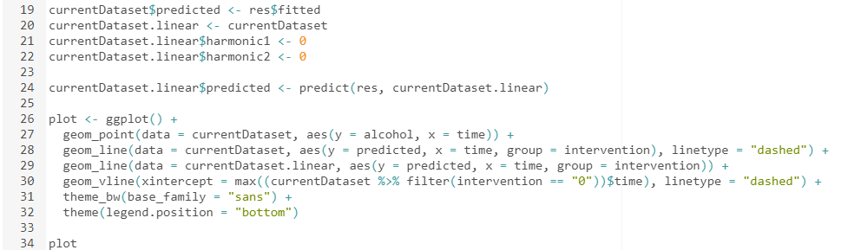
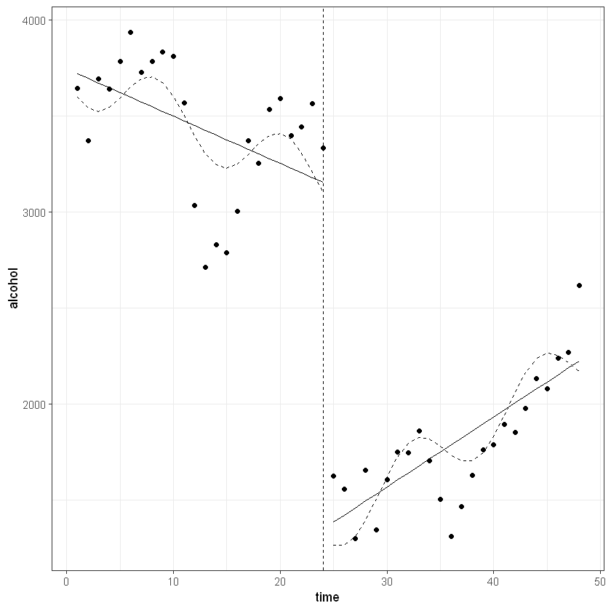
Motivating Example

Slide 30
Interrupted time series analysis (ITS)
Follow a single population over time => free from problems due to between group differences such as selection bias and unmeasured confounding
Controls for within-group characteristics.
Major threat to causal inference
Time-varying confounding
E.g. National Campaign on reducing alcohol use around the same period.
Inclusion of a “control” can address this issue

Slide 31
ITS with controls
Stronger design
Evaluate intervention within (pre/post comparison) and between groups
Absence of any intervention effect in the control provide stronger evidence
Compare the time series data from Northern Territory with those from other states (e.g. Queensland)
If there is an “interruption” in alcohol use Northern Territory and there is no such interruption in Queensland, we can confidently conclude that the minimum pricing policy reduced alcohol consumption in the Northern Territory population.

Slide 32
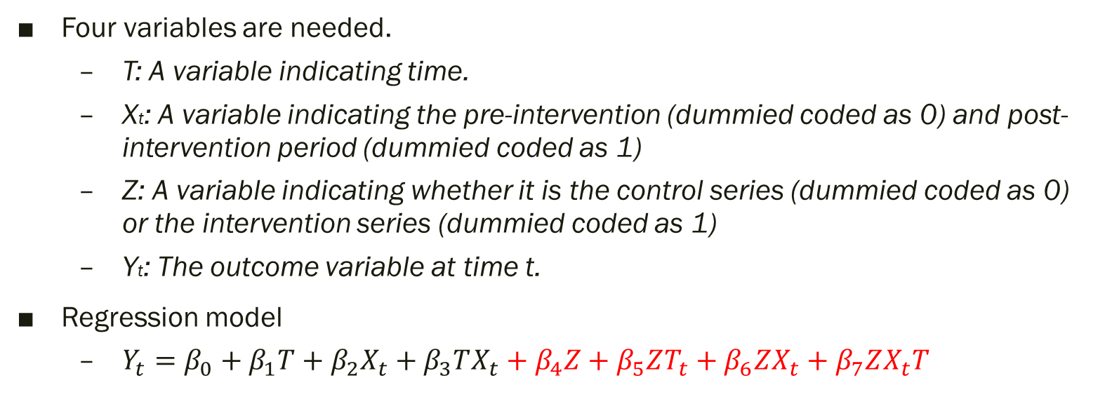
Regression model for ITS with controls
Four variables are needed.
T: A variable indicating time.
Xt: A variable indicating the pre-intervention (dummied coded as 0) and post-intervention period (dummied coded as 1)
Z: A variable indicating whether it is the control series (dummied coded as 0) or the intervention series (dummied coded as 1)
Yt: The outcome variable at time t.
Regression model
$Y_{t}=β_{0}+β_{1}T+β_{2}X_{t}+β_{3}TX_{t}+β_{4}Z+β_{5}ZT_{t}+β_{6}ZX_{t}+β_{7}ZX_{t}T$

Slide 33
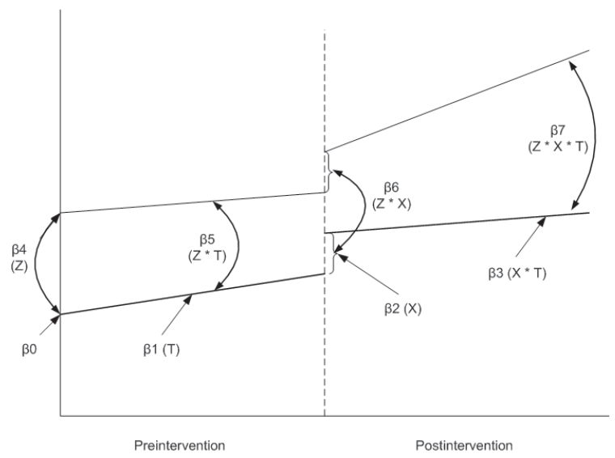

Regression model for ITS with controls
Regression model
$$Y_{t}=β_{0}+β_{1}T+β_{2}X_{t}+β_{3}TX_{t}+β_{4}Z+β_{5}ZT_{t}+β_{6}ZX_{t}+β_{7}ZX_{t}T \\ β_{0}:Intercept −Outcome of the control series at T=0 \\ β_{1}:Slope before the intervention of the control series \\ β_{2}:Immediate change in the control series after the intervention \\ β_{3}:Change in slope after the intervention in the control series \\ β_{4}:Difference in intercept between the control and intervention series \\ β_{5}:Difference in the preintervention slope between the control and intervention series \\ β_{6}:Difference in the immediate change between the control and the intervention series after the intervention \\ β_{7}:Difference in the change in slope after the intervention between the control and the intervention series$$

Slide 34
Motivating Example
To reduce alcohol consumption in Northern Territory, the government implemented a minimum price for alcohol in 2018.
Does this policy work? (i.e. reducing alcohol consumption in the population?)
Compare the population alcohol consumption trends before and after minimum pricing policy in Northern Territory (i.e. within the state)
Compare if the pre/post implementation trend in Northern Territory against Western Australia (across states)

Slide 35
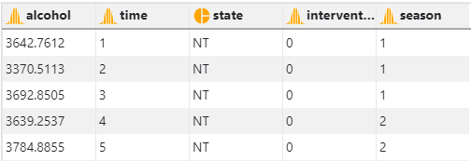
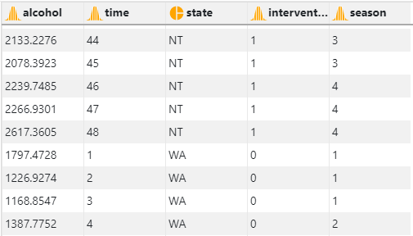
Motivating Example

Slide 36
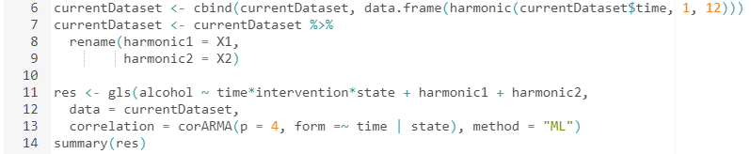
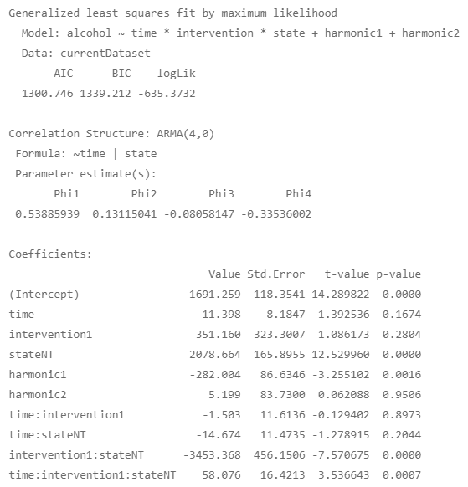
Motivating Example

Slide 37

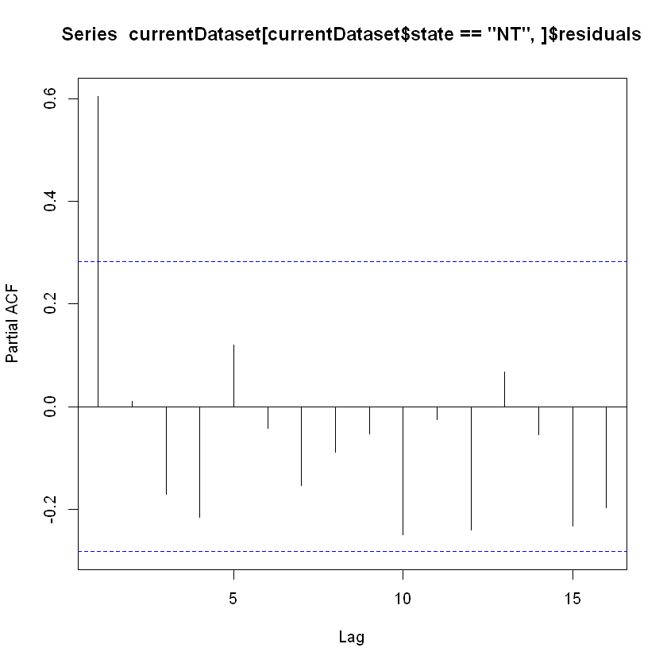
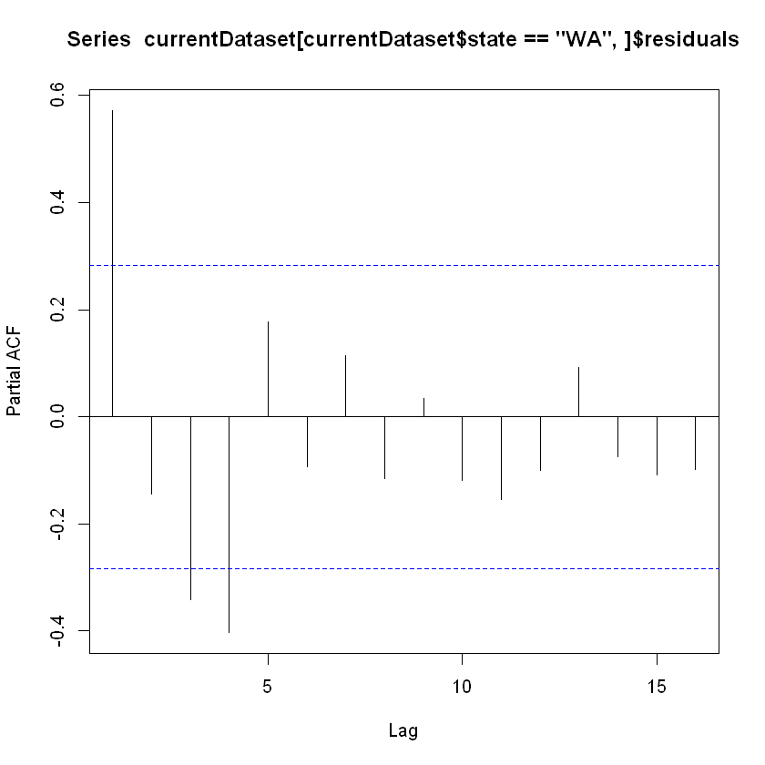
Motivating Example

Slide 38
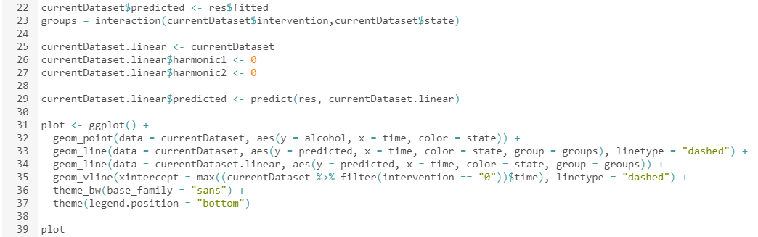
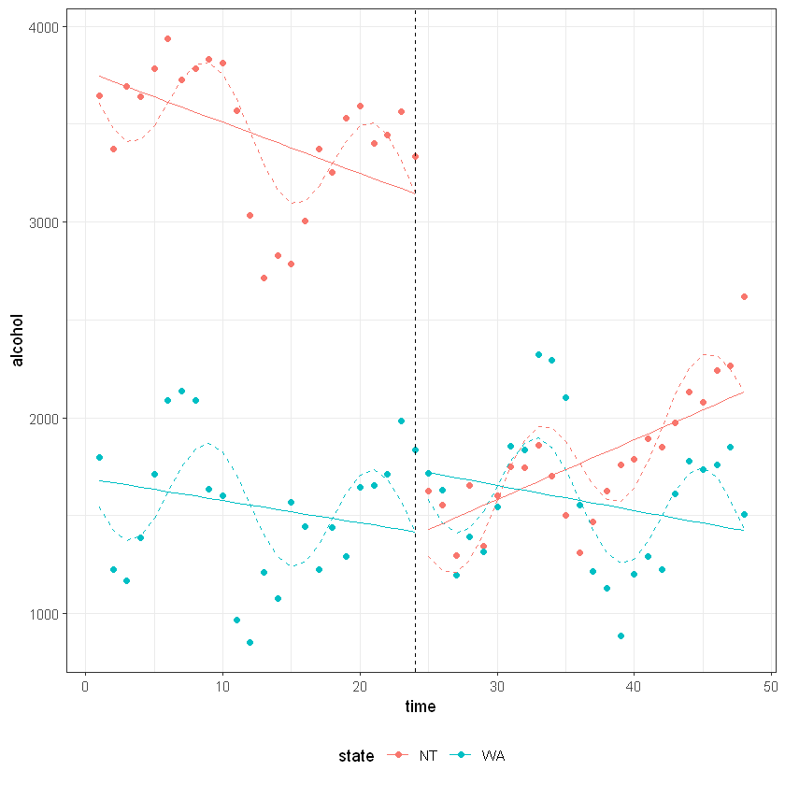
Motivating Example

Slide 39
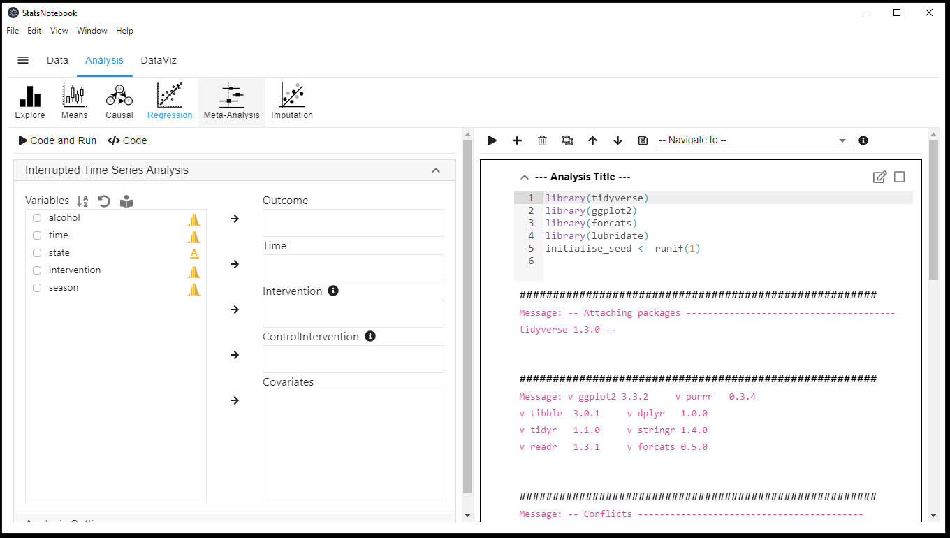
StatsNotebook
Graphical interface for R

Slide 40
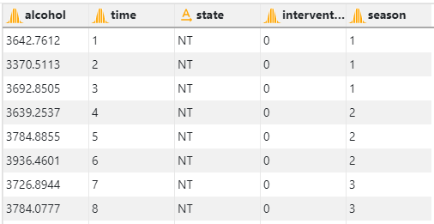
StatsNotebook

Slide 41
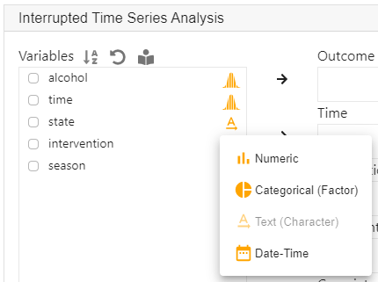
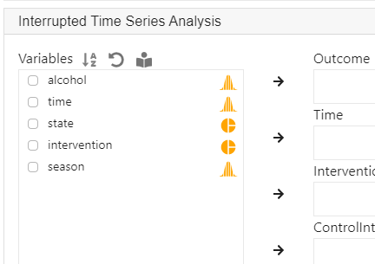
StatsNotebook

Slide 42

StatsNotebook

Slide 43
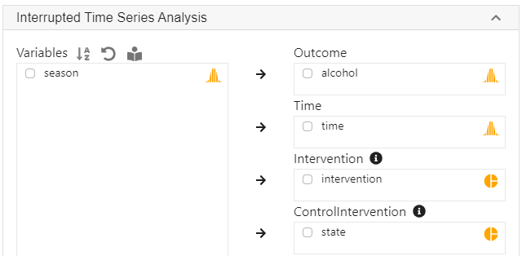
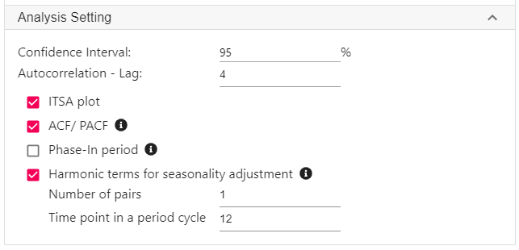
StatsNotebook

Slide 44
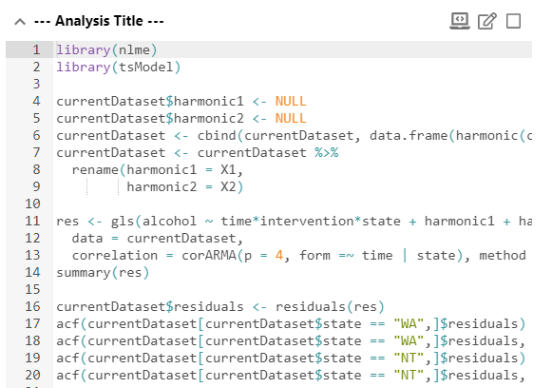
StatsNotebook

Slide 45
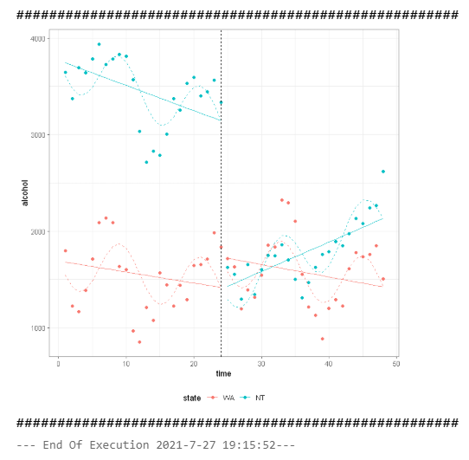
StatsNotebook

Slide 46
Other considerations
Which if my variable is a count variable or a rate
Number of emergency presentation relating to alcohol use (count)
Number of alcohol-related domestic violence incidents per 100000 population (rate)
Count variable with a Poisson distribution can be approximate by normal distribution when the mean of the Poisson distribution is “large” enough.
How large is large?

Slide 47
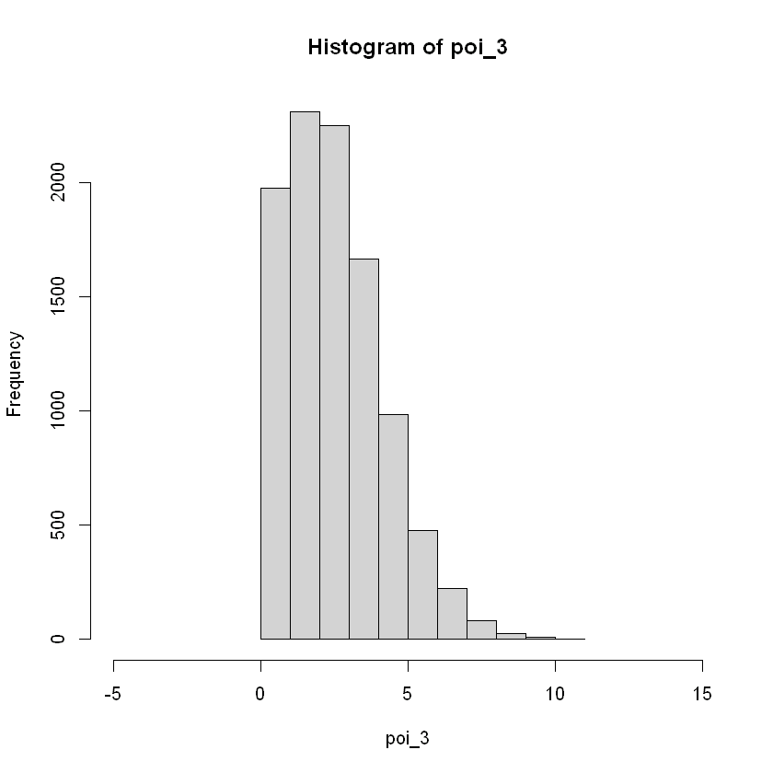
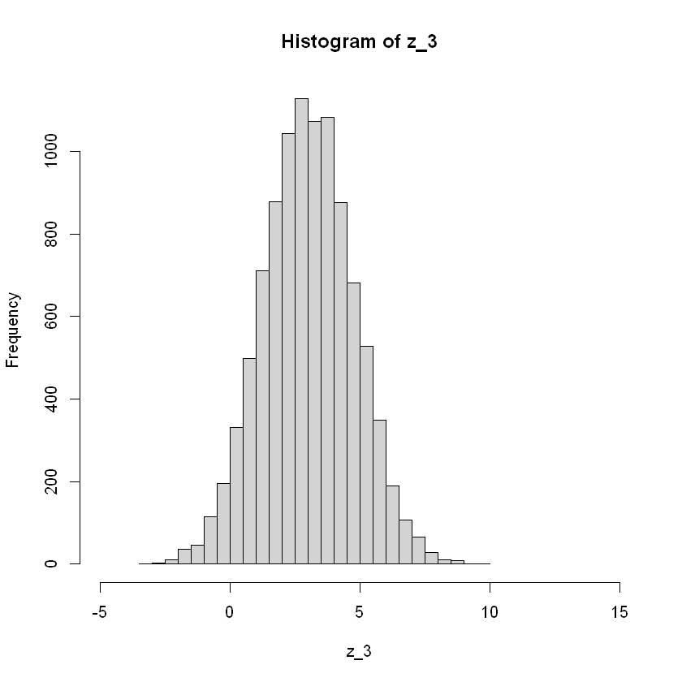
Normal approximation

Slide 48
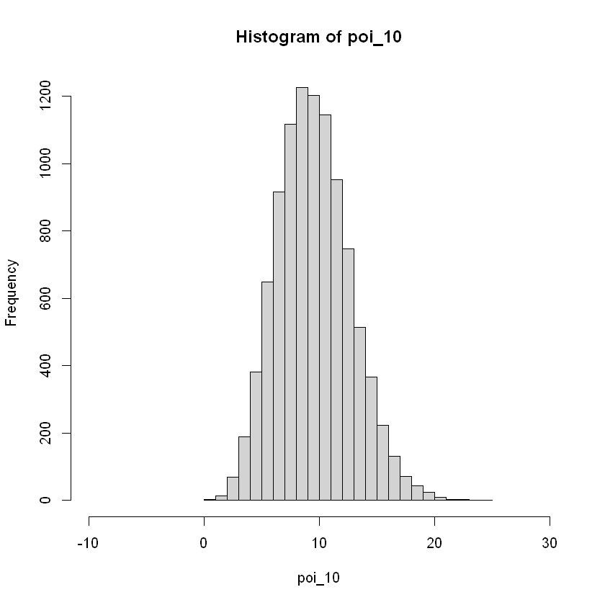
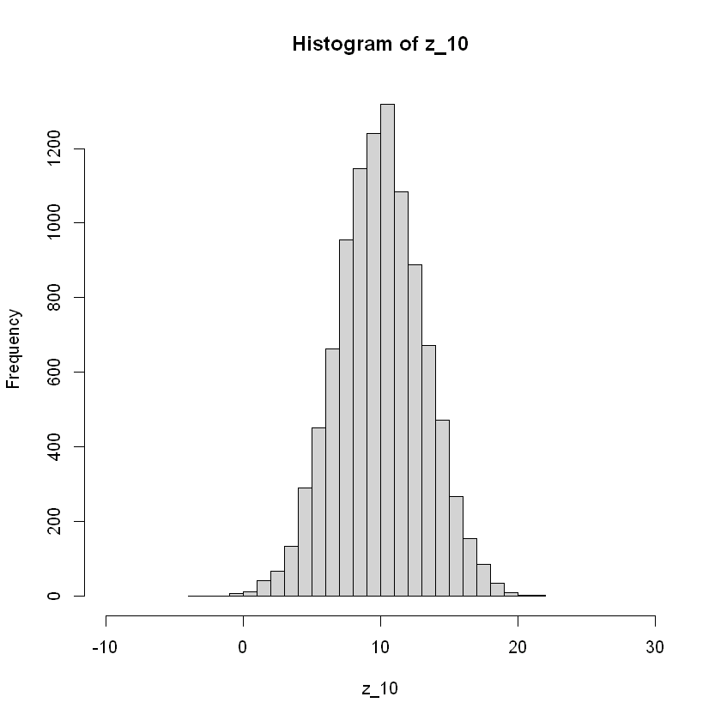
Normal approximation

Slide 49
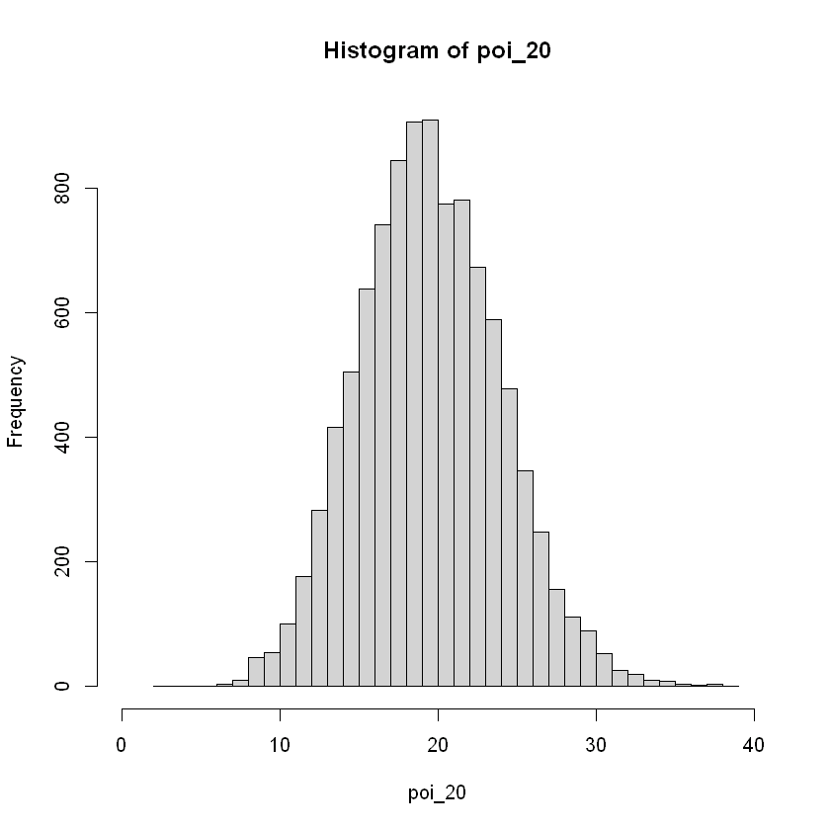
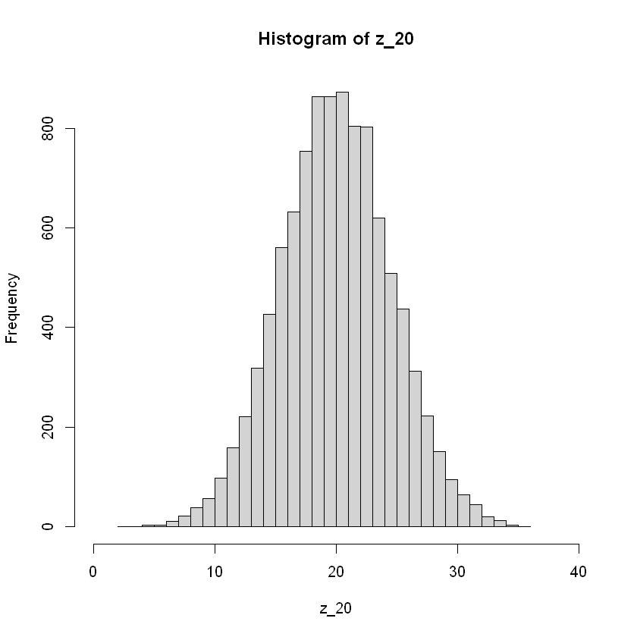
Normal approximation

Slide 50
Poisson regression
Poisson regression can be used to model count variable.
The glm() function can be used.
In the presence of autocorrelation, the standard error will need to be adjusted.
The NeweyWest() function from the package sandwich is needed.

Slide 51
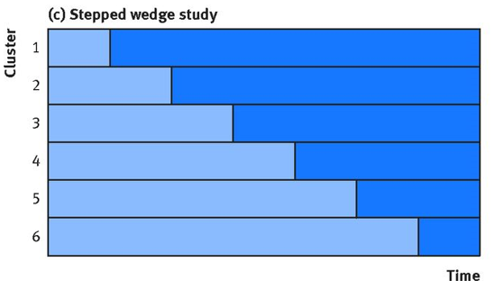
Other related topics
Use of synthetic controls
Create a synthetic control by weighting data from different states (e.g. QLD, WA, NSW, etc)
Stepped wedged design

Slide 52

Thank you.
Dr. Gary Chan
StatsNotebook.io National Centre for Youth Substance Use Research Email: c.chan4@uq.edu.au Twitter: @GaryCKChan

