Slide 1

OPN STORM SURGE
Dog Co
19 OCT 26

Slide 2
GTF Mission Statement
Dog Company conducts a Company (-) Air Assault into Tullahoma, TN to secure an expeditionary FARP on 29 0130Z OCT26 to enable freedom of movement for 6-101 CAB and proof the concept for FARP seizure operations.

Slide 3
GTF CDR Intent
Commanders Intent: Proof a viable concept of FARP Seizure Operations to enable 101st CAB elements to conduct a deep penetration in preparation for a L2A2 on a follow-on objective. We will accomplish this by conducting an Air Assault from CAAF to Tullahoma, TN, validating our internal loading procedures for C2 / BLOS systems, enabler package, and FARP systems while conducting PZ operations in an unfamiliar environment. We will assume risk by training with newly qualified Pathfinders within the Company. We will mitigate this risk through the deliberate rehearsals, air assault planning, leader certifications prior to execution.
Purpose: The purpose of this training event is to validate a FARP Seizure mission set that would be given to a DIV Pathfinder Company.
Risk to Force: Sending a Company(-) with limited sustainment 180 nautical miles from FCKY
Mitigation: Dog Company will provide 1 x DOS of CL I prior to W/U + 1 x DOS carried per soldier on the aircraft.
Key Tasks:
Conduct Air Assault planning (IPC, AMCM, AMB) – Dog Company // Enablers // 6-101
Cold Load Training – Dog Company // 6-101
Assemble and Deploy to CAAF – Dog Company
Conduct an Air Assault– Dog Company // 6-101
Seize a FARP – Dog Company
Conduct Pathfinder Operations (PZ) – Dog Company // 6-101
Endstate:
Friendly: Dog Company maintains 100% accountability of all personnel and equipment and validates our FARP seizure Task Force
Civil: No damage to personnel, equipment, or surrounding infrastructure.

Slide 4
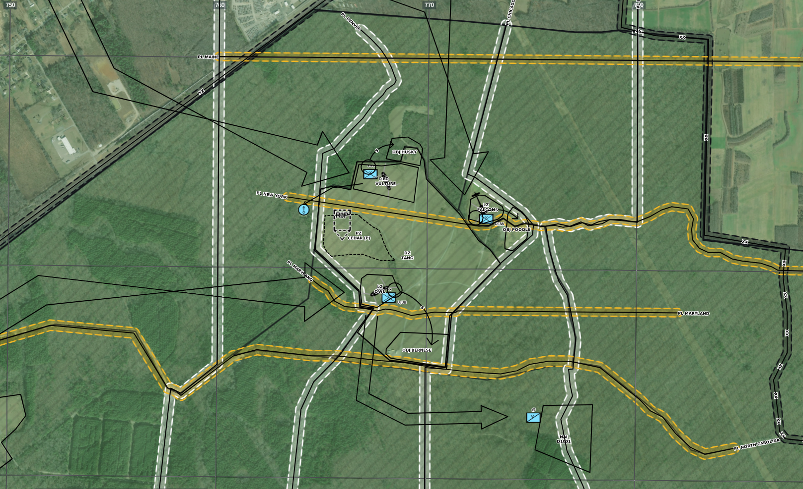
Operation Storm Surge
Mission: Dog Company execute an Air Assaults on O/A 28OCT26 IOT validate the Alpha Echelon required to seize a FARP and certify our ability to conduct Pathfinder Operations.
8-Step Training
Plan: | 02 SEP 2026
Train & Certify: | 30 JUL 2026
Recon: | 08 OCT 2026
Issue Plan: | 23 OCT 2026
Rehearse: | 26 OCT 2026
Execute: | 2829 OCT 2026
AAR: | 30 OCT 2026
Retrain: | N/A
Training Objectives:
07-CO-5135 : Operate a Command Post - Company
011-60Z-1054 : Selecting a Landing Zone- Pickup Zone
Concept of Operation:
Phase 1: Planning and Prep
B: 02SEP26
E: W/U - 28 1930 OCT26
Key Tasks: Air Assault Planning Timeline, Cold Load Training
Phase 2: Movement
B: W/U - 28 1930 OCT26
E: W/D - 28 2020 OCT26
Key Tasks: RxLs, Pathfinder Operations
Phase 3: FARP Seizure
B: W/D - 28 2020 OCT26 (H-Hour)
E: FARP Seized - 28 2200 OCT26
Key Tasks: Air Assault (Night), Land Navigation, Seize FARP Phase 4: FARP Operations
B: FARP Seized - 28 2200 OCT26
E: FARP OPS Complete - 29 0450 OCT26
Key Tasks: Pathfinder Operations (PZ), FARP Operations
Phase 5: Reconsolidation
B: FARP OPS Complete - 29 0450 OCT26
E: Reconsolidated at FCKY - 29 0225 OCT 2026
Key Tasks: Reconsolidation, Pathfinder Operations
Coordinating Instructions:
Uniform: RBU4
A/C Package:
3 x CH (1 x PAX / 1 x FATCOW)
1 x UH
Training Resourcing
Key Personnel:
OIC: CPT LAJEUNESSE
RSO: 1SG SCHAEFER
Safeties: NA
Evaluators: N/A
Concurrent Training NCO: NA
Remedial Training NCO: NA
Medic/CLS: Source from India
Drivers / TCs: Source from HQ/Dog
Signal:
See Slide 25
Scheme of Maneuver:
TF BLOODHOUND assembles and conduct internal loading procedures at Campbell Army Airfield (CAAF). TF BLOODHOUND Air Assaults into LZ OWL (P) / LZ DOVE (A). TF BLOODHOUND seizes OBJ BERNESE and establishes PZ CEDAR (P) / PZ BIRCH (A) NLT H+1:00.
GENERAL (CLI, MED) | LAND / AMMO | TRANSPORTATION
Pax Count: 83 PAX CLI: M Med Support: MEDEVAC | RCNI: TNANG Ammo Pick-up: NA Rounds by DODIC: NA Ammo Turn-in: NA | Status: TBP Pick-Up: TBP Return: TBP
Complete
In-Progress
Incomplete
CAO: 01SEP26
POC: CPT Hoover, Jack

Slide 5
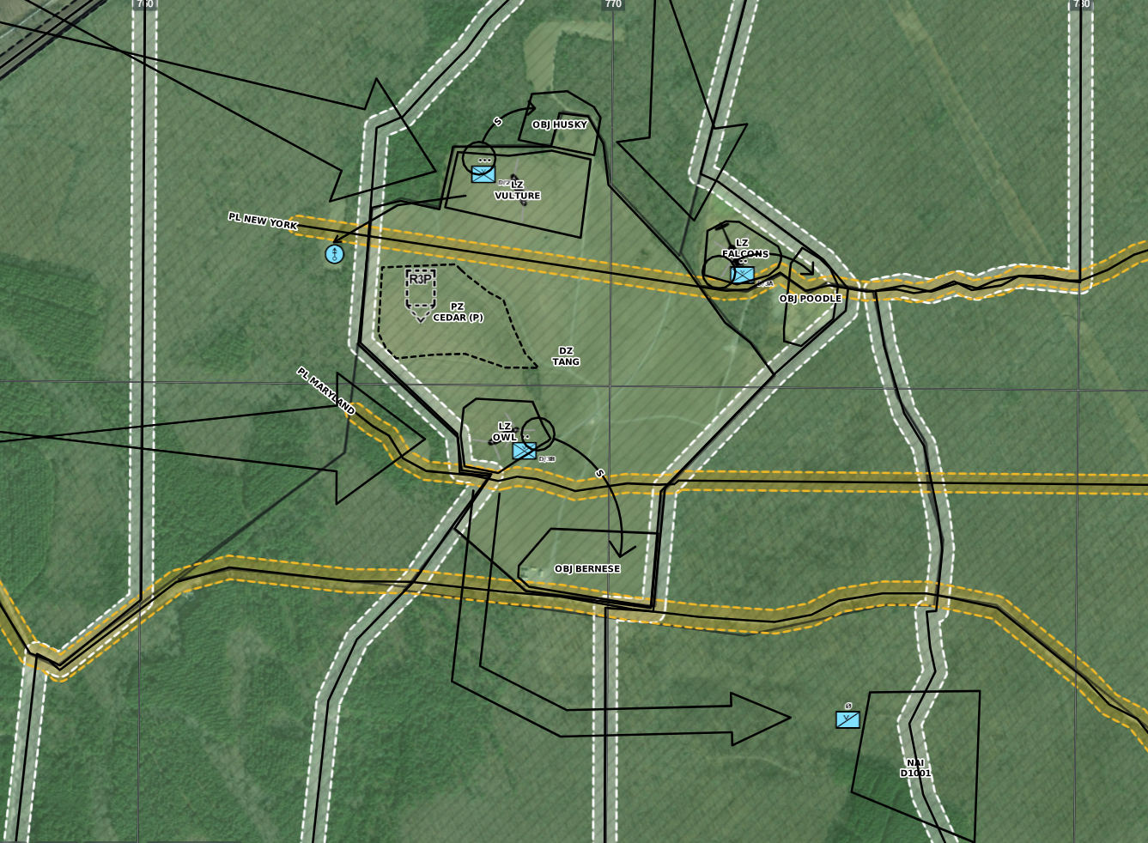
Concept of the Operation
Phase 1: Planning and Prep
B: 02SEP26 – IPC#1 w/ 6-101 CAB
E: W/U - 28 1930 OCT26
Key Tasks: Air Assault Planning Timeline, Cold Load Training
Phase 2: Movement
B: W/U - 28 1930 OCT26
E: W/D - 28 2020 OCT26
Key Tasks: RxLs, Pathfinder Operations
Phase 3: FARP Seizure
B: W/D - 28 2020 OCT26 (H-Hour)
E: FARP Seized - 28 2200 OCT26
Key Tasks: Air Assault (Night), Land Navigation, Seize FARP
Phase 4: FARP Operations
B: FARP Seized - 28 2200 OCT26
E: FARP OPS Complete - 29 0450 OCT26
Key Tasks: Pathfinder Operations (PZ), FARP Operations
Phase 5: Reconsolidation
B: FARP OPS Complete - 29 0450 OCT26
E: Reconsolidated at FCKY - 29 0225 OCT 2026
Key Tasks: Reconsolidation, Pathfinder Operations
Scheme of Maneuver
Dog Company TF Pathfinder PAX and Dog HQ will deploy to CAAF at 1400. TF Pathfinder and Dog HQ will rig and inspect 2 x ISVs and conduct internal loading procedures at Campbell Army Airfield (CAAF). The air package will be 2 x CH-47 from C / 6-101 CAB. W/U 29-30 1900 (T) JUL26 at CAAF. Total flight time is 2:00 hrs flying to MUTC, IL. W/D at LZ CURAHEE (16SFJ 2699 2317) is templated for 29-30 2100 (T) JUL26. TF Pathfinder and Dog HQ will unload 2 x ISV and transition to mounted land navigation, traveling IN TRAVELING overwatch mounted on RTE RED to an urban site where Dog HQ will clear a building and establish Dog CP NLT H+:25. TF Pathfinder will continue travel along RTE YELLOW to PZ DOG (16SFJ 2702 2372), where TF Pathfinder will execute PZ operations. NLT H+:40 DOG HQ will break down the Dog CP and travel along RTE GREEN to PZ DOG. TF Pathfinder and Dog HQ will receive 2 x CH-47 at PZ DOG, internally load 2 x ISV. W/U at PZ DOG 29-30 2200 (T) JUL26. W/D at CAAF is 30-31 0000 (T) JUL26. Dog Elements will RTB and conclude training NLT 30-31 0200 JUL26.

Slide 6
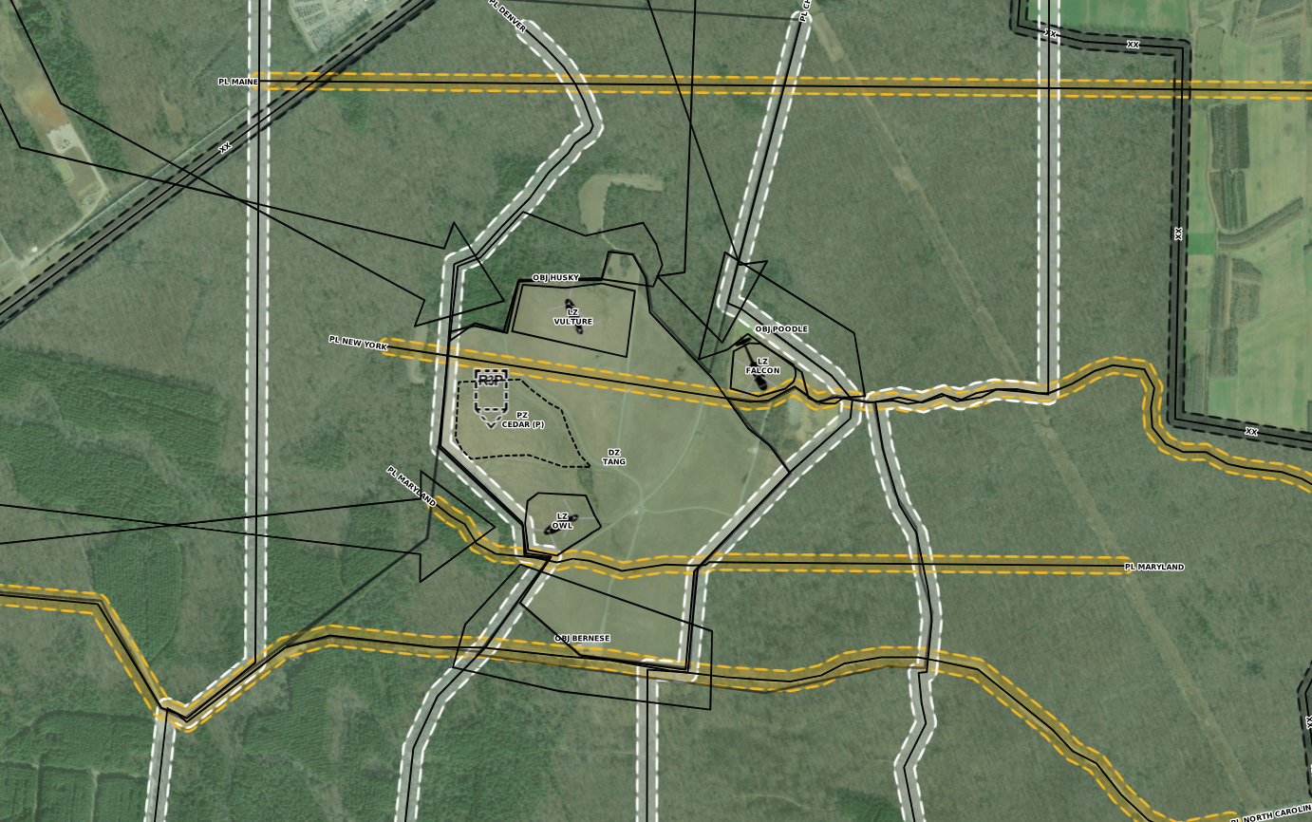
Phase II : Movement
Phase II: Movement
B: W/U - 28 1930 OCT26
E: W/D - 28 2020 OCT26
Key Tasks: RxLs, Pathfinder Operations
Scheme of Maneuver
Dog Company TF Pathfinder PAX and Dog HQ will deploy to CAAF at 1400. TF Pathfinder and Dog HQ will rig and inspect 2 x ISVs and conduct internal loading procedures at Campbell Army Airfield (CAAF). The air package will be 2 x CH-47 from C / 6-101 CAB. W/U 29-30 1900 (T) JUL26 at CAAF. Total flight time is 2:00 hrs flying to MUTC, IL. W/D at LZ CURAHEE (16SFJ 2699 2317) is templated for 29-30 2100 (T) JUL26. TF Pathfinder and Dog HQ will unload 2 x ISV and transition to mounted land navigation, traveling IN TRAVELING overwatch mounted on RTE RED to an urban site where Dog HQ will clear a building and establish Dog CP NLT H+:25. TF Pathfinder will continue travel along RTE YELLOW to PZ DOG (16SFJ 2702 2372), where TF Pathfinder will execute PZ operations. NLT H+:40 DOG HQ will break down the Dog CP and travel along RTE GREEN to PZ DOG. TF Pathfinder and Dog HQ will receive 2 x CH-47 at PZ DOG, internally load 2 x ISV. W/U at PZ DOG 29-30 2200 (T) JUL26. W/D at CAAF is 30-31 0000 (T) JUL26. Dog Elements will RTB and conclude training NLT 30-31 0200 JUL26.

Slide 7
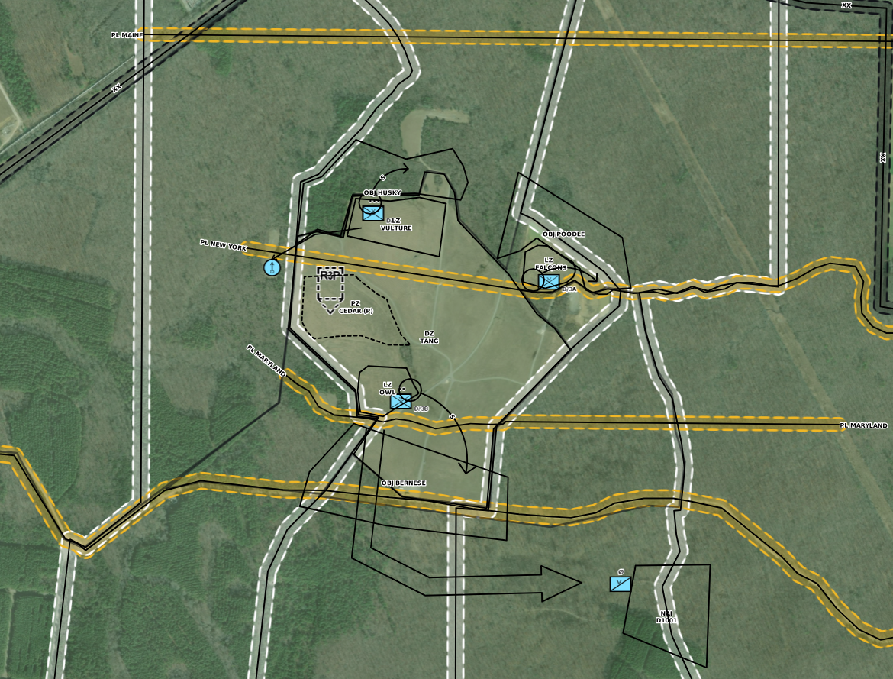
Phase III : FARP Seizure
Phase III: FARP Seizure
B: W/D - 28 2020 OCT26 (H-Hour)
E: FARP Seized - 28 2200 OCT26
Key Tasks: Air Assault (Night), Land Navigation, Seize FARP
Scheme of Maneuver
Dog Company TF Pathfinder PAX and Dog HQ will deploy to CAAF at 1400. TF Pathfinder and Dog HQ will rig and inspect 2 x ISVs and conduct internal loading procedures at Campbell Army Airfield (CAAF). The air package will be 2 x CH-47 from C / 6-101 CAB. W/U 29-30 1900 (T) JUL26 at CAAF. Total flight time is 2:00 hrs flying to MUTC, IL. W/D at LZ CURAHEE (16SFJ 2699 2317) is templated for 29-30 2100 (T) JUL26. TF Pathfinder and Dog HQ will unload 2 x ISV and transition to mounted land navigation, traveling IN TRAVELING overwatch mounted on RTE RED to an urban site where Dog HQ will clear a building and establish Dog CP NLT H+:25. TF Pathfinder will continue travel along RTE YELLOW to PZ DOG (16SFJ 2702 2372), where TF Pathfinder will execute PZ operations. NLT H+:40 DOG HQ will break down the Dog CP and travel along RTE GREEN to PZ DOG. TF Pathfinder and Dog HQ will receive 2 x CH-47 at PZ DOG, internally load 2 x ISV. W/U at PZ DOG 29-30 2200 (T) JUL26. W/D at CAAF is 30-31 0000 (T) JUL26. Dog Elements will RTB and conclude training NLT 30-31 0200 JUL26.

Slide 8
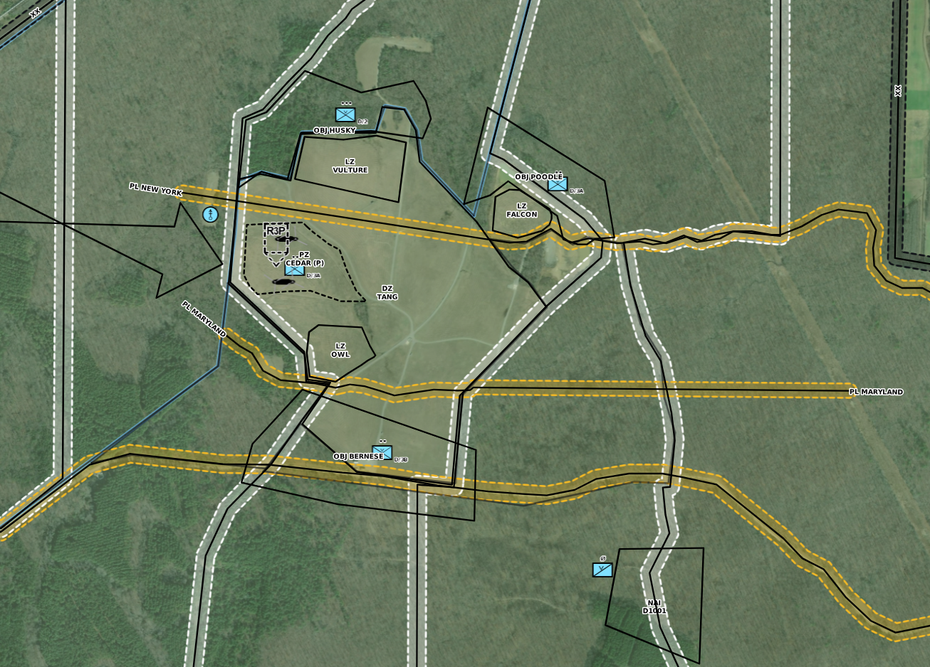
Phase IV : FARP Operations
Phase IV: FARP Operations
B: FARP Seized - 28 2200 OCT26
E: FARP OPS Complete - 29 0450 OCT26
Key Tasks: Pathfinder Operations (PZ), FARP Operations
Scheme of Maneuver
Dog Company TF Pathfinder PAX and Dog HQ will deploy to CAAF at 1400. TF Pathfinder and Dog HQ will rig and inspect 2 x ISVs and conduct internal loading procedures at Campbell Army Airfield (CAAF). The air package will be 2 x CH-47 from C / 6-101 CAB. W/U 29-30 1900 (T) JUL26 at CAAF. Total flight time is 2:00 hrs flying to MUTC, IL. W/D at LZ CURAHEE (16SFJ 2699 2317) is templated for 29-30 2100 (T) JUL26. TF Pathfinder and Dog HQ will unload 2 x ISV and transition to mounted land navigation, traveling IN TRAVELING overwatch mounted on RTE RED to an urban site where Dog HQ will clear a building and establish Dog CP NLT H+:25. TF Pathfinder will continue travel along RTE YELLOW to PZ DOG (16SFJ 2702 2372), where TF Pathfinder will execute PZ operations. NLT H+:40 DOG HQ will break down the Dog CP and travel along RTE GREEN to PZ DOG. TF Pathfinder and Dog HQ will receive 2 x CH-47 at PZ DOG, internally load 2 x ISV. W/U at PZ DOG 29-30 2200 (T) JUL26. W/D at CAAF is 30-31 0000 (T) JUL26. Dog Elements will RTB and conclude training NLT 30-31 0200 JUL26.

Slide 9
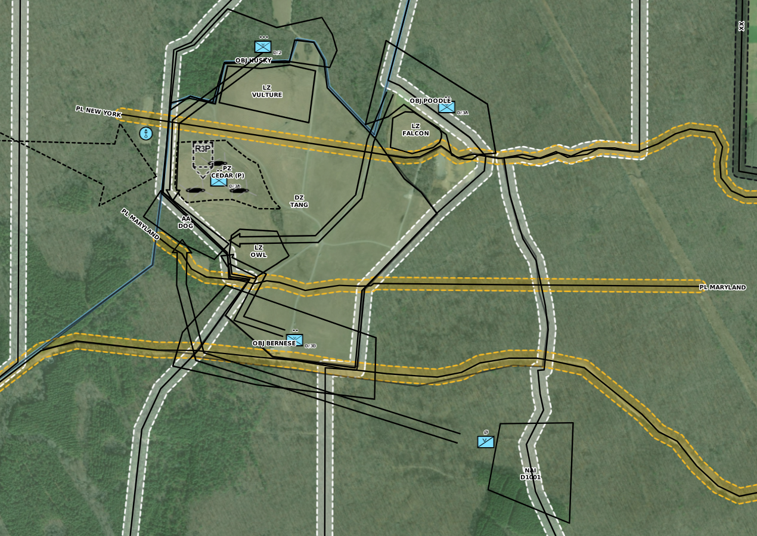
Phase V : Reconsolidation
Phase V: Reconsolidation
B: FARP OPS Complete - 29 0450 OCT26
E: Reconsolidated at FCKY - 29 0225 OCT 2026
Key Tasks: Reconsolidation, Pathfinder Operations
Scheme of Maneuver
Dog Company TF Pathfinder PAX and Dog HQ will deploy to CAAF at 1400. TF Pathfinder and Dog HQ will rig and inspect 2 x ISVs and conduct internal loading procedures at Campbell Army Airfield (CAAF). The air package will be 2 x CH-47 from C / 6-101 CAB. W/U 29-30 1900 (T) JUL26 at CAAF. Total flight time is 2:00 hrs flying to MUTC, IL. W/D at LZ CURAHEE (16SFJ 2699 2317) is templated for 29-30 2100 (T) JUL26. TF Pathfinder and Dog HQ will unload 2 x ISV and transition to mounted land navigation, traveling IN TRAVELING overwatch mounted on RTE RED to an urban site where Dog HQ will clear a building and establish Dog CP NLT H+:25. TF Pathfinder will continue travel along RTE YELLOW to PZ DOG (16SFJ 2702 2372), where TF Pathfinder will execute PZ operations. NLT H+:40 DOG HQ will break down the Dog CP and travel along RTE GREEN to PZ DOG. TF Pathfinder and Dog HQ will receive 2 x CH-47 at PZ DOG, internally load 2 x ISV. W/U at PZ DOG 29-30 2200 (T) JUL26. W/D at CAAF is 30-31 0000 (T) JUL26. Dog Elements will RTB and conclude training NLT 30-31 0200 JUL26.

Slide 10
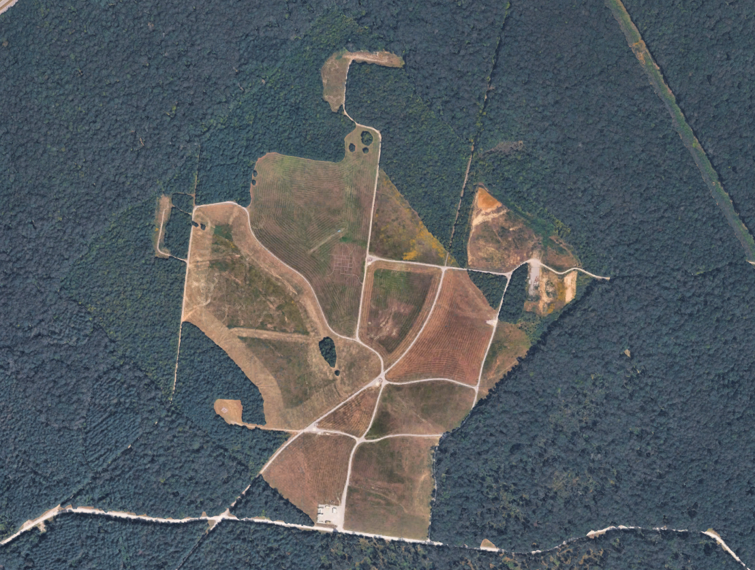
LZ / PZ Overview
LZ VULTURE
LZ FALCON
PZ CEDAR
LZ OWL

Slide 11
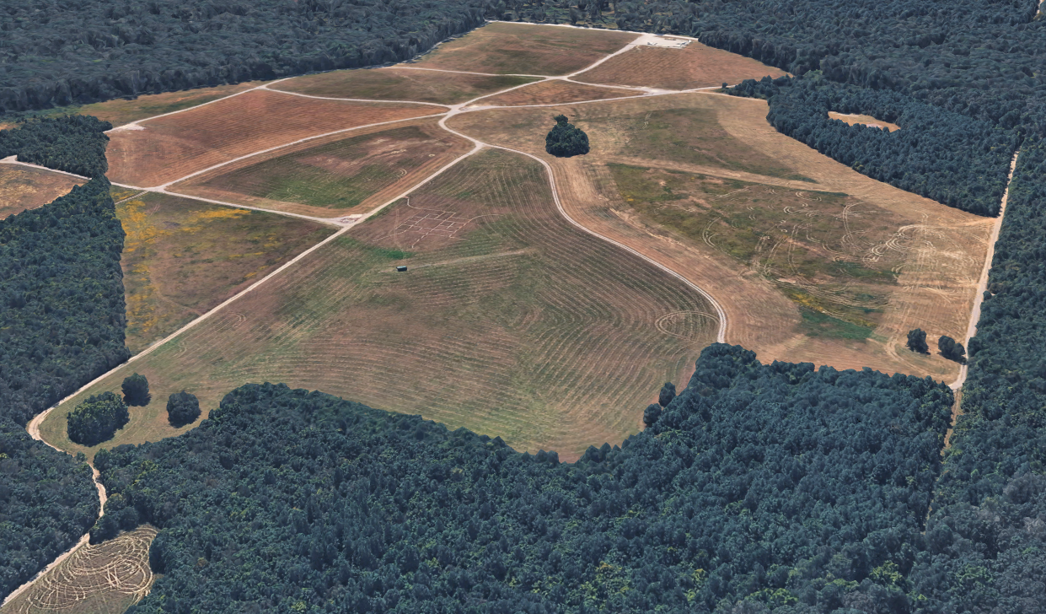
RP Inbound LZ VULTURE

Slide 12
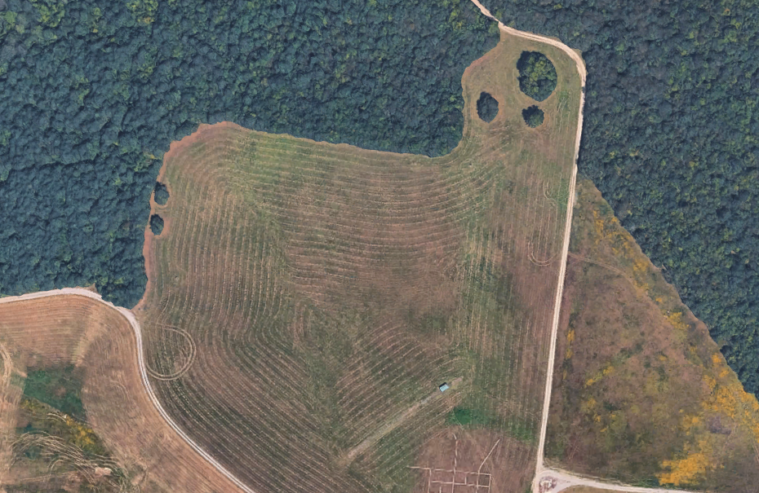

Inbound - LZ VULTURE
LZ VULTURE
***NOT TO SCALE***
MGRS: 16SEE 76802 15413
ELEV: 1070’ MSL
Description: Mostly flat
INB
AA HUSKY
HDG: 158° Deg (INB)
90° Deg (OUT)
FORM: N/A
WPN Status: FREE
Hazards: TREES
290 m
170 m
Primary: FM FH/CT (Freq: TBD)
OUT
264*
226*

Slide 13
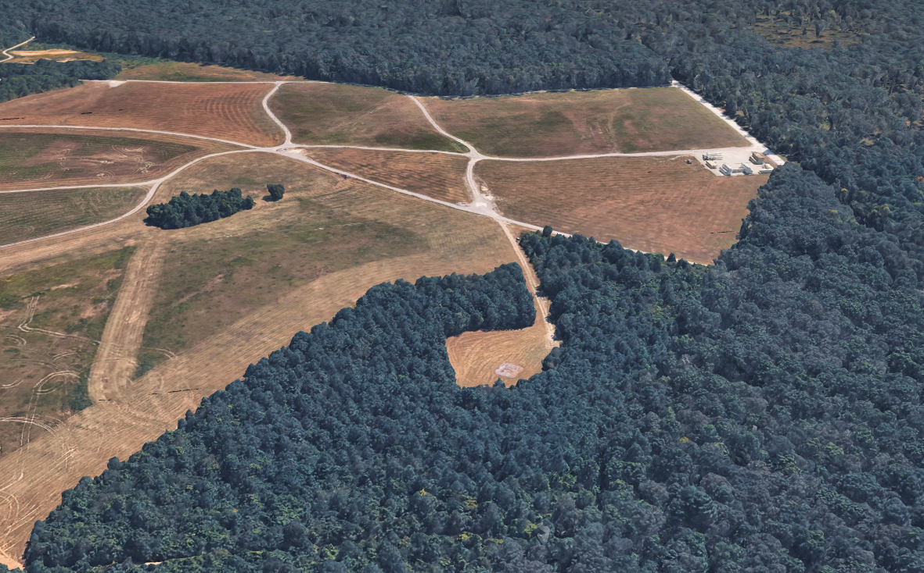
RP Inbound LZ OWL

Slide 14
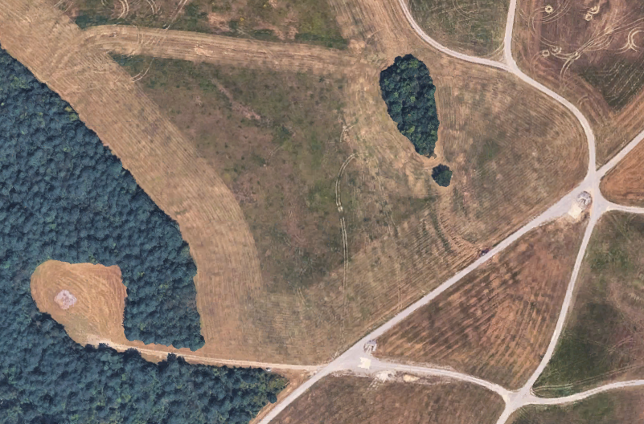
Inbound - LZ OWL
LZ OWL
***NOT TO SCALE***
MGRS: 16SEE 76774 14892
ELEV: 1097’ MSL
Description: Mostly flat
209 m
HDG: 63° Deg (INB)
90° Deg (OUT)
FORM: N/A
WPN Status: FREE
Hazards: TREES
177 m
OUT
Primary: FM FH/CT (Freq: TBD)
281 m
INB
AA BERNESE
135 m
176*
139*

Slide 15
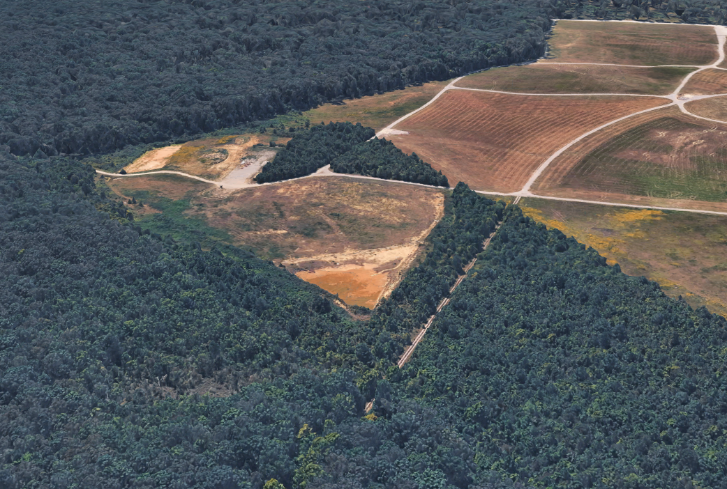
RP Inbound LZ FALCON

Slide 16
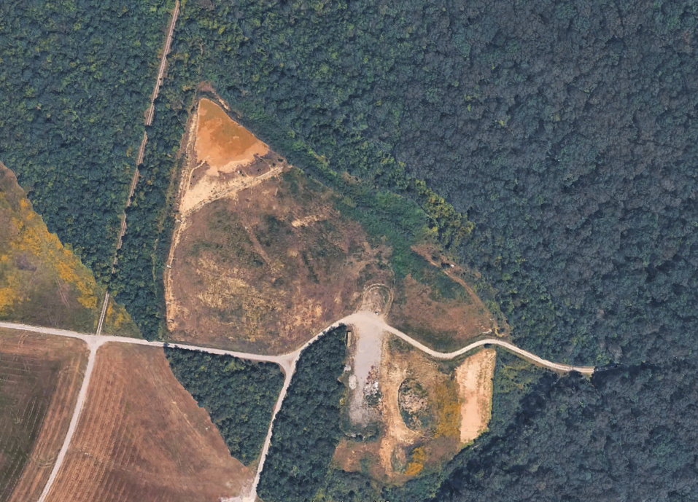
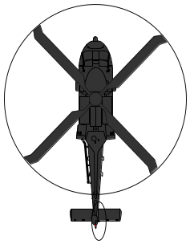
Inbound - LZ FALCON
LZ FALCON
***NOT TO SCALE***
MGRS: 16SEE 77258 15294
ELEV: 1077’ MSL
Description: Mostly flat
INB
HDG: 155° Deg (INB)
90° Deg (OUT)
FORM: N/A
WPN Status: FREE
Hazards: TREES
102 m
AA POODLE
Primary: FM FH/CT (Freq: TBD)
85 m
105 m
OUT
126 m

Slide 17
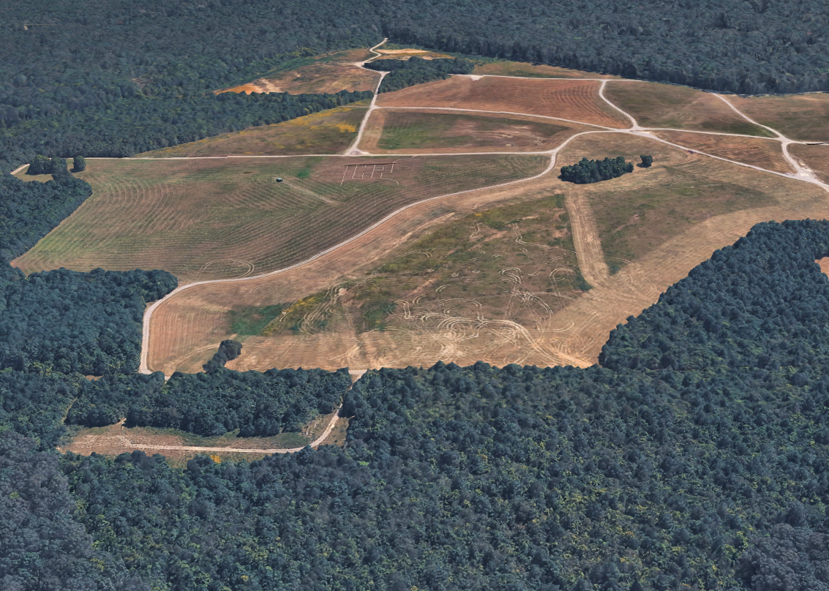
RP Inbound PZ CEDAR

Slide 18
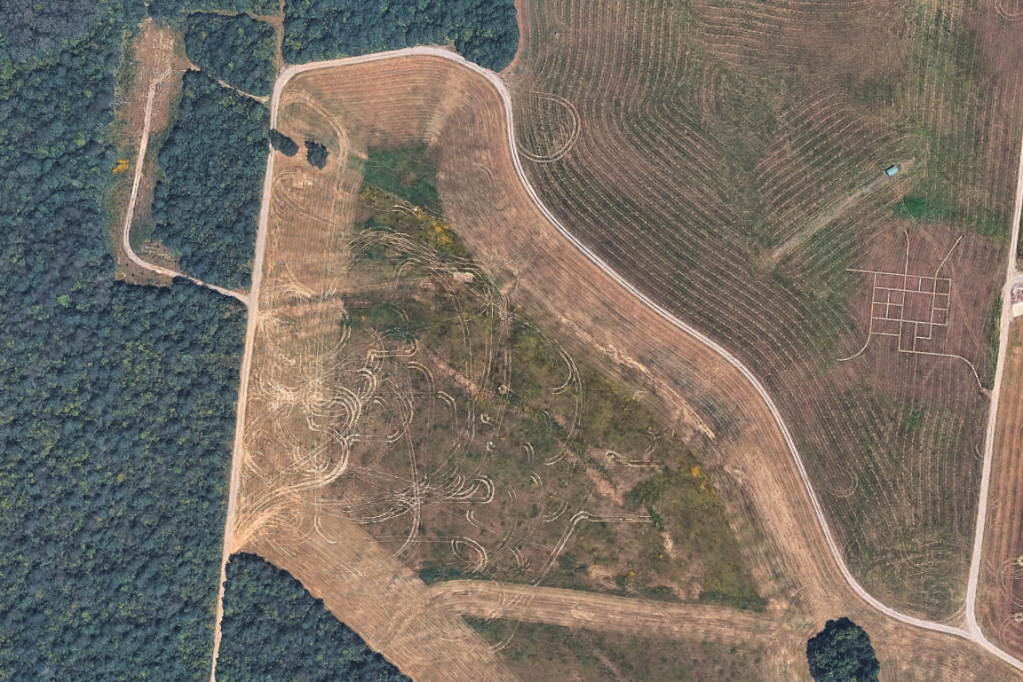
Inbound / Outbound - PZ CEDAR
LZ CEDAR
***NOT TO SCALE***
MGRS: 16SEE 76597 15129
ELEV: 1085’ MSL
Description: Mostly flat
HDG: 90° Deg (INB)
90° Deg (OUT)
FORM: STAG LEFT
WPN Status: Tight
Hazards: TREES
Primary: FM FH/CT (Freq: TBD)
260 m
INB
OUT
150 m
195 m
75 m
AA DOG
260 m

Slide 19
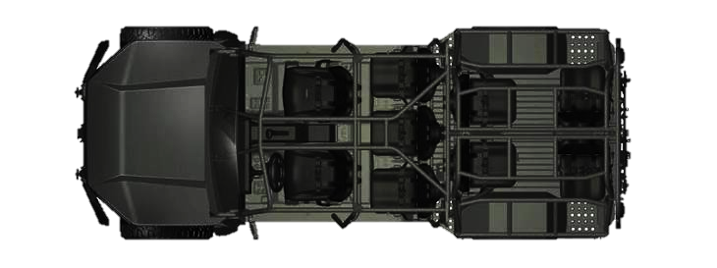


Ground Task Force
LZ OWL
LZ FALCON
LZ VULTURE
LZ OSPREY
DOG5
x 6 (SAPPER)
DOG7
x 1 NOMAD
x 1 SKEDCO (ENG)
DOG6
DOG26
DOG16
PACE
P: Wickr / CROSS-BAND
A: TAK / ICE
C: Signal / MUOS
E: Cell / HF
x 5 (DOG HQ)
x 19 (DOG 3)
x 6 (SAPPER)
x 1 NOMAD
x 1 SKEDCO (ENG)
x 25 (DOG 2)
x 5 (SCOUT)
x 8 (DOG 1)
x 4 ECHO CLC / 6-101
x 2 (DOG HQ)
x 7 (DOG MTR)
x 1 SKEDCO (MTR)
Total Ground Force
66 x 2-506 IN PAX
6 x SAPPER
5 x SCOUT
4 x ECHO / 6-101
2 x FIST
Total = 83 PAX
Equipment
4 x ISV
1 x NOMAD
2 x SKEDCO
KEY
= MINFOR (1 x CH-47 / 1 x UH-60)
= COA1 (2 x CH-47 / 1 x UH-60)
= COA2 (3 x CH-47 / 1 x UH-60)

Slide 20
Timeline
Event | Location | Time (Local) | Time (Zulu)
IPC | 6/101 BN Classroom | 19 1200 OCT 2026 | -
AMCM | 6/101 BN Classroom / MS Teams | 20 1400 OCT 2026 | -
AMB | MS Teams | 23 1200 OCT 2026 | -
Cold Load Training | CAAF | 26 1500 OCT 2026 | -
OPORD | DOG COF / Maven Smart System | 27 1500 OCT 2026 | -
GTF W/U | CAAF | 28 1930 OCT 2026 | 29 0030 OCT 2026
GTF W/D | LZ VULTURE / FALCON / OWL | 28 2020 OCT 2026 | 29 0120 OCT 2026
OBJ POODLE Seized | OBJ POODLE | NLT 28 2050 OCT 2026 | 29 0150 OCT 2026
OBJ HUSKY Seized | OBJ HUSKY | NLT 28 2105 OCT 2026 | 29 0205 OCT 2026
OBJ BERNESE Seized | OBJ BERNESE | NLT 28 2120 OCT 2026 | 29 0220 OCT 2026
AMACO W/U | CAAF | 28 2140 OCT 2026 | 29 0240 OCT 2026
PZ CEDAR Established | PZ CEDAR | NLT 28 2200 OCT 2026 | 29 0300 OCT 2026
PZ CEDAR Established | PZ CEDAR | NLT 28 2200 OCT 2026 | 29 0300 OCT 2026
AWT W/U | CAAF | 28 2210 OCT 2026 | 29 0310 OCT 2026
AMACO W/D | PZ CEDAR | 28 2230 OCT 2026 | 29 0330 OCT 2026
AWT W/D | PZ CEDAR | 28 2300 OCT 2026 | 29 0400 OCT 2026
AWT W/U | PZ CEDAR | 28 2330 OCT 2026 | 29 0430 OCT 2026
AMACO W/U | PZ CEDAR | 28 2350 OCT 2026 | 29 0450 OCT 2026
GTF Reconsolidation | AA DOG | NLT 29 0030 OCT 2026 | NLT 29 0530 OCT 2026
GTF W/D | PZ CEDAR | 29 0120 OCT 2026 | 29 0620 OCT 2026
GTF W/U | PZ CEDAR | 29 0135 OCT 2026 | 29 0635 OCT 2026
GTF W/D | CAAF | 29 0225 OCT 2026 | 29 0725 OCT 2026

