Slide 1

UNCLASSIFIED
CONCEPT BRIEF · GROUND TASK FORCE MISSION SET
J-FARP Seizure.
Air assault seizure of a jump forward arming and refueling point to extend attack aviation into the Division deep area.
Dog Company, 2-506 IN · 3BCT, 101st ABN DIV (AASLT) · with 6-101 CAB · OCT 2026
UNCLASSIFIED
Notes:
J-FARP Seizure. A concept of operations brief: an infantry company (minus) conducts air assault operations to seize a jump forward arming and refueling point in order to enable combat aviation to mass combat power in the Division deep area.

Slide 2
Bottom line up front
A rifle company (-) can seize and secure a jump FARP 180–200 NM forward and hold it for one turn of the attack element, putting Division deep targets 100–150 NM beyond it inside attack aviation combat radius.
3 hours
82 PAX
H + 2:00
28–29 OCT
ON THE GROUND, W/D TO EXTRACTION
LIFT 1 · 2X CH-47 · 2X UH-60
FARP OPERATIONS COMPLETE
PROOF OF CONCEPT · STORM SURGE
DECISIONS THIS BRIEF SUPPORTS
AGENDA
1 Endorse. J-FARP seizure as a Ground Task Force mission set for the deep attack.
2 Resource. The full-distance proof of concept, Operation Storm Surge, 28–29 OCT 26.
3 Transition. On validation, hand the mission set to the Division pathfinder company.
Problem · Mission and concept · Task organization · Phasing · Execution by phase · Risk · Proof of concept
Notes:
Bottom line up front. The concept, the numbers that matter, and the decisions this brief supports. J-FARP Seizure. A concept of operations brief: an infantry company (minus) conducts air assault operations to seize a jump forward arming and refueling point in order to enable combat aviation to mass combat power in the Division deep area.

Slide 3
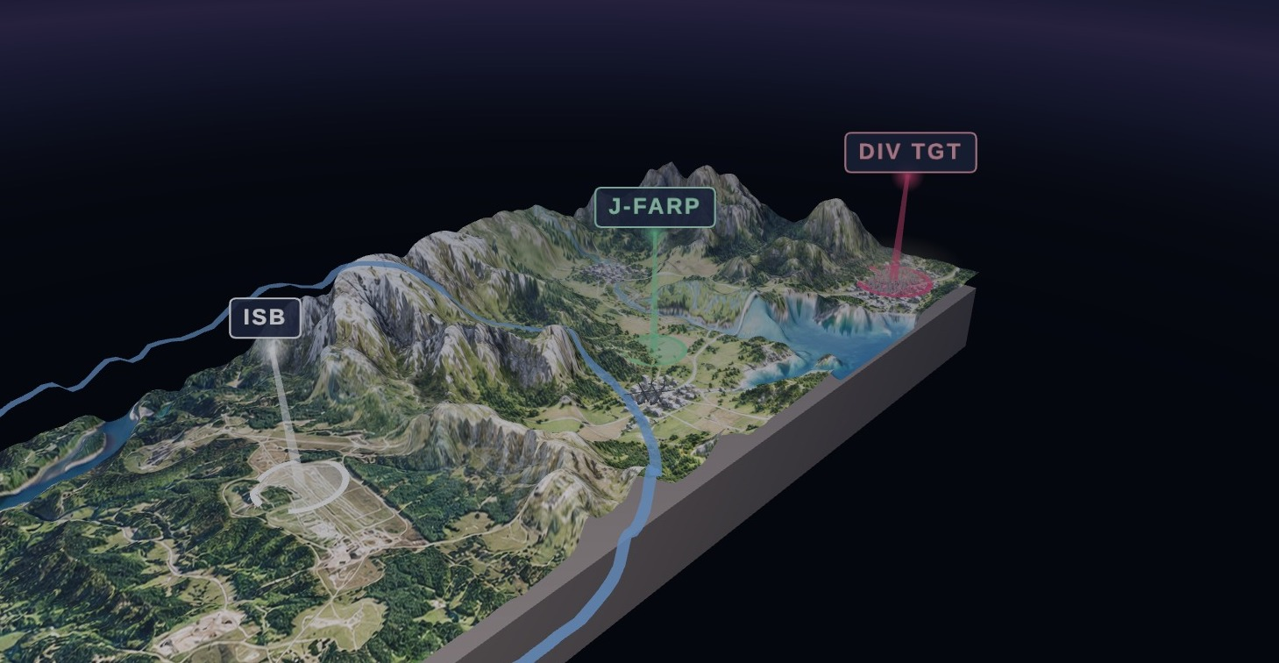
Deep targets lie beyond combat radius
THE PROBLEM · OPERATIONAL REACH
Attack aviation combat radius is bounded by fuel. Ordnance, reserve and time on station draw on the same tank. From the intermediate staging base, the Division deep target is out of reach.
180–200 NM
100–150 NM
ISB TO J-FARP SITE
J-FARP TO DIV DEEP TARGET
Without fuel forward: the attack element reaches bingo short of the objective and turns for home. Terrain beyond that line stays unshaped.
Notes:
The operational problem. Division deep targets lie beyond the combat radius of attack aviation operating from the intermediate staging base. Fuel, ordnance, reserve and station time compete for the same fuel load.

Slide 4
Seize the site. Establish the FARP. Turn the deep attack
MISSION AND CONCEPT OF THE OPERATION
Mission. On order, an Infantry Company (-) conducts Air Assault Operations to seize a J-FARP to enable Combat Aviation Assets to mass combat power in the Division Deep Area to defeat enemy forces and seize key terrain.
KEY TASKS
END STATE
1 Seize the FARP site and the objectives that cover its approaches.
2 Establish the rapid refuel and rearm point from the WETCOW and FATCOW.
3 Turn the attack element forward with full fuel and ordnance.
4 Defend the site for the duration of FARP operations.
5 Close the site and extract through the PZ.
FARP operations complete NLT H+2:00. The attack element is over the Division deep target with full fuel. The site is closed, the force reconsolidated at the ISB by H+3:00 with 100 percent accountability.
LIFT 1 · GROUND TASK FORCE
LIFT 2 · FARP TASK FORCE
LIFT 3 · DEEP ATTACK
2x CH-47 · 2x UH-60 · 82 PAX
2x CH-47 · WETCOW · FATCOW · 18 PAX
2x AH-64 · refuel, rearm, continue
Notes:
Concept of the operation. Three lifts. Lift one, the Ground Task Force, air assaults to seize the J-FARP site. Lift two, the FARP Task Force, delivers the WETCOW with fuel and the FATCOW with AH-64 munitions and establishes the FARP. Lift three, the deep attack, refuels and rearms at the J-FARP and continues to the Division target.

Slide 5
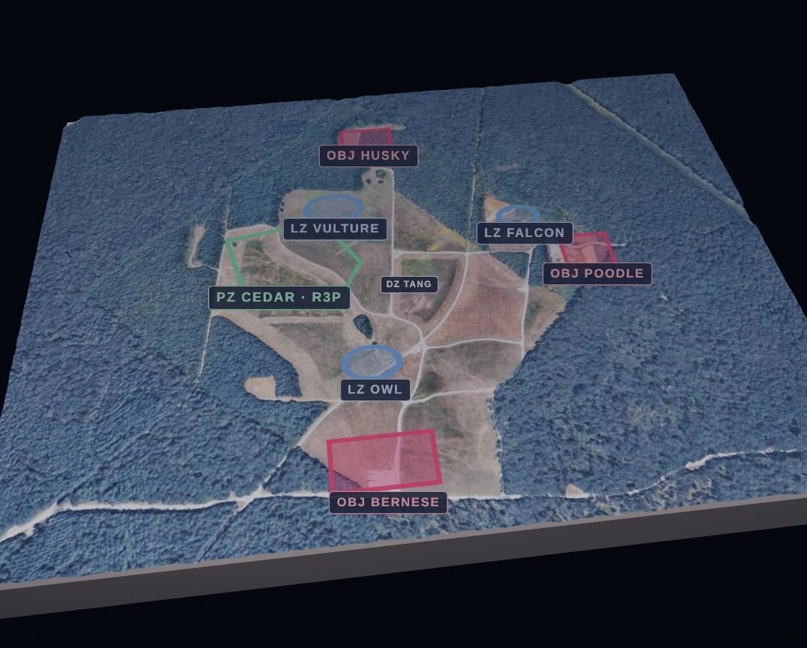
Proposed Ground Task Force
TASK ORGANIZATION · LIFT 1 · 75 PAX IN THREE ELEMENTS
ELEMENT 1
Interdict
54
PAX
Occupies the objectives covering the avenues of approach to the site.
ELEMENT 2
Seize
12
PAX
Seizes the FARP site and reports it secured NLT H+1:00.
ELEMENT 3
Secure
9
PAX
Local security on the aircraft and refuel points for the duration of FARP operations.
Notes:
Proposed Ground Task Force, all on Lift 1 with two CH-47 and two UH-60. Element one, 54 personnel, interdicts enemy forces along the avenues of approach leading to the FARP site. Element two, 12 personnel, seizes the FARP site. Element three, 9 personnel, secures the FARP site.

Slide 6
Four phases, three hours on the ground
PROPOSED PHASING AND H-HOUR SEQUENCE
H − 2:30
H-hour
H + 1:00
H + 2:00
H + 3:00
WHEELS UP
WHEELS DOWN
FARP SEIZED
FARP OPS COMPLETE
RECONSOLIDATED
PHASE I
PHASE II
PHASE III
PHASE IV
Condition setting
Air assault and seizure
FARP operations
FARP defense
Air assault planning. FARP site selection. Rehearsals and leader certification.
Lift 1 lands. Objectives occupied. Site seized and PZ marked NLT H+1:00.
Lift 2 establishes the point. Lift 3 refuels, rearms and departs. Complete NLT H+2:00.
Ground force holds the perimeter for the window the aircraft are on the ground.
Notes:
Phasing. Phase one, condition setting, through wheels up. Phase two, air assault and seizure, from wheels down to FARP seized at H plus one. Phase three, FARP operations, through H plus two. Phase four, FARP defense, runs for the duration the site is open, through reconsolidation at H plus three.

Slide 7
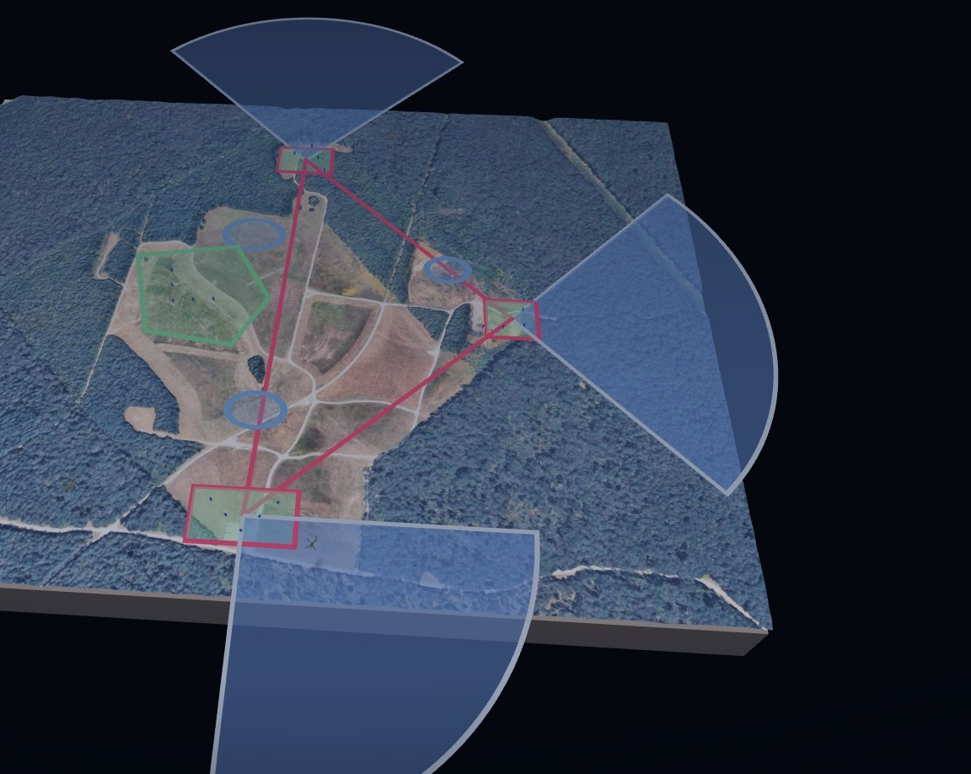
Phase II · Land, seize the objectives, establish the PZ
H-HOUR TO H + 1:00 · LIFT 1
H-hour. Three serials land LZ Vulture, Owl and Falcon on separate headings.
Seize. Element 2 seizes the FARP site from LZ Vulture.
Interdict. Element 1 occupies OBJ Husky, Poodle and Bernese, oriented on the avenues of approach.
Establish. Element 3 secures the site. Pathfinders mark PZ Cedar and the refuel point inside the triangle. Secured NLT H+1:00.
Chalk-to-LZ assignments shown are the Storm Surge AMB plan.
Notes:
Phase two, air assault and seizure. Serials land LZ Vulture, LZ Falcon and LZ Owl. Element two seizes the FARP site. Element one occupies OBJ Husky, Poodle and Bernese to interdict the avenues of approach. Element three secures the site and pathfinders establish PZ Cedar and the rapid refuel point inside the triangle. FARP seized no later than H plus one.

Slide 8
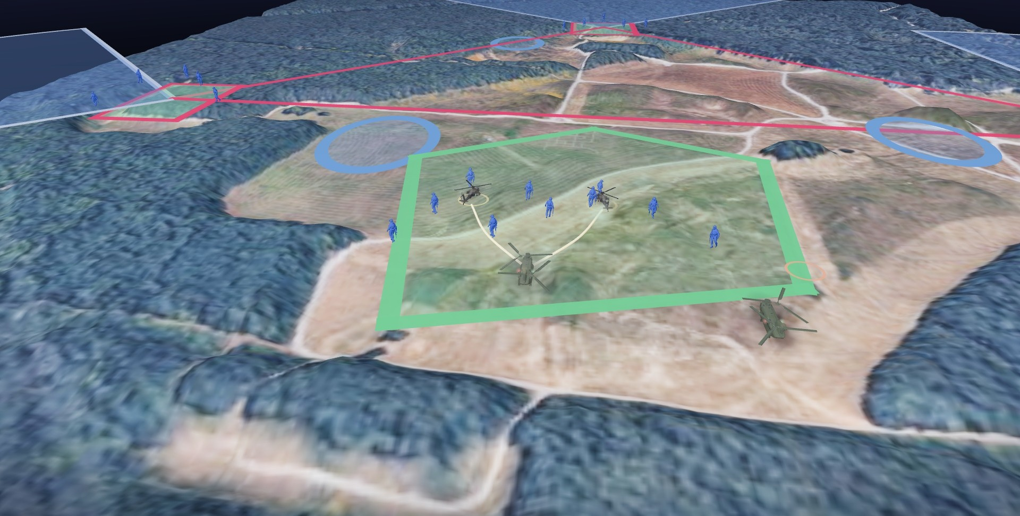
Phase III · Establish the point, turn the deep attack
H + 1:00 TO H + 2:00 · LIFTS 2 AND 3
H+1:00. Lift 2 lands the 18-PAX FARP crew: WETCOW with fuel, FATCOW with AH-64 munitions.
Establish. Refuel points run from the WETCOW, the rearm point from the FATCOW. ECHO / 6-101 operates them.
Turn. Lift 3 lands the points, refuels and rearms with rotors turning, and departs for the deep target with full fuel. Complete NLT H+2:00.
60 NM
185 NM
AH REACH ADDED BY THE WETCOW
EXTENDED RANGE, NO REFUEL, ERFS
Notes:
Phase three, FARP operations. Lift two delivers the 18-person FARP crew on the WETCOW, a CH-47 carrying fuel tanks, and the FATCOW, a CH-47 carrying munitions for the AH-64. The FARP is established at the rapid refuel point. Lift three lands, refuels from the WETCOW and rearms from the FATCOW with rotors turning, and departs for the Division deep target. FARP operations complete no later than H plus two.

Slide 9
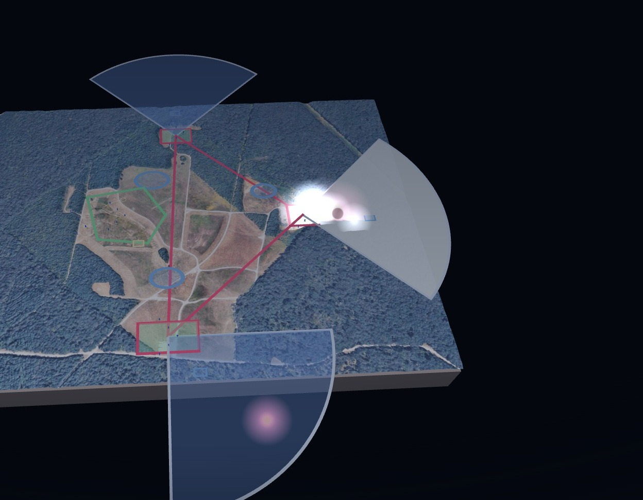
Phase IV · Security is a ground force task
FARP DEFENSE · PRINCIPLES OF THE DEFENSE AT COMPANY SCALE
All-round security. A mobile enemy can approach from any direction. The perimeter covers 360 degrees with no element split.
Early warning in depth. Observation posts on the avenues, then the objectives, then the centre. Contact is made as far from the aircraft as possible.
Mutual support. Any approach is under fire from two positions. The triangular patrol base delivers this with three elements.
Limited exposure. Time on site is the vulnerability. The FARP displaces or closes before the enemy can mass.
ATP 3-04.17 treats the FARP as a high-value, high-signature target with minimal organic security. The ground task force provides it.
PACE
DISPLACEMENT CRITERIA
Primary Wickr over TACSAT-IW. Alternate TAK / ICE. Contingency Signal over MUOS. Emergency cell or HF.
Site compromised, or the alternate site better positioned for the next turn. The FARP moves before it is forced to.
Notes:
Phase four, FARP defense. Aviation doctrine treats the FARP as a high-value, high-signature target with minimal organic security. Security is a ground force task. The posture rests on all-round security, early warning, mutually supporting positions, organic fires and a displacement plan.

Slide 10
Risk and mitigation
RISK TO FORCE
RISK TO MISSION
TRAINING RISK
Distance from sustainment
High-signature fuel point
Newly qualified pathfinders
A company (-) with limited sustainment 180 NM from FCKY. Casualty evacuation and resupply are aviation tasks that must be planned, not assumed.
Rotors turning, fuel flowing, aircraft on the ground on a schedule. The window is the vulnerability.
The company assumes risk training with newly qualified pathfinders; a Division pathfinder company is the intended recipient of the mission set.
MITIGATION
MITIGATION
MITIGATION
Class I carried
Deliberate rehearsals
Proof of concept
1× DOS of CL I issued prior to W/U and 1× DOS carried per soldier on the aircraft.
Air assault planning with 6-101 CAB, cold-load training on the airframes and leader certification before execution.
Validate the task force on a training objective at full distance before the concept is relied on for a deep attack.
Notes:
Risk. A company minus with limited sustainment, 180 nautical miles from Fort Campbell. Mitigations are deliberate: Class I carried, deliberate rehearsals, leader certification before execution, and a proof of concept at full distance before the mission set is assigned.

Slide 11
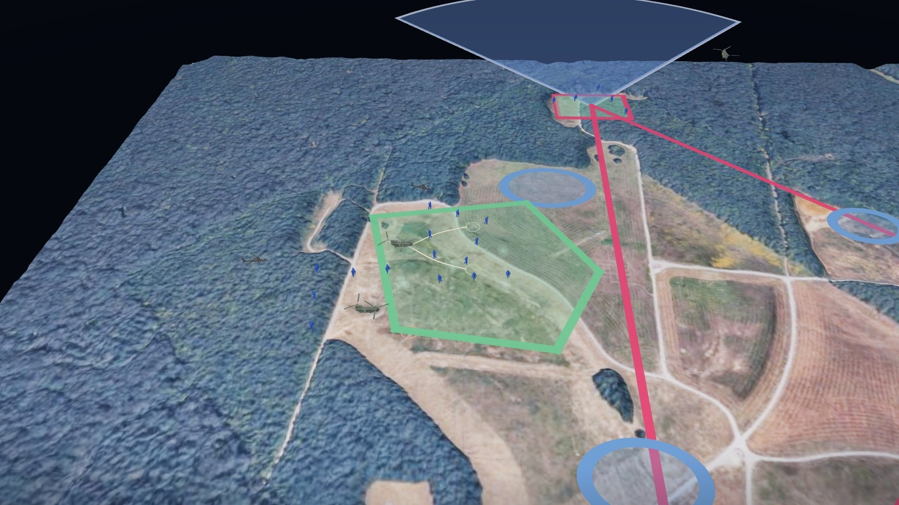
Proof of concept · Operation Storm Surge
28–29 OCT 26 · CAAF TO TULLAHOMA, TN · 184 NM · NIGHT
Mission. Dog Company conducts a Company (-) Air Assault into Tullahoma, TN to secure an expeditionary FARP on 29 0130Z OCT 26 to enable freedom of movement for 6-101 CAB and proof the concept for FARP seizure operations.
185 NM with no refuel, ERFS employment on Serial 1.
WETCOW enables AH operations 60 NM beyond the objective.
3× WETCOWs across 5× FARP locations, simultaneous, secured and dispersed.
Package: 3× CH-47 (1× PAX, 1× FATCOW), 1× UH-60, 83 PAX.
2200Z
0030Z
0130Z
0230Z
0330Z
WHEELS UP
W/D · H-HOUR
FARP SEIZED
FARP OPS COMPLETE
RECONSOLIDATED
Notes:
Proof of concept. Operation Storm Surge, 28 to 29 October 2026. The full sequence on the Tullahoma objective: serials land, the elements move to the objectives and establish their sectors, pathfinders mark PZ Cedar, the WETCOW and FATCOW land, the Apaches refuel and rearm and depart, and the objectives defend the site.

Slide 12

UNCLASSIFIED
END STATE
Fuel forward is reach forward.
An infantry company (-), three hours on the ground, extends the Division deep fight by 200 nautical miles for one turn of the attack element.
DECISIONS REQUESTED
1 Endorse J-FARP seizure as a Ground Task Force mission set.
2 Resource Operation Storm Surge, 28–29 OCT 26.
3 On validation, transition the mission set to the Division pathfinder company.
Dog Company · 2-506 IN · 3BCT, 101st ABN DIV (AASLT) · with 6-101 CAB
UNCLASSIFIED
Notes:
End state. The J-FARP seizure places Class III and Class V inside the Division deep area for one turn of the attack element, then closes. An infantry company, three hours on the ground, extends combat aviation reach by 200 nautical miles.

Slide 13
Backup
Purpose · Doctrine · Reverse planning · Site selection · Reconsolidation · Terms and sources
Notes:
Backup slides.

Slide 14
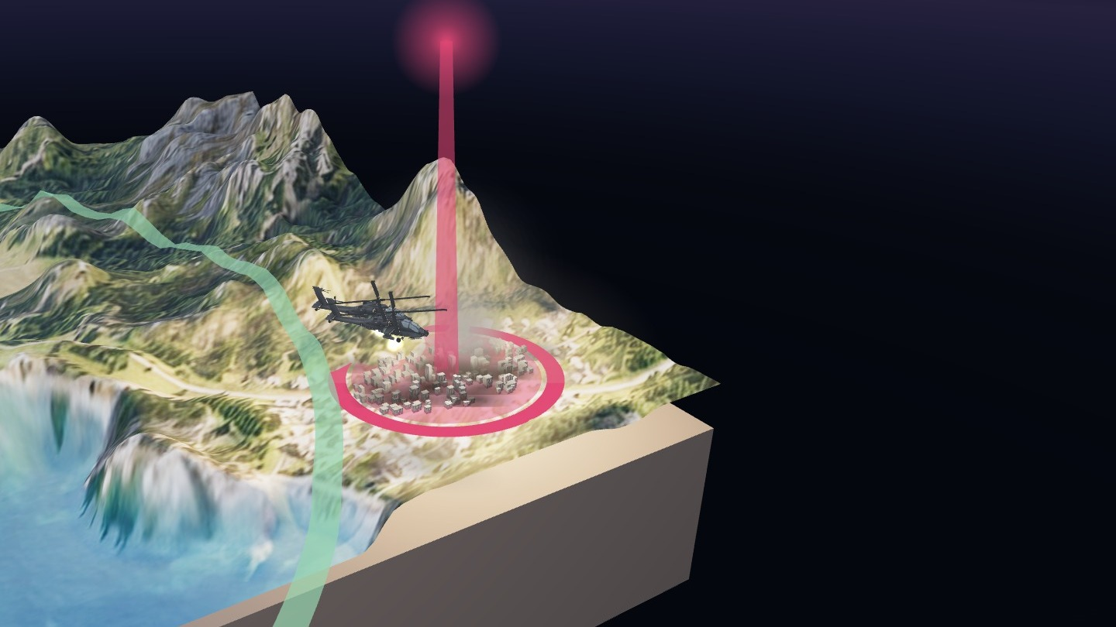
A FARP extends operational reach
PURPOSE · THE DIVISION DEEP AREA
The Division deep area is the terrain beyond the close fight, where aviation shapes enemy forces before the main effort arrives. Reaching it is a sustainment problem before it is a tactical one.
Reach. Refuel 200 NM forward and targets 300 NM from the ISB fall inside combat radius.
Station time. Aircraft arrive on the objective with a full fuel load rather than a reserve.
Tempo. Aircraft turn forward at the FARP in minutes instead of returning hours to the ISB.
Mass. More sorties on the objective within the same window.
For the 101st, the J-FARP is the enabler for the large-scale, long-range air assault. The deep attack sets conditions on the follow-on objective. The J-FARP sets conditions for the deep attack.
Notes:
Why it matters. A FARP positioned 180 to 200 nautical miles forward places the Division deep target inside attack aviation combat radius, with full fuel on arrival, increased time on station and the ability to turn aircraft forward rather than return to the ISB.

Slide 15

FARP variants in doctrine
FM 3-04 · ATP 3-04.17 · FORWARD ARMING AND REFUELING POINT
A temporary facility providing fuel and ammunition to aviation units in combat. Positioning Class III and Class V forward reduces turnaround distance and extends time in the fight. Four variants trade permanence for responsiveness.
ACTIVE
SILENT
Manned and operating
Established, not operating
Equipment emplaced, crews in position, refueling in progress. The standard FARP supporting sustained operations.
Emplaced and concealed. Activated only when aircraft are inbound, to limit signature until required.
JUMP
ROLLING
Minimal footprint, air-delivered
Displaces with the force
Rapidly displaceable, with Class III and Class V delivered on the supporting aircraft. Established for a single deep operation, then displaced or closed.
Moves by bounds behind the maneuvering unit to keep aviation support within reach of the advance.
Notes:
Doctrine. A forward arming and refueling point is a temporary facility organized, equipped and deployed to provide fuel and ammunition for aviation units in combat. Doctrine describes four variants. The jump FARP is the lightest and most rapidly displaceable.

Slide 16
Reverse planning from the ground tactical plan
DOCTRINE · AIR ASSAULT PLANNING
Five plans developed in reverse sequence, each constraining the next. For a FARP seizure the ground tactical plan carries a requirement most air assaults do not: the site must accept a CH-47 with internal fuel aboard.
5
4
3
2
1
Staging plan
Loading plan
Air movement plan
Landing plan
Ground tactical plan
Assembly, sequencing and PZ posture.
Chalk and load assignments by aircraft.
Routes, timing and formation.
Zone, heading and landing sequence.
Actions on the objective.
PLANNING EVENTS
PATHFINDERS
REHEARSALS
IPC · AMCM · AMB
LZ / PZ control
Cold loads and leader certification
Initial planning conference, air mission coordination meeting and air mission brief. One integrated plan between the aviation and ground task forces.
Select, mark and control landing and pickup zones, provide terminal guidance and conduct PZ operations for extraction.
Cold-load training on the airframes, leader certification and deliberate rehearsals mitigate operating 180 NM from the ISB.
Notes:
Air assault planning. FM 3-99 prescribes a reverse planning sequence: the ground tactical plan drives the landing plan, the air movement plan, the loading plan and the staging plan. Pathfinders select, mark and control the landing and pickup zones.

Slide 17
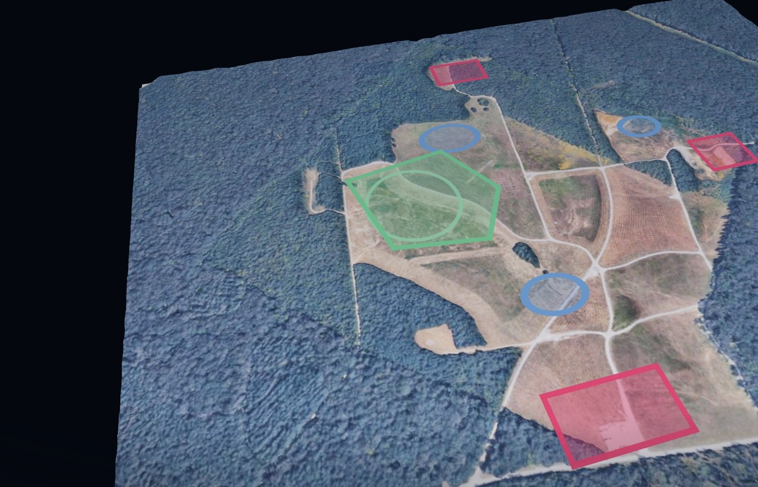
Phase I · Select the site, plan in reverse from it
CONDITION SETTING · FARP SITE SELECTION
The site must satisfy three requirements concurrently.
Aircraft. Dimensions and surface for a CH-47 with internal fuel aboard. Approach and departure headings clear of obstacles. Slope and dust within limits for night landing.
Target. Close enough to the Division deep target to preserve station time. Far enough that the fuel point is not on the objective.
Defense. Limited avenues of approach, cover for the security elements and an alternate site for displacement. Storm Surge plans three WETCOWs across five FARP locations.
Notes:
Phase one, condition setting. Key tasks: air assault planning and FARP site selection. Site selection must satisfy the aircraft, the target and the defense simultaneously. Reconnaissance imagery of each zone, planning with the aviation battalion, cold-load training, leader certification and rehearsals.

Slide 18
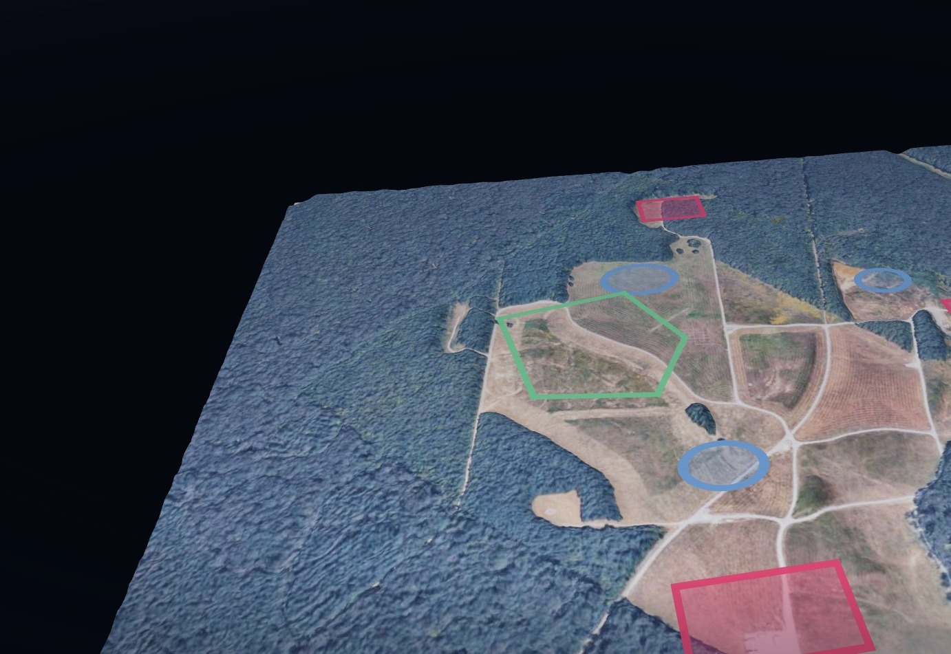
Reconsolidation · Close the site
H + 2:00 TO H + 3:00
Reconsolidation distinguishes a jump FARP from a base. The fuel point exists for one turn of the attack element and is then closed.
H+2:00. FARP operations complete. Refuel and rearm points recovered. WETCOW and FATCOW lift first.
PZ operations. Pathfinders control the pickup: chalks staged, aircraft inbound 090, staggered left, weapons tight.
Collapse in reverse order. Objectives fold in last, under mortar coverage until the mortar section itself lifts.
H+3:00. Reconsolidated at FCKY with 100 percent accountability. FARP seizure task force validated.
Notes:
Reconsolidation. FARP operations complete at H plus two. Pathfinders conduct PZ operations. The force extracts through PZ Cedar and reconsolidates at Fort Campbell by H plus three. The site is closed and the aircraft it refueled are over the Division target.

Slide 19
Terms and sources
J-FARP Jump forward arming and refueling point
ISB Intermediate staging base
GTF Ground task force
WETCOW CH-47 carrying fuel tanks: the Class III point
FATCOW CH-47 carrying munitions for the AH-64: the Class V point
ERFS Extended range fuel system
R3P Rapid refuel point
L2A2 Large-scale, long-range air assault
IPC · AMCM · AMB Initial planning conference · air mission coordination meeting · air mission brief
W/U · W/D Wheels up · wheels down
OP · CCP Observation post · casualty collection point
NOMAD Unmanned ground vehicle carrying the C2 package
MDS Mission design series
Doctrine. FM 3-04 Army Aviation, ATP 3-04.17 Techniques for Forward Arming and Refueling Points, FM 3-99 Airborne and Air Assault Operations, FM 3-90 Tactics, ATP 3-21.8 Infantry Platoon and Squad and TC 3-21.76 Ranger Handbook. Doctrinal statements are paraphrased and should be verified against current editions.
Unit sources. Mission, task organization, lift packages, phasing, timeline and imagery are from the Dog Company J-FARP Seizure CONOP and the Operation Storm Surge AMCM / AMB of 06 OCT 26.
Imagery. Scene renders are from the animated brief. The wide-area terrain is illustrative and not real geography; objective-area scenes are drawn over the unit's overhead imagery. Ground Task Force elements and strengths are as directed by the GTF commander; chalk-to-LZ and objective assignments follow the Storm Surge AMB.
Notes:
Terms and sources.

