Slide 1

CONCEPT OF THE OPERATION · J-FARP SEIZURE
J-FARP Seizure.
On order, an Infantry Company (-) conducts Air Assault Operations to seize a J-FARP to enable Combat Aviation Assets to mass combat power in the Division Deep Area to defeat enemy forces and seize key terrain.
Dog Company · 2-506 IN · 3BCT, 101st ABN DIV (AASLT) · with 6-101 CAB
Notes:
J-FARP Seizure. A concept of operations brief: an infantry company (minus) conducts air assault operations to seize a jump forward arming and refueling point in order to enable combat aviation to mass combat power in the Division deep area.

Slide 2
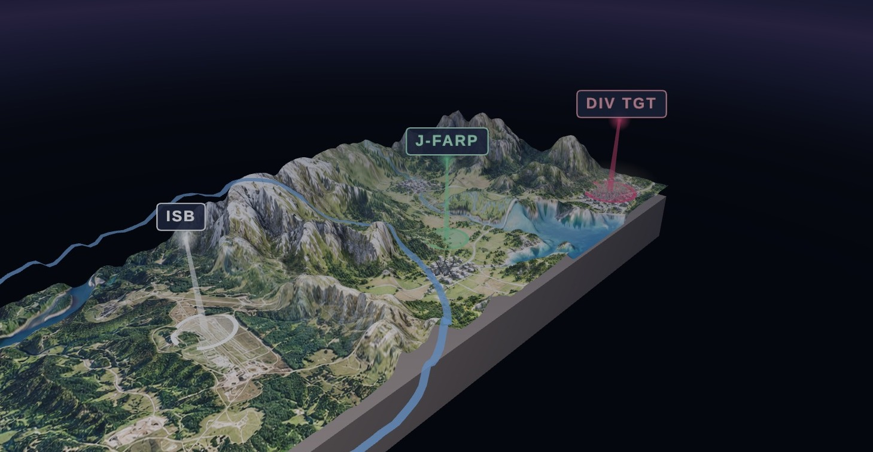
Deep targets lie beyond combat radius
THE PROBLEM · OPERATIONAL REACH
Attack aviation combat radius is bounded by fuel load. Ordnance, required reserve and time on station all draw on the same tank. When the Division deep target sits beyond that radius, the deep attack cannot be executed from the intermediate staging base.
180–200 NM
100–150 NM
ISB TO J-FARP SITE
J-FARP SITE TO DIV DEEP TGT
Bingo fuel. The attack element reaches bingo short of the objective and must return to base. Terrain beyond that line remains unshaped until fuel is positioned forward.
Notes:
The operational problem. Division deep targets lie beyond the combat radius of attack aviation operating from the intermediate staging base. Fuel, ordnance, reserve and station time compete for the same fuel load.

Slide 3

A temporary facility providing fuel and ammunition to aviation units in combat
DOCTRINE · FORWARD ARMING AND REFUELING POINT
FM 3-04 and ATP 3-04.17 define the FARP by that purpose. Positioning Class III and Class V forward reduces turnaround distance and extends the time an aircraft can remain in the fight. Four variants are described, each trading permanence for responsiveness.
ACTIVE
SILENT
Manned and operating
Established, not operating
Equipment emplaced, crews in position, refueling in progress. The standard FARP supporting sustained operations.
Emplaced and concealed. Activated only when aircraft are inbound, to limit signature until required.
JUMP
ROLLING
Minimal footprint, air-delivered
Displaces with the force
Rapidly displaceable, with Class III and Class V delivered on the supporting aircraft. Established to support a single deep operation, then displaced or closed.
Moves by bounds behind the maneuvering unit to keep aviation support within reach of the advance.
Notes:
Doctrine. A forward arming and refueling point is a temporary facility organized, equipped and deployed to provide fuel and ammunition for aviation units in combat. Doctrine describes four variants. The jump FARP is the lightest and most rapidly displaceable.

Slide 4
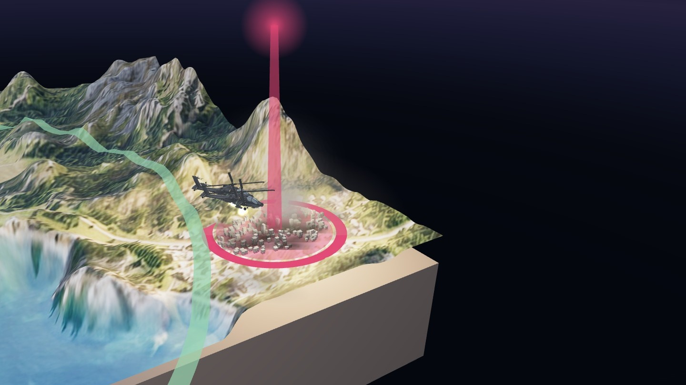
A FARP extends operational reach
PURPOSE · THE DIVISION DEEP AREA
The Division deep area is the terrain beyond the close fight, where aviation shapes enemy forces before the main effort arrives. Reaching it is a sustainment problem before it is a tactical one.
Reach. Refuel 200 NM forward and targets 300 NM from the ISB fall inside combat radius.
Station time. Aircraft arrive on the objective with a full fuel load rather than a reserve.
Tempo. Aircraft turn forward at the FARP in minutes instead of returning hours to the ISB.
Mass. More sorties on the objective within the same window. The mission statement is explicit: mass combat power in the Division deep area.
For the 101st, the J-FARP is the enabler for the large-scale, long-range air assault. The deep attack sets conditions on the follow-on objective. The J-FARP sets conditions for the deep attack.
Notes:
Why it matters. A FARP positioned 180 to 200 nautical miles forward places the Division deep target inside attack aviation combat radius, with full fuel on arrival, increased time on station and the ability to turn aircraft forward rather than return to the ISB.

Slide 5
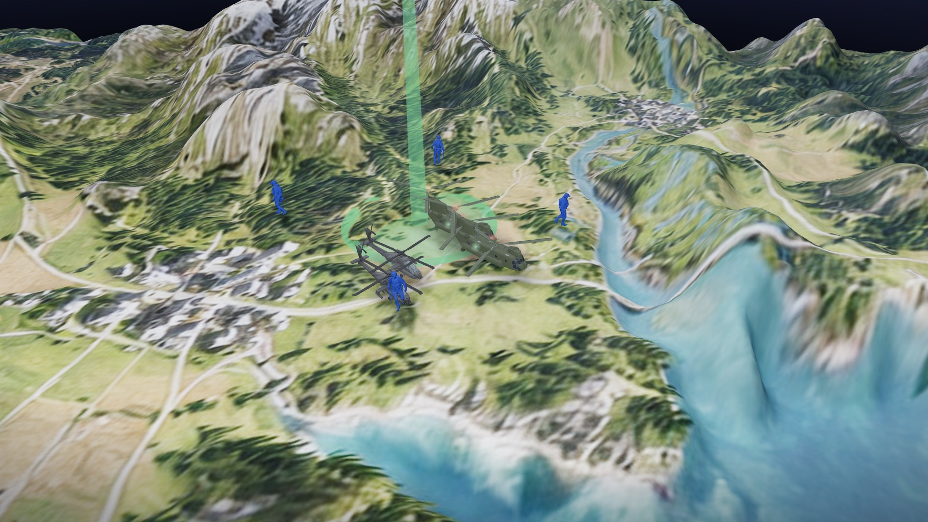
CONCEPT OF THE OPERATION · THREE LIFTS
Seize the site. Establish the FARP. Turn the deep attack.
Mission. On order, an Infantry Company (-) conducts Air Assault Operations to seize a J-FARP to enable Combat Aviation Assets to mass combat power in the Division Deep Area to defeat enemy forces and seize key terrain.
LIFT 1 – GROUND TASK FORCE
LIFT 2 – FARP TASK FORCE
LIFT 3 – DEEP ATTACK
2x CH47 · 2x UH60 · C2 (NOMAD) · 82 PAX
2x CH47 · FATCOW · WETCOW · 18 PAX (ECHO / 6-101 FARP crew)
2x AH64
GTF air assault. FARP seizure. Pathfinder operations.
FARP TF air assault. FARP establishment.
Deep attack air assault. Refuel and rearm at the J-FARP, continue to the DIV deep TGT (100–150 NM).
Dog Company · 2-506 IN · 3BCT, 101st ABN DIV (AASLT) · with 6-101 CAB
Notes:
Concept of the operation. Three lifts. Lift one, the Ground Task Force, air assaults to seize the J-FARP site. Lift two, the FARP Task Force, delivers the WETCOW with fuel and the FATCOW with AH-64 munitions and establishes the FARP. Lift three, the deep attack, refuels and rearms at the J-FARP and continues to the Division target.

Slide 6
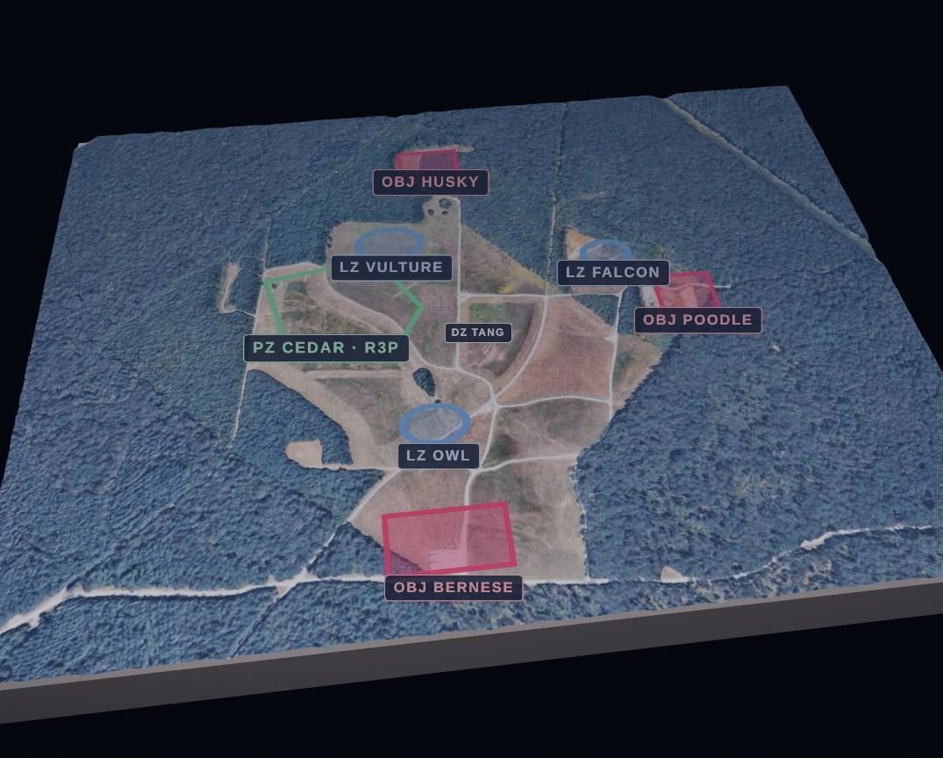
Proposed Ground Task Force
TASK ORGANIZATION · LIFT 1 · 2X CH47 · 2X UH60
ELEMENT 1
Interdict
54
PAX
Interdict enemy forces along the avenues of approach leading to the FARP site. Occupies the objectives that form the perimeter around the site.
ELEMENT 2
Seize
12
PAX
Seize the FARP site. Clears the site and reports it secured NLT H+1:00.
ELEMENT 3
Secure
9
PAX
Secure the FARP site. Local security on the aircraft and refuel points for the duration of FARP operations.
Notes:
Proposed Ground Task Force, all on Lift 1 with two CH-47 and two UH-60. Element one, 54 personnel, interdicts enemy forces along the avenues of approach leading to the FARP site. Element two, 12 personnel, seizes the FARP site. Element three, 9 personnel, secures the FARP site.

Slide 7
Reverse planning from the ground tactical plan
DOCTRINE · AIR ASSAULT PLANNING
Airborne and air assault doctrine develops five plans in reverse sequence. Each constrains the next. For a FARP seizure, the ground tactical plan is governed by a requirement most air assaults do not carry: the site must accept a CH-47 with internal fuel aboard.
5
4
3
2
1
Staging plan
Loading plan
Air movement plan
Landing plan
Ground tactical plan
Assembly, sequencing and PZ posture.
Chalk and load assignments by aircraft.
Routes, timing and formation.
Zone, heading and landing sequence.
Actions on the objective.
PLANNING EVENTS
PATHFINDERS
REHEARSALS
IPC · AMCM · AMB
LZ / PZ control
Cold loads and leader certification
Initial planning conference, air mission coordination meeting and air mission brief. The aviation task force and the ground task force produce a single integrated plan.
Select, mark and control landing and pickup zones, provide terminal guidance to inbound aircraft and conduct PZ operations for extraction.
Cold-load training on the supporting airframes, leader certification and deliberate rehearsals mitigate the risk of operating 180 NM from the ISB.
Notes:
Air assault planning. FM 3-99 prescribes a reverse planning sequence: the ground tactical plan drives the landing plan, the air movement plan, the loading plan and the staging plan. Pathfinders select, mark and control the landing and pickup zones.

Slide 8
Four phases, three hours on the ground
FARP SEIZURE CONCEPT · PROPOSED PHASING
H − 2:30
H-hour
H + 1:00
H + 2:00
H + 3:00
W/U
W/D
FARP SEIZED
FARP OPS COMPLETE
RECONSOLIDATED
PHASE I
PHASE II
PHASE III
PHASE IV
Condition setting
Air assault & seizure
FARP operations
FARP defense
Key tasks: Air assault planning · FARP site selection
Key tasks: GTF air assault (Lift 1) · FARP seizure · Pathfinder operations
Key tasks: FARP TF air assault (Lift 2) · FARP establishment · Deep attack air assault (Lift 3)
Key tasks: FARP defense
Notes:
Phasing. Phase one, condition setting, through wheels up. Phase two, air assault and seizure, from wheels down to FARP seized at H plus one. Phase three, FARP operations, through H plus two. Phase four, FARP defense, runs for the duration the site is open, through reconsolidation at H plus three.

Slide 9
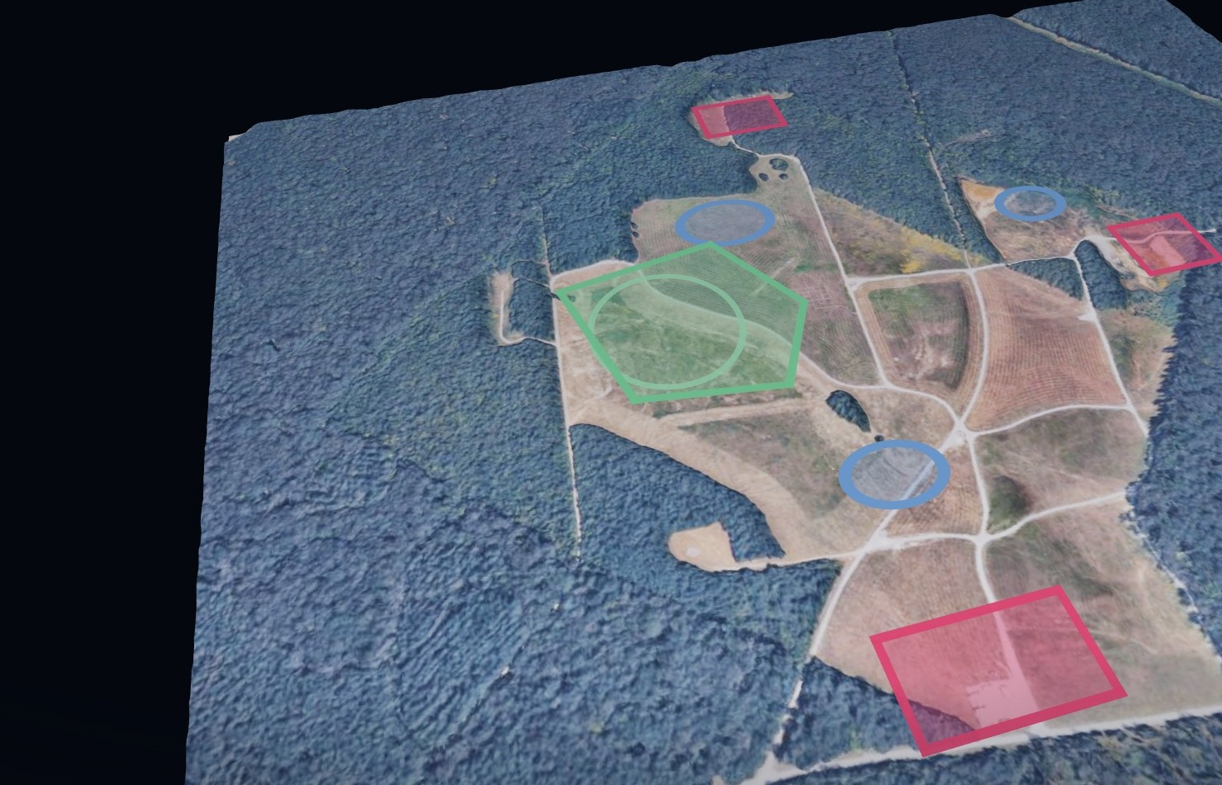
Select the site. Plan in reverse from it
PHASE I · CONDITION SETTING
Key tasks: air assault planning and FARP site selection. The site must satisfy three requirements concurrently.
Aircraft. Dimensions and surface for a CH-47 with internal fuel aboard. Approach and departure headings clear of obstacles. Slope and dust within limits for night landing.
Target. Close enough to the Division deep target to preserve station time. Far enough that the fuel point is not on the objective.
Defense. Limited avenues of approach, cover for the security elements and an alternate site for displacement. Storm Surge plans three WETCOWs across five FARP locations.
Notes:
Phase one, condition setting. Key tasks: air assault planning and FARP site selection. Site selection must satisfy the aircraft, the target and the defense simultaneously. Reconnaissance imagery of each zone, planning with the aviation battalion, cold-load training, leader certification and rehearsals.

Slide 10
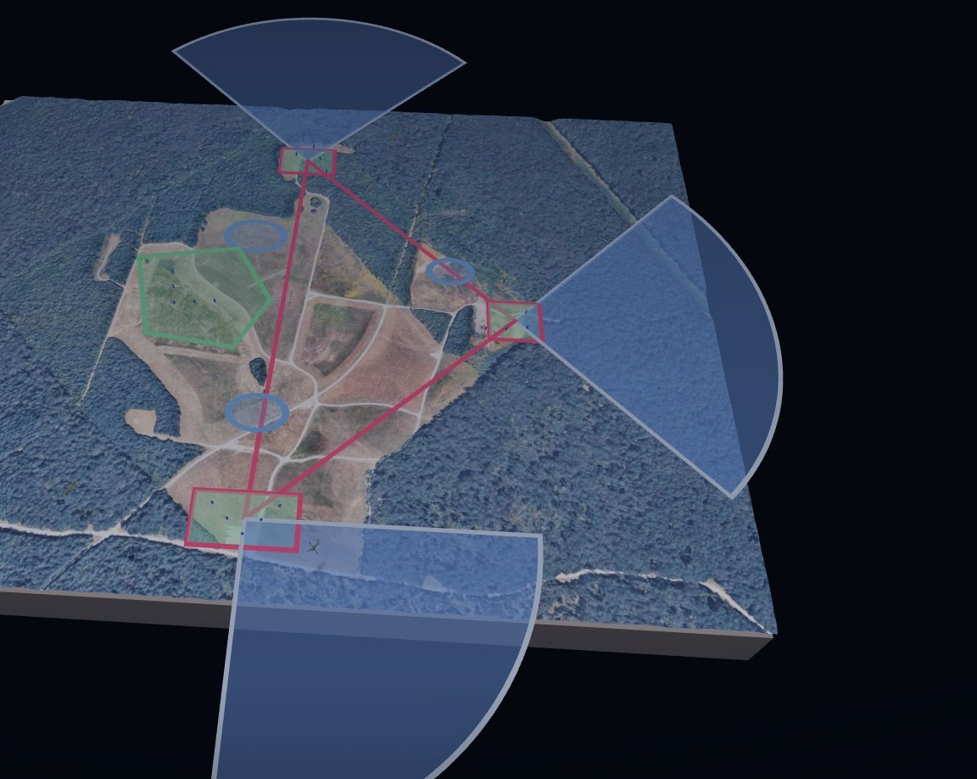
Land. Seize the objectives. Establish the PZ
PHASE II · AIR ASSAULT AND SEIZURE
Key tasks: GTF air assault (Lift 1), FARP seizure, pathfinder operations. Night air assault, dismounted land navigation, seize.
H-hour. Wheels down. CH-47 on LZ Vulture inbound 158°. CH-47 on LZ Owl inbound 063°. UH-60 on LZ Falcon inbound 155°.
Seize the site. Element 2 moves from LZ Vulture and seizes the FARP site. Element 1 moves to OBJ Husky, oriented north.
Interdict the approaches. Element 1 occupies OBJ Poodle from LZ Falcon, oriented east along the road, and OBJ Bernese from LZ Owl, oriented south-east, interdicting the avenues of approach.
Establish the PZ. Element 3 secures the site. Pathfinders mark PZ Cedar and the R3P inside the triangle formed by the objectives. FARP secured NLT H+1:00.
Chalk-to-LZ assignments shown are the Storm Surge AMB plan (3 aircraft). The CONOP Lift 1 package is 2x CH47 / 2x UH60.
Notes:
Phase two, air assault and seizure. Serials land LZ Vulture, LZ Falcon and LZ Owl. Element two seizes the FARP site. Element one occupies OBJ Husky, Poodle and Bernese to interdict the avenues of approach. Element three secures the site and pathfinders establish PZ Cedar and the rapid refuel point inside the triangle. FARP seized no later than H plus one.

Slide 11
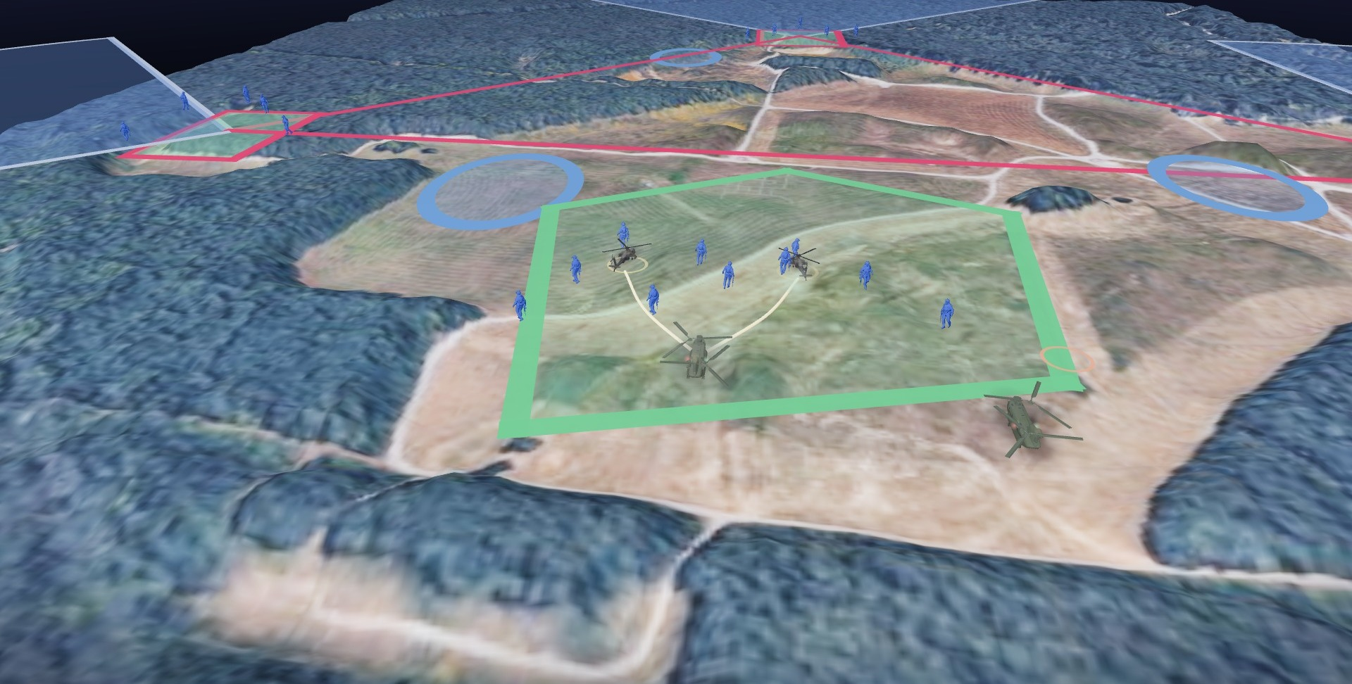
Establish the R3P. Turn the deep attack
PHASE III · FARP OPERATIONS
Key tasks: FARP TF air assault (Lift 2), FARP establishment, deep attack air assault (Lift 3). Pathfinders control the zone.
H+1:00. Lift 2 lands. 2x CH47 with the 18-PAX FARP crew land the marked zone: WETCOW with fuel tanks, FATCOW with AH-64 munitions.
FARP establishment. Refuel points run from the WETCOW; the rearm point is served from the FATCOW. ECHO / 6-101 operates the points. Element 3 secures the zone.
Lift 3 lands. AH-64s land the points, refuel from the WETCOW and rearm from the FATCOW with rotors turning.
Turn forward. The attack element departs for the Division deep target with full fuel. FARP operations complete NLT H+2:00.
60 NM
185 NM
AH OPERATIONS EXTENDED BY WETCOW
EXTENDED RANGE, NO REFUEL, ERFS
Notes:
Phase three, FARP operations. Lift two delivers the 18-person FARP crew on the WETCOW, a CH-47 carrying fuel tanks, and the FATCOW, a CH-47 carrying munitions for the AH-64. The FARP is established at the rapid refuel point. Lift three lands, refuels from the WETCOW and rearms from the FATCOW with rotors turning, and departs for the Division deep target. FARP operations complete no later than H plus two.

Slide 12
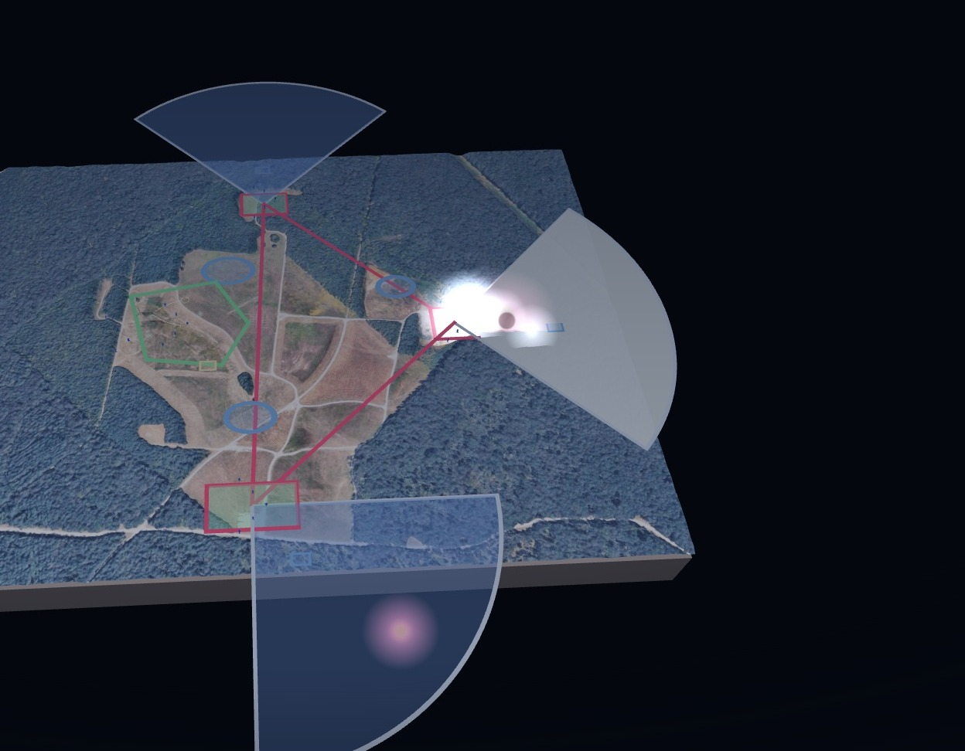
Security is a ground force task
PHASE IV · SECURITY POSTURE
All-round security. The FARP is approached from any direction by a mobile enemy. The perimeter must cover 360 degrees with no element split.
Early warning in depth. Scout observation posts forward on the avenues of approach, then the objectives, then the centre. Contact is made as far from the aircraft as possible.
Mutual support. Positions are sited so that any approach is under fire from two positions. The triangular patrol base is the doctrinal shape that delivers this with three elements.
Organic fires. The mortar section, registered on the avenues, is the company's responsive indirect fire. Aircraft on the points are the protected asset, not part of the perimeter.
Limited exposure. Time on site is the vulnerability. A jump FARP displaces or closes before the enemy can mass against it.
Key task: FARP Defense. ATP 3-04.17 treats the FARP as a high-value, high-signature target. The aviation unit brings minimal organic security; the ground task force provides it. The posture follows the principles of the defense applied at company scale.
PACE
DISPLACEMENT CRITERIA
Primary Wickr over TACSAT-IW. Alternate TAK / ICE. Contingency Signal over MUOS. Emergency cell or HF.
Site compromised, or the alternate site better positioned for the next turn. The FARP moves before it is forced to.
Notes:
Phase four, FARP defense. Aviation doctrine treats the FARP as a high-value, high-signature target with minimal organic security. Security is a ground force task. The posture rests on all-round security, early warning, mutually supporting positions, organic fires and a displacement plan.

Slide 13
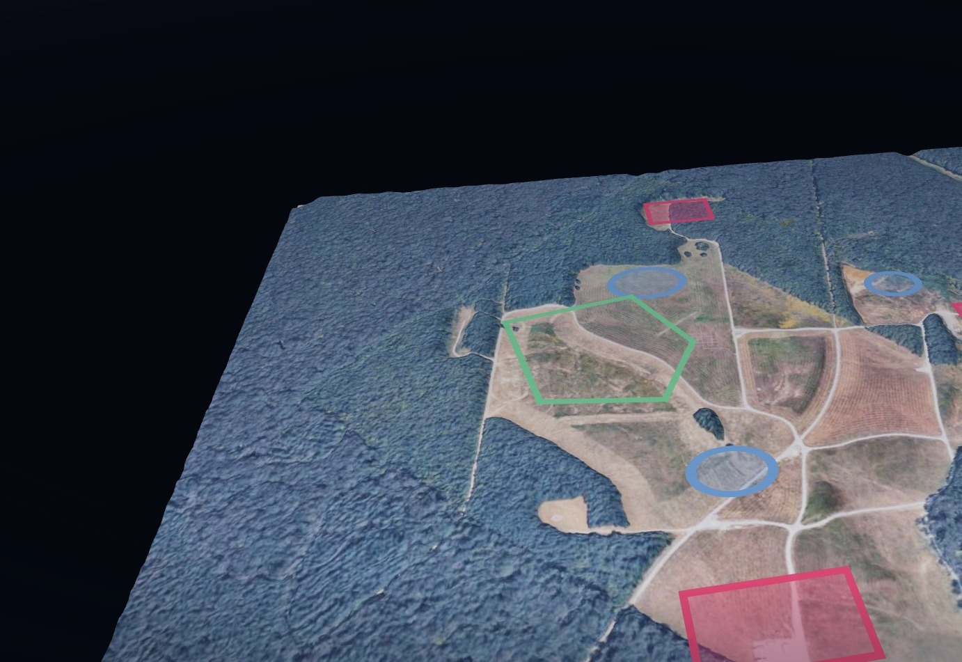
Close the site. The deep attack is on the objective
RECONSOLIDATION · H+2:00 TO H+3:00
Storm Surge Phase 5, reconsolidation, distinguishes a jump FARP from a base. The fuel point exists for one turn of the attack element and is then closed.
H+2:00. FARP operations complete. Refuel and rearm points recovered. WETCOW and FATCOW lift first.
PZ operations. Pathfinders control the pickup: chalks staged, aircraft inbound 090, staggered left, weapons tight.
Collapse in reverse order. Objectives fold in last, in reverse order of occupation, under mortar coverage until the mortar section itself lifts.
H+3:00. Reconsolidated at FCKY. Friendly end state: 100 percent accountability of personnel and equipment, FARP seizure task force validated.
Notes:
Reconsolidation. FARP operations complete at H plus two. Pathfinders conduct PZ operations. The force extracts through PZ Cedar and reconsolidates at Fort Campbell by H plus three. The site is closed and the aircraft it refueled are over the Division target.

Slide 14
Risk
RISK TO FORCE
RISK TO MISSION
TRAINING RISK
Distance from sustainment
High-signature fuel point
Newly qualified pathfinders
A company (-) with limited sustainment 180 nautical miles from FCKY. Casualty evacuation and resupply are aviation tasks that must be planned, not assumed.
Rotors turning, fuel flowing, aircraft on the ground on a schedule. The window is the vulnerability. The concept mitigates with objective security and a compressed timeline.
The company assumes risk by training with newly qualified pathfinders, because a Division pathfinder company is the intended recipient of this mission set.
MITIGATION
MITIGATION
MITIGATION
Class I carried
Deliberate rehearsals
Proof of concept
1× DOS of CL I issued prior to W/U and 1× DOS carried per soldier on the aircraft.
Air assault planning with 6-101 CAB, cold-load training on the supporting airframes, and leader certification prior to execution.
Validate the task force on a training objective at full distance before the concept is relied upon for a deep attack.
Notes:
Risk. A company minus with limited sustainment, 180 nautical miles from Fort Campbell. Mitigations are deliberate: Class I carried, deliberate rehearsals, leader certification before execution, and a proof of concept at full distance before the mission set is assigned.

Slide 15
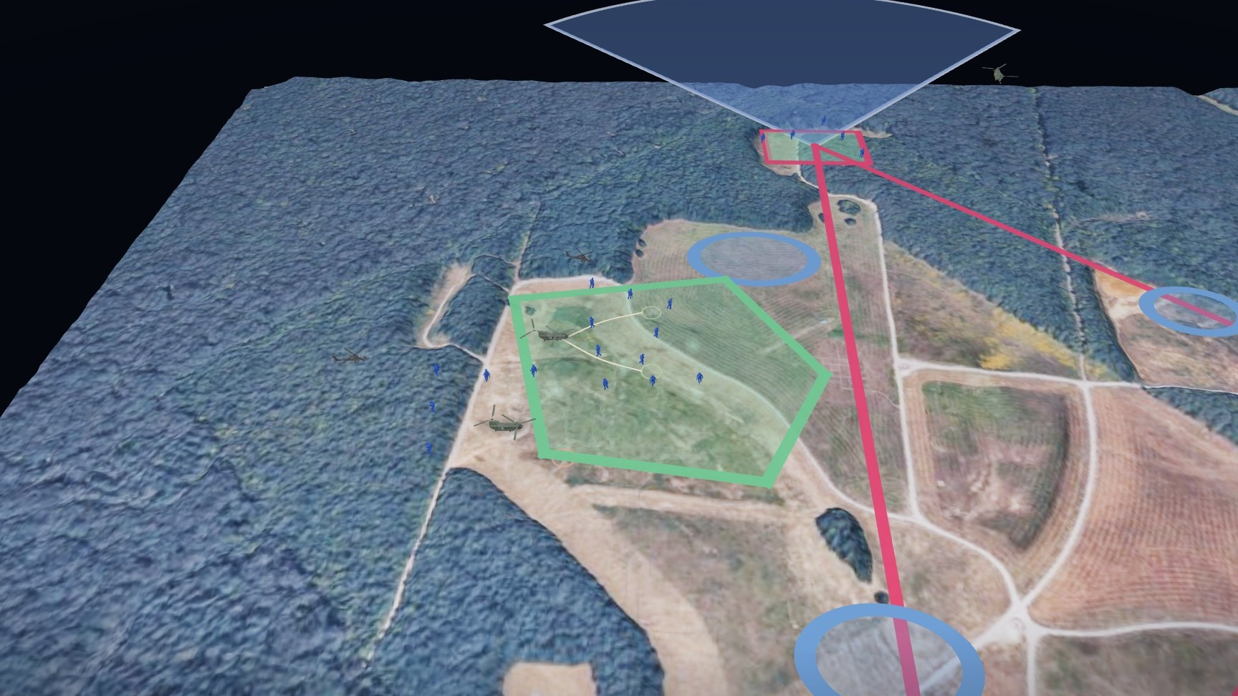
Validate at full distance
PROOF OF CONCEPT · OPERATION STORM SURGE · 28–29 OCT 26
Mission. Dog Company conducts a Company (-) Air Assault into Tullahoma, TN to secure an expeditionary FARP on 29 0130Z OCT 26 to enable freedom of movement for 6-101 CAB and proof the concept for FARP seizure operations.
Extended range: 185 NM with no refuel, ERFS employment on Serial 1.
WETCOW enables AH operations 60 NM beyond the objective.
3× WETCOWs, 5× FARP locations, simultaneous, secured and dispersed, supporting multiple MDS.
Hippo concept validated at 370 NM total, with integration of sustainment and C2 nodes including an air-deliverable Shadow TAC.
2200Z
0030Z
0130Z
0230Z
0330Z
A/C package: 3× CH-47 (1× PAX, 1× FATCOW) · 1× UH-60 · 83 PAX · night · CAAF to Tullahoma, TN · 184 NM
W/U
W/D · H-HOUR
FARP SEIZED
FARP OPS COMPLETE
RECONSOLIDATED
Notes:
Proof of concept. Operation Storm Surge, 28 to 29 October 2026. The full sequence on the Tullahoma objective: serials land, the elements move to the objectives and establish their sectors, pathfinders mark PZ Cedar, the WETCOW and FATCOW land, the Apaches refuel and rearm and depart, and the objectives defend the site.

Slide 16

END STATE
Fuel forward is reach forward.
Seize the site. Establish the FARP. Turn the deep attack. Close the site. An infantry company (-), three hours on the ground, extends the Division's deep fight by 200 nautical miles.
Dog Company · 2-506 IN · 3BCT, 101st ABN DIV (AASLT) · with 6-101 CAB
Notes:
End state. The J-FARP seizure places Class III and Class V inside the Division deep area for one turn of the attack element, then closes. An infantry company, three hours on the ground, extends combat aviation reach by 200 nautical miles.

Slide 17
Terms and sources
J-FARP Jump forward arming and refueling point
ISB Intermediate staging base
GTF Ground task force
WETCOW CH-47 carrying fuel tanks: the Class III point
FATCOW CH-47 carrying munitions for the AH-64: the Class V point
ERFS Extended range fuel system
R3P Rapid refuel point
L2A2 Large-scale, long-range air assault
IPC · AMCM · AMB Initial planning conference · air mission coordination meeting · air mission brief
W/U · W/D Wheels up · wheels down
OP · CCP Observation post · casualty collection point
NOMAD Unmanned ground vehicle carrying the C2 package
MDS Mission design series
Doctrine. FM 3-04 Army Aviation, ATP 3-04.17 Techniques for Forward Arming and Refueling Points, FM 3-99 Airborne and Air Assault Operations, FM 3-90 Tactics, ATP 3-21.8 Infantry Platoon and Squad and TC 3-21.76 Ranger Handbook. Doctrinal statements are paraphrased and should be verified against current editions.
Unit sources. Mission, intent, task organization, lift packages, phasing, timeline, deliverables, aerial imagery and apron photographs are from the Dog Company J-FARP Seizure CONOP and the Operation Storm Surge AMCM / AMB of 06 OCT 26.
Imagery. Scene renders are from the animated brief. The wide-area terrain is built from illustrative terrain-board renders and is not real geography; the objective-area scenes are drawn over the unit's overhead imagery. Lift packages, phasing and key tasks are quoted from the CONOP as briefed; the Ground Task Force elements and strengths are as directed by the GTF commander; chalk-to-LZ and objective assignments follow the Storm Surge AMB.
Notes:
Terms and sources for the brief.

