Slide 1
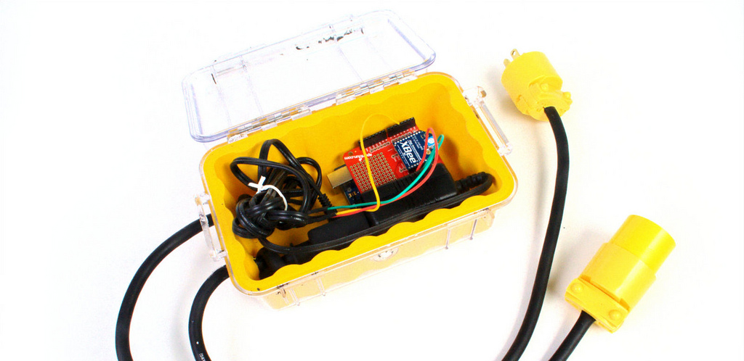
Hackingpot
www.hackingpot.com
hackingpot
LOGIN
SHARE
What ingredients do you have?
ADD A COMPONENT
ADD A COMPONENT
ADD A COMPONENT
ADD A COMPONENT
ADD A COMPONENT
SEARCH RECIPE!

Slide 2
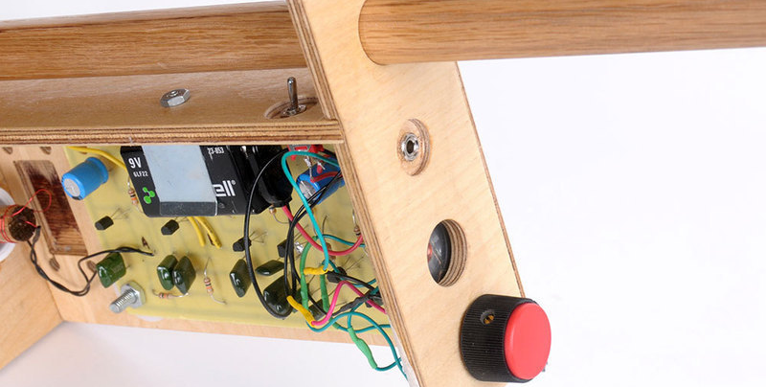
Hackingpot – Treasure Finder
www.hackingpot.com/projects/treasure-finder
hackingpot
ADD A COMPONENT
I HAVE
LOGIN
SHARE
10K POTENTIOMETER
CAPACITORS
X
WIRE COIL
X
Treasure Finder
4 of 42

Slide 3
Hackingpot – Treasure Finder
www.hackingpot.com/projects/treasure-finder
hackingpot
ADD A COMPONENT
I HAVE
LOGIN
SHARE
Treasure Finder
4 of 42
I BUILT THIS!
Your Components
Who hasn't dreamed about owning their own metal detector and searching for buried treasure, or at least a few dropped coins? In this project, we will build a metal detector based on a dual oscillator circuit. One oscillator is fixed, and the other varies depending upon the proximity of metal objects.
Wire coil
10k potentiometer
Capacitors
You need
I HAVE
Speaker wire
Transistor, NPN, 2N3904
Audio Jack, 1/8”, mono
Battery, 9V
I NEED
FULL TUTORIAL @ MAKE PROJECTS

