Slide 2
Introduction
MDE techniques and DSMLs simplifies development of complex software
Appropriate constructs may enable even end-users to create complex applications
Notes:
CVM and MGridVM are execution engines that allow users to create applications by means of a high-level graphical DSML.
Moreover, CML and MGridML models can be created and changed at runtime, triggering adaptations into the provided service.

Slide 3
Introduction
MDE techniques and DSMLs simplifies development of complex software
Appropriate constructs may enable even end-users to create complex applications
CVM and MGridVM are examples
high-level graphical DSMLs
models can be changed at runtime
Notes:
CVM and MGridVM are execution engines that allow users to create applications by means of a high-level graphical DSML.
Moreover, CML and MGridML models can be created and changed at runtime, triggering adaptations into the provided service.

Slide 4
Introduction
Execution engines for DSMLs are complex and difficult to build
Even more complex if models can be changed at runtime
Notes:
Nonetheless, the construction of execution engines for these DSMLs are extremely complex and requires dealing with
Model parsing, transformations, negotiations, synthesis, etc
If dealing with models@run.time, it is even more complex and may require runtime adaptation, monitoring, runtime validation, etc
Why not use MDE to deal with this complexity?

Slide 5
Introduction
Execution engines for DSMLs are complex and difficult to build
Even more complex if models can be changed at runtime
MDE is proposed as an approach to deal with the development of complex software
Notes:
Nonetheless, the construction of execution engines for these DSMLs are extremely complex and requires dealing with
Model parsing, transformations, negotiations, synthesis, etc
If dealing with models@run.time, it is even more complex and may require runtime adaptation, monitoring, runtime validation, etc
Why not use MDE to deal with this complexity?

Slide 6
Introduction
CVM and MGridVM
Provide services described by high-level models upon a set of heterogeneous resources
Rely on a common set of operations: model comparisons, negotiation of models, synthesis of scripts, policy evaluation, autonomic management of resources, etc
Solutions employed by CVM and MGridVM could be captured as a technical (horizontal) domain
And applied to other application (vertical) domains
Notes:
Despite being complex and difficult to build, execution engines for communication and microgrid shows some similarities
Architectures for both of them share the same structure
Both rely on model comparisons, negotiation, synthesis of scripts, enforcement of policies, autonomic management of resources, etc

Slide 7
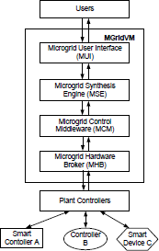
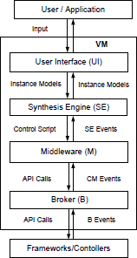
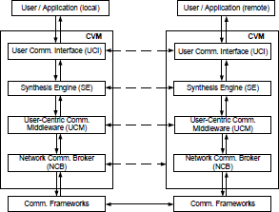
Generic Architecture for DSML EEs
Notes:
Constructs for modeling

Slide 8
Language perspective
DSML metamodel describes the structure of the language (abstract syntax and static semantics)
Execution engine model describes the behavior of the language (dynamic semantics) in an operational way
Notes:
Maybe it could be interesting present the approach from a language perspective

Slide 9
Overall approach
Focused on execution engines for a class of DSMLs
Based on a generic architecture that can be specialized into DSML execution engines
Specialization is achieved by modeling in conformance to a given metamodel
Metamodel encompass constructs related to the operations needed in the execution DSMLs in that given class
Notes:
CVM and MGridVM are built on a layered architecture
Models are specialization

Slide 10
Overall approach
<<conforms to>>
MGridVM
EE Model
EE MetaModel
CVM
EE Model
<<conforms to>>
Notes:
Constructs for modeling

Slide 11
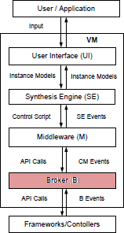
Broker layer
Notes:
In this paper we focused specially on the broker layer

Slide 12
Broker layer
Provide an uniform interface over resources
Abstract details in the setup, selection and maintenance of resources
Automatically identify situations that require adaptations and perform them transparently

Slide 13
Broker layer metamodel
Behavior of a Broker layer is defined by the way it handles calls from upper layer and events from resources
Handlers define an action to be taken:
Call a resource
Generate an event to upper layers
Execute a sequence of other actions
Execute a macro (which may access resources/state)

Slide 14
Broker layer metamodel
Call/Event Handling
Resource management
State management
Autonomic management
Policy evaluation

Slide 15
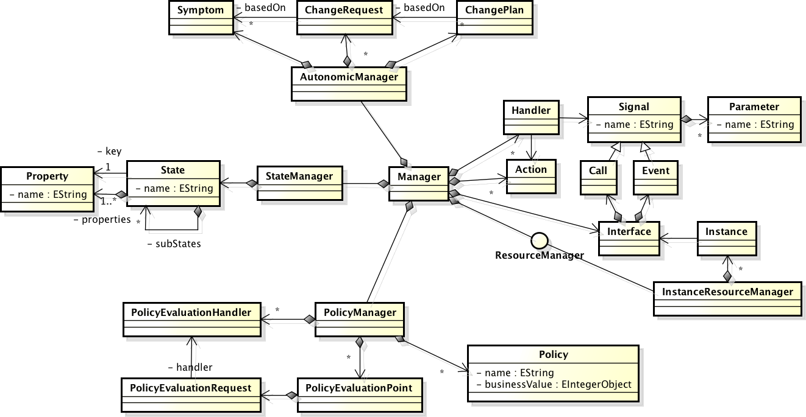
Broker layer metamodel

Slide 16
Broker layer execution environment
Provides operational semantics to the Broker layer metamodel
Loads a Broker layer model and executes accordingly
Provides a library for integrating resource implementations to the execution environment

Slide 17
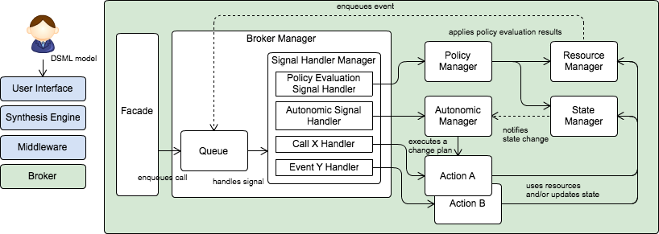
Broker layer execution environment

Slide 18
Network Communication Broker
Provides an uniform API over a set of communication frameworks
Abstracts communication framework selection, setup, monitoring, replacement and recovery

Slide 19
Network Communication Broker
This slide was intended to show a model of the NCB conforming to the proposed metamodel
Problems: the complete model is big and it is not feasible to represent it graphically
Maybe we could show separately each of the main aspects of the model
But it could also be too detailed for the presentation

Slide 20
Example scenario
User requests an audio communication with another party
A session is initially established using Framework 1
A failure is simulated in Framework 1
NCB automatically switches the session to be established using Framework 2
Notes:
Example illustrated in the paper as a table.
Simple connection that is interrupted when framework 1 fails
- Ncb destroys the session in framework 1 and reinitialize it in framework 2

Slide 21
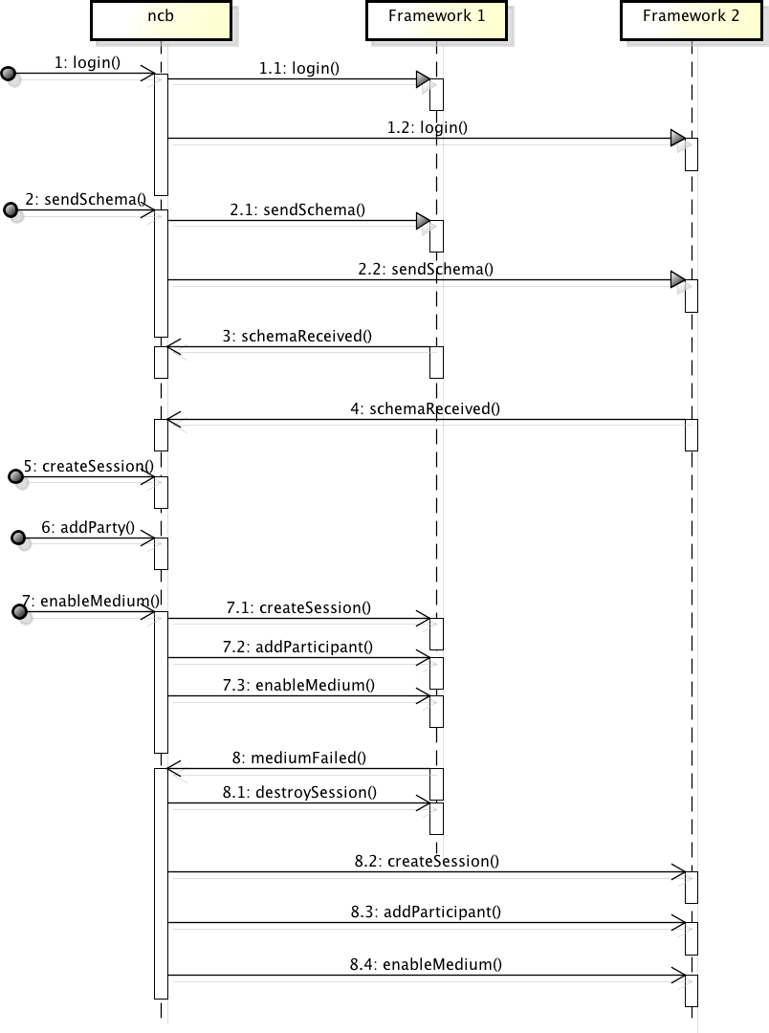
Notes:
Example illustrated in the paper as a table.
Simple connection that is interrupted when framework 1 fails
- Ncb destroys the session in framework 1 and reinitialize it in framework 2

Slide 22
Network Communication Broker
Performance
Substantial performance loss
Simple scenarios (significant loading overhead)
Evaluation of expressions and parameter bindings
Original NCB |  | Modeled NCB
Avg (ms) | Std Dev | Avg (ms) | Std (ms)
1369.29 | 51.60 | 3058.53 | 149.70
Notes:
Running time of the scenario described in the paper (average over 100 executions)
-----
It has room for improving performance by optimizing the way expressions and paramter bindings are currently implemented.

Slide 23
Network Communication Broker
Metrics
Original NCB: 6777 LOC
Modeled NCB:
Model: 264 objects
Macro code: 864 LOC
Notes:
Running time of the scenario described in the paper (average over 100 executions)
-----
It has room for improving performance by optimizing the way expressions and paramter bindings are currently implemented.

Slide 24
Conclusions

