Slide 1
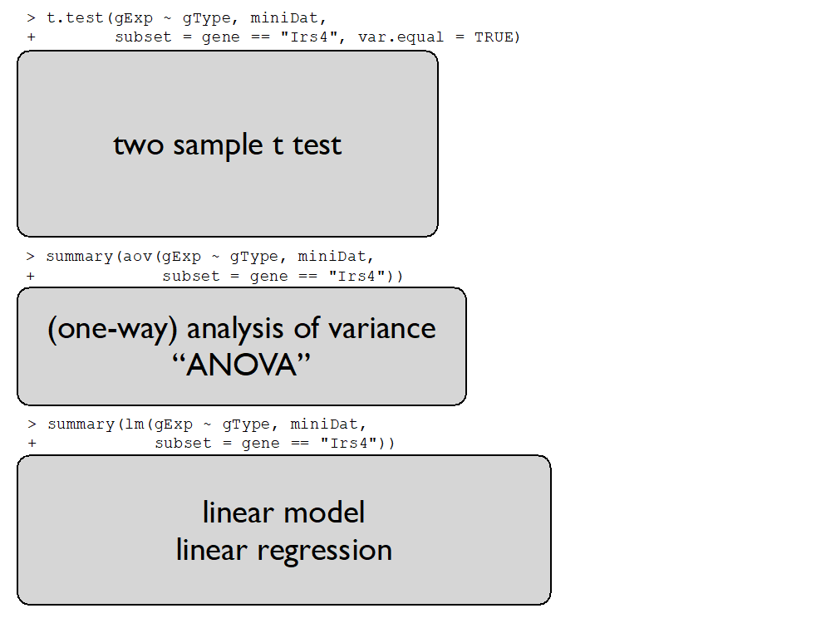


Slide 2
regression parameters
response
Y
design matrix X
error term

Slide 4
