Slide 1
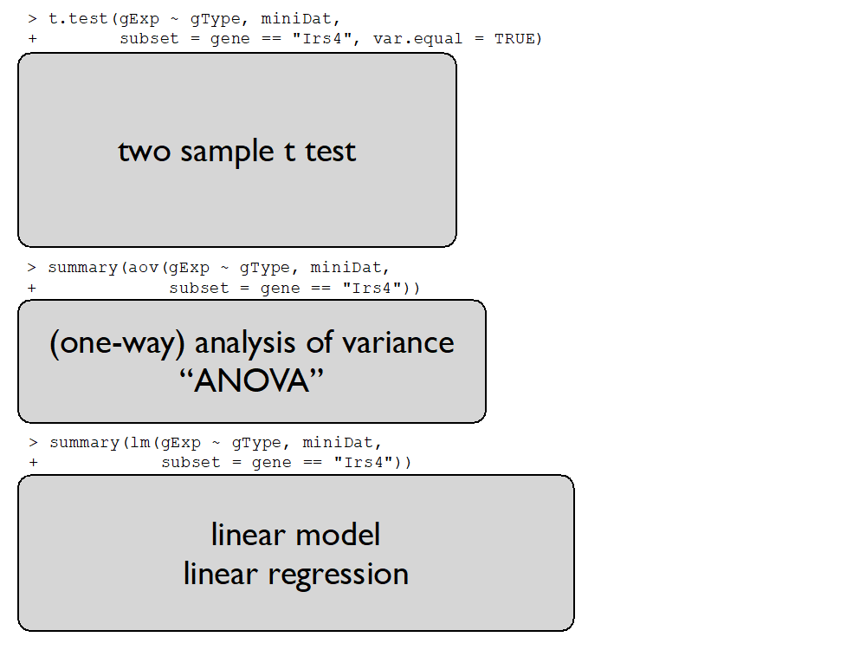


Slide 2
regression parameters
response
Y
design matrix X
error term

Slide 3
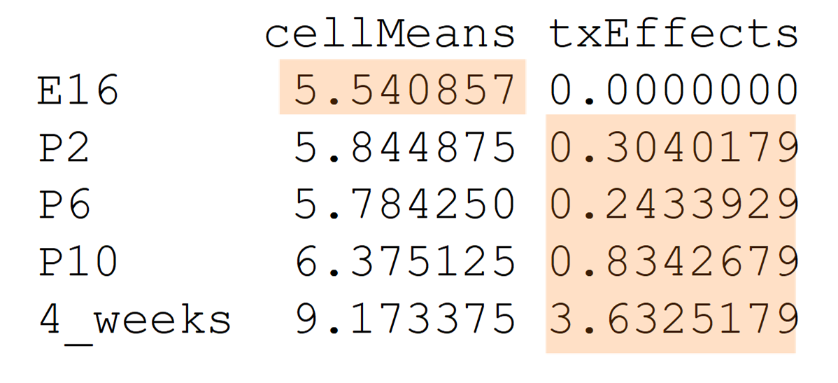
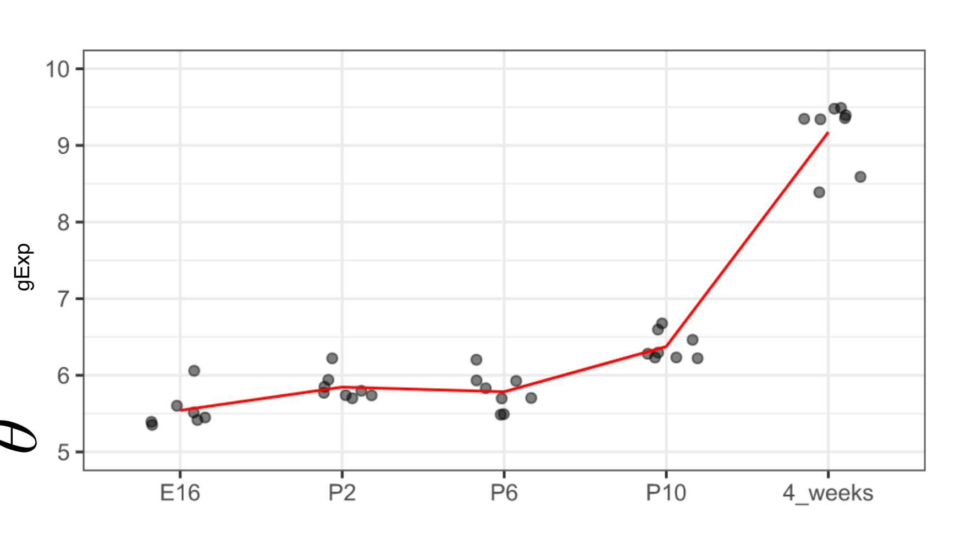




Slide 4
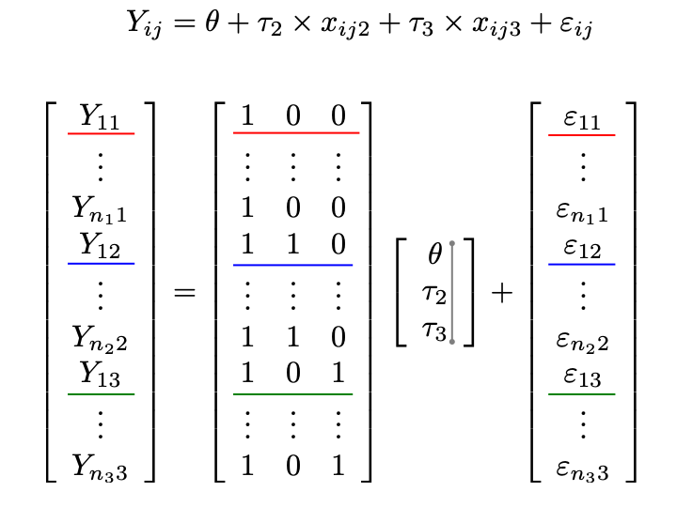

Slide 5
HOW??
Changing the parametrization and using dummy variables
Response variable

Slide 6
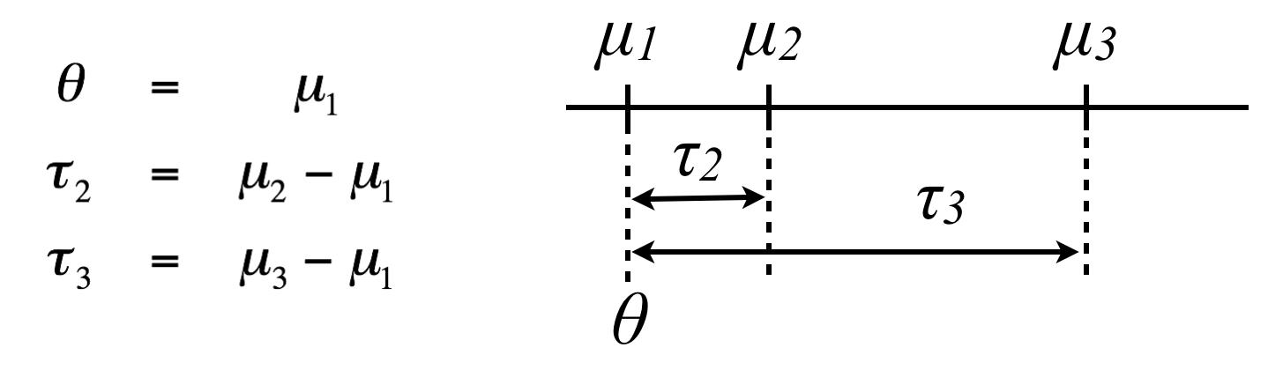
These are NOT population means
These are differences of means

