Slide 1
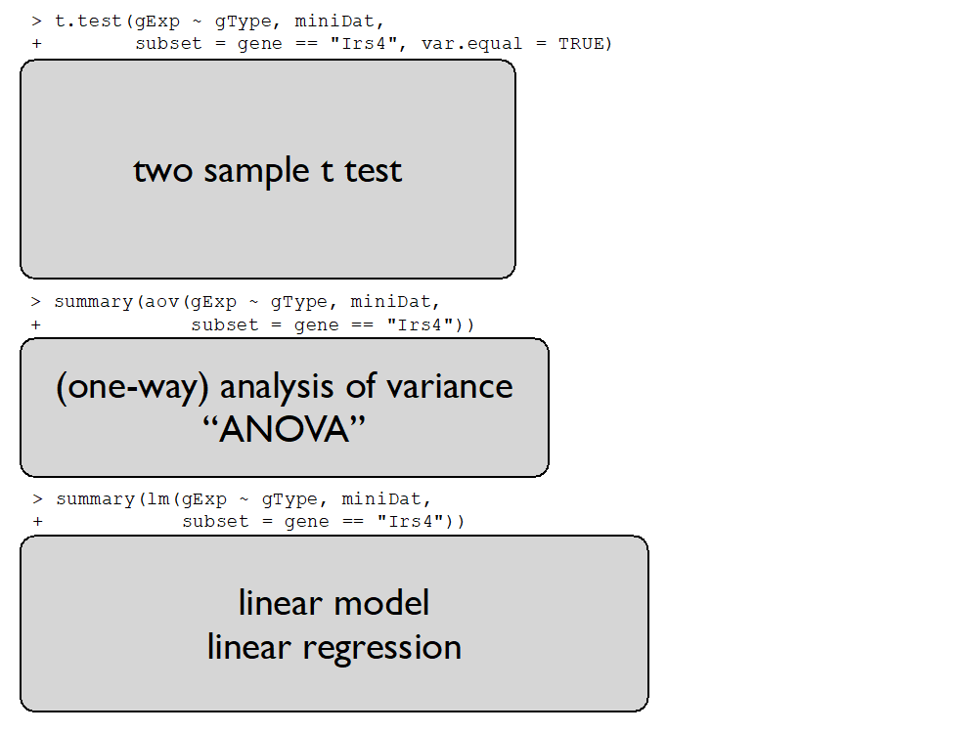


Slide 2
regression parameters
response
Y
design matrix X
error term

Slide 3
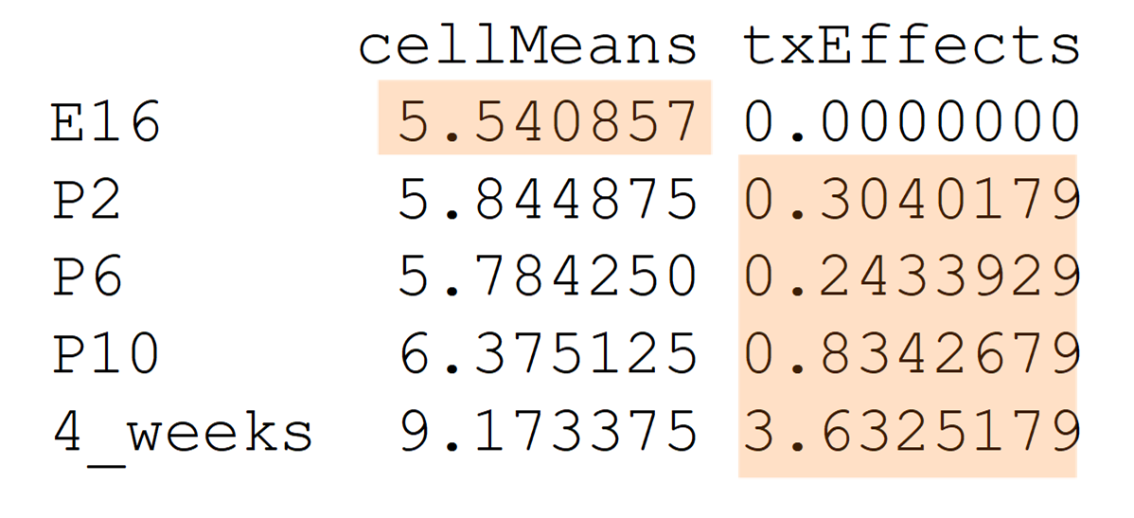
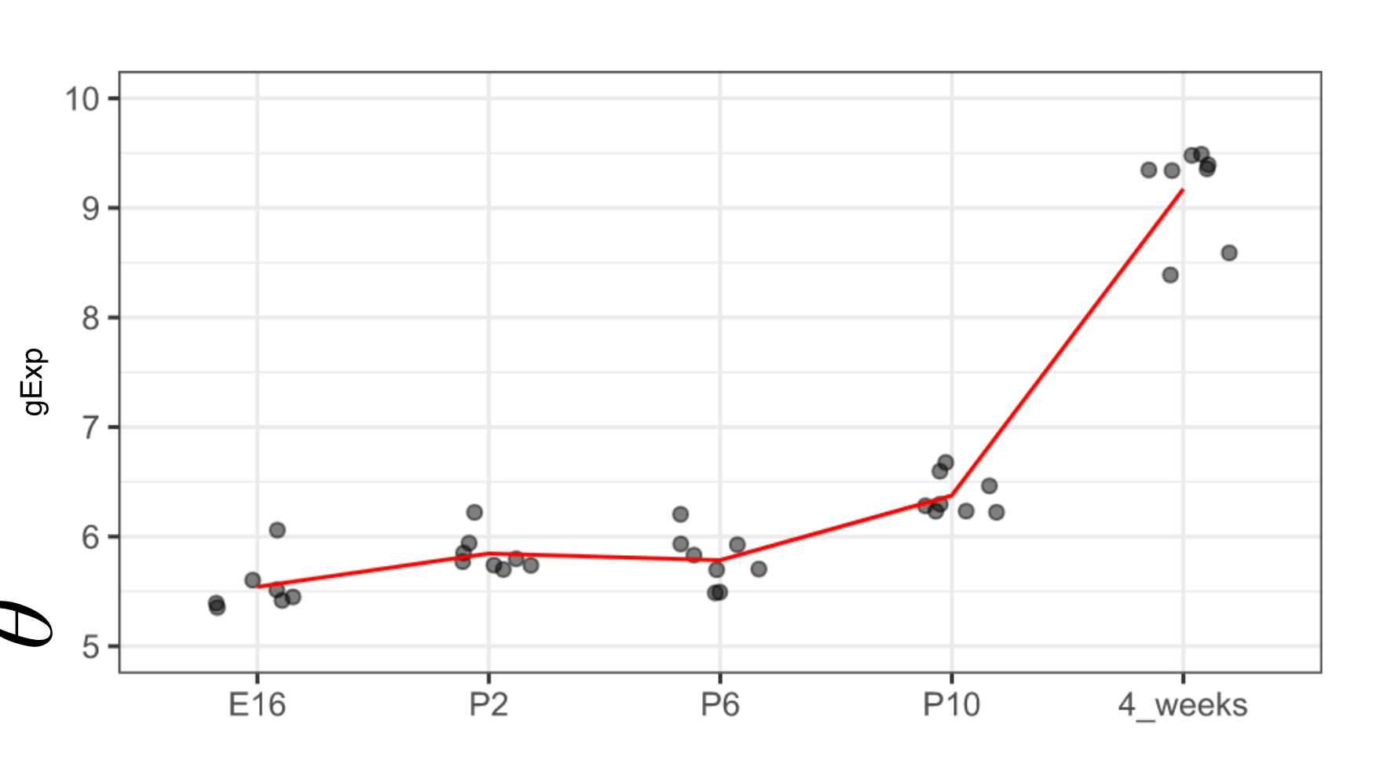




Slide 4
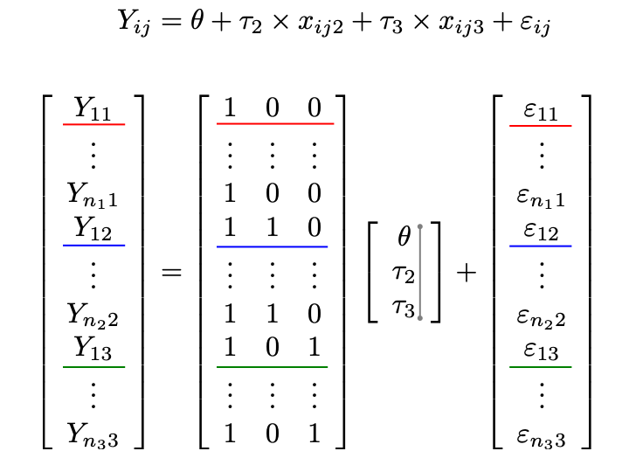

Slide 5
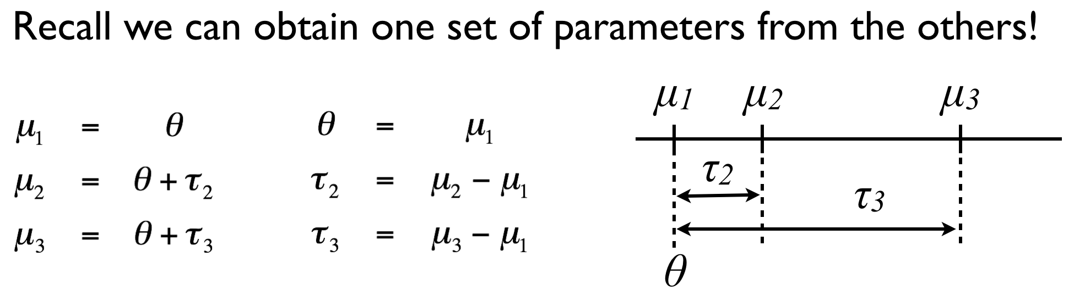
HOW??
Changing the parametrization and using dummy variables
Response variable

Slide 8
These are NOT population means
These are differences of means

Slide 9
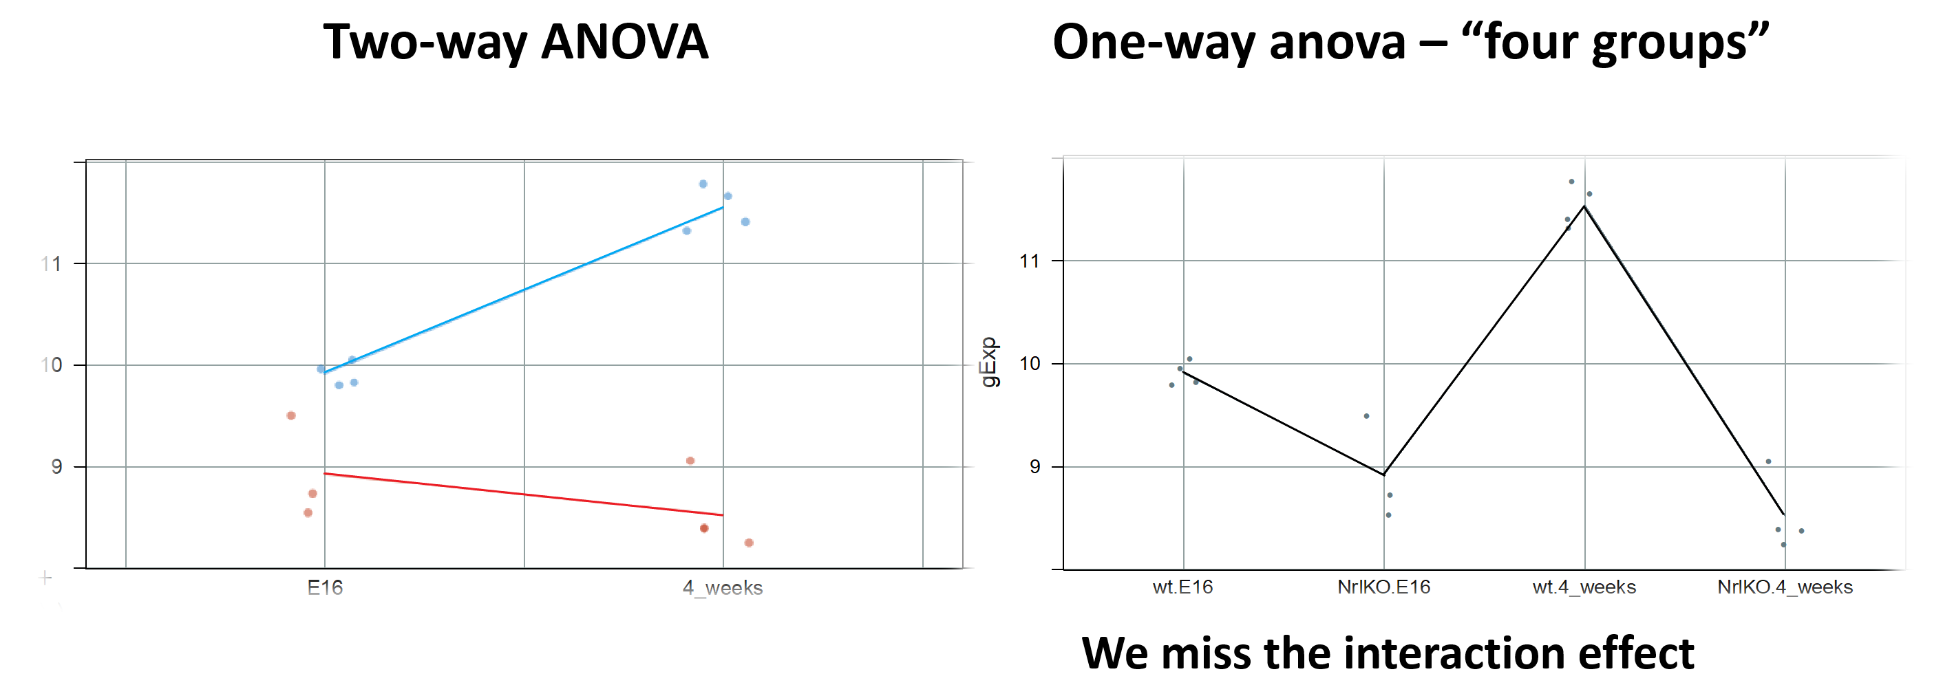
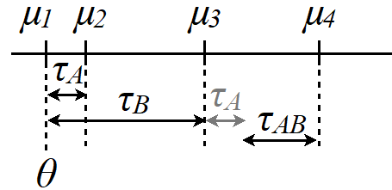
Two-way ANOVA
One-way ANOVA – “4 groups”
wt
NrlKO
E16 4W
wt_E16 NrlKO_E16 wt_4W NrlKO_4W

Slide 12
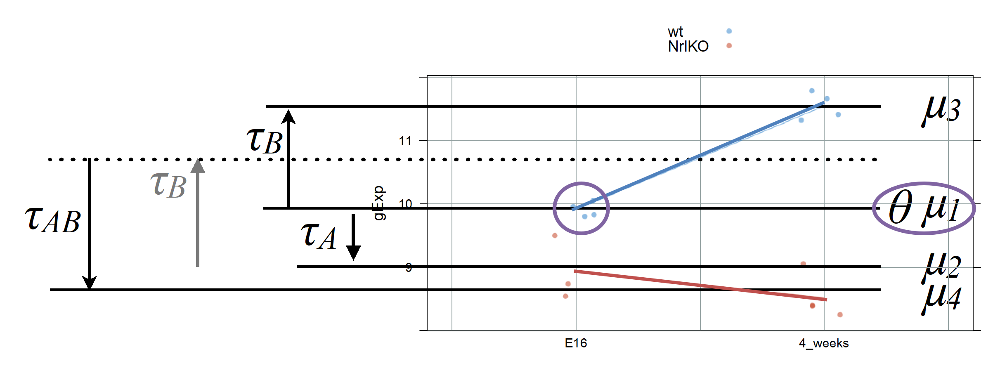
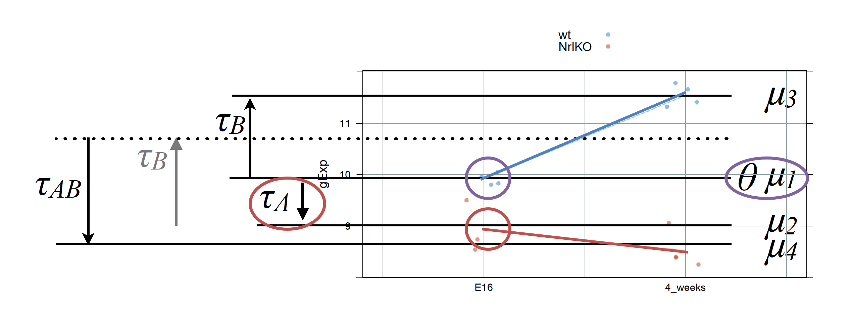

Slide 13
