Slide 1
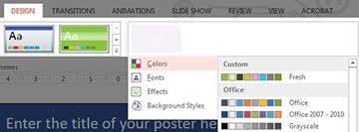




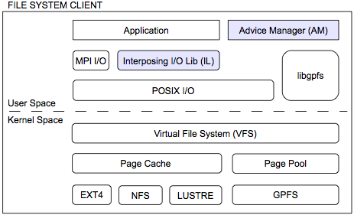
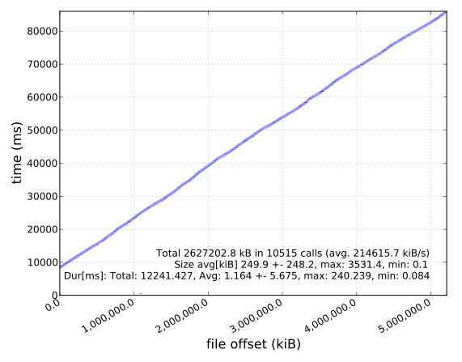
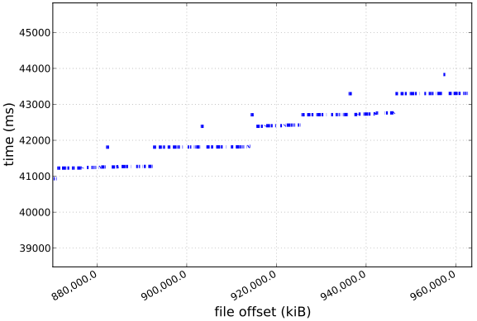
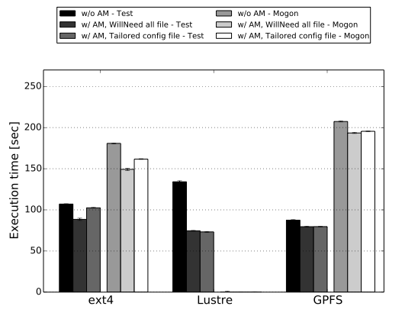
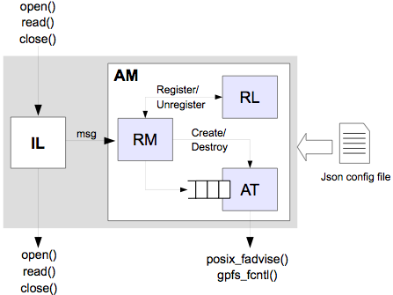
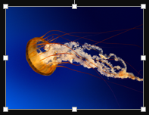

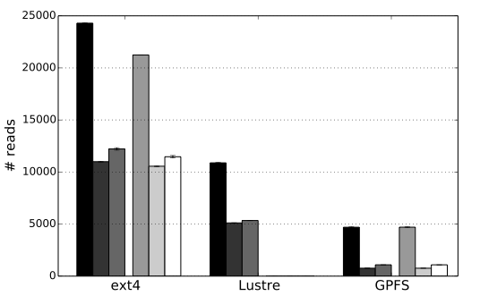



(—THIS SIDEBAR DOES NOT PRINT—)
DESIGN GUIDE
This PowerPoint 2007 template produces a 100cmx140cm presentation poster. You can use it to create your research poster and save valuable time placing titles, subtitles, text, and graphics.
We provide a series of online tutorials that will guide you through the poster design process and answer your poster production questions. To view our template tutorials, go online to PosterPresentations.com and click on HELP DESK.
When you are ready to print your poster, go online to PosterPresentations.com
Need assistance? Call us at 1.510.649.3001
QUICK START
Zoom in and out
As you work on your poster zoom in and out to the level that is more comfortable to you. Go to VIEW > ZOOM.
Title, Authors, and Affiliations
Start designing your poster by adding the title, the names of the authors, and the affiliated institutions. You can type or paste text into the provided boxes. The template will automatically adjust the size of your text to fit the title box. You can manually override this feature and change the size of your text.
TIP: The font size of your title should be bigger than your name(s) and institution name(s).
Adding Logos / Seals
Most often, logos are added on each side of the title. You can insert a logo by dragging and dropping it from your desktop, copy and paste or by going to INSERT > PICTURES. Logos taken from web sites are likely to be low quality when printed. Zoom it at 100% to see what the logo will look like on the final poster and make any necessary adjustments.
TIP: See if your school’s logo is available on our free poster templates page.
Photographs / Graphics
You can add images by dragging and dropping from your desktop, copy and paste, or by going to INSERT > PICTURES. Resize images proportionally by holding down the SHIFT key and dragging one of the corner handles. For a professional-looking poster, do not distort your images by enlarging them disproportionally.
Image Quality Check
Zoom in and look at your images at 100% magnification. If they look good they will print well.
Optimizing Scientific File I/O Patterns using Advice Based Knowledge
QUICK START (cont.)
How to change the template color theme
  You can easily change the color theme of your poster by going to the DESIGN menu, click on COLORS, and choose the color theme of your choice. You can also create your own color theme.
You can also manually change the color of your background by going to VIEW > SLIDE MASTER. After you finish working on the master be sure to go to VIEW > NORMAL to continue working on your poster.
How to add Text
  The template comes with a number of pre-formatted placeholders for headers and text blocks. You can add more blocks by copying and pasting the existing ones or by adding a text box from the HOME menu.
Text size
Adjust the size of your text based on how much content you have to present.
The default template text offers a good starting point. Follow the conference requirements.
How to add Tables
To add a table from scratch go to the INSERT menu and click on TABLE. A drop-down box will help you select rows and columns.
You can also copy and a paste a table from Word or another PowerPoint document. A pasted table may need to be re-formatted by RIGHT-CLICK > FORMAT SHAPE, TEXT BOX, Margins.
Graphs / Charts
You can simply copy and paste charts and graphs from Excel or Word. Some reformatting may be required depending on how the original document has been created.
How to change the column configuration
RIGHT-CLICK on the poster background and select LAYOUT to see the column options available for this template. The poster columns can also be customized on the Master. VIEW > MASTER.
How to remove the info bars
If you are working in PowerPoint for Windows and have finished your poster, save as PDF and the bars will not be included. You can also delete them by going to VIEW > MASTER. On the Mac adjust the Page-Setup to match the Page-Setup in PowerPoint before you create a PDF. You can also delete them from the Slide Master.
Save your work
Save your template as a PowerPoint document. For printing, save as PowerPoint of “Print-quality” PDF.
Print your poster
When you are ready to have your poster printed go online to PosterPresentations.com and click on the “Order Your Poster” button. Choose the poster type the best suits your needs and submit your order. If you submit a PowerPoint document you will be receiving a PDF proof for your approval prior to printing. If your order is placed and paid for before noon, Pacific, Monday through Friday, your order will ship out that same day. Next day, Second day, Third day, and Free Ground services are offered. Go to PosterPresentations.com for more information.
The performance gap between processing and I/O represents a serious scalability limitation. Parallel file systems often provide mechanisms that allow program-mers to disclose their I/O pattern knowledge to the lower layers of the I/O stack. This information can be used by the file system to boost the application performance. Unfortunately, programmers rarely make use of these features.
We provide an advice infrastructure that optimizes file I/O patterns, allowing to control the I/O behavior of applicat-ions without modifying them.
Architecture
Results
We extend the usual I/O software stack with two software components:
Interposing I/O Library (IL)
Advice Manager (AM)
Framework evaluated with a ROOT based applicat-ion in two different systems using three different file systems. The application’s I/O pattern seems linear but a zoom view show something else.
Due to our infrastructure the I/O can be accelerated.
The architecture allows using Linux advice as well as the GPFS hints asynchronously through the Advice Manager and it generates those POSIX advice and GPFS hints
write acceleration factor: 1.1
transparently, without the need to modify the application.
Messages are sent from the Interposing I/O Library to the Advice Manager. The Advice Manager is made up of three smaller modules:
Corner handles
ORIGINAL
DISTORTED
read call reduction factor: 0.8
a Request Manager (RM), receiving requests
a Register Log (RL) keeping track of which files are currently handled
an Advisor Thread (AT), receiving read requests and issuing POSIX advice and GPFS hints
Good printing quality
Bad printing quality
Student discounts are available on our Facebook page.
Go to PosterPresentations.com and click on the FB icon.
RESEARCH POSTER PRESENTATION DESIGN © 2012
www.PosterPresentations.com
© 2013 PosterPresentations.com
2117 Fourth Street , Unit C
Berkeley CA 94710
posterpresenter@gmail.com

