Slide 1
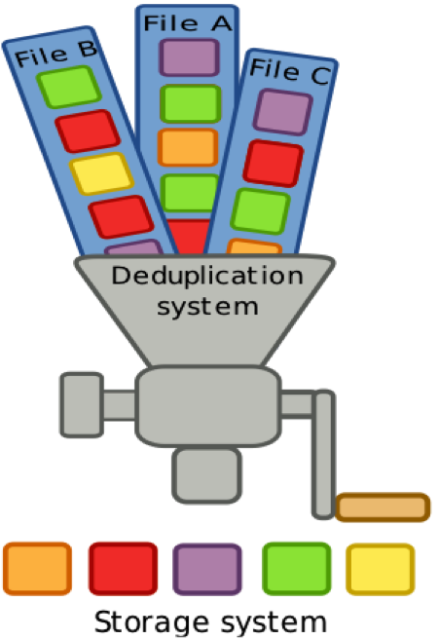
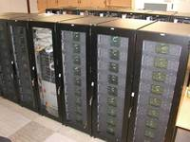
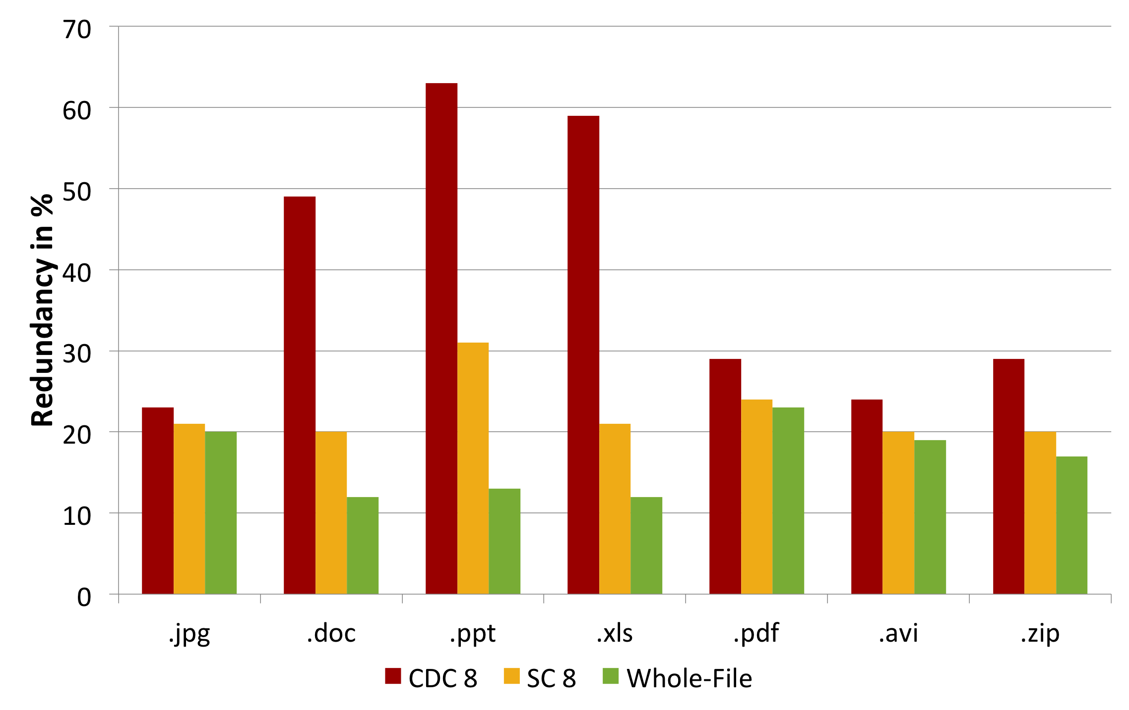
Study: Data Deduplication for HPC Archives
Research Project Summary
Data Deduplication
Enormous storage problems at HPC archives
Multi TB to Multi PB range
Long term archiving
Tape
Fixed, inflexible file formats
Increasing demand for rapid access of archived data e.g. web portals
Is deduplication potentially a way to reduce storage pains in HPC archives?
Large study of the deduplication in HPC archives
Multiple HPC centers
Different sizes
Different sciences
Novel technique saving storage capacity
Commonly used for backup systems
Data Domain, RECS | DEDUPE
Basic technique:
Split data up in chunks
Fingerprint chunks
Compare-by-Hash
Remove duplicates
FS-C
Open Source Deduplication Analysis Suite Developed by PC2
Data Collection Phase
Crawl over (network) file system
Chunking: CDC, Static
Fingerprinting: SHA1, MD5
Generating trace file
Trace file
Hash of filename
file size
file type
chunk fingerprints
Privacy Preserving
Data Analysis Phase
Post processing analysis on HTC cluster (Hadoop)
Cooperation partners
Barcelona Supercomputing Center (BSC)
Deutsches Klimarechenzentrum (DKRZ)
RWTH Aachen University (RWTH)
Renaissance Computing Institute (RENCI)
You? Ask us for details!
Results from previous study (University home directories)
Meister and Brinkmann, Multi-Level Comparision of Data Deduplication in a Backup Scenario, SYSTOR’09

