Slide 1
A Project Management in the age of remote working
How remote work is shaping the future of Project Management?
Group 2: Alice Villar, Hendrick Van Rooven, Gennaro Coppola, Sharon Wong

Slide 2
Agenda
1. The remote work revolution
2. Benefits of remote collaboration for organizations and workers
3. Handling the challenges of remote collaboration
4. Building trust in virtual project teams
5. The SPACE of developer productivity

Slide 3
1. The Remote Work Revolution
In 2012, Gallup data showed that 39% of employees worked remotely in some capacity and in 2016 that number grew to 43%.
As decades of Gallup research shows, when employees are engaged their performance soars: Highly engaged workplaces can claim 41% lower absenteeism, 40% fewer quality defects, and 21% higher profitability.

Slide 4
2. Benefits for organizations and workers
According to a research about the expansion of remote teams conducted by Andrew Filev (2013):
From the organization’s perspective, the benefits include the opportunity to hire talented workers regardless of geography, a “round-the-clock” workday, reduced costs, increased speed to market (product localization is a good example), and more. (Filev, 2013)
Form the employee’s perspective, the opportunity to work remotely is benefit that the majority (89%, to be precise) would like to have in their job. When they asked employees themselves about what they value the most in remote work, the top three answers were time savings (41%), increased productivity (29%) and the opportunity to focus on work, rather than office politics (10%).

Slide 5
3. Handling challenges
As Lukić & Vračar, 2018) observe, given the fact that hiring remotely can cause a number of issues in terms of security, confidentiality, and social differences, it is of vital importance to clearly define the structure and policies an organization wants to foster among its team in order to create a culture of trust.
The authors summarized traits which virtual team members should have to enhance trust:
▪ Ability to work with the technology used by the team;
▪ High degree of functional area competency;
▪ High integrity;
▪ High propensity to trust;
▪ Excellent communication skills;
▪ Openness to innovation and ideas suggested by others;
▪ Cultural and social sensitivity

Slide 6
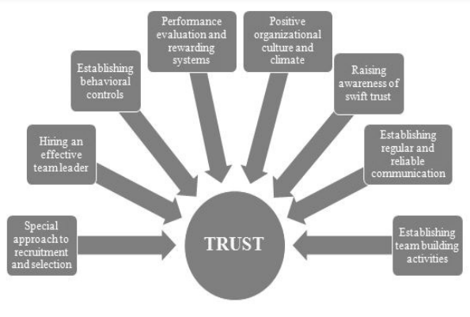
4. Building trust in virtual project teams
Lukić & Vračar (2018) proposed methods and activities for building and nurturing trust among employees in virtual project teams

Slide 7
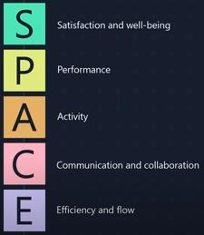
5. The SPACE of developer productivity
A clear understanding of defining, measuring, and predicting developer productivity could provide organizations, managers, and developers with the ability to make higherquality software—and make it more efficiently.
Forsgren et al. (2021) proposed the SPACE framework to understand developer productivity by using the following metrics:

Slide 8
REFERENCES
Filev, A. (2013). Expansion of remote teams: What drives it forward, and how is it shaping the future of project management. PM world journal, 2, 3.
Forsgren, N., Storey, M., Maddila, C., Zimmermann,T., Houck,B. & Butler, J. (2021) The SPACE of Developer Productivity - ACM Queue.
Gallup. (2020) Is Working Remotely Effective? Gallup Research Says Yes. Available from: https://www.gallup.com/workplace/283985/working-remotely-effective-gallup-research-says-yes.aspx [Accessed 22 May 2022].
Lukić, J. M., & Vračar, M. M. (2018). Building and nurturing trust among members in virtual project teams. Strategic Management-International Journal of Strategic Management and Decision Support Systems in Strategic Management, 23(3).

