Slide 1
Joint probability Slides from Probability and Statistics (F. Mangili) Customized by G. Corani for Bayesian Data Analysis and Prob Programming.

Slide 2
Joint probabilities
The joint probability distribution of two random variables X and Y defines the probability of all joint values (x,y)
Lowercase letter denote generic values, uppercase letters denote random variables.

Slide 3
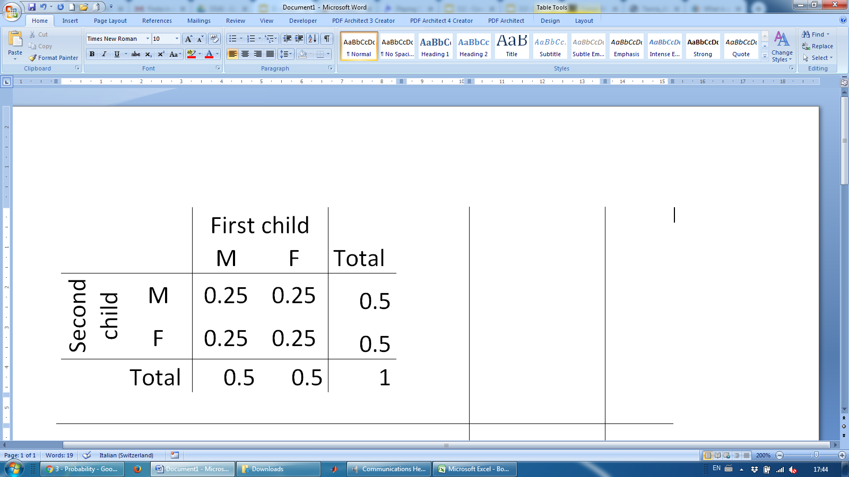
Joint probability mass function
If X and Y are discrete, we can define the joint probability mass function (pmf), which assigns a probability to each pair of values (x,y)
The probability distribution for the genders of two children can be described it by a two-way probability table

Slide 4
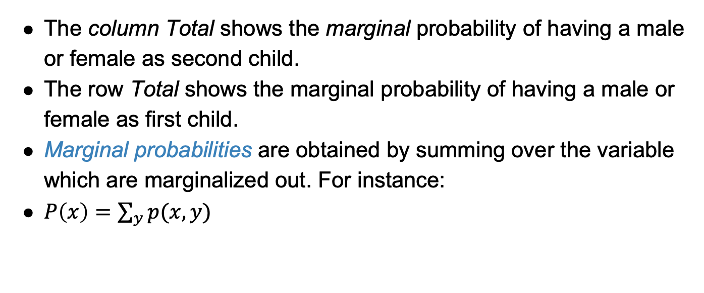
Marginal probabilities
The column Total shows the marginal probability of having a male or female as second child.
The row Total shows the marginal probability of having a male or female as first child.
Marginal probabilities are obtained by summing over the variable which are marginalized out. For instance:
$P\left(x\right)=\sum_{y}{p(x,y)}$

Slide 5
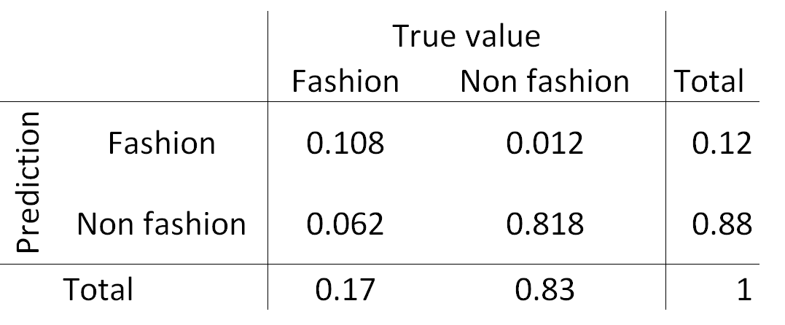
Practice
Consider the confusion matrix of a classifier.
What is the marginal probability that a photo is about fashion?

Slide 6
Practice
What is the joint probability that a photo is about fashion and the classifier predicts it correctly?

Slide 7
Independent random variables p(x,y) = p(x)p(y)
Each joint probability in the table can be obtained as the product of the corresponding marginal probabilities.
This is because the variables “sex of the first child” and “ sex of the second child” are independent.

Slide 8
Independent random variables
We consider a classifier trained to distinguish between fashion and non-fashion photos. The variables of interest are the true type of the photo and the prediction of the algorithm.
Are the two variables independent? NO
≠ 0.17・0.12
≠ 0.83・0.12
≠ 0.17・0.88
≠ 0.83・0.88

Slide 9
Conditional
Probability

Slide 10
Conditional probability
What is the probability that the classifier predict a photo correctly when the photo is about fashion?

Slide 11
Conditional probability
What is the probability that the classifier predict a photo correctly when the photo is about fashion?
We know the photo is fashion, so the probability of the event True value = Non fashion is now 0.

Slide 12
Conditional probability
What is the probability that the classifier predict a photo correctly when the photo is about fashion?
We know the photo is fashion, so the probability of the event True value = Non fashion is now 0.
0
0.635
=0.635
0.17
0
=0.365
0.365
0.17
0
=1
0.17

Slide 13
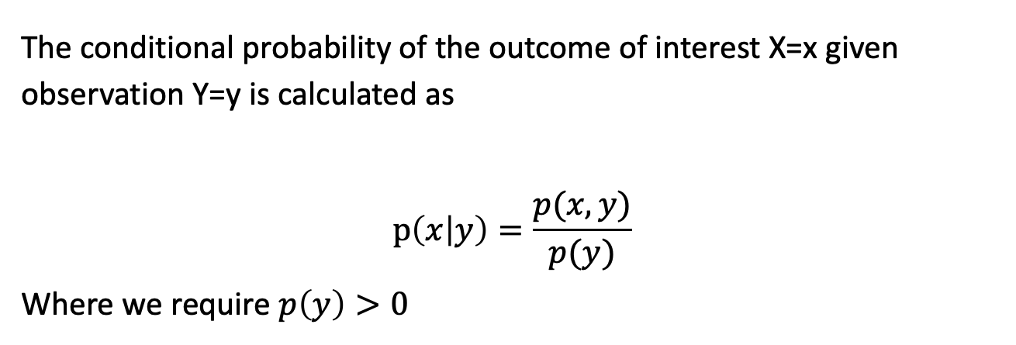
Conditional probability
The conditional probability of the outcome of interest X=x given observation Y=y is calculated as
$$p\left(x | y\right)=\frac{p(x,y)}{p(y)}$$
Where we require $p\left(y\right)>0$

Slide 14
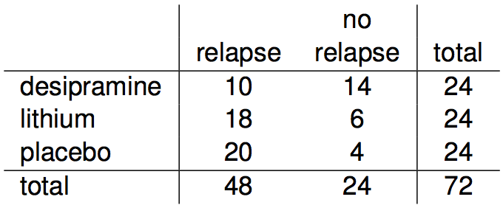
Conditional probability (cont.)
Assume to randomly sample a patient from the set of patients in the table below.
If we know that a patient received the antidepressant (desipramine), what is the probability that he/she relapsed?
P(relapse | desipramine) = 10 / 24 ~ 0.42

Slide 15
Conditional probability (cont.)
If we know that a patient relapsed, what is the probability that they received the antidepressant (desipramine)?
P(desipramine | relapse) = 10 / 48 ~ 0.21

Slide 16
Factorization and law of total probability

Slide 17
General multiplication rule
Earlier we saw that if two events are independent, their joint probability is simply the product of their probabilities. If the events are not believed to be independent, the joint probability is calculated slightly differently.

Slide 18
General multiplication rule
Earlier we saw that if two events are independent, their joint probability is simply the product of their probabilities. If the events are not believed to be independent, the joint probability is calculated slightly differently.
If A and B represent two outcomes or events, then P(A and B) = P(A | B) P(B) This is called factorization of P(A and B)
Note that this formula is simply the conditional probability formula, rearranged.

Slide 19
General multiplication rule
Earlier we saw that if two events are independent, their joint probability is simply the product of their probabilities. If the events are not believed to be independent, the joint probability is calculated slightly differently.
If A and B represent two outcomes or events, then P(A and B) = P(A | B) P(B) This is called factorization of P(A and B)
Note that this formula is simply the conditional probability formula, rearranged.
P(A and B) can also be factorized as P(B | A) P(A)

Slide 20
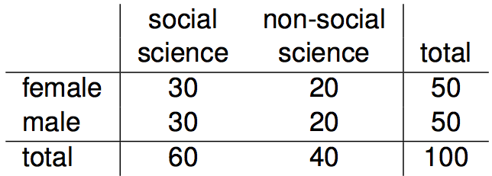
Independence and
conditional probabilities
Consider the following (hypothetical) distribution of gender and major of students in an introductory statistics class:

Slide 21
Independence and
conditional probabilities
Consider the following (hypothetical) distribution of gender and major of students in an introductory statistics class:
The probability that a randomly selected student is a social science major is

Slide 22
Independence and
conditional probabilities
Consider the following (hypothetical) distribution of gender and major of students in an introductory statistics class:
The probability that a randomly selected student is a social science major is
60 / 100 = 0.6.

Slide 23
Independence and
conditional probabilities
Consider the following (hypothetical) distribution of gender and major of students in an introductory statistics class:
The probability that a randomly selected student is a social science major is
60 / 100 = 0.6.
The probability that a randomly selected student is a social science major given that they are female is

Slide 24
Independence and
conditional probabilities
Consider the following (hypothetical) distribution of gender and major of students in an introductory statistics class:
The probability that a randomly selected student is a social science major is
60 / 100 = 0.6.
The probability that a randomly selected student is a social science major given that they are female is
30 / 50 = 0.6.

Slide 25
Independence and
conditional probabilities
Consider the following (hypothetical) distribution of gender and major of students in an introductory statistics class:
The probability that a randomly selected student is a social science major is
60 / 100 = 0.6.
The probability that a randomly selected student is a social science major given that they are female is
30 / 50 = 0.6.
Since P(SS | M) also equals 0.6, major of students in this class does not depend on their gender: P(SS | F) = P(SS).

Slide 26
Independence and
conditional probabilities (cont.)
Generically, if P(A | B) = P(A) then the events A and B are said to be independent.

Slide 27
Independence and
conditional probabilities (cont.)
Generically, if P(A | B) = P(A) then the events A and B are said to be independent.
Conceptually: Giving B doesn’t tell us anything about A.

Slide 28

Independence and
conditional probabilities (cont.)
Generically, if P(A | B) = P(A) then the events A and B are said to be independent.
Conceptually: Giving B doesn’t tell us anything about A.
Mathematically: We know that if events A and B are independent, P(A and B) = P(A) x P(B). Then,

Slide 29



General multiplication rule for more than 2 variables - example
S
Assume that half of the population of interest is used to protracted Sun exposures.
Only 90% among them uses solar Cream.
The risk of developing Melanoma, for people used to protracted solar exposure but using sun protection is 2.6%
What is the probability that a randomly selected person in the population is used to protracted solar exposure, uses solar cream and has developed skin cancer?
C
M

Slide 30
General multiplication rule for more than 2 variables - example
S
Assume that half of the population of interest is used to protracted Sun exposures.
Only 90% among them uses solar Cream.
The risk of developing Melanoma, for people used to protracted solar exposure but using sun protection is 2.6%
What is the probability that a randomly selected person in the population is used to protracted solar exposure, uses solar cream and has developed skin cancer?
C
M
Protracted sun exposure Cream Melanoma Joint probabilities
S C M
Yes
0.5
No
0.5
Yes
0.9
No
0.1
Yes
No
Yes
0.026
No
0.974
Yes
No
Yes
No
Yes
No
P(S=Yes ∩ C=Yes ∩ M= Yes) = 0.5 * 0.9 * 0.026 = 0.0117
Marginal probability of Protracted sun exposure
P(S = Yes)
Conditional probability of using cream when used to protracted sun exposure
P(C=Yes | S =Yes)
Conditional probability of melanoma when used to protracted sun exposure using cream
P(M=Yes | S =Yes ∩ C= Yes)
NOTE: This example also shows how tree diagrams can be useful to deal with conditional probabilities.

Slide 31
General multiplication rule for more than 2 variables - example
S
Assume that half of the population of interest is used to protracted Sun exposures.
Only 90% among them uses solar Cream.
The risk of developing Melanoma, for people used to protracted solar exposure but using sun protection is 2.6%
What is the probability that a randomly selected person in the population is used to protracted solar exposure, uses solar cream and has developed skin cancer?
GENERAL MULTIPLICATION RULE OR FACTORIZATION
P(S=Yes ∩ C=Yes ∩ M= Yes) = P(S=Yes) P(C=Yes | S =Yes) P(M=Yes | S =Yes ∩ C= Yes)
=P(S=Yes ∩ C=Yes)
C
M

Slide 32
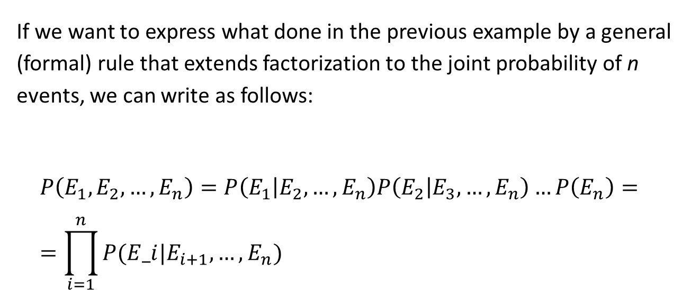
General multiplication rule for more than 2 variables
If we want to express what done in the previous example by a general (formal) rule that extends factorization to the joint probability of n events, we can write as follows:
$$P\left(E_{1}, E_{2},…, E_{n}\right)=P\left(E_{1} | E_{2},…, E_{n}\right)P\left(E_{2} | E_{3},…, E_{n}\right)…P\left(E_{n}\right)= \\ =\prod_{i=1}^{n}{P(E_i|E_{i+1}, …, E_{n})}$$

Slide 33
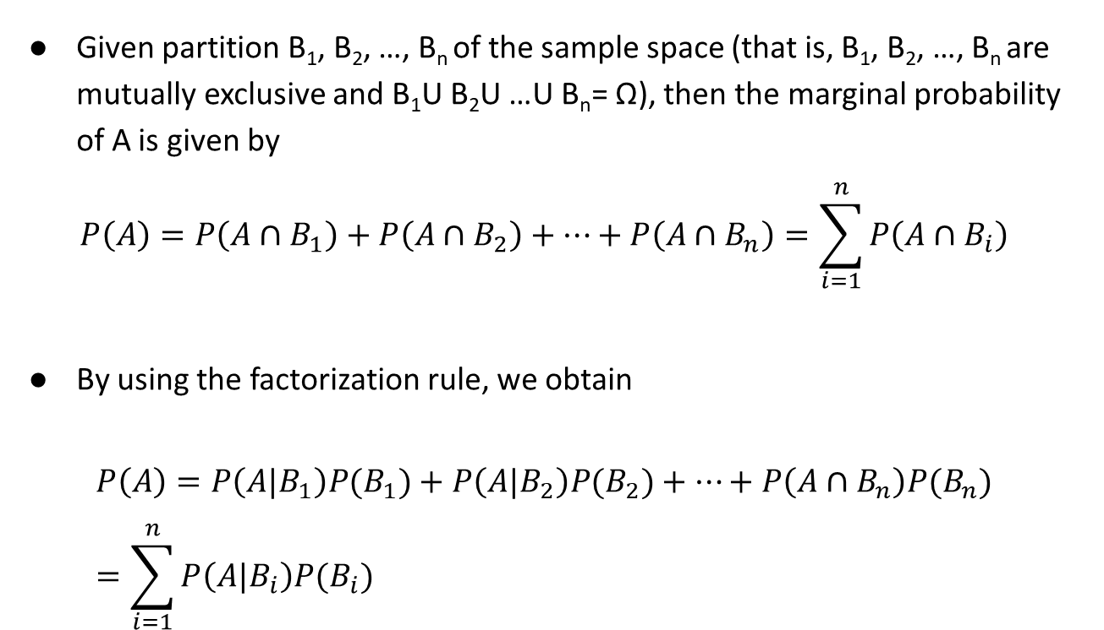
Law of total probability
Given partition B₁, B₂, …, B_{n} of the sample space (that is, B₁, B₂, …, B_{n} are mutually exclusive and B₁U B₂U …U B_{n}= Ω), then the marginal probability of A is given by
$$P\left(A\right)=P\left(A∩B_{1}\right)+P\left(A∩B_{2}\right)+…+P\left(A∩B_{n}\right)=\sum_{i=1}^{n}{P\left(A∩B_{i}\right)}$$
By using the factorization rule, we obtain
$$P\left(A\right)=P\left(A|B_{1}\right)P(B_{1})+P\left(A|B_{2}\right)P(B_{2})+…+P\left(A∩B_{n}\right)P(B_{n})=\sum_{i=1}^{n}{P\left(A|B_{i}\right)P(B_{i})}$$

