Slide 1
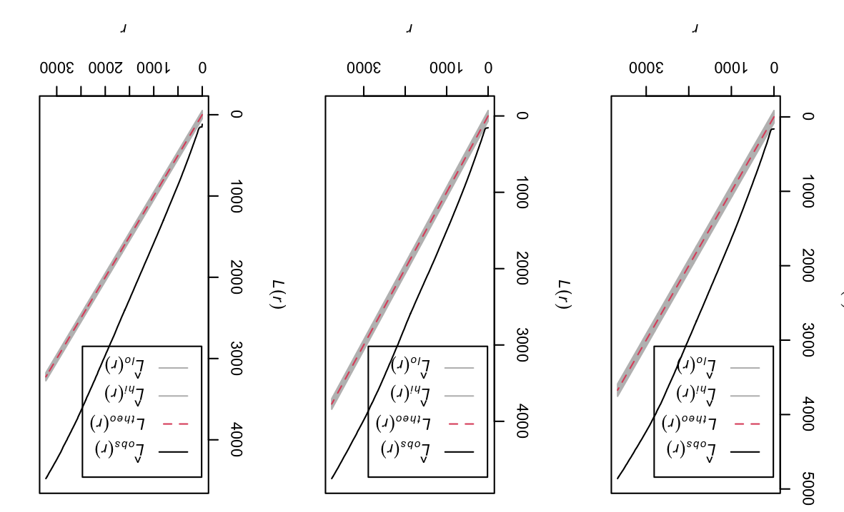
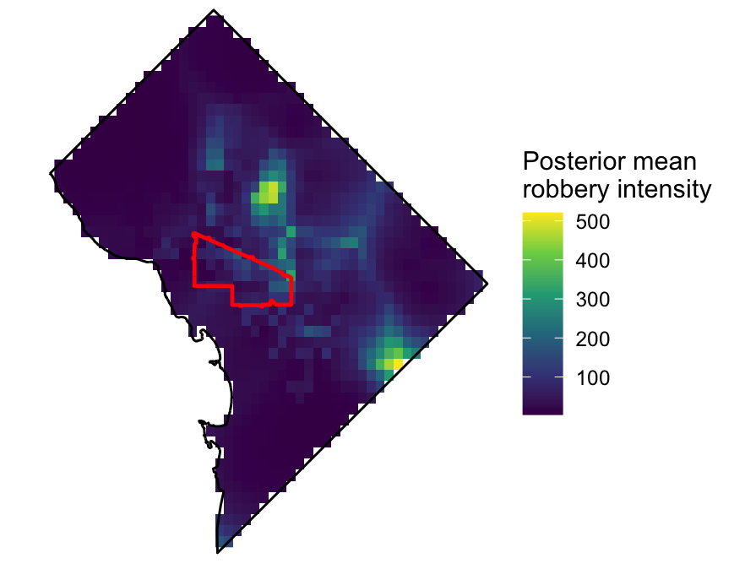
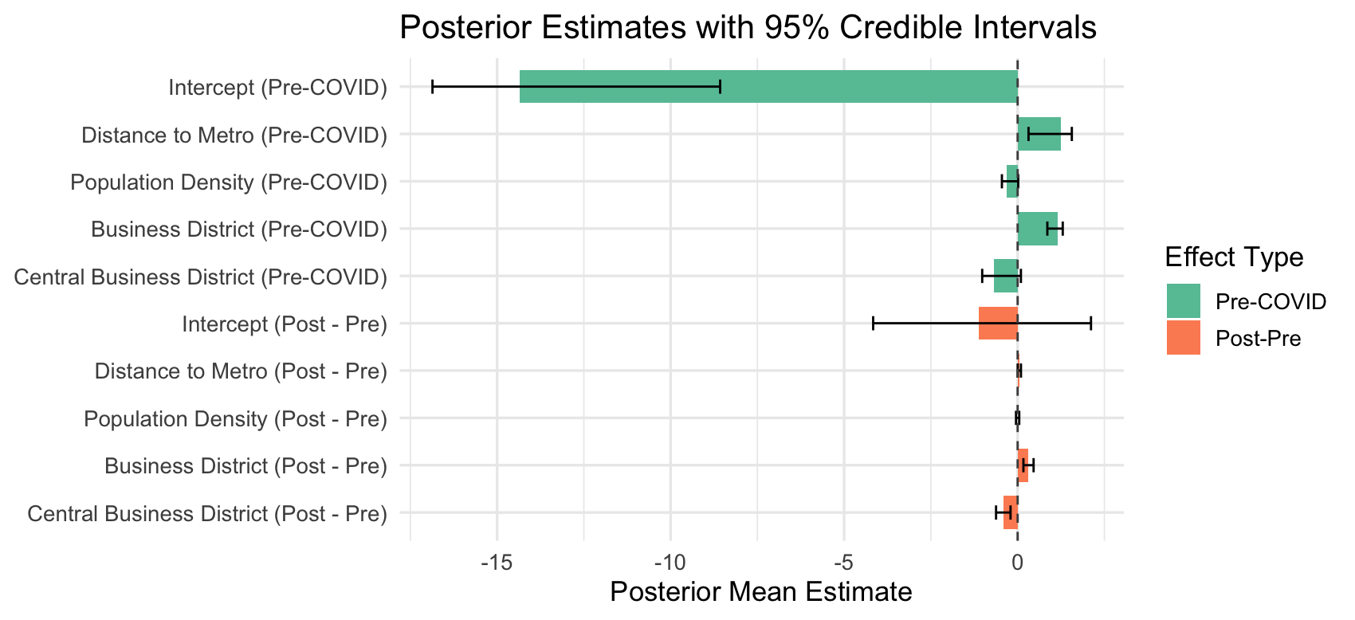
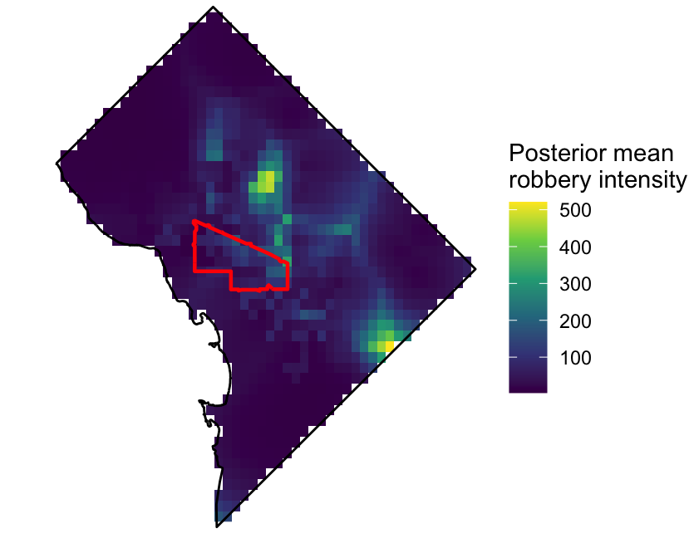
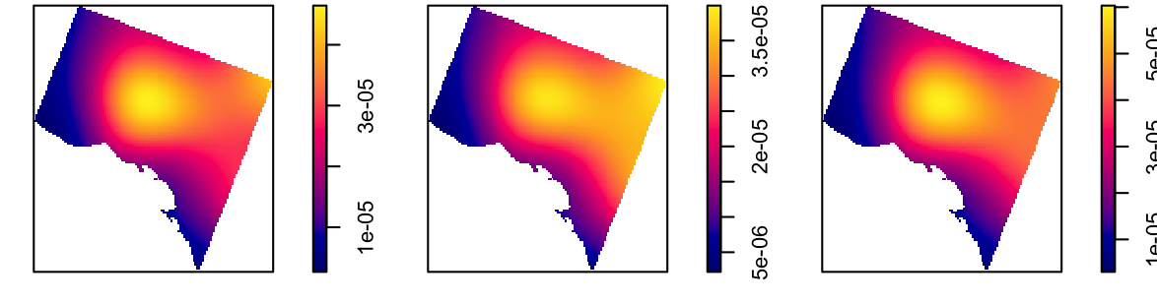
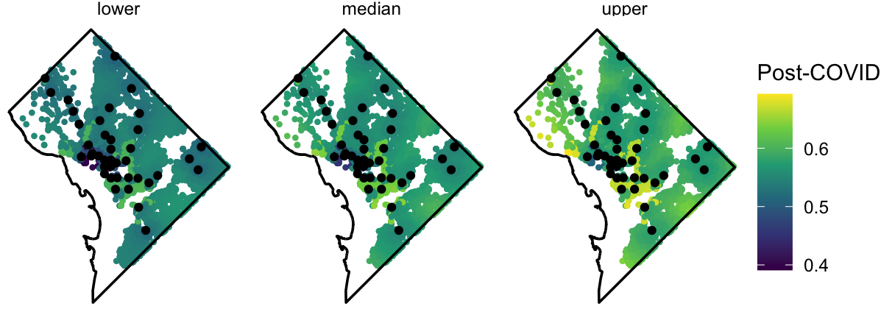
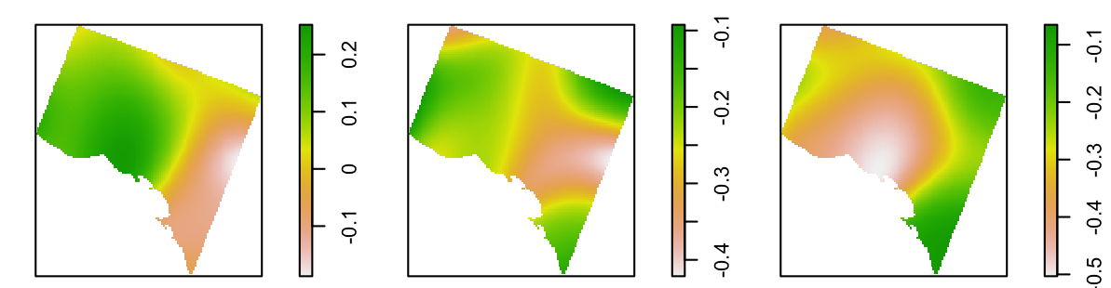
Spatial shifts in robbery risk: covid-19, business districts, and transit in Washington, D.C.
Gretchen Corcoran
INTRODUCTION
METHODOLOGY
CONCLUSIONS
The COVID-19 pandemic robbery rates declined overall and exhibited significant spatial shifts, consistent with Routine Activity theory and Opportunity theory [4]. As life returned to normal post-Covid, it is unclear if robbery patterns return to their baseline pre-pandemic levels.
Washington, D.C. exhibits unique urban patterns with a 79% increase in daytime populations, centered around offices and transit [5]. Understanding how spatial trends in robbery risk may have shifted post-pandemic provides insight into ongoing effects of COVID-19 on relationships between people and the urban environment.
This study uses a two-stage LGCP model to examine whether spatial intensity of robbery changed between pre-COVID (2018-2019) and post-COVID (2022-2024). Distance to metro stations, population density, and business districts were included to assess the nature of any spatial shifts. In robbery patterns.
Data: Robbery incidents in Washington, DC (2018-2020), split into pre-Covid, during Covid, and post-Covid. Covariates include distance to metro, population density, and business districts (central vs. other).
Exploratory analyses included L-functions to plot departures from CSR, kernel density maps, and log-relative risk mapping between time periods.
Fit a two-stage Bayesian LGCP model with pre-Covid effects and post-Covid changes in covariates using 3 MCMC chains with 70,000 iterations.
While robbery overall shows no significant differences between pre- and post-Covid, the intensity exhibited a significant spatial shift.
Robberies shifted toward neighborhoods post-Covid, particularly NE DC and parts of SE, and away from the downtown core. However, business districts outside of the downtown core saw increased robbery intensity. Robberies shifted farther from metro stations, likely reflecting a continued decrease in ridership [1].
These spatial shifts in robbery patterns reflect lasting post-Covid changes in how people live, work, and navigate in urban space.
RESULTS
CSR: Robberies exhibited significantly more clustering than expected across all time periods.
Density Maps: Pre-Covid intensity highest in NW D.C. and downtown (Central Bus. Dist.) During Covid, intensity expanded east into residential areas. Post-Covid, intensity shifted into NE D.C., with less in downtown.
Post-Covid Changes in Robbery Intensity
Covariate | Posterior Mean | 95% CI | Interpretation
Intercept | -1.11 | (-4.16, 2.11) | No overall change
Distance to Metro | 0.04 | (0.0013, 0.095) | ~5% increase in intensity per km
Population Density | -0.00028 | (-0.047, 0.046) | No change
Business District | 0.31 | (0.17, 0.46) | ~36% increase in intensity
Central Business Dist. (Downtown) | -0.41 | (-0.62, -0.20) | ~34% decrease in intensity
Deviations from CSR Across Time
LGCP Results: No significant post-Covid effect. Increased intensity farther from metro stations post-Covid. Increased intensity in business districts overall, but lower in downtown (Central Bus. Dist.)
Estimated Robbery Intensity
Posterior Probability & 95% CI
Limitations
Density Pre, During, and Post-Covid
This model didn’t account for variation across individual metro stations, which may influence robbery risk due to factors such as ridership volume, time of day, station design, and train frequency[2]. Additional covariates such as SES, proximity to parks and other locations weren’t modeled. A notable area of consistently low predicted risk corresponds to Rock Creek Park, a large uninhabited greenspace.
Only one two-stage LGCP model was run due to time and computation limits, limiting comparison between all three time periods. Future work should consider examining other types of crime to further assess similar spatial and temporal shifts.
Pre-Covid
Covid
Post Covid
Posterior Robbery Probability Post-Covid
REFERENCES
Log-Relative Risk
[1] Federal Transit Administration. (2024, August). Effects of the COVID-19 pandemic on transit ridership and accessibility (FTA Report No. 0268). U.S. Department of Transportation. https://www.transit.dot.gov/sites/fta.dot.gov/files/2024-08/FTA-Report-0268-Effects-of-the-COVID-19-Pandemic-on-Transit-Ridership-and-Accessibility.pdf
[2] Irvin-Erickson, Y., La Vigne, N. A Spatio-temporal Analysis of Crime at Washington, DC Metro Rail: Stations’ Crime-generating and Crime-attracting Characteristics as Transportation Nodes and Places. Crime Sci 4, 14 (2015). https://doi.org/10.1186/s40163-015-0026-5
[3] Data retrieved from Open Data DC catalog (https://opendata.dc.gov)
[4] Hou M, Zeng Z, Hu X, Hu J. Investigating the impact of the COVID-19 pandemic on crime incidents number in different cities. Journal of Safety Science and Resilience. 2022 Dec;3(4):340–52. doi: 10.1016/j.jnlssr.2021.10.008. Epub 2022 Feb 17. PMCID: PMC8849845.
[5] Laughlin L., Mateyka P. & Burd C. 2015. Characteristics of daytime urban commuters for 20 U.S. cities: gender, work and family. https://www.census.gov/content/dam/Census/library/working-papers/2015/demo/2015- Laughlin-01-Abstract.pdf, retrieved on Sunday, May 4, 2025.
CONTACT INFORMATION
Gretchen Corcoran M.S. Candidate, Department of Statistics gcorcora@umn.edu 240.778.3567
Pre v. Covid
Pre v. Post
Covid v. Post

