Slide 1

Windows Azure
Miguel Garnique
Jesús Peñaranda H.

Slide 2
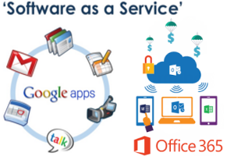
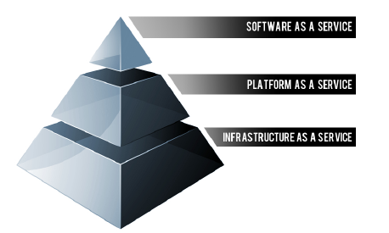

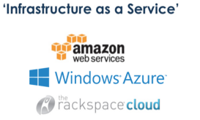
Tipos de Nube

Slide 3
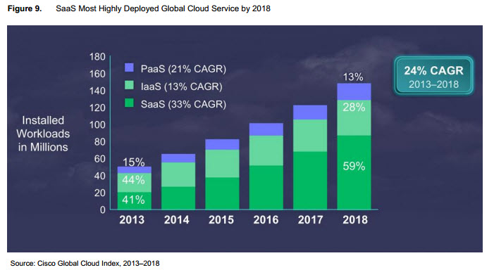
El crecimiento de la Nube
Notes:
Tarifa de crecimiento media durante varios años

Slide 4
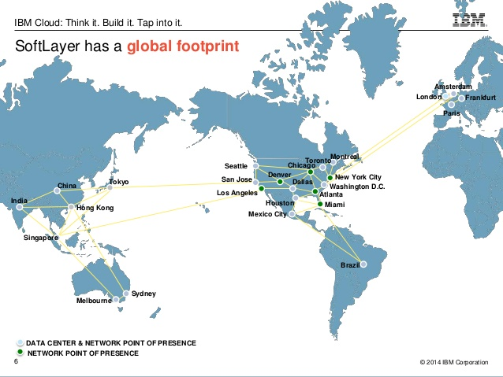
Centros de Datos Alrededor del Mundo

Slide 5
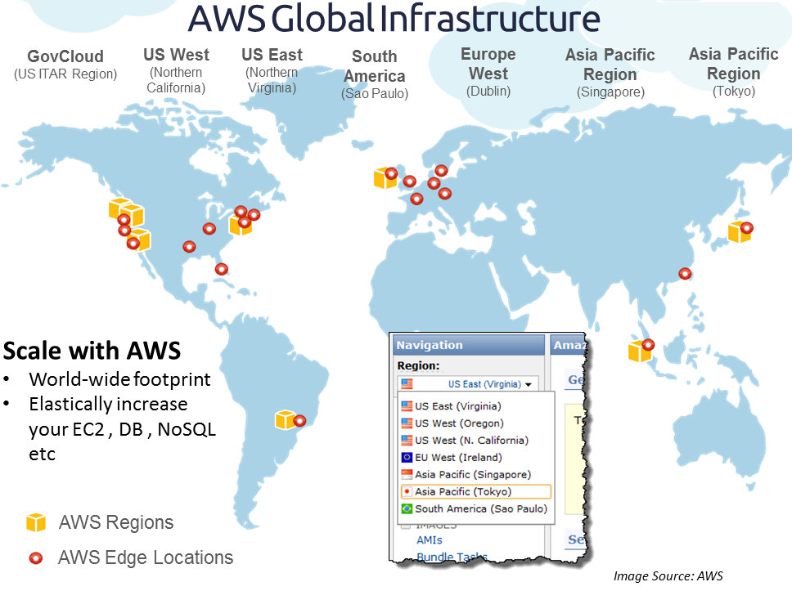
Centros de Datos Alrededor del Mundo

Slide 6
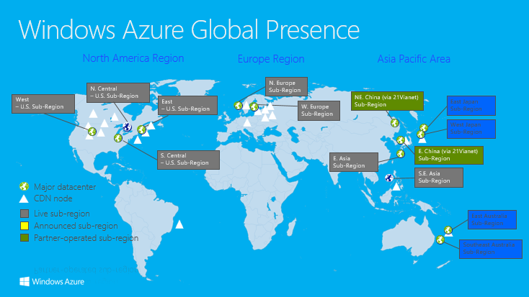
Centros de Datos Alrededor del Mundo
Notes:
What is a CDN?
A CDN is essentially a network of geographically dispersed servers. Each CDN node (also called Edge Servers) caches the static content of a site like the images, CSS/JS files and other structural components. The majority of an end-user's page load time is spent on retrieving this content, and so it makes sense to provide these "building blocks" of a site in as many server nodes as possible, distributed throughout the world.
When a user requests your site, the node closest in proximity to user will deliver the static content, ensuring the shortest distance for the data to travel (reduced latency), therefore providing the fastest site experience.

Slide 7
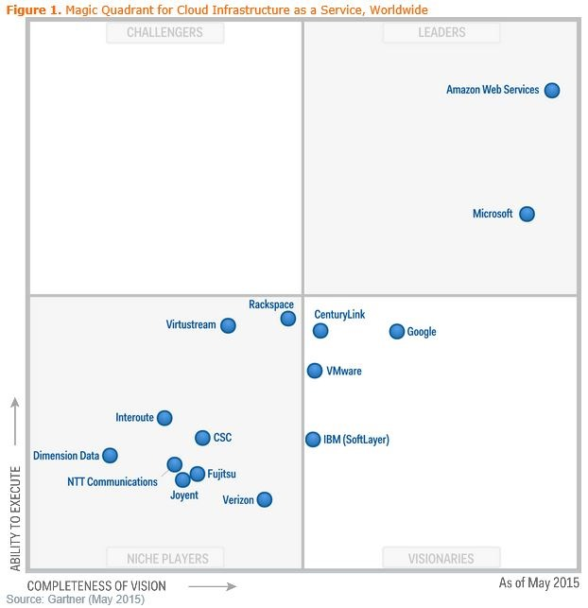
Los lideres de la Nube
Notes:
Leaders execute well against their current vision and are well positioned for tomorrow.
Visionaries understand where the market is going or have a vision for changing market rules, but do not yet execute well.
Niche Players focus successfully on a small segment, or are unfocused and do not out-innovate or outperform others.
Challengers execute well today or may dominate a large segment, but do not demonstrate an understanding of market direction.

Slide 8
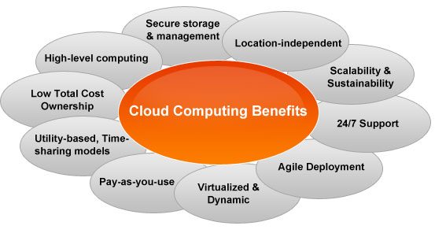
Ventajas de la Nube

Slide 9
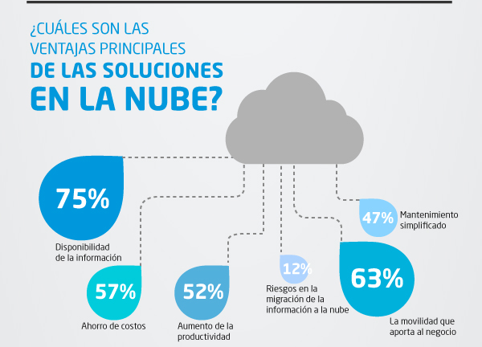
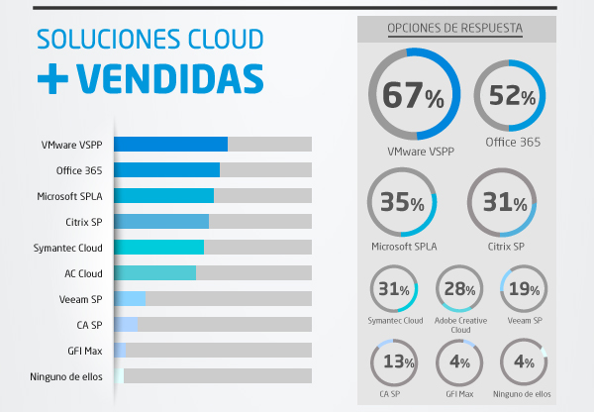
La Nube en el Perú
“El 40% de empresas en el Perú trabajan con alguna tecnología en la nube”
Diego Pantoja Navajas, CEO y visionario LogFire, mayo del 2015
“La nube en todas sus manifestaciones será un habilitador inevitable, con los negocios y TI buscando caminos para apalancar y dominar la nube lo mejor que puedan”
IDC Consulting
Fuente: Licencias On Line (2014)

Slide 10
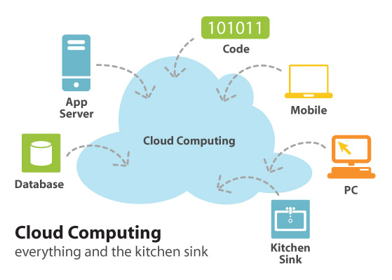
Qué soluciones ofrece la Nube?

Slide 11
CASO DEMOSTRATIVO
http://tallerprog.azurewebsites.net/login.php

Slide 12
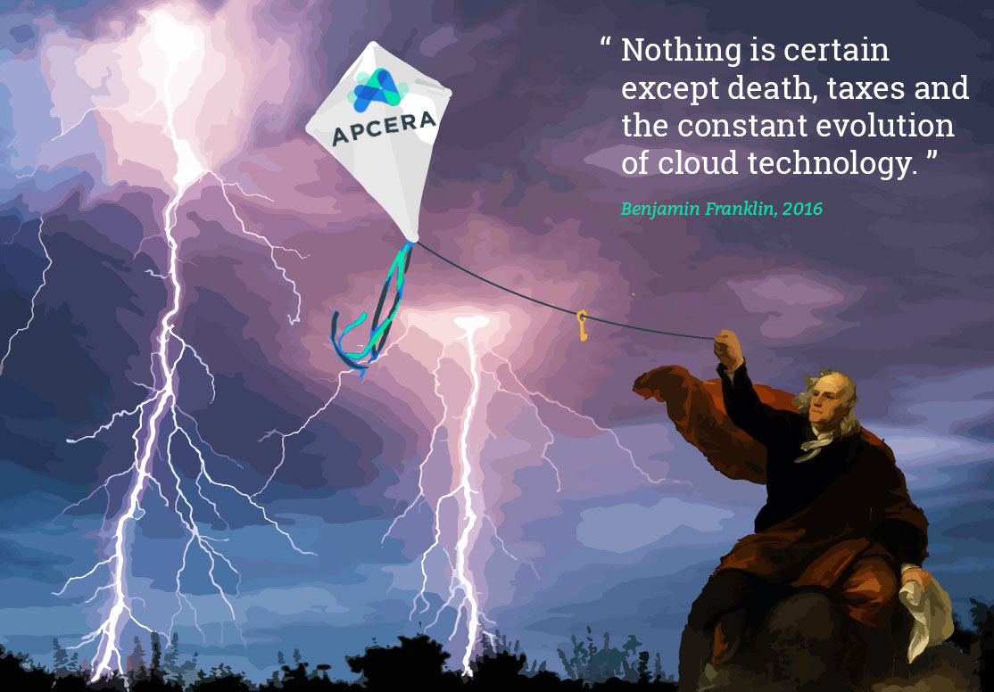
En Conclusión

