Slide 1
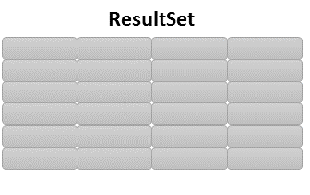
Service
List<DTO>
ó
List<Map<String,?>>
idCurso
BD

Slide 2
while( rs.next() ){
}

