Slide 1


Learned Apodization Fusion for Robust Ultrasound Beamforming Near Array Boundaries
Guillermo Cosarinsky¹, Mario Muñoz¹, Adrián Rubio¹, Laura Monelleo¹, Jorge F. Cruza¹
¹Ultrasonic and Nuclear Technology Group (GTUN), Institute for Physical and Information Technologies (ITEFI), Spanish National Research Council (CSIC), c/Serrano 144, 28006 Madrid, Spain
Corresponding author email: g.cosarinsky@csic.es

Slide 2
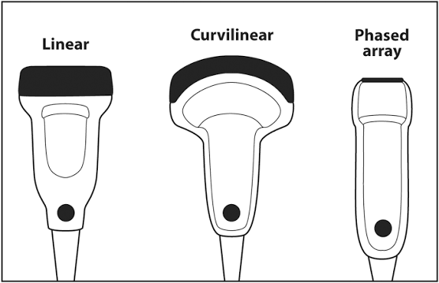
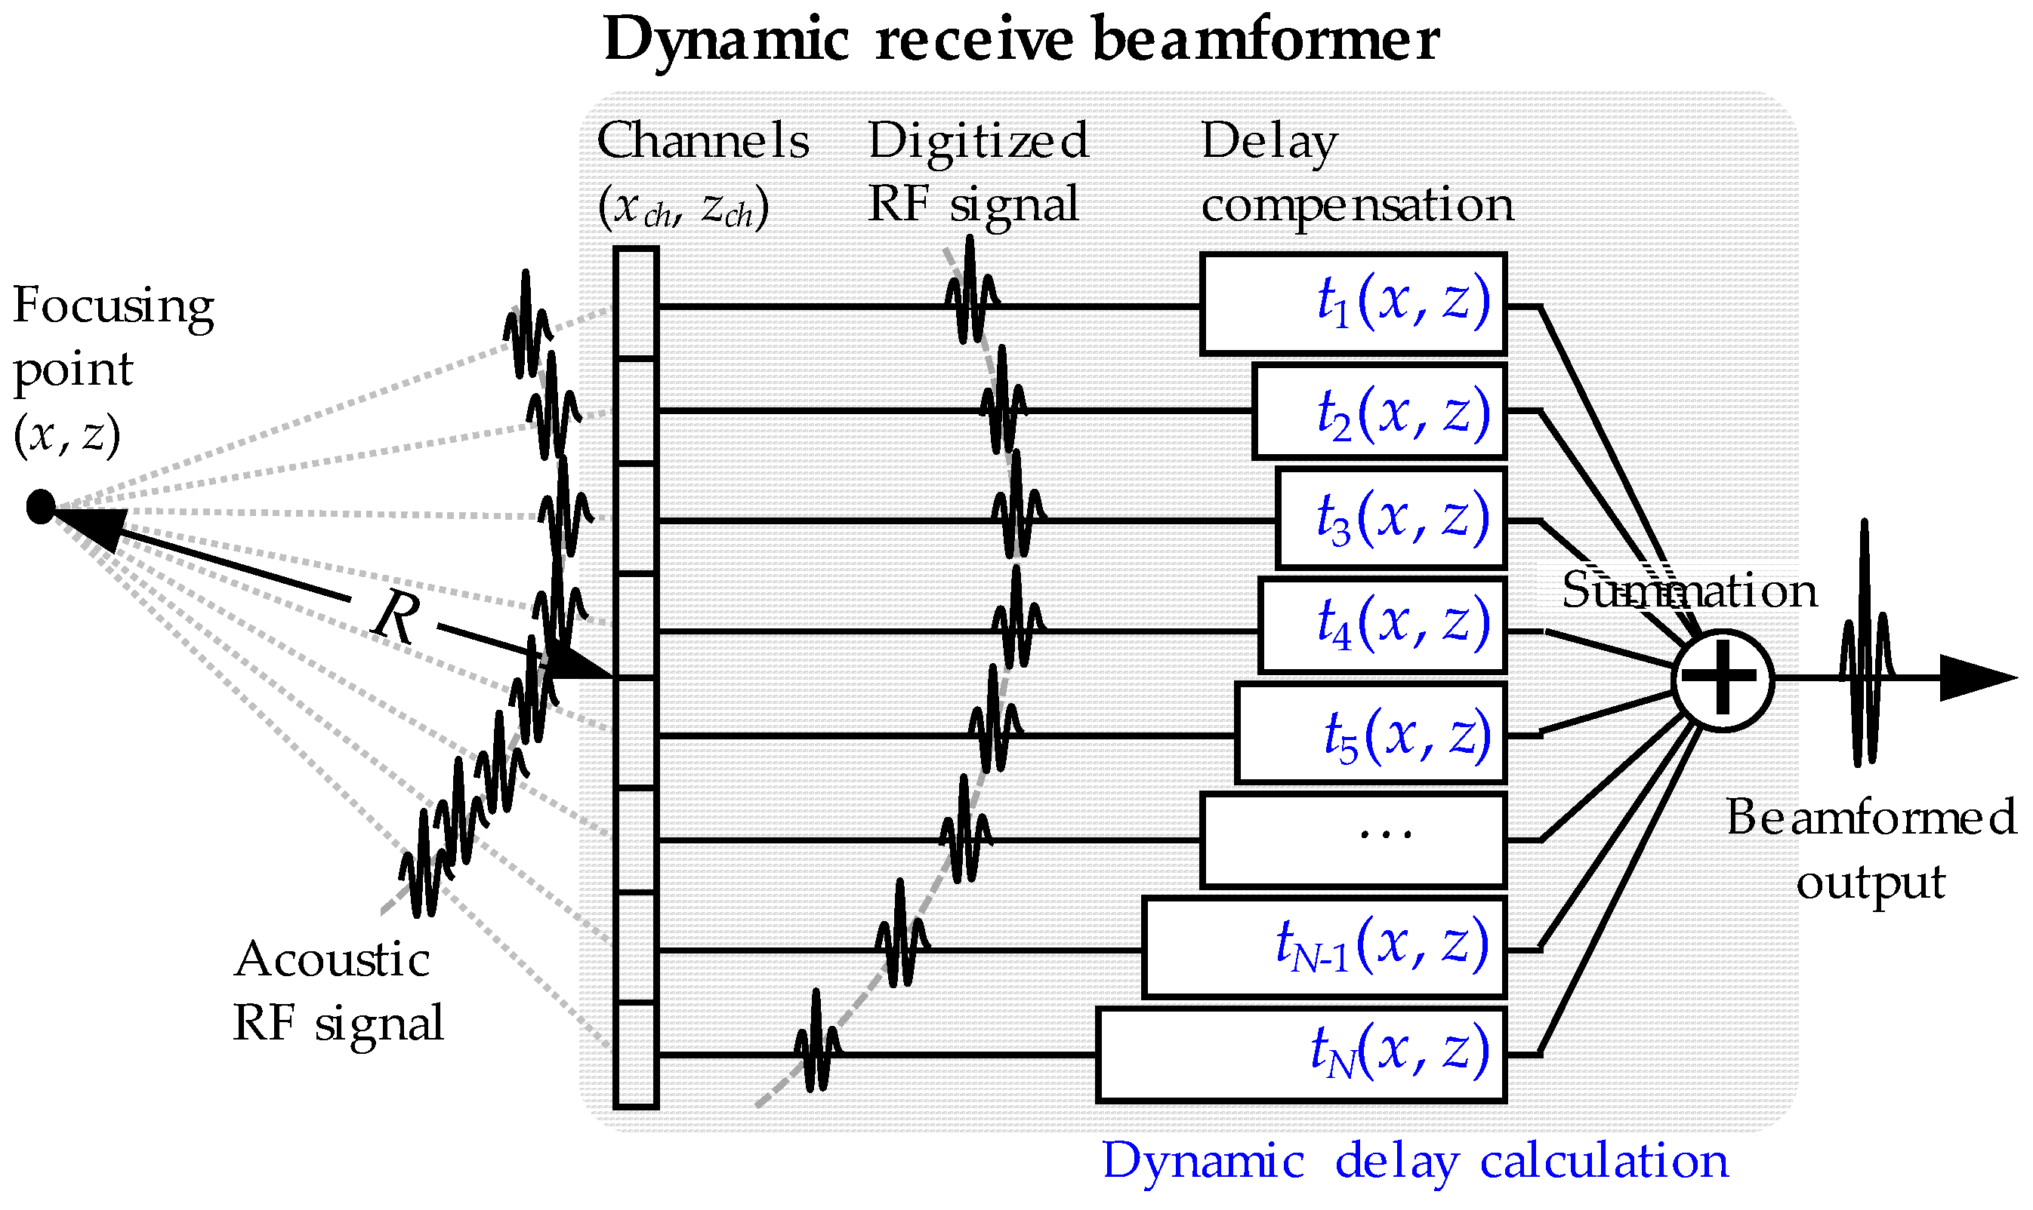

Receive beamforming and apodization
Delayed signals from each array element j
Apodization function
Kim et al., Electronics 8, 242 (2019). doi:10.3390/electronics8020242
Notes:
Source: Kim, P.; Kang, J.; Song, T.-K. A Pseudo-Dynamic Delay Calculation Using Optimal Zone Segmentation for Ultra-Compact Ultrasound Imaging Systems. Electronics 2019, 8, 242. https://doi.org/10.3390/electronics8020242

Slide 3
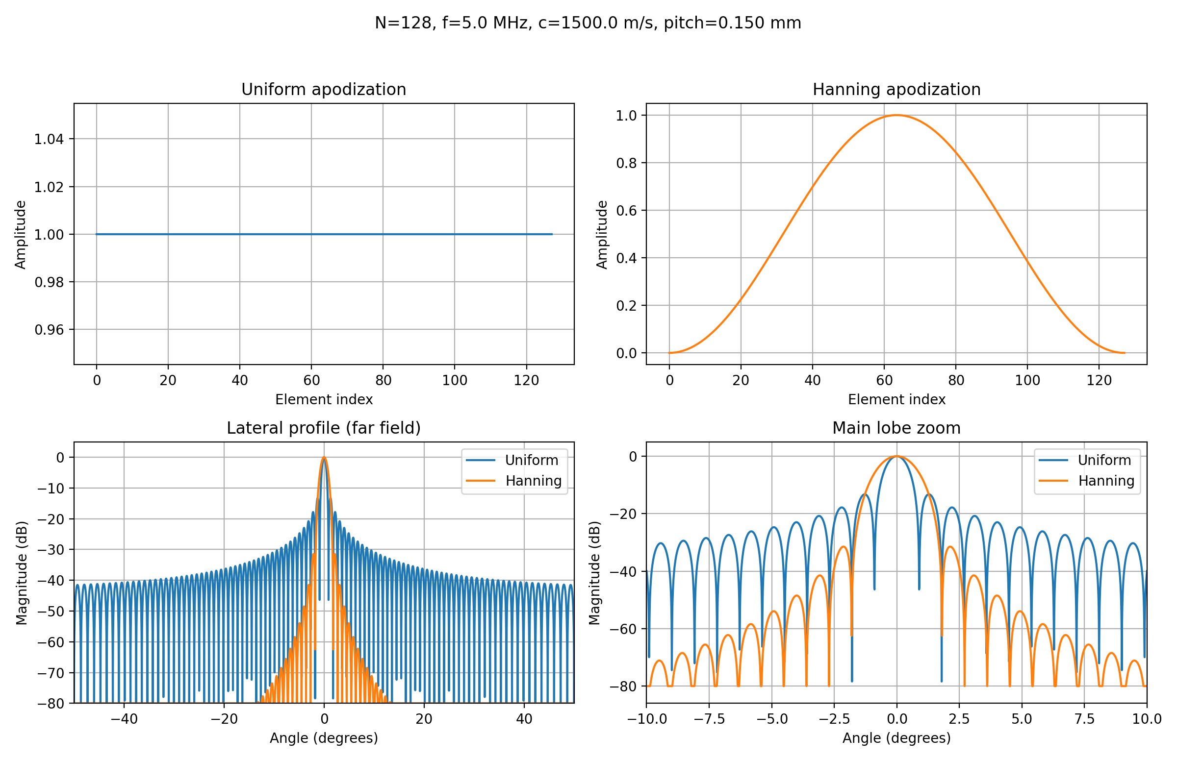

Apodization controls resolution and sidelobes
Delayed signals from each array element j
Apodization function
Resolution and sidelobe trade-off

Slide 4

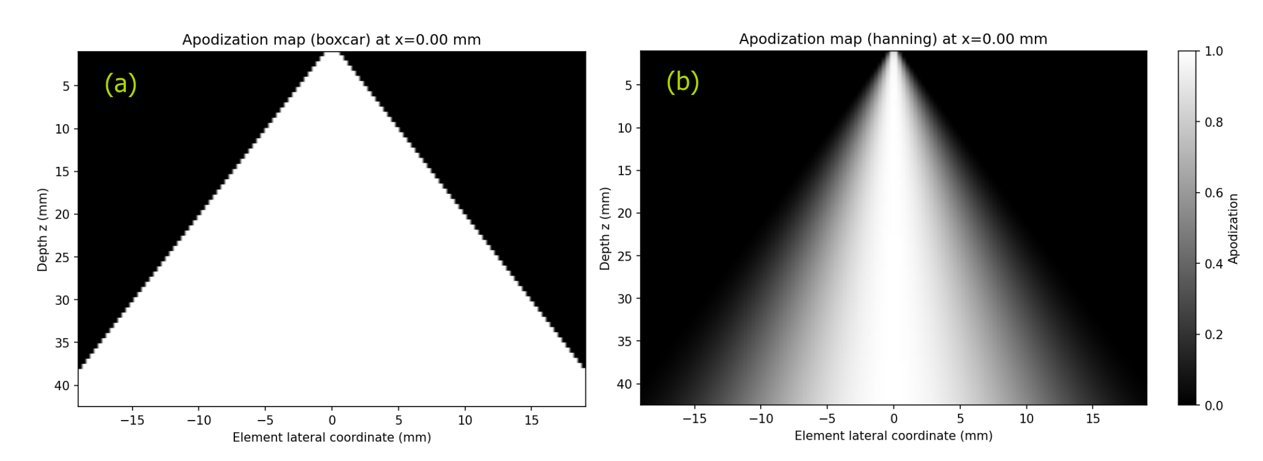

Dynamic receive aperture
F-number controls the active subaperture at each focal point

Slide 5
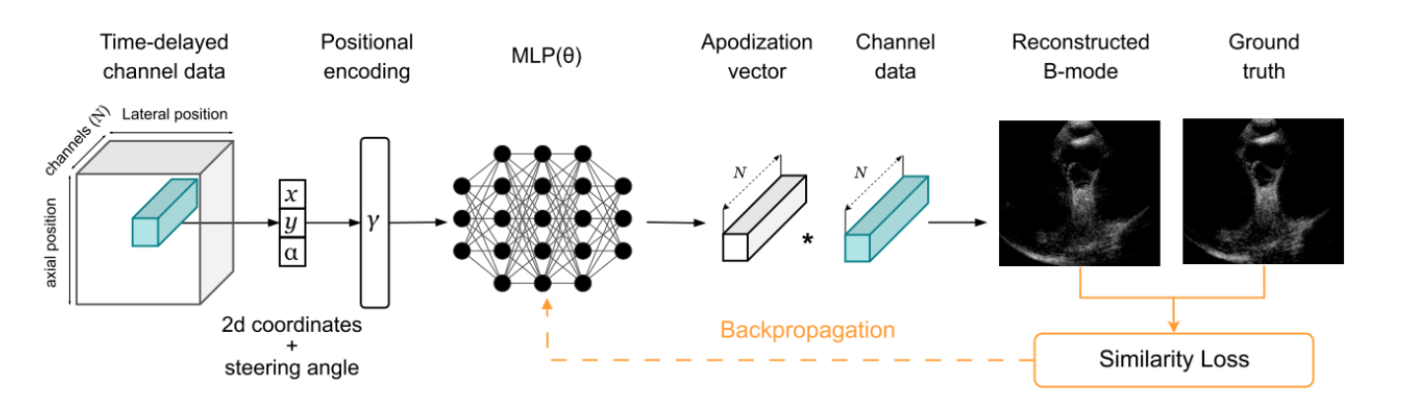
Learning continuous apodization weights
Delaunay et al., IEEE IUS 2025. doi:10.1109/IUS62464.2025.11201299
Notes:
Source: R. Delaunay, C. Hennersperger, and S. Wörz, Learning Continuous Receive Apodization Weights via Implicit Neural Representation for Ultrafast ICE Ultrasound Imaging. IEEE IUS 2025. doi:10.1109/IUS62464.2025.11201299

Slide 6
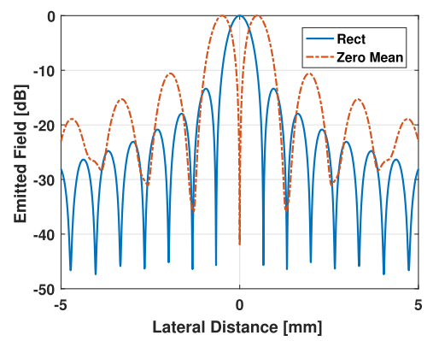
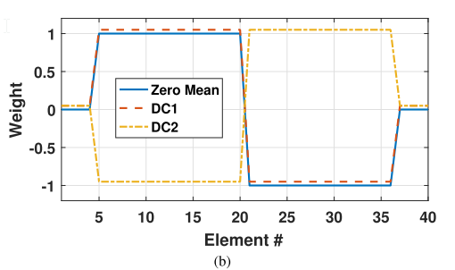
Null Subtraction Imaging (NSI)
Agarwal et al. (2019): complementary receive apodizations
Apodization inside sub-aperture
Null
Agarwal et al., IEEE TUFFC 66(1), 5–17 (2019). doi:10.1109/TUFFC.2018.2876285
Notes:
Source: A. Agarwal, J. Reeg, A. S. Podkowa, and M. L. Oelze, Improving Spatial Resolution Using Incoherent Subtraction of Receive Beams Having Different Apodizations. IEEE TUFFC 66(1), 5–17, 2019. doi:10.1109/TUFFC.2018.2876285

Slide 7
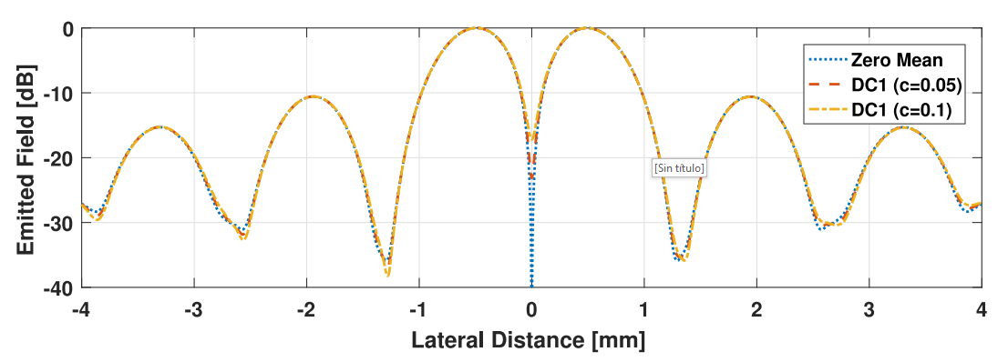
Null Subtraction Imaging (NSI)
Agarwal et al. (2019): complementary receive apodizations
Apodization inside sub-aperture
Beam profile / PSF
Agarwal et al., IEEE TUFFC 66(1), 5–17 (2019). doi:10.1109/TUFFC.2018.2876285
Notes:
Source: A. Agarwal, J. Reeg, A. S. Podkowa, and M. L. Oelze, Improving Spatial Resolution Using Incoherent Subtraction of Receive Beams Having Different Apodizations. IEEE TUFFC 66(1), 5–17, 2019. doi:10.1109/TUFFC.2018.2876285

Slide 8
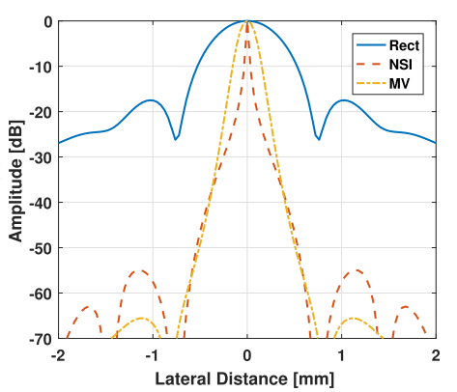
Null Subtraction Imaging (NSI)
Agarwal et al. (2019): complementary receive apodizations
Apodization inside sub-aperture
Beam profile / PSF
Agarwal et al., IEEE TUFFC 66(1), 5–17 (2019). doi:10.1109/TUFFC.2018.2876285
Notes:
Source: A. Agarwal, J. Reeg, A. S. Podkowa, and M. L. Oelze, Improving Spatial Resolution Using Incoherent Subtraction of Receive Beams Having Different Apodizations. IEEE TUFFC 66(1), 5–17, 2019. doi:10.1109/TUFFC.2018.2876285

Slide 9
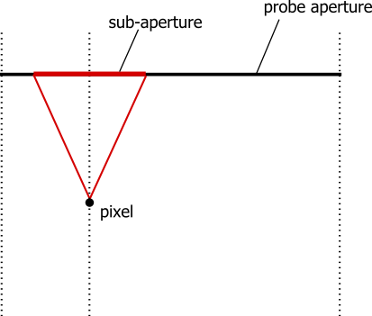
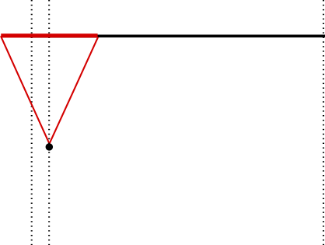
A problem: sub-aperture reduction close to array edges
Aperture edges

Slide 10
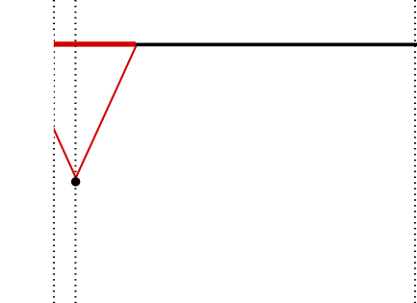
A problem: sub-aperture reduction close to array edges

Slide 11
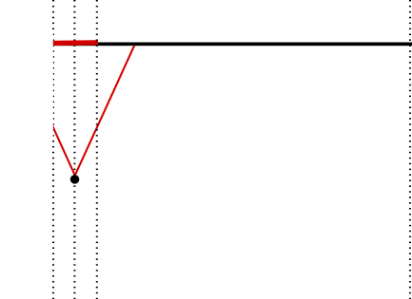
Aperture clipping near array boundaries
Symmetric clipping preserves the NSI null

Slide 12

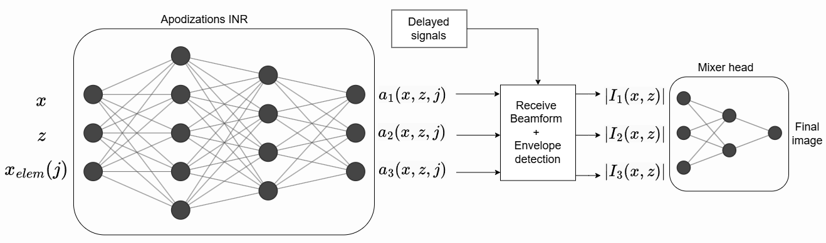
Learned apodization fusion architecture
|x−x_f| / z
|x| / z
z
(x−x_f)x / z²
Evaluated model
run 20260520_151111
[4 features, 16, 8, 4, 2 apodizations]
[2 images, 2, 1 final image]
Notes:
Architecture and parameters correspond to training run 20260520_151111: four physical features, hidden layers 16-8-4, two apodization channels, tanh apodization output, hard boxcar F-number 0.5.

Slide 13
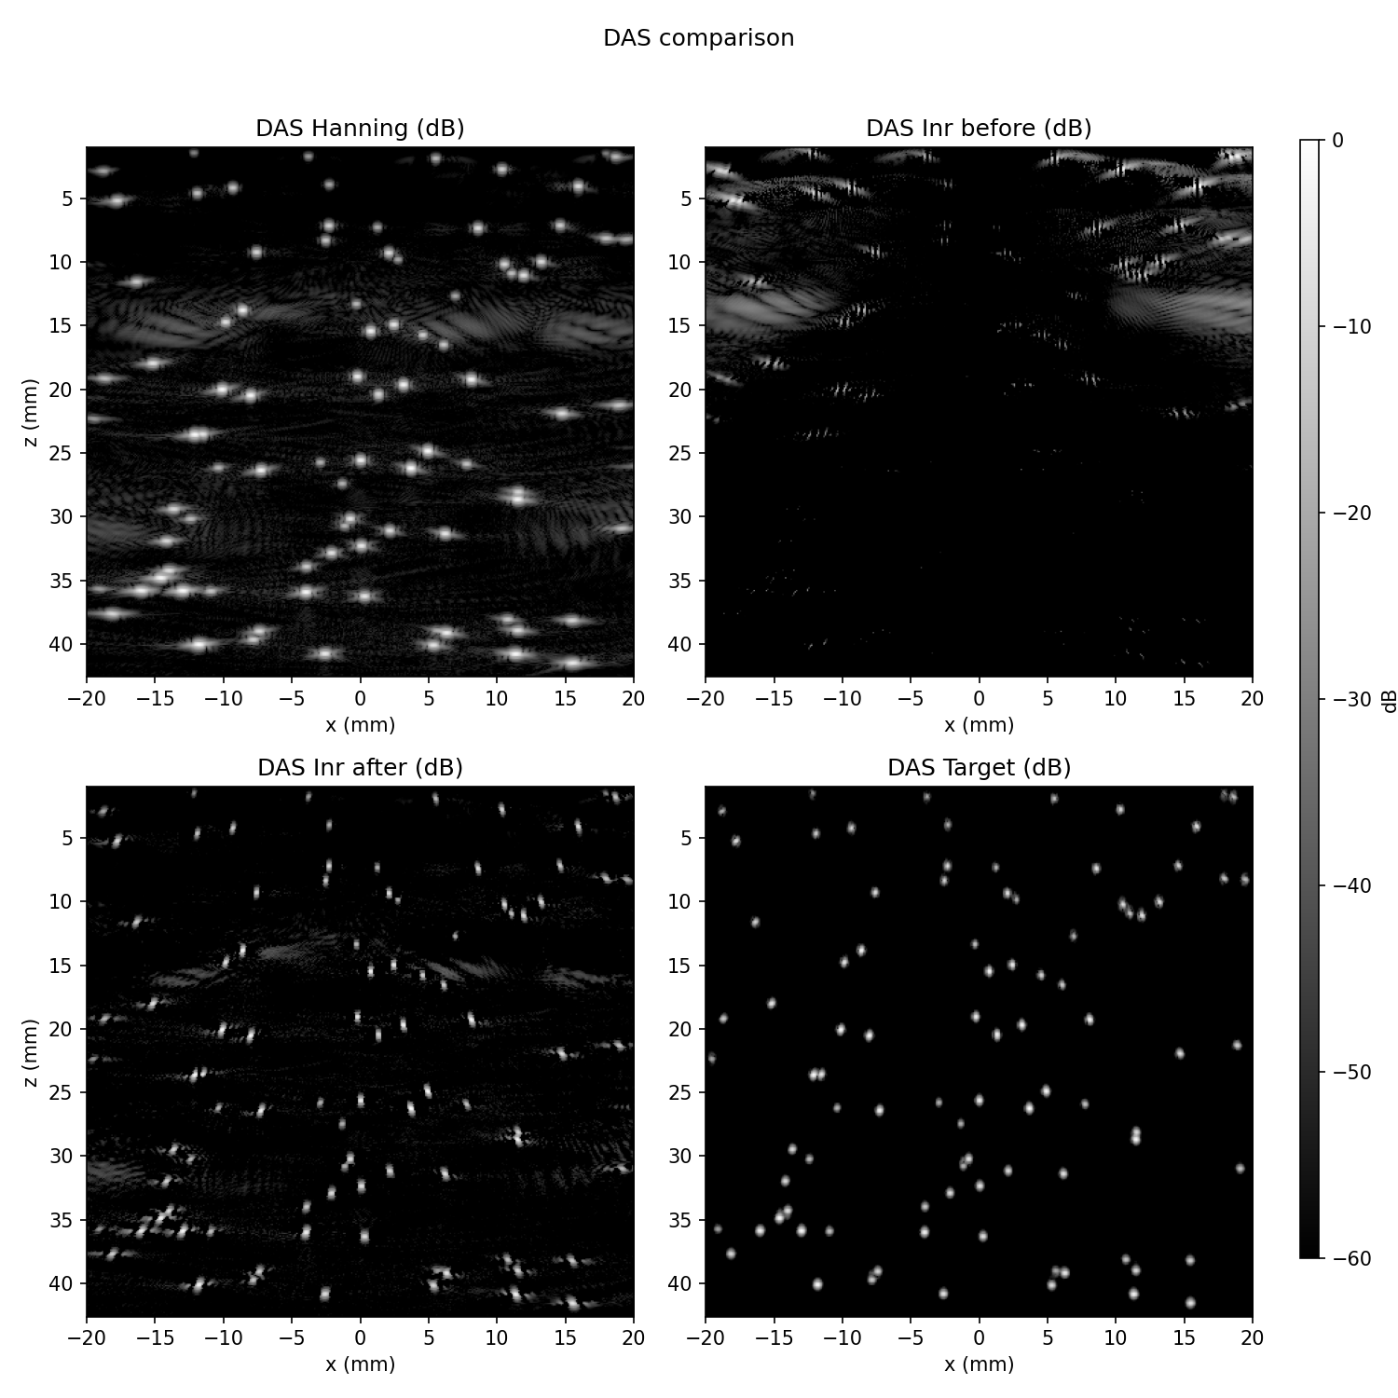
Synthetic training target and loss
Plane-wave simulations generated with PyMUST
Target: |I_DAS| multiplied by Gaussian masks centred on the reflectors
Loss: reflector-weighted MAE in linear amplitude
The objective does not directly optimise FWHM, sidelobes, CNR or gCNR
Notes:
PyMUST: https://www.biomecardio.com/MUST/index.html. The target and loss emphasize reflector recovery and background suppression; they do not directly optimize FWHM, sidelobes, CNR or gCNR.

Slide 14
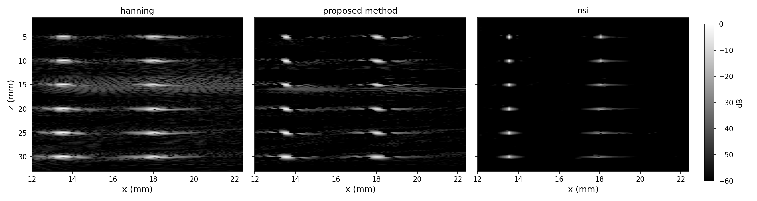
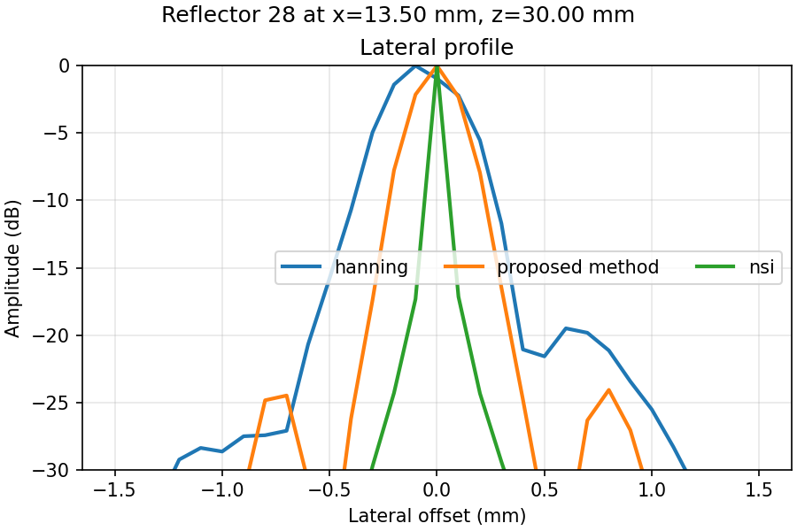
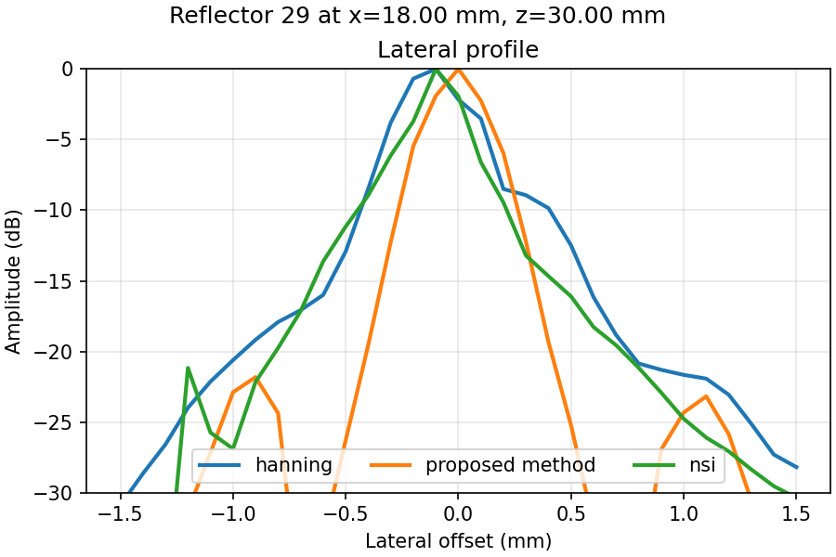
Numerical phantom: lateral resolution
array boundary
At this edge reflector, the proposed profile is narrower than NSI

Slide 15
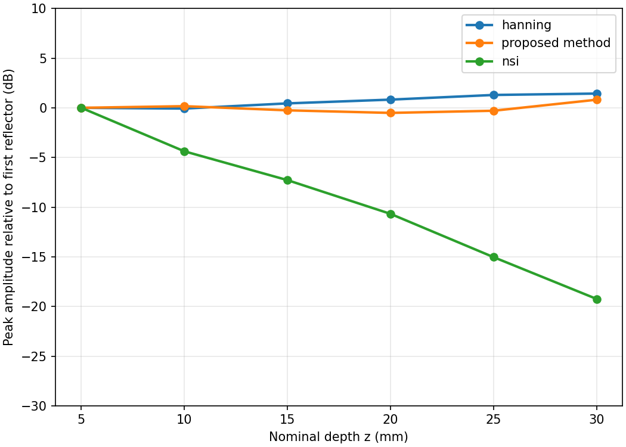
Numerical phantom: edge amplitude stability
array boundary
Without subaperture normalisation, NSI peak amplitude decreases with depth near the boundary
Notes:
Interpret amplitude cautiously: the evaluated NSI configuration uses normalize_by_n_subap: false. Peak-normalized profiles should be used for resolution comparisons.

Slide 16
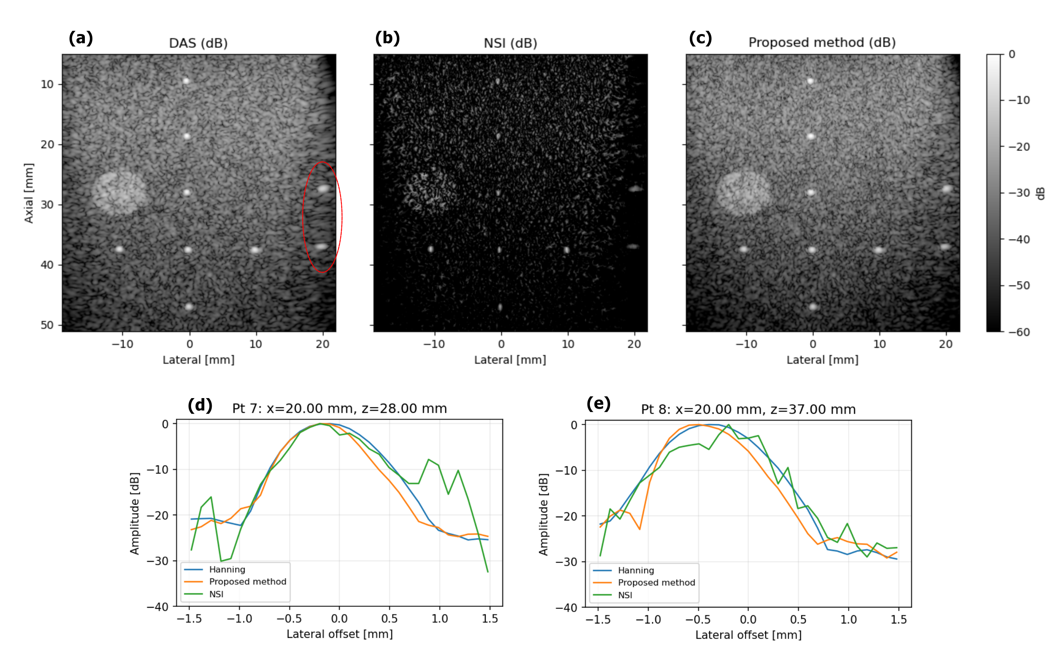
PICMUS phantom: edge profiles
Image appearance remains close to DAS
Selected edge profiles show modest narrowing

Slide 17
Conclusions and next evaluation
Two learned receive apodizations and pixel-wise fusion produce DAS-like images.
NSI remains sharper overall in the numerical phantom.
Near array boundaries, learned fusion preserves peak amplitude better in the current non-normalised comparison.
Next evaluation: report peak-normalised FWHM, sidelobes and CNR or gCNR separately for interior and boundary reflectors.

Slide 18
Questions
Learned fusion mitigates NSI amplitude loss near array boundaries, but it does not yet match NSI resolution overall.
g.cosarinsky@csic.es

Slide 19
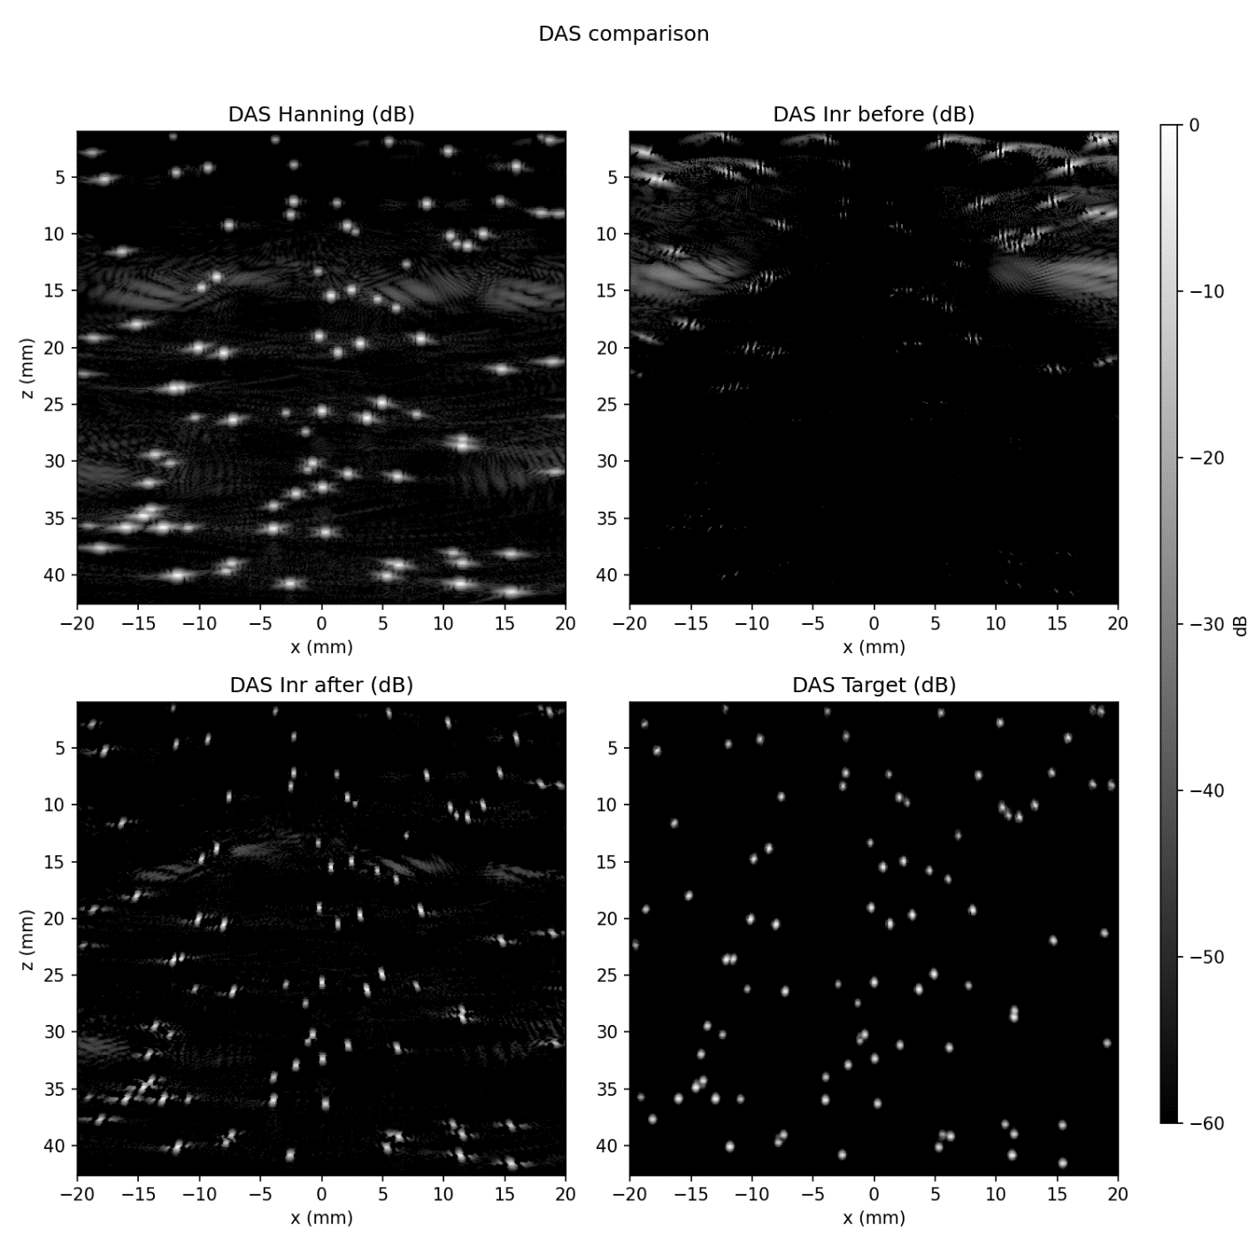

Weight to give more importance to reflectors vs background

Slide 20
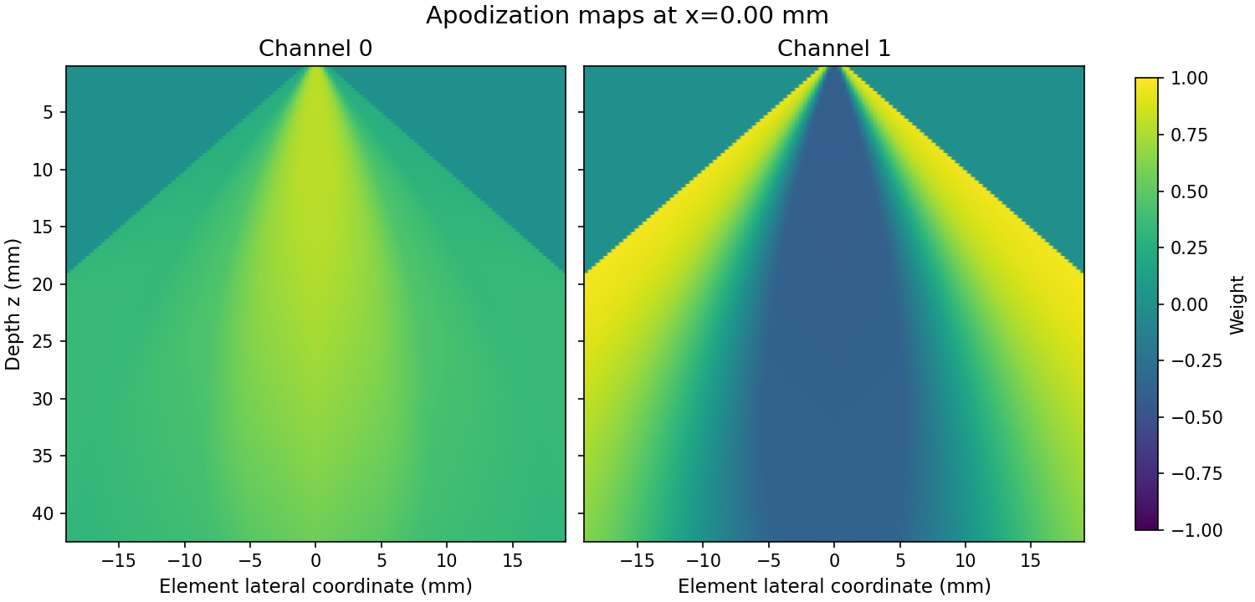
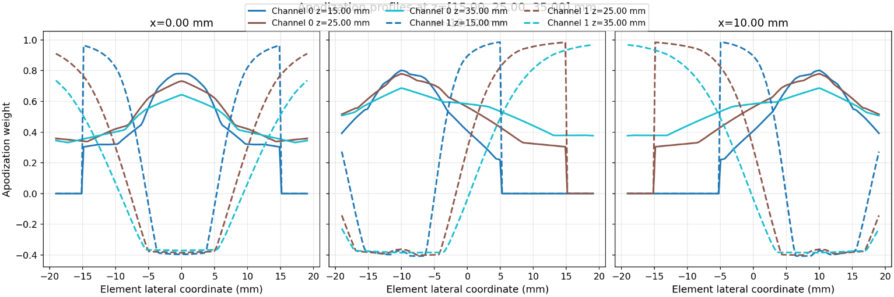
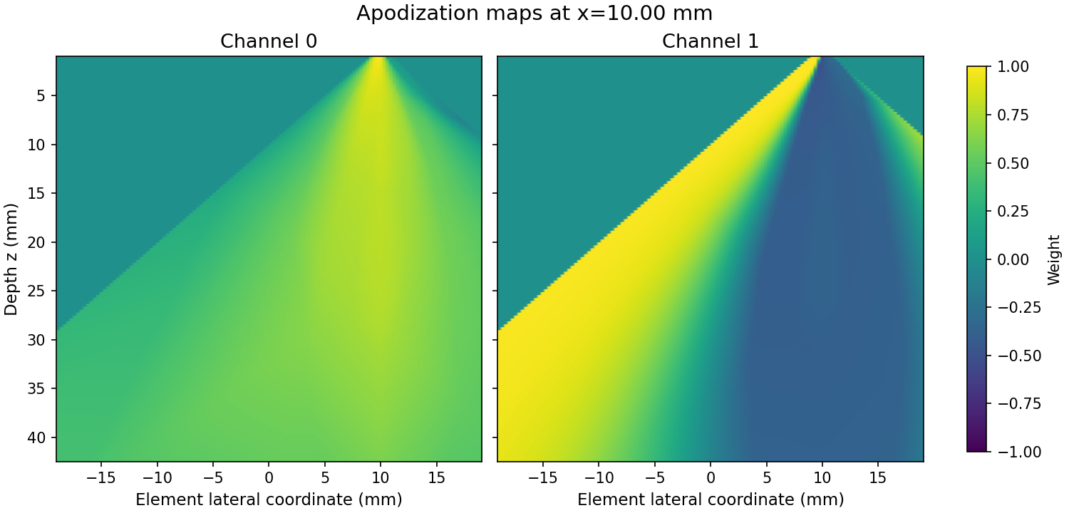

Slide 21
Proposed framework: learning and mixing
ReLU
ReLU
tanh
Example (layers and neurons)
[4 features, 16, 8, 4, 2 apodizations]
[2 (images), 2, 1 (final image)]

