Slide 1
Extracting Safety Intelligence from Healthcare Incident Reports:
Combining Human Factors and
Artificial Intelligence
Professor Georgina Cosma Loughborough University
14 October 2026
Notes:
Good afternoon everyone, and thank you for inviting me. I’m Georgina Cosma from Loughborough University.
The talk today is on “Extracting Safety Intelligence from Healthcare Incident Reports: Combining Human Factors and Artificial Intelligence”.

Slide 2
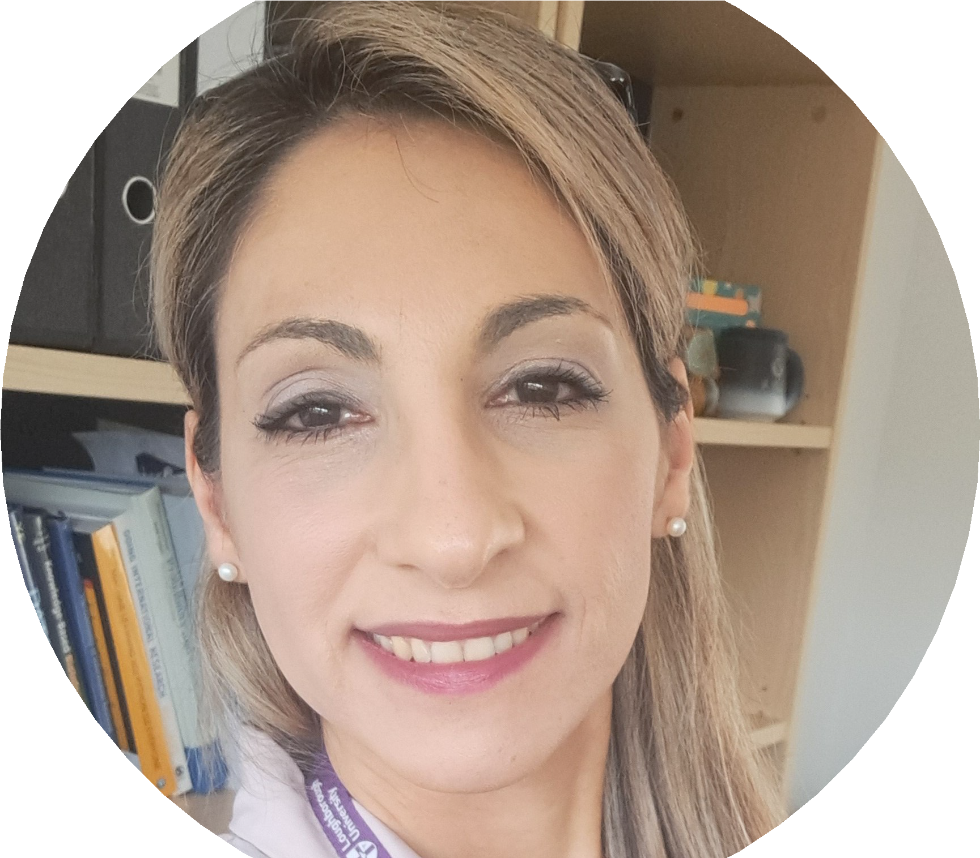

About Me
Georgina Cosma
Professor of AI & Data Science
Computer Science
Loughborough University
g.cosma@lboro.ac.uk
https://cosmos-ai.com/
Patrick Waterson
Professor of Human Factors and Complex Systems
School of Design and Creative Arts
Loughborough University
P.Waterson@lboro.ac.uk
https://www.lboro.ac.uk/schools/design-creative-arts/people/patrick-waterson/
Notes:
So, a little about me.
I’m a Professor of AI and Data Science at Loughborough, a computer scientist by background, and my work is fundamentally about developing AI methods and applying them to healthcare challenges.
My research is mainly in natural language processing. I develop methods for extracting, modelling and retrieving information from reports, and often from multimodal data, which combines different types of data such as text and images.
The work I will describe today has been funded by NHSX and The Health Foundation, and supported by the NIHR.
The project was conducted in collaboration with Professor Patrick Waterson, who is joint PI and a human factors expert at Loughborough University. Professor Waterson is a Fellow of the Institute of Ergonomics and Human Factors, Chartered Psychologist and Associate Fellow of the British Psychological Society.
We also worked with colleagues from the Health Services Safety Investigations Body, who investigate serious patient safety incidents across the NHS.
Unfortunately, Patrick is unable to attend today, and he sends his apologies. If you have any questions on human factors please email Patrick.

Slide 3
Our Partner: HSIB → HSSIB
Healthcare Safety Investigation Branch (HSIB)
Established in 2017 to improve patient
safety through independent investigations. We collaborated with HSIB on this research, analysing their maternity investigation reports.
Transformation in October 2023:
HSIB transformed into two separate organisations:
MNSI — Maternity and Newborn Safety Investigations
HSSIB — Health Services Safety Investigations Body
Core functions:
Conduct independent patient safety investigations across NHS England
Publish reports with safety recommendations and learnings
Deliver patient safety investigation training
Investigations focus on learning, not
blame. Staﬀ who contribute are legally protected.
Notes:
A little bit about our partner.
We worked with colleagues who were then at HSIB, which was set up in 2017 to carry out independent patient safety investigations. In 2023 it split into MNSI and HSSIB, where our colleagues are today.
Together we analysed 188 of their maternity investigation reports.
Their approach focuses on learning, not blame, and staff who contribute are legally protected. This shaped our AI design. The AI helps people see patterns. It doesn’t make decisions about people.

Slide 4

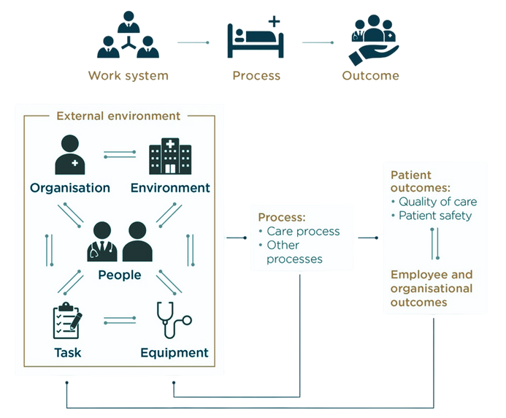
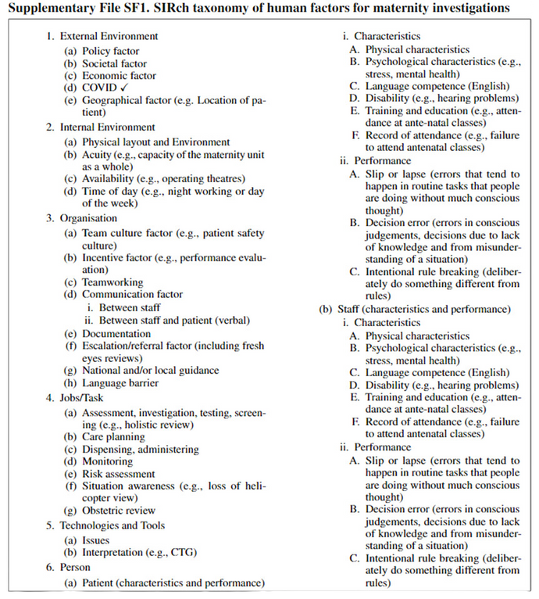
Extracting Insights from Maternity Incident Investigation Reports
From long, free-text reports to structured human factors insight
1 The reports
2 The SEIPS model
3 The SIRch taxonomy
Many long reports, analysed by hand
Notes:
Here is an illustration of the challenge. On the left, you’ll see an investigator with reports that need detailed human factors analysis.
In the middle is the SEIPS model, the Systems Engineering Initiative for Patient Safety. It shows how work systems connect to healthcare outcomes.
The challenge faced by human factors experts is that they need to extract intelligence from these reports, and they often use taxonomies to organise it.
And on the right is the SIRch taxonomy, which stands for Safety Intelligence Research. This is the taxonomy Patrick developed specifically for maternity investigations. It is based on SEIPS and gives us a structured way to categorise these factors. More about this later.

Slide 5
The Challenge
Making sense of safety data at scale
The problem:
Healthcare generates vast unstructured text
Safety reports contain actionable insights
Patterns are hard to spot at scale
Manual analysis cannot keep pace
The considerations:
Health data requires careful handling under GDPR
AI must perform fairly across all groups
Findings must be traceable and veriﬁable
Human oversight remains essential
By identifying recurring themes, we can help prevent future harm.
Responsible AI means designing in safeguards from the start.
Notes:
The incident reports we analysed describe what went wrong and why in maternity investigations. They cover what happened during care, family experiences, staff observations, and contributing factors like communication breakdowns, missed assessments, equipment issues and staffing pressures. They focus on system-level factors, not individual blame.
Maternity was our case study, but this challenge applies to any healthcare safety reports.
On the left is the problem. Healthcare generates vast amounts of unstructured text containing actionable insights, but patterns are hard to spot at scale, and manual analysis cannot keep pace.
On the right are the considerations. Health data requires careful handling under GDPR, AI must perform fairly across all groups, findings must be traceable, and human oversight remains essential.

Slide 6
How can we use AI to extract actionable safety intelligence
from hundreds of unstructured reports
— responsibly and fairly?
Notes:
How can we use AI to extract actionable safety intelligence from hundreds of unstructured reports, responsibly and fairly?
[PAUSE]
This was our driving question.

Slide 7
01
The Methods
How we built and tested the AI models
Notes:
Let me show you the AI methods we developed.

Slide 8
What is Concept Annotation?
Extracting human factors from investigation text
Step 1 | Read the sentence
SEIPS Taxonomy (main areas)
Investigation report:
“The
External Environment – Policy, Societal, Eco-nomic, COVID, Geographical
abnormal CTG
was not
recognised and did not prompt escalation to the obstetric team , in line with local guidance .”
Step 2 | Assign concept labels
Internal Environment – Physical layout, Acuity, Availability, Time of day
Organisation – Teamworking, Communication, Escalation/referral, Guidance
Job/Task – Assessment, Care planning, Moni-toring, Risk assessment
Interpretation | Escalation/referral | Local guidance
Technologies & Tools – Issues, Interpretation (CTG)
A single sentence can reveal multiple human factors. Systematic annotation lets us spot patterns across hundreds of reports.
Person – Physical, Psychological, Slips/lapses, Decision errors
Notes:
We trained the AI using concept annotation. Here’s how it works.
Concept annotation is the process of mapping sentences to factors, which we also call labels. The aim is then to train a machine learning model to apply those labels to unseen sentences.
Take this sentence from a real report. “The abnormal CTG was not recognised and did not prompt escalation to the obstetric team, in line with local guidance.”
An expert spots three things, a CTG interpretation problem, no escalation, and a local guidance issue. So one sentence can get multiple labels, here Interpretation, Escalation/referral and Local guidance.
Why does this matter? Once every sentence is labelled, we can ask bigger questions. Which factors appear most often? Do certain issues cluster together? Are there patterns across ethnic groups, or across adverse event types like maternal death, neonatal death or stillbirth?
Where ethnicity and outcome data were recorded, we could examine whether certain human factors appeared more frequently for specific groups.
Reading reports one by one won’t answer that. We need structured data. That’s what concept annotation gives us, and we trained the AI to do it automatically.
On the right is the taxonomy that Patrick developed, based on SEIPS, an internationally recognised framework that organises human factors into six areas. Patrick refined it to make it specific to maternity incidents, and the AI learns to apply its factors consistently at scale.

Slide 9
The SIRch Taxonomy: SEIPS Framework
Human factors framework for maternity safety investigations
1 External Environment
Policy · Societal · Economic · COVID · Geographical (e.g. location of patient)
4 Jobs/Task
Assessment, investigation, testing, screening (e.g. holistic review) · Care planning · Dispensing, administering · Monitoring · Risk assessment · Situation awareness (e.g. loss of helicopter view) · Obstetric review
2 Internal Environment
Physical layout and environment · Acuity (capacity of the maternity unit as a whole) · Availability (e.g. operating theatres) · Time of day (e.g. night working, day of the week)
5 Technologies and Tools
Issues · Interpretation (e.g. CTG)
6 Person, for patient and for staff
Characteristics, physical · psychological (e.g. stress, mental health) · language competence (English) · disability (e.g. hearing problems) · training and education · record of attendance
Performance, slip or lapse · decision error · intentional rule breaking
3 Organisation
Team culture (e.g. patient safety culture) · Incentive (e.g. performance evaluation) · Teamworking · Communication (between staff, and between staff and patient) · Documentation · Escalation/referral (including fresh eyes reviews) · National and/or local guidance · Language barrier
44 factors in total, 27 found in our 188 maternity reports. Source, Supplementary File SF1, SIRch taxonomy of human factors for maternity investigations
Notes:
Here is the full taxonomy we used, and this is what the AI learns to recognise.
It has 44 possible factors across six areas, with person factors recorded separately for patients and for staff. In our 188 maternity reports, 27 of these factors actually appeared.
It covers everything from external policy down to individual decision errors.

Slide 10
I-SIRch: How It Works
Human expertise at every stage, fully offline
Data preparation
Training and learning
Monitoring
1 Reports
188 maternity reports, 2019 to 2022
2 Select text
Negative sentences selected
3 Experts label
3 experts, ethnicity hidden
4 AI learns
Trained on 91 reports
5 People check
Tested on 97 unseen reports
New batches labelled, then used to retrain
The result is patterns across all 188 reports, traceable to source
Orange steps are done by people
Notes:
This is I-SIRch, our framework for safety intelligence extraction. There are three stages, and none of it is a black box. Human oversight runs through the whole thing.
First, data preparation. We extract the text from the reports and select the negative sentences, the ones that describe what went wrong. Not everything gets processed. We control what goes in.
Second, training and learning, and this is where the human expertise comes in. Three domain experts, colleagues then at HSIB and now at HSSIB, with deep expertise in patient safety and human factors, annotated the reports, in sessions led by Professor Patrick Waterson.
The annotators couldn’t see the patient’s ethnic background while coding the text. This helps prevent human biases from entering the training data, where the AI would then amplify them.
Our inter-rater reliability was 80.15 per cent. That’s the percentage of sentences where all three annotators agreed, and it gave us confidence that the concepts were being applied consistently before we used them to train the model.
We then trained the AI to replicate their judgements. The word is replicate. It learns from human expertise, it doesn’t replace it. It learned from 91 reports and was tested on 97 it had never seen. As new batches arrived, they were annotated and used for retraining.
Third, monitoring. Continuous bias checks across demographic groups, and human verification of outputs.
[PAUSE]
So why not just use ChatGPT or something off the shelf? A few reasons. We trained this model specifically to recognise our taxonomy of human factors, which reduces the risk of inheriting biases from large language models trained on internet data. It runs entirely offline, so no data leaves our secure environment. Every output traces back to source documents, which means it can be verified. And we have full control over what the model learns.
General-purpose AI just wasn’t built with these requirements in mind.

Slide 11
I-SIRch: Overall Performance
Tested on 97 real unseen reports
Key ﬁnding: High recall (93%) means the model catches the vast majority of safety issues.
Tested on real, unseen data to validate real-world performance.
But does it perform equally for all groups?
Notes:
These are the results on the 97 real, unseen reports. The model was trained on real data from batches 1 and 2, and tested on batch 3. It achieved 90 per cent balanced accuracy, 93 per cent recall and 87 per cent precision.
The key number is that 93 per cent recall. It means the model catches the vast majority of safety issues.
But good overall performance isn’t enough. The question is, does it perform equally for all groups?

Slide 12
I-SIRch: Fairness Across Ethnic Groups
Does the model perform equally for all groups?
Accuracy by ethnic group:
Statistical analysis:
No signiﬁcant diﬀerence between Black and White British, and Asian and White groups.
Some groups were small, so testing
n = number of concept annotations tested Fairness evaluated on synthetic data (ethnicity unavailable for real test set)
continues as more data arrives.
AI systems must be tested for fairness across protected characteristics. ✓
Notes:
So does the model perform equally for all groups?
We only had ethnicity data for batch 1, so we could only test fairness on synthetic data. The n values here are concept annotations, not reports.
Balanced accuracy ranged from 82 to 85 per cent across the ethnic groups. Precision was 100 per cent across the board, meaning that when the model flagged a concept, it was correct. Recall ranged from 64 to 69 per cent.
We tested for statistical significance between the groups where we had sufficient sample sizes. There was no significant difference between the Black and White British groups, and no significant difference between the Asian and White groups.
We didn’t run pairwise tests across all groups, because the sample sizes for some groups, particularly Mixed Background with just 13 concepts, were too small for meaningful statistical comparison.
So these are encouraging early results. Performance was consistent across the groups we could test.

Slide 13
02
The Findings
What the AI revealed about maternity safety
Notes:
Let’s look at some of the findings. There isn’t enough time to go through all the detailed findings today, as I’ve focused this presentation on the AI methods.

Slide 14
What patterns emerge when AI analyses
maternity investigation reports
systematically and equitably?
Notes:
What patterns emerge when AI analyses 188 maternity investigation reports systematically and equitably?
[PAUSE]

Slide 15
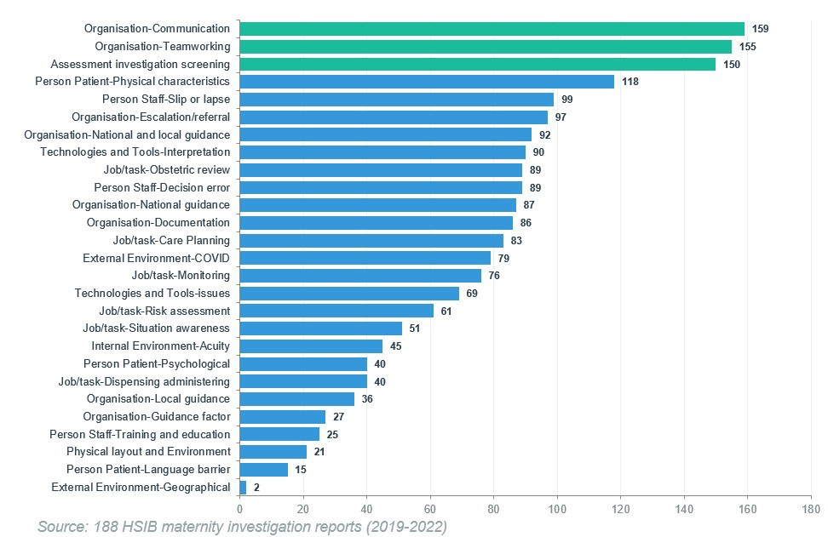
Human Factors Distribution Across Reports
188 reports, 3,122 annotated sentences
Adverse Outcomes:
Therapeutic hypothermia
Maternal death
Stillbirth
The three green bars highlight the most common factors:
Communication: 159 reports
Teamworking: 155 reports
Assessment/investigation/screening: 150 reports
Each bar shows the number of reports where that human factor appeared, e.g. Communication appeared in 159 out of 188 reports.
Notes:
This chart shows the distribution of human factors across all 188 reports.
The three green bars are the most common factors, Communication, Teamworking and Assessment.
The adverse outcomes in these reports are serious, including therapeutic hypothermia, maternal death and stillbirth.
[PAUSE]
The AI shows patterns across the whole dataset that no individual could spot by reading alone.

Slide 16

Communication
Not listened to, dismissing or ignoring women’s concerns, preferences and
requests
Not providing suﬃcient information for informed decisions
Conﬂicting recollections of discussions
Problematic staﬀ interactions with women and their families
Lack of translation services prevented understanding of concerns and care
options
Identiﬁed in 159 of 188 investigation reports
Notes:
These are actual sentences from the reports, not AI-generated. Communication was the most frequently occurring factor, found in 159 of the 188 reports.

Slide 17

Teamworking
Fragmented triage care with many staﬀ and inconsistent handovers
Communication and handover issues between teams
Hierarchy perceptions and
communication gaps on needed interventions
Ambulance delays and excess workloads without adequate cover
Identiﬁed in 155 of 188 investigation reports
Notes:
Teamworking was the second most common factor the AI identified, in 155 of the 188 reports.

Slide 18

Assessment
Gaps in assessments and documentation, lack of key lab tests
Failure to recognise start of second stage of labour
Failures to appreciate full clinical
pictures and perform key examinations
Busy units prevented appreciating mothers’ concerns and performing needed assessments
Missed assessments, examinations, and reviews
Identiﬁed in 150 of 188 investigation reports
Notes:
And Assessment was the third most common factor across the reports, identified in 150 of the 188.

Slide 19
03
Summarisation
Multi-document synthesis by human factor
Notes:
Next, summarisation.

Slide 20
Can we automatically synthesise ﬁndings across 188 reports
into coherent summaries for each human factor?
Notes:
Can we automatically synthesise findings across 188 reports into coherent summaries for each human factor?
[PAUSE]

Slide 21
Example AI-Generated Summaries
Demonstrating summarisation quality and traceability
Communication concept:
Acuity concept:
Heading: Staﬀ not heard
Staﬀ voiced concerns to the senior obstetrician but were left feeling unheard. No formal de-brieﬁng occurred, which staﬀ valued. The opportunity to share reﬂections wasn’t com-pleted with all involved. Incremental delays and communication breakdown further impacted the Decision-to-Delivery Interval (DDI).
Heading: Reviews with seniors did not occur
The ambulance Trust experienced high call vol-umes. Due to high labour ward acuity, ini-tial decisions weren’t discussed with senior clin-icians. Senior face-to-face review didn’t occur until 2 hours 50 minutes after recognising abnormalities. The abnormal CTG wasn’t reviewed by the senior obstetrician.
Each summary is traceable to source ﬁle and sentence IDs, enabling veriﬁcation and accountability.
Notes:
Here are two of the summaries our AI tool generated, for Communication and Acuity.
We extract the original sentences first, then generate summaries from them. Both are stored, so we can always compare the summary against the source sentences and check its accuracy.
Every sentence traces back to the report sentences that were used to generate it.

Slide 22
Ethical Risks of AI Summarisation
Identiﬁed risks and mitigations
Risk | How we reduce it
Hallucination and bias | Summaries checked against the original sentences, with bias audits
Inadequate content control | Every summary traceable to its source sentences
Sensitive data exposure | Offline models, so no data leaves our systems
Small sample sizes | Results reported for each group
Key safeguard. Every summary can be traced to its source sentences.
Notes:
So what can go wrong with generative AI?
Hallucination and bias. AI can generate content that sounds plausible but isn’t true, and it can amplify patterns in the training data. We reduce this risk by keeping the original sentences, so we can check each summary against the source, and we run regular bias audits across ethnic groups.
Inadequate content control. Every summary can be traced back to its source sentences, so it can always be checked.
Sensitive data exposure. Healthcare data is highly sensitive. We use offline models, so no data leaves our secure environment.
Small sample sizes. Small numbers for minority groups can affect reliability, so we report performance for each group.

Slide 23
How can we apply this framework to other types of investigations?
Notes:
How can we apply this framework to other types of investigations?
[PAUSE]

Slide 24
LENS.ai
04
Learning Through Evidence from Natural Language Systems
Notes:
Now I want to show you how we’re extending these methods beyond maternity.

Slide 25
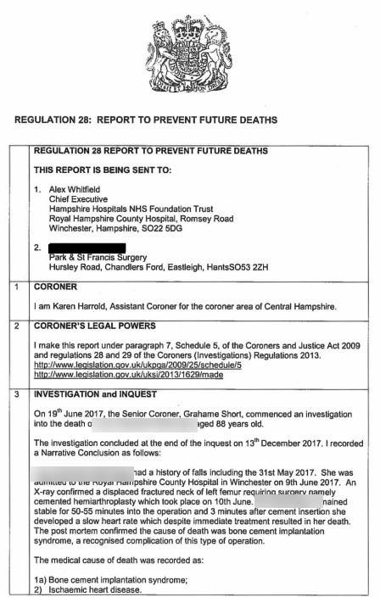
Beyond Maternity: LENS.ai
Extending the framework to Prevention of Future Deaths reports
What are PFD reports?
Reports issued by coroners after inquests where action may help prevent future deaths. They highlight risks, system failures, and opportunities for learning across organisations.
What LENS.ai supports
Systematic analysis of coronial reports and responses
Identiﬁcation of recurring risks, themes, and contributing factors
Structured analysis across cases, years, factors, combinations
Adaptable to diﬀerent analytical frameworks (e.g. Yorkshire Contributory Factors)
Notes:
[PAUSE]
We developed LENS.ai, applying the same approach to Prevention of Future Deaths reports.
PFD reports are issued by coroners when action could prevent future deaths. They highlight risks, system failures and learning opportunities.
LENS.ai supports systematic review, identification of recurring themes, and structured analysis across cases. It’s adaptable to different frameworks, like the Yorkshire Contributory Factors Framework.
The same principles apply. It is transparent and traceable, and people stay in control.

Slide 26
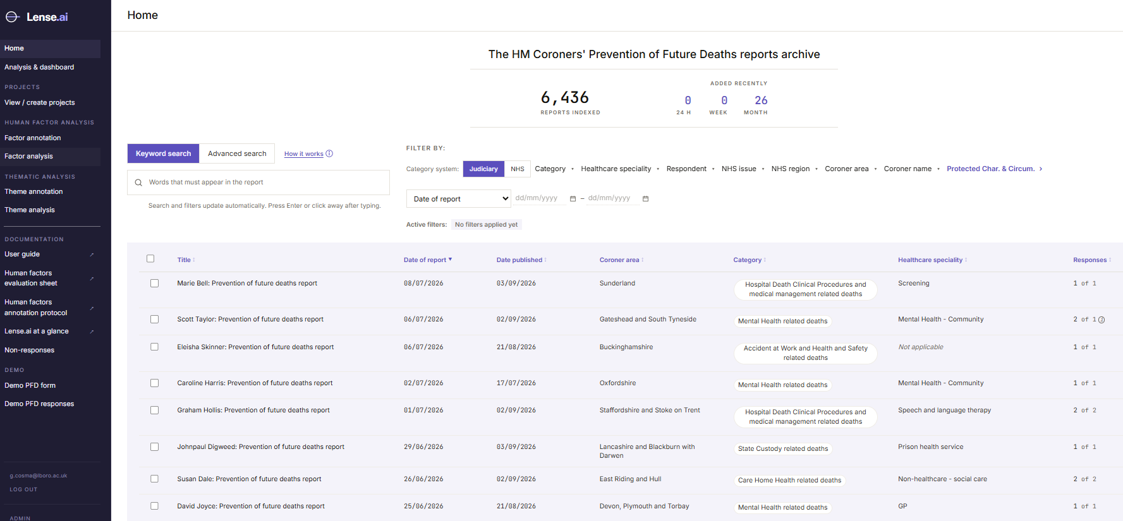
LENS.ai: Updated Automatically Every Night
Only new reports are processed
Every night, starting at 11pm
1
Check judiciary.uk for new reports
2
AI extracts key details
3
Made searchable
4
Causes and medicines coded
5
Added to themes
Funded by a Loughborough University Impact Accelerator Award,
as part of a REF 2029 impact case study.
Access is currently limited to NHS England and HSSIB.
6
Contributory factors annotated
6,436
26
7
Data checked
reports indexed
new reports in the last month
Notes:
This is the LENS.ai archive of Prevention of Future Deaths reports. It held 6,436 reports when this screenshot was taken. LENS.ai is funded by Loughborough University through an Impact Accelerator Award, as part of a REF 2029 impact case study. For now, access is limited to NHS England and HSSIB.
Every night at 11pm the platform checks the judiciary website for new reports and responses to process.
[Point to the timeline]
After the check, the steps run in order. AI extracts the key details, and the new reports are made searchable, coded, added to the themes and annotated, before a final check of the data.
So new reports are ready to analyse by the next morning.

Slide 27
LENS.ai: How It Works
From a coroner’s PDF to structured, coded evidence
1
2
3
4
Collect
Extract
Standardise
Analyse
Nightly check of judiciary.uk for new reports
AI records key details, such as cause of death
Causes coded to ICD-10, medicines to ATC
Search, dashboards and annotation
AI suggests, people decide
Notes:
So what happens when a new coroner’s report comes in? There are four steps.
First, the tool collects the report. That’s the step we’ve just seen.
Second, the tool’s AI pulls out the key details. For example, the cause of death, who the coroner sent the report to, and what the coroner was worried about.
Third, the tool puts those details into standard codes, so that every report is described in the same way. Causes of death are coded using ICD-10.
Medicines are coded using ATC, the World Health Organization’s system for grouping medicines. This means the tool can compare reports and count patterns across them, even when coroners use different words for the same thing.
Fourth, the tool lets users explore the results. They can search the reports, look at charts, and check or add annotations.
At every step, the tool makes suggestions, but people make the decisions.
[If asked, ICD-10 is the International Statistical Classification of Diseases and Related Health Problems, 10th Revision, from the World Health Organization, 2019 edition. ATC is the Anatomical Therapeutic Chemical classification, the World Health Organization’s system for classifying medicines, 2024 index.]

Slide 28
LENS.ai: From Local Models to LLMs
More capable AI for PFD reports, with a human in the loop
Maternity · I-SIRch
Local models, fully offline
Confidential reports
PFD reports · LENS.ai
More powerful LLMs
Public reports
A human in the loop, on every report
1 AI suggests
Quotes the exact sentence
2 Evidence check
Quote must be in the report
3 Human review
Confirm, relabel or reject
4 Traceable result
Linked to its source sentence
Repeated for every report
Fully transparent. Every result is logged and can be inspected.
Notes:
For maternity we used local models that ran fully offline, because those reports were confidential. PFD reports are public, so for LENS.ai we moved to more powerful large language models.
A more powerful model needsvery careful design, stronger safeguards, so there is a human in the loop for every report. We have placed extra focus on designing it in a transparent way.
[Point to the diagram]
The AI must quote the exact sentence behind each suggestion. A person then confirms, relabels or rejects it, and every result is logged and traceable.
So the AI suggests, the evidence is checked, and people decide.

Slide 29
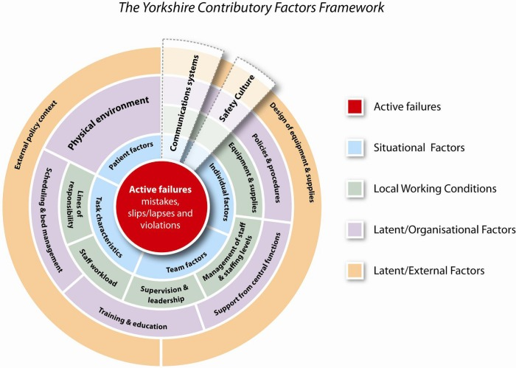
Yorkshire Contributory Factors Framework
Developed by the Yorkshire Quality and Safety Research Group following a systematic review of 83 studies of hospital patient safety incidents (2012).
Identifies potential contributory factors that can lead to patient safety incidents.
Encourages a systems-based approach, examining individual, team, working environment and organisational factors.
Aim: Improve learning from incidents and prevent recurrence, while recognising individual accountability where appropriate.
Source: https://improvementacademy.org/resource/yorkshire-contributory-factors-framework/
Notes:
To analyse the factors behind these deaths, we use the Yorkshire Contributory Factors Framework. It is an evidence-based tool developed in 2012, following a systematic review of 83 studies on hospital patient safety incidents.
It helps investigators understand why incidents happen by looking beyond individual errors to the wider factors that may have contributed, including teamwork, working conditions and organisational processes.
The aim is to identify the underlying causes of incidents, and use this learning to improve patient safety and prevent similar incidents from happening again.

Slide 30
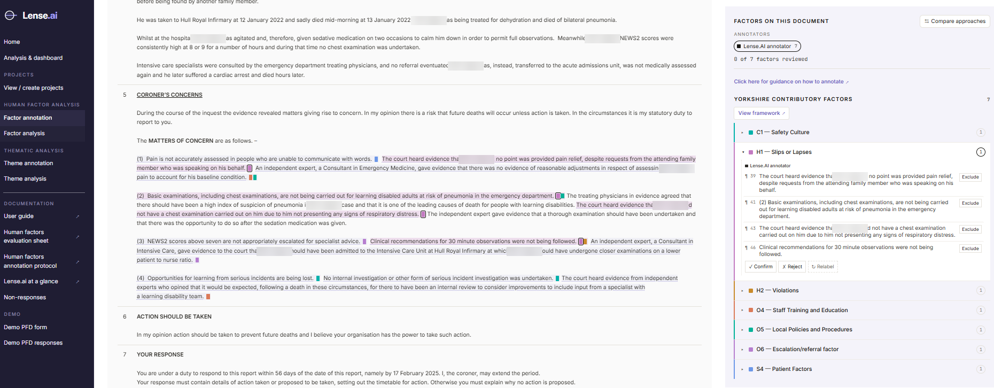
LENS.ai: Annotation in Action
Colour-coded themes with full traceability
Each annotation links to the original sentence
Full traceability maintained
Text is highlighted by factor
Notes:
This is the annotation screen. Each factor is linked to the sentence that supports it, and a reviewer confirms, relabels or rejects it. I’ll show this live in the demo.

Slide 31
LENS.ai: How Well Does It Work?
Evaluated against expert annotation of 130 PFD reports
1 Annotate
2 Compare with experts
3 Adjudicate
4 Result
88%
0.68
81%
70%
agreement with the experts
Cohen’s kappa, substantial
of expert factors found (recall)
of AI factors correct (precision)
Model choice. Claude found 80% of the experts’ factors and ChatGPT 54%, so Claude was selected.
Notes:
So how well does it work? We compared LENS.ai with expert human annotation of 130 PFD reports, coded by Patrick and a trained researcher, Ms Krina Vara.
The AI annotated each report, and we compared its output with the experts’, factor by factor. Every disagreement was checked against the report text.
The tool and the experts agreed 88 per cent of the time. Cohen’s kappa, which corrects for chance, was 0.68, which is substantial. The tool found 81 per cent of the factors the experts recorded, and 70 per cent of the factors it identified were confirmed correct.
We also compared two models on the same reports. Claude found 80 per cent of the experts’ factors and ChatGPT only 54 per cent, so we chose Claude.
[If asked, this covers one framework and one set of reports. Testing on other kinds of report is ongoing.]

Slide 32
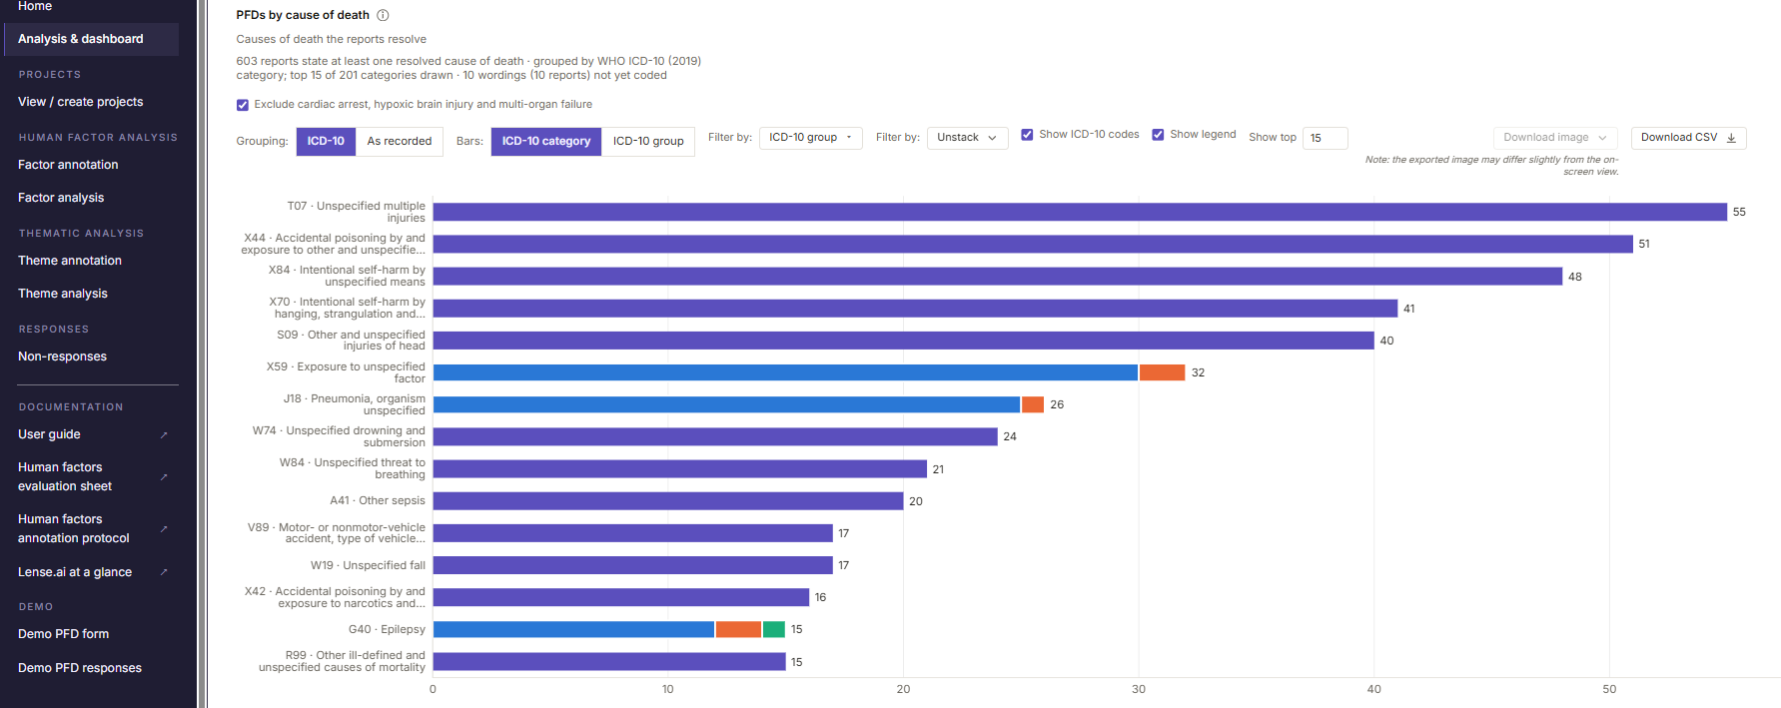
LENS.ai: Causes of Death
Coded to ICD-10, with grouping, filters and downloads
Notes:
This dashboard shows causes of death, coded to ICD-10. Users can group causes by ICD-10 category, or switch to the coroner’s own wording, filter the results, and download the chart or the data.
[If asked, ICD-10 is the International Statistical Classification of Diseases and Related Health Problems, 10th Revision, published by the World Health Organization. We use the 2019 edition, the version used for NHS data.]

Slide 33
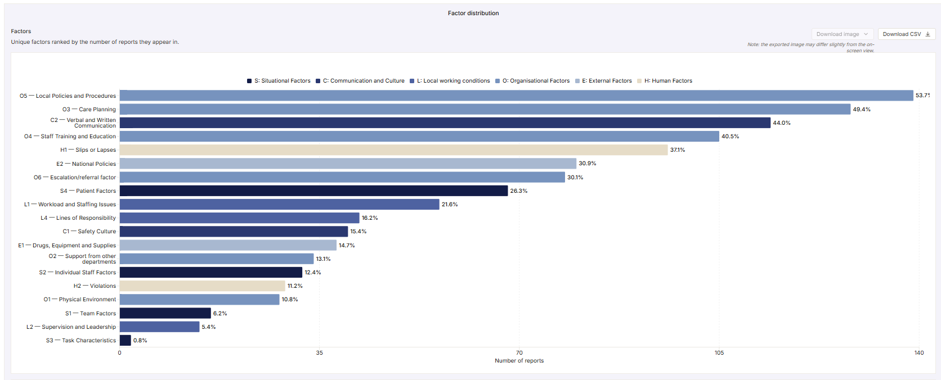
LENS.ai: Contributory Factors
Factors ranked by how many reports they appear in
Notes:
This chart ranks the contributory factors by how many reports they appear in, coloured by factor category. It updates as reports are annotated, and it can be filtered and downloaded.

Slide 34
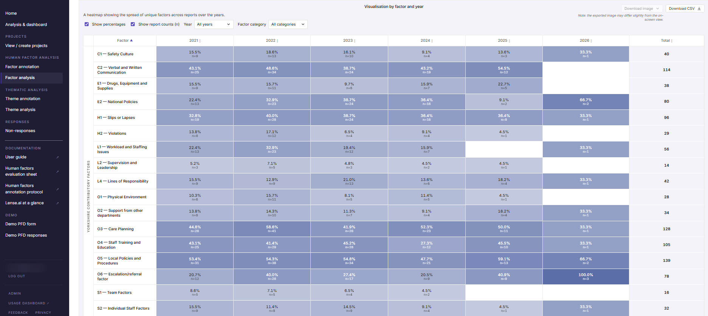
LENS.ai: Factors Over Time
Each factor tracked year by year
Notes:
This heatmap shows how often each factor appears in each year, as a percentage with the number of reports. It can be filtered by year and by factor category.

Slide 35
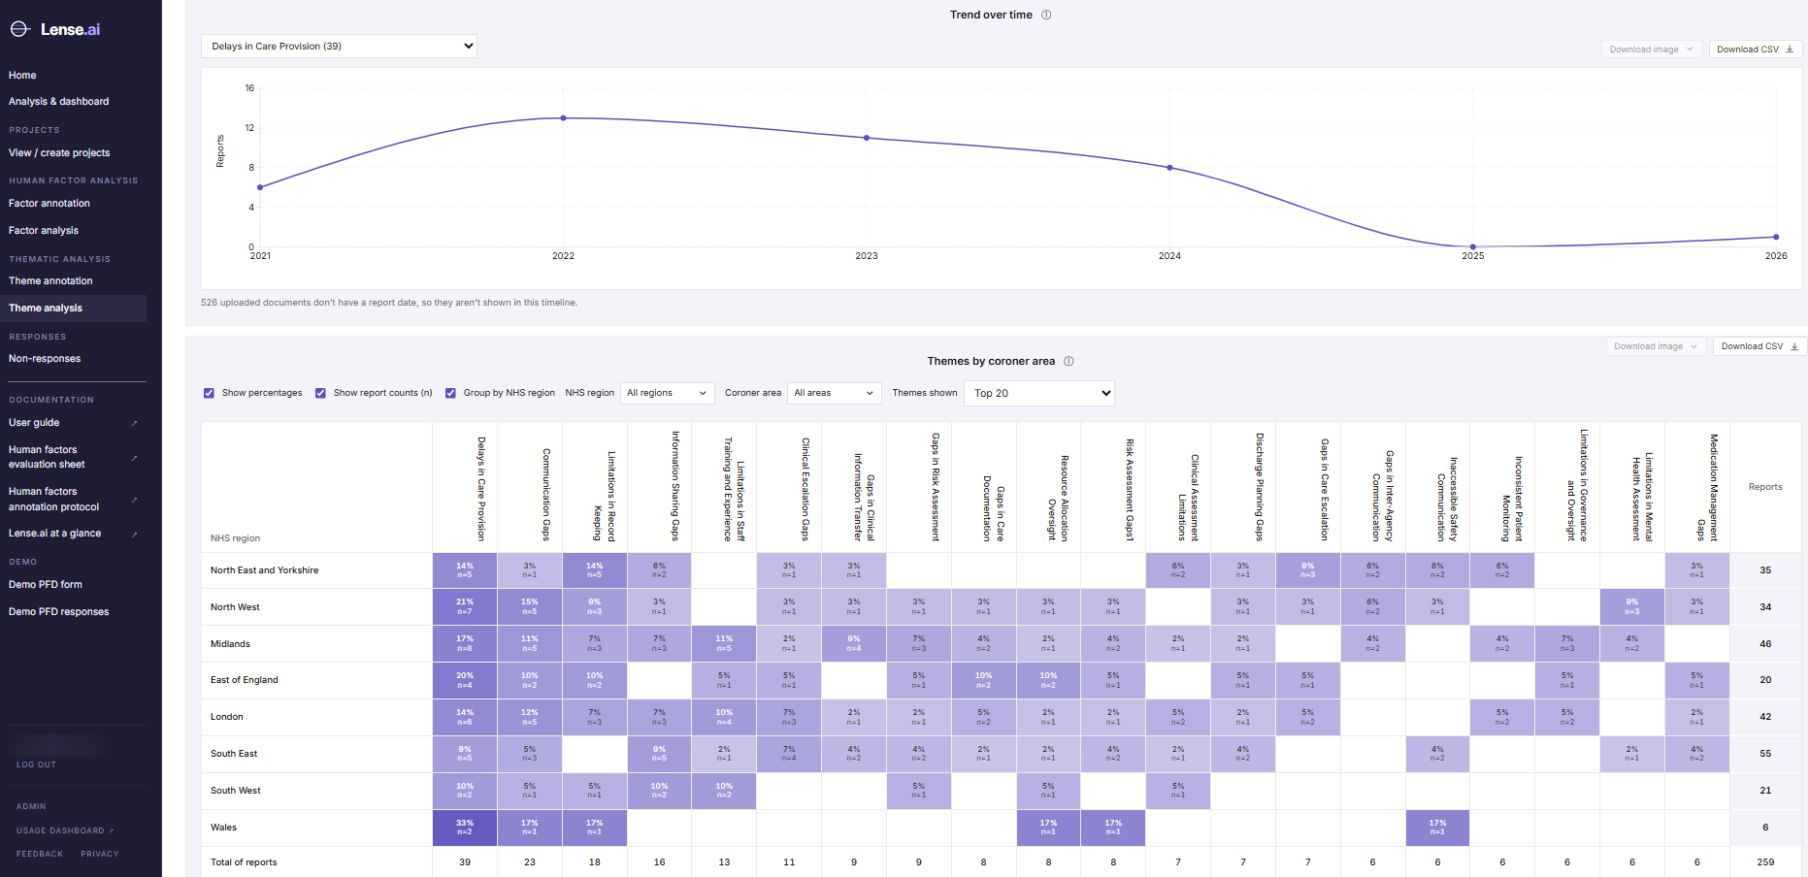
LENS.ai: Themes Over Time and by Region
Follow a theme over time and compare NHS regions
Notes:
Users can pick any theme to see its trend over time, and compare themes across NHS regions.

Slide 36
LENS.ai: Could It Help Your Work?
Ways teams can use it
Find
Understand
Compare
Share
Reports on a topic, speciality or area
Recurring themes and contributory factors
Trends over time and across regions
Shared projects, with charts and data to download
LENS.ai is currently available to NHS England and HSSIB.
Interested in analysing particular types of death? We would be glad to talk.
Funded by a Loughborough University Impact Accelerator Award, as part of a REF 2029 impact case study.
Notes:
So how could LENS.ai help your work?
Teams can use it to find reports on a topic, speciality or area, to understand the themes and contributory factors that keep coming up, to compare trends over time and across regions, and to share projects, downloading charts and data for their own work.
A word on access. LENS.ai is funded by Loughborough University through an Impact Accelerator Award, as part of a REF 2029 impact case study. At the moment it is available to NHS England and HSSIB only. But if you are interested in analysing particular types of death, we would be very happy to talk with you about it.

Slide 37
Key Takeaways
Challenge
Unstructured safety data contains insights but is hard
to analyse at scale.
Methods
Our tools combine human expertise with AI to extract safety intelligence fairly.
Ethics
Fairness, transparency, and human oversight must be designed in from the start.
AI assists, humans decide
Notes:
[PAUSE]
Let me bring together what we’ve covered.
[Three columns]
The challenge. Unstructured safety data contains insights, but it is hard to analyse at scale.
The methods. Our AI tools combine human expertise with machine learning. The AI learns from humans and augments their capabilities. It doesn’t replace judgement.
The ethics. Fairness, transparency and human oversight are designed in from the start, and every output is traceable.
Our aim is to build software that extracts and analyses reports for teams working to improve healthcare and prevent deaths. AI assists, and humans decide.

Slide 38
Get in Touch
Georgina Cosma
Professor of AI & Data Science
Loughborough University
g.cosma@lboro.ac.uk
Research website: https://cosmos-ai.com/
If you are interested in:
Finding out more about our work
Using the tool to analyse your reports
Research partnerships
Patrick Waterson
Professor of Human Factors and Complex Systems
Loughborough University
P.Waterson@lboro.ac.uk
Website: https://www.lboro.ac.uk/schools/design-creative-arts/people/patrick-waterson/
Notes:
[PAUSE]
If you’re interested in exploring how these AI methods might apply to your work, I’d love to hear from you.
[Contact details]
I’m happy to discuss healthcare AI research partnerships, patient safety data projects, or ethical AI frameworks. You can reach me at g.cosma@lboro.ac.uk.

Slide 39
Thank You
Selected Publications
I-SIRch: AI-powered concept annotation tool for equitable extraction and analysis of safety insights from maternity investigations
International Journal of Population Data Science, 2024 doi: 10.23889/ijpds.v9i2.2439
Intelligent Multi-Document Summarisation for Extracting Insights on Racial Inequalities from Maternity Incident Investigation Reports
Artiﬁcial Intelligence in Healthcare (AIiH), Springer, 2024 https://arxiv.org/abs/2407.08322
Notes:
Thank you for listening. Our selected publications are listed here, and I’m very happy to take any questions.

