Slide 1
Extracting Safety Intelligence from
Healthcare Incident Reports
Responsible AI in Healthcare
Professor Georgina Cosma Loughborough University
18 March 2026
Notes:
Good afternoon everyone, thank you for inviting me. I'm Georgina Cosma from Loughborough University.
Today I’ll explain how we built and used AI to extract safety intelligence from healthcare investigation reports and share some findings from our maternity safety case study. I'll also show how we extended this work to coroner reports and other healthcare investigations.

Slide 2
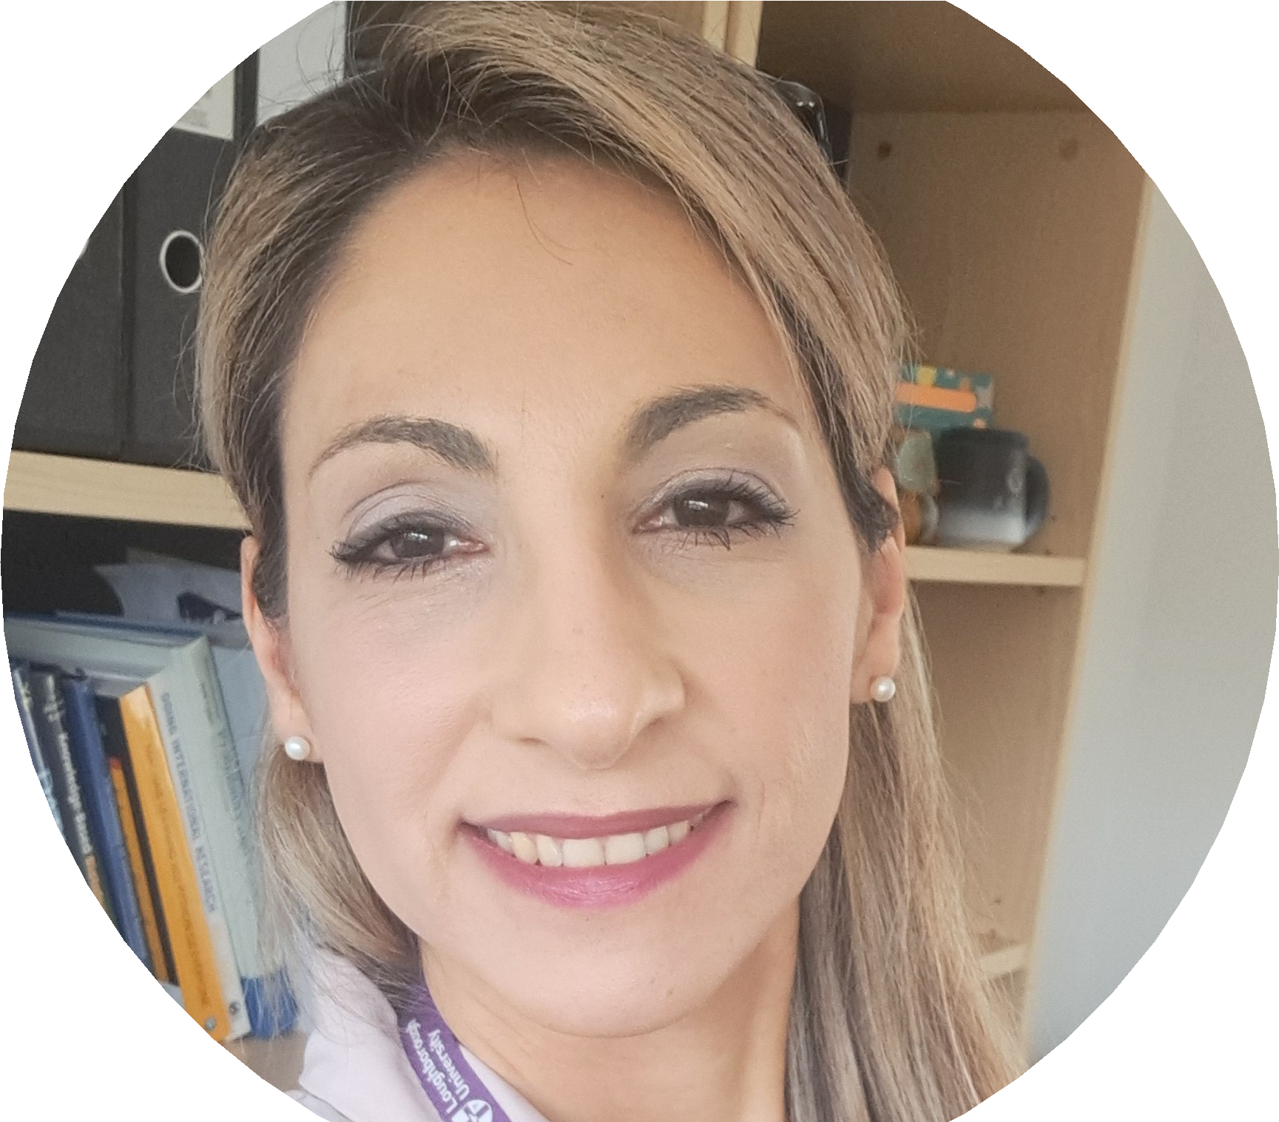
About Me
Healthcare AI research spanning:
Clinical text & reports
Electronic health records
Physiological sensors
Multimodal data fusion
Temporal data modelling
Georgina Cosma
Professor of AI & Data Science
Computer Science, Loughborough University
g.cosma@lboro.ac.uk
https://cosmos-ai.com/
Notes:
So, a little about me.
I'm a Professor of AI and Data Science at Loughborough, a computer scientist by background, and my work is fundamentally about developing AI methods and applying these to healthcare challenges. I have a lot of experience in developing tools that that are equitable and ethical.
My research spans several types of healthcare data: clinical text and reports, electronic health records, physiological sensors, and training AI models by fusing features from different types of data (for example images and text).
This work I will describe today been funded by NHSX, The Health Foundation, and supported by the NIHR.
The project I'll discuss today was conducted in collaboration with Professor Patrick Waterson who is joint-PI and a human factors experts at Loughborough University, and with colleagues from the Health Services Safety Investigations Body who investigate serious patient safety incidents across the NHS.

Slide 3
Our Partner: HSIB → HSSIB
Healthcare Safety Investigation Branch (HSIB)
Established in 2017 to improve patient
safety through independent investigations. We collaborated with HSIB on this research, analysing their maternity investigation reports.
Transformation in October 2023:
HSIB transformed into two separate organisations:
MNSI — Maternity and Newborn Safety Investigations
HSSIB — Health Services Safety Investigations Body
Core functions:
Conduct independent patient safety investigations across NHS England
Publish reports with safety recommendations and learnings
Deliver patient safety investigation training
Investigations focus on learning, not
blame. Staﬀ who contribute are legally protected.
Notes:
A little bit about our partner.
HSIB was established in 2017 to improve patient safety through independent investigations.
In October 2023, HSIB split into two organisations: MNSI for maternity and newborn safety, and HSSIB for broader health services investigations.
They produce detailed reports on adverse incidents, written for families, clinicians, and the healthcare system to learn from.
We collaborated with HSIB to analyse hundreds of their maternity investigation reports.
Their approach focuses on learning, not blame. Staff who contribute are legally protected. This shaped our AI design.
We built a system that supports investigators. The AI helps humans see patterns and it doesn't make decisions about people.

Slide 4

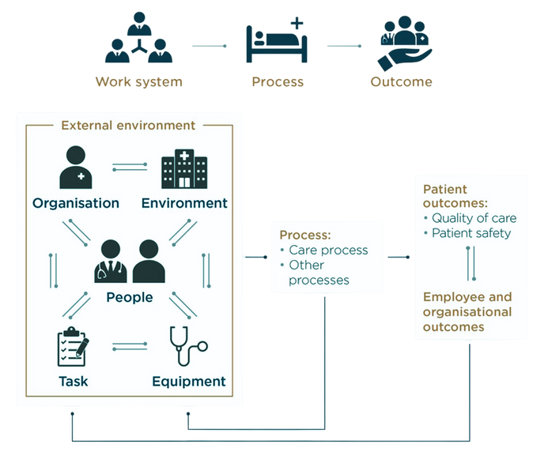
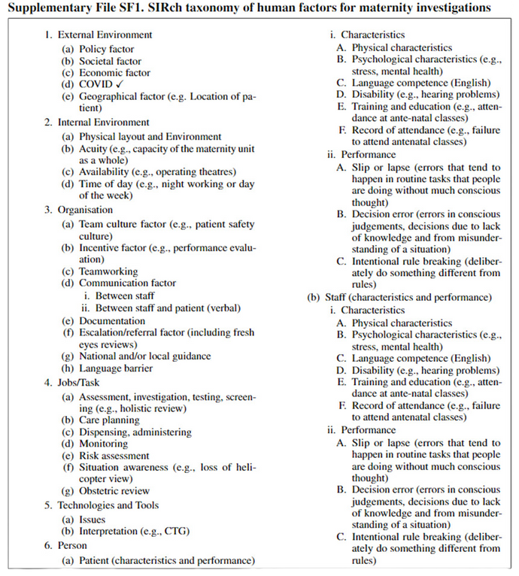

Extracting Insights from Maternity Incident Investigation Reports
A faster and more efficient way is needed for extracting insights from maternity incident investigation reports.
Notes:
Here is an illustration of the challenge. On the left, you'll see an investigator with reports that need detailed human factors analysis.
The middle shows us the SEIPS (Systems Engineering Initiative for Patient Safety) model - that's how work systems connect to healthcare outcomes.
The challenge faced my human factors experts is that they need to extract intelligence from these reports and often use taxonomies to organise
And on the right, we have a taxonomy developed by Professors Waterson, which gives us a structured way to categorise these factors in maternity investigations. This taxonomy is based on SEIPS. More about this later.

Slide 5
What We’ll Explore Today
The Challenge: how can AI help extract, organise, and analyse important findings from incident investigation reports?
The Methods: what AI techniques did we use? How did we develop and test them? Can AI find patterns reliably and fairly across all patient groups?
The Ethics: how did we ensure AI systems remain accountable? How did we keep humans in the loop and in control?
Using UK maternity safety as our case study
Notes:
I've structured todays talk around three key questions..
First, the challenge: Healthcare generates enormous amounts of unstructured text. How can AI help us make sense of it? And to extract and organise important findings and analyse those.
Second, what AI techniques did we use? How did we develop and test them? And can AI find patterns reliably and fairly across all patient groups?
And third, how do we ensure AI systems remain accountable? How do we keep humans in control?
We'll use UK maternity safety as our case study — but the AI principles we'll discuss apply far more broadly across healthcare.

Slide 6
The Challenge
Making sense of safety data at scale
The problem:
Healthcare generates vast unstructured text
Safety reports contain actionable insights
Patterns are hard to spot at scale
Manual analysis cannot keep pace
The considerations:
Health data requires careful handling under GDPR
AI must perform fairly across all groups
Findings must be traceable and veriﬁable
Human oversight remains essential
By identifying recurring themes, we can help prevent future harm.
Responsible AI means designing in safeguards from the start.
Notes:
The incident reports we analysed describe what went wrong and why in maternity investigations, covering what happened during care, family experiences, staff observations, and contributing factors like communication breakdowns, missed assessments, equipment issues, and staffing pressures. They focus on system-level factors, not individual blame.
Maternity is our case study, but this challenge applies to any healthcare safety reports.
On the left, the problem: healthcare generates vast unstructured text containing actionable insights, but patterns are hard to spot at scale and manual analysis cannot keep pace.
On the right, the considerations: health data requires careful handling under GDPR, AI must perform fairly across all groups, findings must be traceable, and human oversight remains essential.

Slide 7
How can we use AI to extract actionable safety intelligence
from hundreds of unstructured reports
— responsibly and fairly?
Notes:
How can we use AI to extract actionable safety intelligence from hundreds of unstructured reports, responsibly and fairly?
[PAUSE]
This was our driving question. Let me show you the AI methods we developed.

Slide 8
01
The Methods
How we built and tested the AI models
Notes:
Let's look at some of the findings. There isn't enough time to go through all the detailed findings today — I've focused this presentation on the AI methods. But if you're interested in the maternity findings specifically, I'm happy to arrange another meeting or share them with you directly.

Slide 9
What is Concept Annotation?
Extracting human factors from investigation text
Step 1 | Read the sentence
SEIPS Taxonomy (6 categories)
Investigation report:
“The
External Environment – Policy, Societal, Eco-nomic, COVID, Geographical
abnormal CTG
was not
recognised and did not prompt escalation to the obstetric team , in line with local guidance .”
Step 2 | Assign concept labels
Internal Environment – Physical layout, Acuity, Availability, Time of day
Organisation – Teamworking, Communication, Escalation/referral, Guidance
Job/Task – Assessment, Care planning, Moni-toring, Risk assessment
Interpretation | Escalation/referral | Local guidance
Technologies & Tools – Issues, Interpretation (CTG)
A single sentence can reveal multiple human factors. Systematic annotation lets us spot patterns across hundreds of reports.
Person – Physical, Psychological, Slips/lapses, Decision errors
Notes:
We trained the AI using concept annotation. Here's how it works.
Concept annotation is the process of mapping sentences to factors (what we also call labels). The aim is to then train a machine learning model to map labels to unseen sentences.
Take this sentence from a real report: "The abnormal CTG was not recognised and did not prompt escalation to the obstetric team, in line with local guidance."
An expert spots three things: CTG interpretation problem, no escalation, local guidance issue. One sentence, multiple human factors.
Why does this matter? Once every sentence is labelled, we can ask bigger questions. Which factors appear most often? Do certain issues cluster together? Are there patterns across ethnic groups or adverse event types like maternal death, neonatal death, or stillbirth?
In our analysis, we had ethnicity and outcome data for each report, so we could examine whether certain human factors appeared more frequently for specific groups.
Reading reports one by one won't answer that. We need structured data. That's what concept annotation gives us—and we trained the AI to do it automatically.
[Step 2 - labels appear]
Hence one sentence can get multiple labels. Here we get three: Interpretation, Escalation/referral, Local guidance.
This is what we can train AI to do. Given a sentence, it identifies which human factors concepts are present.
[PAUSE for separator]
[After taxonomy reveals]
We use the taxonomy that Patrick developed which is based on SEIPS-based Patient Safety. It's an internationally recognised framework that organises human factors into six categories.
My colleague Professor Patrick Waterson refined the SEIPS taxonomy to make it specific to maternity incidents. The AI learns to apply the factors within the taxonomy consistently at scale.

Slide 10
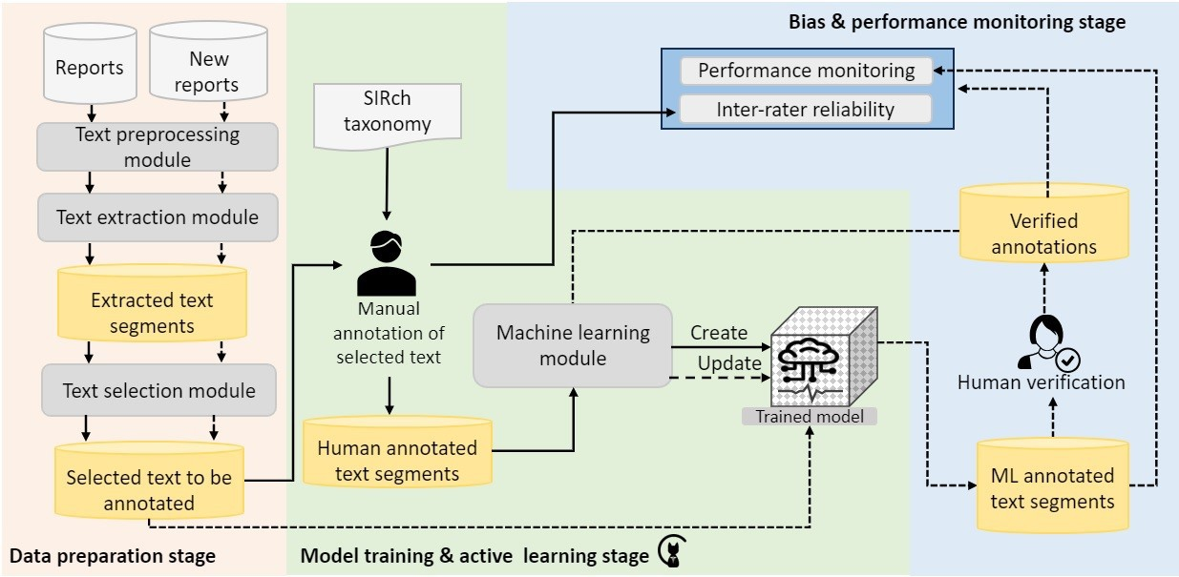
I-SIRch: Framework Overview
End-to-end pipeline for safety intelligence extraction
Why not generic AI?
Domain-speciﬁc
Runs oﬄine
Fully traceable
Human-in-the-loop
Data Preparation
Extract + select text
|
Training & Learning
Human annotation +
ML model
|
Monitoring
Bias checks + human
veriﬁcation
Notes:
This is I-SIRch, our framework for safety intelligence extraction. Three stages, and none of it is a black box—human oversight runs through the whole thing.
[First column] Data Preparation. We extract text from the reports and select the relevant sections. Not everything gets processed—we control what goes in.
[Second column] Training and Learning. Human experts annotate sentences with human factors concepts, then we train the AI to replicate their judgements. The word is replicate—it learns from human expertise, it doesn't replace it.
[Third column] Monitoring. Continuous bias checks across demographic groups, and human verification of outputs.
[PAUSE]
So why not just use ChatGPT or something off the shelf?
A few reasons. We trained this model from scratch, specifically to recognise our taxonomy of human factors. No inherited biases from large language models trained on internet data. It runs entirely offline, so no data leaves our secure environment. Every output traces back to source documents, which means it can be verified. And we have full control over what the model learns.
General-purpose AI just wasn't built with these requirements in mind.

Slide 11
The SIRch Taxonomy: SEIPS Framework
Human factors framework for maternity safety investigations
External Environment (5)
Policy, Societal, Economic, COVID, Geographical
Internal Environment (4)
Physical layout, Acuity, Availability, Time of day
Organisation (8)
Team culture, Incentive, Teamworking, Communication, Documentation,
Escalation/referral, National/local guidance, Language barrier
Job/Task (7)
Assessment, Care planning, Dispensing,
Monitoring, Risk assessment, Situation awareness, Obstetric review
Technologies & Tools (2) Issues, Interpretation (e.g. CTG)
Person — Patient (9)
Physical, Psychological, Language, Disability,
Training, Attendance, Slip/lapse, Decision error, Rule breaking
Person — Staﬀ (9)
Physical, Psychological, Language, Disability,
Training, Attendance, Slip/lapse, Decision error, Rule breaking
44 factors in full taxonomy.
27 appeared in our 188 maternity reports.
Notes:
Let me walk you through the full taxonomy we used. This is what the AI learns to recognise.
As previously mentioned, this taxonomy was developed by Professor Patrick Waterson. The full taxonomy. 44 possible factors across 7 categories. In our 188 maternity reports, 27 actually appeared in the reports we analysed. This gives the scope of what we're tracking: everything from external policy down to individual decision errors.

Slide 12
I-SIRch: Training the Model
Expert annotation with human-in-the-loop validation
Human annotation process:
Three domain experts annotated reports
Used SIRch taxonomy
Ethnicity blinded during annotation
Inter-rater reliability: 80.15%
Dataset composition:
188
Real investigation reports
2019–2022, 3,122 sentences
Blinding ethnicity during annotation pre-
Training: 91 reports (1,162 sentences)
Testing: 97 reports (1,960 sentences)
vents biases entering the training data.
Key principle: Train on real data, test on unseen data to validate real-world performance.
Notes:
[PAUSE]
How did we actually train the AI? This is where the human expertise comes in.
[Left column]
Three domain experts annotated the reports, colleagues from HSSIB with deep expertise in patient safety and human factors. The sessions were lead by Prof Patrick Waterson.
The annotators couldn't see the patient's ethnic background while coding the text. This prevents human biases from entering the training data, which would then be amplified by the AI.
Our inter-rater reliability was 80.15%, that's the percentage of sentences where all three annotators agreed. This high agreement gives us confidence that the concepts are being applied consistently before we used them to train the model.

Slide 13
Dataset: Training and Testing Batches
188 maternity investigation reports (2019–2022) from HSIB
Batch | No. Reports | No. Concepts | No. Sentences | Purpose
Batch 1 | 76 real | 970 | 818 | Initial Training
Batch 2 | 15 real | 452 | 344 | Retraining
Batch 3 | 97 real | 2644 | 1960 | Testing (Real)
Batch 4 | 76 synthetic | 970 | 818 | Testing (Synth)
Ethnic Group Distribution (Batch 1):
White British: 52 (70.93%) Asian: 6 (8.97%) Black: 7 (8.35%)
White Other: 6 (4.74%) Mixed Background: 1 (1.34%)
Human Annotation: 3 experts (HSIB + Human Factors) Inter-rater reliability: 80.15%
Notes:
The reports came In batches and we only had ethnicity for 72 reports. Also, while waiting for batch 2 we created a synthetic dataset that was based on batch 1 and we used that for further evaluations.
In total we received 188 reports, 3122 sentences extracted from real reports, and 818 from synthetic batch.

Slide 14
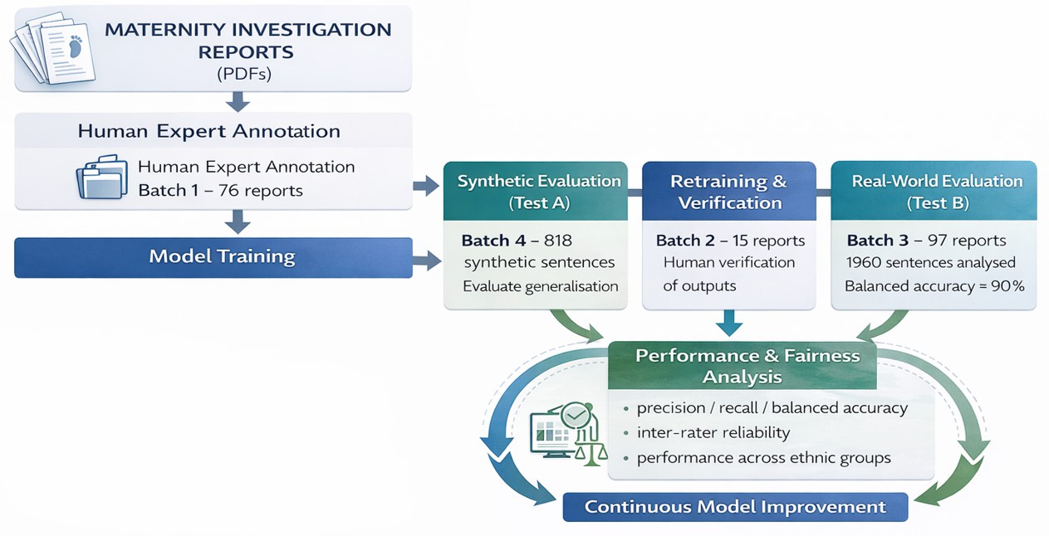
I-SIRch: Development & Evaluation Cycle
Rigorous iterative validation across multiple batches
Why synthetic data?
Batch 4 tests whether the model genuinely learned
Continuous fairness evaluation:
Performance tested across ethnic groups at each
concepts or merely memorised patterns.
Responsible AI in Healthcare
stage
Notes:
This diagram shows our iterative development process.
[Point to diagram] Starting from the left. Batch 1, we train the initial model on 76 annotated reports. We test it on Batch 4, the synthetic data, to check whether the model has genuinely learned the concepts or just memorised phrases. These are paraphrased versions of the original sentences, same meaning but different wording.
When a new batch comes in, we first test the model on it to evaluate performance on unseen data. Then instead of discarding that batch, we annotate it and use it for retraining. The model keeps improving as more data arrives.
[Right column] At each stage, we evaluate fairness. Not just overall accuracy, but performance per factor and across ethnic groups.

Slide 15
I-SIRch: Evaluation Approach
Rigorous testing to ensure reliability and fairness
Performance evaluation:
Tested on real unseen data (97 reports)
Tested on synthetic data to check generalisation
Multiple metrics: balanced accuracy, recall, precision, F-score
Iterative retraining and retesting cycle
Human validation:
Three domain experts annotated reports
Inter-rater reliability measured (80.15%)
Human veriﬁcation of AI outputs
Fairness evaluation:
Performance tested across ethnic groups
Statistical tests for group diﬀerences
Ethnicity blinded during annotation
Bias mitigation:
Continuous monitoring for performance drift
Retraining capability as new data arrives
Sentence-level traceability for veriﬁcation
Notes:
This slide summarises what we've just covered. Let's move on to the results.

Slide 16
I-SIRch: Overall Performance
Tested on 97 real unseen reports
Metric | Score
Balanced Accuracy | 0.90 ± 0.18
Recall | 0.93 ± 0.18
Precision | 0.87 ± 0.34
F-score | 0.96 ± 0.10
Key ﬁnding: High recall (93%) means the model catches the vast majority of safety issues.
Balanced Accuracy = Overall accuracy corrected for label imbalance
Recall = How many actual issues did the AI catch?
Precision = When the AI flags an issue, is it correct?
Tested on real, unseen data to validate real-world performance.
But does it perform equally for all groups?
Notes:
Trained on real data batch 1 and 2 and tested on real data batch 3 we achieved high recall (93%) means the model catches the vast majority of safety issues.
These are the results on the 97 real unseen reports. 90% balanced accuracy, 93% recall, 87% precision.
The key number is that 93% recall. That means the model catches the vast majority of safety issues. In this context, missing an issue is worse than flagging something incorrectly, so high recall matters.
But good overall performance isn't enough. The question is: does it perform equally for all groups?

Slide 17
I-SIRch: Fairness Across Ethnic Groups
Does the model perform equally for all groups?
Performance by ethnicity:
Statistical analysis:
Ethnic Group | Bal. Acc. | Recall | n
White British | 84% | 67% | 688
Asian | 84% | 68% | 87
Black | 82% | 65% | 81
Mixed Background | 85% | 69% | 13
Other White | 82% | 64% | 46
No signiﬁcant diﬀerence between Black and White British, and Asian and White groups.
The model performs consistently across
n = number of concept annotations tested Precision = 1.0 (std=0) across all groups
Fairness evaluated on synthetic data (ethnicity unavailable for real test set)
all ethnic groups — no evidence of bias.
AI systems must be tested for fairness across protected characteristics. ✓
Notes:
So does the model perform equally for all groups?
We couldn't test fairness on Batch 3 because ethnicity data wasn't available for those 97 real reports. So we tested fairness on Batch 4, the synthetic data, where ethnicity was preserved from the original Batch 1 reports.
The n values here are concept annotations, not reports.
Looking at the results, balanced accuracy ranges from 82% to 85% across all ethnic groups. Precision is 1.0 across the board, meaning when the model flags a concept, it's correct. Recall ranges from 64% to 69%.
We tested for statistical significance between the groups where we had sufficient sample sizes. No significant difference between Black and White British groups, and no significant difference between Asian and White groups.
We didn't run pairwise tests across all groups because the sample sizes for some groups, particularly Mixed Background with just 13 concepts, were too small for meaningful statistical comparison.
The model performs consistently across ethnic groups. This is what we need to demonstrate before deploying AI in a clinical safety context.

Slide 18
02
The Findings
What the AI revealed about maternity safety
Notes:
Let's look at some of the findings. There isn't enough time to go through all the detailed findings today — I've focused this presentation on the AI methods. But if you're interested in the maternity findings specifically, I'm happy to arrange another meeting or share them with you directly.

Slide 19
What patterns emerge when AI analyses
188 maternity investigation reports
systematically and equitably?
Notes:
What patterns emerge when AI analyses 188 maternity investigation reports?

Slide 20
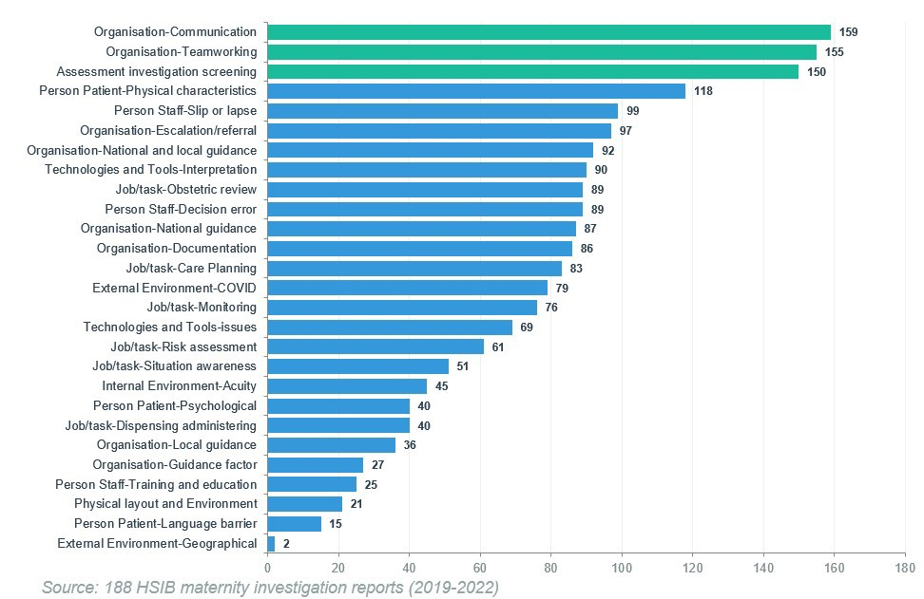
Human Factors Distribution Across Reports
188 reports, 3,122 annotated sentences
Adverse Outcomes:
Therapeutic hypothermia
Maternal death
Stillbirth
The three green bars highlight the most common factors:
Communication: 159 reports
Teamworking: 155 reports
Assessment/investigation/screening: 150 reports
Each bar shows the number of reports where that human factor appeared, e.g. Communication appeared in 159 out of 188 reports.
Notes:
This chart shows the distribution of human factors across all 188 reports.
The three green bars are the most common factoes: Communication, Teamworking, and Assessment
The adverse outcomes are serious: therapeutic hypothermia, maternal death, stillbirth.
[PAUSE]
The AI shows patterns across the whole dataset that no individual could spot by reading alone.

Slide 21

Communication
Not listened to, dismissing or ignoring women’s concerns, preferences and
requests
Not providing suﬃcient information for informed decisions
Conﬂicting recollections of discussions
Problematic staﬀ interactions with women and their families
Lack of translation services prevented understanding of concerns and care
options
Responsible AI in Healthcare
Identiﬁed in 159 of 188 investigation reports
Notes:
These are actual sentences and not AI generated. Communication was the most frequently occurring factor.

Slide 22

Teamworking
Fragmented triage care with many staﬀ and inconsistent handovers
Communication and handover issues between teams
Hierarchy perceptions and
communication gaps on needed interventions
Ambulance delays and excess workloads without adequate cover
Identiﬁed in 155 of 188 investigation reports
Responsible AI in Healthcare
Notes:
Teamworking was the second most common factor the AI identified.

Slide 23

Assessment
Gaps in assessments and documentation, lack of key lab tests
Failure to recognise start of second stage of labour
Failures to appreciate full clinical
pictures and perform key examinations
Busy units prevented appreciating mothers’ concerns and performing needed assessments
Missed assessments, examinations, and reviews
Responsible AI in Healthcare
Identiﬁed in 150 of 188 investigation reports
Notes:
And Assessment — the third key factor we identified as most commonly occurring across reprots..

Slide 24
03
Summarisation
Multi-document synthesis by human factor

Slide 25
Can we automatically synthesise ﬁndings across 188 reports
into coherent summaries for each human factor?

Slide 26
Method 2: Multi-Document Summarisation
I-SIRch:CS Framework
Quantitative Results
Qualitative Results
Incident Reports
I-SIRch
Tool
Annotated Documents
Analytics Engine
Dynamic Clustering
Generative
Summarisation
Technical approach:
Sentence embeddings (all-MiniLM-L6-v2) → K-means clustering → Abstractive summarisation with BART
Oﬄine models ensure GDPR compliance
Best model (BART) performance:
Relevance: 0.922 | Coherence: 0.794 |
Diversity: 0.806
Dataset: 188 reports, 3,760 annotated sentences across 27 concepts
Notes:
[PAUSE]
This is our I-SIRch:CS Framework. CS stands for Concept Summarisation.
Incident reports go in, get annotated with human factors, then clustered and summarised.
[PAUSE]
Because we have factor, sentences per factor, ethnic group, and outcome linked together, we generated summaries for all combinations — for example, communication issues in Black maternal deaths.
Generative summaries are often needed when we want to preserve anonymity.

Slide 27
Summarisation Dataset Composition
3,760 annotated sentences across 27 human factors concepts
ID Concept
Index
Label
1 Acuity (54)
3 Assessment, investigation, testing,
5 Care Planning (132)
7 Decision error (169)
9 Documentation (168)
11 Guidance factor (42)
13 Language barrier (30)
15 Monitoring (118)
17 National guidance (169)
19 Physical characteristics (320)
21 Psychological characteristics (54)
23 Situation awareness (77)
25 Teamworking (530)
27 Training and education (40)
2
4
6
8
10
12
14
16
18
20
22
24
26
Antenatal (69)
COVID (142)
Communication (477)
Dispensing, administering (62)
Escalation/referral factor (158)
Interpretation (197)
Local guidance (88)
National and local guidance (80) Obstetric review (147)
Physical layout and Environment (35)
Risk assessment (94) Slip or lapse (188)
Technologies and Tools-issues (112)
screening (381)
The numbers in brackets are total annotations — how many sentences were tagged with each factor across all reports. E.g. Communication had 477 annotated sentences, Teamworking had 530.
Notes:
[PAUSE]
This table shows what the AI was working with. 3,760 annotated sentences across 27 human factors concepts.
[Highlight key entries]
The three most frequent match what we saw earlier: Teamworking with 530 sentences, Communication with 477, Assessment with 381.
[PAUSE]
The AI can generate summaries for any of these concepts. A synthesised view of what all 188 reports say about, for example, communication failures.
Information scattered across hundreds of documents, made accessible.

Slide 28
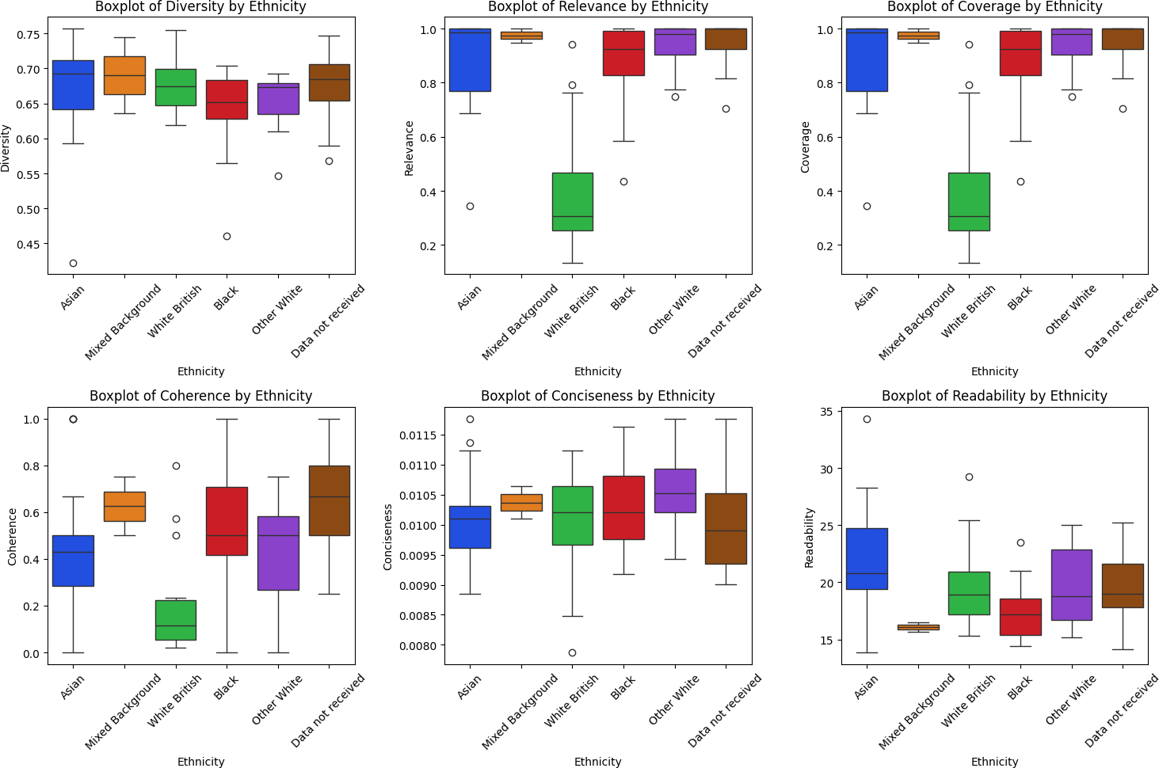
Evaluating Equity in Summarisation
Do summaries perform fairly across ethnic groups?
BART performance by ethnicity:
Group | Rel. | Coh. | Div.
Asian | 0.89 | 0.46 | 0.67
Black | 0.87 | 0.54 | 0.64
Mixed | 0.97 | 0.63 | 0.69
Other White | 0.93 | 0.42 | 0.65
White British | 0.40 | 0.18 | 0.68
Ethnicity data: 76 of 188 reports (Batch 1)
Lower White British scores attributed to
larger sample size introducing variability, not model bias.
Fairness, transparency, and accountability must be designed in from the start.
Notes:
We measured six things.
Diversity: does it cover different aspects?
Relevance: does it capture what matters?
Coverage: how much of the original content is included?
Coherence: does it flow logically?
Conciseness: is it brief without losing meaning?
Readability: is it easy to understand?
The boxplots show consistent performance across ethnic groups. White British shows more variability and some lower scores, but look at the sample sizes: 52 reports for White British compared to 6 or 7 for Asian and Black. More data means more variability. It's not model bias.
Asian, Black, Mixed, and Other White all score consistently high. White British shows lower scores and more spread, but that's because it has 52 reports compared to 6 or 7 for other groups. Larger sample, more variability. Not model bias.
Fairness, transparency, and accountability must be designed in from the start.

Slide 29
How We Evaluate Summary Quality
Six metrics assess diﬀerent quality dimensions
Diversity: Variety of vocabulary (unique words / total words)
Relevance: Similarity to original text (cosine similarity)
Coverage: Proportion of key concepts captured
Coherence: Logical ﬂow between sentences
Conciseness: Brevity of summary
Readability: Ease of understanding (Flesch score)
Higher values indicate better performance.
These metrics enable objective comparison across models and demographic groups
Notes:
SKIP
We measured six things.
Diversity: does it cover different aspects?
Relevance: does it capture what matters?
Coverage: how much of the original content is included?
Coherence: does it flow logically?
Conciseness: is it brief without losing meaning?
Readability: is it easy to understand?
The boxplots show consistent performance across ethnic groups. White British shows more variability and some lower scores, but look at the sample sizes: 52 reports for White British compared to 6 or 7 for Asian and Black. More data means more variability. It's not model bias.

Slide 30
Example Summaries Generated by BART
Demonstrating summarisation quality and traceability
Communication concept:
Acuity concept:
Heading: Staﬀ not heard
Staﬀ voiced concerns to the senior obstetrician but were left feeling unheard. No formal de-brieﬁng occurred afterwards, which staﬀ valued. The opportunity to share reﬂections wasn’t com-pleted with all involved. Incremental delays and communication breakdown further impacted the DDI.
Heading: Reviews with seniors did not occur
The ambulance Trust experienced high call vol-umes. Due to high labour ward acuity, ini-tial decisions weren’t discussed with senior clin-icians. Senior face-to-face review didn’t occur until 16:05, 2 hours 50 minutes after recognis-ing abnormalities. The abnormal CTG wasn’t reviewed by the senior obstetrician.
Each summary is traceable to source ﬁle and sentence IDs, enabling veriﬁcation and accountability.
Notes:
Here are two of the summaries our AI tool generated for Communication and Acuity.

Slide 31
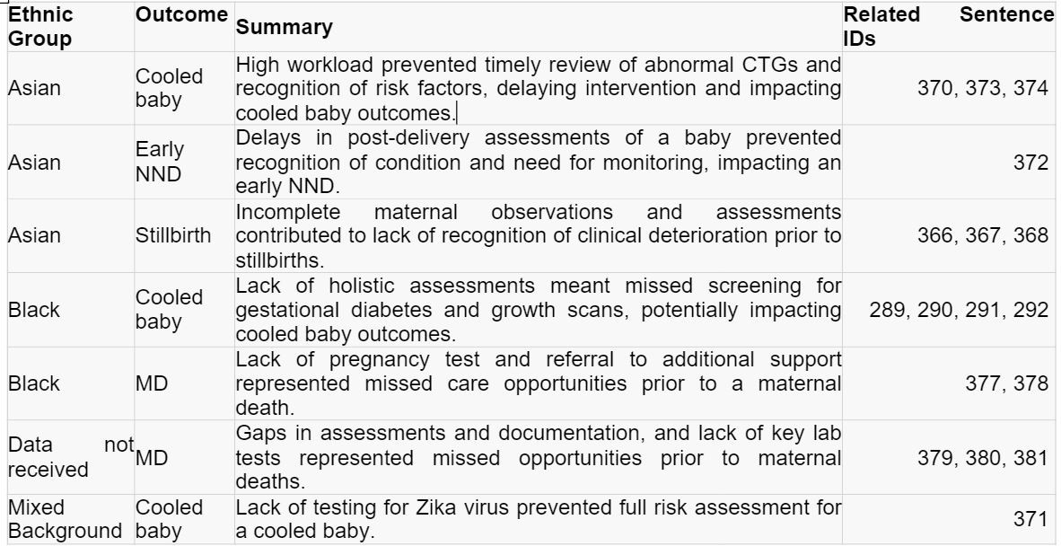
Traceability in Summarisation
Linking summary content back to source documents for transparency and auditability
Notes:
This screenshot shows example summaries from real reports.
We extract the original sentences first, then generate summaries from them. Both are stored. So we can always compare the summary against the source sentences and check accuracy.

Slide 32
Ethical Risks of AI Summarisation
Identiﬁed risks and mitigations
Risk
Mitigation
Information hallucination & bias ampliﬁcation
Inadequate content control
Diversify training datasets; implement debiasing techniques; cross-reference with original texts; regular bias audits
Develop models with embedded ethical constraints; employ sentence ID traceability for veriﬁcation
Use oﬄine LLMs to reduce breach risks; balance security against performance needs
Robust data preprocessing; ML algorithms customised for high variability datasets
Sensitive data exposure
Sample size variability
Key safeguard: Sentence-level traceability enables veriﬁcation of every summary,
ensuring veriﬁability, trustworthiness, and accountability.
Notes:
So what can go wrong with generative AI?
Hallucination: AI generates content that sounds plausible but isn't true. We mitigate this by keeping the original sentences so we can check the summary against the source.
Bias amplification: AI can amplify patterns in the training data. We run regular bias audits across ethnic groups.
Sensitive data exposure: healthcare data is highly sensitive. We use offline models so no data leaves our secure environment.
Sample size variability: small numbers for minority groups can affect reliability. We use algorithms designed for high-variability data and report performance per group.

Slide 33
How we applied this framework work for other types of investigations?

Slide 34
LENS.ai
04
Learning Through Evidence from Natural Lan-guage Systems
Notes:
Now I want to show you how we're extending these methods beyond maternity.

Slide 35
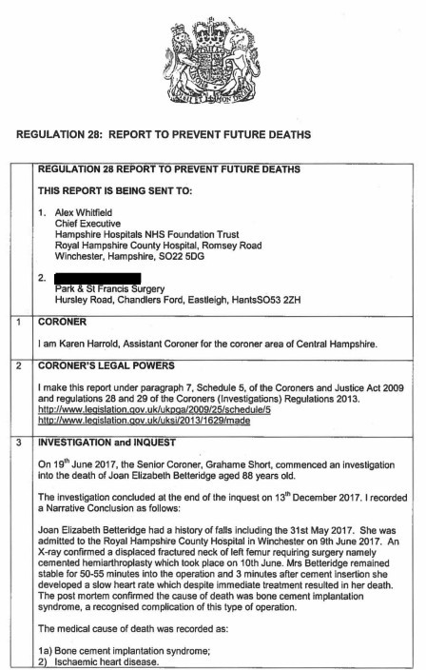
Beyond Maternity: LENS.ai
Extending the framework to Prevention of Future Death reports
What are PFD reports?
Reports issued by coroners after inquests where action may help prevent future deaths. They highlight risks, system failures, and opportunities for learning across organisations.
What LENS.ai supports
Systematic analysis of coronial reports and responses
Identiﬁcation of recurring risks, themes, and contributing factors
Structured analysis across cases, years, factors, combinations
Adaptable to diﬀerent analytical frameworks (e.g. Yorkshire Contributory Factors)
Notes:
[PAUSE]
We developed LENS.ai, applying the same approach to Prevention of Future Death reports.
PFD reports are issued by coroners when action could prevent future deaths. They highlight risks, system failures, and learning opportunities.
LENS.ai supports systematic review, identification of recurring themes, and structured analysis across cases. It's adaptable to different frameworks like the Yorkshire Contributory Factors.
Same principles: domain-specific, traceable, tested for fairness.

Slide 36
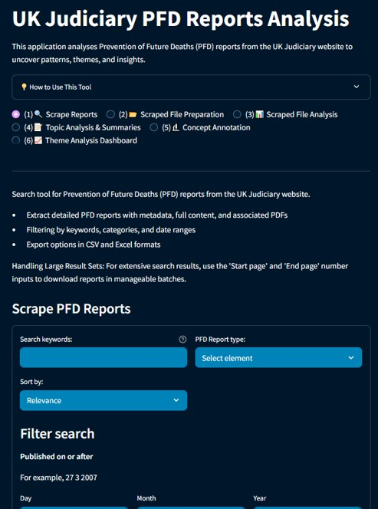
LENS.ai: The Platform
Learning Through Evidence from Natural Language Systems
Key capabilities
Search and exploration
Browse reports using keywords and ﬁlters
Pattern discovery
Identify trends across themes, time, and regions
Thematic analysis
Extract recurring concepts and contributing factors
Interactive outputs
Visualise ﬁndings and export data
Designed for use beyond technical audiences
A web-based platform for exploring and analysing coronial safety data

Slide 37
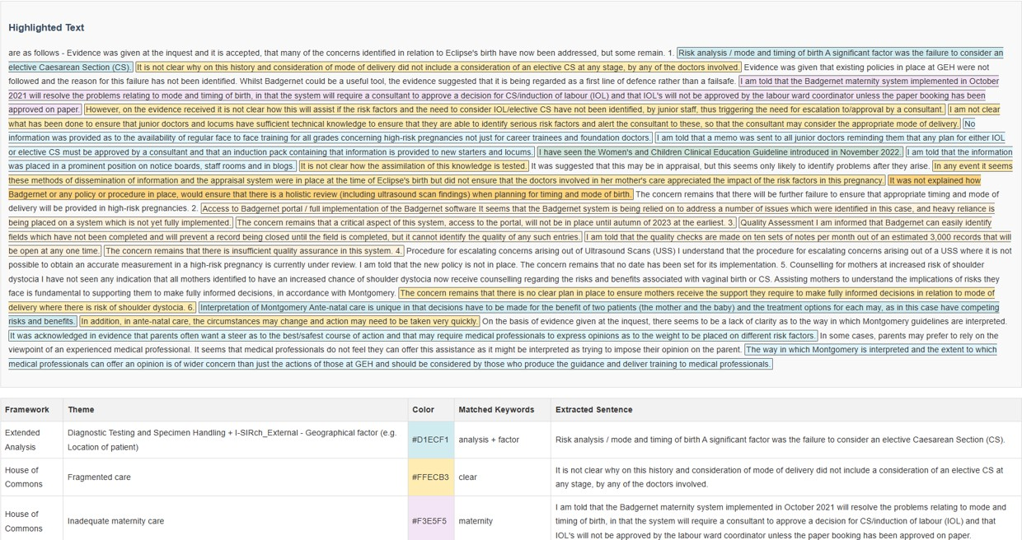
LENS.ai: Annotation in Action
Colour-coded themes with full traceability
Text is highlighted by theme Fragmented care, guidance gaps, inadequate maternity care
Each annotation links to the original sentence
Full traceability maintained

Slide 38
LENS.ai: A Living Platform
From research prototype to operational tool
NOW USED BY
HSSIB Part-nership Supporting annotation
of coroners’ reports
STARTED AS
Research Tool
Proof of concept
for PFD analysis
LENS.ai
Interface Revamp
Improved usability
Secure server
NEXT
Continuous Work
HF experts annotating
AI experts ﬁne-tuning
Model evaluation
ONGOING
Hundreds of reports annotated | Model ﬁne-tuned per concept and process
Notes:
Lense.ai Started as a research prototype. Now used by HSSIB to support their incident report annotation.
Patrick is leading the annotation work and has annotated hundreds of non-maternity reports. My team handles the fine-tuning and evaluation. We are working hard on improving the model with each iteration.
We have internal funding to revamp the interface and continue this work. If you're interested in collaborating, please get in touch.

Slide 39
Key Takeaways
Challenge
Unstructured safety data contains insights but is hard
to analyse at scale.
Methods
Our tools combine human expertise with AI to extract safety intelligence fairly.
Ethics
Fairness, transparency, and human oversight must be designed in from the start.
AI assists, humans decide
Notes:
[PAUSE]
Let me bring together what we've covered.
[Three columns]
The Challenge: unstructured safety data contains insights but is hard to analyse at scale.
The Methods: our AI tools combine human expertise with machine learning. The AI learns from humans and augments their capabilities. It doesn't replace judgement.
The Safeguards: fairness, transparency, and human oversight designed in from the start. Every output is traceable. Performance tested across all groups.

Slide 40
Get in Touch
Georgina Cosma
Professor of AI & Data Science Loughborough University
g.cosma@lboro.ac.uk
Research website: https://cosmos-ai.com/
If you are interested in:
Finding out more about our work
Using the tool to analyse your reports
Research partnerships
The tool is designed to work both online and oﬄine.
Notes:
[PAUSE]
If you're interested in exploring how these AI methods might apply to your work, I'd love to hear from you.
[Contact details]
I'm happy to discuss healthcare AI research partnerships, patient safety data projects, or ethical AI frameworks.
You can reach me at g.cosma@lboro.ac.uk

Slide 41
Thank You
Selected Publications
I-SIRch: AI-powered concept annotation tool for equitable extraction and analysis of safety insights from maternity investigations
International Journal of Population Data Science, 2024 doi: 10.23889/ijpds.v9i2.2439
Intelligent Multi-Document Summarisation for Extracting Insights on Racial Inequalities from Maternity Incident Investigation Reports
Artiﬁcial Intelligence in Healthcare (AIiH), Springer, 2024 https://arxiv.org/abs/2407.08322

